Slide 1


COS711 Assignment 2
Segmenting solar filaments with deep learning
Person A | Person B | Person C
[Add names and student numbers]
All members | COS711 Assignment 2 | 1
Notes:
All members | Target: 15 seconds
We built a deep-learning system that identifies the pixels belonging to each individual solar filament. Filaments are clouds of solar material that appear as dark structures in these telescope images. Replace the names and student numbers before recording.
Evidence:
COS711-A2.pdf

Slide 2
Team and Responsibilities
Person A [name / student number]: prepared and analysed the data; built image, annotation and validation tools.
Person B [name / student number]: trained the segmentation network; compared methods and repeated the selected recipe.
Person C [name / student number]: improved individual-filament predictions; compared compression and checked the final CSV.
Goal: give every filament its own pixel mask, not just detect that filaments are present.
All members | COS711 Assignment 2 | 2
Notes:
All members | Target: 25 seconds
Each member introduces themselves and their responsibility. A mask is a pixel-level marking of an object. Instance segmentation means producing a separate mask for each individual object. Each presenter must be visible, head and shoulders, in the upper-right corner.
Evidence:
HANDOFF.md
COS711-A2.pdf

Slide 3
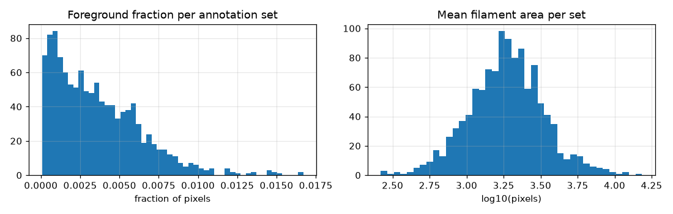
Dataset Preparation
707 labelled observations; 1,154 annotation sets; 8,199 marked filaments.
180 unlabelled test images; six GONG instruments; 2011-2022.
Filaments occupy only 0.36% of pixels: about 278 background pixels per filament pixel.
Challenges: faint thin structures, image noise and disagreement between annotators.
Person A | COS711 Assignment 2 | 3
Notes:
Person A | Target: 40 seconds
We analysed the supplied Kaggle images and labels. An annotation is a human marking. Multiple annotation sets can describe the same observation. Filaments cover less than one percent of pixels; this is class imbalance, meaning one category is much more common than the other. A model predicting only background could get most pixels right while finding no filaments. We therefore evaluate individual objects and shapes. We did not obtain external labels for the test images.
Evidence:
results/eda_summary.json
figures/eda_imbalance.png

Slide 4
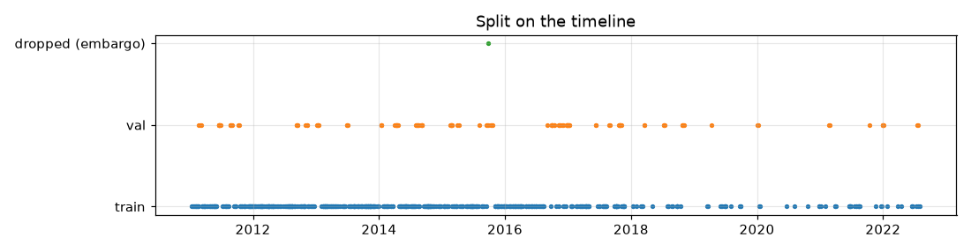
Dataset Preparation: Our Choices
584 training / 122 validation / 1 excluded observation; all labels for one image stay together.
14-day time blocks and a 1-day gap reduce near-duplicate leakage; instrument mix follows the test set.
Train on random 512 x 512 patches; 70% of crop attempts target filament pixels when present.
Screened contrast, disc masking, local normalisation and added transformations. Selected recipe keeps random crops, without added transformations.
Person A | COS711 Assignment 2 | 4
Notes:
Person A | Target: 45 seconds
The training set teaches the model; validation is held back for comparing choices. Leakage means allowing information from evaluation examples to influence learning in an unfair way. We group related observations and keep all annotation sets together. Instruments still occur on both sides, so this is not an unseen-instrument test. Normalisation rescales pixel brightness using training-only statistics. Preprocessing changes inputs before prediction; augmentation creates varied training examples. The selected no-augmentation recipe disables added flips, rotations, brightness, noise and blur, but still samples random patches.
Evidence:
splits/split_v1.json
results/person_b_study/methodology.md
results/eda_summary.json

Slide 5
Experimental Setup and Methodology
U-Net with a ResNet34 encoder, initialised from ImageNet: grayscale image in, filament score per pixel out.
Training loss: binary cross entropy + Dice; rewards correct pixel labels and foreground overlap.
AdamW; learning rate 0.0003; cosine schedule; batch 4; mixed precision; 20-epoch full runs.
Python / PyTorch / segmentation_models_pytorch; OpenCV, Albumentations and pycocotools.
Person B: RTX 5060 Ti. Person C: RTX 3070 (8 GB); ONNX Runtime and torch-pruning for compression.
Person B | COS711 Assignment 2 | 5
Notes:
Person B | Target: 45 seconds
U-Net is a network that combines broad image patterns with fine spatial detail. The ResNet34 encoder is its feature-extracting component, starting from ImageNet pretrained weights. Loss is a number measuring prediction error. Binary cross entropy penalises wrong pixel labels; Dice rewards overlap. AdamW adjusts the learned weights, and the learning rate controls the update size. The cosine schedule gradually reduces that rate. An epoch here contains 960 sampled examples, not a pass over every unique image. Mixed precision uses smaller numerical formats for some calculations to reduce memory. GPUs accelerate this computation.
Evidence:
results/person_b_study/methodology.md
results/person_c/person_c_results.md

Slide 6
Methodology: Tuning and Evaluation
11 recipes screened for 6 epochs; strongest two retrained for 20 epochs alongside the baseline.
Compared learning rates, image strategy, preprocessing, augmentation, voted labels, loss and U-Net++.
After selection, three fresh random seeds measured run-to-run variation; 17 runs / 186 epochs in Person B's study.
Panoptic Quality (PQ): rewards finding individual filaments and matching their shapes; not pixel accuracy.
Match only if intersection-over-union (IoU) > 0.5; pool counts across all 200 validation annotation sets.
Person B | COS711 Assignment 2 | 6
Notes:
Person B | Target: 45 seconds
A random seed controls random choices during training. We separated recipe selection from three fresh runs. IoU is shared mask area divided by the area covered by either mask. PQ equals the sum of matched IoUs divided by matched objects plus half the extra and missed objects. Our evaluator follows the organiser's reference and keeps overlapping annotation layers. The fixed sample budgets improve comparability, but the 1024 whole-image recipe also changes field of view and computing cost. Voted labels change observation weighting. A short screen may favour fast learners; it does not prove every rejected recipe would lose after longer training.
Evidence:
results/person_b_study/protocol.json
results/person_b_study/methodology.md
results/evaluation_reference.json

Slide 7
Results
Approach | Validation PQ
Original baseline (20 epochs) | 0.3201
1024 whole images (selection seed 42) | 0.3375
No added transforms (selection seed 42) | 0.3381
Selected recipe: 3 fresh runs, mean +/- SD | 0.3370 +/- 0.0076
Representative seed 45 | 0.3448
Seed 45 + output cleanup | 0.4034
Final compressed model + cleanup | 0.4031
Kaggle: add result
Public PQ: [ADD]
Rank / date: [ADD]
[Insert leaderboard screenshot here]
The two full-budget alternatives nearly tied (+0.00063 PQ). Final compressed result is one run, not a three-run mean.
Person B / C | COS711 Assignment 2 | 7
Notes:
Person B / C | Target: 55 seconds
The original full-budget baseline scored 0.3201. The two alternatives nearly tied; we do not claim statistical superiority from that difference. Across fresh seeds 43, 44 and 45, the selected recipe averaged 0.3370 with sample standard deviation 0.0076. Standard deviation describes variation across runs. Seed 45 is the representative checkpoint, not the mean. Person C's cleanup raises its score to 0.4034, and the final smaller model scores 0.4031. Fill the Kaggle score, rank, date and screenshot after an actual submission; they are not measured here. Local validation and Kaggle evaluate different images.
Evidence:
results/person_b_study/confirmation.csv
results/person_b_study/fresh_seed_summary.csv
results/person_c/summary.json
results/person_c/final_submission.json

Slide 8
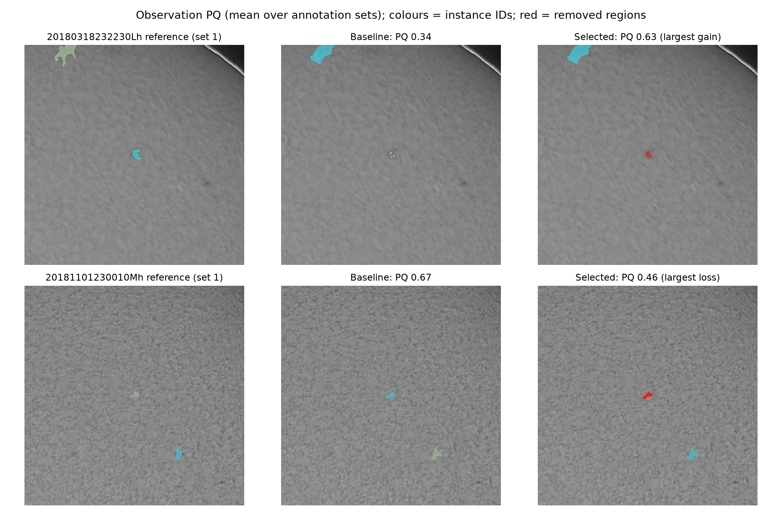
Results: Example Predictions
Labelled validation crops: teacher before / after cleanup.
Largest gain: 0.34 to 0.63. Removing extra regions helps.
Largest loss: 0.67 to 0.46. Small real structures can be removed.
Colours = object IDs; red = removed pixels.
Person C | COS711 Assignment 2 | 8
Notes:
Person C | Target: 45 seconds
These are actual labelled validation crops, selected by the largest improvement and largest decrease in observation PQ after cleanup. They are not rankings of hidden test accuracy. The score is averaged over all annotation sets for the complete observation; the pictured reference is the first set and the view is a crop. In the favourable case, removing extra regions reduces penalties. In the unfavourable case, the size rule also removes small structures marked by a human. Red highlights removed pixels; colours identify separate objects and have no physical meaning. These illustrate the teacher's cleanup, not final-model masks.
Evidence:
results/person_c/summary.json: examples
figures/person_c/pp_examples_slide.png

Slide 9
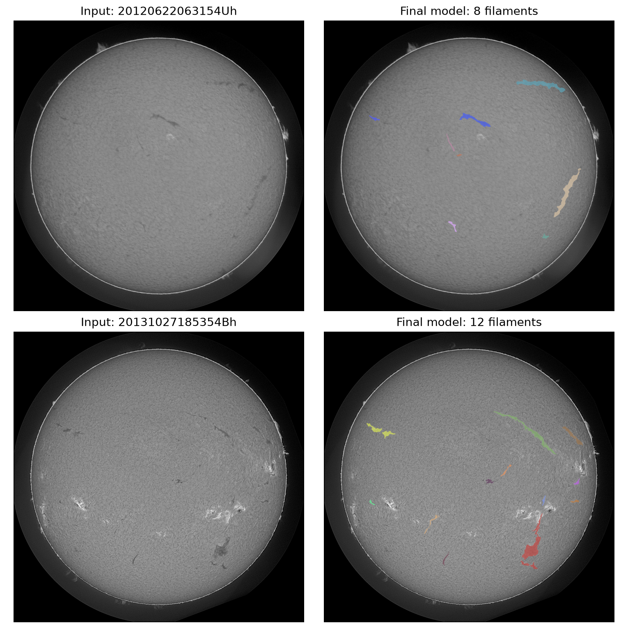
Results: Final Test Predictions
Original inputs beside masks decoded from the final CSV.
Two fixed scenes; not best / worst accuracy rankings.
Dark structures look plausible; faint edges and nearby filaments remain difficult.
Unlabelled: Kaggle score pending.
Person C | COS711 Assignment 2 | 9
Notes:
Person C | Target: 40 seconds
Left: original grayscale input. Right: the final pruned FP16 model's submitted masks overlaid in colour. The two fixed images are 20120622063154Uh, 20131027185354Bh. They were chosen to illustrate different scenes, not ranked by test accuracy. Masks are decoded directly from the hash-checked final CSV, so these are the submitted predictions rather than the teacher's predictions. Some elongated dark structures are captured, but visual plausibility cannot establish correctness. Faint edges, background texture and adjacent structures remain risks; no test labels are used.
Evidence:
runs/person_c/final/submission.csv
results/person_c/final_submission.json

Slide 10
Segmentation Enhancement
Post-processing on the same saved scores | Validation PQ
Baseline: cutoff 0.5, connected regions | 0.3448
Remove regions smaller than 320 pixels | 0.3948
Group nearby fragments under one ID | 0.3782
Both rules together (selected) | 0.4034
Offline scorer first reproduced B's result exactly.
55 + 50 settings tested.
More complex rule: only +0.0005 above the selected pair.
Flip averaging was slower and did not justify adoption.
Group fragments about <= 16 pixels apart (bridge radius 8); do not add foreground pixels. Then remove groups < 320 pixels.
Extra predictions: 1,007 to 510. Splitting cases: 84 to 50. Cost: 17 fewer matches; merging cases 20 to 25.
PQ gain +0.0585; 95% bootstrap interval +0.0486 to +0.0679. Held-out half gains: +0.0592 and +0.0557.
Person C | COS711 Assignment 2 | 10
Notes:
Person C | Target: 55 seconds
Post-processing changes the output after the network predicts. We investigated extra blobs and fragmented filaments using saved scores, first exactly reproducing Person B's results. Of unmatched regions, 48 percent were below 320 pixels, compared with about 4 percent of matched regions. We group nearby fragments under one ID without filling their gap, then discard small groups. This roughly halves extra detections. Counts are pooled over annotation sets, and fragmentation/merging are our recorded overlap diagnostics. Bootstrap intervals come from repeatedly resampling observations; they support the gain, but do not remove every risk from validation tuning. Held-out-half checks also improved. Watershed splitting, hole filling and changing the cutoff alone offered no meaningful benefit. Flip averaging means predicting flipped copies too; it cost about 3.8 times model inference and was not adopted.
Evidence:
results/person_c/postprocess_stage1.csv
results/person_c/postprocess_stage2.csv
results/person_c/summary.json
results/person_c/person_c_results.md

Slide 11
Segmentation Enhancement: Compression
GPU variant | PQ | MiB | ms/image
Teacher, mixed precision | 0.4034 | 93.4 | 456
Teacher, FP16 storage | 0.4033 | 46.7 | 445
Distilled ResNet18 | 0.4012 | 54.7 | 489
Label-only control | 0.3976 | 54.7 | 461
50% channel pruning | 0.3652 | 23.5 | 494
30% pruning + FP16 (FINAL) | 0.4031 | 22.9 | 475
Pruning removes internal feature channels.
FP16 stores learned numbers with fewer bits.
Distillation teaches a smaller model using the teacher's outputs.
Choose smallest GPU file within 0.002 PQ of teacher; speed breaks ties.
Final: 11.93 M parameters; 22.9 MiB (~75% smaller). Training: 12.4 min teacher (B GPU) + 4.0 min pruning fine-tune (C GPU).
475 ms/image over 180 images: read-to-CSV, model loading excluded. Smaller did not mean faster.
CPU INT8: PQ 0.4068; 23.6 MiB; 1,158 ms/image (20 images). Separate CPU deployment.
Person C | COS711 Assignment 2 | 11
Notes:
Person C | Target: 60 seconds
Parameters are the model's learned numbers. Pruning removes selected internal feature channels and fine-tuning trains the remaining network again. FP16 stores weights using 16-bit numbers. Distillation trains a smaller student from both labels and teacher predictions; our matched label-only control isolates that teaching effect for this run. Fifty percent channel pruning lost quality, so we transparently added a milder thirty percent follow-up and its FP16 composition. The unchanged selection rule chooses the smallest eligible GPU model within 0.002 PQ of the teacher. The final file is 22.9 MiB (one MiB is 1,048,576 bytes), compared with 93.4 MiB, and takes 475 milliseconds per image end-to-end on the RTX 3070. This includes reading, preparation, model execution, cleanup, mask encoding checks and CSV. Training times use different GPUs and are not a hardware-controlled comparison. INT8 stores quantised values in eight bits; its CPU deployment is a separate timing comparison on twenty test images, with calibration using training images only. The final CSV contains 1,421 filaments for 180 images, including three without detections; every encoded mask was independently checked.
Evidence:
results/person_c/compression.csv
results/person_c/final_selection_rule.json
results/person_c/final_submission.json
results/person_c/final_submission_check.json

Slide 12
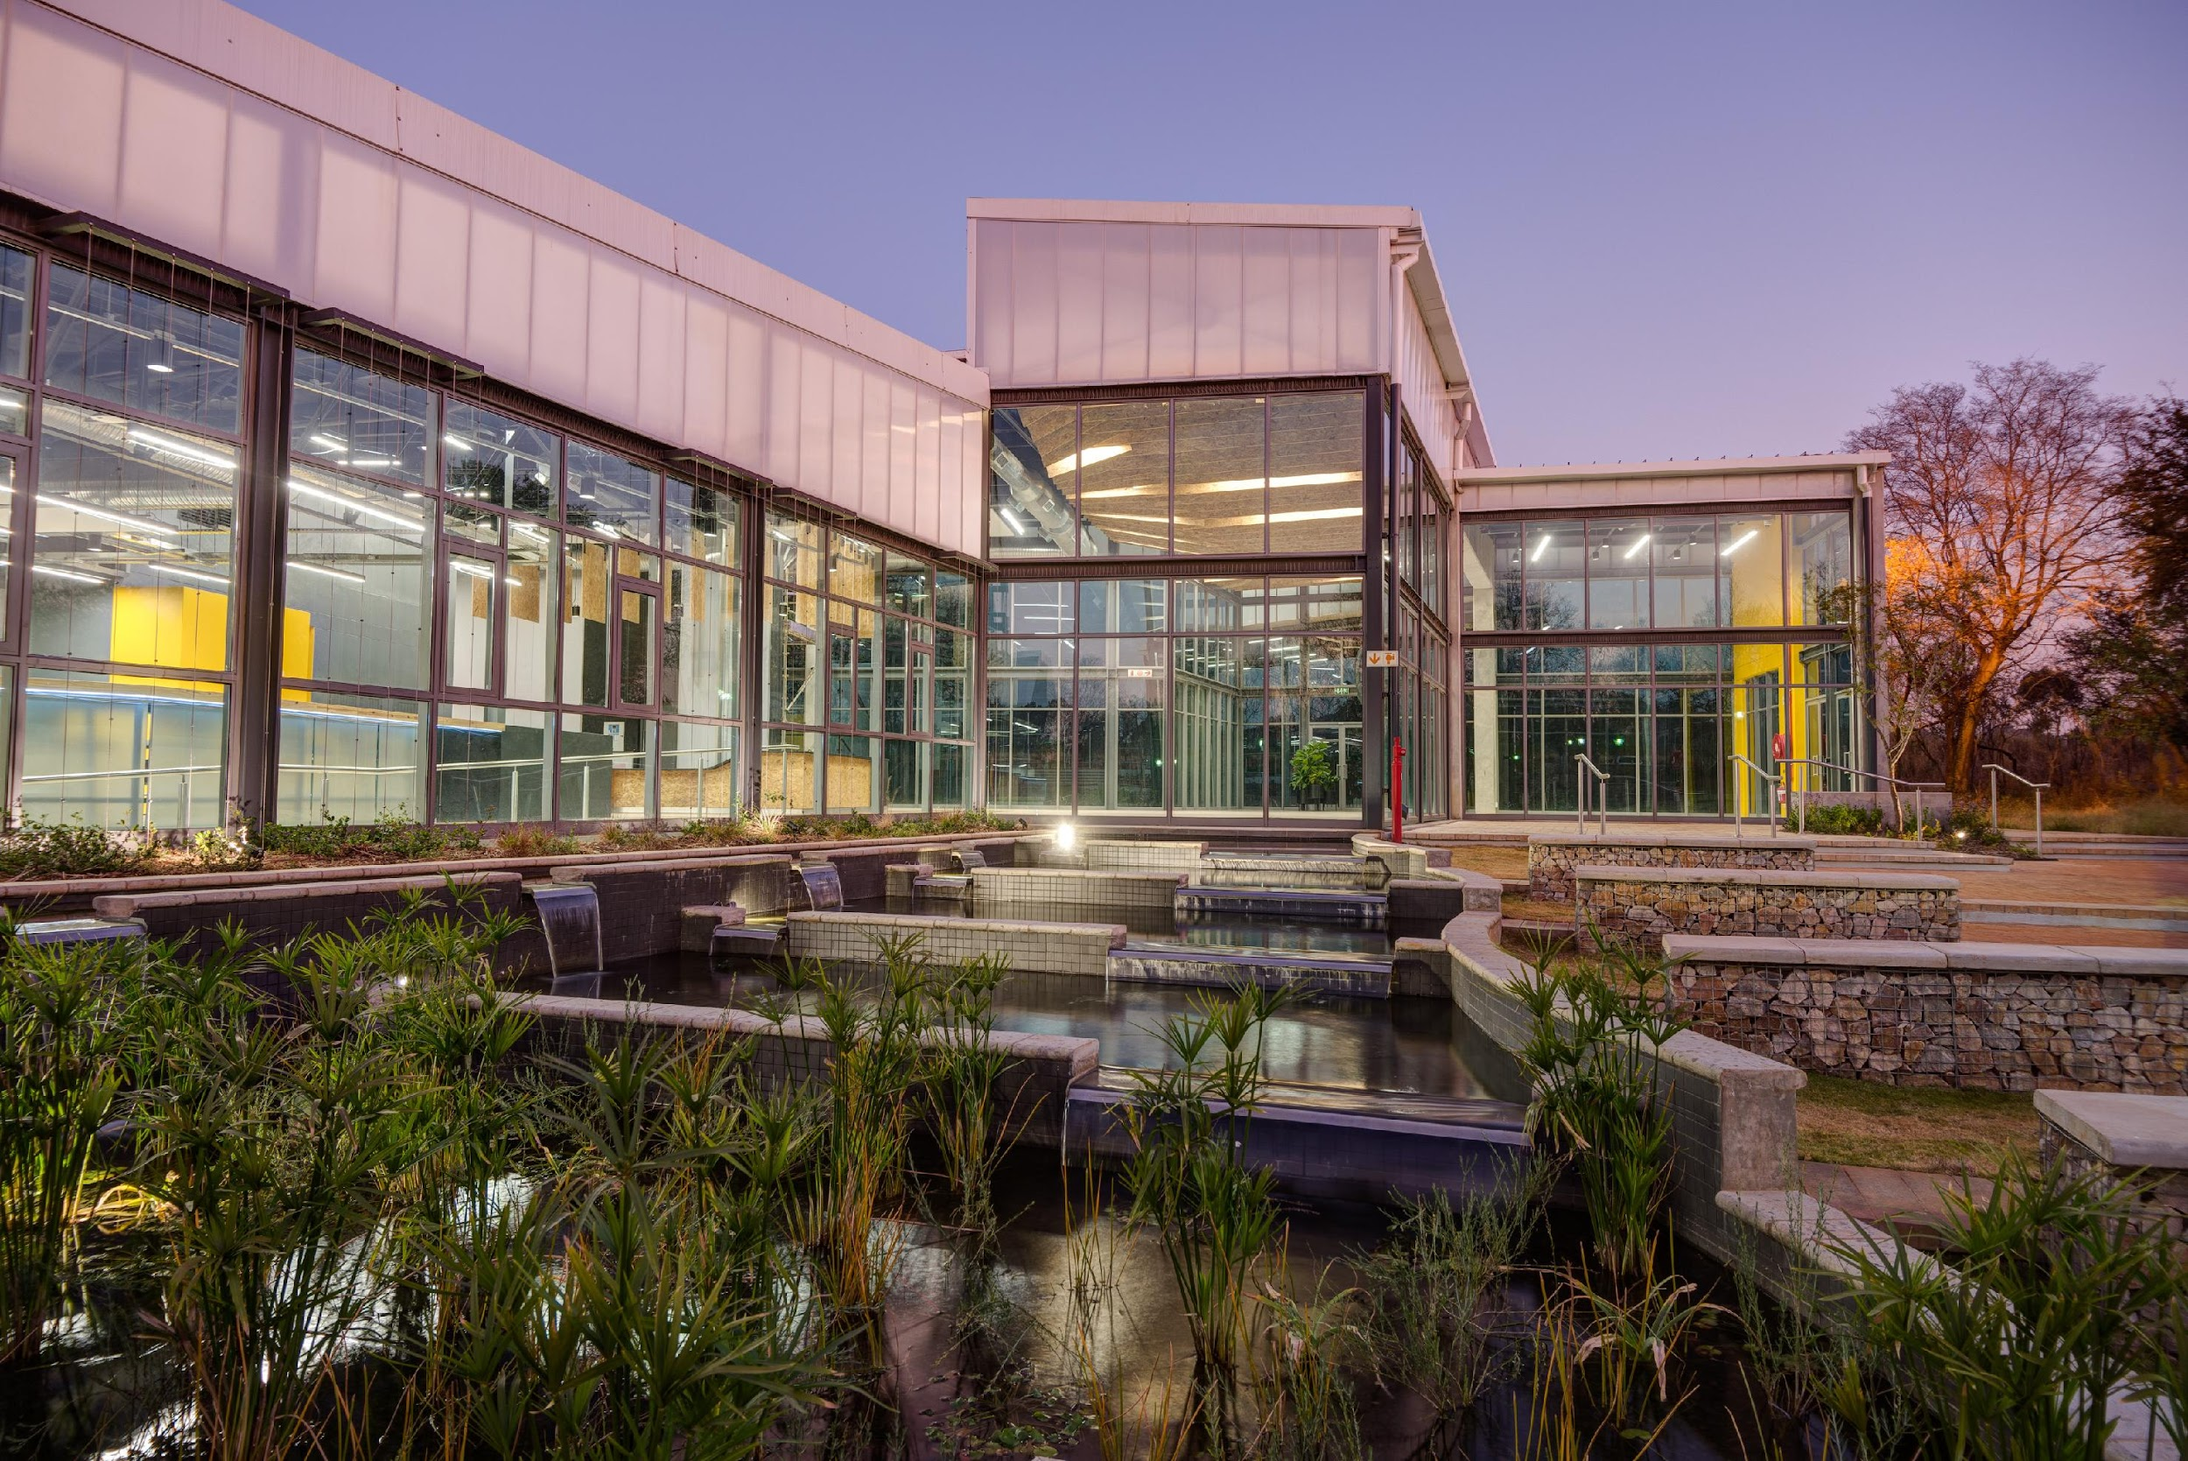
Conclusions
Main gain: better individual-object cleanup, not a more complicated network. Final local PQ: 0.4031.
Compression reduced the file by about 75% while retaining nearly the same PQ; not the fastest GPU option.
Roadblocks: faint thin structures, noisy / disagreeing labels, and cleanup removing small real filaments.
Next: repeat final-model runs, test boundary-aware learning and consistent mild contrast enhancement; obtain Kaggle evidence.
Person C / all | COS711 Assignment 2 | 12
Notes:
Person C / all | Target: 40 seconds
The main demonstrated improvement came from understanding object-level errors. File-size reduction did not automatically make the entire pipeline faster, because processing outside the network also matters. The final compressed result is one run and the hidden-test score still needs to be added. If repeating the project, we would allocate time for repeated final-model runs and for methods that learn thin boundaries and continuity. We would test mild contrast enhancement during both training and prediction rather than assuming prettier images improve scores. Future ideas are proposals, not measured results. Before submission add names, Kaggle evidence, and record all presenters within ten minutes and fifty MB.
Evidence:
results/person_c/person_c_results.md
COS711-A2.pdf

Slide 13
Bibliography
Ahmadzadeh et al. (2024). A dataset of manually annotated filaments.
Kirillov et al. (2019). Panoptic Segmentation.
Ahmadzadeh (2026). Self Evaluation Notebook, version 6.
Ronneberger, Fischer & Brox (2015). U-Net.
He et al. (2016). Deep Residual Learning for Image Recognition.
Loshchilov & Hutter (2019). Decoupled Weight Decay Regularization.
Reference only | COS711 Assignment 2 | 13
Notes:
Reference only | Target: 0 seconds
References are provided for completeness; no narration required.
Evidence:
https://doi.org/10.1038/s41597-024-03876-y
https://arxiv.org/abs/1801.00868
https://www.kaggle.com/code/azimahmadzadeh/self-evaluation-notebook
https://arxiv.org/abs/1505.04597
https://arxiv.org/abs/1512.03385
https://arxiv.org/abs/1711.05101
https://www.kaggle.com/competitions/filament-segmentation-2026
https://arxiv.org/abs/1503.02531
https://arxiv.org/abs/2301.12900
https://onnxruntime.ai/docs/performance/model-optimizations/quantization.html

Slide 14
Bibliography: Methods and Tools
Milletari, Navab & Ahmadi (2016). V-Net.
Salehi, Erdogmus & Gholipour (2017). Tversky loss.
Zhou et al. (2018). UNet++.
segmentation_models_pytorch, version 0.6.0.
PyTorch 2.14 documentation. CosineAnnealingLR.
Compression: Hinton et al. (2015), Distilling the Knowledge in a Neural Network; Fang et al. (2023), DepGraph; ONNX Runtime quantisation documentation.
Reference only | COS711 Assignment 2 | 14
Notes:
Reference only | Target: 0 seconds
References are provided for completeness; no narration required.
Evidence:
https://arxiv.org/abs/1606.04797
https://arxiv.org/abs/1706.05721
https://arxiv.org/abs/1807.10165
https://github.com/qubvel-org/segmentation_models.pytorch
https://docs.pytorch.org/docs/2.14/generated/torch.optim.lr_scheduler.CosineAnnealingLR.html
https://www.kaggle.com/competitions/filament-segmentation-2026
https://arxiv.org/abs/1503.02531
https://arxiv.org/abs/2301.12900
https://onnxruntime.ai/docs/performance/model-optimizations/quantization.html

