Slide 1
Solar filament segmentation
Segmenting solar filaments with deep learning: Kaggle Solar Filament Segmentation Challenge 2026 (MAGFiLO, GONG H-alpha images)
Team member | Responsibility | Code
Person A | Data and evaluation: EDA, cleaning, observation-grouped time-block split, augmentation, local PQ metric | data.py, metrics.py, eda.ipynb
Person B | Modelling: U-Net/ResNet34, losses, training loop, controlled comparisons, repeated seeds | models.py, losses.py, train.py, experiments.py
Person C | Instances and delivery: post-processing, instance separation, compression, timing, submission, slides and video | postprocess.py, offline_eval.py, compress.py, predict.py
Primary metric: Panoptic Quality (PQ), an instance-level score. Every number in this talk comes from the same frozen validation split (122 images, 200 annotation sets).
COS711 Assignment 2
1
Notes:
Each member introduces themselves and states their responsibility in one sentence. Replace 'Person A/B/C' with names before recording.

Slide 2
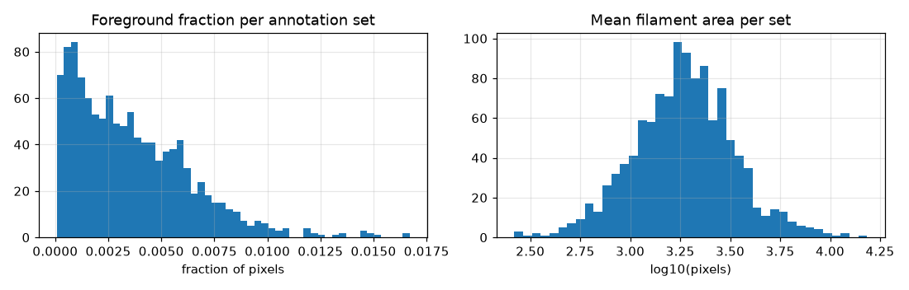
Dataset: what we found
• 707 images (2048 x 2048), 1,154 annotation sets, 8,199 filaments
• 1 / 2 / 3 annotation sets per image: 411 / 145 / 151
• 7.1 filaments per set on average (max 26)
• Filaments cover 0.36% of pixels: background/filament about 278 : 1
• 6 GONG instruments, 2011 to 2022; test file names have a similar mix
• Annotator vs annotator PQ 0.34 (sample of 100 images): noisy labels, a reference not a ceiling
• 5 sets with overlapping polygons; original layers kept for scoring
Person A
2
Notes:
We have 707 full-disc H-alpha images with one to three independent annotation sets each. Filaments cover about 0.36 percent of the pixels, so background outnumbers filament roughly 278 to 1. Annotators disagree a lot: scoring one annotator against another gives a PQ of only about 0.34 on a sample of 100 images, which tells us the labels are noisy.

Slide 3
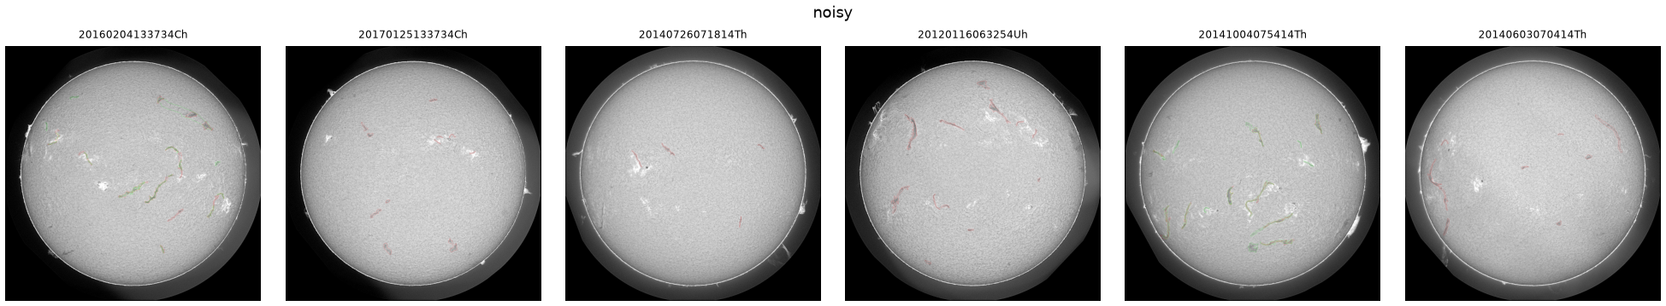
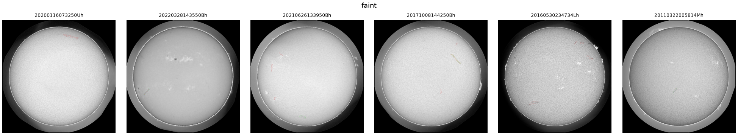
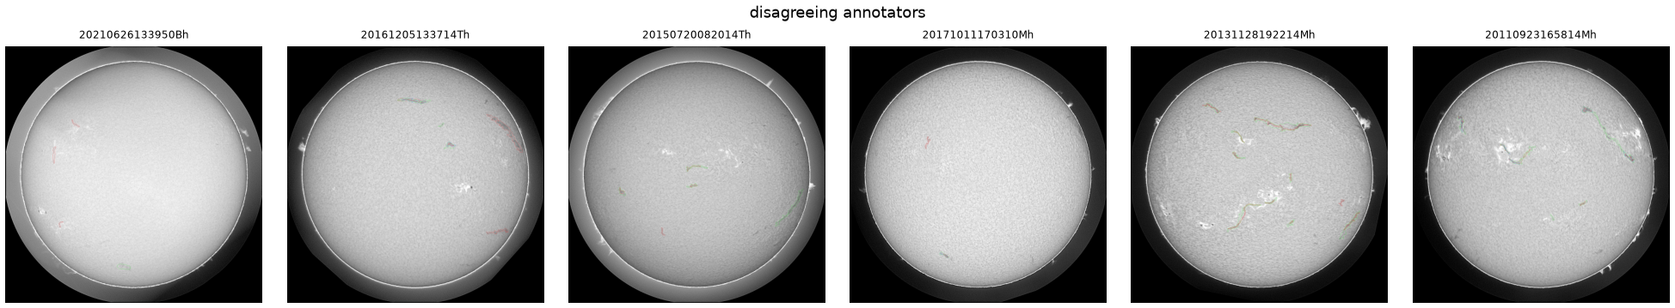
Noisy, faint and disagreeing images
Noisy observing conditions
Faint filaments
Annotators disagree (colours = different annotators)
Person A
3
Notes:
Looking at images by eye showed three difficult groups: noisy observing conditions, very faint filaments, and images where annotators drew different filaments. These motivated the use of every annotation set as a separate training target and the robust evaluation over all sets.

Slide 4
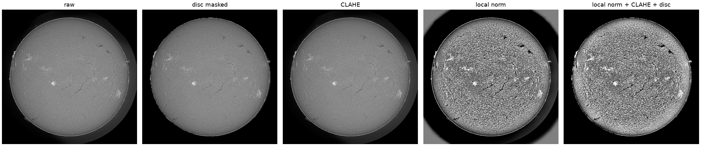
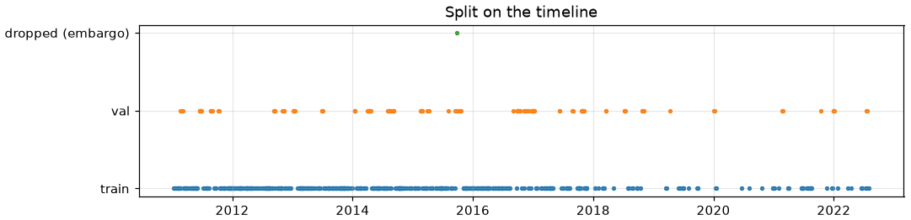
Preparation and validation split
• Split by observation in 14-day time blocks, 1-day embargo: 584 train / 122 validation / 1 dropped
• Validation blocks chosen to match the instrument mix of the test file names
• Cached instance masks; deterministic seeded crops (70% centred on filaments)
• Preprocessing built: disc mask, CLAHE, local normalisation; augmentation: flips, rotations, affine, brightness/contrast, noise, blur (screened in Person B's study)
Person A
4
Notes:
All annotation sets of an image stay on the same side of the split. Because images close in time are not independent, validation uses whole 14-day blocks with a one-day embargo, and the block choice matches the instrument mix of the test file names. Preprocessing and augmentation options were built here and screened by Person B.

Slide 5
Baseline model
U-Net with a ResNet34 encoder
Input | One grayscale image channel
Network | ImageNet initialization and a U-Net decoder
Prediction | Filament probability at every pixel
Instances | Probability > 0.5, then connected components
Touching filaments may merge. Broken masks may split.
Person B
5
Notes:
I handled the models, training and controlled comparisons. U-Net predicts a filament probability for each pixel, using a ResNet34 encoder initialized from ImageNet. We threshold those probabilities and label connected regions. This gives separate objects, but touching filaments can merge and broken masks can split. Person C can improve that conversion using our saved probabilities.
Sources
Ronneberger, Fischer & Brox (2015). U-Net.
https://arxiv.org/abs/1505.04597
He et al. (2016). Deep Residual Learning for Image Recognition.
https://arxiv.org/abs/1512.03385
segmentation_models_pytorch, version 0.6.0.
https://github.com/qubvel-org/segmentation_models.pytorch
Project evidence
C:\Users\user-pc\Desktop\COS711_Assig2\AI_Assignment2\models.py
C:\Users\user-pc\Desktop\COS711_Assig2\AI_Assignment2\inference.py
C:\Users\user-pc\Desktop\COS711_Assig2\AI_Assignment2\configs\baseline.yaml

Slide 6
Training and validation
Training input | 512 × 512 crops with foreground sampling
Loss | Binary cross entropy + Dice overlap loss
Optimization | AdamW with a cosine learning-rate schedule
Validation | 122 complete observations, grouped by time blocks
Checkpoint choice | Highest pooled validation Panoptic Quality
Selected setting: added transforms off. Random foreground-biased crops remain.
Person B
6
Notes:
Filaments cover very little of each image. BCE learns pixel classification, while Dice emphasizes foreground overlap. We use AdamW, cosine scheduling and mixed precision. All labels for one observation stay together. Validation scores complete images and pools matching counts across annotation sets, following the organizer's reference. A match requires IoU above 0.5. The selected U-Net/ResNet34 keeps BCE + Dice and random foreground-biased 512 × 512 crops. It disables the added flips, rotations, affine and appearance transforms. Random crop sampling still changes between epochs.
Sources
Milletari, Navab & Ahmadi (2016). V-Net.
https://arxiv.org/abs/1606.04797
Loshchilov & Hutter (2019). Decoupled Weight Decay Regularization.
https://arxiv.org/abs/1711.05101
PyTorch 2.14 documentation. CosineAnnealingLR.
https://docs.pytorch.org/docs/2.14/generated/torch.optim.lr_scheduler.CosineAnnealingLR.html
Kirillov et al. (2019). Panoptic Segmentation.
https://arxiv.org/abs/1801.00868
Ahmadzadeh (2026). Self Evaluation Notebook, version 6.
https://www.kaggle.com/code/azimahmadzadeh/self-evaluation-notebook
Project evidence
C:\Users\user-pc\Desktop\COS711_Assig2\AI_Assignment2\losses.py
C:\Users\user-pc\Desktop\COS711_Assig2\AI_Assignment2\train.py
C:\Users\user-pc\Desktop\COS711_Assig2\AI_Assignment2\data.py
C:\Users\user-pc\Desktop\COS711_Assig2\AI_Assignment2\splits\split_v1.json
C:\Users\user-pc\Desktop\COS711_Assig2\AI_Assignment2\results\evaluation_reference.json
Measured evidence
Frozen selected configuration: no_augmentation
C:\Users\user-pc\Desktop\COS711_Assig2\AI_Assignment2\results\person_b_study\configuration_selection.json

Slide 7
Controlled comparisons
Learning rate | Low, baseline and high settings
Data | 1024 resolution, preprocessing, augmentation and targets
Loss | BCE + Dice compared with BCE + Tversky
Model | U-Net compared with U-Net++
Repeatability | Fresh seeds after configuration selection
Comparisons match sampled images and planned update attempts.
Person B
7
Notes:
We kept the split fixed and matched sample budgets and planned update attempts. The six-epoch screen can favor quick learners, so the strongest candidates received full-budget runs before selection. Fresh seeds then measured variability. A few AMP overflow skips can change applied update counts. The 1024 experiment also changes field of view, and consensus changes observation weighting, so those comparisons have limits.
Sources
Salehi, Erdogmus & Gholipour (2017). Tversky loss.
https://arxiv.org/abs/1706.05721
Zhou et al. (2018). UNet++.
https://arxiv.org/abs/1807.10165
Project evidence
C:\Users\user-pc\Desktop\COS711_Assig2\AI_Assignment2\experiments.py
C:\Users\user-pc\Desktop\COS711_Assig2\AI_Assignment2\configs\
C:\Users\user-pc\Desktop\COS711_Assig2\AI_Assignment2\results\person_b_study\
Measured evidence
Study protocol: {"path":"C:\\Users\\user-pc\\Desktop\\COS711_Assig2\\AI_Assignment2\\results\\person_b_study\\protocol.json","primary_metric":"PQ_dataset","split_sha256":"58245fc1fdc3c39c7e482d703cd4c9e26ebdbcae6e08c6c328149d417284eec3","selection_seed":42,"fresh_seeds":[43,44,45]}

Slide 8
Validation results
Full-budget run | Seed | Epochs | PQ | SQ | RQ
Baseline | 42 | 20 | 0.320127 | 0.675 | 0.474
No added transforms | 42 | 20 | 0.338081 | 0.675 | 0.501
1024 input | 42 | 20 | 0.337451 | 0.669 | 0.505
Near-tie at seed 42: ΔPQ 0.000629. One seed cannot establish superiority.
Fresh-seed PQ: 0.33695 ± 0.00758
3 runs, seeds 43, 44, 45. Sample standard deviation across runs.
Foreground Dice 0.640 ± 0.003 IoU 0.488 ± 0.004
Local PQ measures the frozen validation set. Kaggle uses different images.
Person B
8
Notes:
The full-budget selection runs were a near-tie. We chose the numerical winner, with added transforms off. Across three fresh seeds, pooled PQ averaged 0.33695, with sample standard deviation 0.00758. This describes training variability, not proof of superiority. The displayed seed 45 checkpoint is the best fresh run, not the average. It missed more reference instances than baseline: 507 versus 449. But it produced fewer extras: 1007 versus 1416. Higher PQ therefore came with a tradeoff. We have no Kaggle score.
Sources
Kirillov et al. (2019). Panoptic Segmentation.
https://arxiv.org/abs/1801.00868
Ahmadzadeh (2026). Self Evaluation Notebook, version 6.
https://www.kaggle.com/code/azimahmadzadeh/self-evaluation-notebook
Project evidence
C:\Users\user-pc\Desktop\COS711_Assig2\AI_Assignment2\results\person_b_study\summary.json
C:\Users\user-pc\Desktop\COS711_Assig2\AI_Assignment2\results\person_b_study\configuration_selection.json
Measured evidence
Foreground Dice 0.640 ± 0.003 and IoU 0.488 ± 0.004 are fresh-seed means/sample SDs. Each run first averages semantic foreground-mask scores over annotation sets. These differ from pooled instance PQ and best-per-filament overlap. Good pixel coverage can still merge or split objects.
Pooled counts compare predictions against every available annotation set; they are not unique-image instance totals. Seed 42 selects the configuration and is excluded from the fresh-seed mean. Representative seed 45 has PQ 0.3448101728178549; it is the highest-scoring fresh run, not the mean run. Best-per-reference-filament Dice is 0.6028158367364901 versus 0.6458612145378748 for baseline.
Summary: C:\Users\user-pc\Desktop\COS711_Assig2\AI_Assignment2\results\person_b_study\summary.json
Configuration decision: C:\Users\user-pc\Desktop\COS711_Assig2\AI_Assignment2\results\person_b_study\configuration_selection.json
Plain-language metric guide: PQ combines finding the right objects with tracing their shapes. SQ measures overlap quality for matched objects. RQ penalizes missed and extra objects. Dice and IoU measure how much two foreground masks overlap; they do not by themselves check whether separate filaments stay separate.

Slide 9
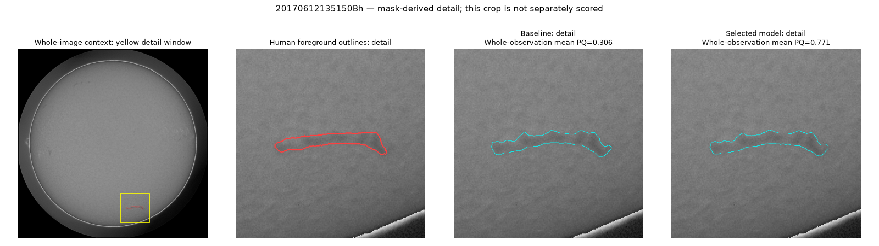
Highest validation score
Red: human outlines. Cyan: predictions. Representative checkpoint: seed 45.
Whole Sun
Human reference
Baseline
Selected model
Whole-observation mean PQ: baseline 0.306 → selected 0.771.
Person B
9
Notes:
This is the highest-scoring validation observation for our representative checkpoint. Both models trace the same filament fairly similarly. Across the whole image, the baseline also has three unmatched extra predictions, while the selected model has none. That helps explain the score increase from 0.306 to 0.771. The detail window is only for visibility; the score is for the whole observation.
Sources
Ahmadzadeh (2026). Self Evaluation Notebook, version 6.
https://www.kaggle.com/code/azimahmadzadeh/self-evaluation-notebook
Project evidence
C:\Users\user-pc\Desktop\COS711_Assig2\AI_Assignment2\report.py
C:\Users\user-pc\Desktop\COS711_Assig2\AI_Assignment2\results\person_b_study\
C:\Users\user-pc\Desktop\COS711_Assig2\AI_Assignment2\runs\person_b_final\
Measured evidence
These are per-observation means, not pooled dataset PQ. Interpret fragmentation/merging alongside recognition quality and TP/FP/FN: missing more filaments can reduce both relation-error counts.
Observation: 20170612135150Bh
Selection rule: Highest selected-model observation mean PQ
Panel: C:\Users\user-pc\Desktop\COS711_Assig2\AI_Assignment2\results\person_b_study\figures\validation_zoom_20170612135150Bh.png

Slide 10
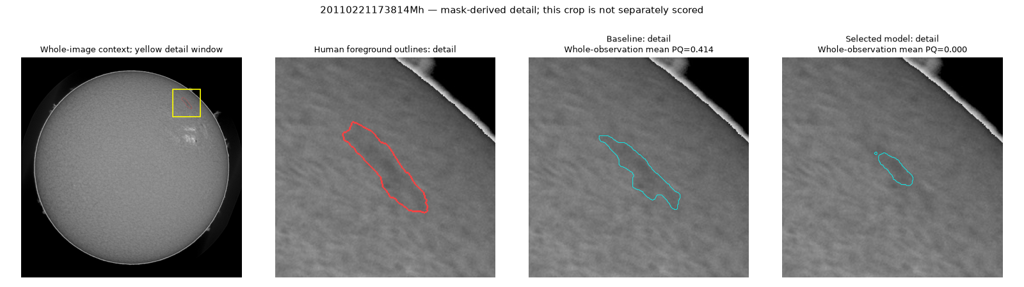
Lowest validation score
Red: human outlines. Cyan: predictions. Representative checkpoint: seed 45.
Whole Sun
Human reference
Baseline
Selected model
Whole-observation mean PQ: baseline 0.414 → selected 0.000.
Person B
10
Notes:
This is the lowest-scoring validation observation. The selected model covers much less of the long human-marked filament and adds a tiny island. None of its predicted objects reaches the required matching overlap, so PQ is zero, compared with 0.414 for the baseline. This is a real regression. The detail window is not scored separately.
Sources
Ahmadzadeh (2026). Self Evaluation Notebook, version 6.
https://www.kaggle.com/code/azimahmadzadeh/self-evaluation-notebook
Project evidence
C:\Users\user-pc\Desktop\COS711_Assig2\AI_Assignment2\study_report.py
C:\Users\user-pc\Desktop\COS711_Assig2\AI_Assignment2\results\person_b_study\
Measured evidence
These are per-observation means, not pooled dataset PQ. Interpret fragmentation/merging alongside recognition quality and TP/FP/FN: missing more filaments can reduce both relation-error counts.
Observation: 20110221173814Mh
Selection rule: Lowest selected-model observation mean PQ
Panel: C:\Users\user-pc\Desktop\COS711_Assig2\AI_Assignment2\results\person_b_study\figures\validation_zoom_20110221173814Mh.png

Slide 11
Efficiency and handoff
Parameters | 24.43 million
Inference weights | 93.4 MiB
Training loop | 12.4 min, excluding validation and setup
Full training run | 24.2 min wall time, latest invocation
Test image to CSV | 536.3 ms/image, without archive saving
Person C receives probabilities, instance maps, weights and the exact configuration.
Person B
11
Notes:
The model has 24.43 million parameters and 93.4 MiB of weights. The training loop took 12.4 minutes; the full invocation took 24.2 minutes including setup, validation and checkpoints. The checked image-to-CSV export averaged 536.3 milliseconds per image on this computer. That includes the first image, but excludes model loading and probability-archive saving. Person C receives the weights, probabilities, instance maps and exact configuration. Advanced post-processing and compression comparisons remain their work.
Sources
segmentation_models_pytorch, version 0.6.0.
https://github.com/qubvel-org/segmentation_models.pytorch
Project evidence
C:\Users\user-pc\Desktop\COS711_Assig2\AI_Assignment2\train.py
C:\Users\user-pc\Desktop\COS711_Assig2\AI_Assignment2\predict.py
C:\Users\user-pc\Desktop\COS711_Assig2\AI_Assignment2\runs\person_b_final\
Measured evidence
Representative: C:\Users\user-pc\Desktop\COS711_Assig2\AI_Assignment2\runs\final\no_augmentation_seed45; seed 45.
Timing: 96.53502770001069 seconds / 180 images; includes read, preprocessing, transfers, model, components, RLE round-trip and complete CSV writing. No warm-up images were removed. Latest training subprocess time is not cumulative resumed-run time.
Summary: C:\Users\user-pc\Desktop\COS711_Assig2\AI_Assignment2\results\person_b_study\summary.json
Benchmark details: C:\Users\user-pc\Desktop\COS711_Assig2\AI_Assignment2\results\person_b_study\inference_benchmarks.json

Slide 12
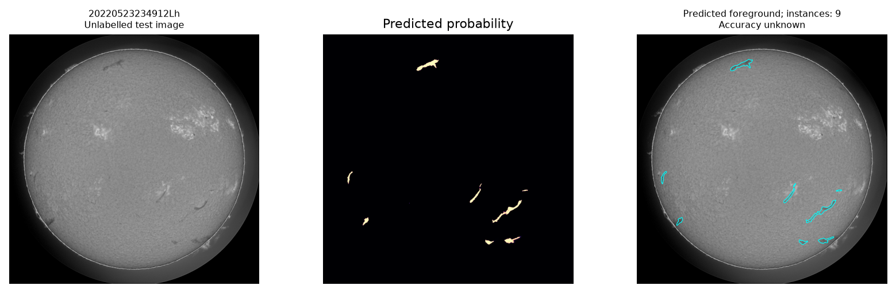
Test image illustration
Unlabelled test illustration. No ground-truth accuracy ranking.
Person B
12
Notes:
This is an unlabelled test image, selected by typical prediction count for its instrument. The exact rule is: Median predicted-instance count for instrument Lh; visual coverage only, accuracy unknown. The panel shows the final probability map and detected regions. We cannot say how accurate these are without labels. The complete export covers 180 test images, with 1831 predicted instances. Three images have no detections; those are recorded in the sidecar. Nothing has been uploaded to Kaggle.
Sources
Ahmadzadeh (2026). Self Evaluation Notebook, version 6.
https://www.kaggle.com/code/azimahmadzadeh/self-evaluation-notebook
Project evidence
C:\Users\user-pc\Desktop\COS711_Assig2\AI_Assignment2\study_report.py
C:\Users\user-pc\Desktop\COS711_Assig2\AI_Assignment2\results\person_b_study\
C:\Users\user-pc\Desktop\COS711_Assig2\AI_Assignment2\runs\person_b_final\
Measured evidence
Observation: 20220523234912Lh
Selection rule: Median predicted-instance count for instrument Lh; visual coverage only, accuracy unknown
Panel: C:\Users\user-pc\Desktop\COS711_Assig2\AI_Assignment2\results\person_b_study\figures\test_20220523234912Lh.png

Slide 13
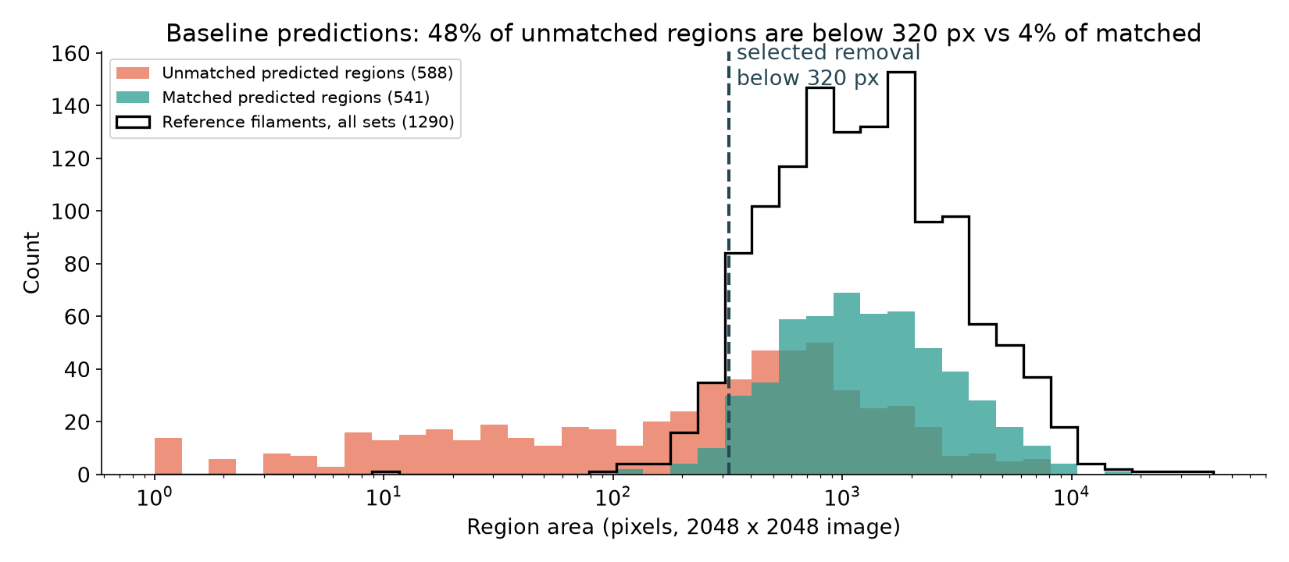
Where the errors were
• Baseline conversion (cutoff 0.5, 8-connected regions): PQ 0.345 = 783 matched, 1,007 extra, 507 missed
• Extra detections outnumber misses 2 : 1; fragmentation (84) is 4x more common than merging (20)
• 48% of unmatched regions are < 320 px, vs 4% of matched and 5% of human filaments
Person C
13
Notes:
I took the seed-45 probabilities from Person B and first asked which errors cost PQ. Pooled over the 200 validation annotation sets there were 783 matched filaments, 1,007 extra predictions and 507 misses, so extra detections outnumber misses two to one. The histogram shows why: 48% of the unmatched predicted regions are smaller than 320 pixels, while only 4% of matched regions and 5% of human-drawn filaments are that small. Fragmentation was 84 cases against 20 merges.

Slide 14
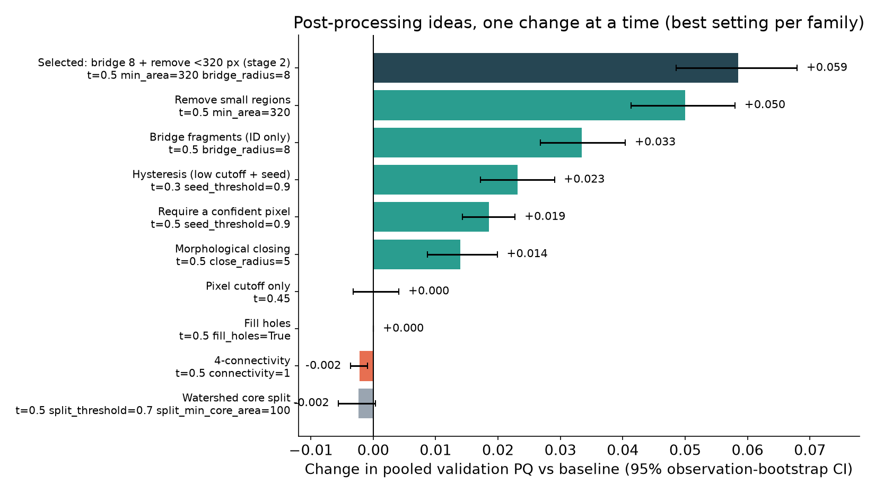
Post-processing study
Same probabilities, same scorer
Offline runner reproduces Person B's PQ exactly (0.3448101728)
Declared grids: 55 + 50 settings
Error bars: 95% bootstrap over validation images
Person C
14
Notes:
Because the probabilities were saved, I built an offline runner that re-scores them with exactly the same evaluator. It first reproduced Person B's PQ of 0.3448101728 bit for bit. I then declared a grid of 55 settings, changing one thing at a time. Removing small regions and bridging nearby fragments helped most; hysteresis and closing helped less. Changing the pixel cutoff alone did nothing, which tells us the misses are not just faint pixels below 0.5. Splitting regions at confident cores with a watershed made things worse. The error bars are 95 percent bootstrap intervals over images.

Slide 15
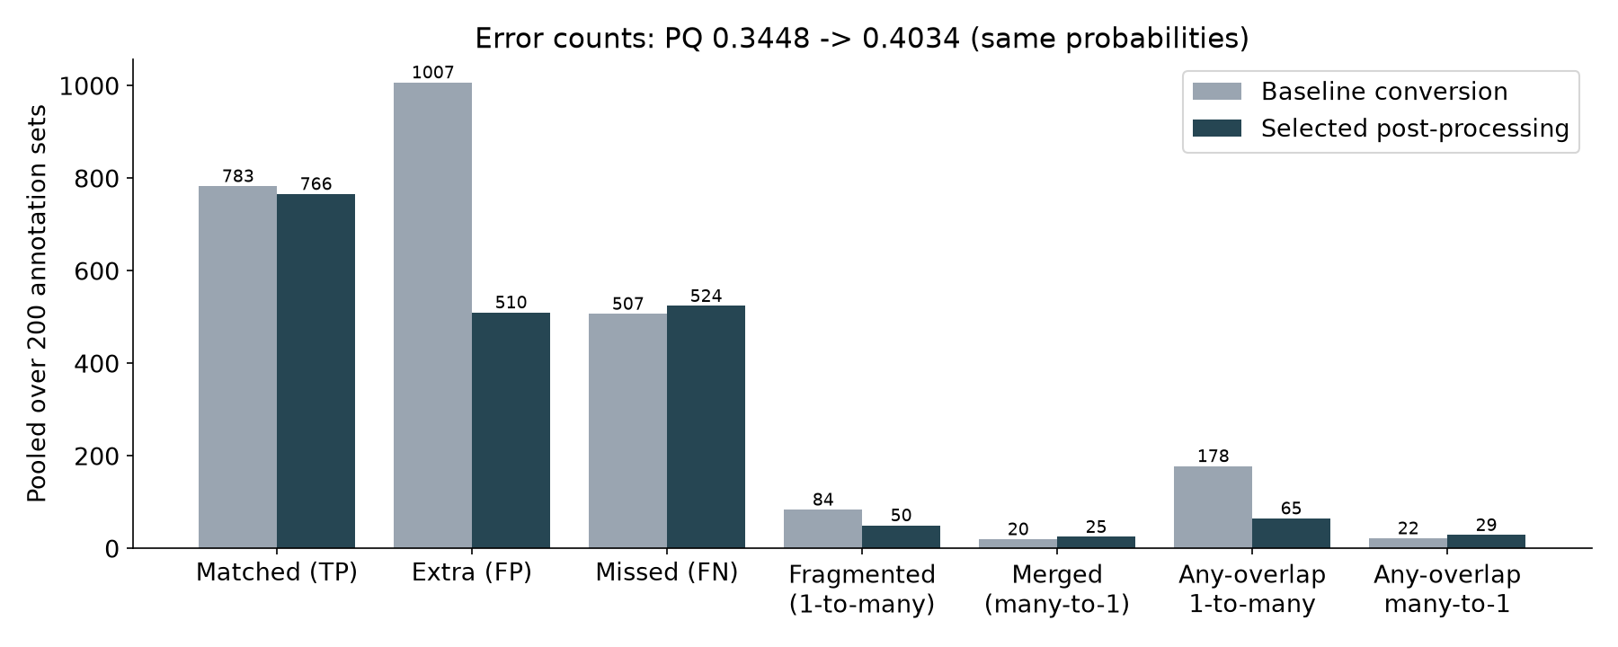
Selected post-processing
Bridge fragments up to 16 px apart (one ID, no pixels added), then drop regions < 320 px
PQ 0.345 → 0.403 (+0.059; 95% CI +0.049 to +0.068)
Tuned on half of the validation blocks, tested on the other half: +0.056 and +0.059
Trade-off
Extra regions 1,007 → 510
Fragmented 84 → 50
Lost matches: 17 small filaments
Merges 20 → 25
Person C
15
Notes:
The selected rule has two steps. First, fragments separated by at most 16 pixels get the same instance ID, without adding any pixels. Then regions smaller than 320 pixels are removed. PQ rises from 0.345 to 0.403. To check that we did not just fit the validation set, I tuned on one half of the validation time blocks and tested on the other half: the gain held at +0.056 and +0.059. Extra predictions halve and fragmentation drops, at a cost of 17 matched small filaments and a few more merges.

Slide 16
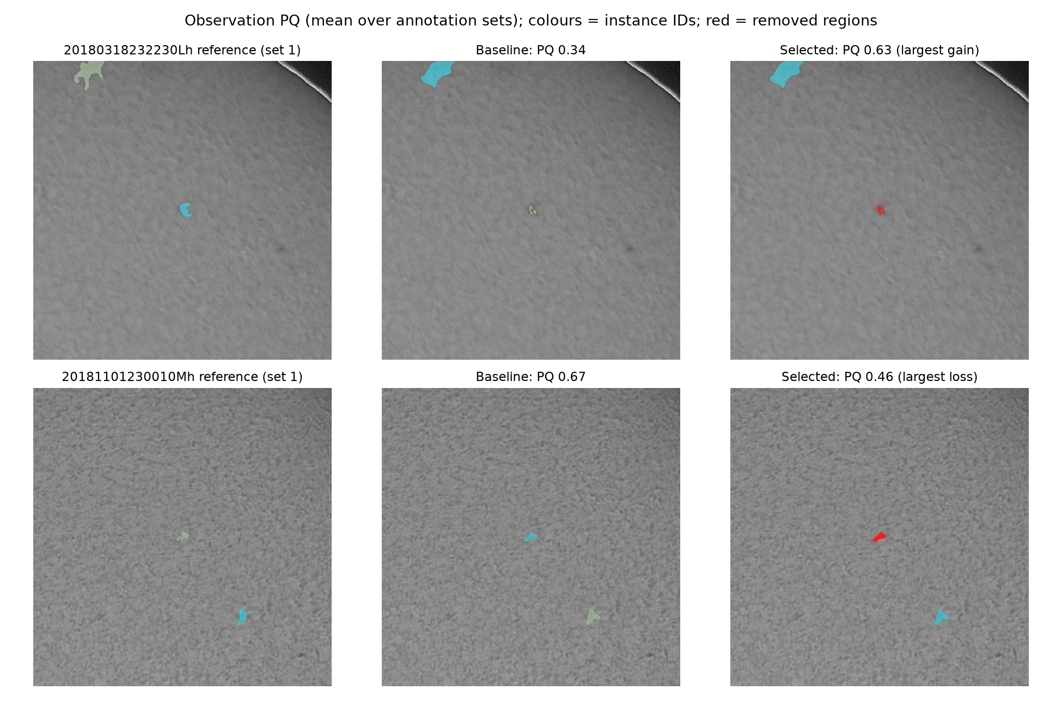
Best and worst cases
Best case
PQ 0.34 → 0.63: a tiny partial detection (IoU < 0.5) only counted as an extra object
Worst case
PQ 0.67 → 0.46: a real filament smaller than 320 px was removed
Red = removed region; colours = instance IDs
Person C
16
Notes:
These are the validation images that changed most. In the best case, a tiny partial detection of a real filament was removed: it never reached the IoU of 0.5 needed for a match, so it only counted as an extra object. In the worst case, a small real filament below 320 pixels was removed, which is the price of the size filter. Bridged fragments appear as one colour.

Slide 17
What did not help
Idea | Change in PQ | Why
Pixel cutoff 0.3 to 0.7 (alone) | best +0.000 | Misses are not just faint pixels below 0.5
Watershed split at confident cores | -0.002 to -0.010 | Cuts single filaments; merges were rare (20)
Flip test-time augmentation | -0.004 | 3.8x model time; best re-tuned cutoff only +0.0007
Fill holes | +0.000 | Predicted regions have no holes
4-connectivity | -0.002 | Breaks thin diagonal filaments
Hysteresis (+0.023) and closing (+0.014) helped alone but were subsumed by the selected pair.
Person C
17
Notes:
Negative results matter too. Moving the pixel cutoff between 0.3 and 0.7 never beat 0.5. Watershed splitting at confident cores made PQ worse because single filaments have uneven confidence and get cut into pieces, and merges were rare anyway. Flip test-time augmentation lowered PQ at our selected setting and, even after re-tuning the cutoff, gained almost nothing while costing nearly four times the model time. Filling holes and four-connectivity did not help either.

Slide 18
Compression
Same validation split, selected post-processing, complete image-to-CSV timing on one RTX 3070 (batch 1, model loading excluded)
Variant | Params | File | Val PQ | ms / image | Training
Teacher FP32 | 24.4 M | 93 MB | 0.4034 | 491 | -
Teacher mixed precision (B default) | 24.4 M | 93 MB | 0.4034 | 456 | -
Teacher FP16 weights | 24.4 M | 47 MB | 0.4033 | 445 | -
KD student ResNet18 | 14.3 M | 55 MB | 0.4012 | 489 | 11 min
Label-only ResNet18 (control) | 14.3 M | 55 MB | 0.3976 | 461 | 8 min
Pruned 50% channels + fine-tune | 6.1 M | 23 MB | 0.3652 | 494 | 4 min
Pruned 30% channels + fine-tune | 11.9 M | 46 MB | 0.4028 | 478 | 4 min
Pruned 30% + FP16 weights | 11.9 M | 23 MB | 0.4031 | 475 | 4 min
CPU deployment (first 20 test images, per image): PyTorch FP32 2.5 s, 93 MB; ONNX Runtime FP32 1.7 s, 93 MB; ONNX Runtime INT8 1.2 s, PQ 0.407, 24 MB
FP16 weights: PQ change -0.00001 at 47 vs 93 MB; distillation 0.401 vs label-only 0.398 (ResNet18, 14.3 M params); 50% channel pruning 0.365 (6.1 M params); 30% channel pruning 0.403 (11.9 M params). Chosen by the declared rule: Pruned 30% + FP16 weights.
Person C
18
Notes:
For compression I compared every variant on the same validation split, the deployable file size, and the complete test pipeline time from reading the image to writing the CSV, on the same RTX 3070. Storing the weights in half precision halves the file with no measurable loss in PQ. Removing 30 percent of the channels in every layer and fine-tuning for ten epochs kept PQ at 0.403 against 0.403 with half the parameters; removing 50 percent was too destructive for the same short fine-tune (0.365). The distilled ResNet18 student scored 0.401 and the label-only control 0.398; before post-processing the order was reversed, so with one run each, distillation's effect is within run-to-run noise. The network itself takes only about 96 of the 456 milliseconds per image: reading the image, post-processing and checking the encoding dominate, so a smaller network barely changes total time. For CPU-only deployment, ONNX Runtime with INT8 weights is four times smaller and faster than PyTorch, without losing PQ.

Slide 19
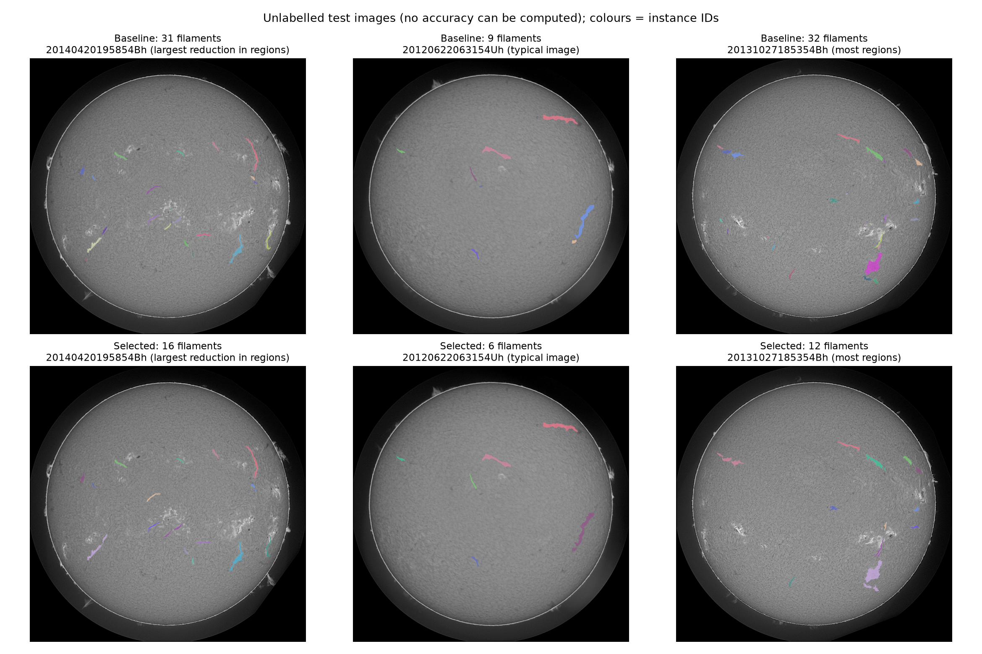
Final pipeline and submission
Item | Value
Final model | U-Net / ResNet34, seed 45 (Pruned 30% + FP16 weights)
Size | 11.93 M parameters, 22.9 MB weights file
Training time | 12.4 min teacher training loop (20 epochs, RTX 5060 Ti) + 4.0 min fine-tuning after pruning (RTX 3070)
End-to-end inference | 475 ms/image over 180 test images (476 ms excluding the first), RTX 3070
Validation PQ | 0.4031 (selected post-processing; baseline conversion 0.3288)
Test output | 1421 filaments, 180 images, 3 empty
Kaggle PQ | add after upload (not yet submitted)
Person C
19
Notes:
The final pipeline runs whole-image inference, the selected post-processing, and checked RLE encoding. It produced 1421 filaments on the 180 test images. Model size, training time and end-to-end time are on the slide. The images are unlabelled test predictions, shown as illustrations only. The Kaggle score is added after the upload.

Slide 20
Conclusions
Take-aways
• Instance conversion mattered as much as the network: +0.059 PQ from post-processing alone, more than the training-configuration study
• Small extra detections, not misses, dominated the errors; let the data choose the filter
• Pruning + FP16 storage kept validation PQ at a fraction of the size (11.93 M parameters, 22.9 MB weights file); the network is a small part of end-to-end time
• Labels are noisy: annotator vs annotator PQ is about 0.34; validation is a reference, not a leaderboard guarantee
Roadblocks
• Many settings, one validation split: declared grids, split-half and bootstrap checks
• Limited GPU time: single-seed compression runs; 50% pruning needed longer fine-tuning
Next time
• Train for instances (boundary or skeleton targets) instead of repairing them afterwards; prune gradually; repeat compression with more seeds; submit to Kaggle early
Person C, then all
20
Notes:
Our main take-away is that turning probabilities into separate objects mattered as much as the network: post-processing alone added more PQ than the whole training-configuration study. Errors were dominated by small extra detections, and a data-driven size filter plus fragment bridging targeted them. For efficiency, pruning and half-precision storage shrank the model a lot at the same validation PQ, but the network is only a small part of the end-to-end time. Our biggest roadblocks were tuning many settings on one validation split, which we handled with declared grids, split-half and bootstrap checks, and limited GPU time, so compression runs used one seed and aggressive pruning needed more fine-tuning than we had. Next time we would train for instances directly, for example with a boundary or skeleton target, prune gradually, repeat compression with several seeds, and submit to Kaggle early to compare local and leaderboard scores.

Slide 21
Model and loss references
Ronneberger, Fischer & Brox (2015). U-Net.
https://arxiv.org/abs/1505.04597
He et al. (2016). Deep Residual Learning for Image Recognition.
https://arxiv.org/abs/1512.03385
Milletari, Navab & Ahmadi (2016). V-Net.
https://arxiv.org/abs/1606.04797
Salehi, Erdogmus & Gholipour (2017). Tversky loss.
https://arxiv.org/abs/1706.05721
Zhou et al. (2018). UNet++.
https://arxiv.org/abs/1807.10165
segmentation_models_pytorch, version 0.6.0.
https://github.com/qubvel-org/segmentation_models.pytorch
Person B
21
Notes:
Bibliography. No narration is needed.
Sources
Ronneberger, Fischer & Brox (2015). U-Net.
https://arxiv.org/abs/1505.04597
He et al. (2016). Deep Residual Learning for Image Recognition.
https://arxiv.org/abs/1512.03385
Milletari, Navab & Ahmadi (2016). V-Net.
https://arxiv.org/abs/1606.04797
Salehi, Erdogmus & Gholipour (2017). Tversky loss.
https://arxiv.org/abs/1706.05721
Zhou et al. (2018). UNet++.
https://arxiv.org/abs/1807.10165
segmentation_models_pytorch, version 0.6.0.
https://github.com/qubvel-org/segmentation_models.pytorch

Slide 22
Evaluation and training references
Ahmadzadeh et al. (2024). A dataset of manually annotated filaments.
https://doi.org/10.1038/s41597-024-03876-y
Kirillov et al. (2019). Panoptic Segmentation.
https://arxiv.org/abs/1801.00868
Ahmadzadeh (2026). Self Evaluation Notebook, version 6.
https://www.kaggle.com/code/azimahmadzadeh/self-evaluation-notebook
Loshchilov & Hutter (2019). Decoupled Weight Decay Regularization.
https://arxiv.org/abs/1711.05101
PyTorch 2.14 documentation. CosineAnnealingLR.
https://docs.pytorch.org/docs/2.14/generated/torch.optim.lr_scheduler.CosineAnnealingLR.html
Person B
22
Notes:
Bibliography. The project uses ordinary cosine annealing without SGDR restarts. The MAGFiLO paper describes the dataset; only the supplied competition training labels enter this project.
Sources
Ahmadzadeh et al. (2024). A dataset of manually annotated filaments.
https://doi.org/10.1038/s41597-024-03876-y
Kirillov et al. (2019). Panoptic Segmentation.
https://arxiv.org/abs/1801.00868
Ahmadzadeh (2026). Self Evaluation Notebook, version 6.
https://www.kaggle.com/code/azimahmadzadeh/self-evaluation-notebook
Loshchilov & Hutter (2019). Decoupled Weight Decay Regularization.
https://arxiv.org/abs/1711.05101
PyTorch 2.14 documentation. CosineAnnealingLR.
https://docs.pytorch.org/docs/2.14/generated/torch.optim.lr_scheduler.CosineAnnealingLR.html

Slide 23
Enhancement references
Kirillov et al. (2019). Panoptic Segmentation. CVPR. https://doi.org/10.1109/CVPR.2019.00963
Canny (1986). A Computational Approach to Edge Detection (hysteresis thresholding). IEEE TPAMI.
Beucher & Meyer (1993). The morphological approach to segmentation: the watershed transformation.
van der Walt et al. (2014). scikit-image: image processing in Python. PeerJ. https://doi.org/10.7717/peerj.453
Hinton, Vinyals & Dean (2015). Distilling the Knowledge in a Neural Network. https://arxiv.org/abs/1503.02531
Fang et al. (2023). DepGraph: Towards Any Structural Pruning. CVPR. https://arxiv.org/abs/2301.12900
Li et al. (2017). Pruning Filters for Efficient ConvNets (L1 channel importance). https://arxiv.org/abs/1608.08710
Micikevicius et al. (2018). Mixed Precision Training. ICLR. https://arxiv.org/abs/1710.03740
Efron & Tibshirani (1993). An Introduction to the Bootstrap. Chapman & Hall.
Iakubovskii. segmentation_models_pytorch. https://github.com/qubvel-org/segmentation_models.pytorch
Person C
23
Notes:
Bibliography slide; not spoken.

