Slide 1
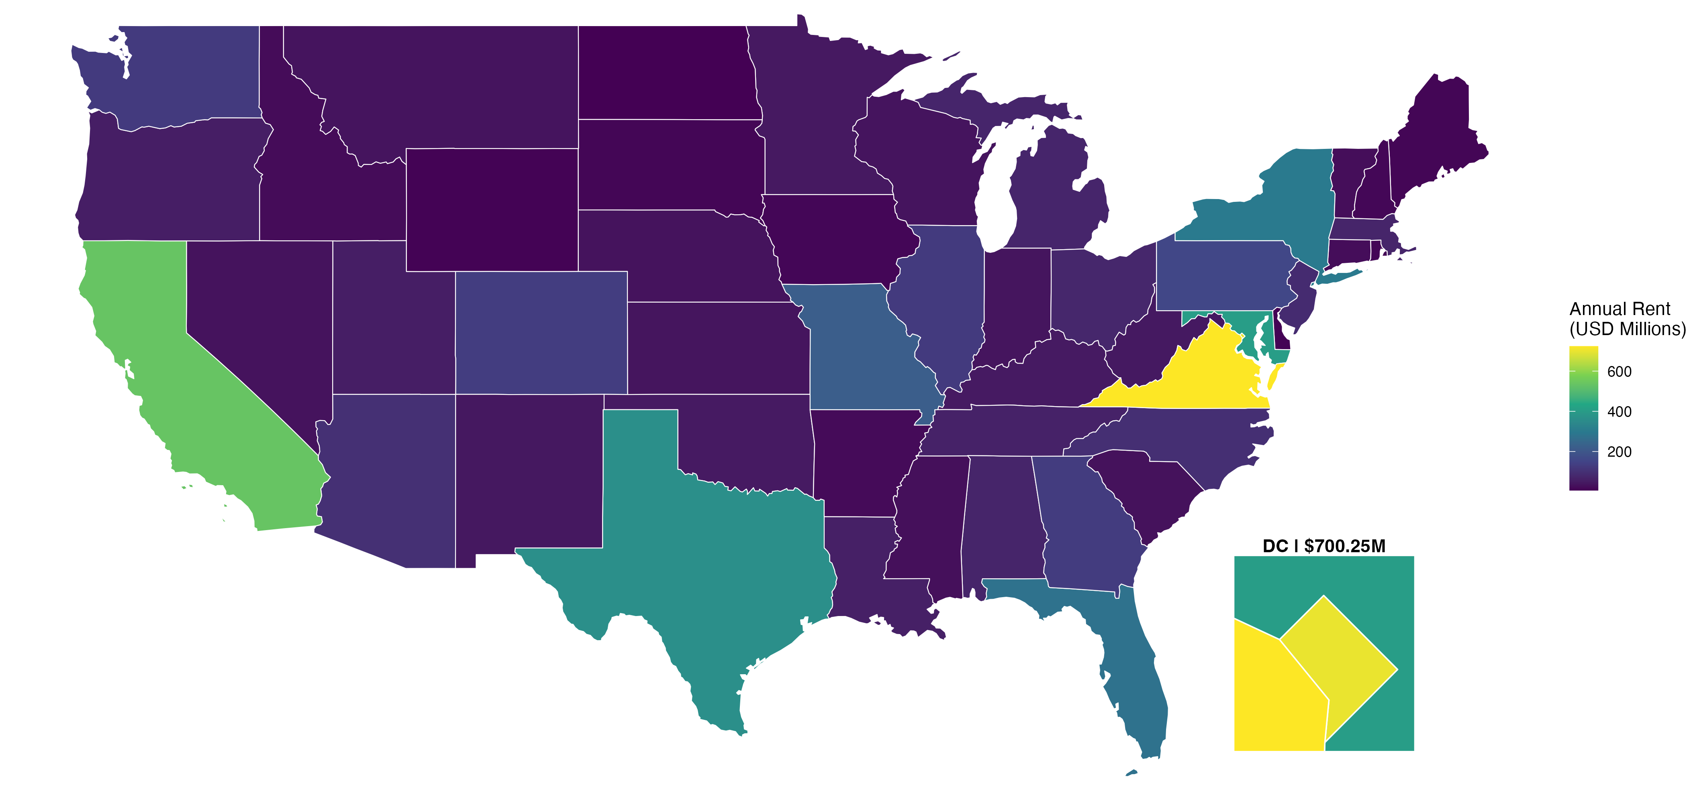
JLL · GSA LEASE PORTFOLIO CASE STUDY
Federal Lease Portfolio Analysis
FEDERAL ANNUAL RENT BY STATE
Rent concentration, upcoming expirations and leasing strategy for JLL
PRESENTED BY
Alisha Pokharel
COURSE
BAN 5100 · Data Visualization & Inferential Statistics
7,368
$5.84B
56
PROFESSOR
Omar El Mghari
leases
rent per year
jurisdictions
UNIVERSITY
William Paterson University
DATE
October 21, 2026
Data: GSA Lease Inventory, August 31, 2026

Slide 2
Three questions this presentation answers
OBJECTIVES
1
2
3
OBJECTIVE 1
OBJECTIVE 2
OBJECTIVE 3
Where does the federal government pay the most rent?
Where are large portions of that rent coming up for renewal in the next two years?
Can we map this by state, and what does it mean for JLL's leasing strategy?
Rent by state
Expirations, Sep 2026 – Aug 2028
Maps and priorities

Slide 3




Every lease eventually ends, and each ending is a business decision
INTRODUCTION
When a lease ends, the government must choose:
ONE REAL EXAMPLE FROM THE DATA
Federal office, 300 E St SW, Washington, DC
Renew
Stay in the same building, usually with new terms
Annual rent
$32.4 million
Relocate
Move the agency to a different building
Lease ends
August 3, 2028
Consolidate
Combine offices and use less space
Renewal options left
None
1,687 federal leases reach their expiration date by August 2028

Slide 4



How it works: GSA leases space for federal agencies, and firms like JLL advise on the deals
INTRODUCTION
THE TENANT
THE LEASE MANAGER
THE OWNERS
Federal agencies
GSA
Private landlords
Agencies such as the FBI and Social Security need offices and other space.
Leases buildings on the agencies' behalf and manages 7,368 leases worth $5.84B a year.
Own the buildings, often as LLCs or partnerships, and collect the rent.
WHY EXPIRATIONS MATTER
THE BROKER
Upcoming expirations may create work for advisors like JLL: renewals, relocations and portfolio advice.
JLL (like CBRE), a commercial real estate firm
Can advise on lease deals between GSA and landlords and earns a fee when it does.
1,687 leases expire by Aug 2028
Rule of thumb from class: ~20% expire within two years. In this data: 19.8% of rent.

Slide 5





Six lease terms explain everything that follows
INTRODUCTION
Annual rent
Lease expiration
What the government pays for a lease each year
The date the lease ends and a decision is needed
Holdover
Soft term
The lease has ended, but the agency is still in the space
The period when the government is allowed to cancel early
Firm term remaining
Renewal option
Time left before early cancellation is allowed (0 = can cancel now)
A pre-agreed right to extend the lease

Slide 6
01
Introduction
Data cleanup
Part 1 · Data cleanup
Making sure the data is complete and correct before analyzing it
Part 2 · Analysis
Conclusion

Slide 7
The dataset: 7,368 federal leases, and each row is one lease
PART 1 · DATA CLEANUP
7,368
42
$5.84B
Aug 31, 2026
leases (rows)
columns of information
total annual rent
date of the data snapshot
WHAT EACH ROW CONTAINS
Location
Money
Dates
Contract
state, city, address
annual rent, square feet
start and expiration dates
soft term, holdover, renewal
Grain check: 7,368 rows = 7,368 unique lease numbers, so each lease appears once and no rent is counted twice.

Slide 8
What I checked, what I found, and what I did — no lease and no dollar was lost
PART 1 · DATA CLEANUP
Check | What I found | What I did and why
Column names | Already consistent | Ran the standard steps (trim, lowercase, underscores) so code is reliable
Data types | Rent is numeric; expiration is a date | Confirmed, because the two-year window needs date math
Duplicates | 0 duplicate lease numbers | Nothing removed; each lease counted once
Missing values | 182 leases missing address and coordinates | Kept: their state is known, so their rent still counts
Unusual values | 2 leases with $0 rent; 208 square-footage flags | Kept and noted: no proof the rent is wrong
Past-due leases | 233 leases already at or past their end date | Kept as a separate "already due" group
Result: 7,368 leases and $5,838,396,051 in rent before and after cleaning. The cleaned file feeds Part 2.

Slide 9
02
Introduction
Analysis
Part 1 · Data cleanup
One finding at a time, each answering one of the three objectives
Part 2 · Analysis
Conclusion

Slide 10
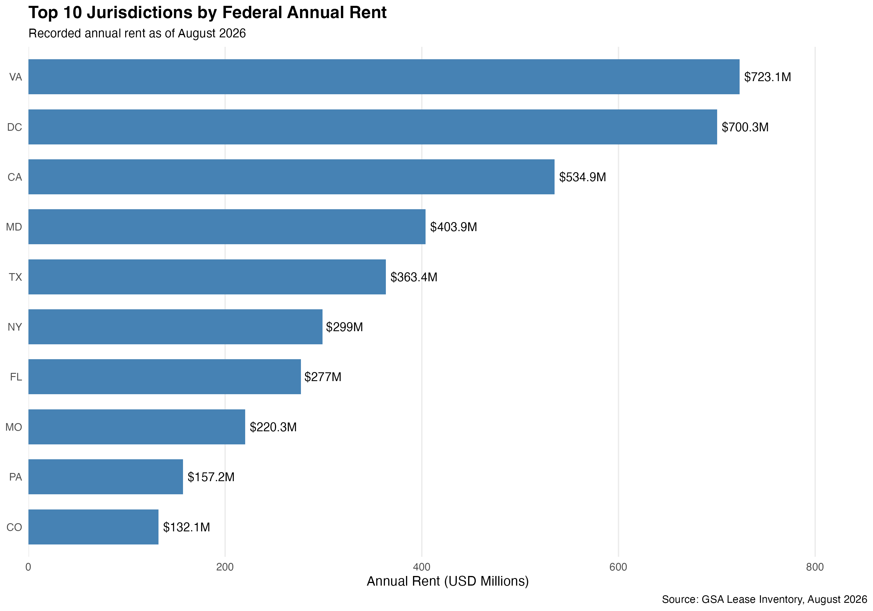
One-third of federal rent is concentrated in Virginia, DC and California
OBJECTIVE 1
Where does the federal government pay the most rent?
ANSWER
33.5%
of all federal rent is paid in just 3 of 56 jurisdictions (top 5: 46.7%)
WHAT IT MEANS FOR JLL
Spending is concentrated. JLL's research should start in these few markets.

Slide 11
DC has the fewest leases of the top three, but the largest leases on average
OBJECTIVE 1
Where does the federal government pay the most rent?
California
Virginia
Washington, DC
ANSWER
$0.82M
$2.03M
$4.76M
$4.76M
average rent per lease
average rent per lease
average rent per lease
average rent per DC lease, almost 6× a California lease ($0.82M)
649 leases
357 leases
147 leases
WHAT IT MEANS FOR JLL
SEPARATE TEST: DC + VIRGINIA VS. ALL OTHER JURISDICTIONS (WILCOXON)
DC needs lease-by-lease review. California needs a broad portfolio review.
Median lease: $914K in DC and Virginia vs. $255K elsewhere.
p < 2.2e-16: lease rents differ significantly. The test shows a difference, not its cause.

Slide 12
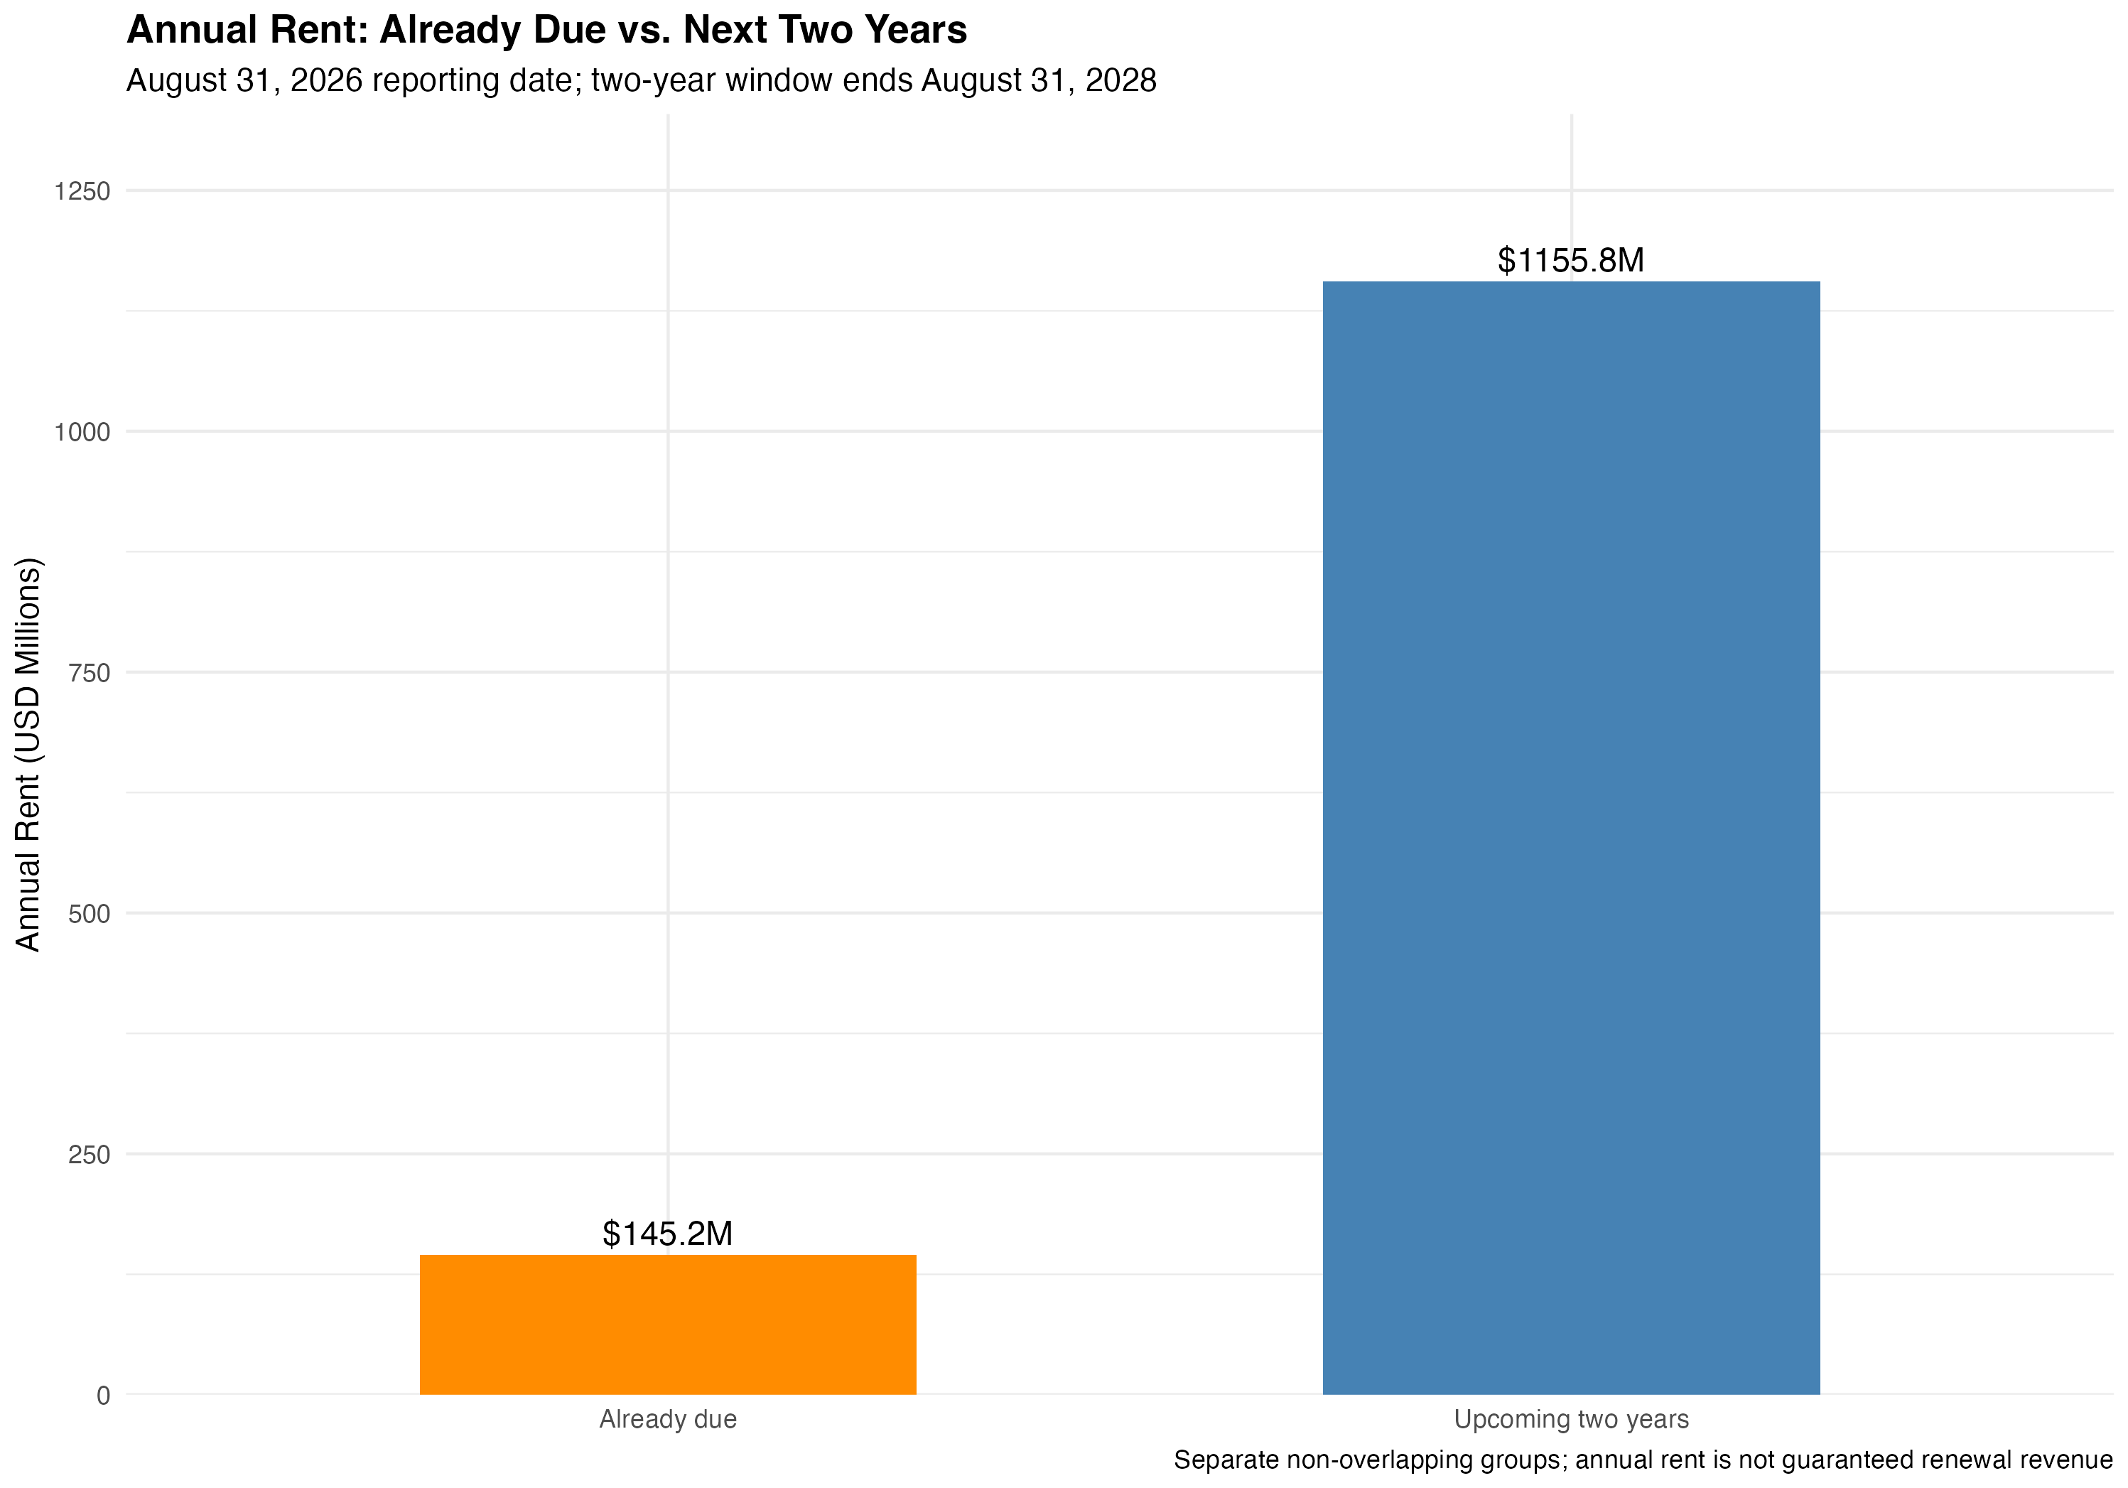
$1.30 billion of federal rent is already due or expires by August 2028
OBJECTIVE 2
Where is rent coming up for renewal in the next two years?
ANSWER
$1.30B
22.3% of all federal rent (1,920 leases) to review by Aug 2028
WHAT IT MEANS FOR JLL
Already-due leases need attention now. Upcoming leases give time to plan renewals early.

Slide 13
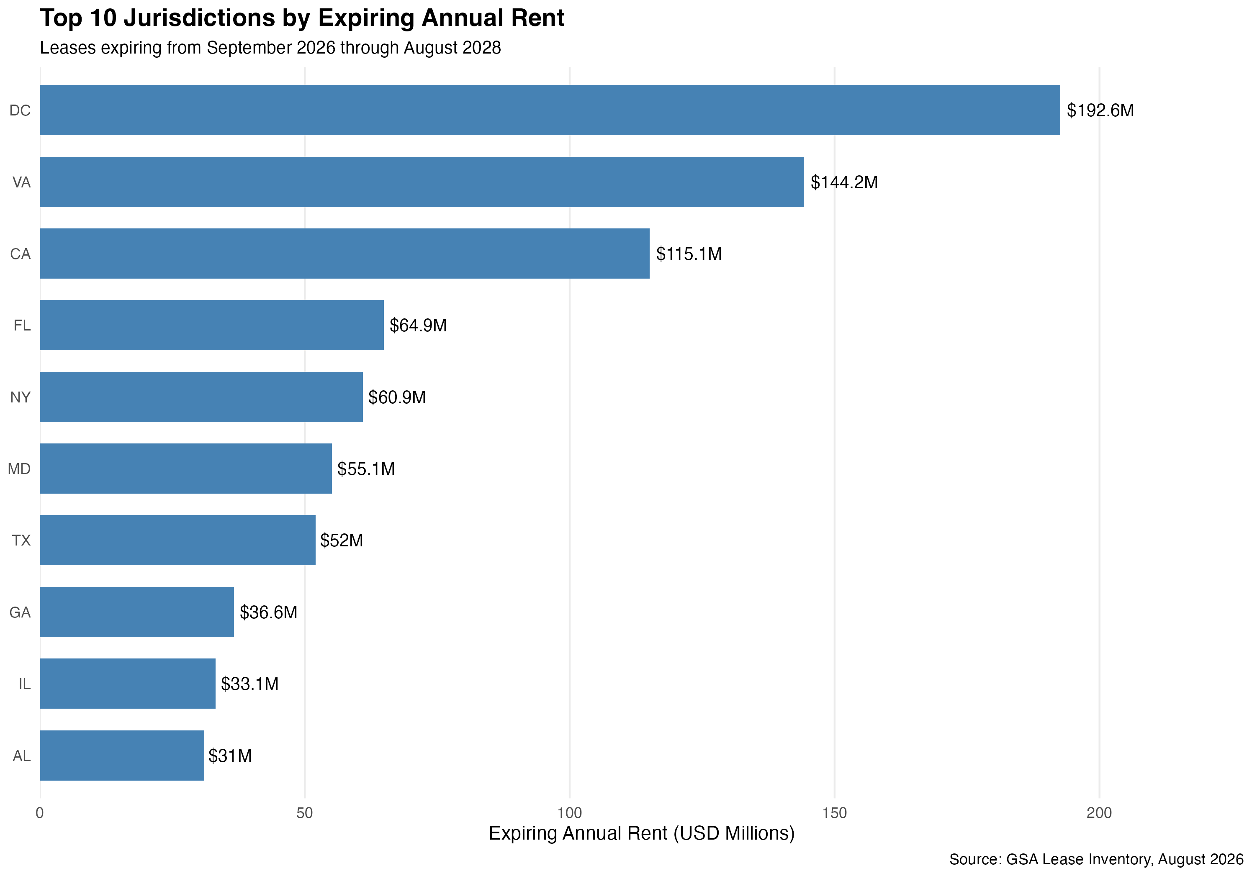
DC, Virginia and California hold 39% of all rent expiring in the next two years
OBJECTIVE 2
Where is rent coming up for renewal in the next two years?
ANSWER
$192.6M
expiring in DC across only 38 leases, the largest of any jurisdiction
WHAT IT MEANS FOR JLL
DC and Virginia hold the biggest renewal decisions and should come first.

Slide 14
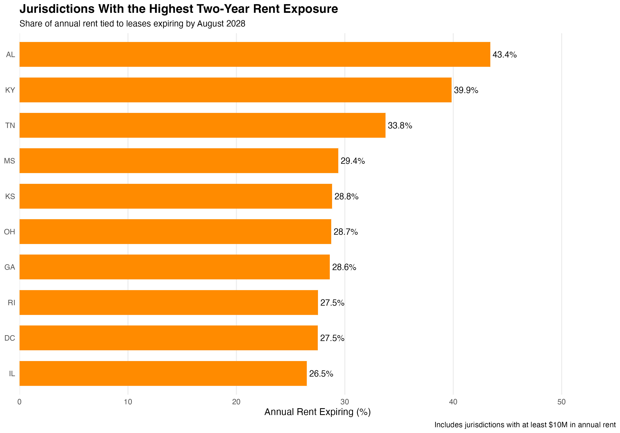
In Alabama, 43% of federal rent expires in two years, more than double the national 19.8%
OBJECTIVE 2
Where is rent coming up for renewal in the next two years?
ANSWER
43.4%
of Alabama's federal rent expires by Aug 2028; Kentucky 39.9%, Tennessee 33.8%
WHAT IT MEANS FOR JLL
Smaller dollars, but a large share of each local market turns over at once: a focused regional opportunity.

Slide 15
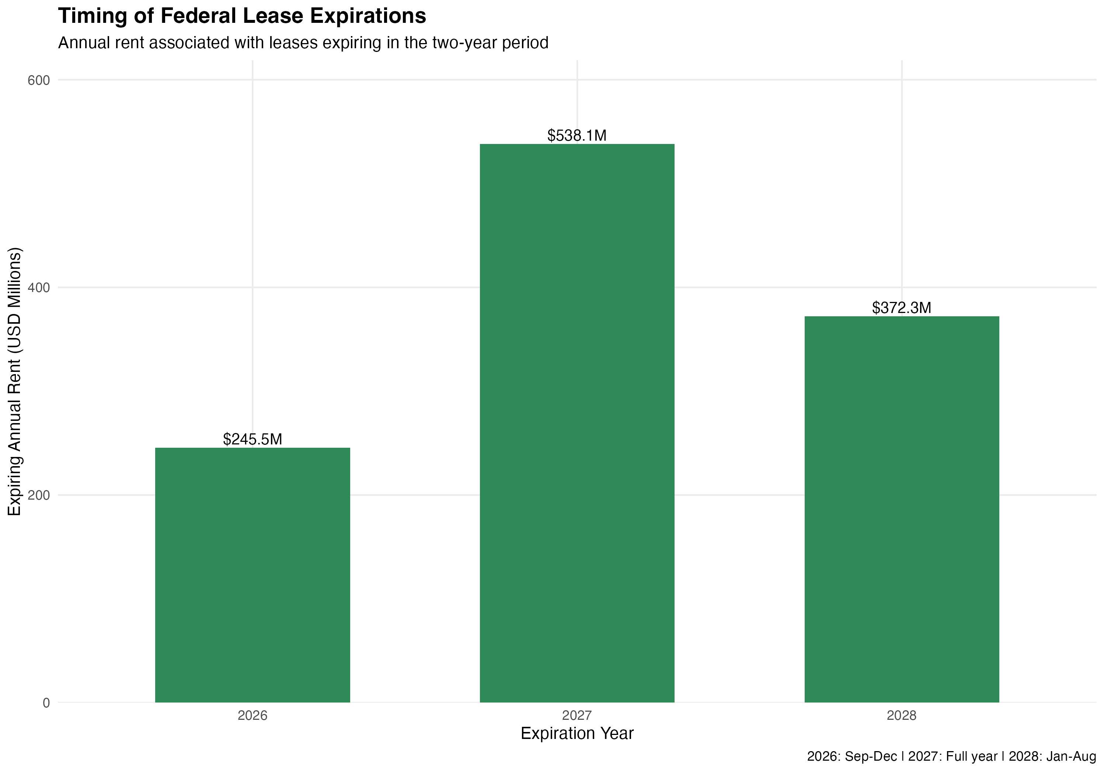
Expirations peak in 2027, but late 2026 is already busy
OBJECTIVE 2
Where is rent coming up for renewal in the next two years?
ANSWER
$538.1M
expires in 2027, the peak year. Sep–Dec 2026 already has $245.5M in only 4 months
WHAT IT MEANS FOR JLL
Lease reviews should start now, not when 2027 arrives.
Periods differ in length: 2026 = Sep–Dec (4 months) · 2027 = 12 months · 2028 = Jan–Aug (8 months)

Slide 16
Some leases can end before their expiration date: $548M is easy to miss
OBJECTIVE 2
Where is rent coming up for renewal in the next two years?
2,765
1,262
3,182
leases in soft term
of them expire after 2028
leases to review in total
$1.24B in yearly rent. The government may already cancel these early.
$548M in yearly rent that a date-only review would miss.
$1.85B (31.7% of rent): already due, expiring soon, or cancellable early. Each counted once.
What it means for JLL: Check cancellation rights, not just expiration dates. Soft term means the government can leave early, not that it will.

Slide 17
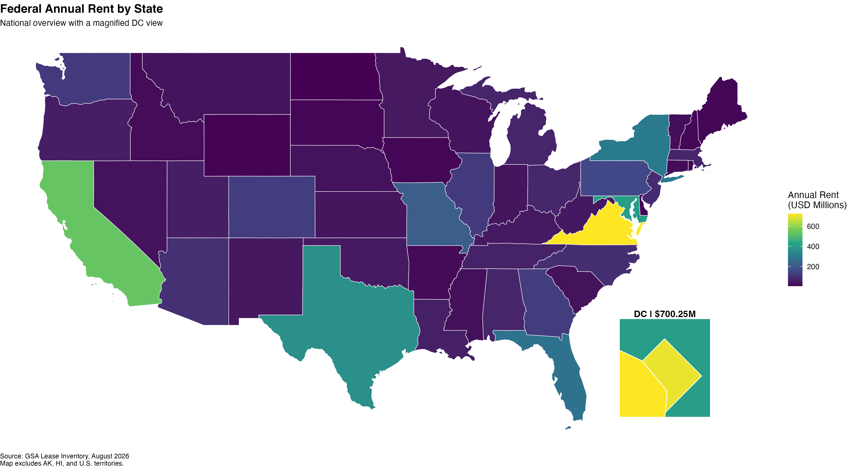
Mapped by state, federal rent is brightest in Virginia, DC and California
OBJECTIVE 3
Can we map this by state, and what does it mean for strategy?
ANSWER
$700.3M
rent in DC (close-up box): tiny on the map, #2 in the country
WHAT IT MEANS FOR JLL
The map confirms Objective 1: the largest federal leasing markets are on the East Coast and in California.

Slide 18
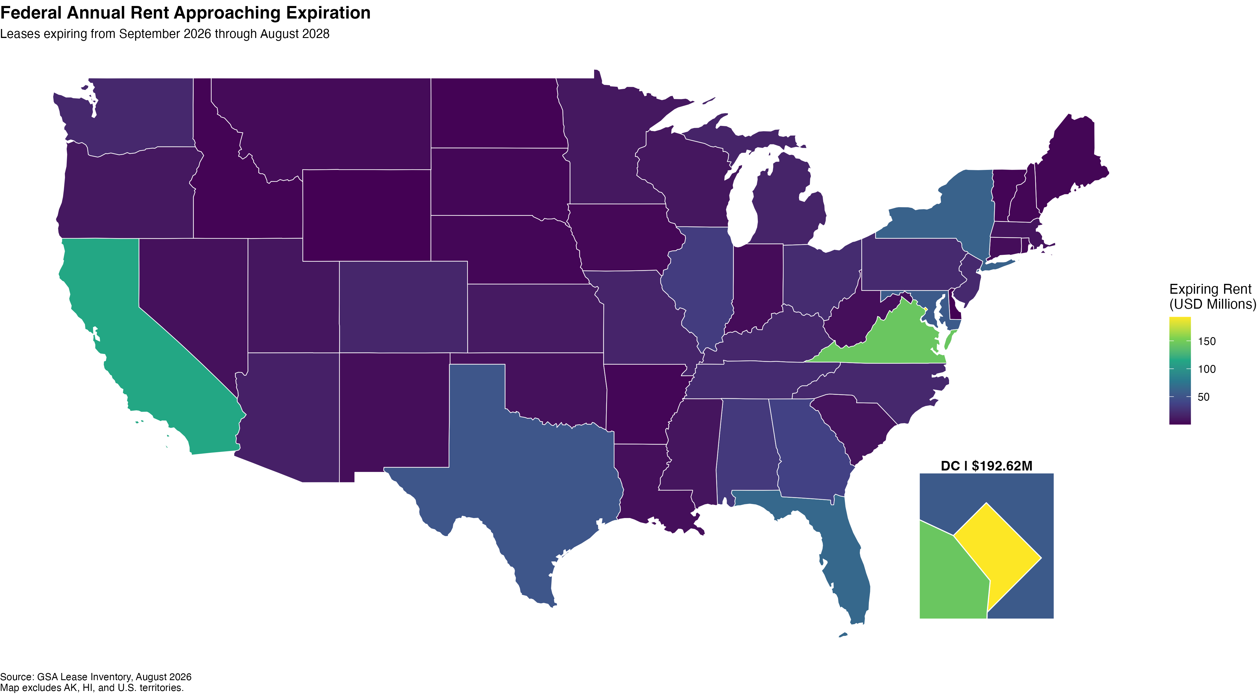
The same states lead in rent expiring by August 2028
OBJECTIVE 3
Can we map this by state, and what does it mean for strategy?
ANSWER
$192.6M
expiring in DC, the most of any jurisdiction; then Virginia and California
WHAT IT MEANS FOR JLL
Where the rent is today is also where the biggest renewal decisions are coming.

Slide 19
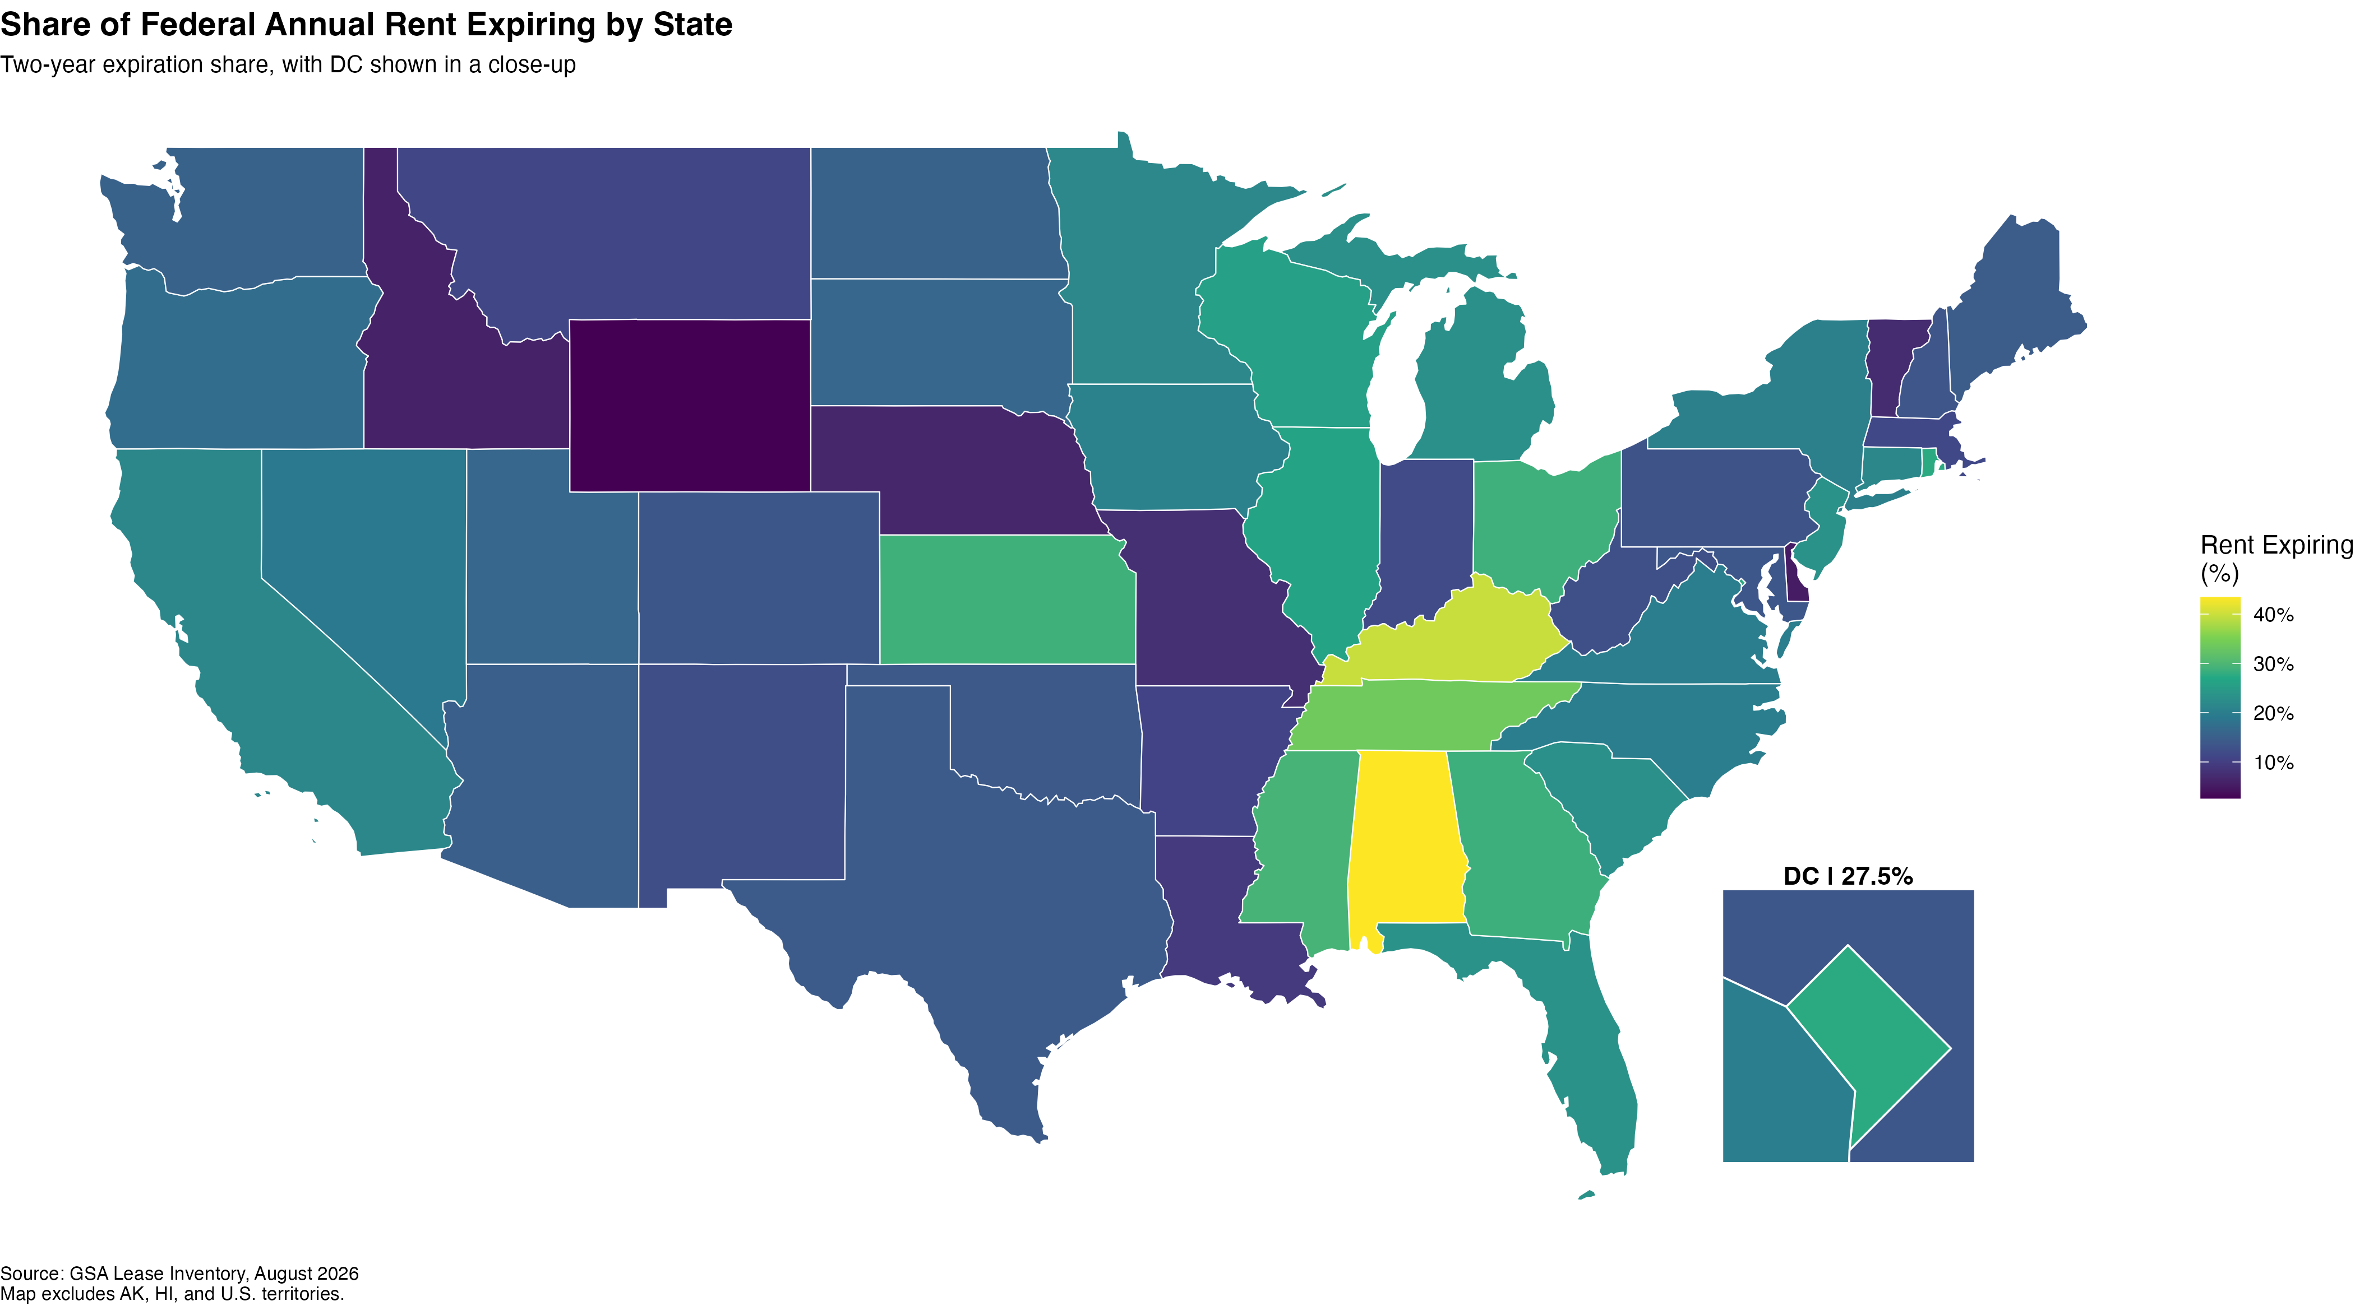
By share of rent expiring, the Southeast stands out
OBJECTIVE 3
Can we map this by state, and what does it mean for strategy?
ANSWER
AL · KY · TN
brightest on the map: 43.4%, 39.9% and 33.8% of rent expiring
WHAT IT MEANS FOR JLL
Dollars show where the money is. Share shows where a whole local market turns over at once. JLL needs both views.

Slide 20
What it means for leasing strategy: three priority levels
OBJECTIVE 3
Can we map this by state, and what does it mean for strategy?
PRIORITY
1
Washington, DC and Virginia
NEXT STEP
$336.8M expiring. Very large leases. 8 of the 10 largest expiring leases are here.
Review each major lease individually
PRIORITY
2
California, Florida, New York
NEXT STEP
$240.9M expiring across 345 leases. Many mid-size leases.
Screen for renewal, relocation or consolidation
PRIORITY
3
Alabama, Kentucky, Tennessee
NEXT STEP
33.8%–43.4% of local rent expiring. Smaller dollars, high share.
Find the few leases driving local turnover
In every market: also review soft-term leases that can be cancelled early.

Slide 21
New Jersey's office market: 25% of office space is vacant, which may give tenants negotiating room
WEB EXERCISE 4 READING
JLL, New Jersey Office Market Dynamics, Q2 2026
WHAT JLL'S REPORT SAYS
FEDERAL LEASES IN NEW JERSEY
135
leases, $86.7M a year (#16 of 56)
25.0%
$32.40
office vacancy
asking rent per sq ft
44
leases ($24.5M) due by Aug 2028
lowest since the end of 2022
overall direct; Class A is $35.31
70
leases ($30.1M) in soft term
1.29M
13.5%
sq ft absorbed so far in 2026
vacancy in Premier Class A
WHAT IT MEANS FOR JLL
5th straight quarter of positive demand
vs. 27.1% in other Class A buildings
With high vacancy, GSA may negotiate better terms on these 44 leases or move agencies to better space: potential work for advisors like JLL.
Key trend: "flight to quality." Tenants are moving to the best buildings, while others stay emptier.
Source: jll.com/en-us/insights/market-dynamics/new-jersey-office · Covers Northern and Central New Jersey

Slide 22
03
Introduction
Conclusion
Part 1 · Data cleanup
Answers to the three objectives and recommendations for JLL
Part 2 · Analysis
Conclusion

Slide 23
Answers to the three objectives
CONCLUSION
Where does the federal government pay the most rent?
Virginia ($723.1M), DC ($700.3M) and California ($534.9M): one-third of the $5.84B total. DC's leases are the largest, $4.76M on average.
1
Where is rent coming up for renewal in the next two years?
$1.30B (22.3%) is already due or expires by Aug 2028. DC, Virginia and California lead in dollars; Alabama, Kentucky and Tennessee lead in share.
2
What do the maps mean for leasing strategy?
Start with DC and Virginia, then California, Florida and New York, then the high-share Southeast states, and check soft-term leases everywhere.
3

Slide 24


Four recommendations for JLL
CONCLUSION
Start with the biggest leases
Act on already-due leases now
The 10 largest expiring leases are worth $211.1M a year; 8 of them are in DC and Virginia.
233 leases ($145.2M) are already at or past their end date; confirm the status of each.
Plan ahead, starting in 2026
Look beyond expiration dates
Late 2026 is already busy ($245.5M in 4 months) and 2027 is the peak year ($538.1M).
1,262 soft-term leases ($547.9M) can end early even though they expire after 2028.

Slide 25
KEY TAKEAWAY
Federal rent is concentrated in a few markets, and $1.30 billion of it is already due or expires by August 2028. JLL should start in DC and Virginia, and start now.
$5.84B
$1.30B
$1.85B
federal rent analyzed
already due or expiring by Aug 2028
on the full review list incl. soft term
Limitation: an expiration date shows where a decision is coming, not whether a lease will be renewed, vacated or brokered.
Thank you · Questions?

