Slide 1
HPML Final Project · Spring 2026
Performance Optimization of
the TSFM Agent in an
Industrial Agentic Benchmark
Optimization of the TSFM MCP agent in IBM's AssetOpsBench industrial AI benchmark, achieving a 3.3x reduction in workflow completion latency
Team 27
Alisha Vinod · av3311
Thomas Ajai · tl3444
Jonathan Ang · ma4624
Sanjaii Vijayakumar · sv2851
GitHub: https://github.com/alishavinod/AssetOpsBench/tree/baseline
Tracking: https://wandb.ai/av3311-columbia-university/hpml-tsfm-optimization/workspace?nw=nwuserav3311
Dr. Kaoutar El Maghraoui · Columbia University · Week of May 4, 2026
Notes:
We are Team 27, and our project focuses on Performance optimization of TSFM Agent in an Industrial Agentic Benchmark. This is a mentor-guided project under Mr. Dhaval Patel, and our goal was to optimize the TSFM MCP agent, specifically for IBM’s AssetOpsBench.

Slide 2

Motivation & Problem
Why this matters
Problem Statement & Goal
Industrial maintenance workflows depend on fast, reliable TSFM forecasting.
Current MCP tool calls add latency from model loading, data filtering, and inference.
A naive baseline makes workflows slower and harder to scale across many sensors.
We profile and optimize the TSFM MCP agent in IBM’s AssetOpsBench benchmark, targeting latency bottlenecks across data quality filtering, model loading, and forecasting inference.
Goal:
Reduce per-tool-call and end-to-end workflow latency through three targeted optimizations while preserving forecast quality.
HPML · Spring 2026
2 / 14
Notes:
Why is this optimization necessary? In industrial maintenance, reliable time series forecasting is essential for operational efficiency. We identified that the current MCP tool calls suffer from high latency due to:
Repeated model loading from disk
Data filtering overhead
Inefficient inference that does not scale well across multiple sensors. Our goal was to profile these bottleneecks and implement the targeted optimizations to reduce per-tool-call and end-to-end latency while preserving the forecast quality.

Slide 3
Technical Approach — Model & Data
Model
Dataset
Hardware
TinyTimeMixer (TTM) - IBM Research
Parameter count: ~1M (ttm_96_28), ~5M (ttm_512_96)
Framework: HuggingFace Transformers + granite-tsfm library
Two variants: ttm_96_28 (context length 96, horizon 28) and ttm_512_96 (context length 512, horizon 96)
IBM AssetOpsBench - Chiller 6 Sensor Data
chiller6_june2020_sensordata_couchdb
2,896 rows × 12 sensor columns
License: Apache 2.0 (IBM AssetOpsBench)
No train/test splits - zero-shot inference only
Sensors: temperature, efficiency, tonnage, power input, flow rate, refrigerant pressure
GPU: NVIDIA T4 (GCP n1-standard-4 instance)
VRAM: 16GB
CUDA: 12.4
PyTorch: 2.6
Orchestrator LLM: IBM Granite 3.3 8B Instruct via watsonx.ai API
HPML · Spring 2026
3 / 14
Notes:
To tackle this, we used the following stack:
For the model, we used IBM Research’s TinyTimeMixer which is a lightweight model with variants ranging from 1M-5M parameters. We evaluated two specific variants: one with 96 context length and 28 horizon and another with 512 contex length and 96 horizon.
For the dataset, we focused on the Chiller 6 sensor data that was given in the AssetOpsBench repository, and we did not split them into train and test, rather, we did zero shot inferencing across all the sensor datas.
For the hardware, we used a GCP cloud instance, with Nvidia T4 GPU, and for the orchestrator, we used IBM Granite 3.3 via the Watsonx API to manage the agentic workflow.

Slide 4
Technical Approach — Optimizations Applied
1.
Model Pre-loading and torch.compile
The TTM model re-initializes from disk on every tool call, loading it once at server startup and compiling the computation graph eliminates repeated cold-start overhead and fuses 19,032 CUDA kernel launches into fewer, faster operations.
2.
Trainer Replacement with Direct Model Call
The HuggingFace Trainer wraps inference in a DataLoader loop adding 458ms of unnecessary per-batch memcpy and tensor allocation overhead, a direct batched model call processes all samples in one shot.
3.
Mixed-Precision Inference (bf16)
TTM runs in float32 by default, wrapping the forward pass in torch.autocast(dtype=torch.bfloat16) halves activation memory and enables Tensor Core acceleration on the T4 GPU.
HPML · Spring 2026
4 / 14
Notes:
We implemented three technical shifts to improve performance:
Model pre-loading: We eliminated the cold start overhead by loading the model at server startup rather than on every tool call. Using torch.compile, we fused over 19,000 CUDA kernel launches into fewer faster operations.
Trainer Replacement: The standard Hugginface trainer adds nearly 458ms of overhead due to Dataloader loops and memory copies. We replaced this with a direct batched model call to process samples in one shot.
Mixed precision: We wrapped the forward pass in torch.autocast using bfloat16, which halves the activation memory and enables Tensor Core acceleration on the GPU.

Slide 5
Profiling Methodology
Tools
Metrics captured
PyTorch Profiler (torch.profiler) - kernel-level CPU/CUDA timing, 19,032 kernel launches identified per forward pass
Weights & Biases - run-level metric tracking across all optimization configurations
Custom TSFMProfiler - per-stage wall-clock timing (data loading, preprocessing, model loading, ttm_forward, postprocessing)
Per-stage latency: data loading, preprocessing, model loading, ttm_forward, postprocessing
Total workflow completion latency (end-to-end)
Peak GPU memory (VRAM) per stage in MB
Model loading overhead per tool call
n_sensors scaling (1, 2, 5, 9 sensors)
Speedup ratio across optimization configurations (baseline, GPU, bf16)
HPML · Spring 2026
5 / 14
Notes:
To ensure our optimizations were effective, we used the following profiling tools:
PyTorch profiler: To identify kernel level timing and the 19,032 specific kernel launches per forward pass.
Weights and Biases: For tracking metrics across all optimization configurations.
Custom TSFMProfiler: This allowed us to measure wall-clock timing for specific stages like preprocessing.
Metrics: We focused on per-stage latency, peak VRAM usage and how the model scales as we increase the number of sensors.

Slide 6
Experimental Setup
Setting | Baseline | Optimized
Precision | [FP32] | [FP32 + BF16]
Device | CPU | NVIDIA T4 GPU
Model loading | Per tool call | Pre-loaded at startup
Trainer | HuggingFace Trainer | Direct model(**inputs) call
Hardware | GCP n1-standard-4, T4 16GB | GCP n1-standard-4, T4 16GB
Software stack | PyTorch 2.6.0+cu124, granite-tsfm 0.3.6 | [+torch.compile]
Pipeline: data loading, pre processing, model loading, ttm_forward, post processing
HPML · Spring 2026
14 / 14

Slide 7
Results — Headline Numbers
3.3x
68%
9x
Faster inference
Reduction in in total workflow latency
9x faster model loading overhead per tool call
40,161 ms → 16,000 ms (model loading)
torch.compile + kernel fusion
43,021 ms → 13,798 ms
233 ms → 26 ms
All measurements averaged over 3 runs for 1,2,5,9 sensors.
HPML · Spring 2026
6 / 14

Slide 8
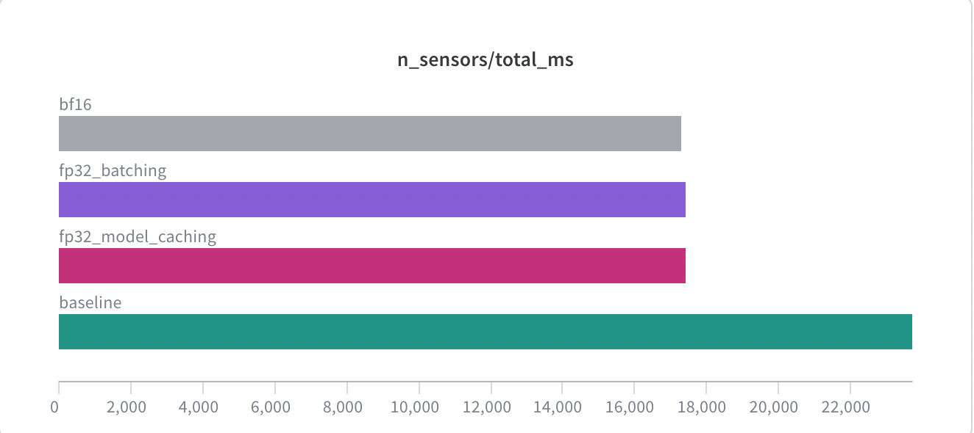
Results — Before vs. After
Takeaway
Total workflow latency reduced from 40,161 ms to 16,000 ms - 3.3x speedup from torch.compile + model caching
All three optimized configs (bf16, fp32_batching, fp32_model_caching) are identical at ~17,000ms - confirming model caching is the dominant optimization
Adding GPU placement on top brings total latency to 13,798ms - 3.3x vs the true baseline of 43,021ms
bf16 shows no benefit over fp32, TTM's MLP architecture does not leverage Tensor Core acceleration
HPML · Spring 2026
7 / 14

Slide 9
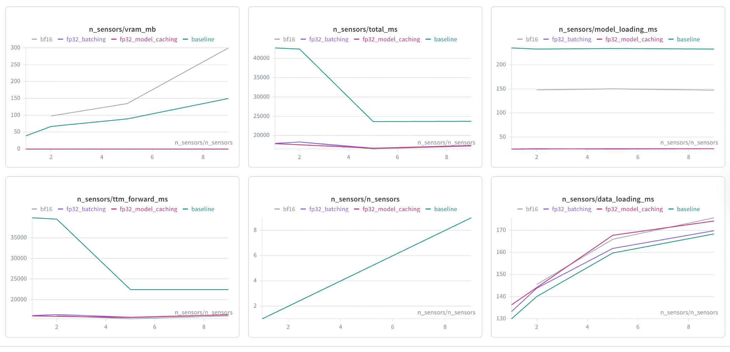
Results - comparison of optimization across metrics

Slide 10
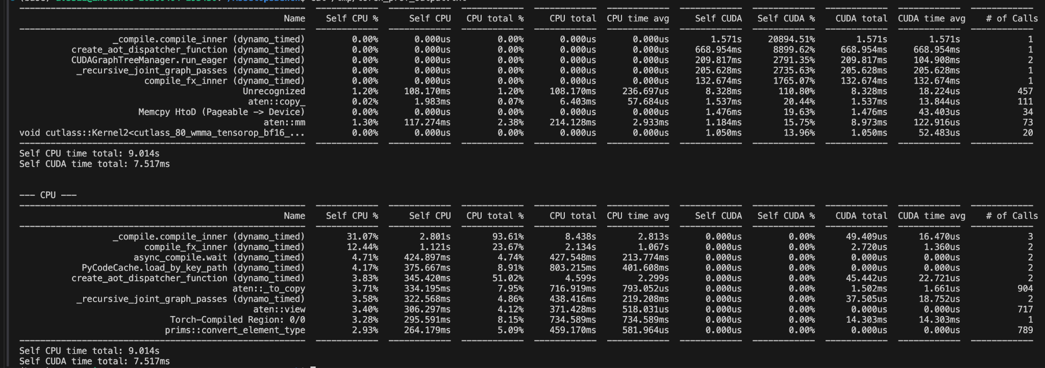
Profiler Evidence
[ Insert profiler trace, Nsight timeline, or torch.profiler chrome trace screenshot here ]
What to point at
Bottleneck before optimization
Kernel that disappeared / fused
Idle gap that shrank
Memory copy avoided
HPML · Spring 2026
8 / 14

Slide 11
Profiler Interpretation
Key findings
The trace is dominated by torch.compile warmup : _compile.compile_inner: ~8.4s CPU total
CUDA execution is active, but not the main bottleneck: Self CUDA time total: ~7.5ms
GPU kernels are present: aten::mm and CUTLASS BF16 Tensor Core kernels appear in the trace.
Data transfer is small: Memcpy HtoD: ~1.5ms total
BF16 is active, but not enough by itself: Copy and dtype conversion overhead reduces the benefit.
Main interpretation The first compiled call is CPU/compiler dominated. The optimization only pays off when the model is compiled once, cached at server startup, and reused for later MCP tool calls.
Final takeaway For TinyTimeMixer, the biggest win came from model caching + direct compiled inference, not from BF16 alone.
HPML · Spring 2026
8 / 14

Slide 12
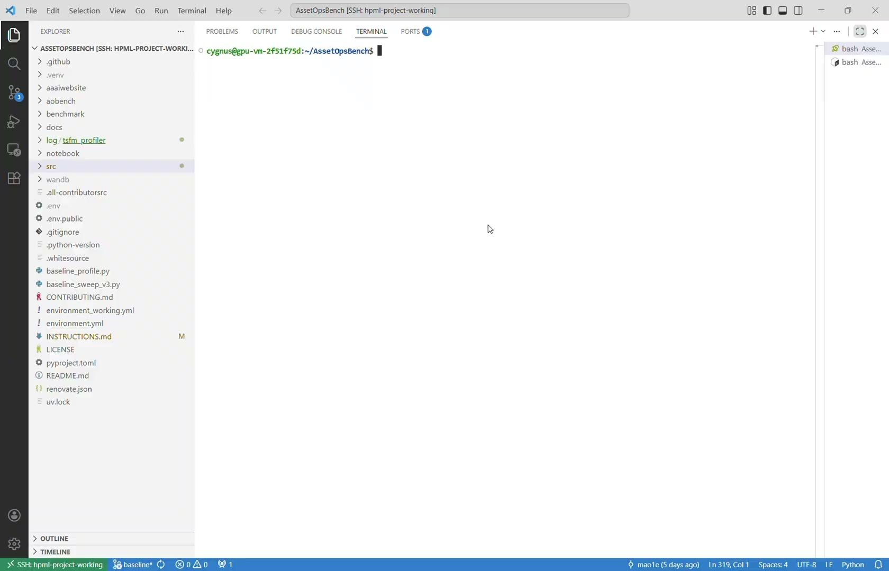
Demo / Visualization
Time budget: 1 minute. Live demo, animated comparison, or short recorded clip.
[ Demo / GIF / Screen recording / Live notebook ]
Have a fallback static image in case live demo fails
Pre-load any models or data — do not wait for downloads on stage
Narrate what to look at while it runs
HPML · Spring 2026
9 / 14

Slide 13
Ablation study
Optimization Stack | ttm_forward | Total | Speedup
Baseline CPU | ~38,000ms | ~41,000ms | 1x
+ Model caching | ~16,000ms | ~17,000ms | 2.4x
+ bf16 | ~16,000ms | ~17,000ms | same
+ using GPU | ~12,293ms | ~13,798ms | 3.3x
HPML · Spring 2026
9 / 14
Notes:
ttm _forward is inference part

Slide 14

Lessons Learned
Time budget: 1 minute. What surprised you? What didn't work? Be honest.
check_circle What worked
cancel What didn't work
torch.compile: 2.5x speedup on ttm_forward. Kernel fusion eliminated 19,032 CUDA launches.
Direct model calls: Replacing HF Trainer eliminated DataLoader and memcpy overhead per inference.
Model pre-loading: Reduced loading time from ~230ms to ~25ms (9x faster per tool call).
GPU placement: Unlocked additional 1.3x speedup; total 3.3x vs baseline.
bf16 precision: Performance dropped (15,272ms vs 12,293ms fp32). TTM's MLP structure didn't benefit Tensor Cores.
Batching: No impact. Orchestrator LLM passes sensors in a single call, leaving no serial behavior to collapse.
GPU Idle Assumption: TTM is CPU-optimized by IBM; GPU gains are modest unlike attention-based models.
HPML · Spring 2026
10 / 14

Slide 15
Next Steps
Time budget: 30 seconds. Be specific — vague "more experiments" is not next steps.
dns
FastAPI
Concurrent tool calls
memory
INT8 Quantization via bitsandbytes
Reduce ttm_forward memory bandwidth
analytics
Full AssetOpsBench Evaluation
Extend to scenarios 216-223 using official chiller9 dataset once access is obtained from IBM.
HPML · Spring 2026
11 / 14

Slide 16
Teamwork & Contributions
Time budget: 30 seconds. Who did what. Required slide — graded individually.
Member | Primary contributions | Tools / artifacts
Alisha | Baseline sweep, Wandb logging, mixed precision | baseline_profile.py, baseline_sweep.py
Thomas | Report writing, results analysis, figures, resolving dependency/integration conflicts
Jonathan | Model caching | forecasting.py, model_cache.py
Sanjaii | Initial baseline setup, building configurations, testing out the plan-execute pipeline, brainstorming ideas for optimization.
Collaboration: regular [twice-weekly] meetings via [n person], shared [Whatsapp] channel
HPML · Spring 2026
12 / 14

Slide 17
Thank you
Questions?
GitHub: https://github.com/alishavinod/AssetOpsBench/tree/baseline
Tracking: https://wandb.ai/av3311-columbia-university/hpml-tsfm-optimization/workspace?nw=nwuserav3311
HPML · Spring 2026
13 / 14

