Slide 1
Taxi-v4 Reinforcement Learning Project
Reward Design,
Prioritized Sweeping
and Generalization
R
G
T
Y
B
Names: [Name 1], [Name 2]
Algorithm: SARSA + Planning + Kernel
01

Slide 2
Reward Design | Prioritized Sweeping | Generalization
The Challenge: Efficient Taxi Learning
Task
Problem
Goal
Pick up a passenger
and drop them at
the correct destination
Naive SARSA learns slowly
because each real step
updates only one pair
Accelerate learning with
Planning and Generalization
while keeping Taxi-v4 fixed
02

Slide 3
Reward Design | Prioritized Sweeping | Generalization
The Engine: SARSA + Prioritized Sweeping + Kernel
State
→
Action
→
Reward
→
TD Error
→
Priority Queue
→
Planning
SARSA update:
Q(s,a) ← Q(s,a) + α[r + γQ(s',a') − Q(s,a)]
• The real update comes from the environment
• Planning updates come from the learned internal model
• The priority queue focuses on large TD errors
03

Slide 4
Reward Design | Prioritized Sweeping | Generalization
Reward Design
Role
Core Idea
Name
Benchmark
Original Taxi reward
Base
Hard challenge
+1 only for successful dropoff
Sparse
Dense progress
Progress toward current target
Reward 3
Safety
Subgoals + illegal-action penalty
Reward 4
Composite path
Shortens the full remaining path
Reward 5
04

Slide 5
Reward Design | Prioritized Sweeping | Generalization
Kernel Generalization: Sharing Learning Across Similar States
R
G
K(s,ŝ) = 1 / (1 + exp(β(d(s,ŝ) − c)))
• Similarity is based on Manhattan distance between taxi positions
T
• States are compared only with the same passenger status and destination
• Generalization is applied to movement actions, not pickup/dropoff
• This spreads knowledge locally while preserving task semantics
Y
B
05

Slide 6
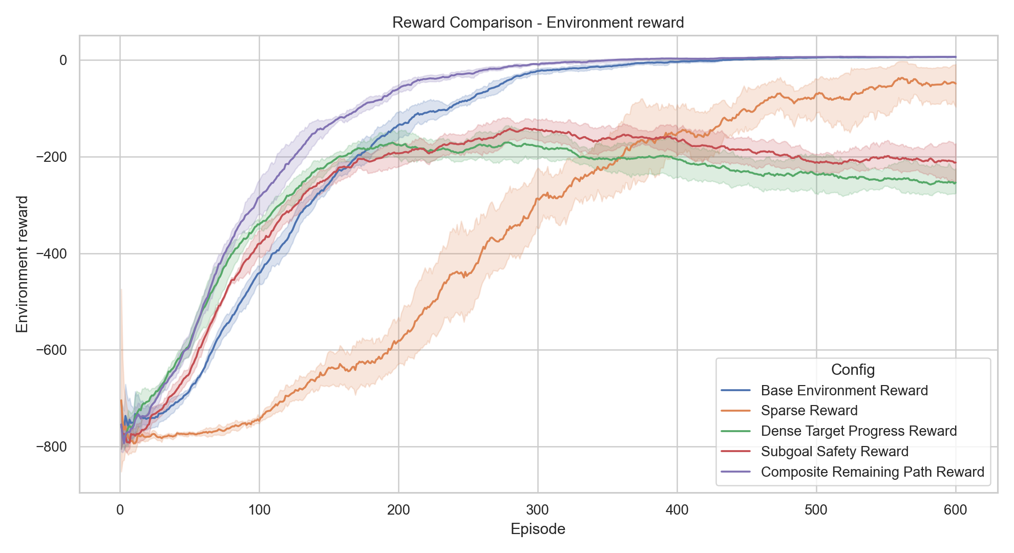
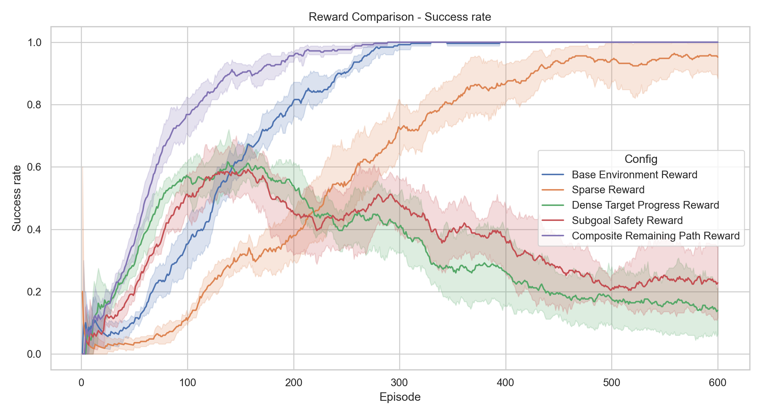
Reward Design | Prioritized Sweeping | Generalization
Experimental Results: Reward Comparison
Key message: internal reward scales differ, so Environment Reward and Success Rate provide the fairest comparison.
06

Slide 7
Reward Design | Prioritized Sweeping | Generalization
The Animation: What We Show During the Demo
Demo command:
R
G
python main.py --visualize-saved --seed 1
T
Visualization episode 1
steps=12 | reward=9 | SUCCESS
Y
B
During the presentation: load a successful saved seed and show the policy without retraining.
07

Slide 8
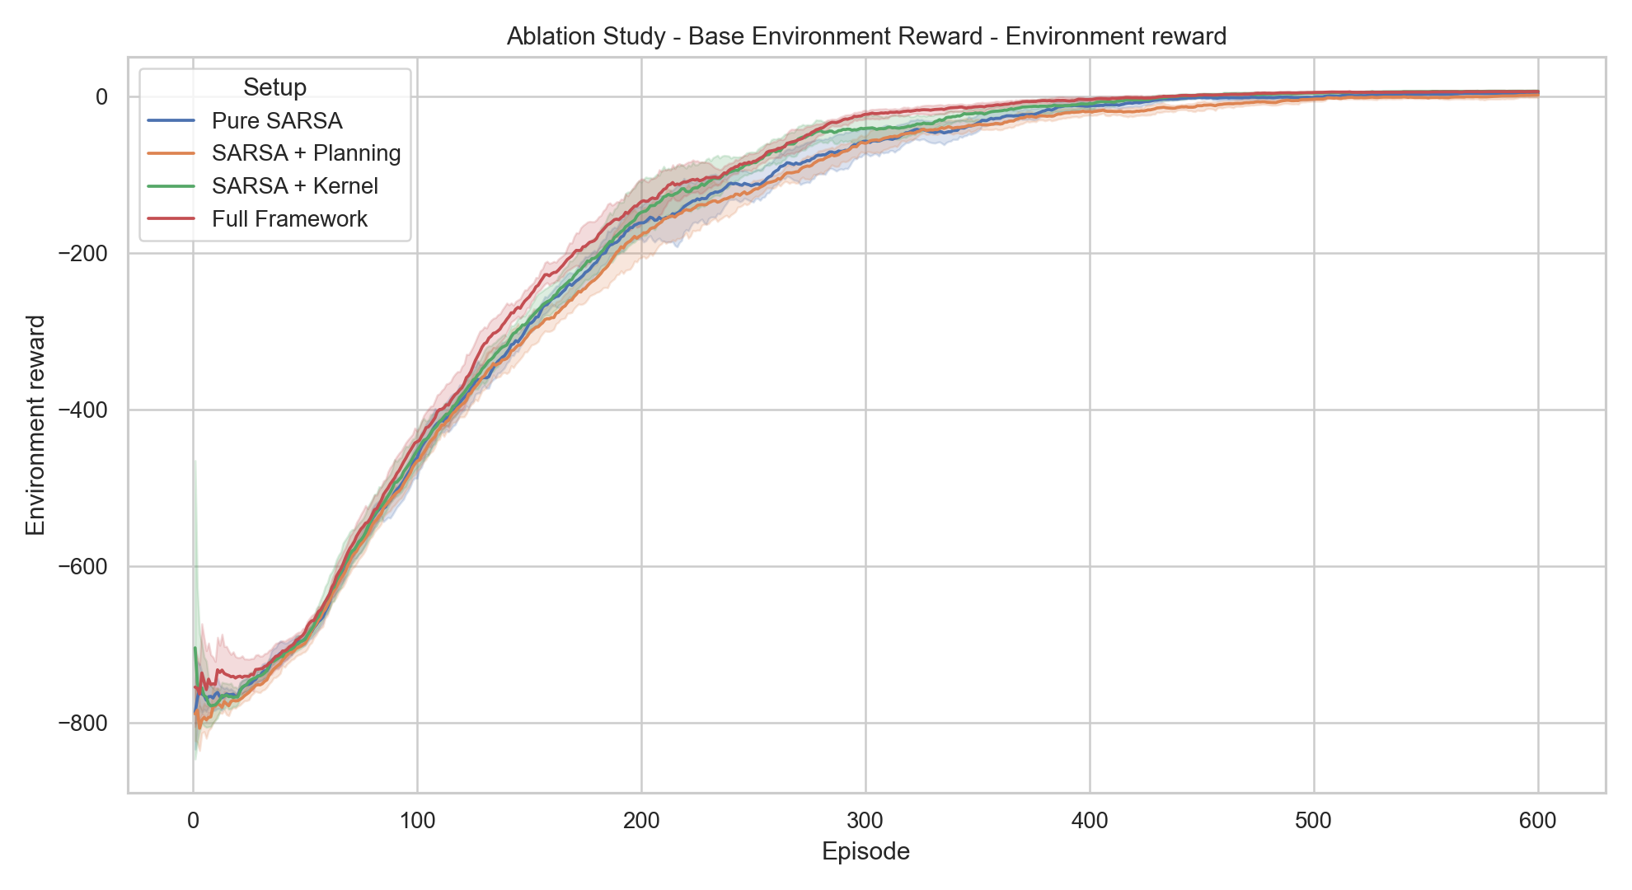
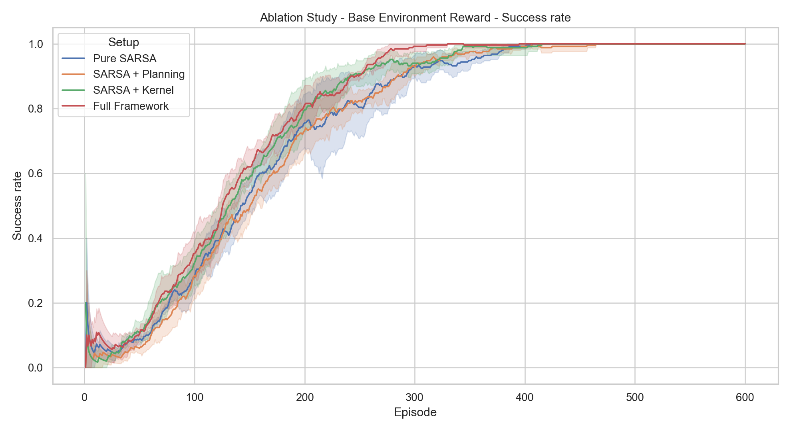
Reward Design | Prioritized Sweeping | Generalization
Ablation Study: Contribution of Each Component
This is the core research story: Planning and Kernel change both learning speed and stability.
08

Slide 9
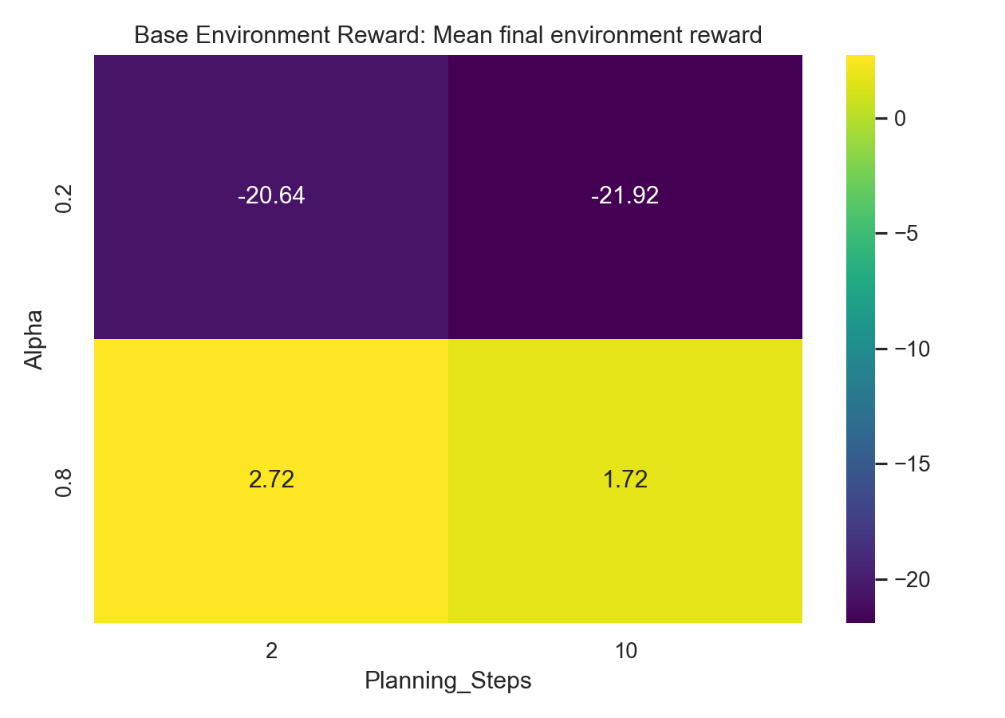
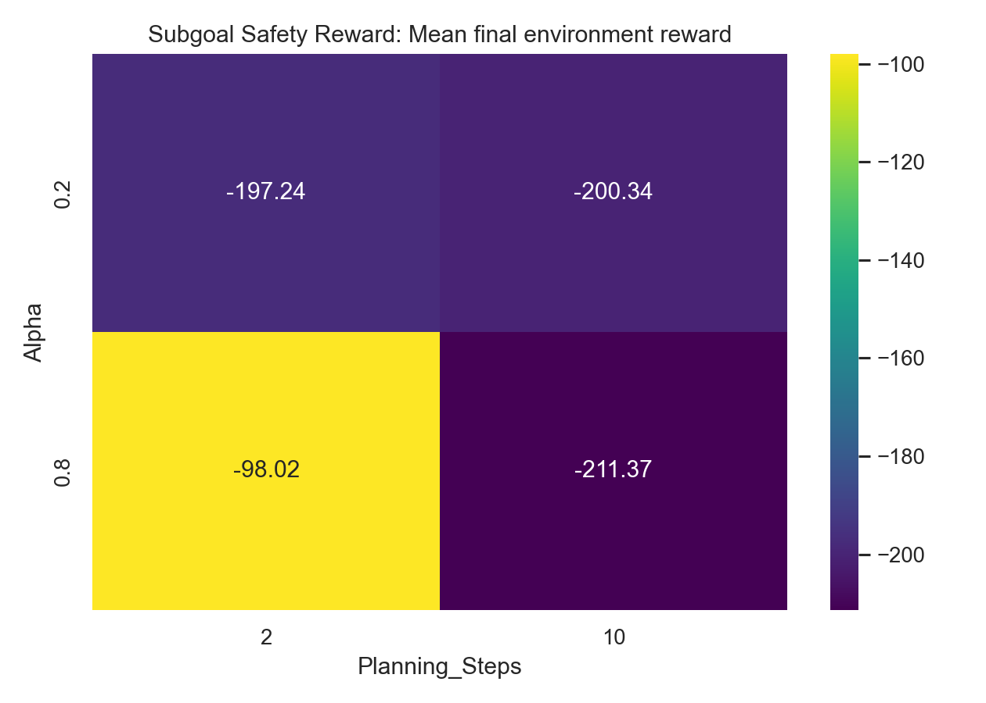
Reward Design | Prioritized Sweeping | Generalization
Parameter Sweep: Hyperparameters Were Tested
The heatmaps show final mean Environment Reward for each combination of α and planning steps n.
09

Slide 10
Reward Design | Prioritized Sweeping | Generalization
Stability Metric: Illegal Actions Decrease
The final experiment tracks three metrics: Environment Reward, Success, and Illegal Actions. This slide shows whether behavior becomes more stable.
10

Slide 11
Reward Design | Prioritized Sweeping | Generalization
Insights and Conclusions
What Worked
What Was Hard
Main Insight
Planning reuses experience
Kernel spreads local knowledge
Dense rewards guide navigation
Sparse reward gives weak signal
Kernel must be constrained
Some seeds can still fail
Performance comes from the combination:
reward design, planning,
and controlled generalization
11

Slide 12
Q&A
Questions to be ready for:
Why SARSA instead of Q-learning? Why apply Kernel only to movement? Why 5 seeds? How should we interpret the 95% CI?
Demo command: python main.py --visualize-saved --seed 1
12

