Slide 1

A Machine Learning Approach to Credit Card Default Prediction
by Alishba Tahir

Slide 2
2. Project Aim
1. Problem Statement
The surge in credit card and bank loans has come with an increase in loan defaults, costing banks billions annually. To navigate this rising risk, accurate and efficient credit assessment has become more crucial than ever.
This project aims to identify machine learning models that can effectively predict credit card and loan defaults.

Slide 3
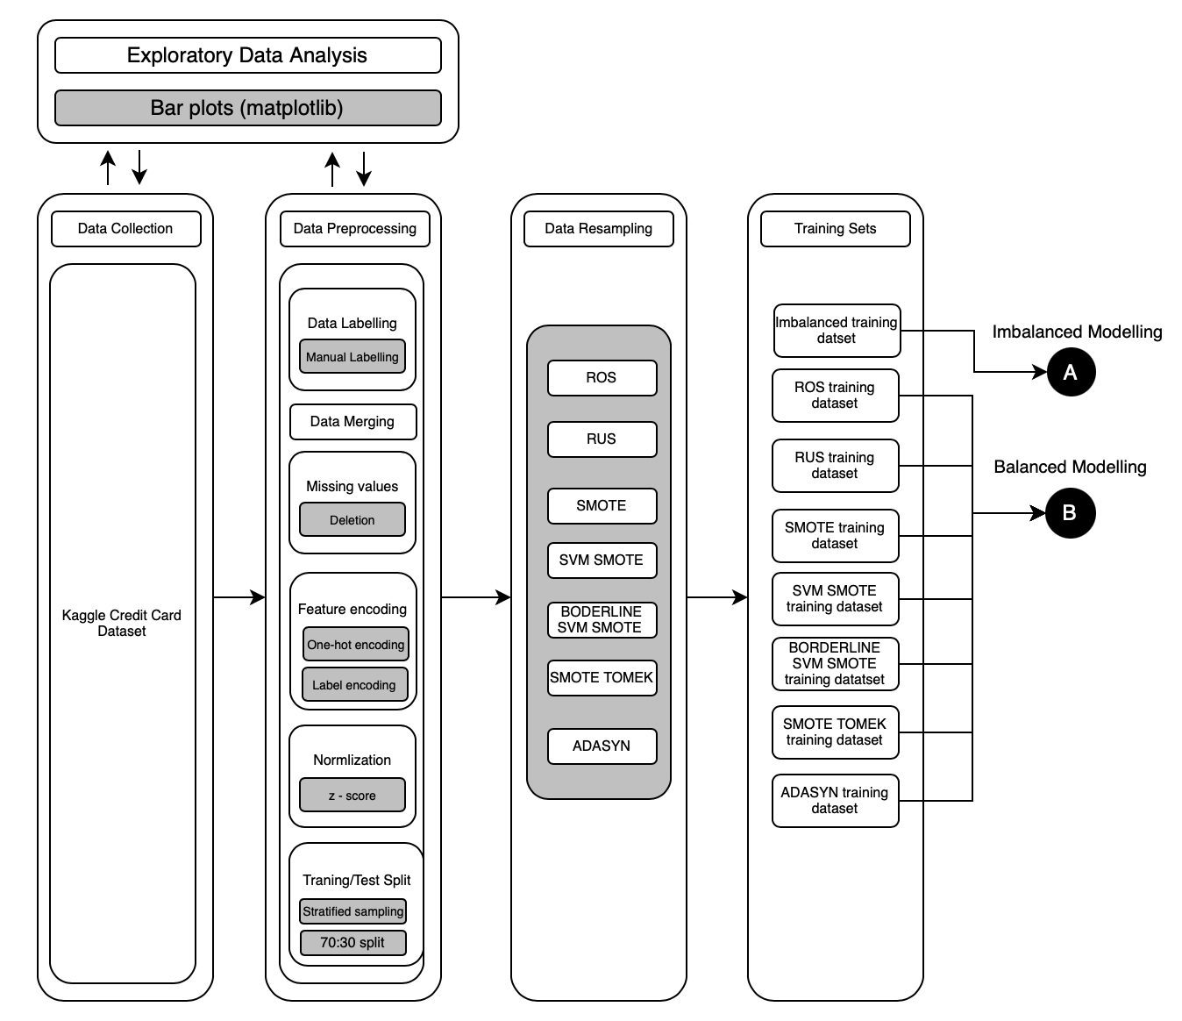
3. Methodology
DATA PREPROCESSING

Slide 4
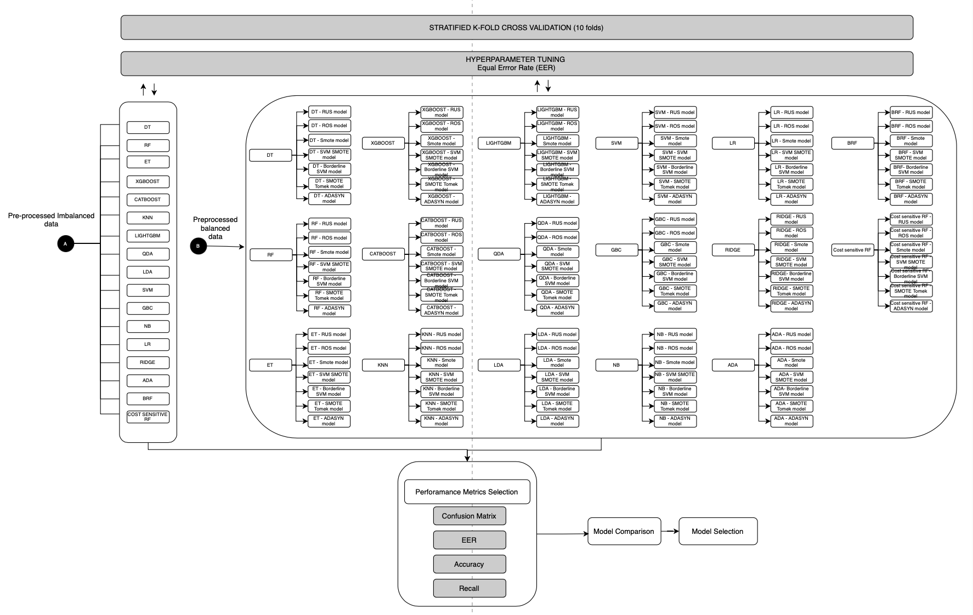

Slide 5
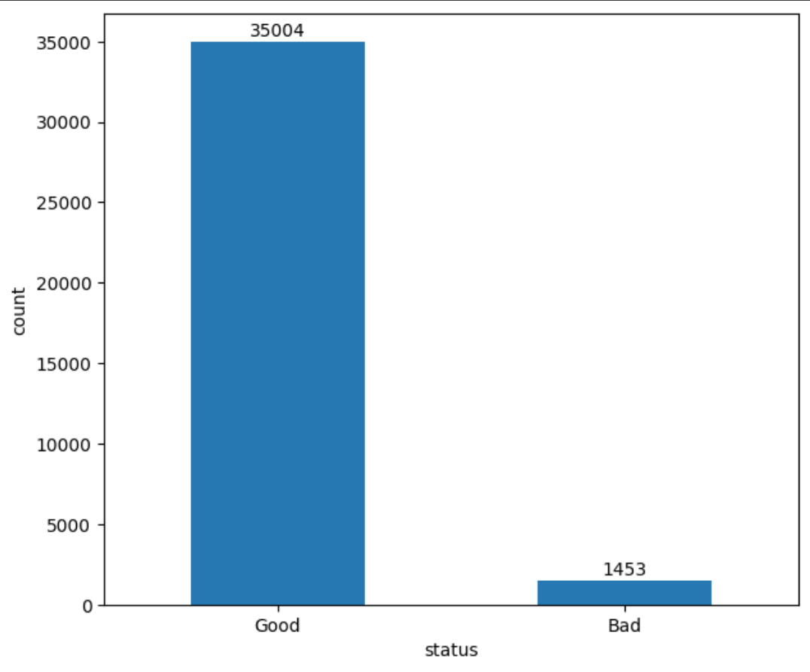
4. Challenges
4.1. Imbalanced Data

Slide 6
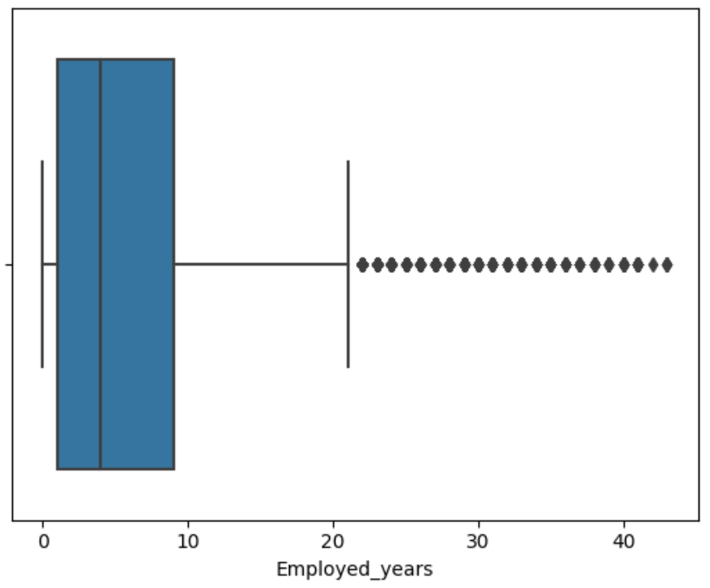
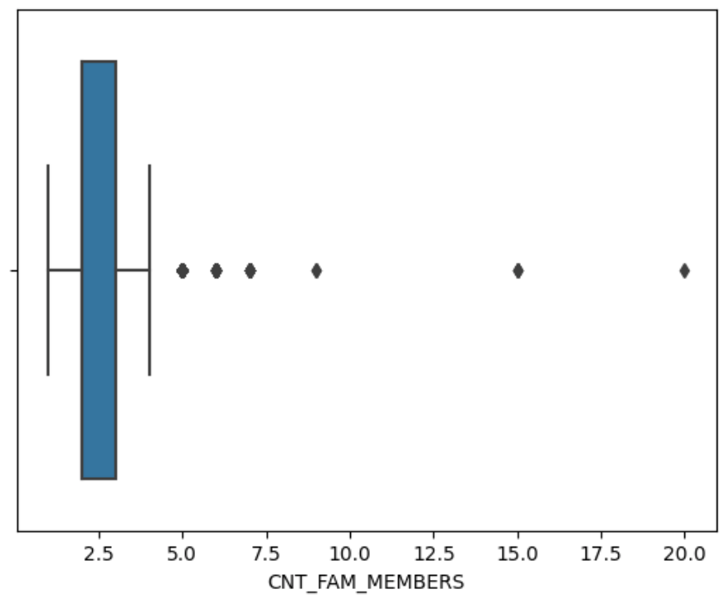
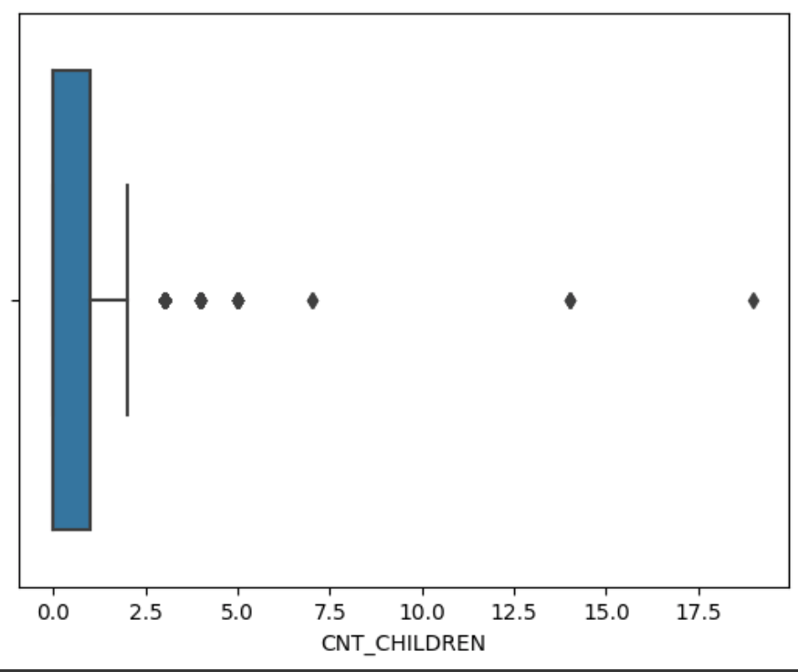
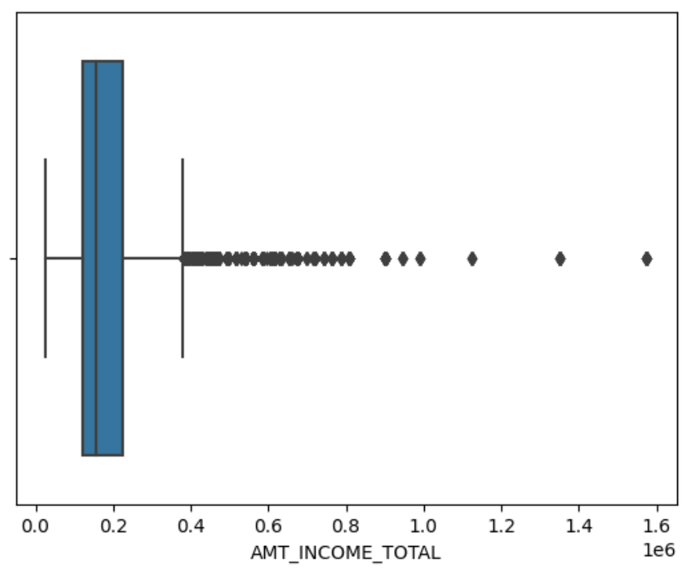
4.2. Outliers

Slide 7
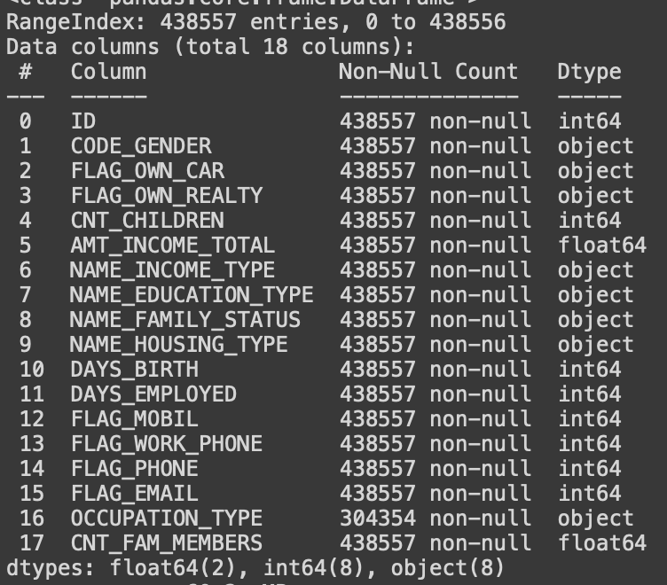
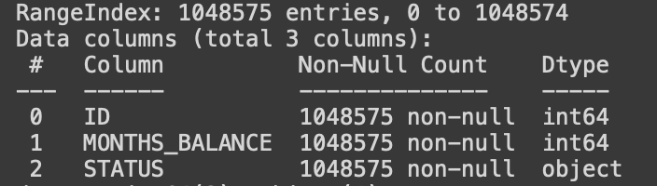
4.3. Data Merging
application.csv
credit.csv

Slide 8
4.4. Hyperparameter Tuning
Navigating the vast parameter space and identifying the most optimal set of parameters to maximize model performance and avoid overfitting was a complex task.
Fine-tuning ensemble models such as random forest using GridCVSearch proved to be highly resource-intensive, requiring a substantial 5 hours to optimize a single model within the constraints of a limited parameter set.

Slide 9
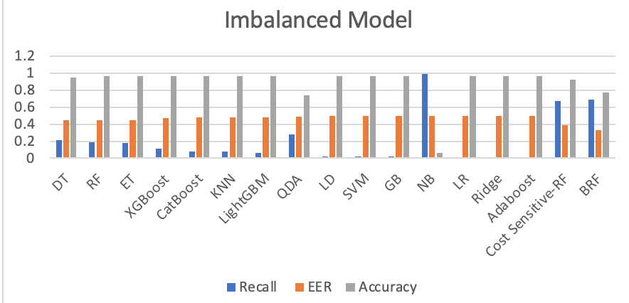
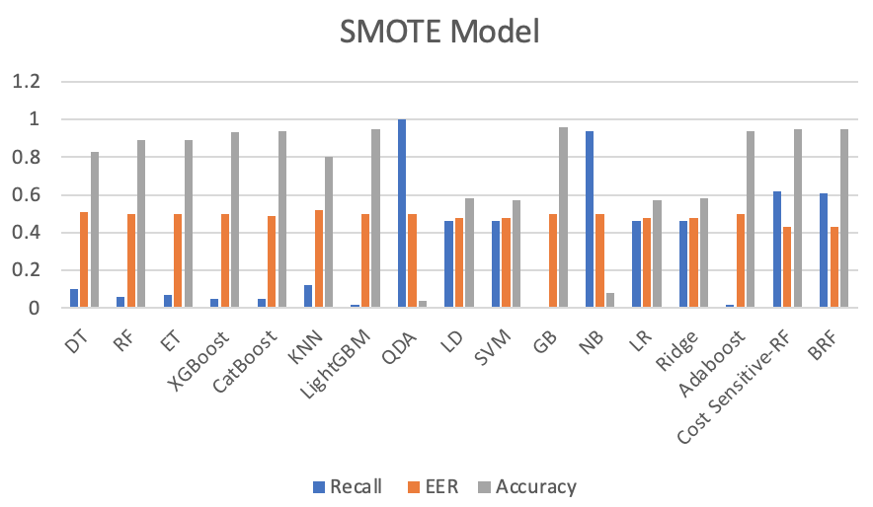
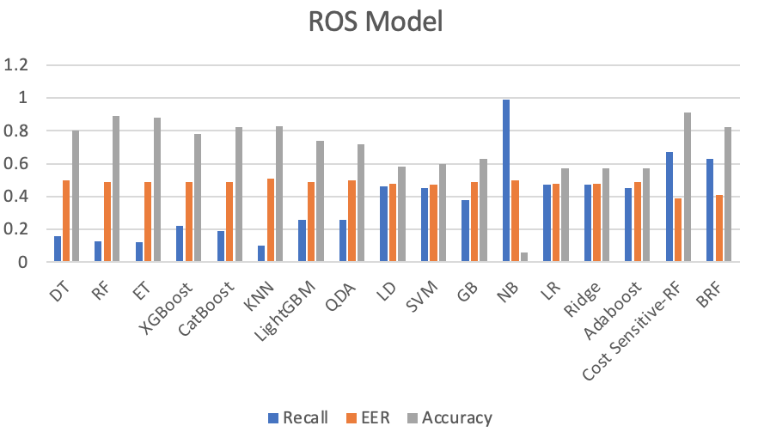
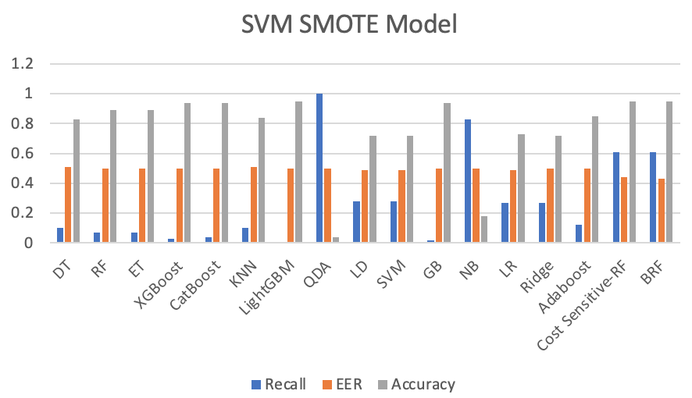
Model Results

Slide 10
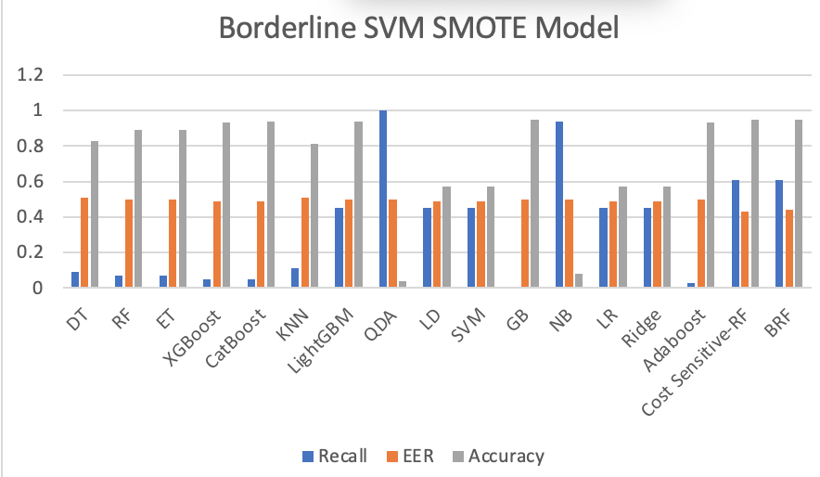
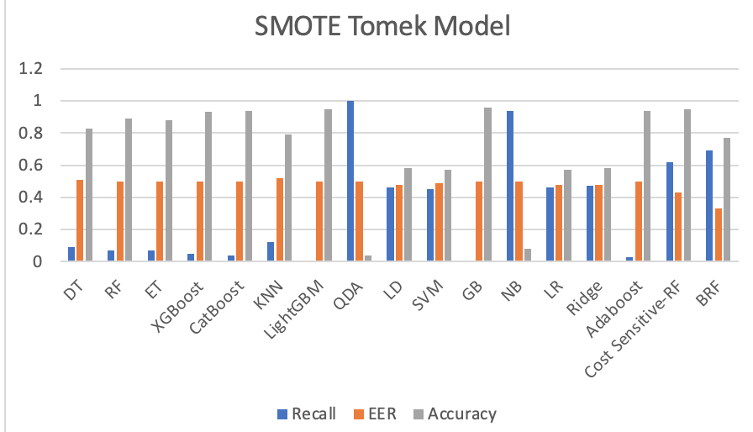
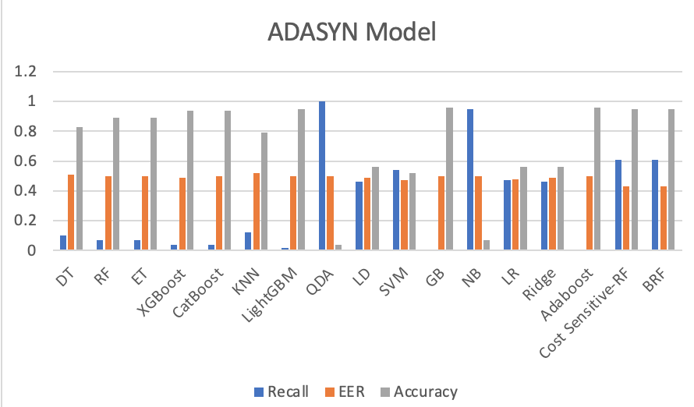

Slide 11
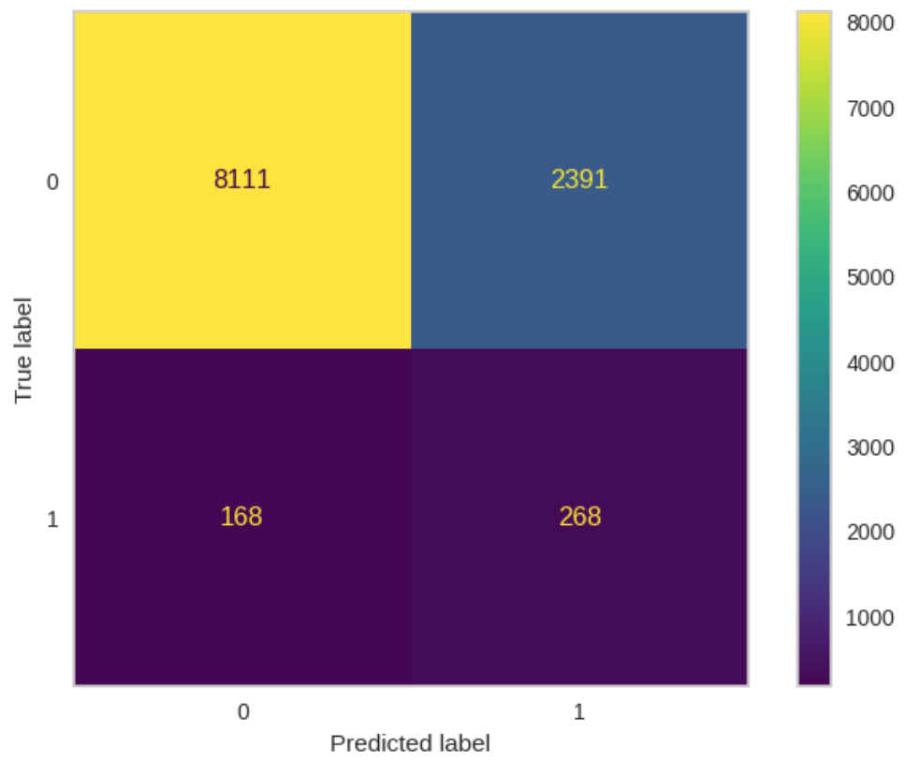
Model Selection
Balanced Random Forest

Slide 12
Conclusion
To find the optimal model to predict loan defaulters we built seventeen machine learning classification models Decision Trees, Random Forest, Light Gradient Boosting Machine, Linear Discriminant Analysis, Ridge Classifier, Logistic Regression, CatBoost, AdaBoost, Extreme Gradient Boosting, K-Nearest Neighbors, SVM with a Linear Kernel, Quadratic Discriminant Analysis, Extra Trees, Gradient Boosting, Naïve Bayes, Balanced Random Forest and Cost Sensitive Learning (Random Forest).
To tackle the imbalance data problem we used different variations of datasets using seven different data sampling techniques namely SMOTE, SVM SMOTE, BORDERLINE SVM SMOTE, SMOTE TOMEK, ADASYN, Random Undersampling, and Random Oversampling.
Balanced Random Forest with imbalanced data and default parameters stands out with its well-rounded performance with an accuracy of 77% and lowest EER score of 0.33.

Slide 13
Limitations
We did not investigate any feature selection methods.
We could not conduct a more extensive search for optimal hyperparameters for the selected models.
We did not incorporate deep learning algorithms.

Slide 14
THANK YOU!

