Slide 1

McGraw-Hill Technology Education
Copyright © 2006 by The McGraw-Hill Companies, Inc. All rights reserved.

Slide 2
Chapter 5B
Measuring and Improving Drive Performance

Slide 3
Drive Performance
Average access time
  Also known as seek time
  Time to find desired data
  Measured in milliseconds
  Depends on two factors
    RPM
    Time to access a track
  Hard drive between 6 and 12 ms
  CD between 80 and 800 ms
5B-<number>
Notes:
Teaching tip
To provide contrast, present the speed of memory as measured in the nanoseconds, or billionth of a second. Then discuss virtual RAM as defined earlier in the text. More RAM, less virtual RAM makes a faster machine.

Slide 4
Drive Performance
Data transfer rate
  How fast data can be read
  Measured in Bps or bps
  Hard drive ranges from 15 to 160 MBps
  CD ROMS depend on X factor
    24x CD transfers 24 x 150 KBps
  Floppy disks transfer at 45 KBps
6B-<number>
Notes:
Insider information
Most hard disks do not list the time to access a track. This is a good topic to tread lightly with.

Slide 5
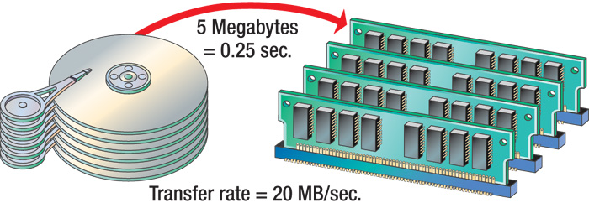
Data Transfer Rate
6B-<number>

Slide 6
Optimizing Performance
Disk optimization
  Optimization is the action of making the best or most effective use of a situation or resource.
  Handled by operating system tool
  Routine disk maintenance
  Optimization should be run monthly
6B-<number>

Slide 7
Optimizing Performance
Clean up unnecessary files
  Delete temp files
  Uninstall unused programs
  Delete obsolete data files
  Files should be cleaned weekly
6B-<number>
Notes:
Teaching tip
Figure 6B.3 on page 249 shows the disk cleanup utility for Windows XP.

Slide 8
Optimizing Performance
Scan a disk for errors
  Bad spots on the media
  Find and fix the error
    Move data to a good spot
    Mark the spot as bad
  Disks should be scanned monthly
6B-<number>

Slide 9
Optimizing Performance
Defragment a disk
  Why fragment?
  Files fragment when resaved
  Fragmented files load slower
  Defragment puts the fragments together
  Disks should be defragged monthly
6B-<number>
Notes:
Insider information
Windows 9x required the screen saver to be disabled before running scan or defrag. Failing to disable the screen saver could lead to catastrophic data loss!

Slide 10
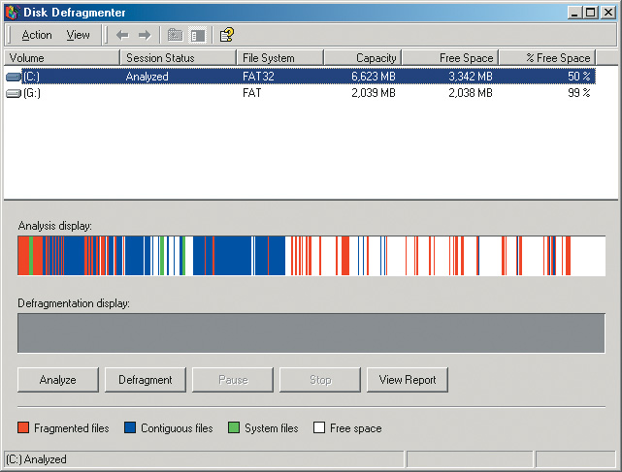
Defragment
6B-<number>

Slide 11
Optimizing Performance
File compression
  Shrinks the size of a file using algorithm
  Takes up less space on disk
  Reduce a disks performance (time to decompress)
  Will increase disk capacity
  PKZip, WinZip and WinRAR, 7-Zip
6B-<number>
Notes:
Teaching tip
MP3s are created using compression. If a audio song is recorded on a hard drive, the required storage is about 1 MB per second. When the MP3 compression is applied, the size is reduced to about 1 MB per minute.
Windows XP provides several compression routines. It provides for .zip file compression and archive creation. Zip archives can be accessed like normal folders. Folders can be compressed to shrink the contents. Finally, the entire disk can be compressed .

Slide 12
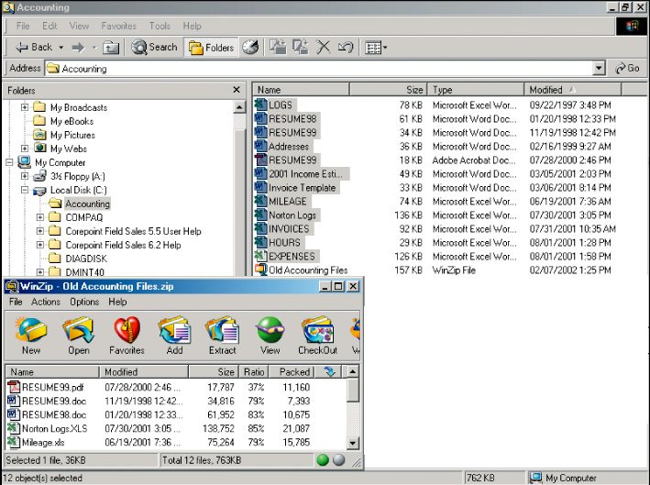
File Compression
763 KB
on disk
Compressed
157 KB
6B-<number>

Slide 13
Drive Interface Standards
Drive Interface Standard
  The logical and physical means by which the hard disk connects to the PC
Interface
  How the device is connected and operated
  Drive controllers allow transfer of data
  Dictates transfer rate and access time
  User interfaces are the keyboards, mice, commands and menus for communication to computer.
6B-<number>

Slide 14
Drive Interface Standards
Enhanced Integrated Drive Electronics
  EIDE is improved version of IDE.
  It's a technology that facilitates the connection between computer motherboard and storage devices like hard drives and compact disc-read only memory (CD-ROM) drives.
  Generic term for drive controllers
  Several names
    Fast IDE
    Advanced Technology Attachment (ATA)
  Up to 2 devices per controller
  Most computers have 2 EIDE controllers
6B-<number>
Notes:
Insider Information
Serial ATA (SATA) is a newer standard aimed at replacing EIDE/ATA. SATA is quite fast and easy to use.

Slide 15
Drive Interface Standards
Small Computer System Interface
  SCSI
  Higher transfer rates than EIDE
  More than 40 devices per SCSI controller
    Computers may have several SCSI controllers
  Many versions exist
    Versions are typically incompatible
  Found in servers and workstations
6B-<number>
Notes:
Teaching tip
SCSI was introduced in chapter 5B of the text as a bus.

Slide 16
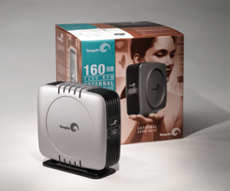
Drive Interface Standards
USB and FireWire
  External drives
  Transfer rate is limited
  Many devices can be connected
6B-<number>

Slide 17
Chapter 5B
End of Chapter

