Slide 1
Random Number Generators and Physical Unclonable Function (PUF) Alishba Kanwal

Slide 2
Random Number Generator basics:
Computation
Transform uniform number/s into custom PDF
Employ either:
Inversion (ICDF)
Box-Muller
Ziggurat
Polar method
Acceptance-rejection methods
Generate uniform random number/s
Use simple LFSR/Tausworthe generator/Mersenne-Twister
Software implementation

Slide 3
Random Number Generator basics:
Generation
Write algorithm in C++
Export to MATLAB using the C/MEX method
Use a System Generator tool to generate Verilog/VHDL for the design
Write a testbench and simulate design in ModelSim/Isim
Compare results from MATLAB model with simulation results
Explore properties of RNG using statistical tests e.g. the χ2
test or the Anderson-Darling
Statistical tests may not be necessary, since
the derivation of the inversion-based GRNG
algorithm itself is correct [1].
Notes:
[1] Inversion-based Hardware Gaussian Random Number Generator: A Case Study of Function Evaluation via Hierarchical Segmentation, Cheung, Luk

Slide 4
A Hardware Gaussian Noise Generator Using the Box-Muller Method and Its Error Analysis
Dong-U Lee, Member, IEEE, John D. Villasenor, Senior Member, IEEE, Wayne Luk, Member, IEEE, and Philip H.W. Leong, Senior Member, IEEE
IEEE TRANSACTIONS ON COMPUTERS, VOL. 55, NO. 6, JUNE 2006

Slide 5
Overview

Slide 6
Design approach

Slide 7
Hardware Generation of Arbitrary Random Number Distributions From Uniform Distributions Via the Inversion Method
Ray C. C. Cheung, Student Member, IEEE, Dong-U Lee, Member, IEEE, Wayne Luk, Senior Member, IEEE, and John D. Villasenor, Senior Member, IEEE
IEEE TRANSACTIONS ON VERY LARGE SCALE INTEGRATION (VLSI) SYSTEMS, 2007

Slide 8
Overview

Slide 9
Design approach

Slide 10
A Gaussian Noise Generator for Hardware-Based Simulations
Dong-U Lee, Student Member, IEEE, Wayne Luk, Member, IEEE,
John D. Villasenor, Senior Member, IEEE, and Peter Y.K. Cheung, Senior Member, IEEE
IEEE TRANSACTIONS ON COMPUTERS, VOL. 53, NO. 12, DECEMBER 2004

Slide 11
Overview

Slide 12
Design approach
Uses nonuniform piecewise linear approximation in computing trigonometric and logarithmic functions

Slide 13
Hardware Architecture of a Gaussian Noise Generator Based on the Inversion Method
R. Gutierrez, V. Torres, and J. Valls
IEEE TRANSACTIONS ON CIRCUITS AND SYSTEMS—II: EXPRESS BRIEFS, VOL. 59, NO. 8, AUGUST 2012

Slide 14
Overview

Slide 15
Design approach

Slide 16
Comparison table

Slide 17
Extracting Secret Keys From Integrated Circuits
Daihyun Lim, Jae W. Lee, Blaise Gassend, G. Edward Suh,
Marten van Dijk, and Srinivas Devadas
IEEE TRANSACTIONS ON VERY LARGE SCALE INTEGRATION (VLSI) SYSTEMS, 2005

Slide 18
Overview

Slide 19
Design approach

Slide 20
On the Problems of Realizing Reliable and Efficient Ring Oscillator PUFs on FPGAs
Alexandre Wild, Georg T. Becker, Tim G¨uneysu
IEEE International Symposium on Hardware Oriented Security and Trust (HOST), 2017

Slide 21
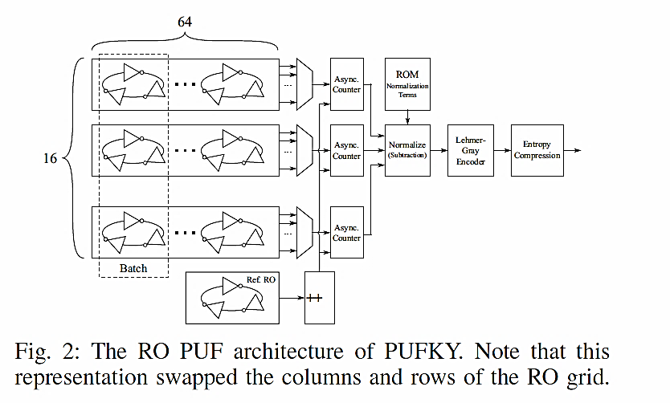
Overview
Implements design on Xilinx Spartan-6
Improves upon PUFKY [2] architecture by decreasing area utilization by 50%
Detailed analysis of PUFKY code
PUFKY exhibits a strong structural bias, the reason for which is the different slice types and the non-public switching matrix. A RO in PUFKY is instantiated in half of a slice using the Xilinx tools

Slide 22
Design approach
PUFKY consists of two stages:
RO PUF architecture, used to as an entropy source
Post processing that consists of a Fuzzy Extractor for error correction and entropy extraction
To fix the RO structure, Xilinx offers the opportunity to use Hard Macros or directed routing constraints (DIRT) to fix specific routes
Implementing a glitch core at the opposite corner of the FPGA from the RO causes the frequencies of the RO to change drastically -> the entire FPGA design (including third party IP cores) has to be considered during PUF analysis
Notes:
[2] PUFKY: A Fully Functional PUF-Based Cryptographic Key Generator, R. Maes, A. Van Herrewege, and I. Verbauwhede in CHES 2012, Springer, 2012.

Slide 23
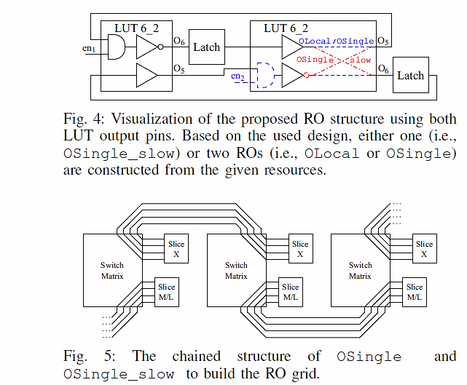
Design approach
3 different designs with different optimization goals and tradeoffs are tested:
OLocal places all components of a RO into a single slice and only uses local routing resources
OSingle places half of its components into a slice of horizontally neighbored CLBs. In contrast to OLocal, this design uses single wires instead of local wires to form the RO loop. This routing aims to slow down the design with minimal area increase.
OSingle_slow doubles the number of delay elements (LUTs) per RO and uses neighbored CLBs that are connected via single wires. The goal of this design is to drastically reduce the oscillation frequency.
Notes:
[2] PUFKY: A Fully Functional PUF-Based Cryptographic Key Generator, R. Maes, A. Van Herrewege, and I. Verbauwhede in CHES 2012, Springer, 2012.

