Slide 1
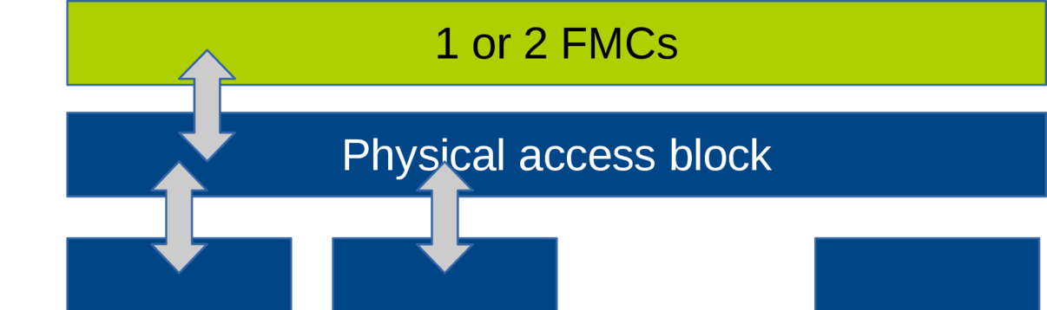
wrapper
wrapper
.
.
.
GBT-FPGA
GBT-FPGA
. . .
.
.
.
.
.
.

Slide 2
FMC
TX_SERIAL_DATA
RX_SERIAL_DATA
wrapper
Interface
[for one GBT-FPGA,
replicated Nx for Nx GBT-FPGA’s]
GBT-FPGA link
MGT
Tx
Rx
TX_DATA_IN
[from Module block]
RX_DATA_OUT
[to Module block]
Header
(H)
Slow Control
(SC)
User Data (D)
Extra User Data
(ED)
@40MHz
4bit
4bit
80bit
32bit
Header
(H)
Slow Control
(SC)
User Data (D)
Extra User Data
(ED)
@40MHz
4bit
4bit
80bit
32bit

Slide 3
120bit
Header
(H)
Slow Control
(SC)
User Data (D)
Forward Error
Correction (FEC)
@40MHz
(4.8Gbps)
4bit
4bit
80bit
32bit
120bit
Header
(H)
Slow Control
(SC)
User Data (D)
Extra User Data
(ED)
@40MHz
(4.8Gbps)
4bit
4bit
80bit
32bit

Slide 4
COTS/custom-made FMC by Kovacs
[electrical]
SFP+
[optical]
0
1
10/20-bit
DATA_TO/FROM_MGT
Decoding logic
GBT-FPGA
0/1
… xN
Selection logic (?)
wrapper
120-bit
DATA_TO/FROM_MODULE
Physical access block

Slide 5
The GBT-FPGA also selects if data is to be sent/received via SFP+/FMC
TO/FROM SFP+ or FMC
TO/FROM SFP+ or FMC
TO/FROM SFP+ or FMC
10/20-bit
DATA_TO/FROM_MGT
Every module has its own GBT-FPGA (alternately referred to as a wrapper)
GBT-FPGA
GBT-FPGA
GBT-FPGA
CLKS_IN
…
CLKS_OUT
120-bit
DATA_TO/FROM_MODULE
Physical access block
Module block
Module block
Readout block
…

