Slide 1
Random Number Generators and Physical Unclonable Function (PUF) Alishba Kanwal

Slide 2
Random Number Generator basics:
Computation
Transform uniform number/s into custom PDF
Employ either:
Inversion (ICDF)
Box-Muller
Ziggurat
Polar method
Acceptance-rejection methods
Generate uniform random number/s
Use simple LFSR/Tausworthe generator/Mersenne-Twister
Software implementation

Slide 3
Random Number Generator basics:
Generation
Write algorithm in C++
Export to MATLAB using the C/MEX method
Use a System Generator tool to generate Verilog/VHDL for the design
Write a testbench and simulate design in ModelSim/Isim
Compare results from MATLAB model with simulation results
Explore properties of RNG using statistical tests e.g. the χ2
test or the Anderson-Darling
Statistical tests may not be necessary, since
the derivation of the inversion-based GRNG
algorithm itself is correct [1].
Notes:
[1] Inversion-based Hardware Gaussian Random Number Generator: A Case Study of Function Evaluation via Hierarchical Segmentation, Cheung, Luk

Slide 4
A Gaussian Noise Generator for Hardware-Based Simulations
Dong-U Lee, Student Member, IEEE, Wayne Luk, Member, IEEE,
John D. Villasenor, Senior Member, IEEE, and Peter Y.K. Cheung, Senior Member, IEEE
IEEE TRANSACTIONS ON COMPUTERS, VOL. 53, NO. 12, DECEMBER 2004

Slide 5
Overview
Design implemented on Xilinx Virtex-2
Employs non-uniform piecewise linear approximation in computing trigonometric and logarithmic functions
Properties of design explored using the Chi-square test and the Anderson-Darling test
Performance can be improved by exploiting parallelism
Uses the Box-Muller method for generating Gaussian distribution from two uniform random variables

Slide 6
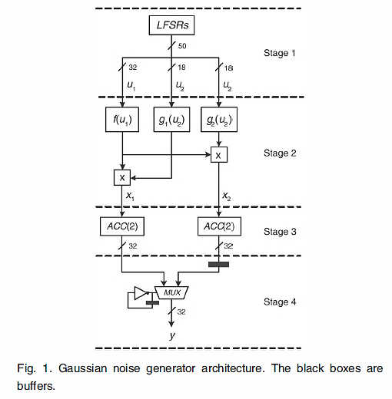
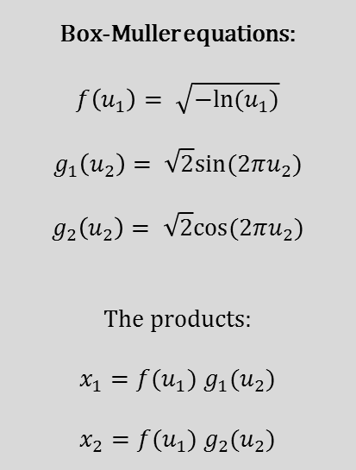
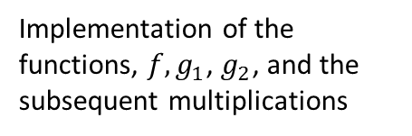
Design approach
A shift-register based uniform random number generator
Box-Muller equations:
$$f\left(u_{1}\right)= \sqrt{−ln⁡(u_{1})}$$
$$g_{1}\left(u_{2}\right)= \sqrt{2}sin⁡(2πu_{2})$$
$$g_{2}\left(u_{2}\right)= \sqrt{2}cos⁡(2πu_{2})$$
The products:
$x_{1}=f(u_{1})$ $g_{1}(u_{2})$
$x_{2}=f(u_{1})$ $g_{2}(u_{2})$
Implementation of the functions, ${f, g}_{1}$, $g_{2}$, and the subsequent multiplications
A sample accumulation step that exploits the central limit theorem to overcome quantization and approximation errors
A sample multiplexor-based circuit to support generation of one result per clock cycle

Slide 7
Hardware Generation of Arbitrary Random Number Distributions From Uniform Distributions Via the Inversion Method
Ray C. C. Cheung, Student Member, IEEE, Dong-U Lee, Member, IEEE, Wayne Luk, Senior Member, IEEE, and John D. Villasenor, Senior Member, IEEE
IEEE TRANSACTIONS ON VERY LARGE SCALE INTEGRATION (VLSI) SYSTEMS, 2007

Slide 8
Overview
Design implemented on Xilinx Virtex-4
The ICDF is evaluated via piecewise polynomial approximation with a hierarchical segmentation scheme that involves uniform segments and segments with size varying by powers of two which can adapt to local function nonlinearities
Produces 16-bit random samples up to 8.2σ
Generates one sample every clock cycle
Techniques including analytical error analysis, bit-width optimization, hierarchical segmentation, and piecewise polynomial approximation are used in combination to guarantee accuracy of one ulp (unit in the last place)

Slide 9
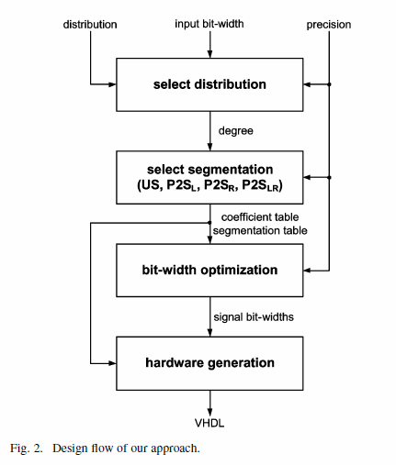
Design approach
The design generator divides the ICDF into segments for polynomial approximation using a non-uniform segmentation scheme
The design generator also determines the minimum number of bits required for each signal in the datapath
Three design specifications are required for the design generator:
Target distribution
Bit-width of the input x
Precision of output y

Slide 10
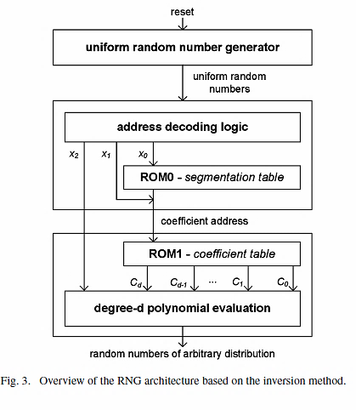
Design approach
Extracts x₀, x₁, and x₂
X₀ is used for indexing the segmentation table ROM0
X₁ is used with the ROM0 output for indexing the polynomial coefficients in ROM1
X₂ is used in polynomial evaluation

Slide 11
Design approach
Basically, x₀ and x₁ are used to index the outer and inner segments, while x₂ is used for polynomial arithmetic
For each segment of the first pass (outer segment), the Chebyshev coefficients for the approximating polynomial are computed.
In the second pass, each segment can be further subdivided, again using any of the four HSM schemes.

Slide 12
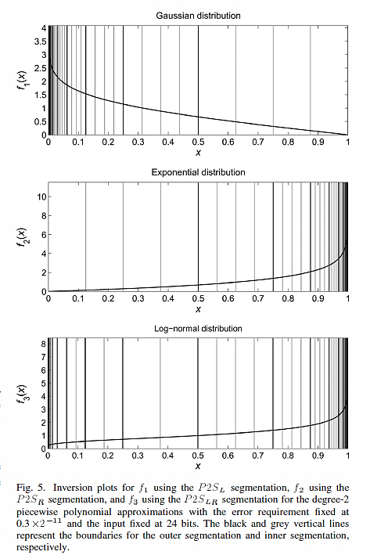
Design approach
HSM provides four basic segmentation schemes:
US: segments are uniformly sized
P2S_{L} : segment sizes increase by powers of 2 from the beginning of the input interval to the end of the interval
P2S_{R} : segment sizes decrease by powers of 2 from the beginning of the input interval to the end of the interval
P2S_{LR}: segment sized increase by powers of 2 until the mid-point of the interval and then decreases by powers of 2 until the end is reached

Slide 13
Hardware Architecture of a Gaussian Noise Generator Based on the Inversion Method
R. Gutierrez, V. Torres, and J. Valls
IEEE TRANSACTIONS ON CIRCUITS AND SYSTEMS—II: EXPRESS BRIEFS, VOL. 59, NO. 8, AUGUST 2012

Slide 14
Overview
Design implemented on Xilinx Virtex-2
Employs piecewise polynomial approximation of ICDF
Uses non-uniform segmentation scheme
Achieves a tail of 13.1σ
A new uniform variable is created from the one generated by the URNG . As a consequence, the barrel-shifter is eliminated and a simpler bit-masking block is introduced to cope with the specific problem of interpolation inside of the smaller segments
The quality of the generated Gaussian noise samples has been analyzed using two statistical tests: Chi-square and Anderson-Darling

Slide 15
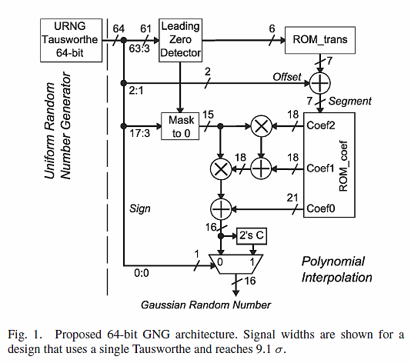
Design approach
The LZD is used to get the position of the most significant zero bit of the input word.
The segment number is calculated as the addition of the ROM_trans output and the offset bits.
A barrel-shifter is usually used to select the appropriate bits from the URNG output as input for polynomial approximation.
When working with big word lengths, the barrel-shifter implies an important hardware cost

Slide 16
Extracting Secret Keys From Integrated Circuits
Daihyun Lim, Jae W. Lee, Blaise Gassend, G. Edward Suh,
Marten van Dijk, and Srinivas Devadas
IEEE TRANSACTIONS ON VERY LARGE SCALE INTEGRATION (VLSI) SYSTEMS, 2005

Slide 17
Overview
Chips fabricated using TSMC 0.18-µm
Instead of using digital circuitry, propose to build random functions based on the randomness in physical materials
Propose a scheme called arbiter-based PUF that improves the reliability of the PUFs against environmentally induced noise by using a differential structure

Slide 18
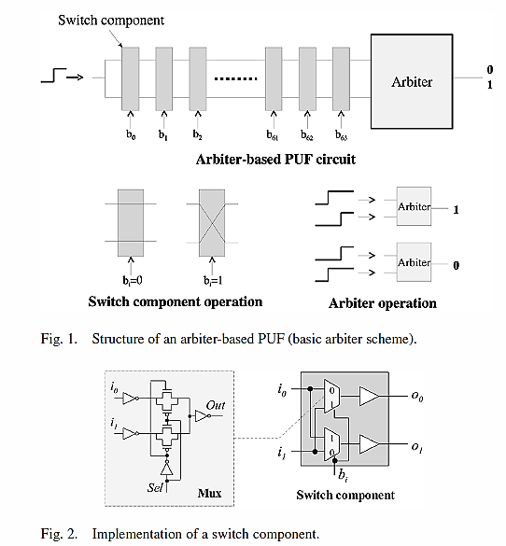
Design approach
In order to maximize the inter-chip variation of PUF responses, the delay paths must be placed and routed as symmetrically as possible so as to minimize the nominal delay difference between two paths
Symmetrical place and route makes it extremely difficult for an adversary to probe internal nodes to read out a logic value without breaking the PUF
The arbiter-based PUF can be used as a hardware random number generator by using the metastable responses. The arbiter generates metastable responses when the delay differences between the top and bottom are negligibly small
Arbiter-based PUF composed of delay paths and an arbiter located at the end of the delay paths.
Arbiter decides which rising edge arrives first and set its output to 0/1 depending on the winner.
The response of the arbiter can vary across ICs if the maximum delay variation in manufacturing is greater than the delay difference

Slide 19
On the Problems of Realizing Reliable and Efficient Ring Oscillator PUFs on FPGAs
Alexandre Wild, Georg T. Becker, Tim G¨uneysu
IEEE International Symposium on Hardware Oriented Security and Trust (HOST), 2017

Slide 20
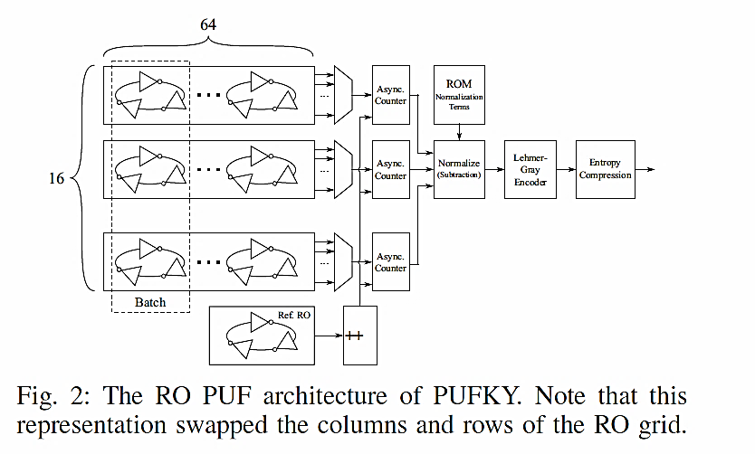
Overview
Design implemented on Xilinx Spartan-6
Improves upon PUFKY [2] architecture by decreasing area utilization by 50%
Detailed analysis of PUFKY code
PUFKY exhibits a strong structural bias, the reason for which is the different slice types and the non-public switching matrix. A RO in PUFKY is instantiated in half of a slice using the Xilinx tools

Slide 21
Design approach
PUFKY consists of two stages:
RO PUF architecture, used to as an entropy source
Post processing that consists of a Fuzzy Extractor for error correction and entropy extraction
To fix the RO structure, Xilinx offers the opportunity to use Hard Macros or directed routing constraints (DIRT) to fix specific routes
Implementing a glitch core at the opposite corner of the FPGA from the RO causes the frequencies of the RO to change drastically -> the entire FPGA design (including third party IP cores) has to be considered during PUF analysis
Notes:
[2] PUFKY: A Fully Functional PUF-Based Cryptographic Key Generator, R. Maes, A. Van Herrewege, and I. Verbauwhede in CHES 2012, Springer, 2012.

Slide 22
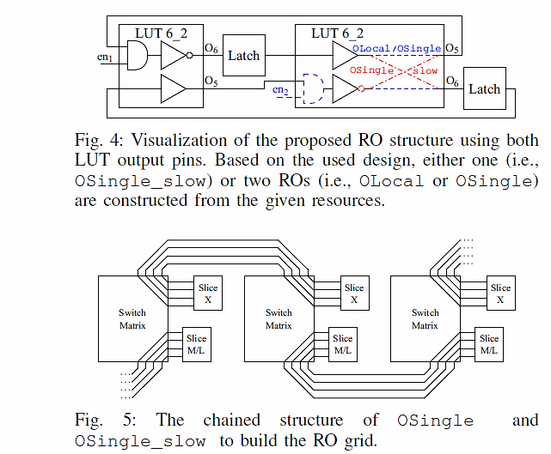
Design approach
3 different designs with different optimization goals and tradeoffs are tested:
OLocal places all components of a RO into a single slice and only uses local routing resources
OSingle places half of its components into a slice of horizontally neighbored CLBs. In contrast to OLocal, this design uses single wires instead of local wires to form the RO loop. This routing aims to slow down the design with minimal area increase.
OSingle_slow doubles the number of delay elements (LUTs) per RO and uses neighbored CLBs that are connected via single wires. The goal of this design is to drastically reduce the oscillation frequency.
Notes:
[2] PUFKY: A Fully Functional PUF-Based Cryptographic Key Generator, R. Maes, A. Van Herrewege, and I. Verbauwhede in CHES 2012, Springer, 2012.

