Slide 1
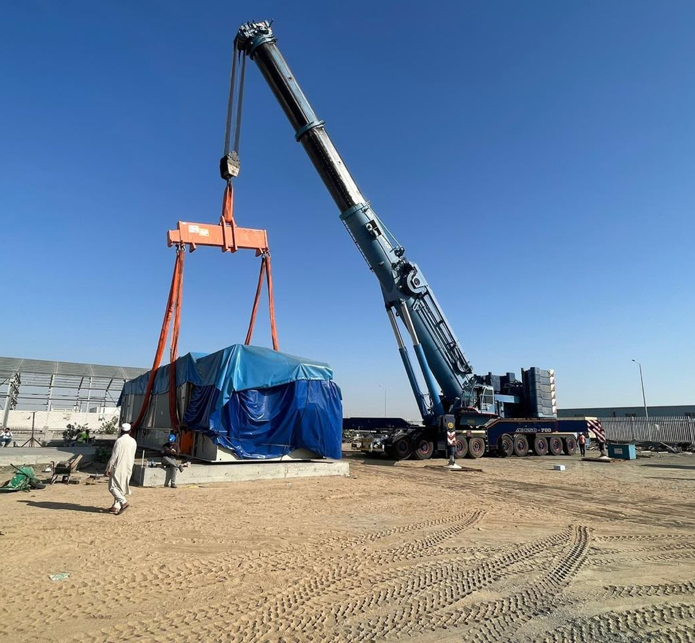
CORPORATE PORTFOLIO
WASEEM
CONSTRUCTION
COMPANY
LIFTING. MOVING.
BUILDING POSSIBILITIES.
Equipment and operations
for the work ahead.
WORK IN FOCUS.
COMPANY PROFILE
LIFTING / HANDLING / TRANSPORT

Slide 2
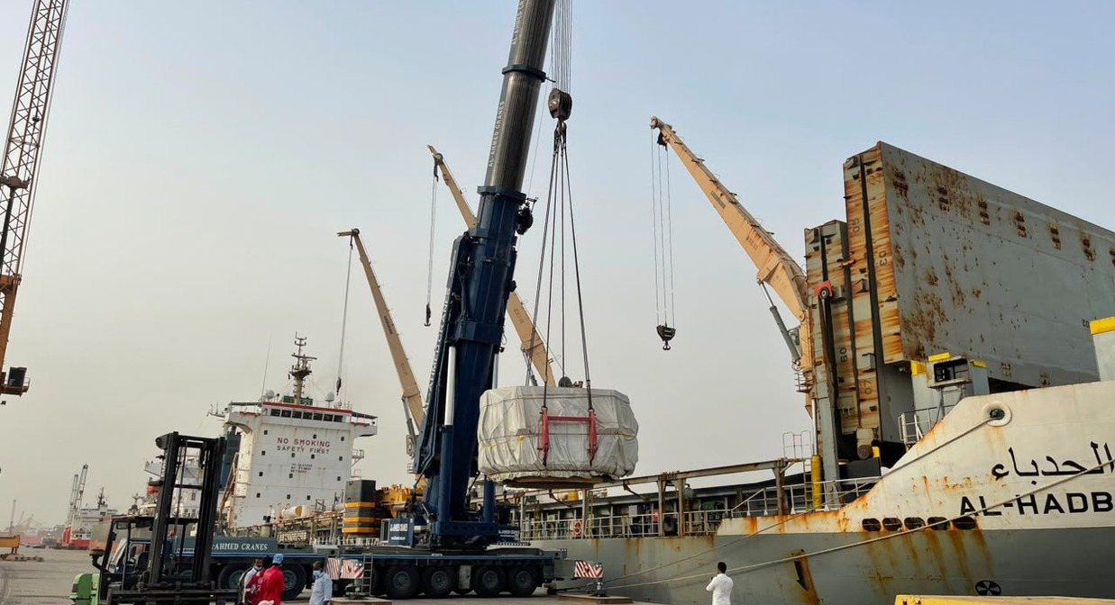
01 / COMPANY OVERVIEW
WORK BEGINS
WITH A CLEAR
DIRECTION.
Lifting. Handling. Transport.
Site access.
The work behind the movement.
An introduction to Waseem Construction Company and the equipment featured in this portfolio.
Our portfolio covers lifting, material handling, heavy transport and site equipment, from industrial yards to waterfront cargo areas.
Equipment availability, technical requirements, commercial terms and scope are confirmed for each enquiry.
WASEEM CONSTRUCTION COMPANY
02

Slide 3
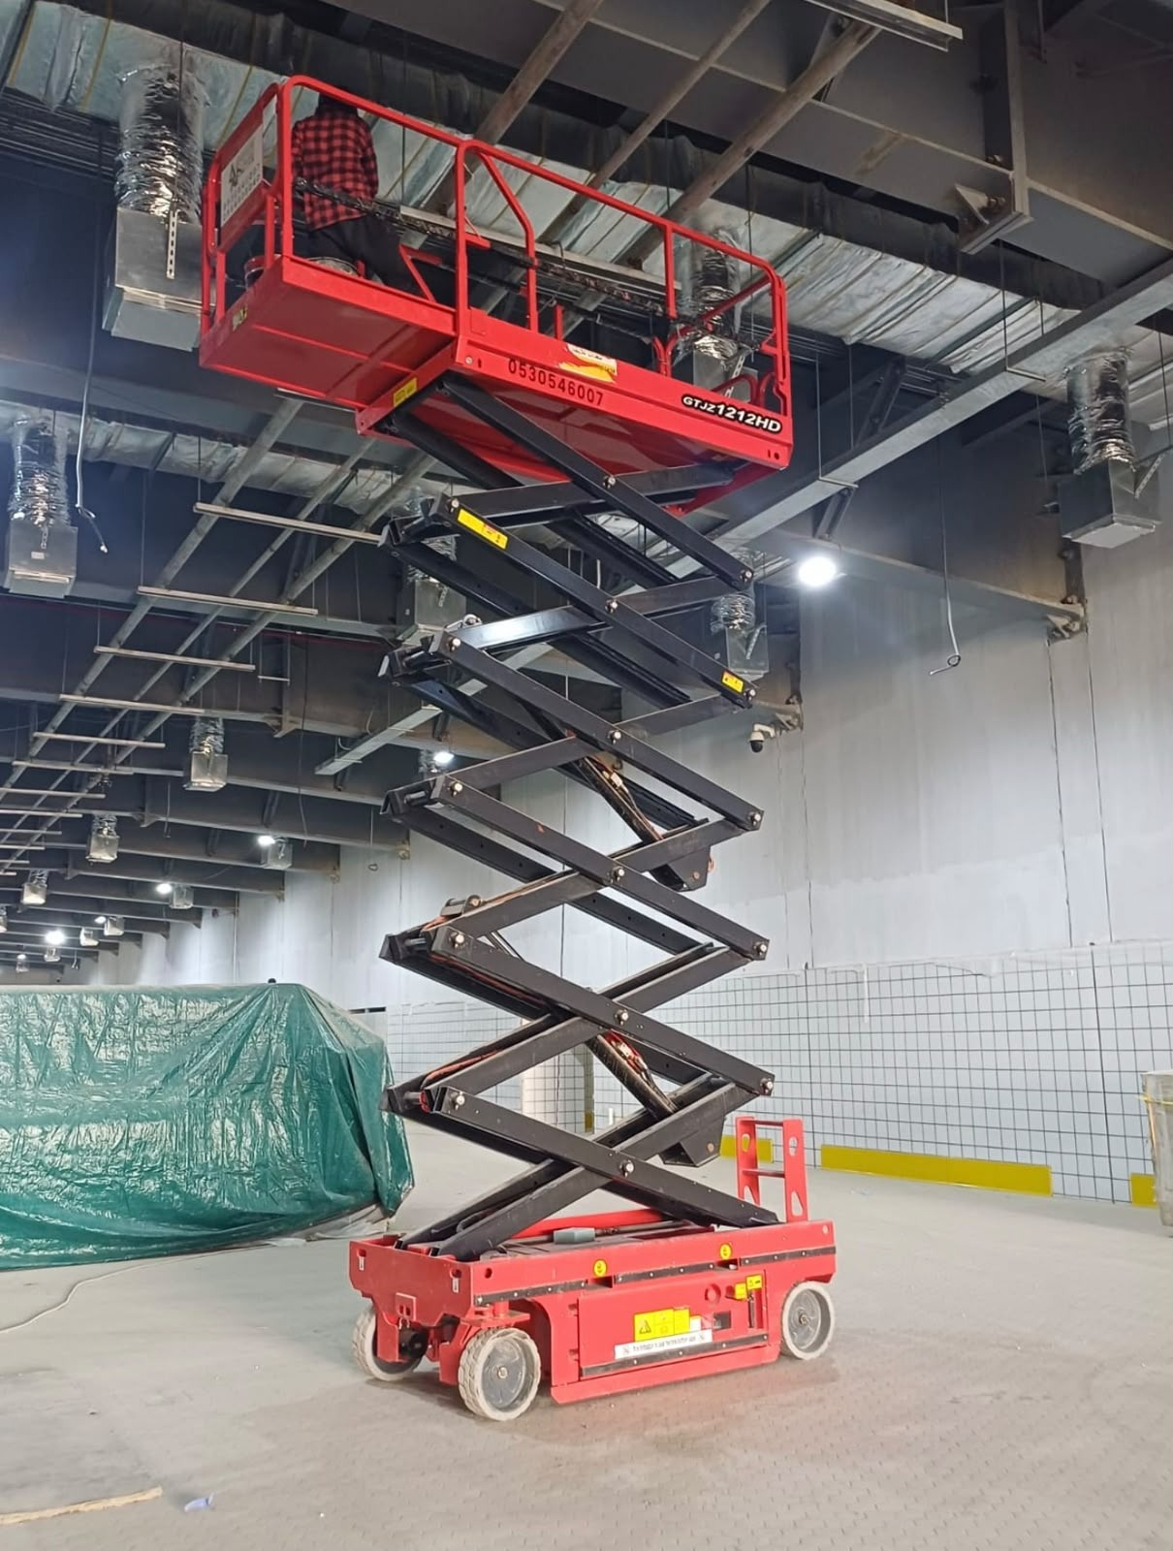
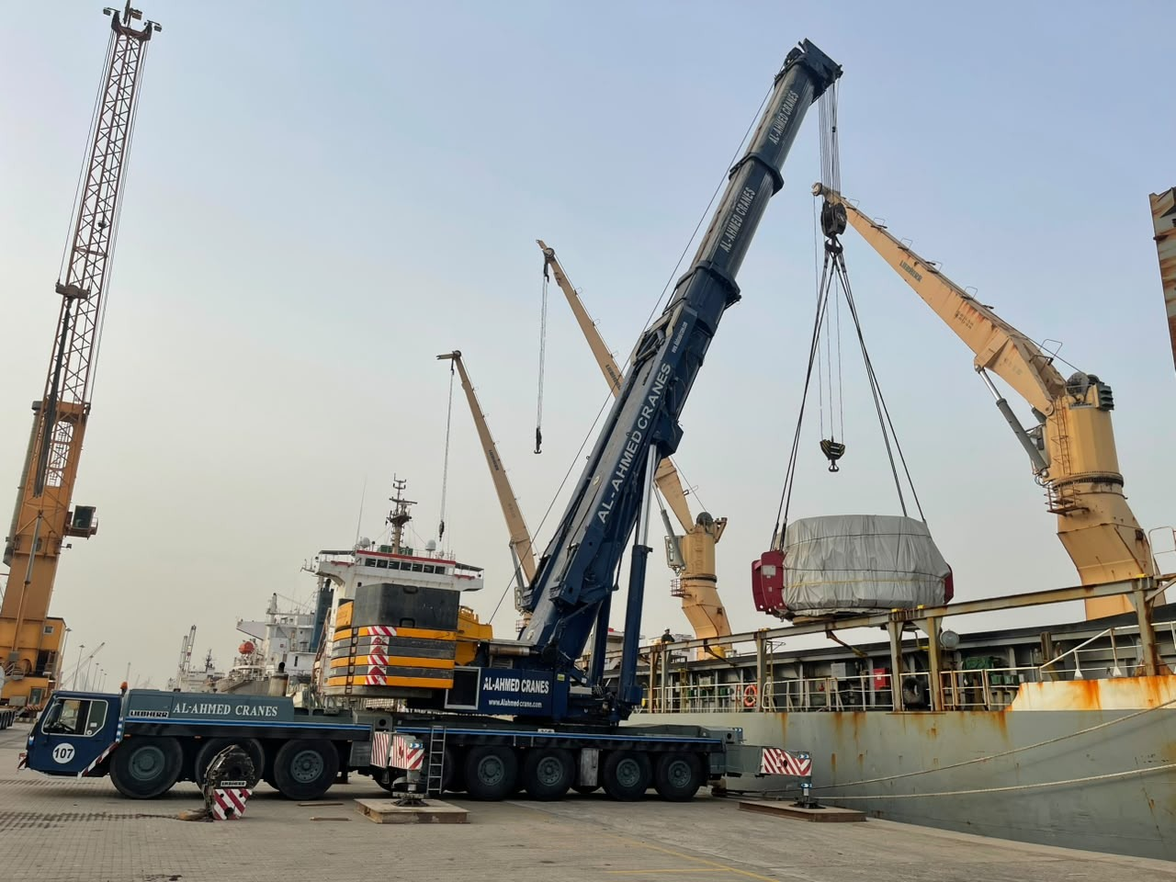
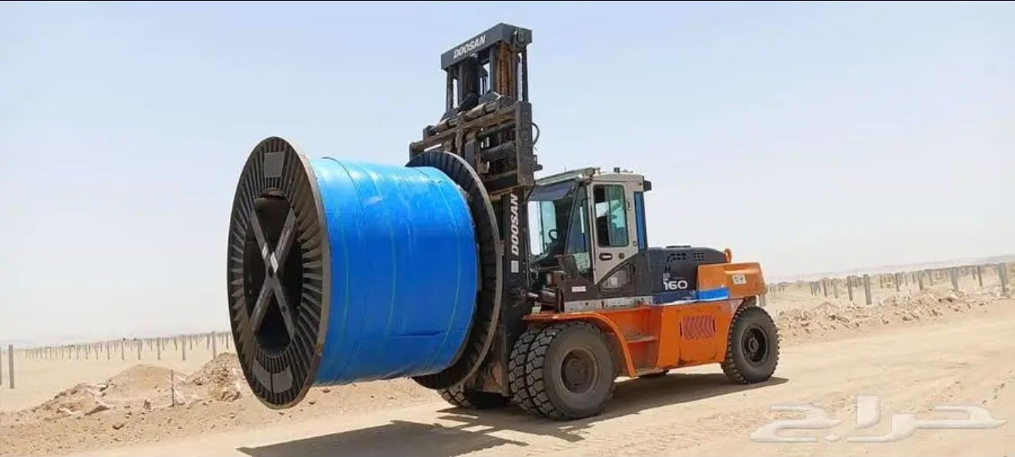
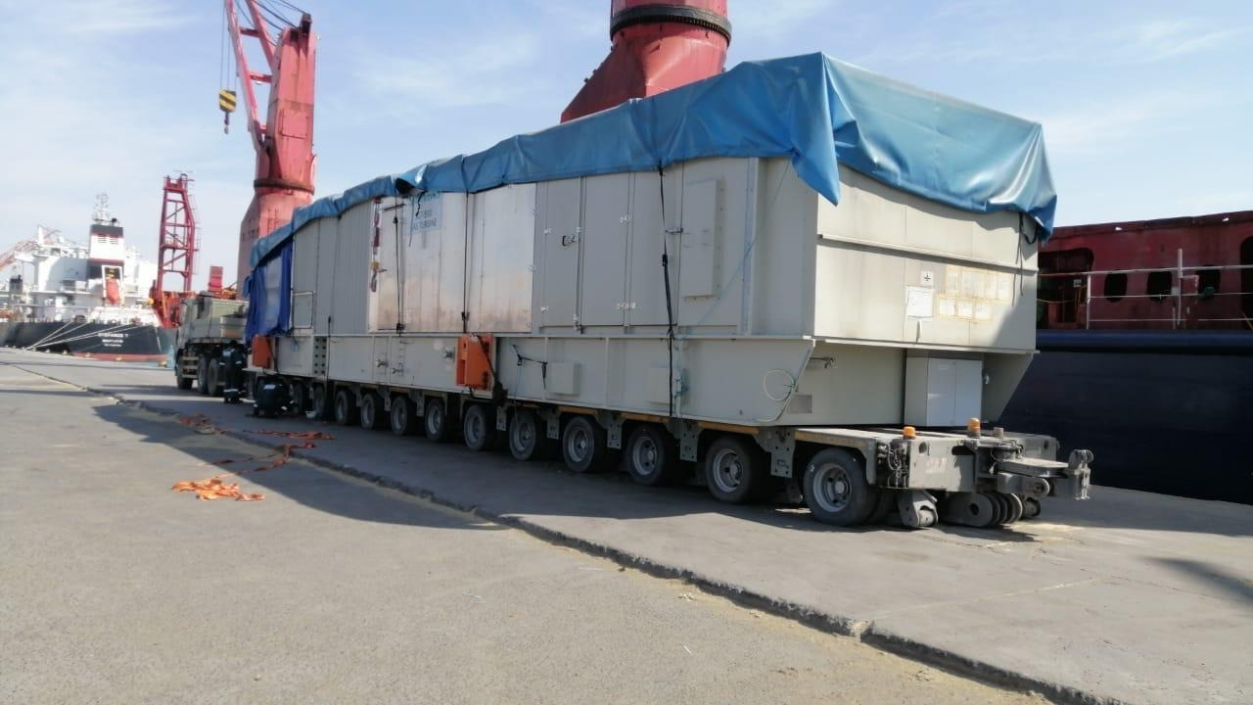
WASEEM
CONSTRUCTION COMPANY
04
02 / AREAS OF WORK
EQUIPMENT THAT
KEEPS WORK MOVING.
FOCUS AREAS
Proposed service categories based on supplied photographs. Company confirmation required.
01
02
03
04
CRANE OPERATIONS
MATERIAL HANDLING
HEAVY TRANSPORT
SITE & ACCESS
Lifting and positioning
Handling with purpose
Movement at scale
Reach the working area
Mobile cranes handling cargo and larger loads.
Forklifts and yard equipment moving materials.
Low-bed and multi-axle transport for equipment and cargo.
Elevated access and machinery for site activities.
WASEEM CONSTRUCTION COMPANY
SERVICE CONCEPT / FOR REVIEW
03

Slide 4
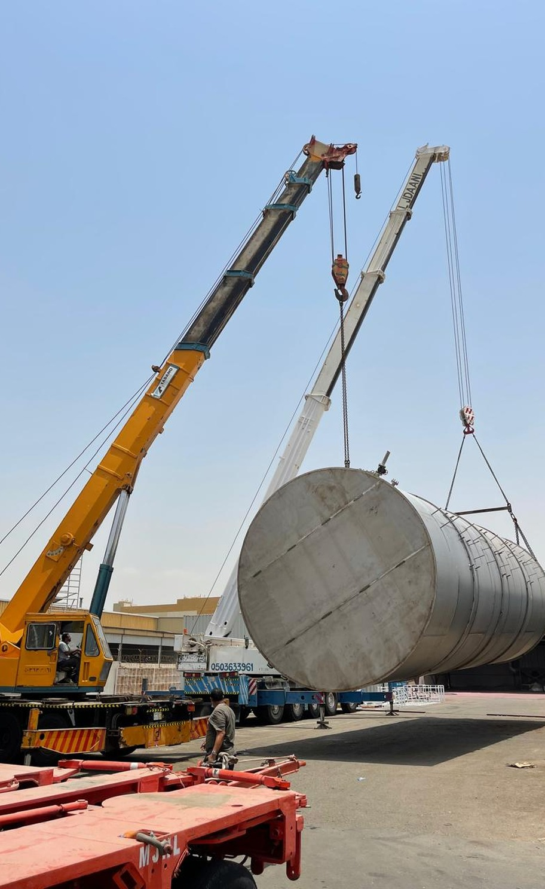
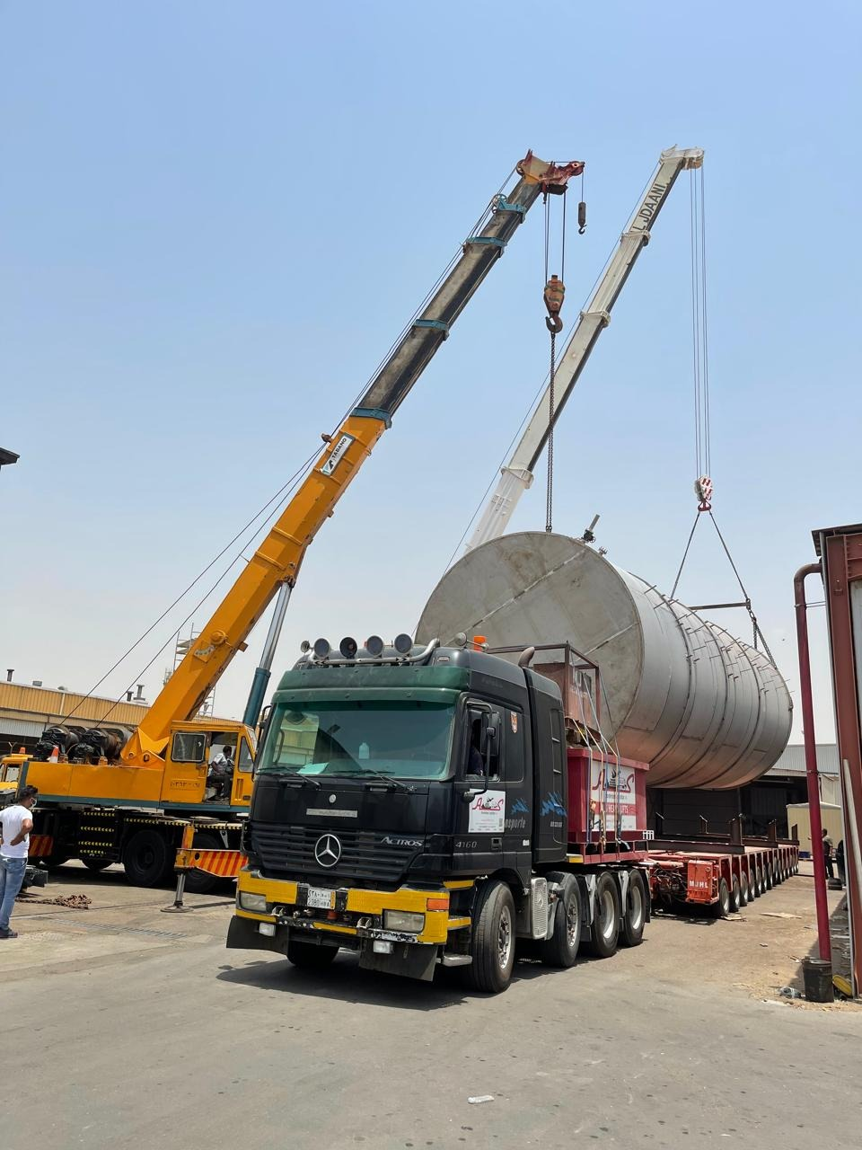
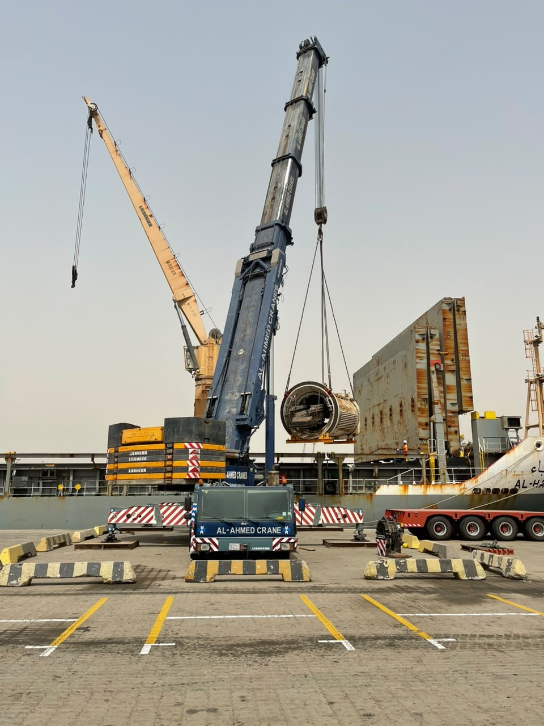
03 / OPERATIONS SHOWCASE
BIG LOADS.
CLEAR FOCUS.
A closer look at lifting and load positioning.
Mobile cranes handle cylindrical loads beside transport trailers. Supporting views show equipment positioning and the working area.
01 / LOAD HANDLING
02 / CRANE POSITIONING
LIFTING & LOAD POSITIONING
WASEEM CONSTRUCTION COMPANY
04

Slide 5
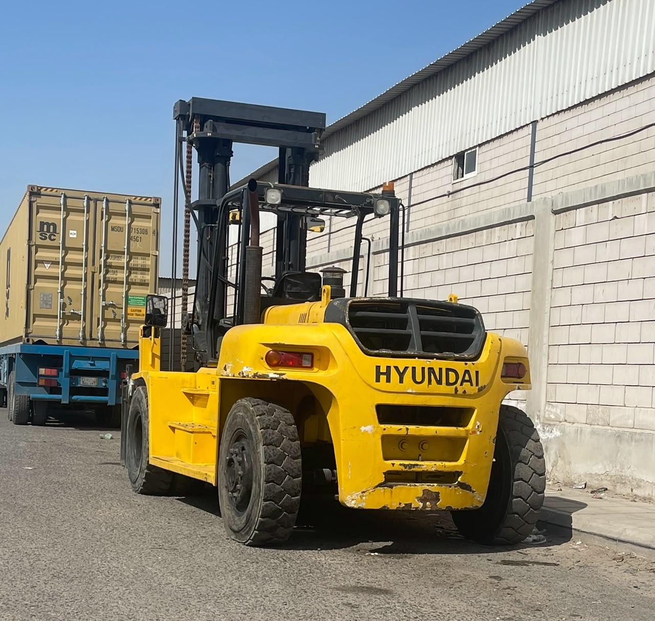
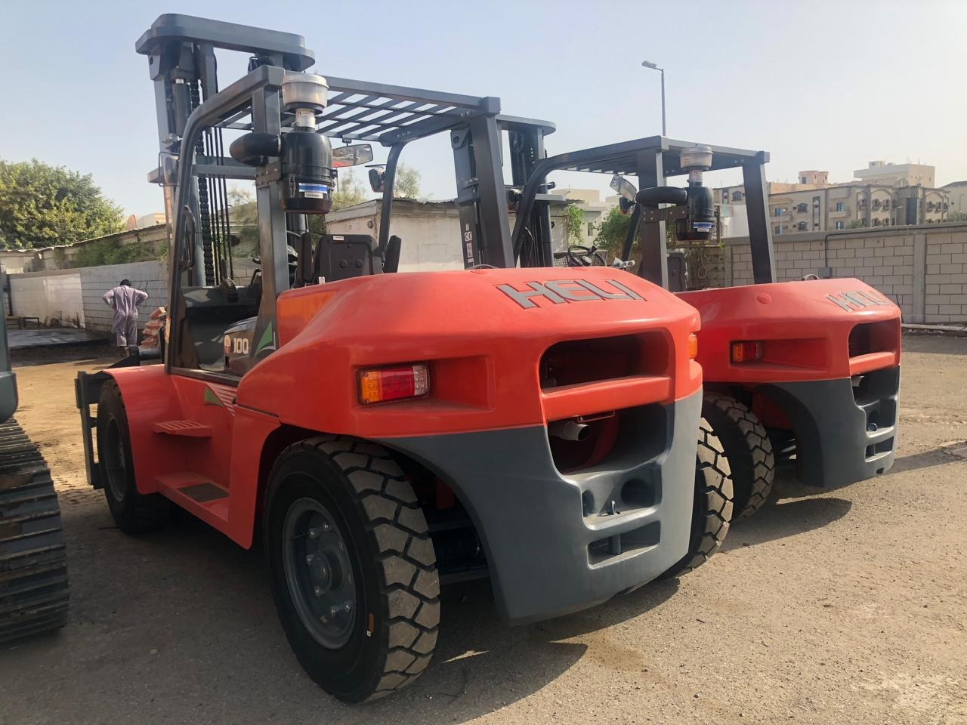
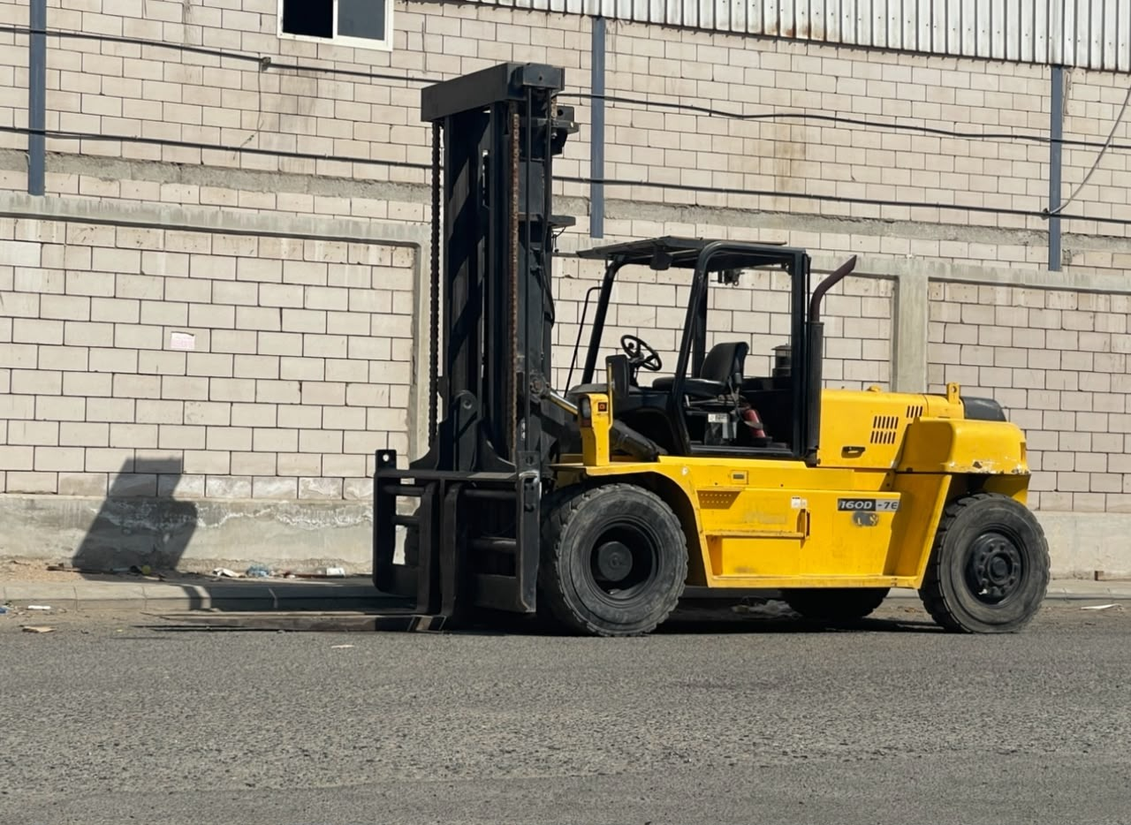
WASEEM
04 / MATERIAL HANDLING
CONSTRUCTION COMPANY
MATERIALS IN MOTION.
Forklifts and handling equipment in industrial yards
INDUSTRIAL YARD FORKLIFT
LARGE-REEL HANDLING
WASEEM CONSTRUCTION COMPANY
05

Slide 6
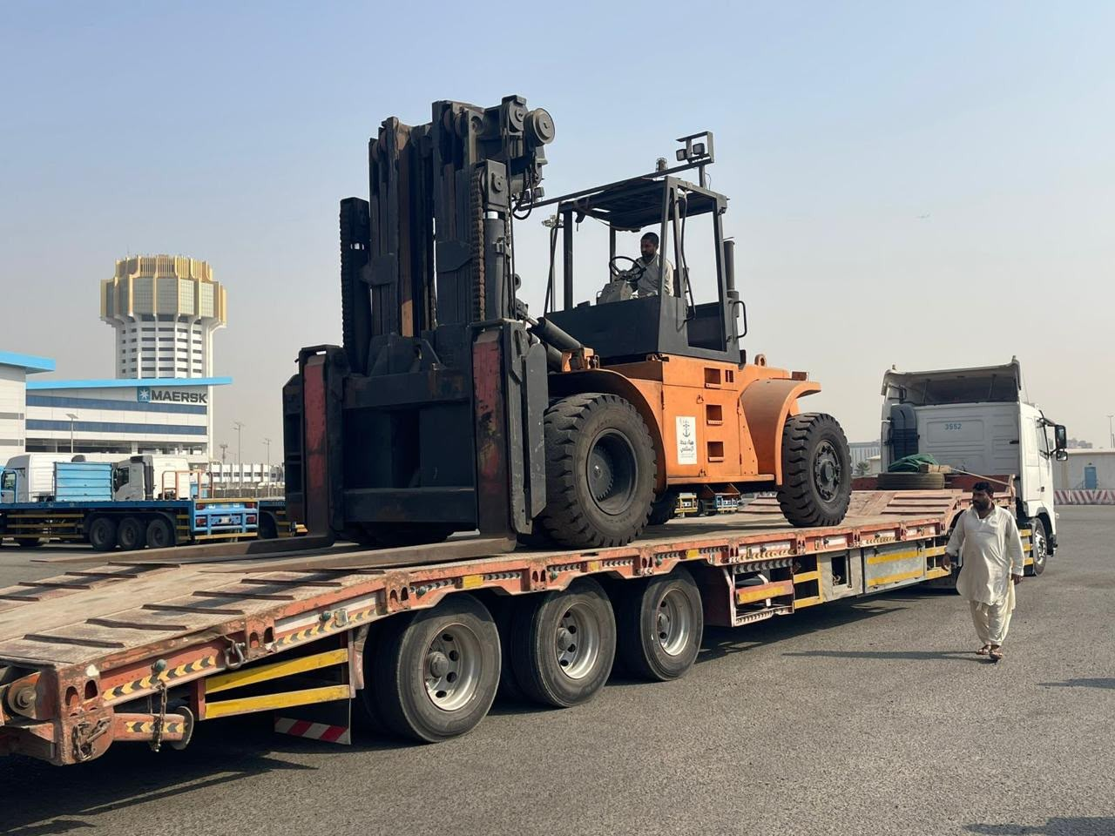
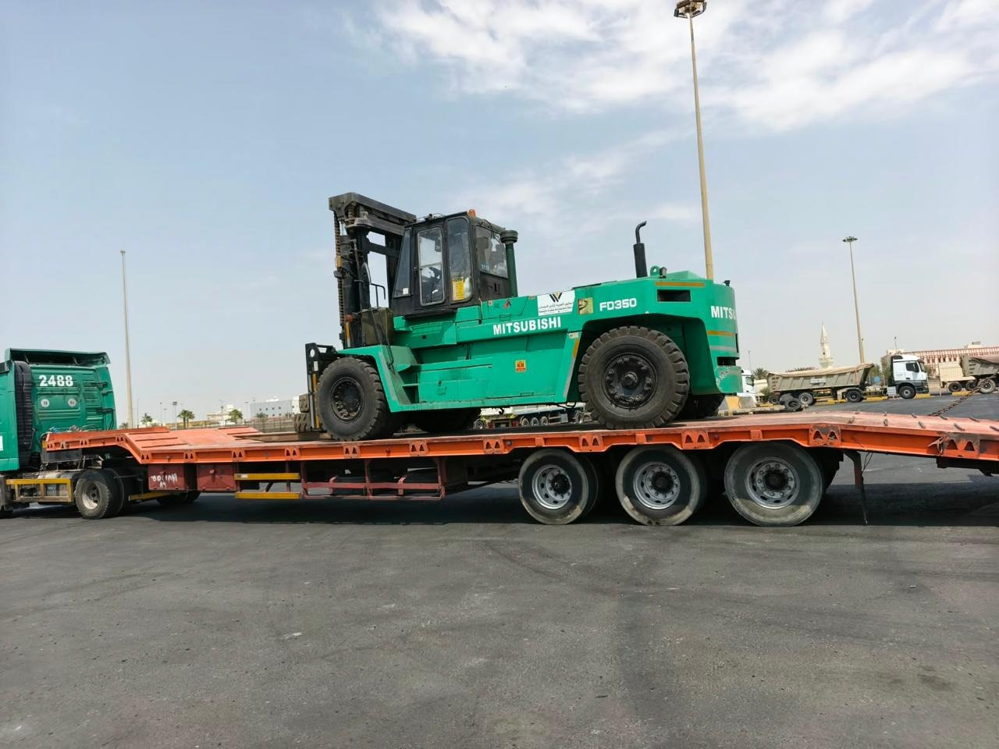
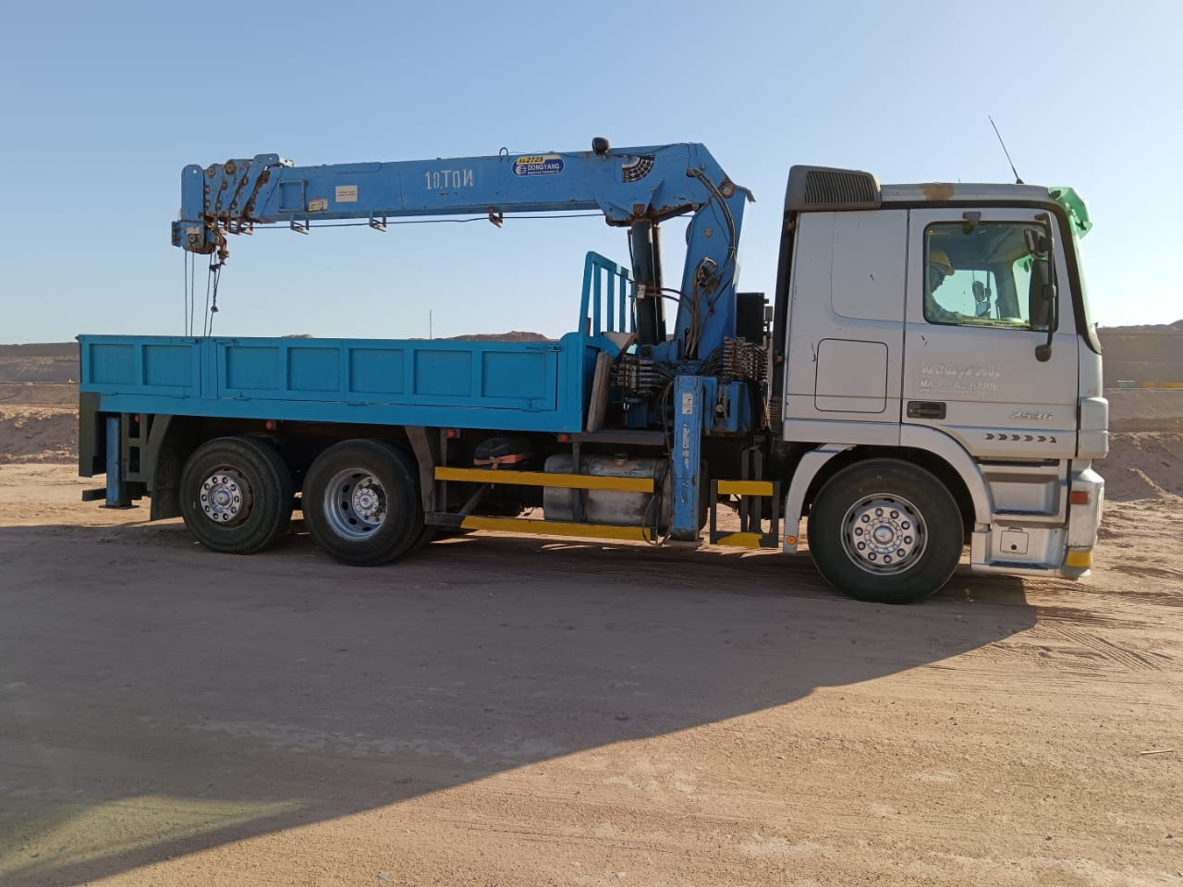
WASEEM
05 / EQUIPMENT TRANSPORT
CONSTRUCTION COMPANY
READY FOR THE NEXT MOVE.
Loading, transport and truck-mounted lifting equipment
FORKLIFT TRANSPORT
EQUIPMENT ON LOW-BED TRAILER
Transport planning starts with equipment dimensions and conditions at the loading and receiving areas.
WASEEM CONSTRUCTION COMPANY
06

Slide 7
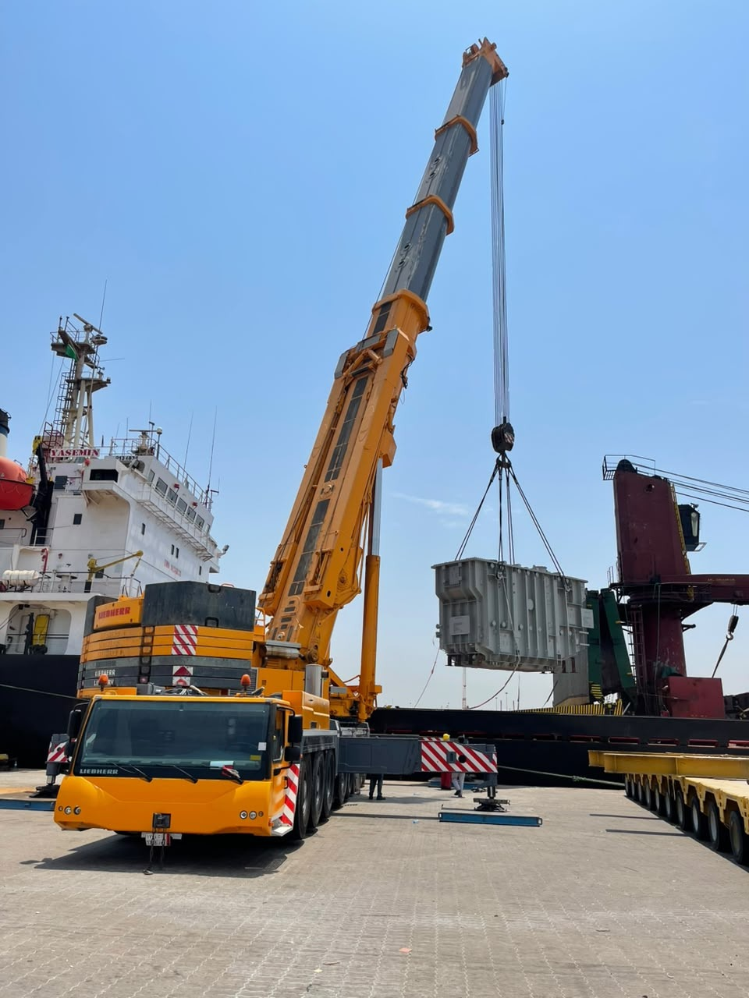
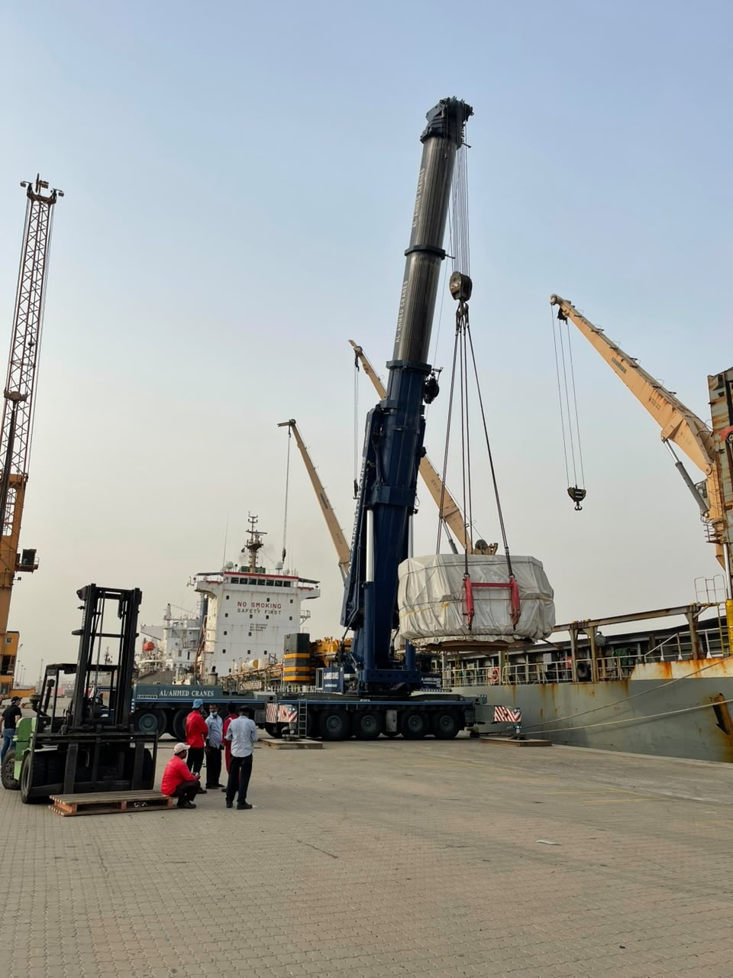
WASEEM
06 / WATERFRONT OPERATIONS
CONSTRUCTION COMPANY
LIFTING AT
Mobile cranes and cargo handling
in port environments
THE WATERFRONT.
CRANE ARRANGEMENT
CARGO LIFTING
PORT-SIDE POSITIONING
WASEEM CONSTRUCTION COMPANY
07

Slide 8
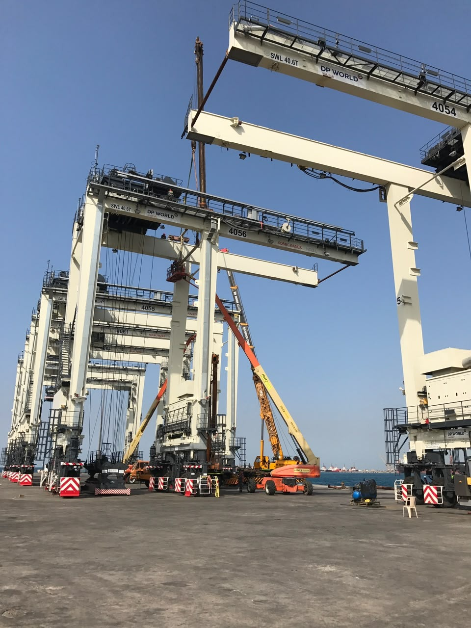
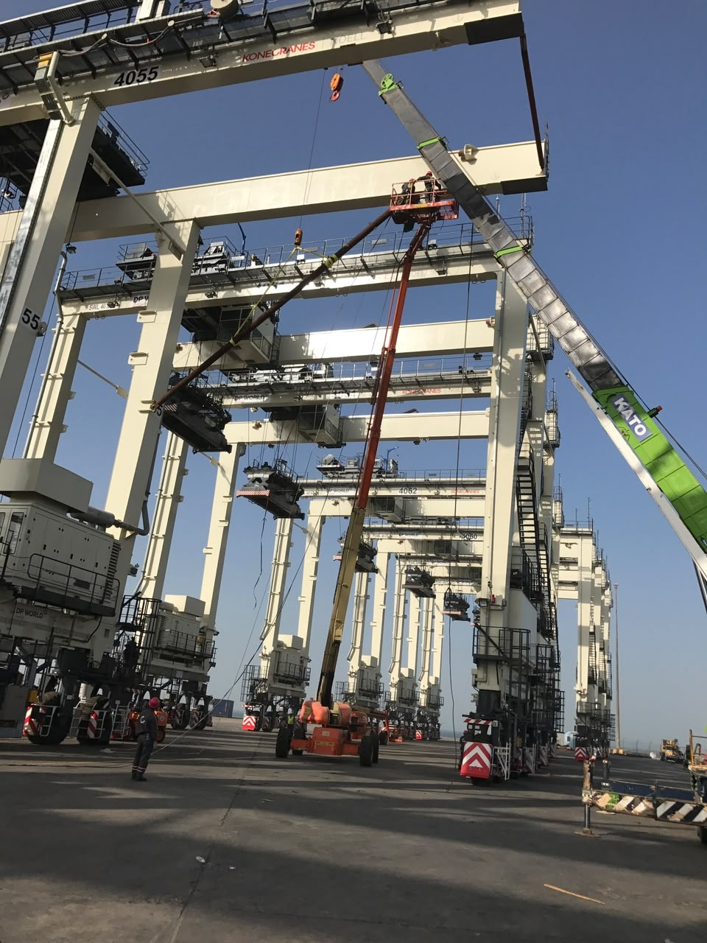
WASEEM
07 / PORT STRUCTURES & ACCESS
CONSTRUCTION COMPANY
PORT
ENVIRONMENTS
STRUCTURES AT
SCALE.
Gantry structures and elevated equipment in waterfront working environments.
STRUCTURE & WORKING AREA
EQUIPMENT & ACCESS
WASEEM CONSTRUCTION COMPANY
08

Slide 9

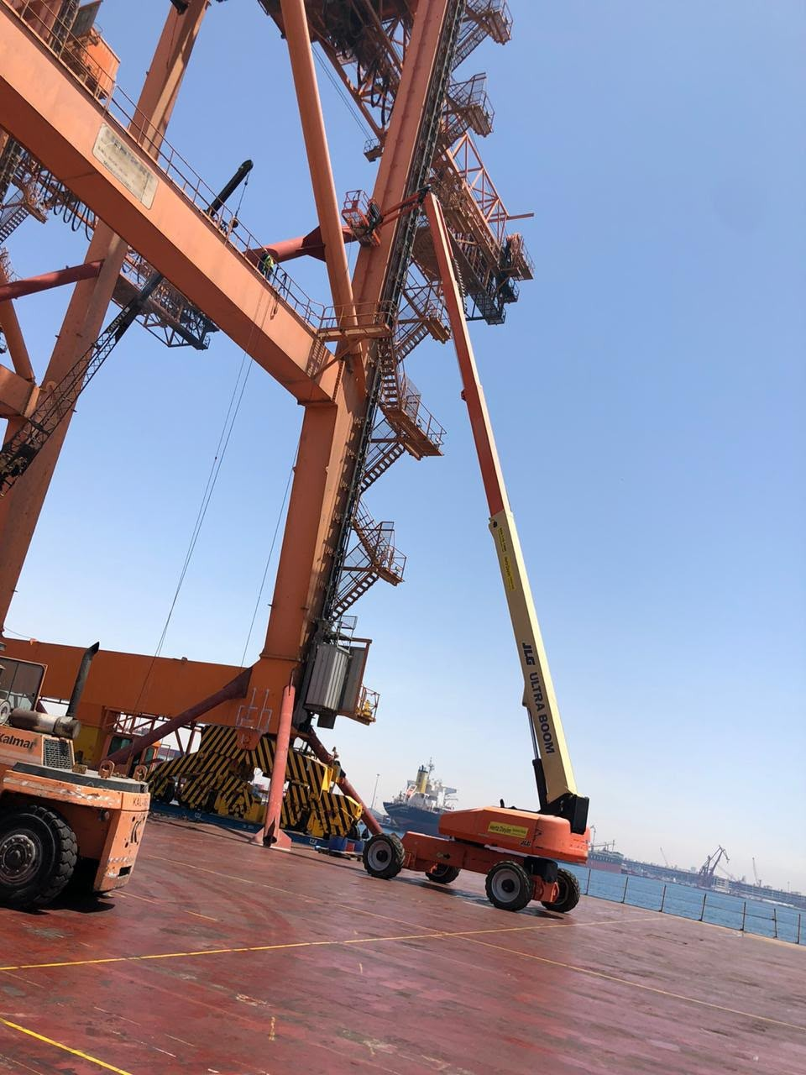
WASEEM
07 / PORT STRUCTURES & ACCESS
CONSTRUCTION COMPANY
PORT
ENVIRONMENTS
ACCESS IN CONTEXT.
Gantry structures and elevated equipment in waterfront working environments.
STRUCTURE & WORKING AREA
EQUIPMENT & ACCESS
WASEEM CONSTRUCTION COMPANY
09

Slide 10
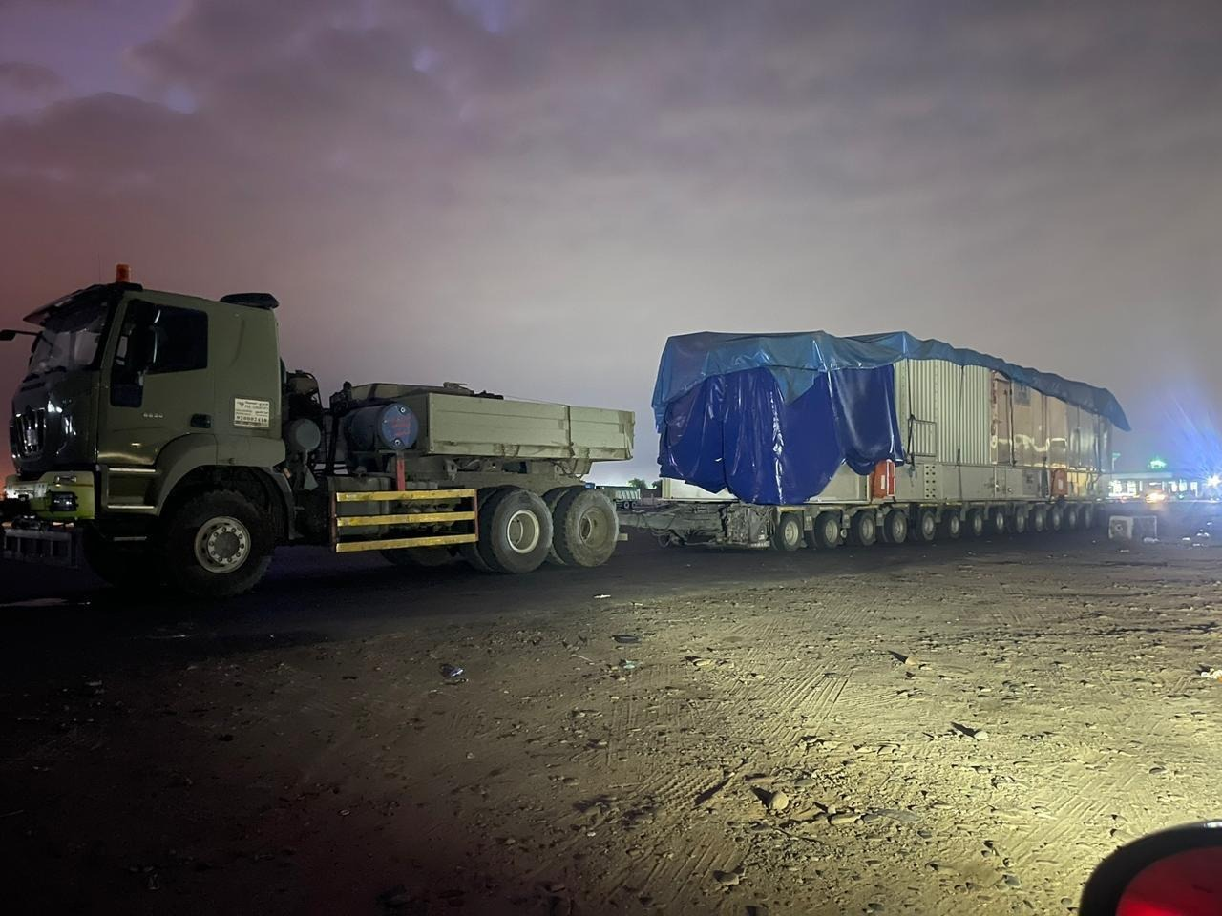
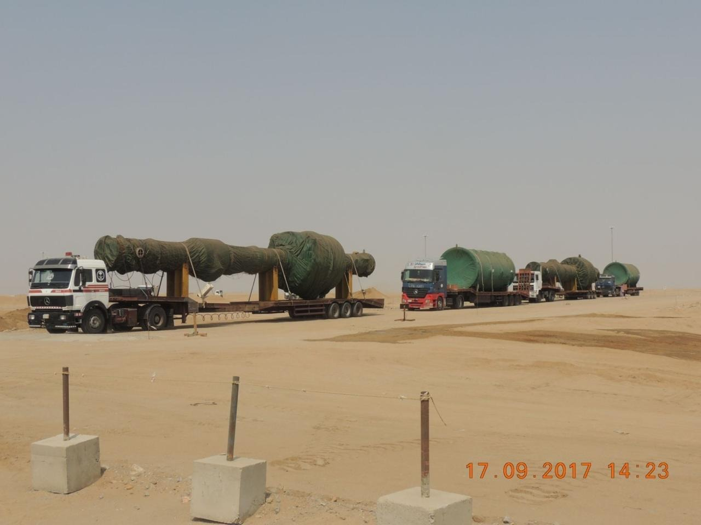
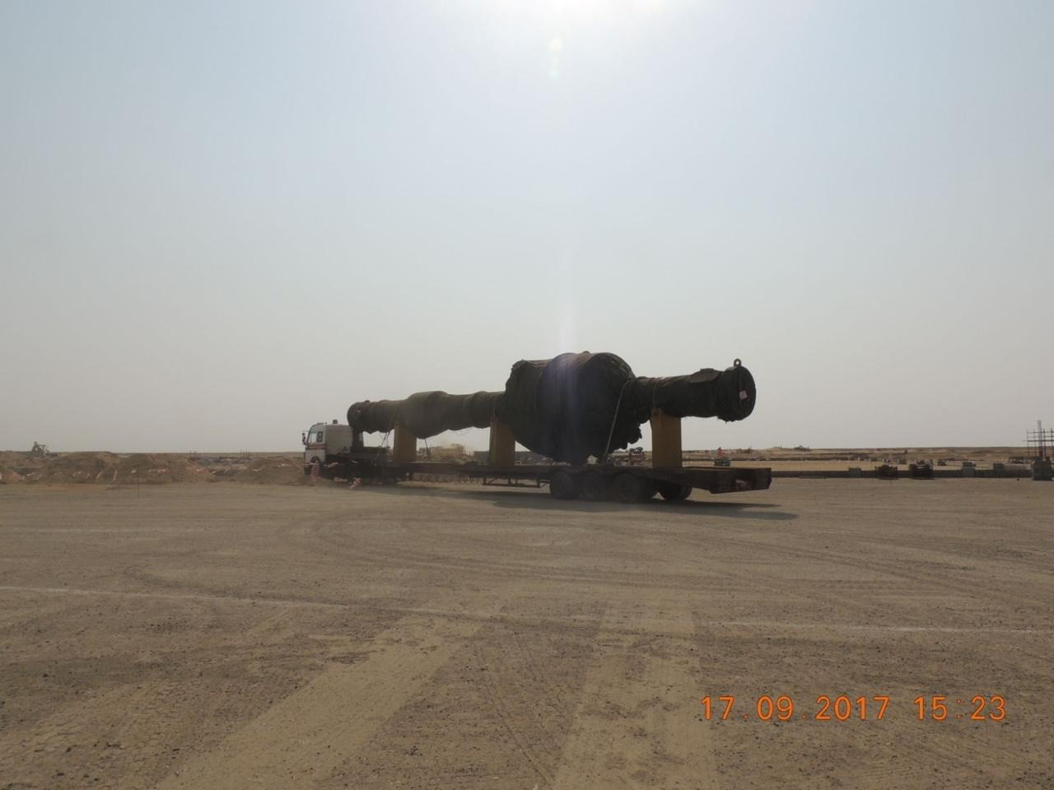
WASEEM
08 / HEAVY CARGO
CONSTRUCTION COMPANY
MOVEMENT AT SCALE.
Covered loads and oversized cargo on multi-axle trailers
COVERED CARGO
MULTI-AXLE TRAILER
OVERSIZED MOVEMENT
HEAVY TRANSPORT CONFIGURATION
WASEEM CONSTRUCTION COMPANY
10

Slide 11
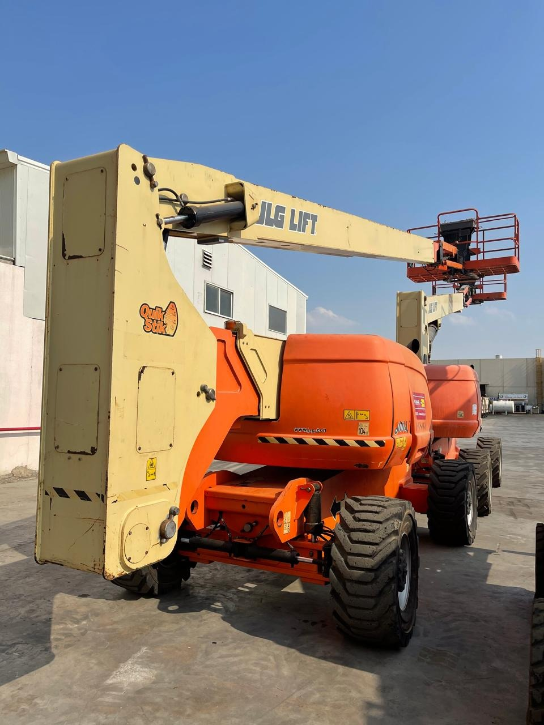
WASEEM
09 / SITE ACCESS
CONSTRUCTION COMPANY
REACH THE
WORKING
AREA.
Scissor lifts and boom lifts provide access to elevated working areas, indoors and outdoors.
SCISSOR LIFT
ARTICULATING BOOM LIFT
WASEEM CONSTRUCTION COMPANY
11

Slide 12
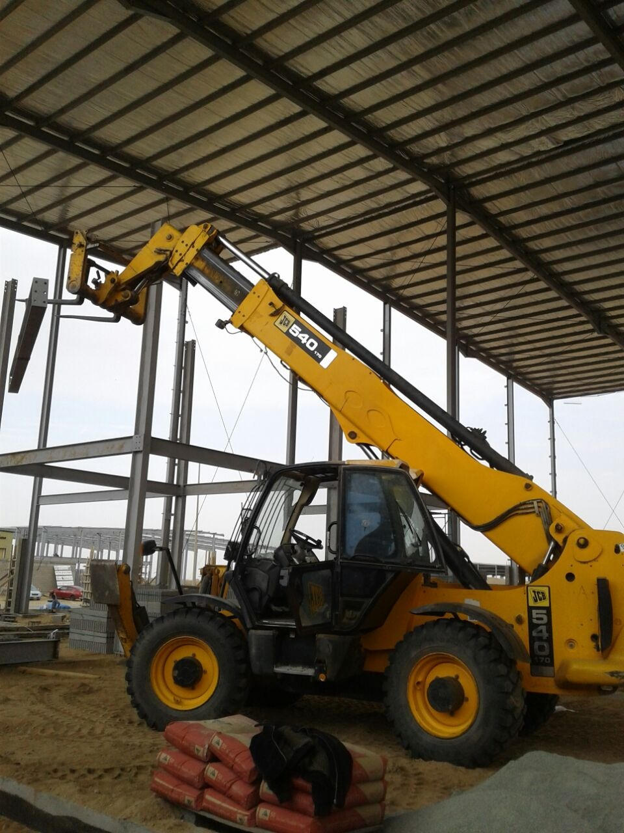
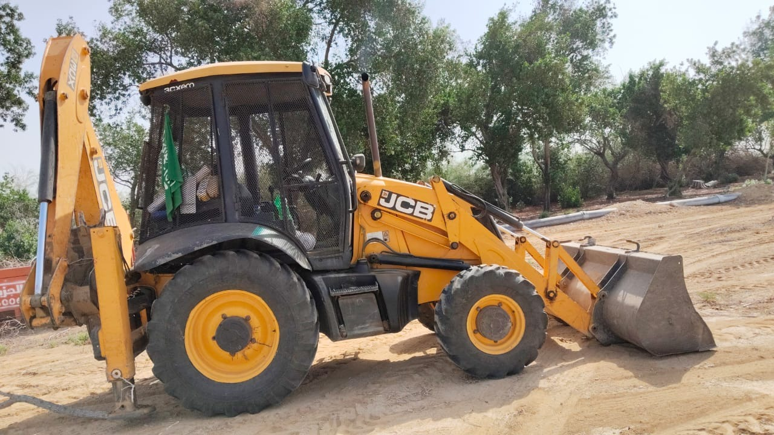
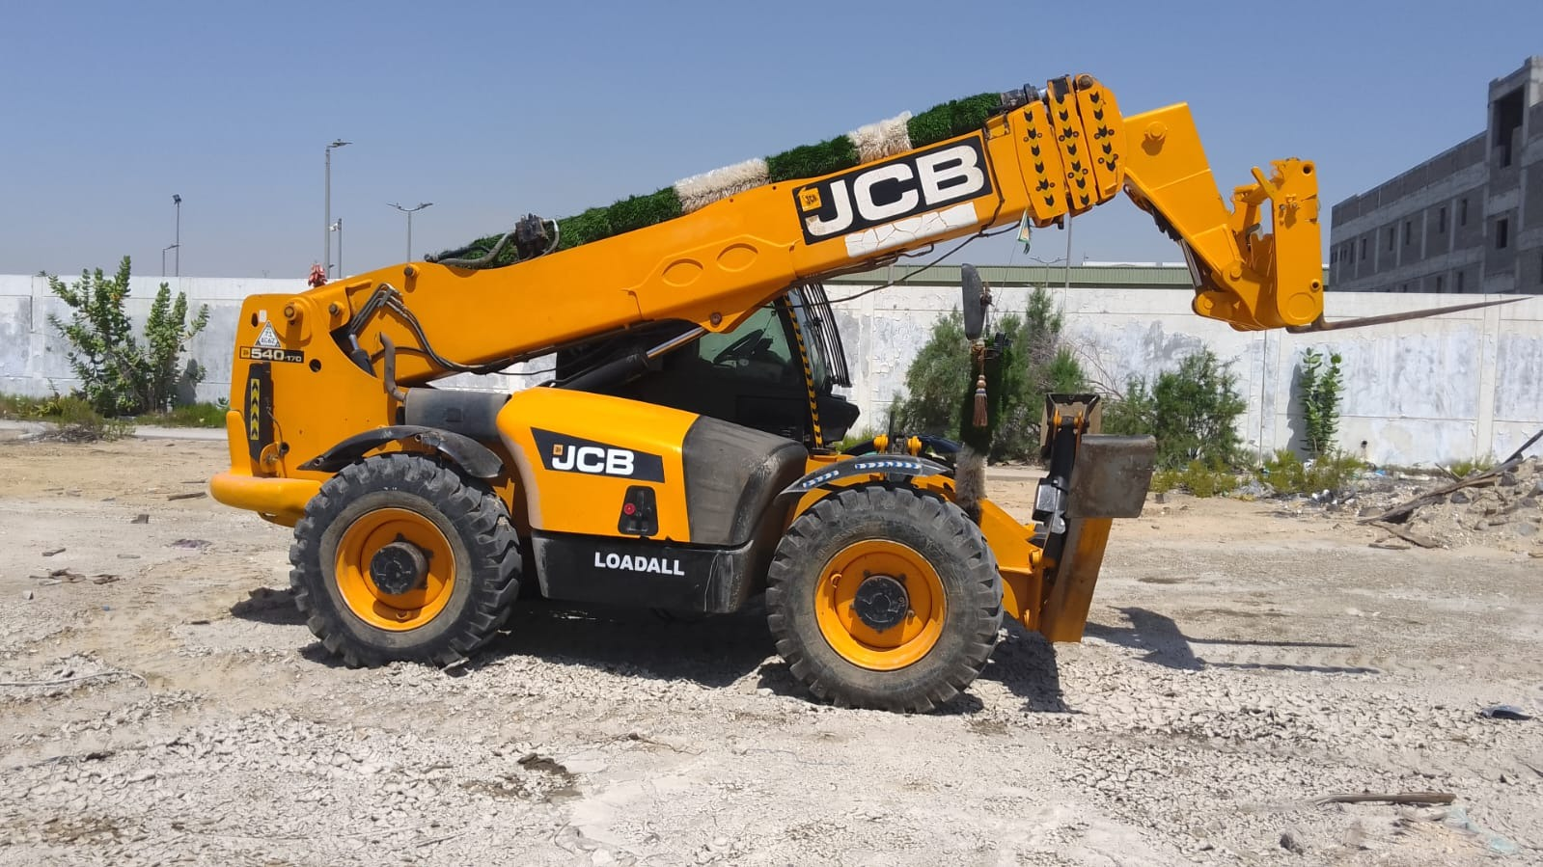
WASEEM
10 / SITE MACHINERY
CONSTRUCTION COMPANY
DIFFERENT TASKS.
PRACTICAL EQUIPMENT.
TELEHANDLER ON SITE
BACKHOE LOADER
TELESCOPIC HANDLER
WASEEM CONSTRUCTION COMPANY
12

Slide 13
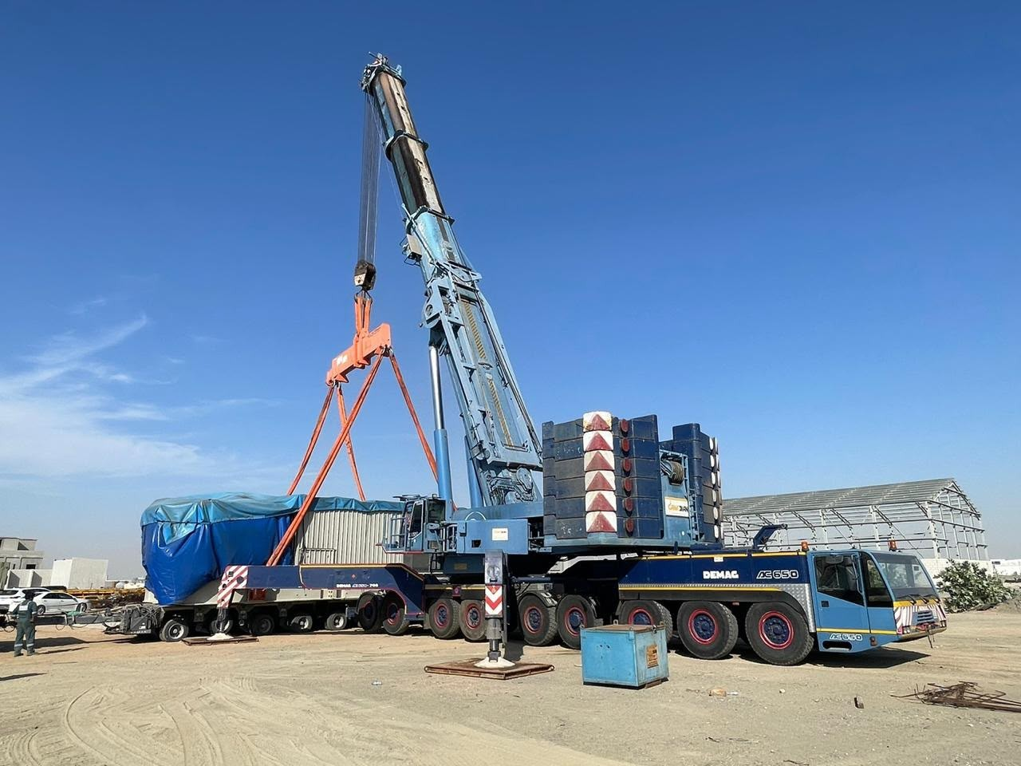
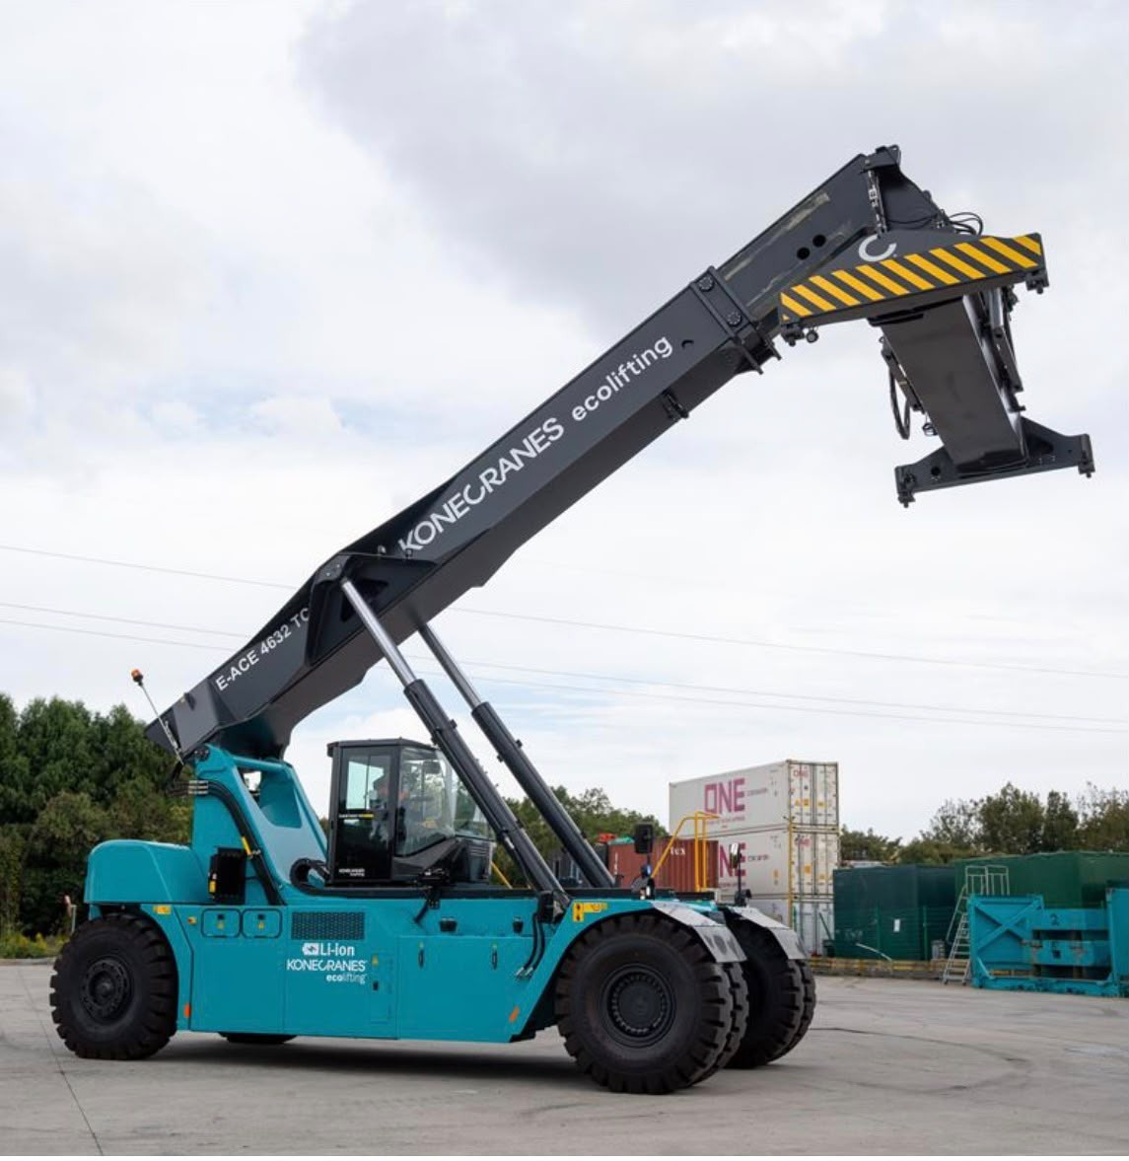
WASEEM
11 / SPECIALIST HANDLING
CONSTRUCTION COMPANY
HANDLING WITH PURPOSE.
Mobile crane activity and container-handling equipment
MOBILE CRANE & SLUNG LOAD
REACH STACKER
WASEEM CONSTRUCTION COMPANY
13

Slide 14
WASEEM
12 / PLANNING THE REQUIREMENT
CONSTRUCTION COMPANY
A CLEAR BRIEF.
A BETTER START.
Four points to discuss when preparing an equipment enquiry
01
02
03
04
THE TASK
THE LOAD
THE LOCATION
THE TIMING
What needs to be lifted, moved or accessed?
What are the dimensions, weight and handling requirements?
What access, space and ground conditions affect the work?
When is the equipment needed, and for how long?
WASEEM CONSTRUCTION COMPANY
14

Slide 15
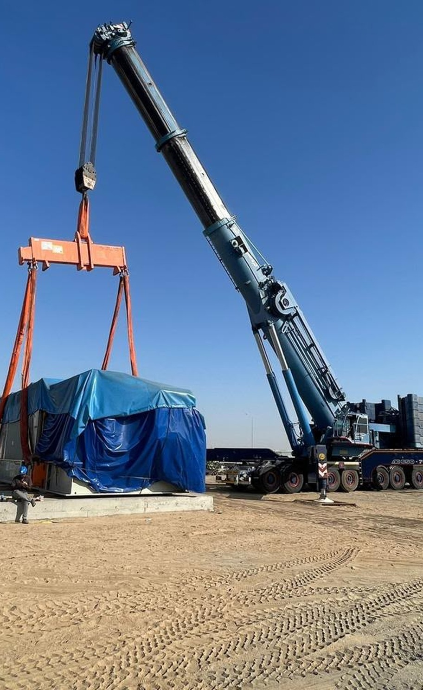
WASEEM CONSTRUCTION COMPANY
LET'S PLAN
THE NEXT MOVE.
Send your requirements to our team
GENERAL ENQUIRIES
Wasim@wasconarabia.com
SALES ENQUIRIES
Sales@wasconarabia.com
Telephone
Office address
Registration no.
15

