Slide 1
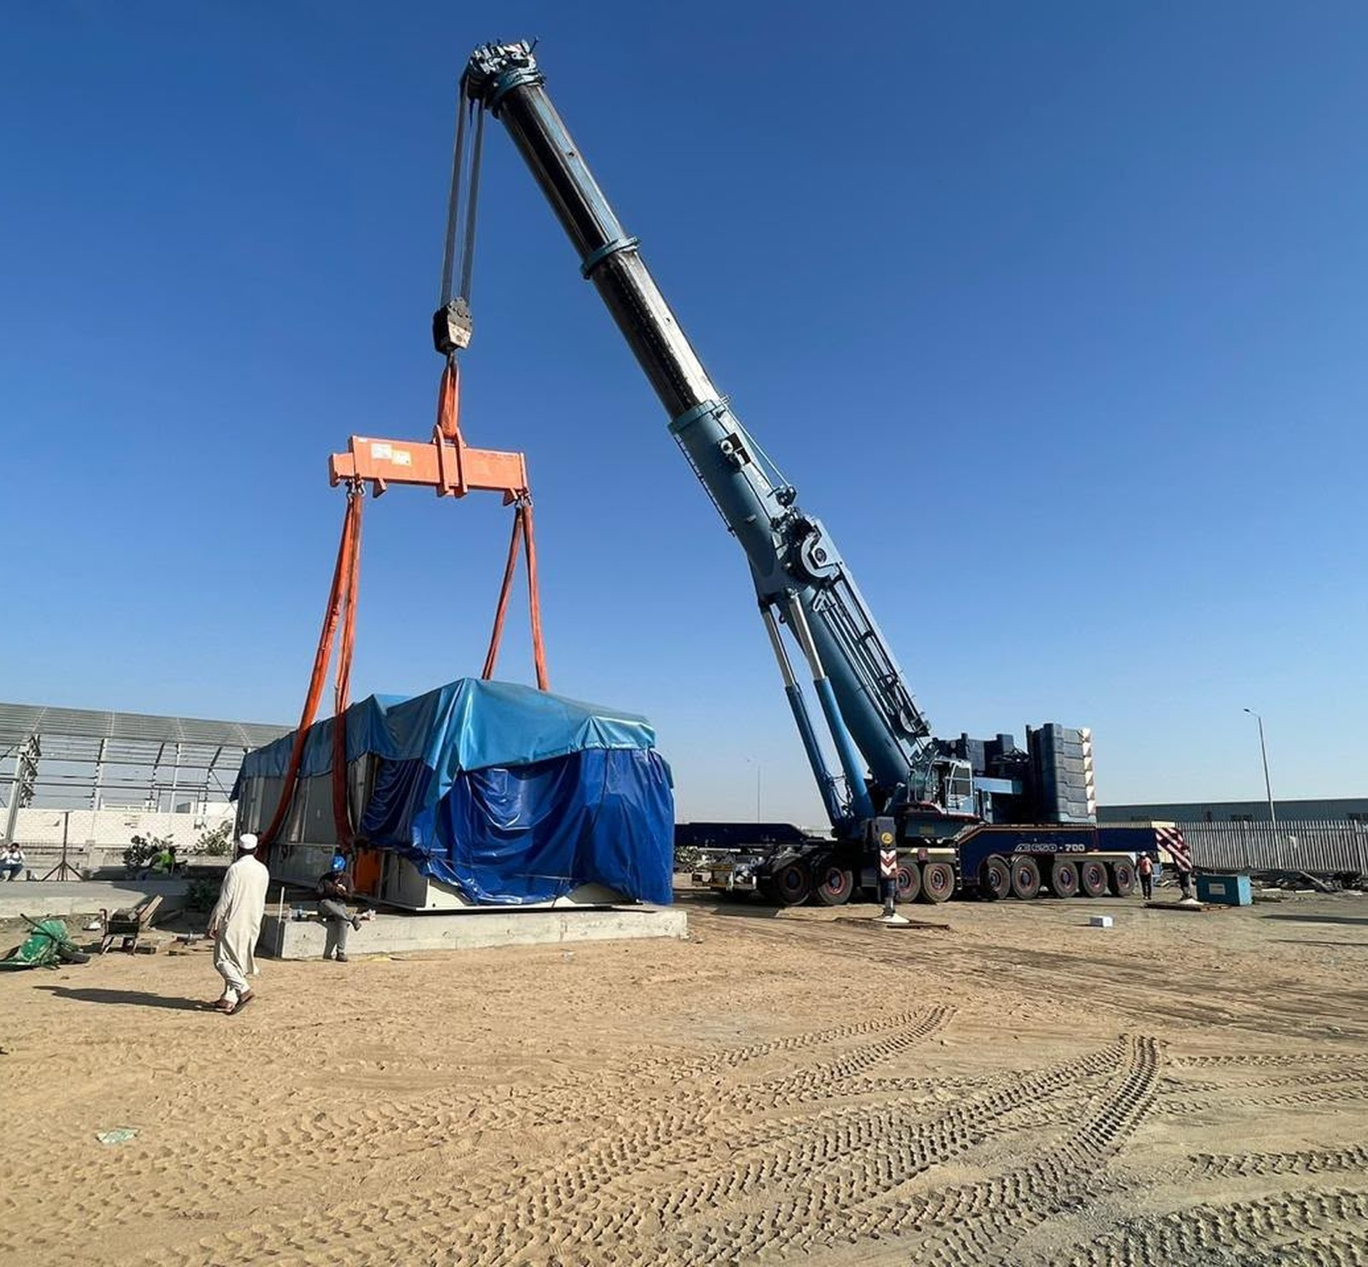
CORPORATE PORTFOLIO
WASEEM
CONSTRUCTION
COMPANY
LIFTING. MOVING.
BUILDING POSSIBILITIES.
Equipment and operations
for the work ahead.
WORK IN FOCUS.
COMPANY PROFILE
LIFTING / HANDLING / TRANSPORT

Slide 2
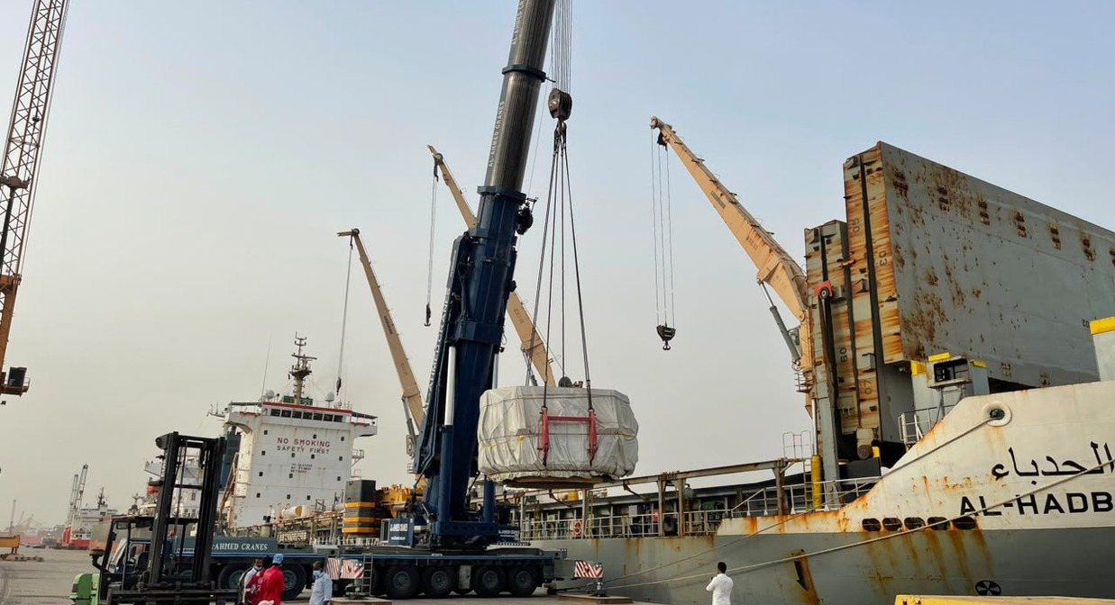
01 / COMPANY OVERVIEW
WORK BEGINS
WITH A CLEAR
DIRECTION.
Lifting. Handling. Transport.
Site access.
The work behind the movement.
A focused introduction to Waseem
Waseem Construction Company brings lifting, material handling, heavy transport and site
Construction Company and the equipment
equipment into one visual portfolio. The photographs show a range of operating environments,
activities featured in this portfolio.
from industrial yards to waterfront cargo areas.
Use this portfolio as a starting point for discussing a specific task. Equipment availability,
technical requirements, commercial terms and the final scope of work can be confirmed for each
enquiry.
WASEEM CONSTRUCTION COMPANY
02

Slide 3
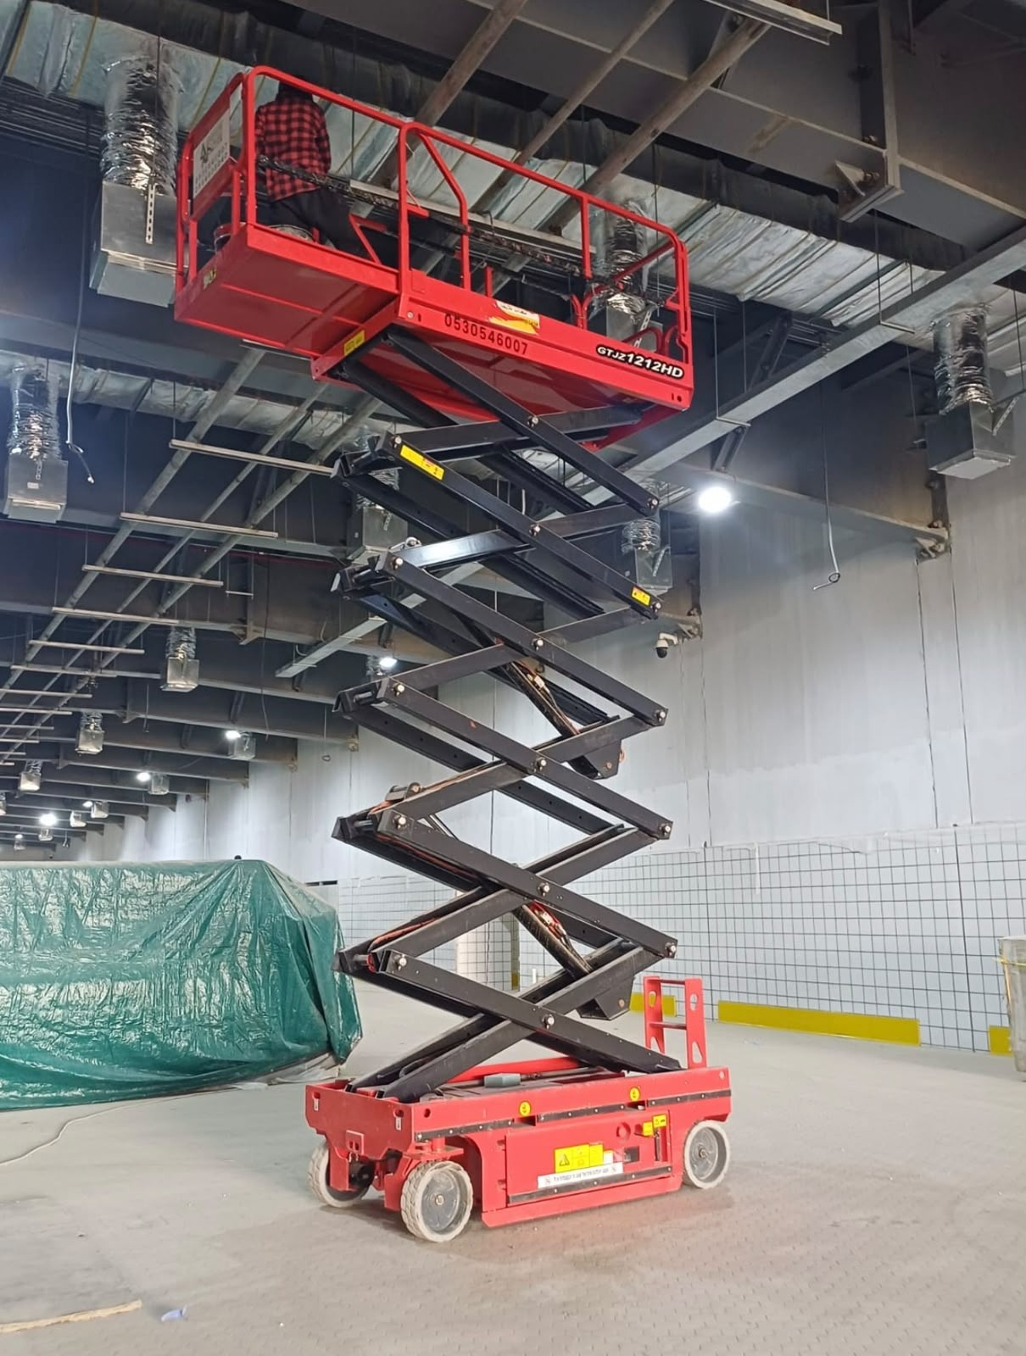
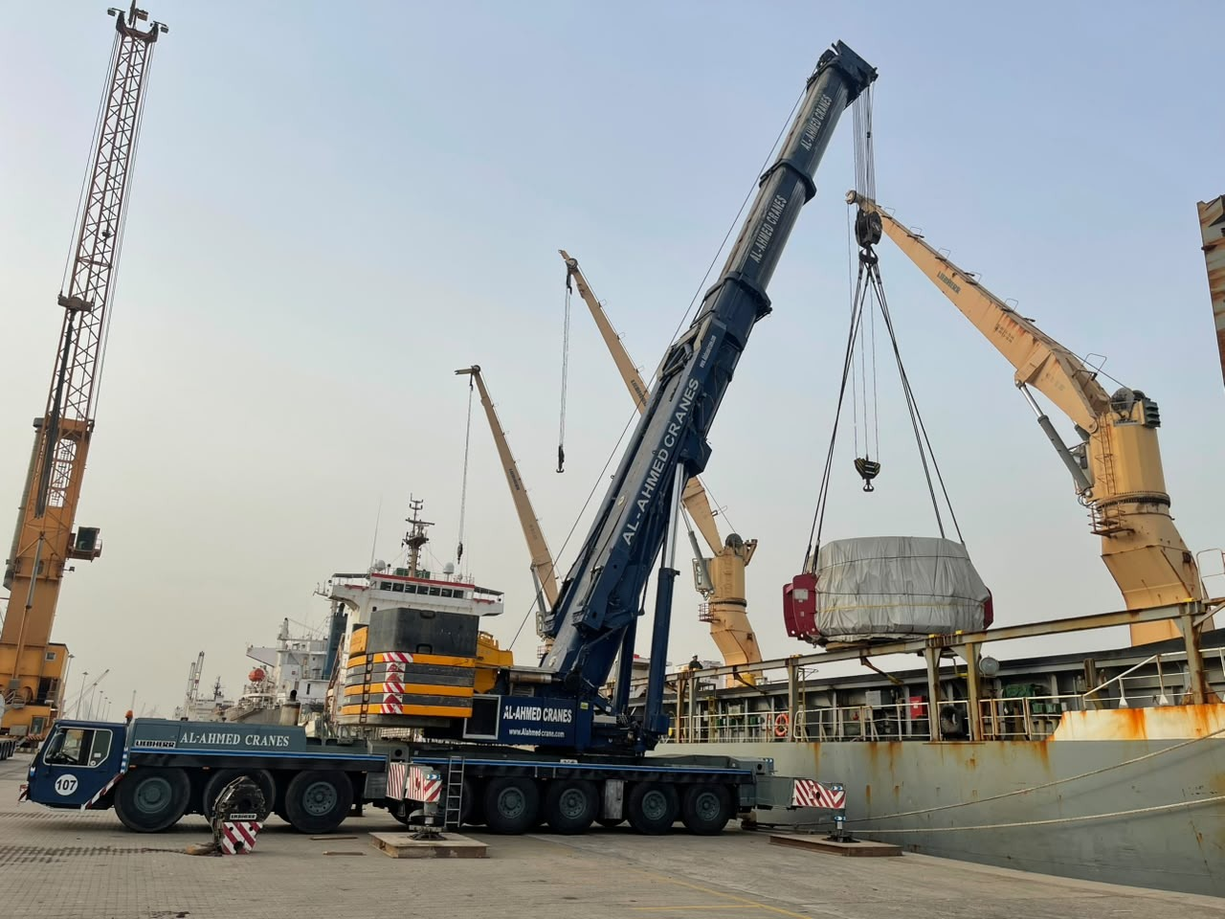
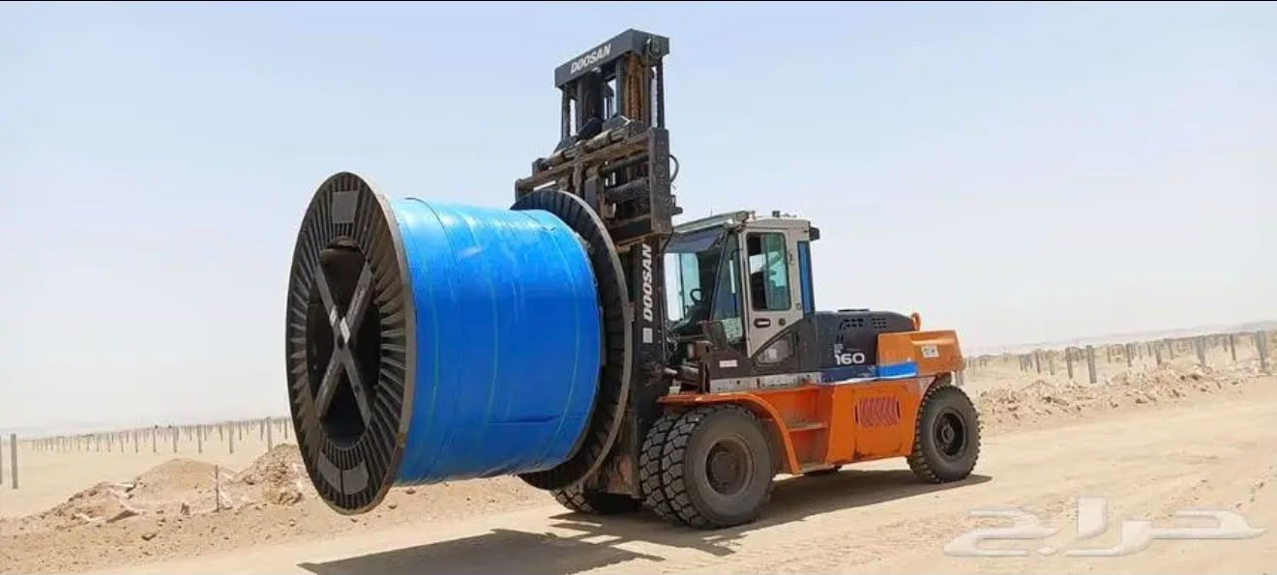
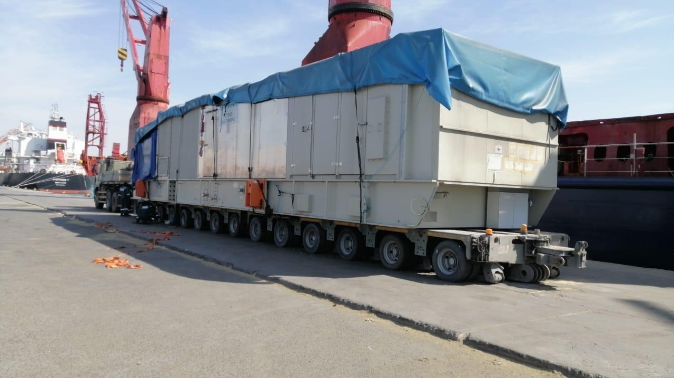
WASEEM
CONSTRUCTION COMPANY
04
02 / AREAS OF WORK
EQUIPMENT THAT
FOCUS AREAS
KEEPS WORK MOVING.
Proposed service categories below are based on the supplied photographs and require company confirmation.
01
02
03
04
CRANE OPERATIONS
MATERIAL HANDLING
HEAVY TRANSPORT
SITE & ACCESS
Lifting and positioning
Handling with purpose
Movement at scale
Reach the working area
Mobile cranes shown handling cargo and
Forklifts and yard equipment pictured
Low-bed and multi-axle transport for
Elevated access and machinery for
larger loads.
moving materials.
equipment and cargo.
varied site activities.
WASEEM CONSTRUCTION COMPANY
SERVICE CONCEPT / FOR REVIEW
03

Slide 4
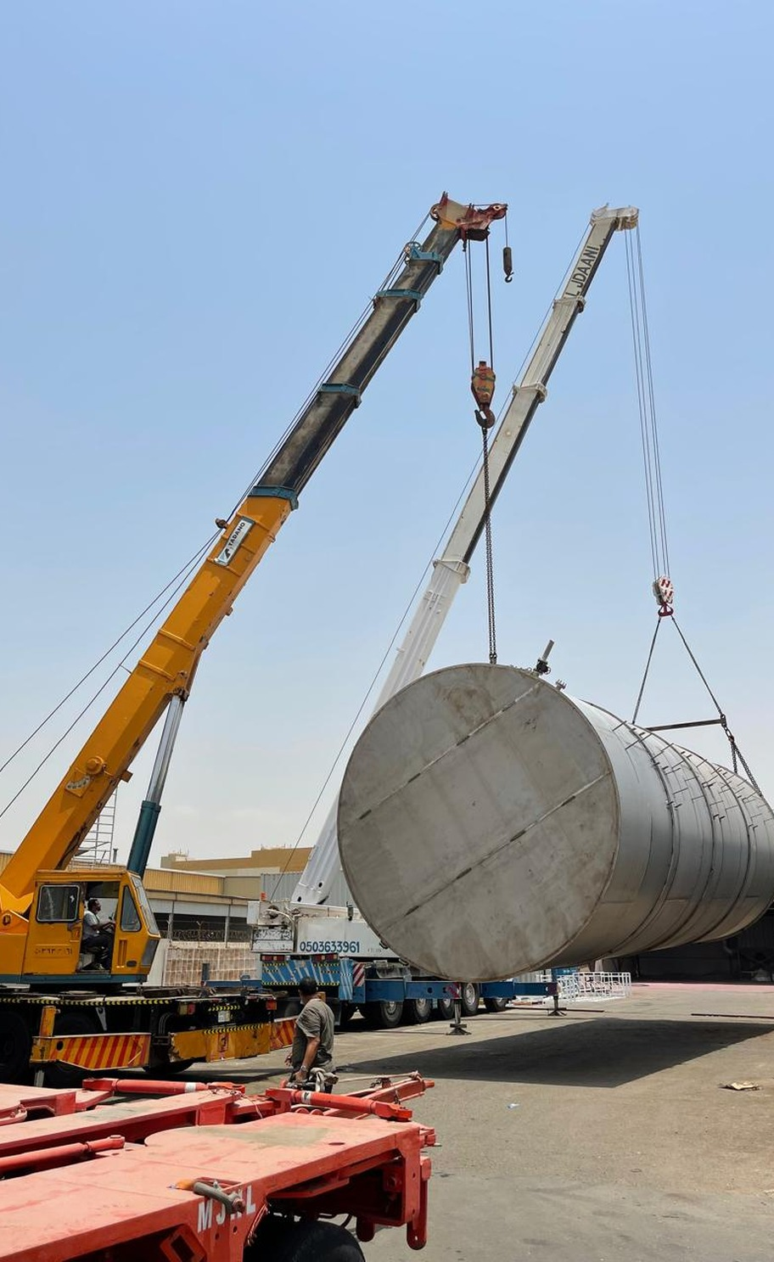
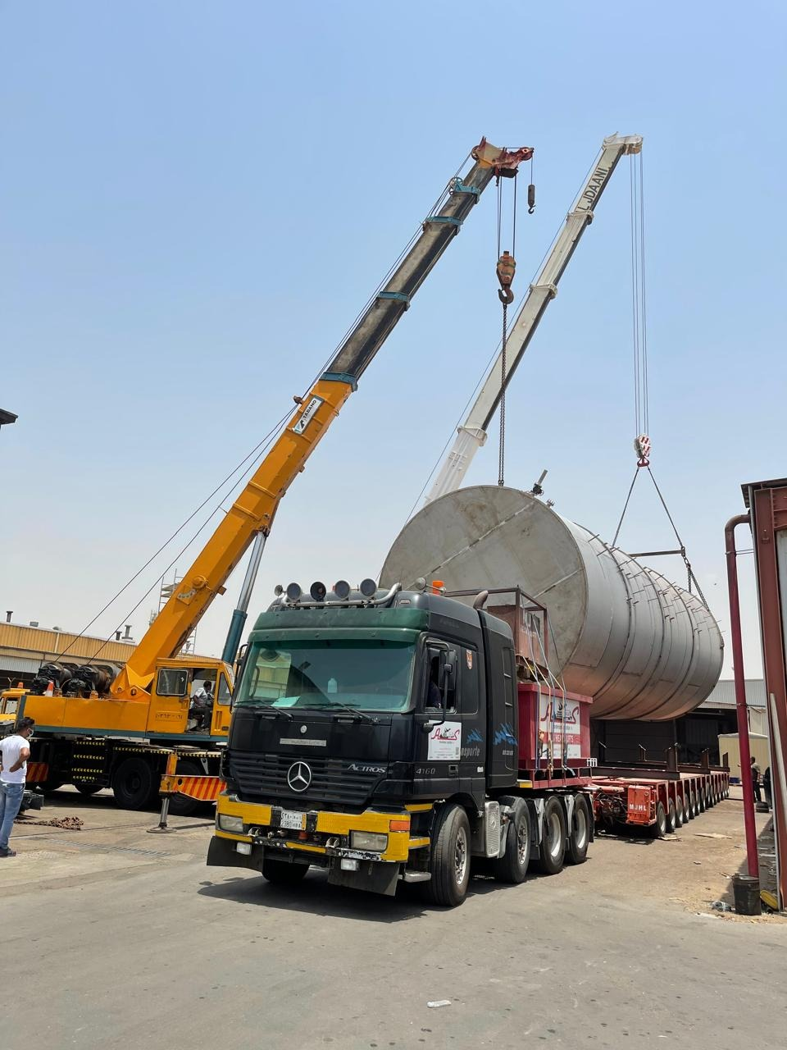
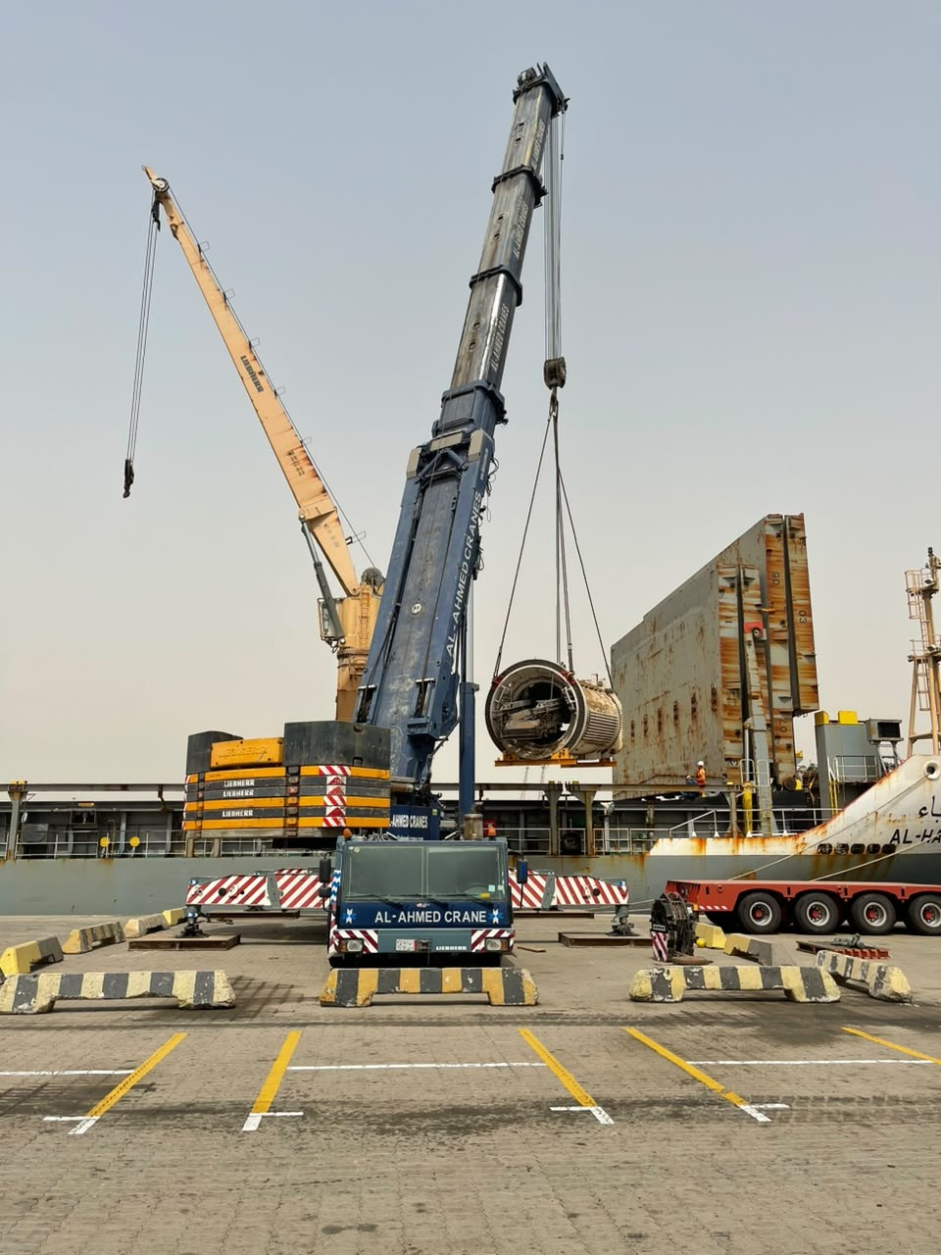
03 / OPERATIONS SHOWCASE
BIG LOADS.
CLEAR FOCUS.
A closer look at lifting and load positioning.
Mobile cranes pictured alongside cylindrical loads and transport trailers. The supporting
views show equipment positioning and the wider working environment.
01 / LOAD HANDLING
02 / CRANE POSITIONING
LIFTING & LOAD POSITIONING
WASEEM CONSTRUCTION COMPANY
04

Slide 5
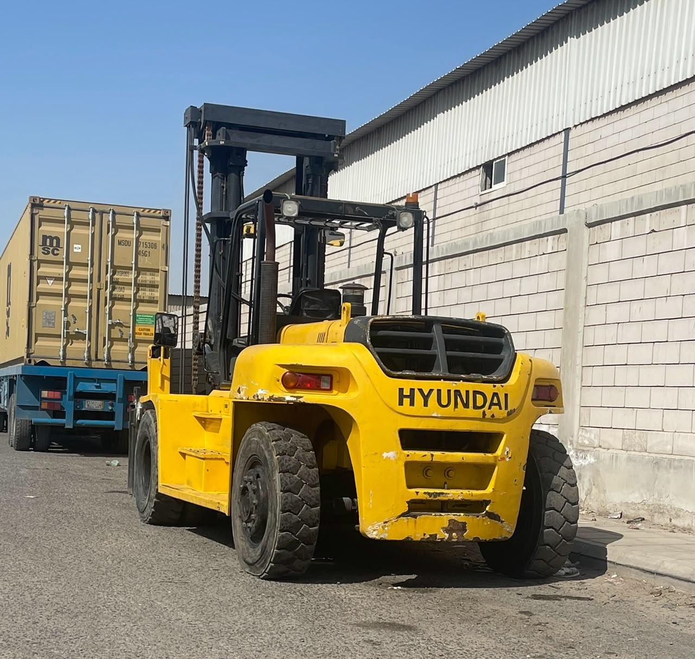
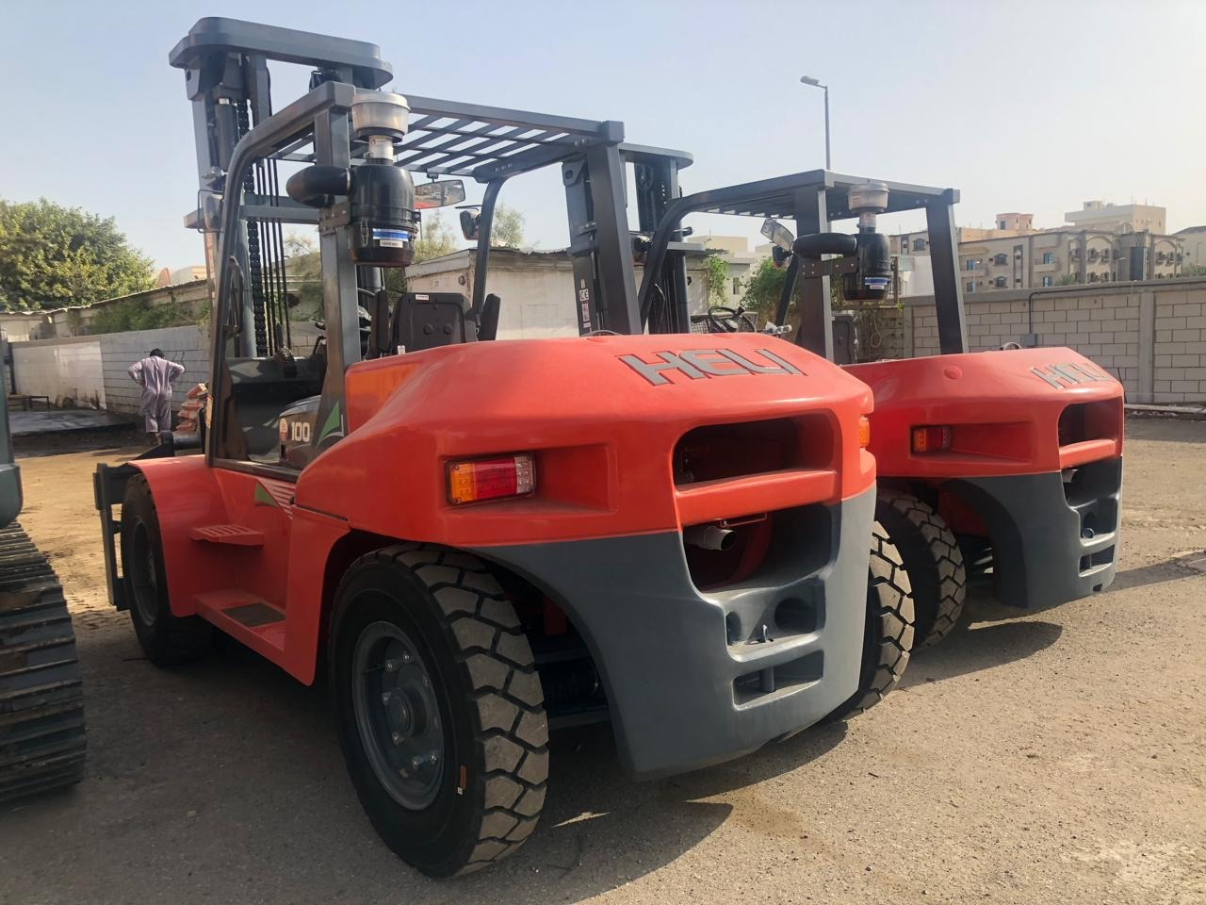
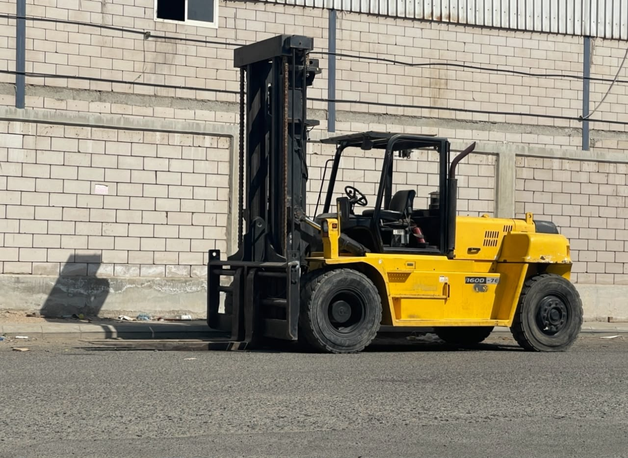
WASEEM
04 / MATERIAL HANDLING
CONSTRUCTION COMPANY
MATERIALS IN MOTION.
Forklifts and handling equipment pictured in industrial yards.
INDUSTRIAL YARD FORKLIFT
LARGE-REEL HANDLING
WASEEM CONSTRUCTION COMPANY
05

Slide 6
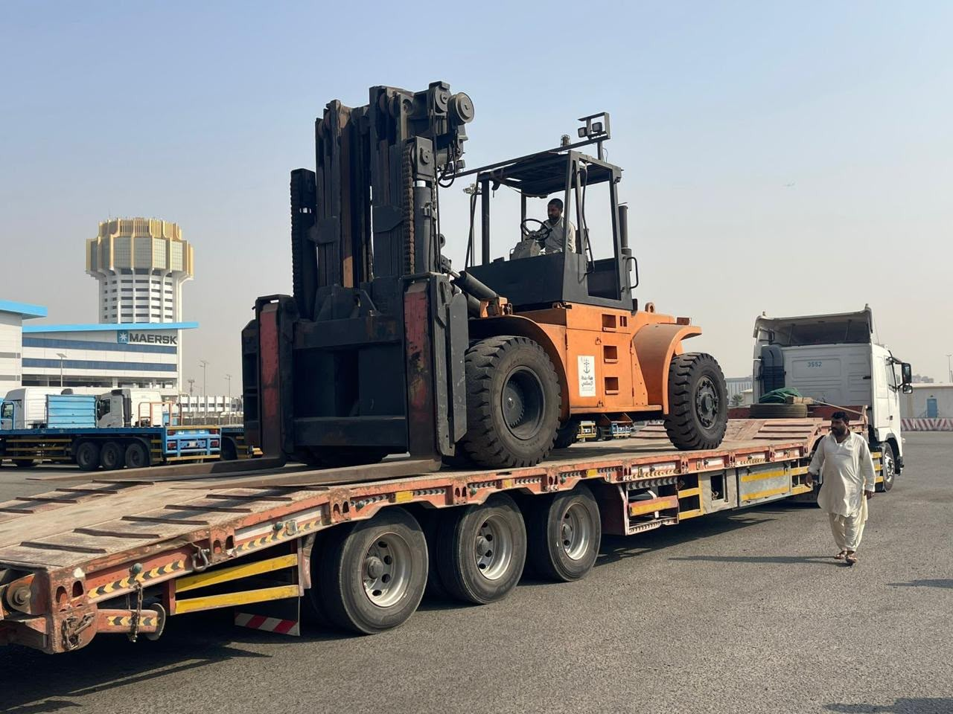
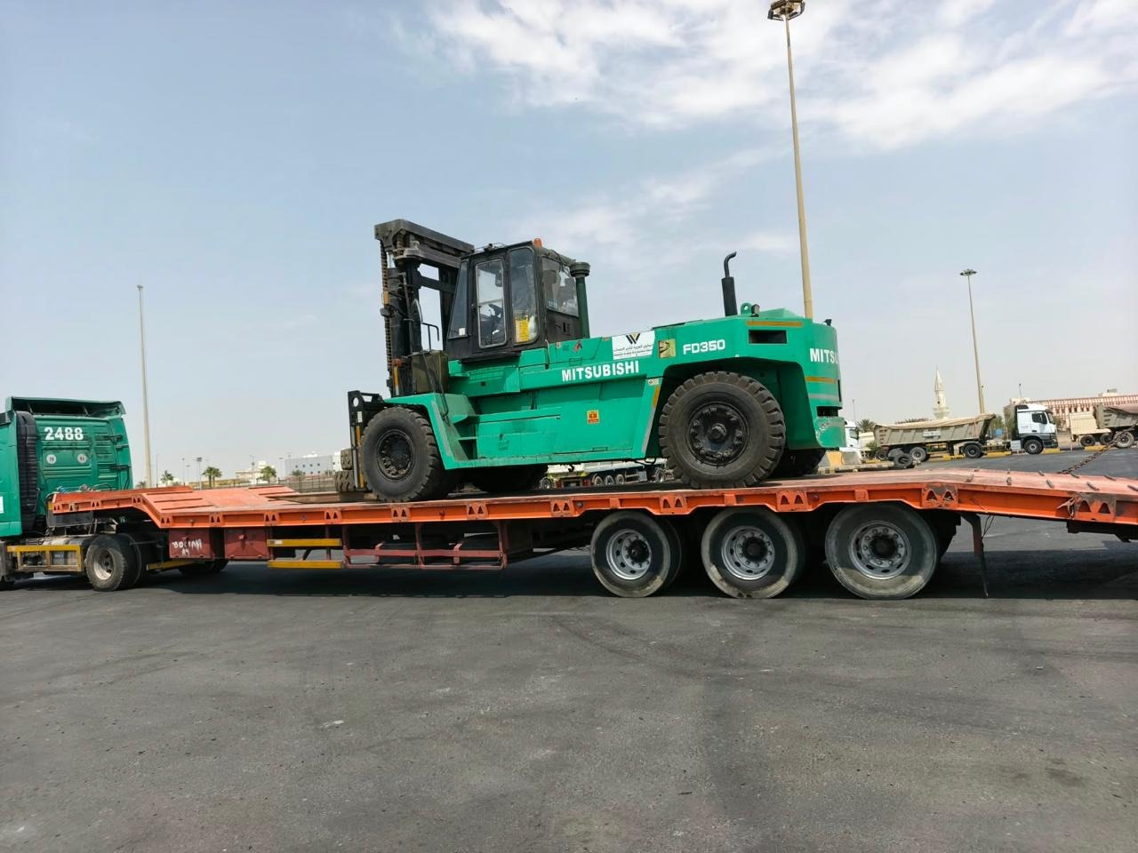
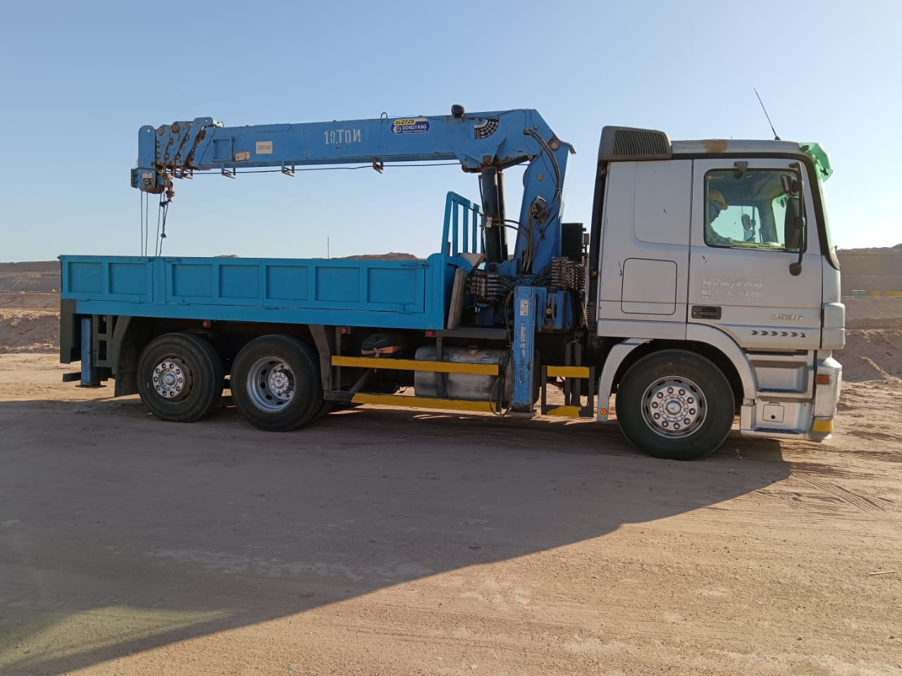
WASEEM
05 / EQUIPMENT TRANSPORT
CONSTRUCTION COMPANY
READY FOR THE NEXT MOVE.
Loading, transport and truck-mounted lifting equipment.
FORKLIFT TRANSPORT
EQUIPMENT ON LOW-BED TRAILER
The transport task begins with the equipment, its dimensions and the practical conditions at the
loading and receiving areas.
WASEEM CONSTRUCTION COMPANY
06

Slide 7
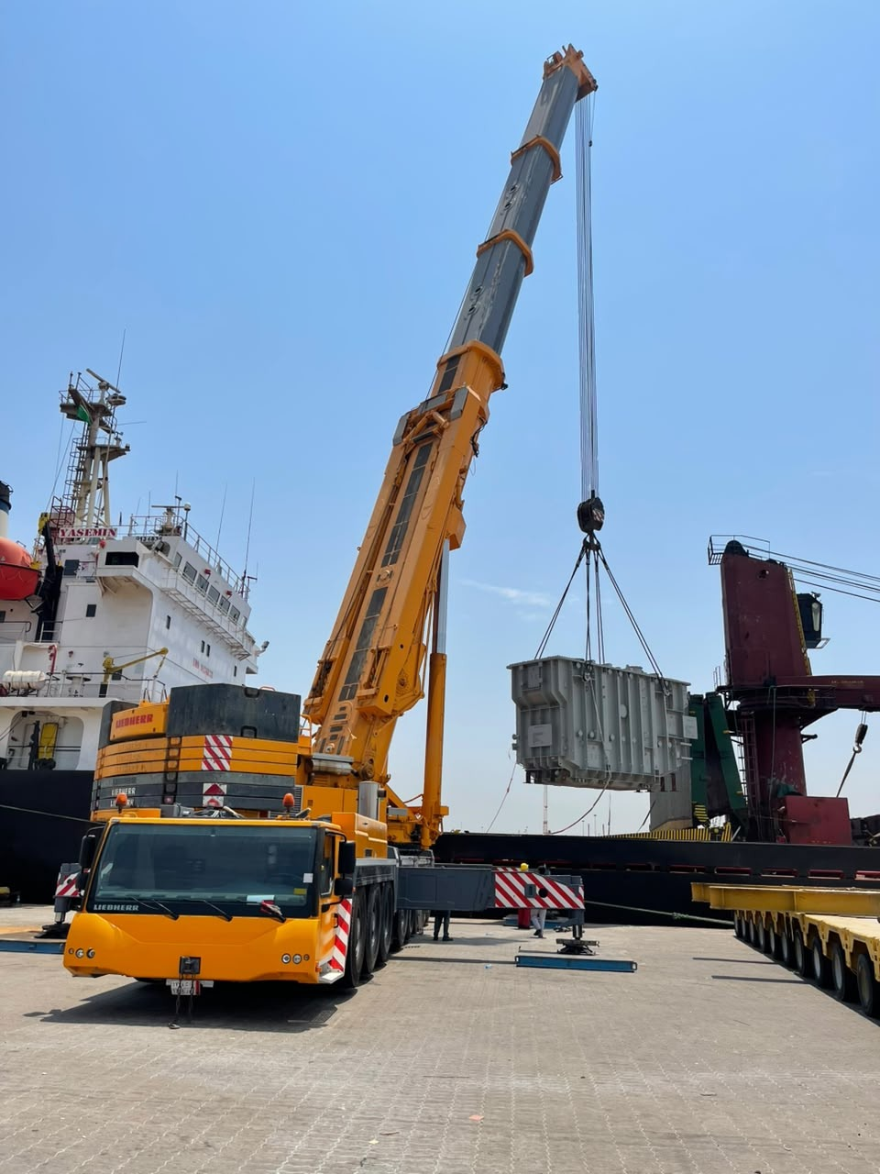
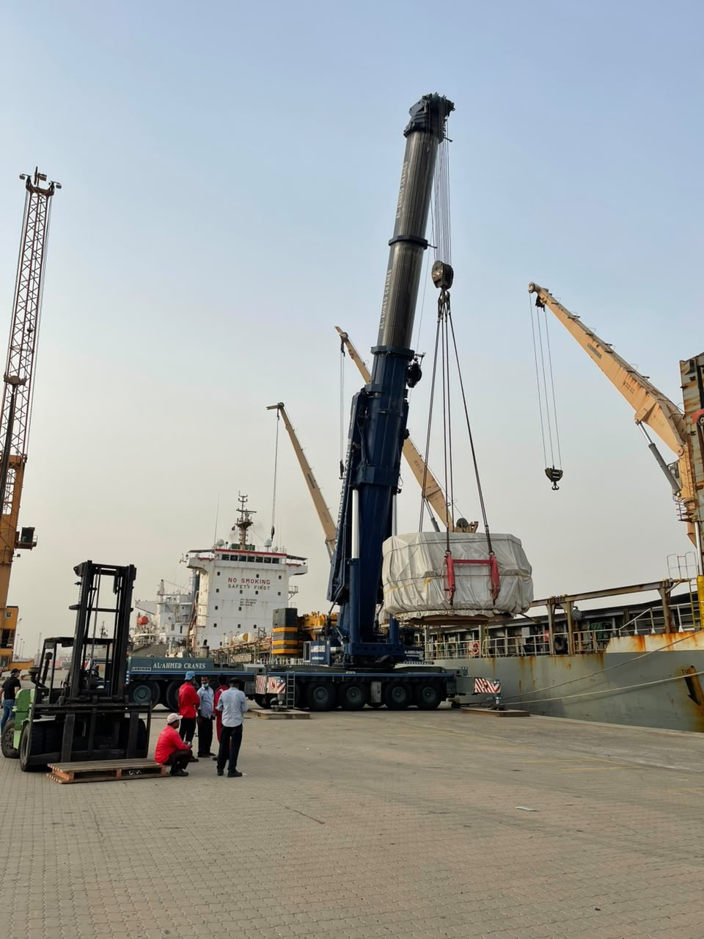
WASEEM
06 / WATERFRONT OPERATIONS
CONSTRUCTION COMPANY
LIFTING AT
Mobile cranes and cargo handling in port environments.
THE WATERFRONT.
CRANE ARRANGEMENT
CARGO LIFTING
PORT-SIDE POSITIONING
WASEEM CONSTRUCTION COMPANY
07

Slide 8
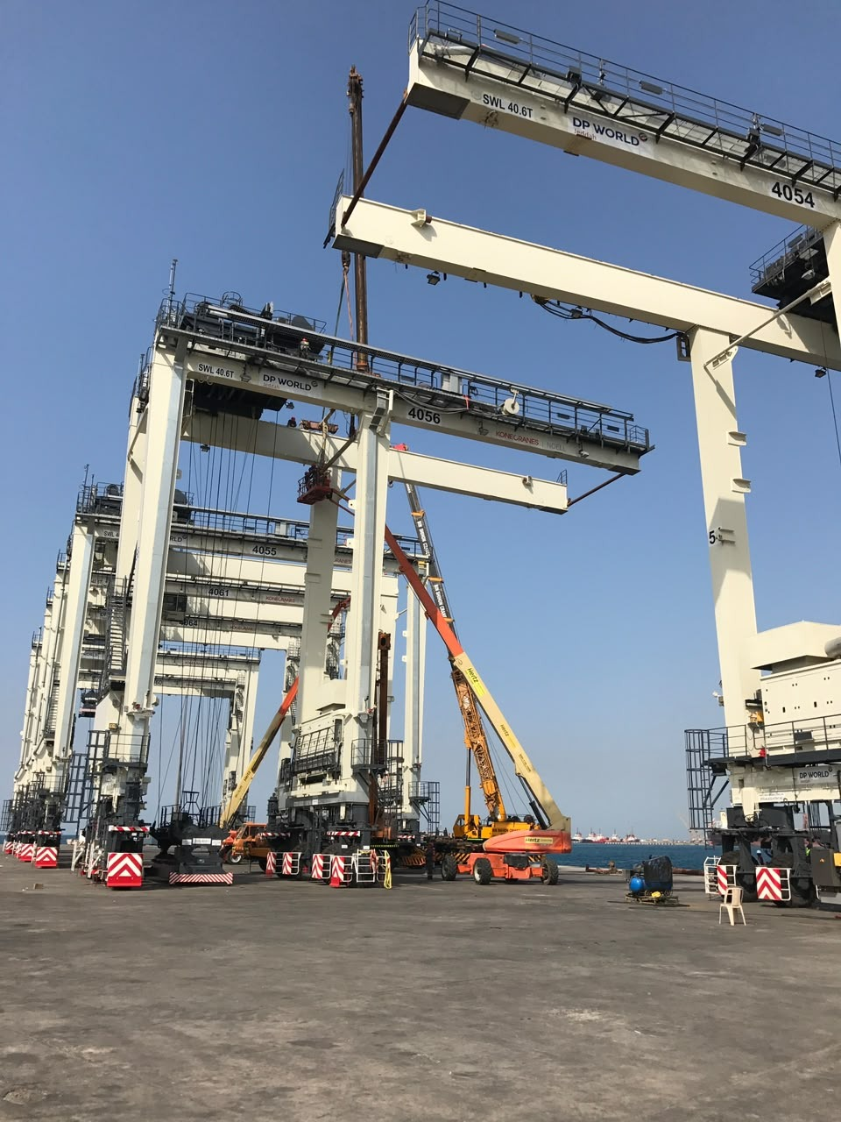
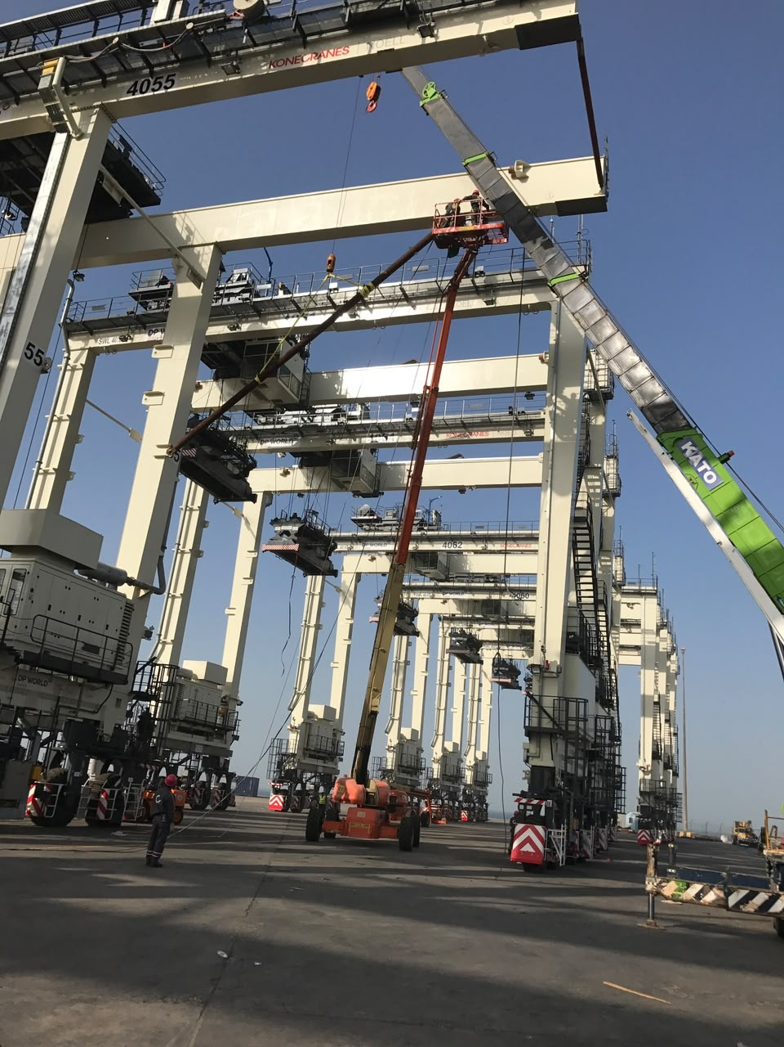
WASEEM
07 / PORT STRUCTURES & ACCESS
CONSTRUCTION COMPANY
PORT
ENVIRONMENTS
STRUCTURES AT
SCALE.
Gantry structures and elevated
equipment pictured in waterfront
working environments.
STRUCTURE & WORKING AREA
EQUIPMENT & ACCESS
WASEEM CONSTRUCTION COMPANY
08

Slide 9

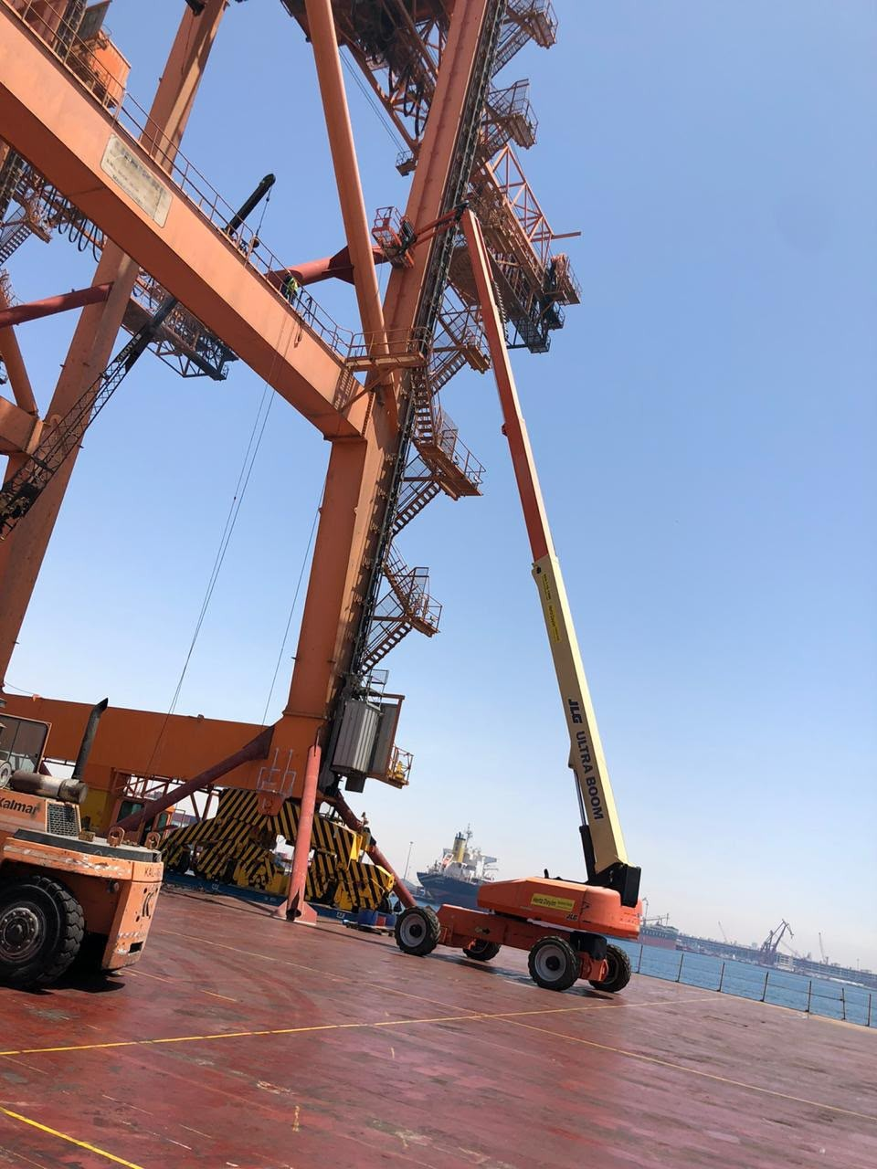
WASEEM
07 / PORT STRUCTURES & ACCESS
CONSTRUCTION COMPANY
PORT
ENVIRONMENTS
ACCESS IN CONTEXT.
Gantry structures and elevated
equipment pictured in waterfront
working environments.
STRUCTURE & WORKING AREA
EQUIPMENT & ACCESS
WASEEM CONSTRUCTION COMPANY
09

Slide 10
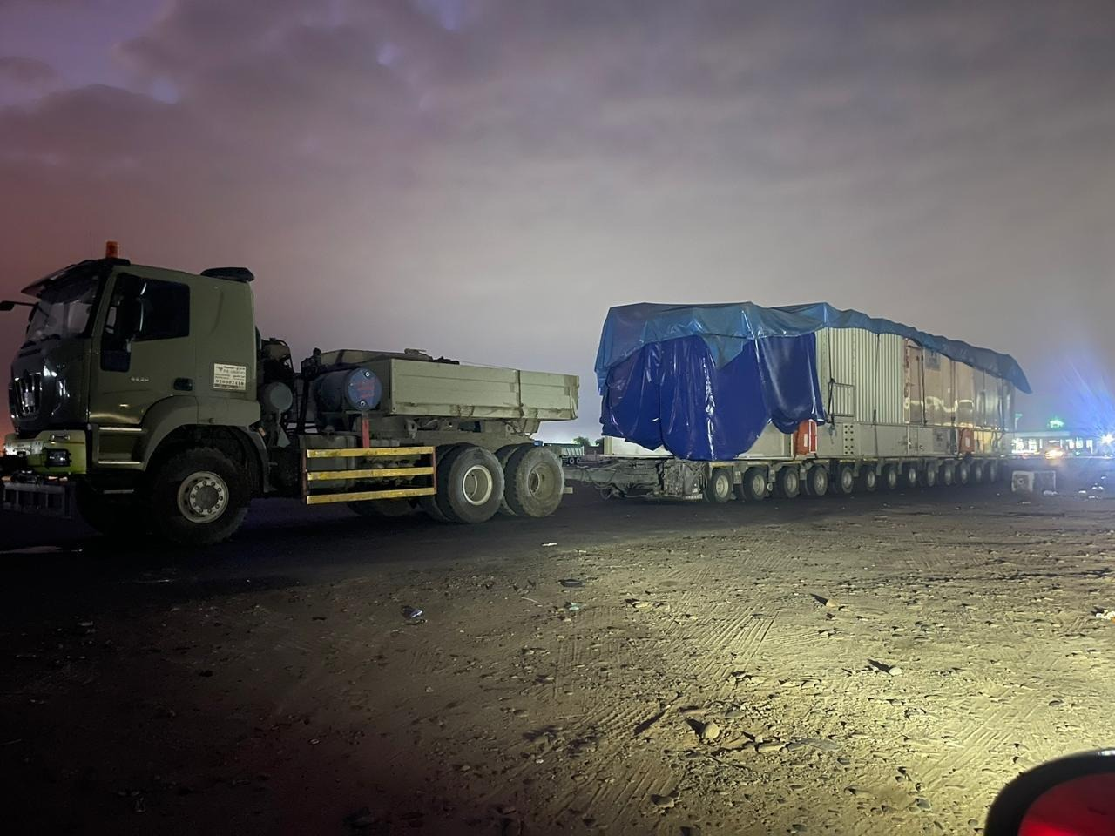
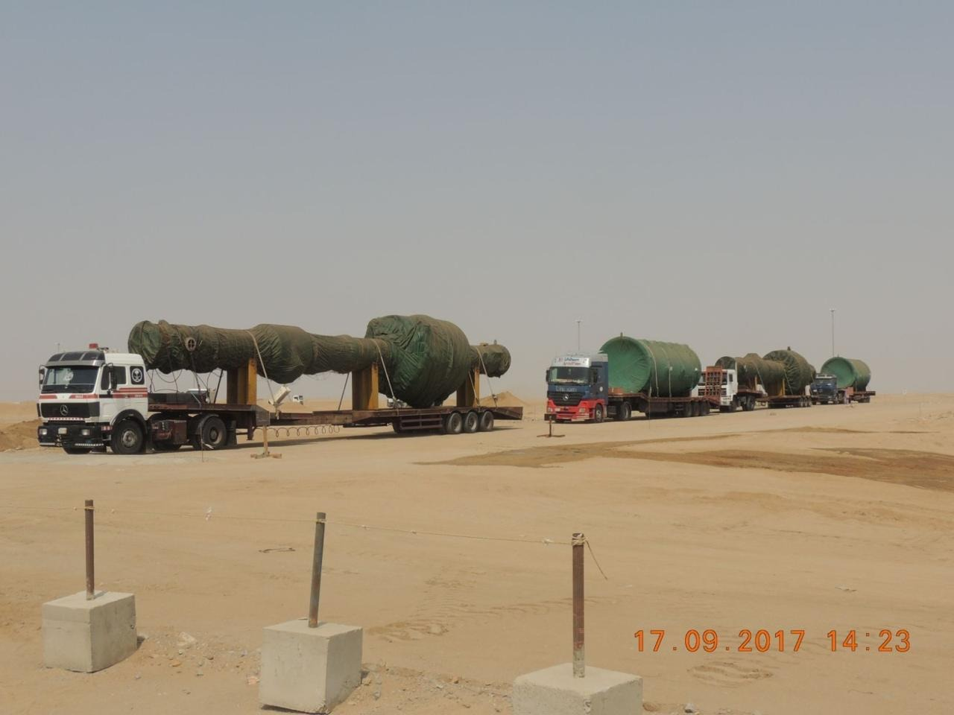
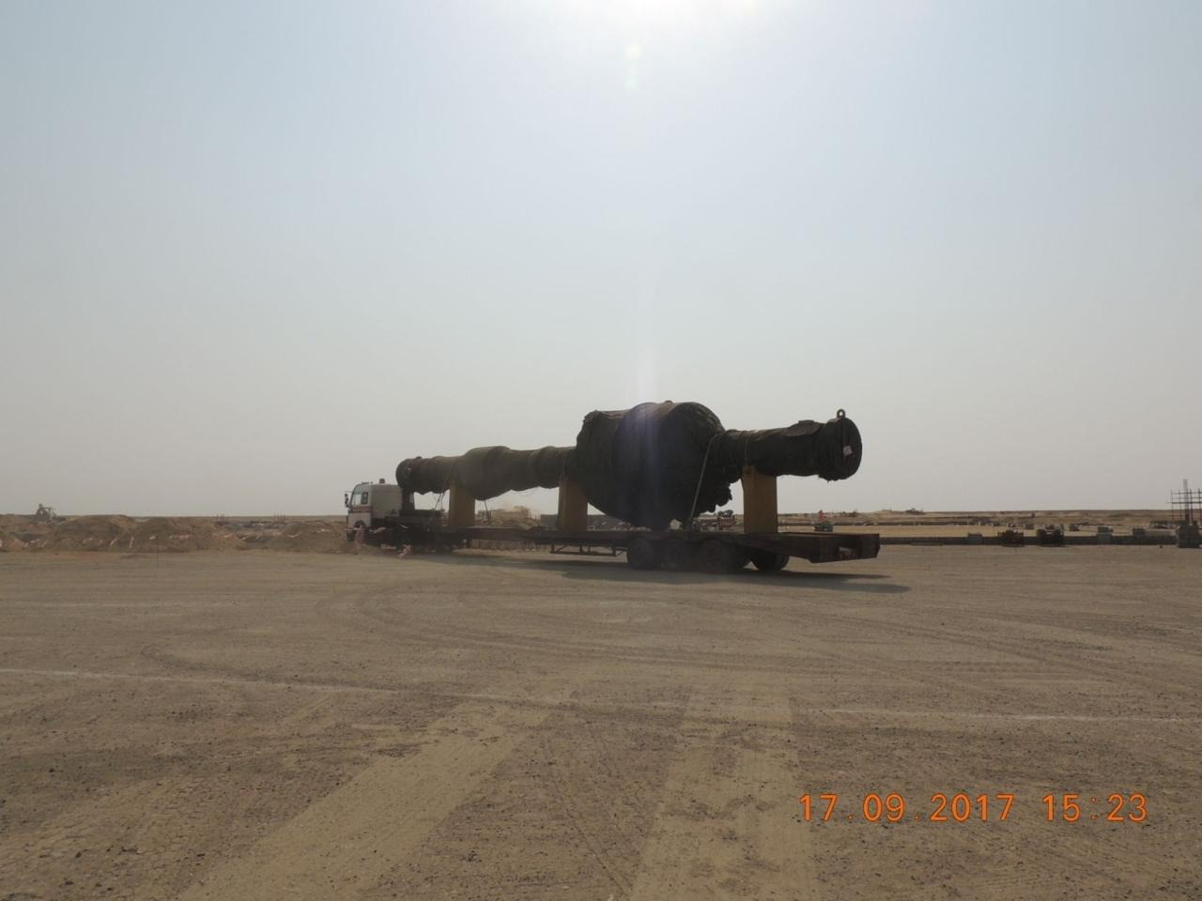
WASEEM
08 / HEAVY CARGO
CONSTRUCTION COMPANY
MOVEMENT AT SCALE.
Covered loads and oversized cargo on multi-axle transport equipment.
COVERED CARGO
MULTI-AXLE TRAILER
OVERSIZED MOVEMENT
HEAVY TRANSPORT CONFIGURATION
WASEEM CONSTRUCTION COMPANY
10

Slide 11
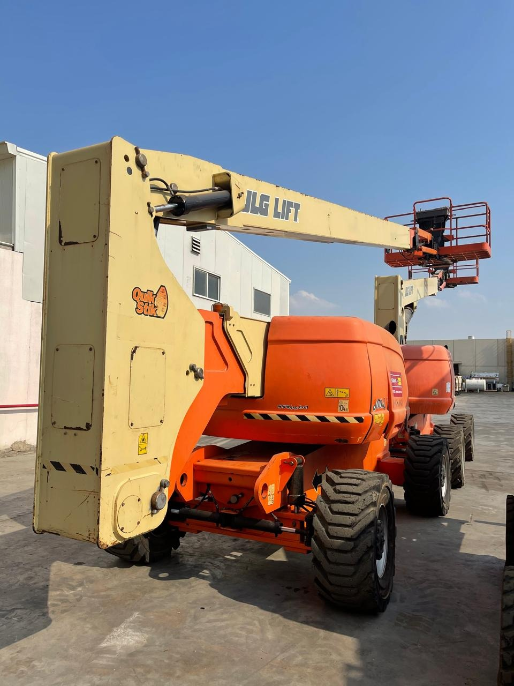
WASEEM
09 / SITE ACCESS
CONSTRUCTION COMPANY
REACH THE
WORKING
AREA.
Scissor lifts and boom lifts support access
to elevated working areas. These
photographs show equipment in indoor
and outdoor settings.
SCISSOR LIFT
ARTICULATING BOOM LIFT
WASEEM CONSTRUCTION COMPANY
11

Slide 12
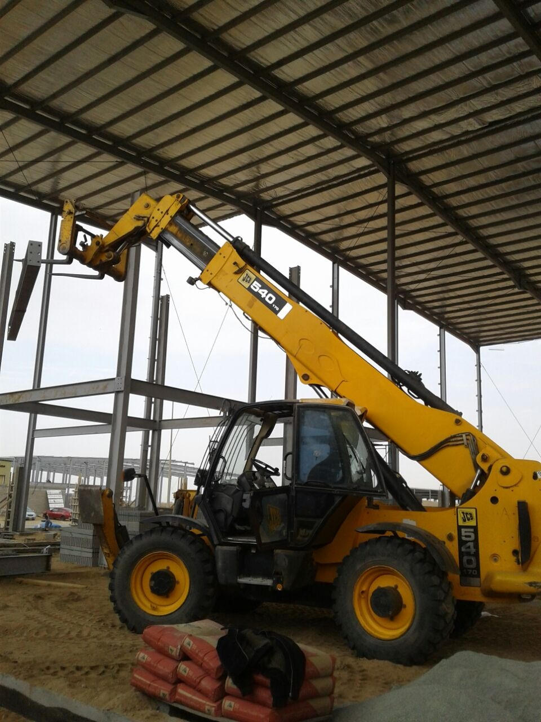
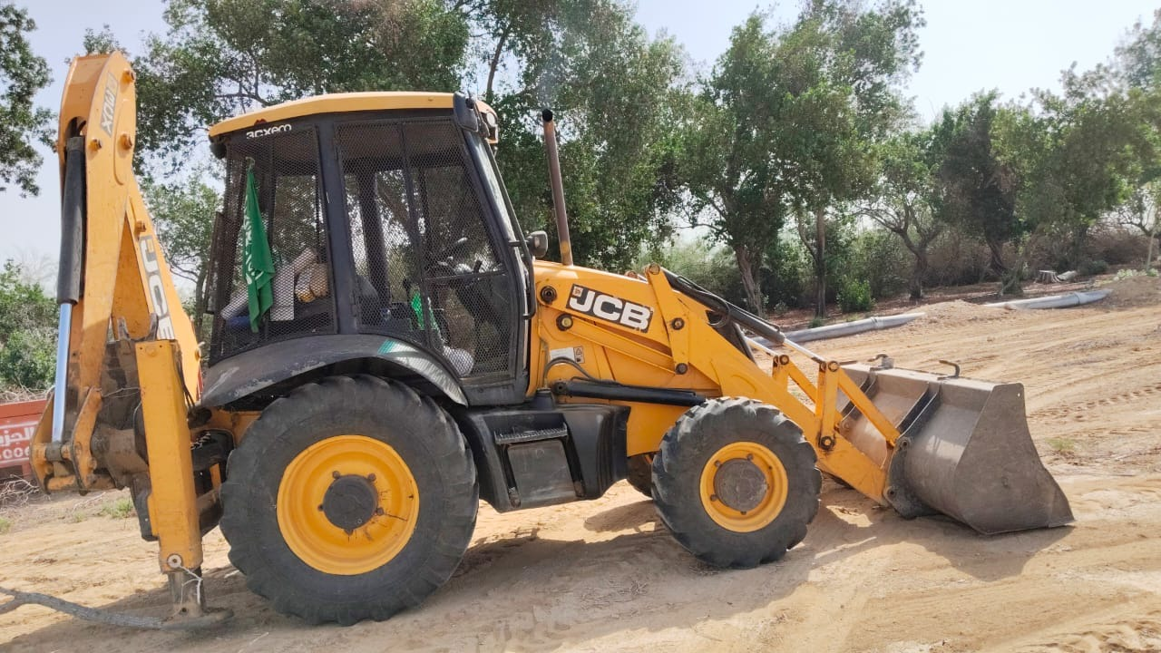
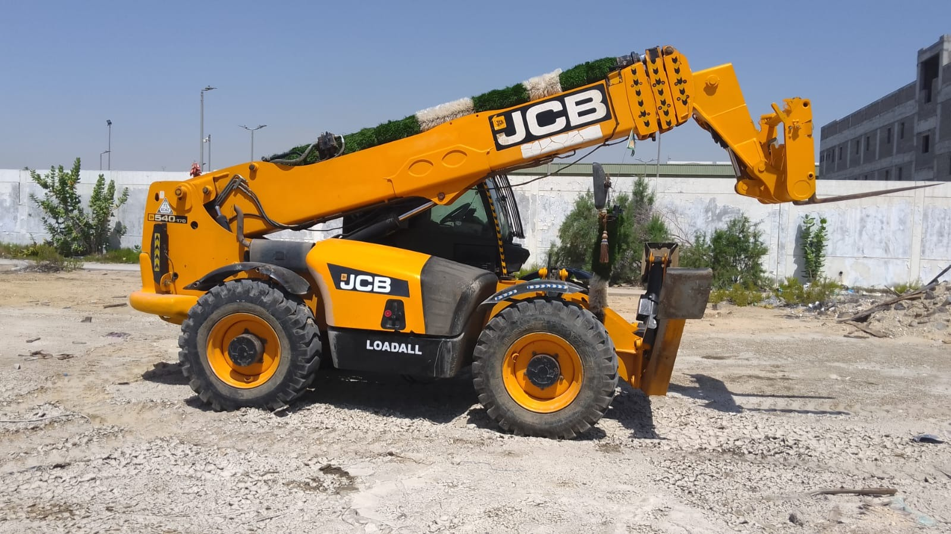
WASEEM
10 / SITE MACHINERY
CONSTRUCTION COMPANY
DIFFERENT TASKS.
PRACTICAL EQUIPMENT.
TELEHANDLER ON SITE
BACKHOE LOADER
TELESCOPIC HANDLER
WASEEM CONSTRUCTION COMPANY
12

Slide 13
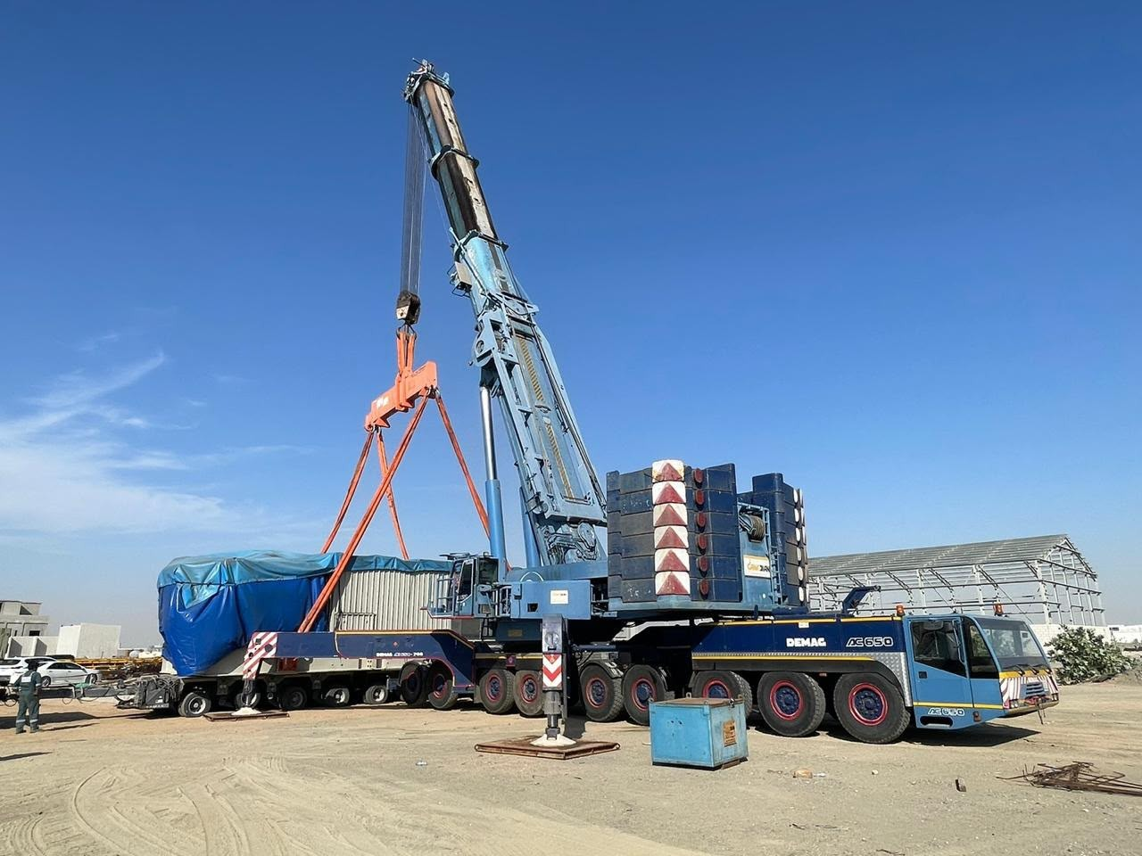
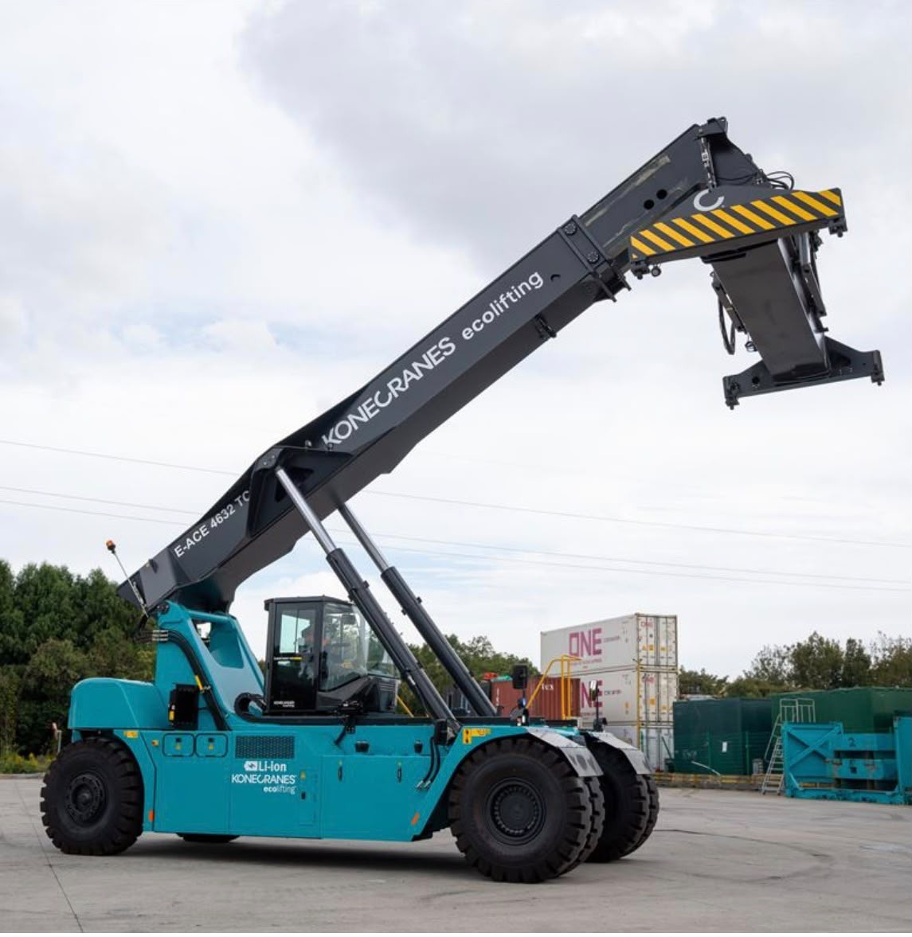
WASEEM
11 / SPECIALIST HANDLING
CONSTRUCTION COMPANY
HANDLING WITH PURPOSE.
Mobile crane activity and container-handling equipment.
MOBILE CRANE & SLUNG LOAD
REACH STACKER
WASEEM CONSTRUCTION COMPANY
13

Slide 14
WASEEM
12 / PLANNING THE REQUIREMENT
CONSTRUCTION COMPANY
A CLEAR BRIEF.
A BETTER START.
Four points to discuss when preparing an equipment enquiry.
01
02
03
04
THE TASK
THE LOAD
THE LOCATION
THE TIMING
What needs to be lifted, moved
What are the dimensions,
What access, space and
When is the equipment
or accessed?
weight and handling
ground conditions affect the
needed, and for how long?
requirements?
work?
WASEEM CONSTRUCTION COMPANY
14

Slide 15
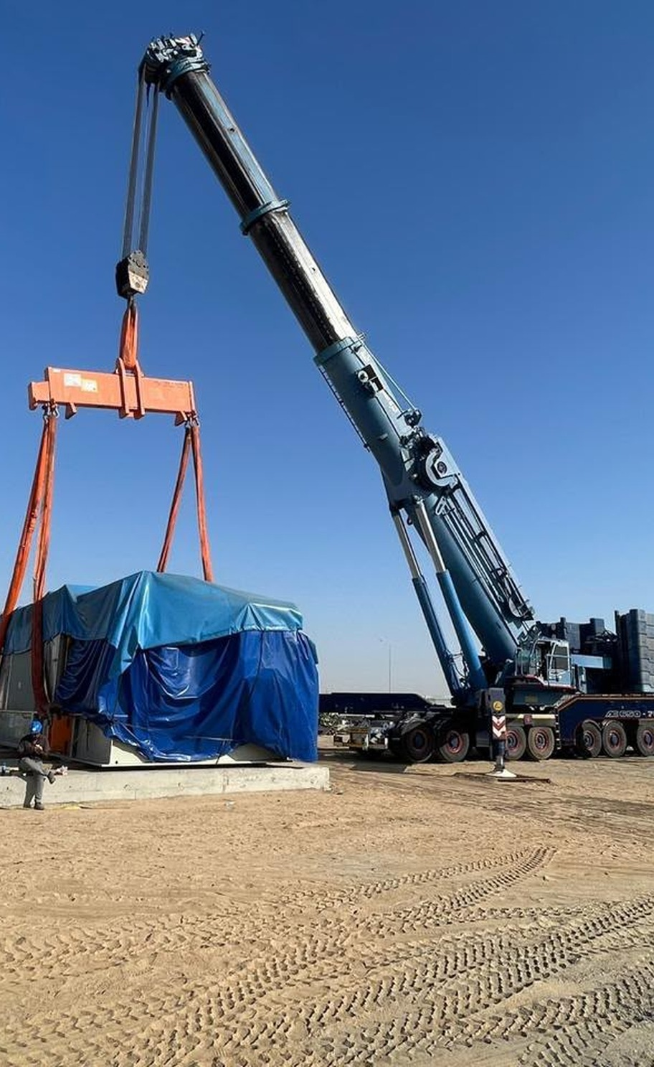
WASEEM CONSTRUCTION COMPANY
LET'S PLAN
THE NEXT MOVE.
Send your requirements to our team.
GENERAL ENQUIRIES
Wasim@wasconarabia.com
SALES ENQUIRIES
Sales@wasconarabia.com
Telephone
Office address
Registration no.
15

