Slide 1
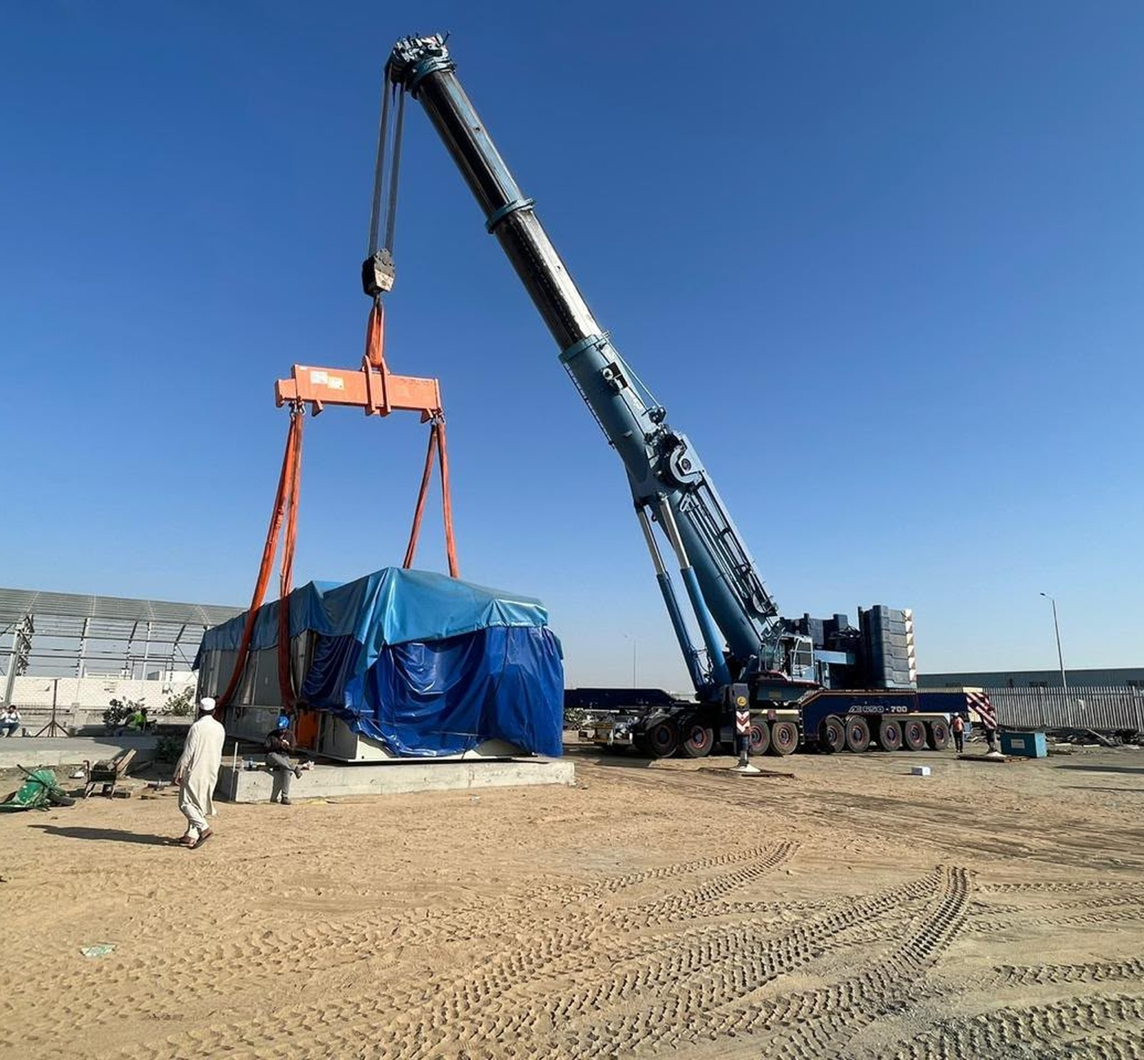
CORPORATE PORTFOLIO
WASEEM
CONSTRUCTION
COMPANY
Lifting and heavy transport
Equipment for lifting, handling
and site access
Company portfolio
LIFTING / HANDLING / TRANSPORT

Slide 2
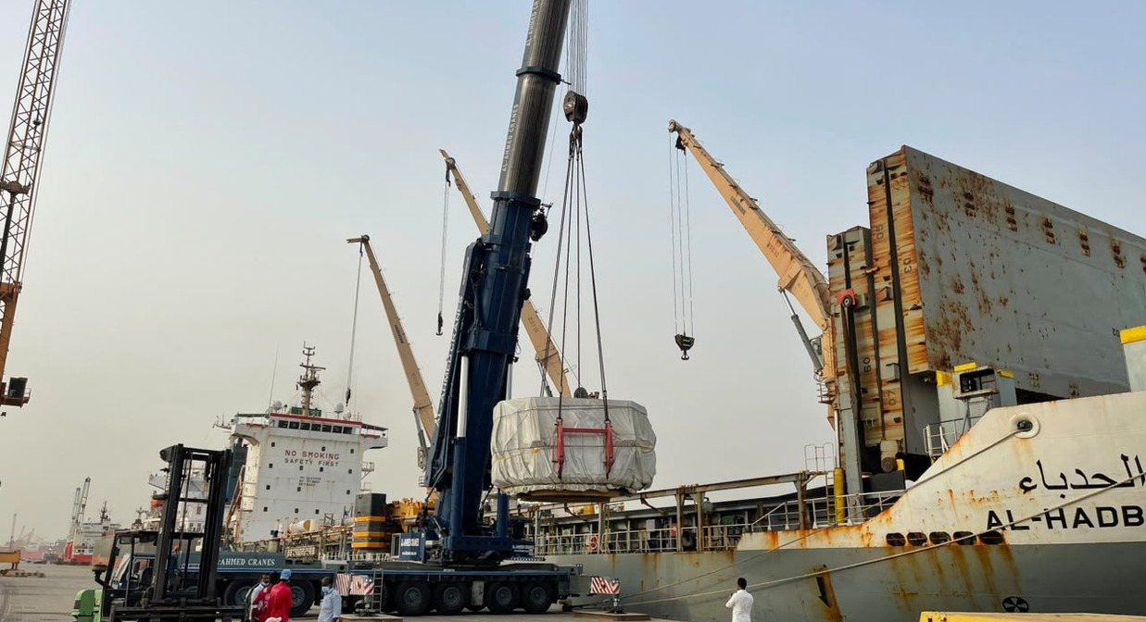
01 / COMPANY OVERVIEW
About Waseem
Construction
Lifting. Handling. Transport.
Site access.
Equipment and operations
Our equipment and operations, with examples from industrial yards, construction sites and port areas.
This portfolio brings together examples of lifting, material handling, equipment transport and access work.
Contact us to discuss equipment availability, site requirements, pricing and the scope of your job.
WASEEM CONSTRUCTION COMPANY
02

Slide 3
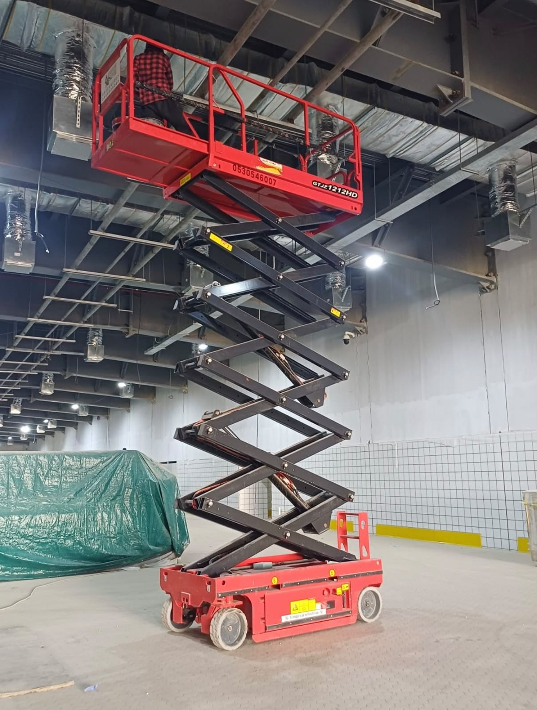
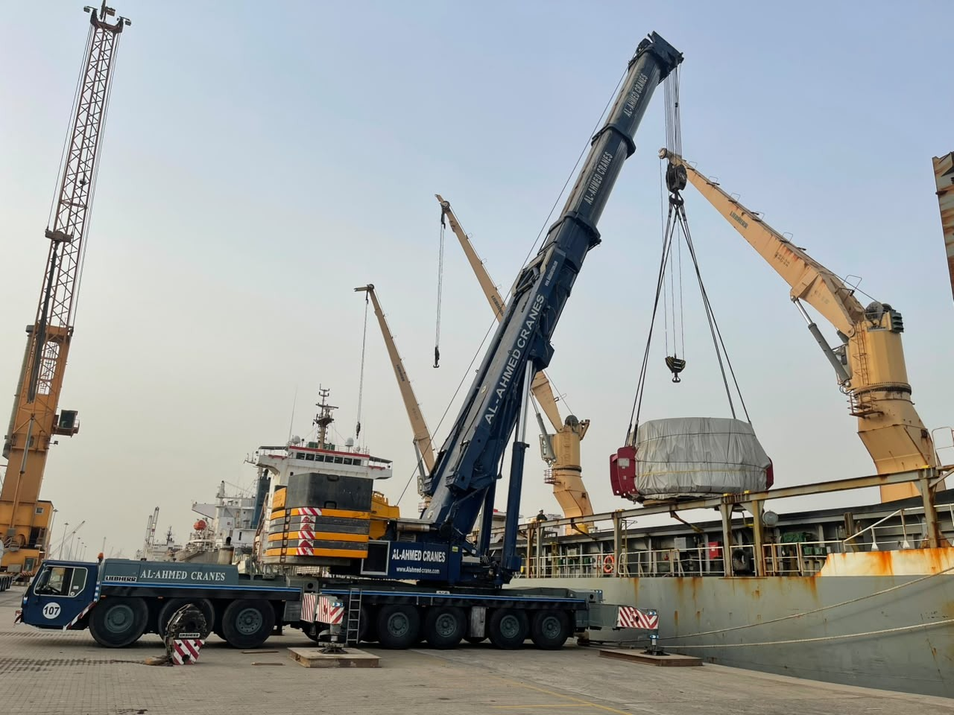
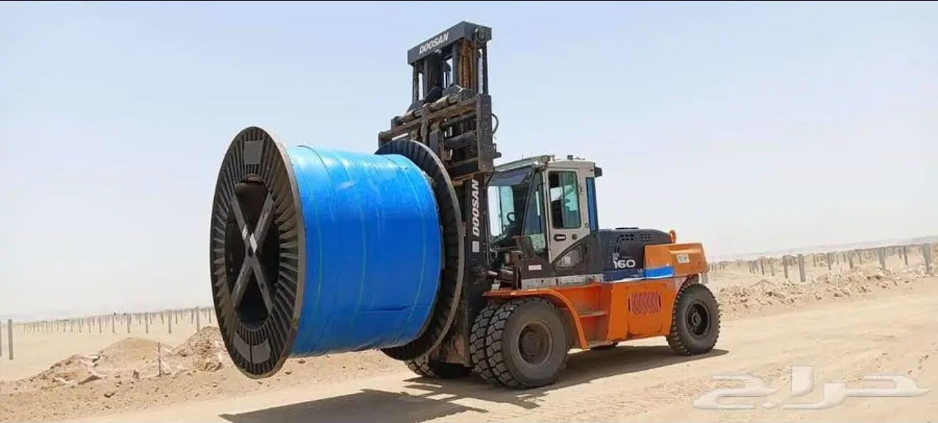
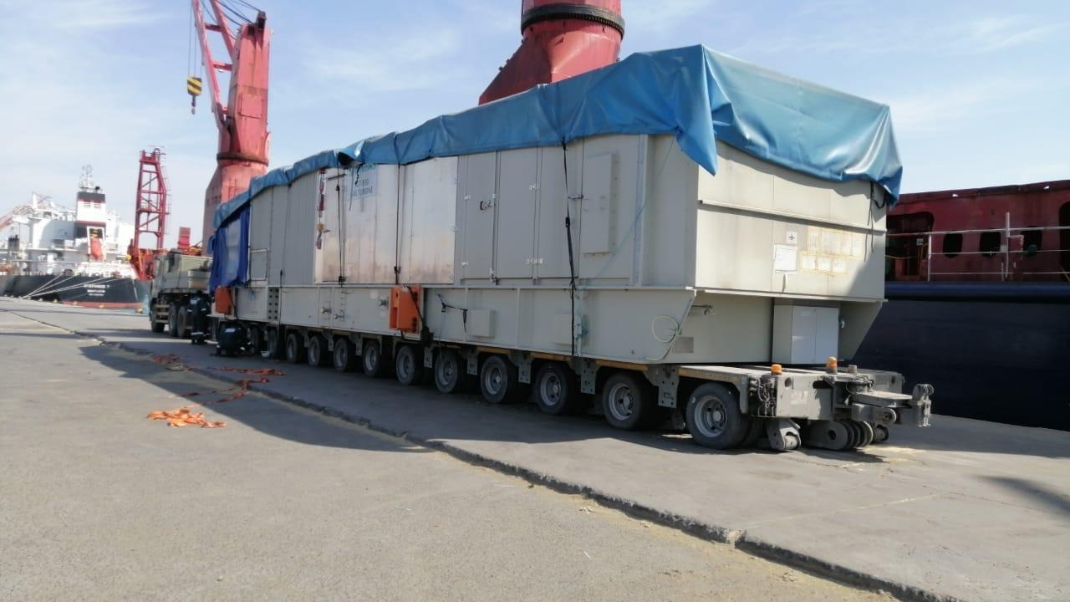
WASEEM
CONSTRUCTION COMPANY
04
02 / AREAS OF WORK
Equipment and areas of work
FOCUS AREAS
Equipment shown in this portfolio. Availability and suitability are confirmed for each job.
01
02
03
04
CRANE OPERATIONS
MATERIAL HANDLING
HEAVY TRANSPORT
SITE & ACCESS
Cargo lifting
Yard handling
Cargo transport
Site access
Mobile cranes handling cargo and larger loads.
Forklifts and yard equipment moving materials.
Low-bed and multi-axle transport for equipment and cargo.
Elevated access and machinery for site activities.
WASEEM CONSTRUCTION COMPANY
SERVICE CONCEPT / FOR REVIEW
03

Slide 4
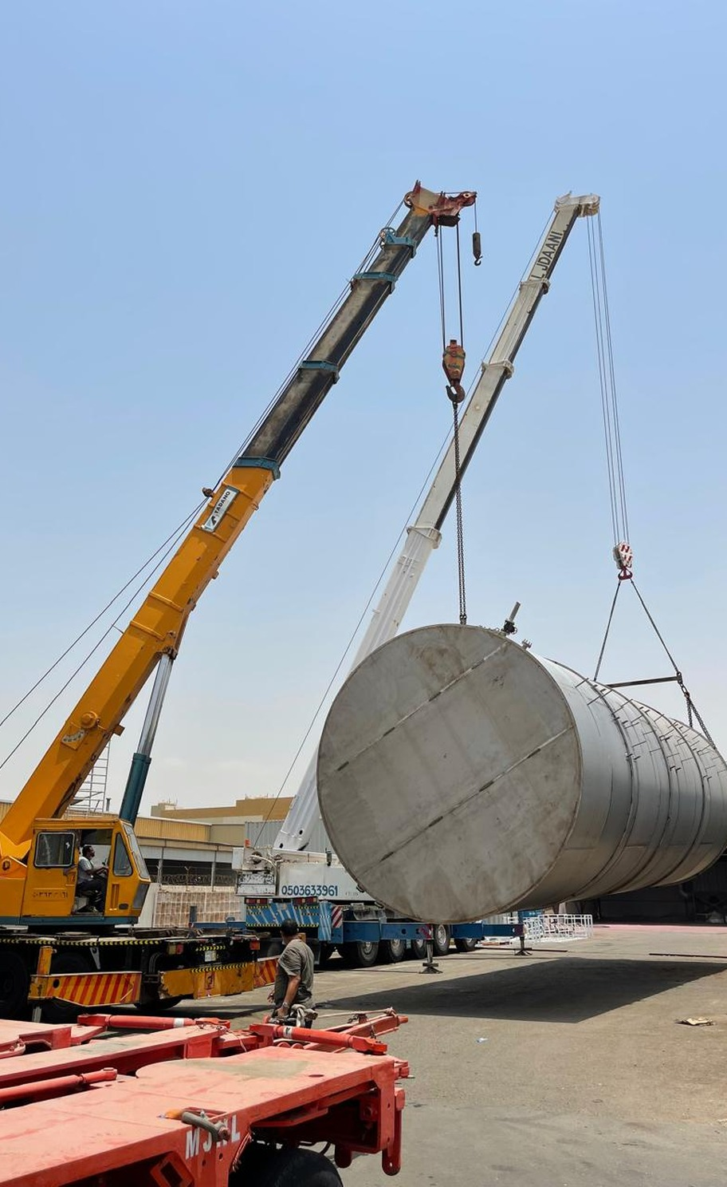
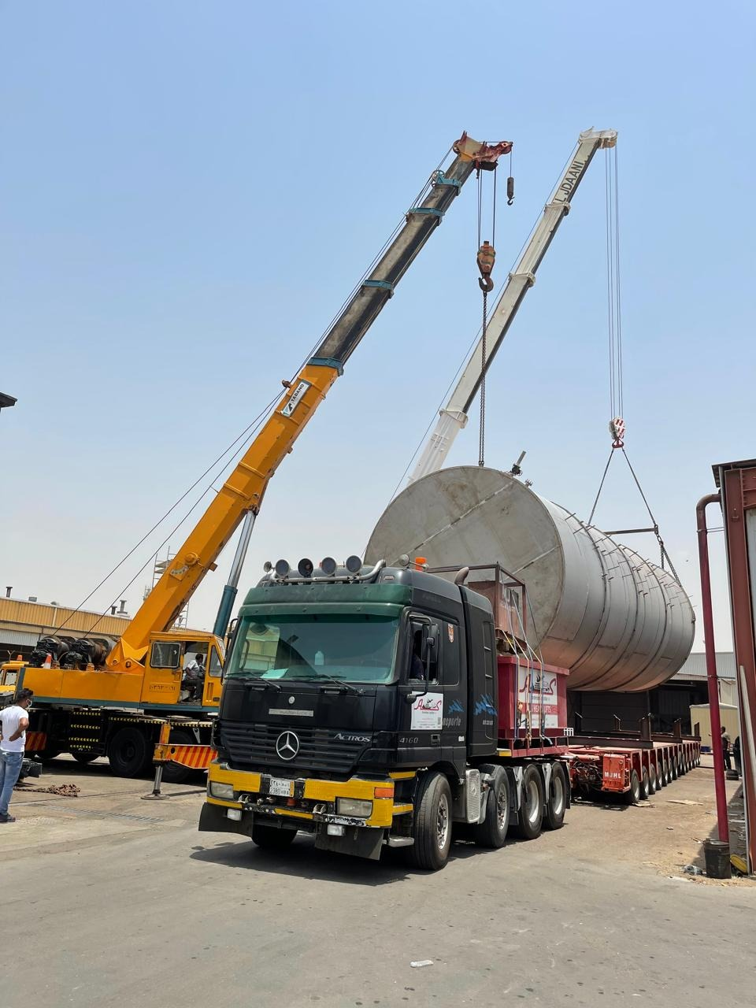
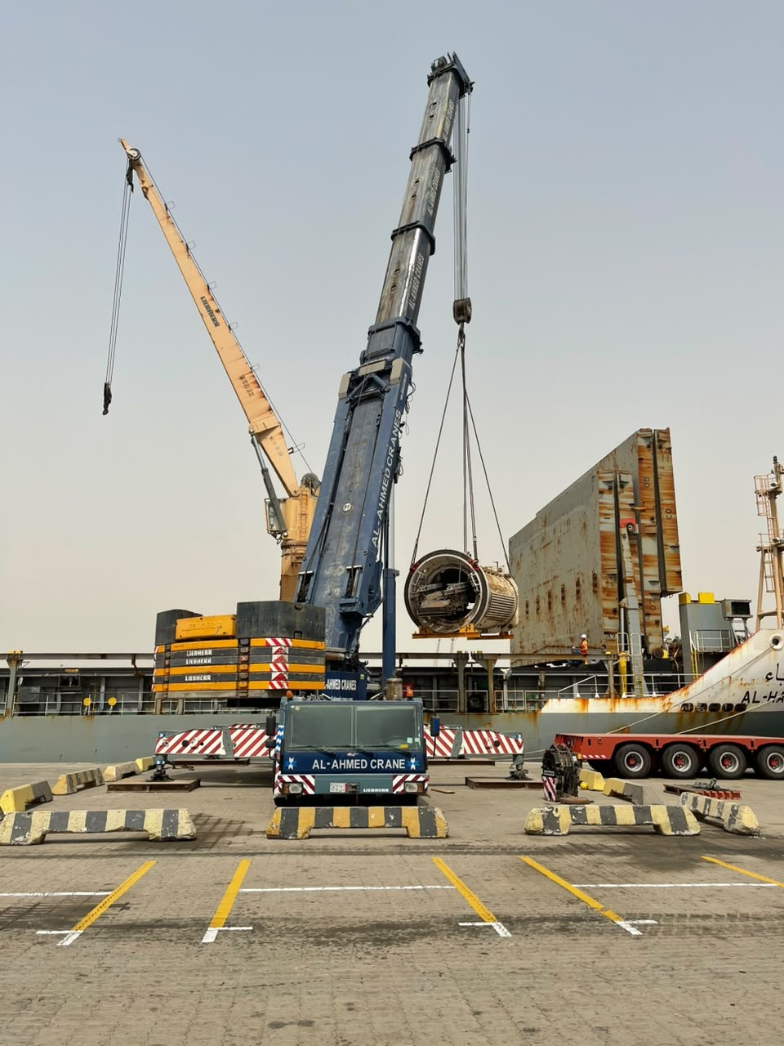
03 / OPERATIONS SHOWCASE
Crane operations
Lifting and positioning heavy loads
Mobile cranes handling heavy loads alongside transport trailers.
01 / LOAD HANDLING
02 / CRANE POSITIONING
LIFTING & LOAD POSITIONING
WASEEM CONSTRUCTION COMPANY
04

Slide 5
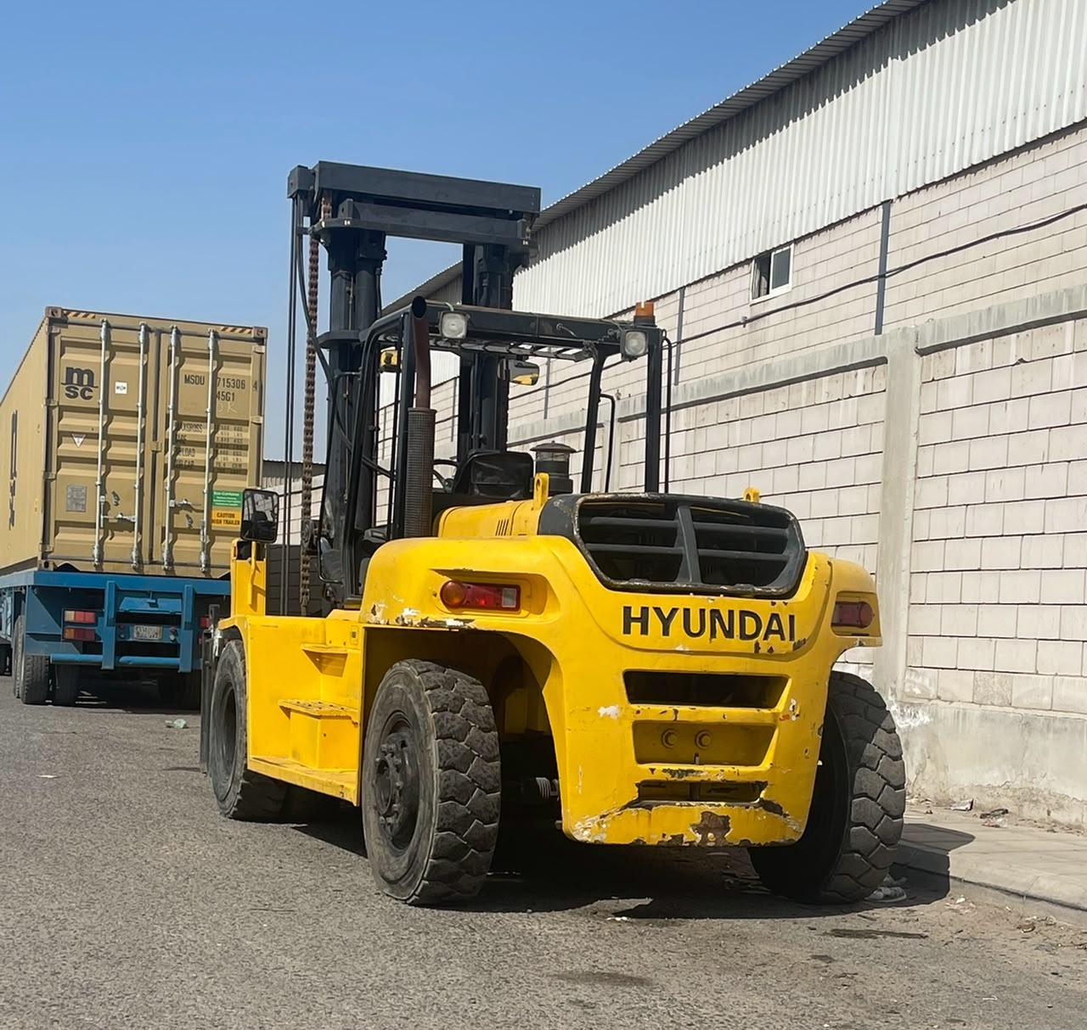
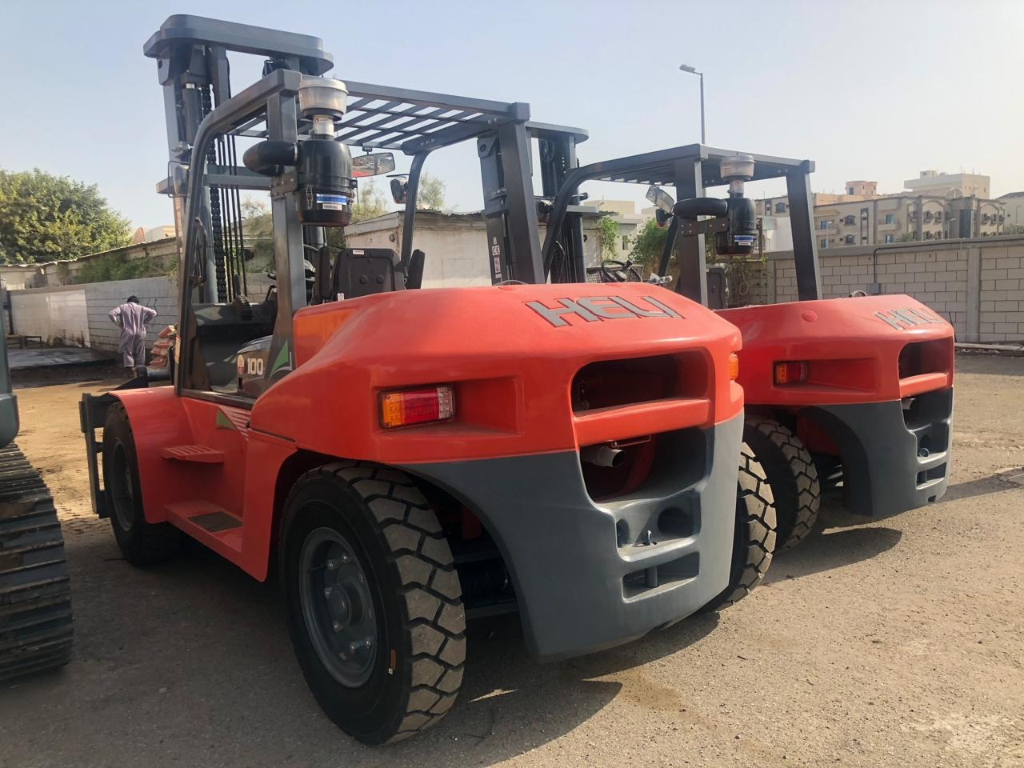
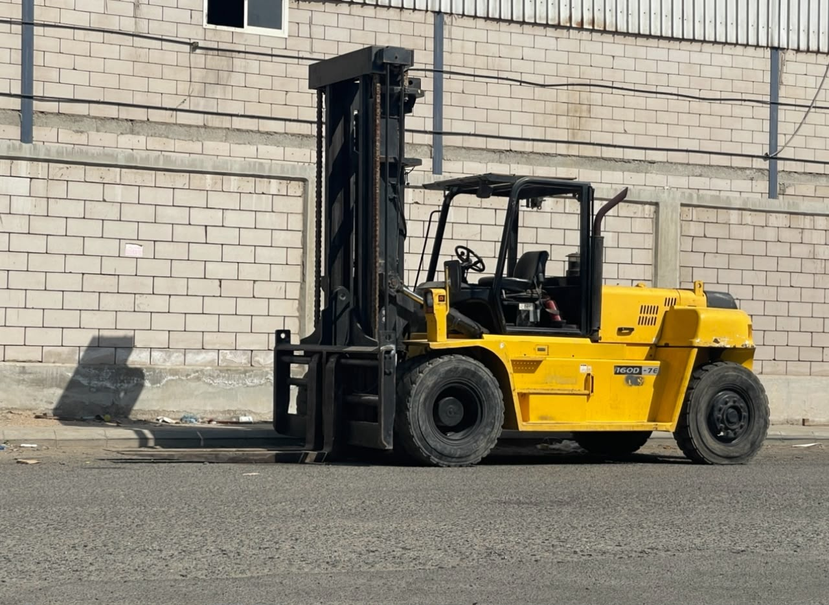
WASEEM
04 / MATERIAL HANDLING
CONSTRUCTION COMPANY
Forklifts and material handling
Handling materials and large reels in industrial yards
INDUSTRIAL YARD FORKLIFT
LARGE-REEL HANDLING
WASEEM CONSTRUCTION COMPANY
05

Slide 6
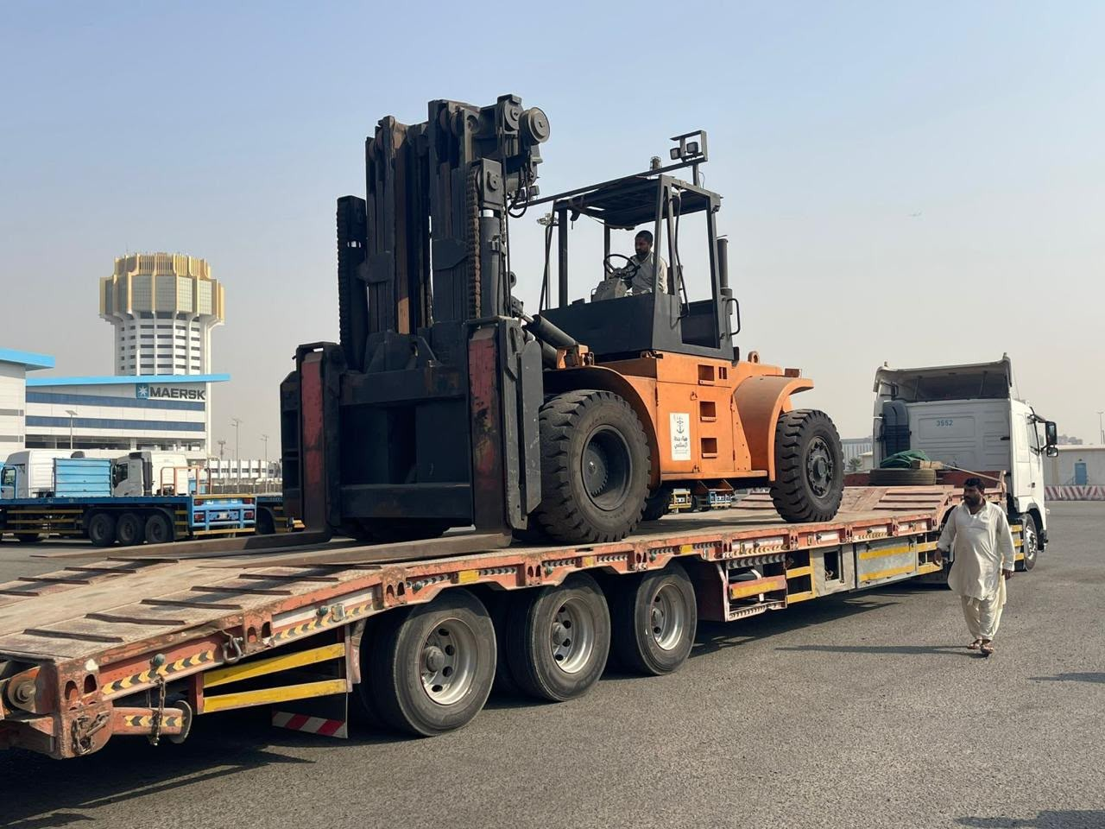
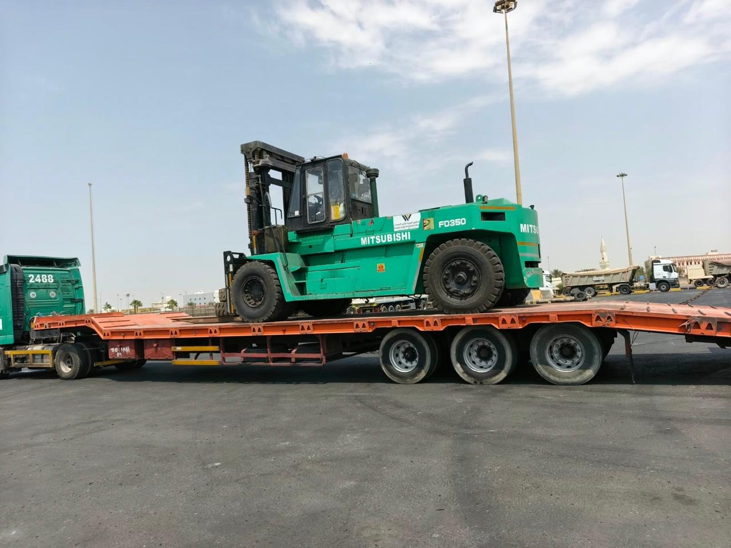
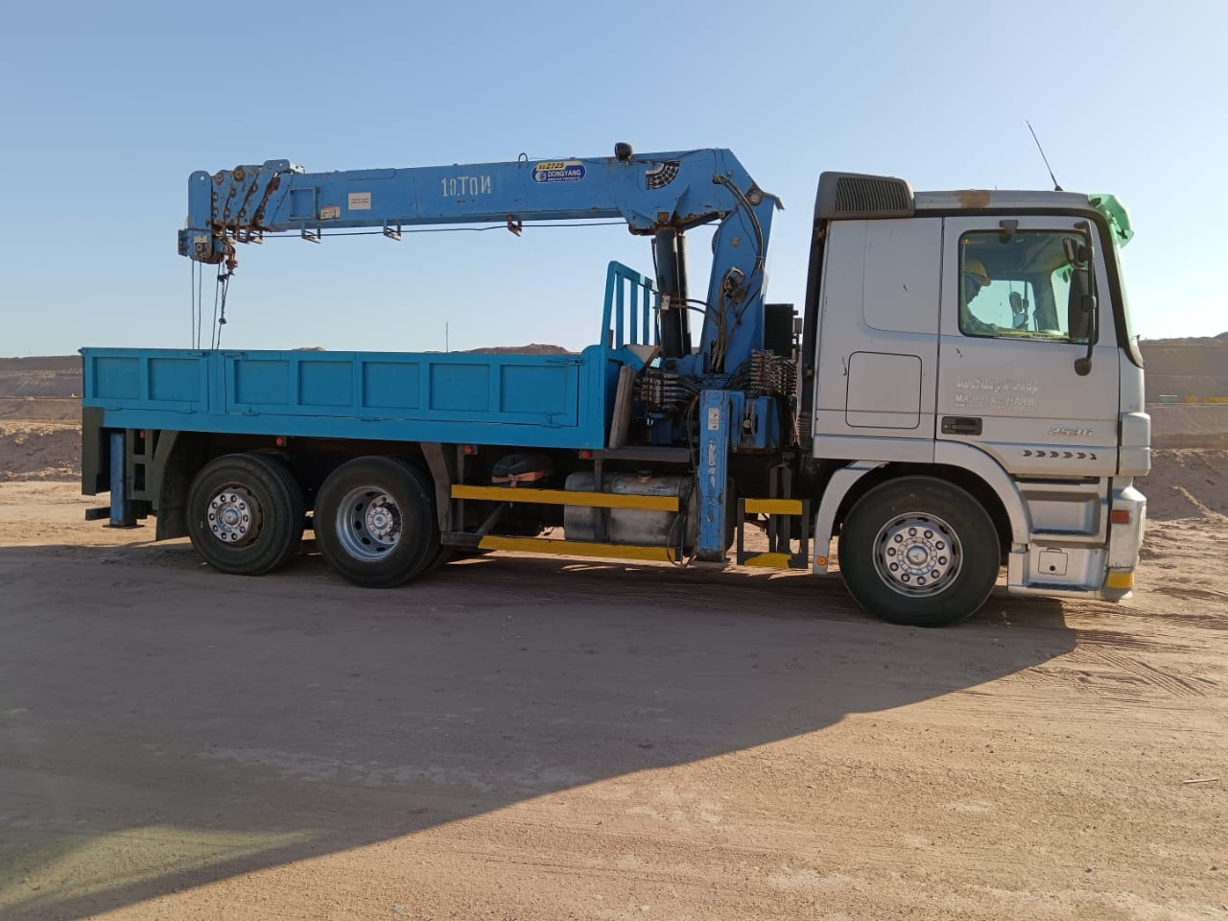
WASEEM
05 / EQUIPMENT TRANSPORT
CONSTRUCTION COMPANY
Equipment transport
Forklifts, low-bed trailers and truck-mounted lifting equipment
FORKLIFT TRANSPORT
EQUIPMENT ON LOW-BED TRAILER
We discuss equipment dimensions and access at both the loading and delivery locations before planning transport.
WASEEM CONSTRUCTION COMPANY
06

Slide 7
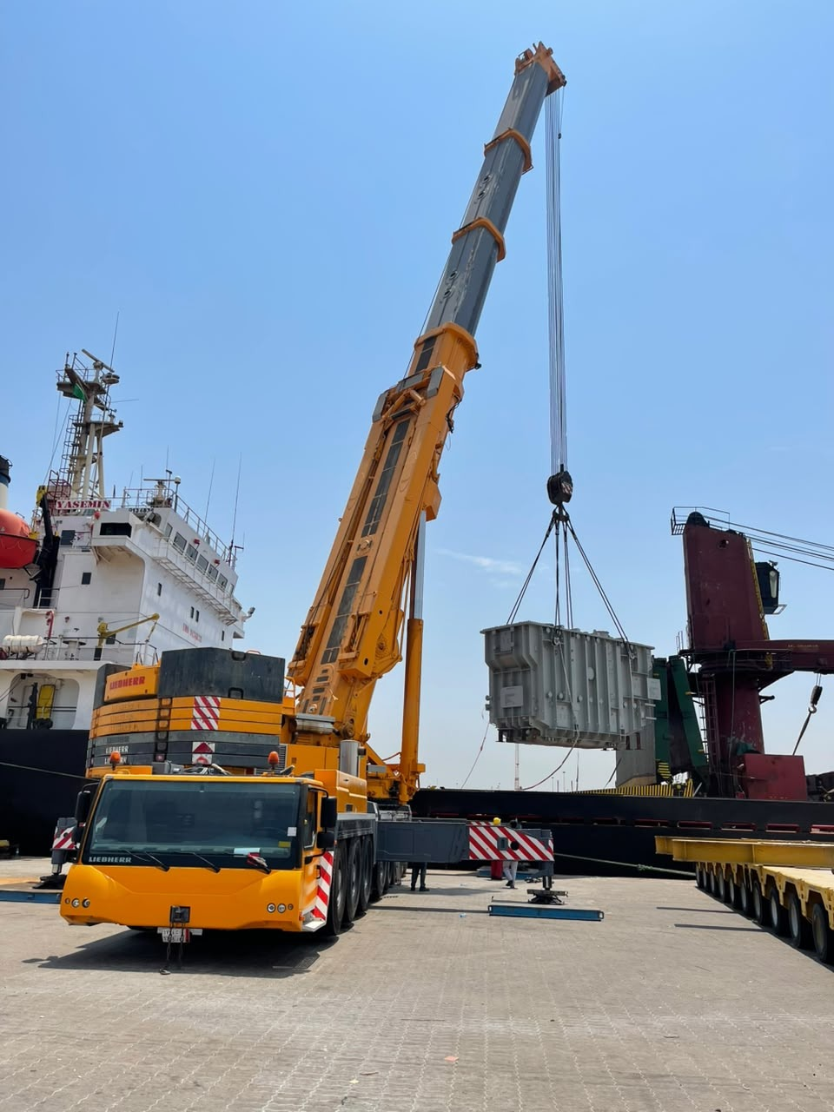
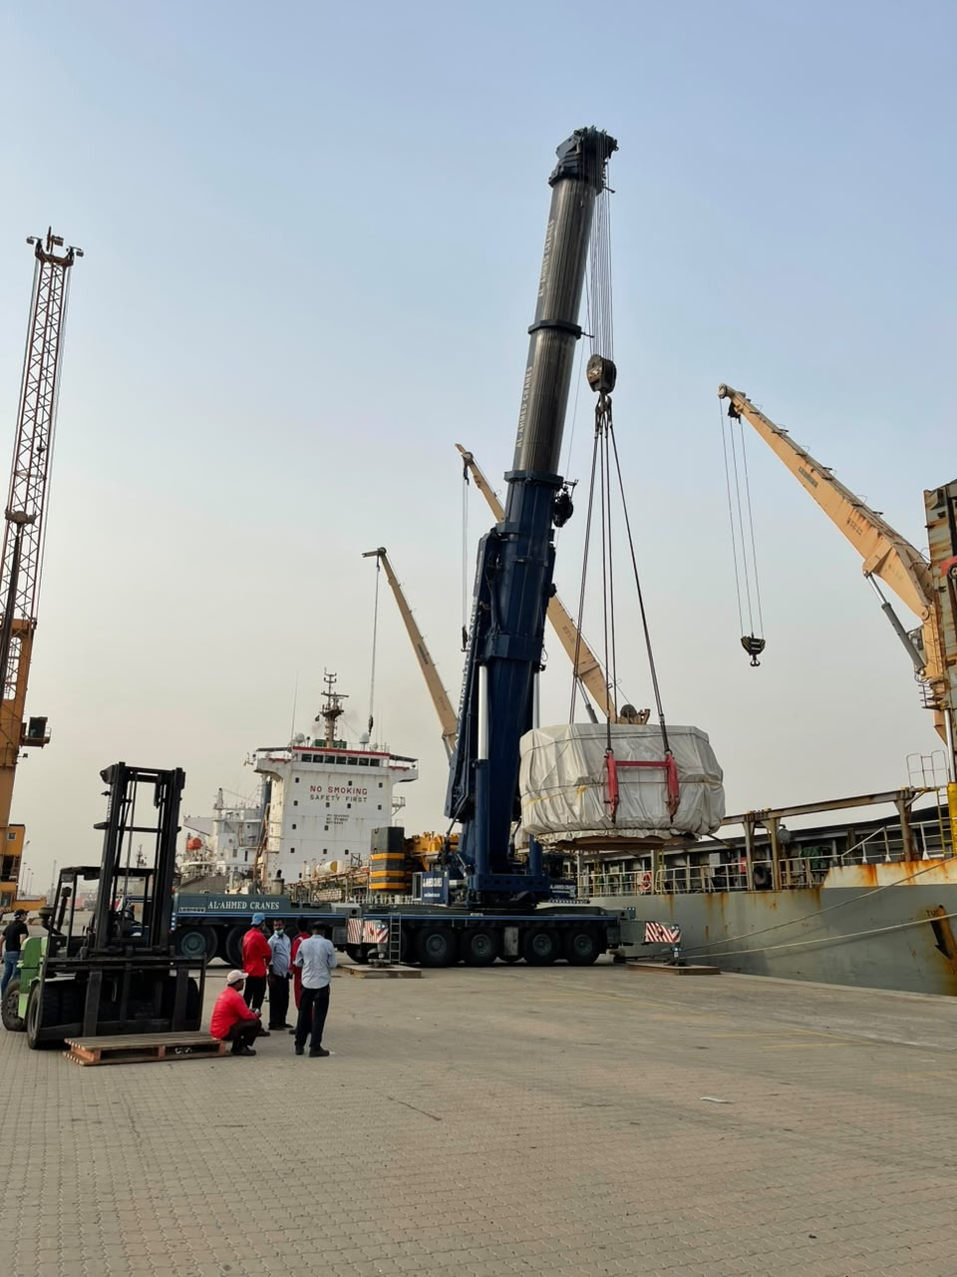
WASEEM
06 / WATERFRONT OPERATIONS
CONSTRUCTION COMPANY
Port lifting
operations
Crane positioning and cargo handling
at the waterfront
CRANE ARRANGEMENT
CARGO LIFTING
PORT-SIDE POSITIONING
WASEEM CONSTRUCTION COMPANY
07

Slide 8
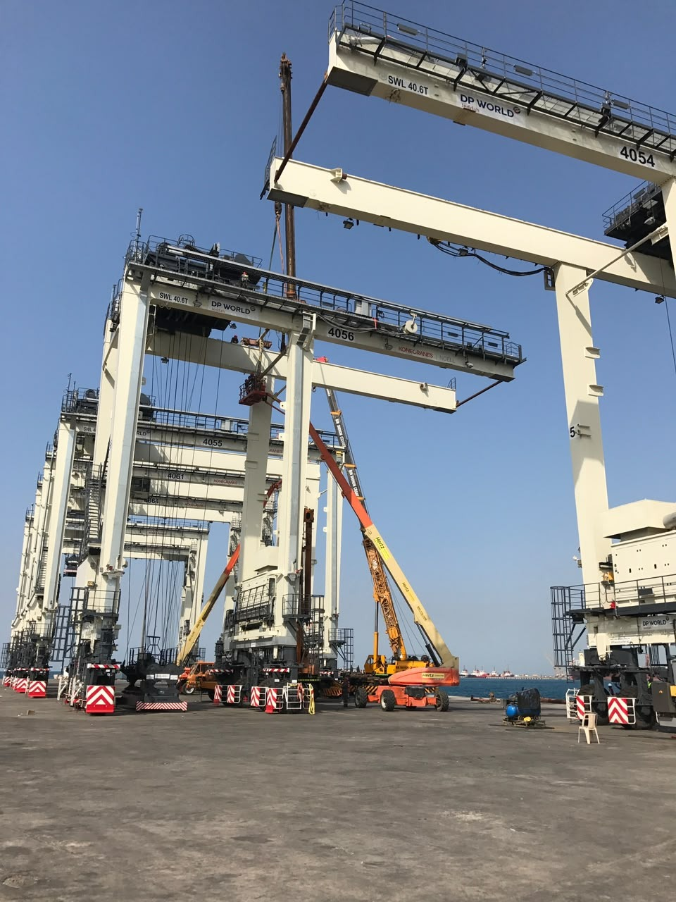
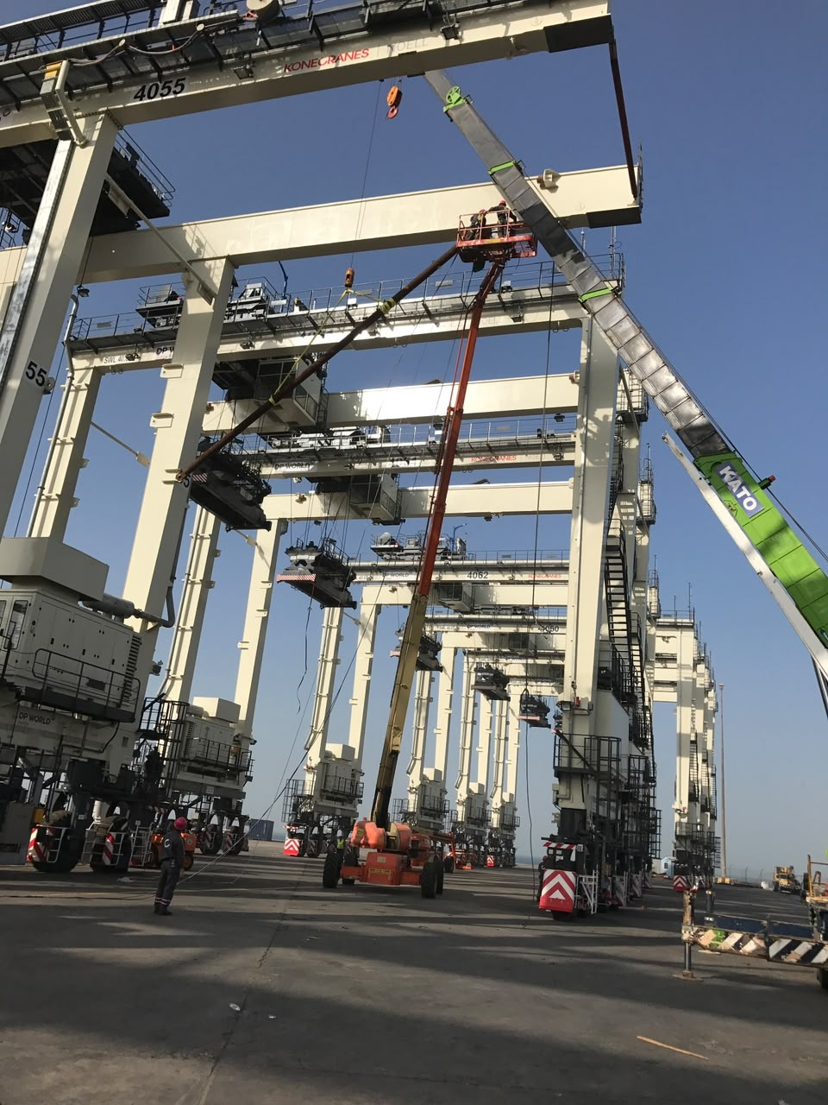
WASEEM
07 / PORT STRUCTURES & ACCESS
CONSTRUCTION COMPANY
Port equipment
Gantry structures
Gantry structures and lifting equipment working in port areas.
STRUCTURE & WORKING AREA
EQUIPMENT & ACCESS
WASEEM CONSTRUCTION COMPANY
08

Slide 9

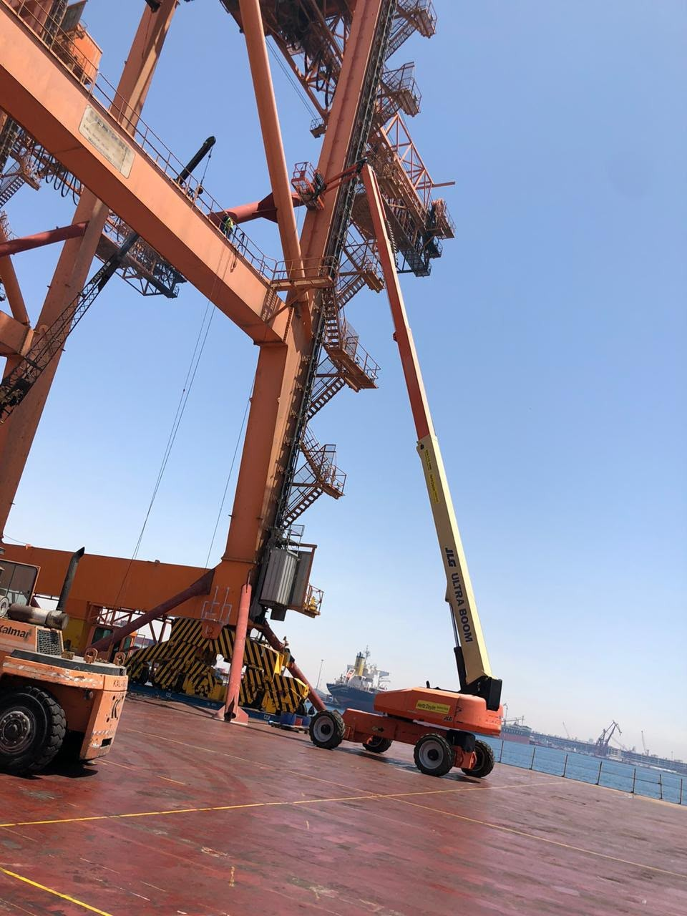
WASEEM
07 / PORT STRUCTURES & ACCESS
CONSTRUCTION COMPANY
Port equipment
Equipment access
Gantry structures and lifting equipment working in port areas.
STRUCTURE & WORKING AREA
EQUIPMENT & ACCESS
WASEEM CONSTRUCTION COMPANY
09

Slide 10
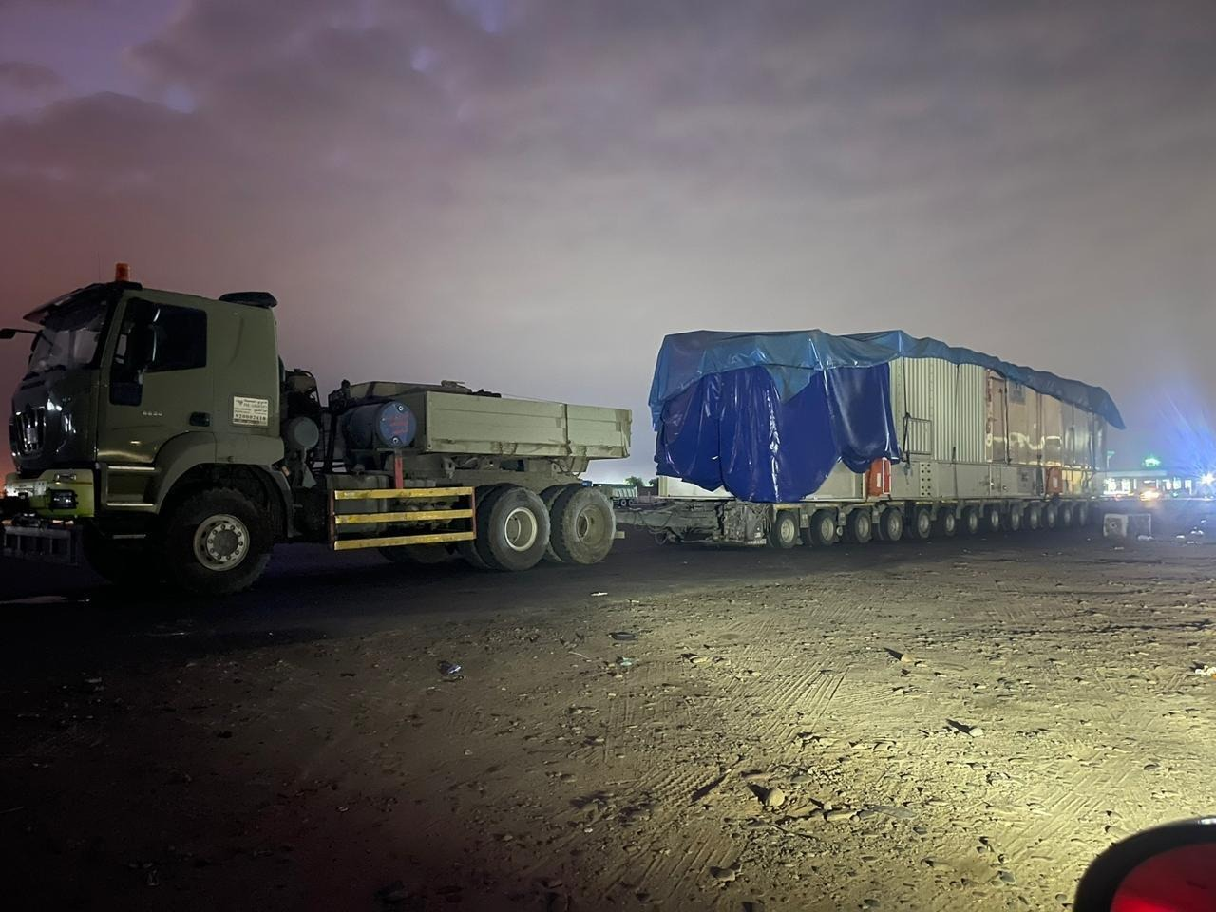
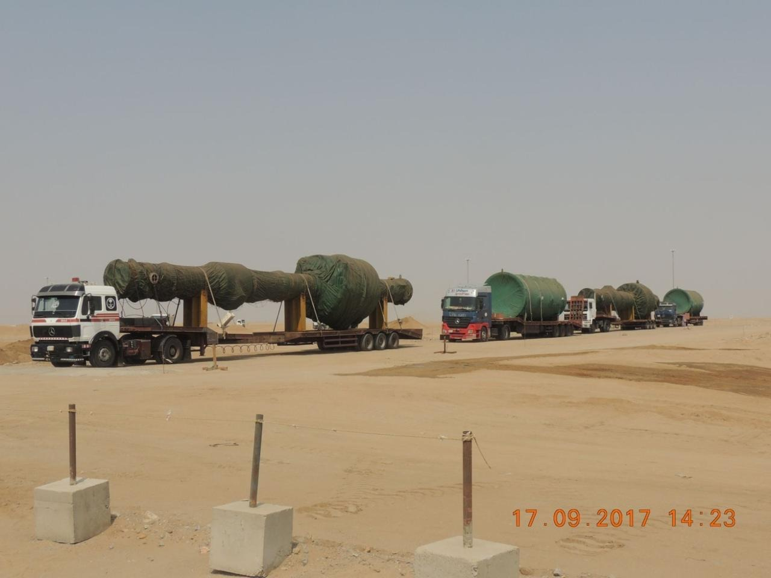
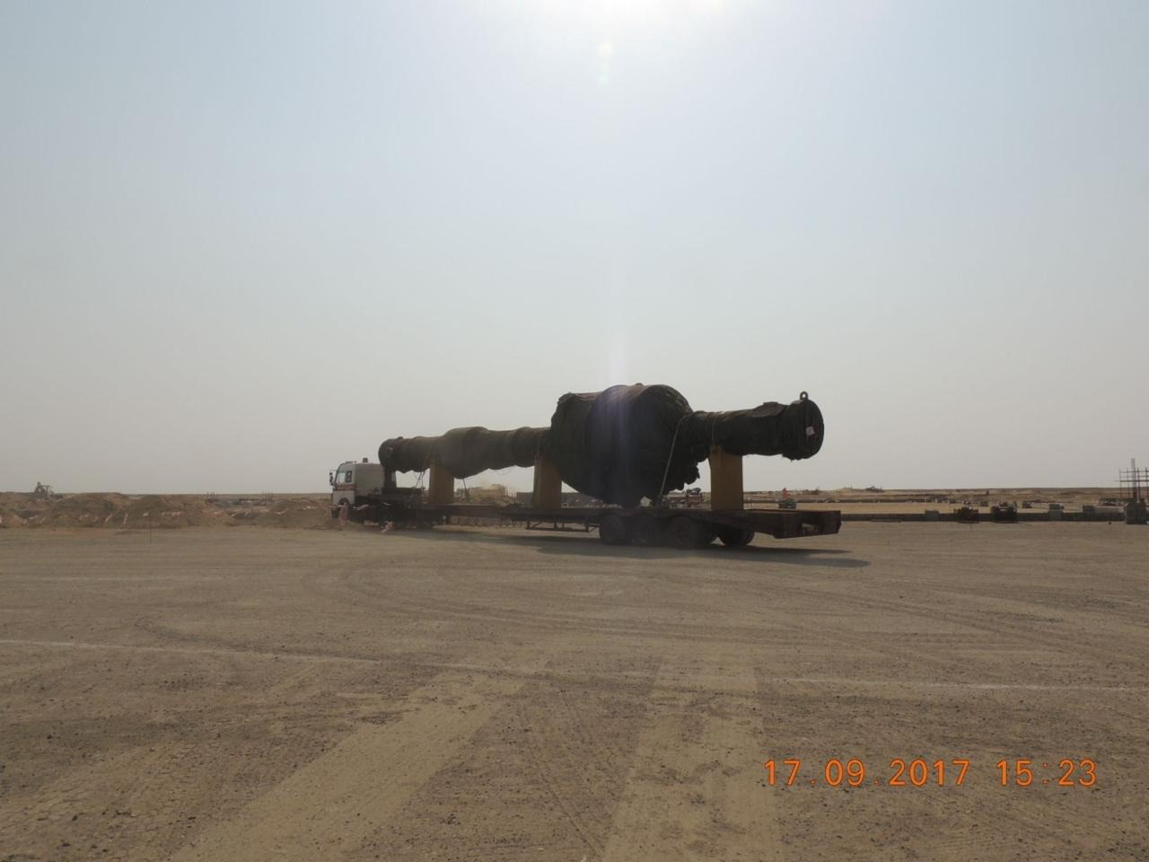
WASEEM
08 / HEAVY CARGO
CONSTRUCTION COMPANY
Heavy cargo transport
Covered and oversized loads on multi-axle trailers
COVERED CARGO
MULTI-AXLE TRAILER
OVERSIZED MOVEMENT
HEAVY TRANSPORT CONFIGURATION
WASEEM CONSTRUCTION COMPANY
10

Slide 11
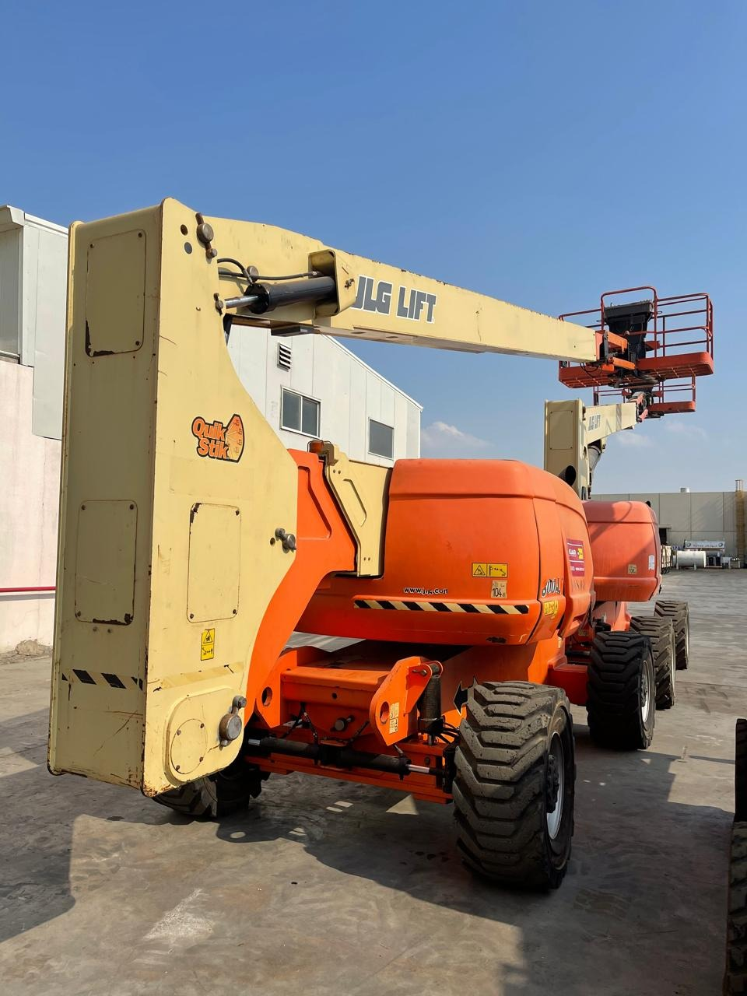
WASEEM
09 / SITE ACCESS
CONSTRUCTION COMPANY
Access
equipment
Scissor lifts and boom lifts for work at height, indoors and outdoors.
SCISSOR LIFT
ARTICULATING BOOM LIFT
WASEEM CONSTRUCTION COMPANY
11

Slide 12
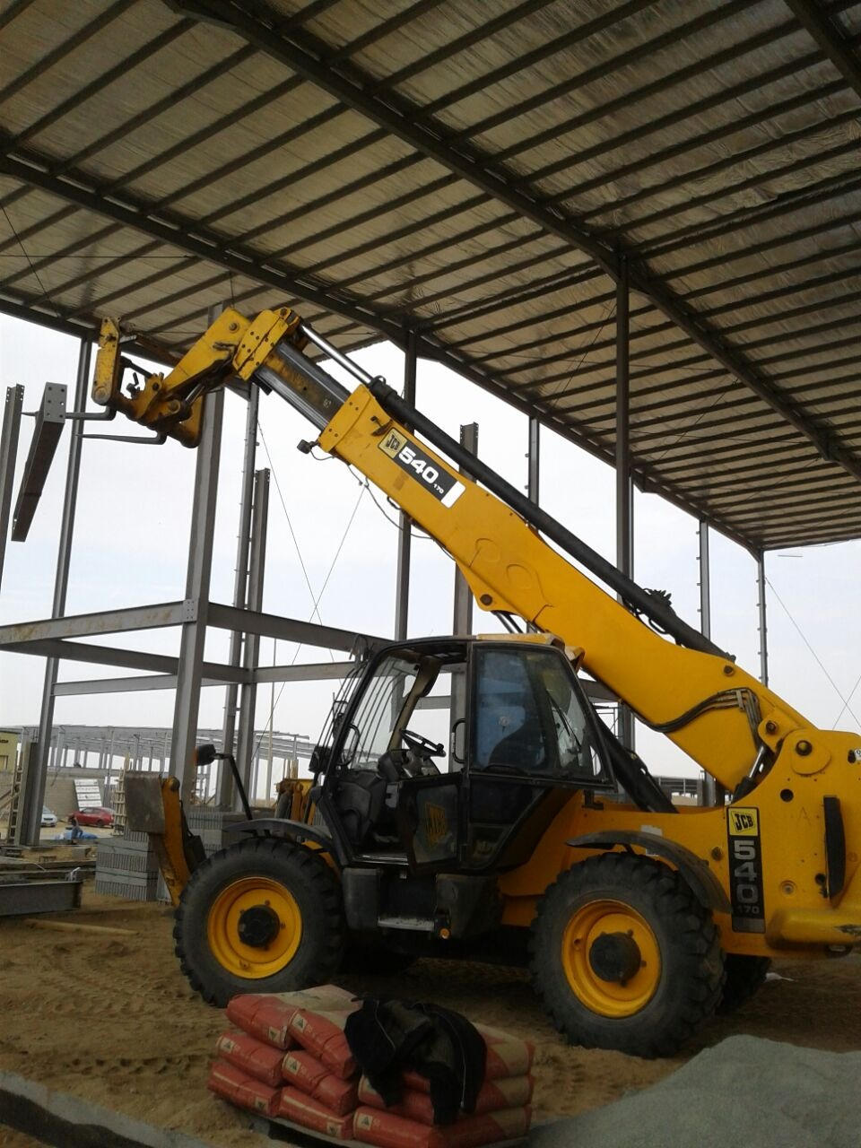
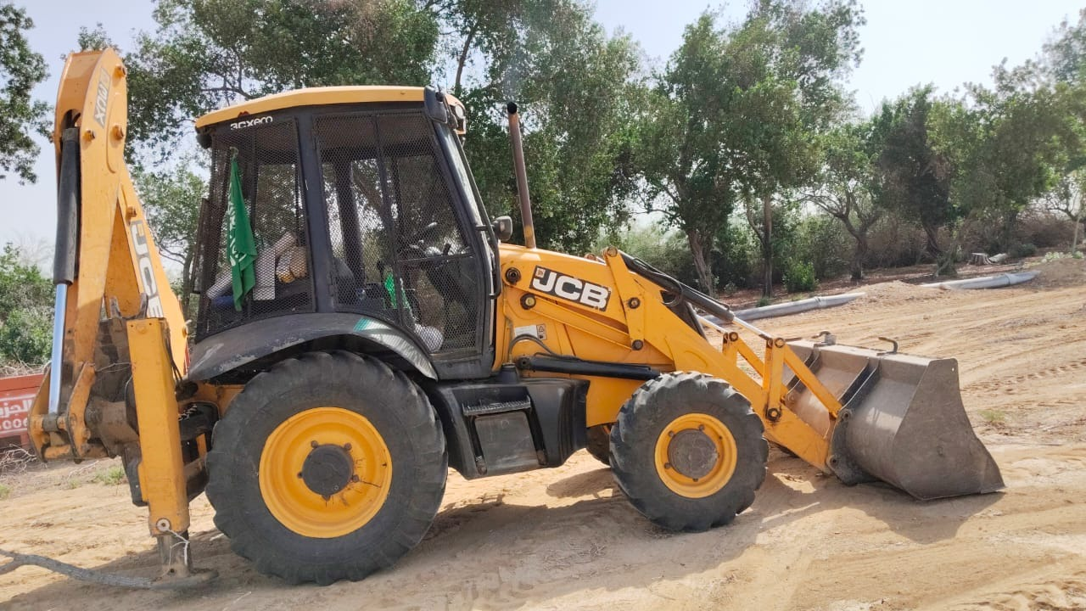
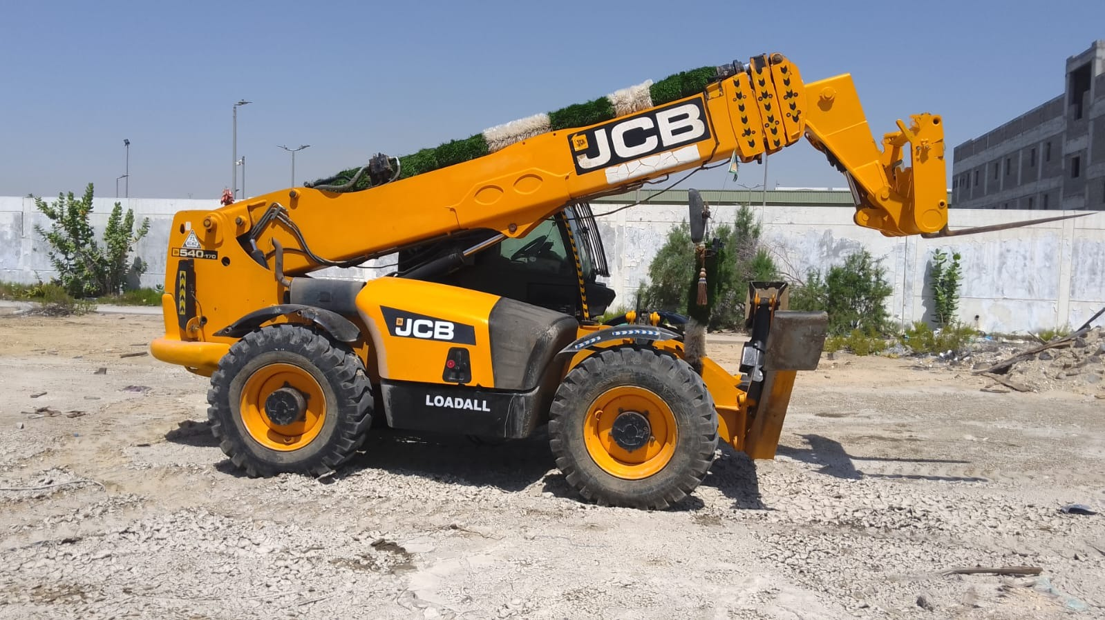
WASEEM
10 / SITE MACHINERY
CONSTRUCTION COMPANY
Site machinery
TELEHANDLER ON SITE
BACKHOE LOADER
TELESCOPIC HANDLER
WASEEM CONSTRUCTION COMPANY
12

Slide 13
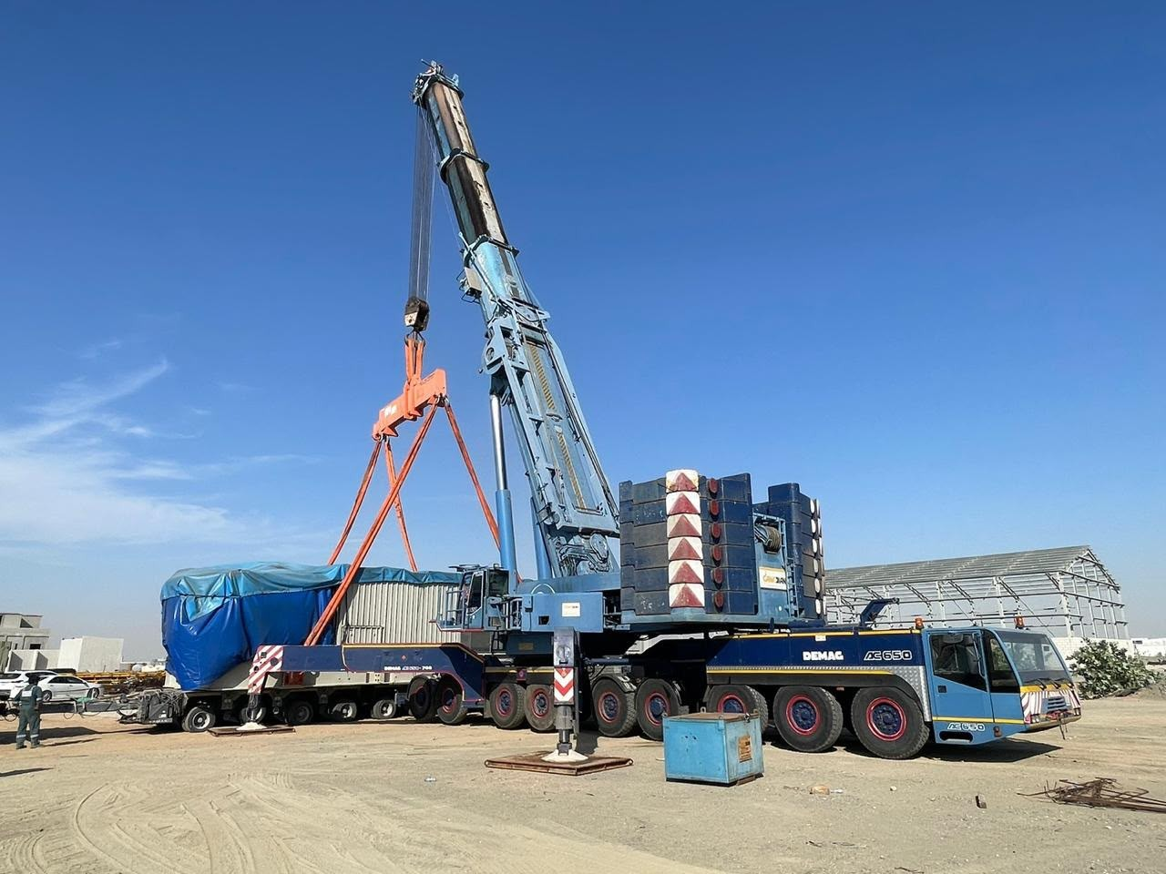
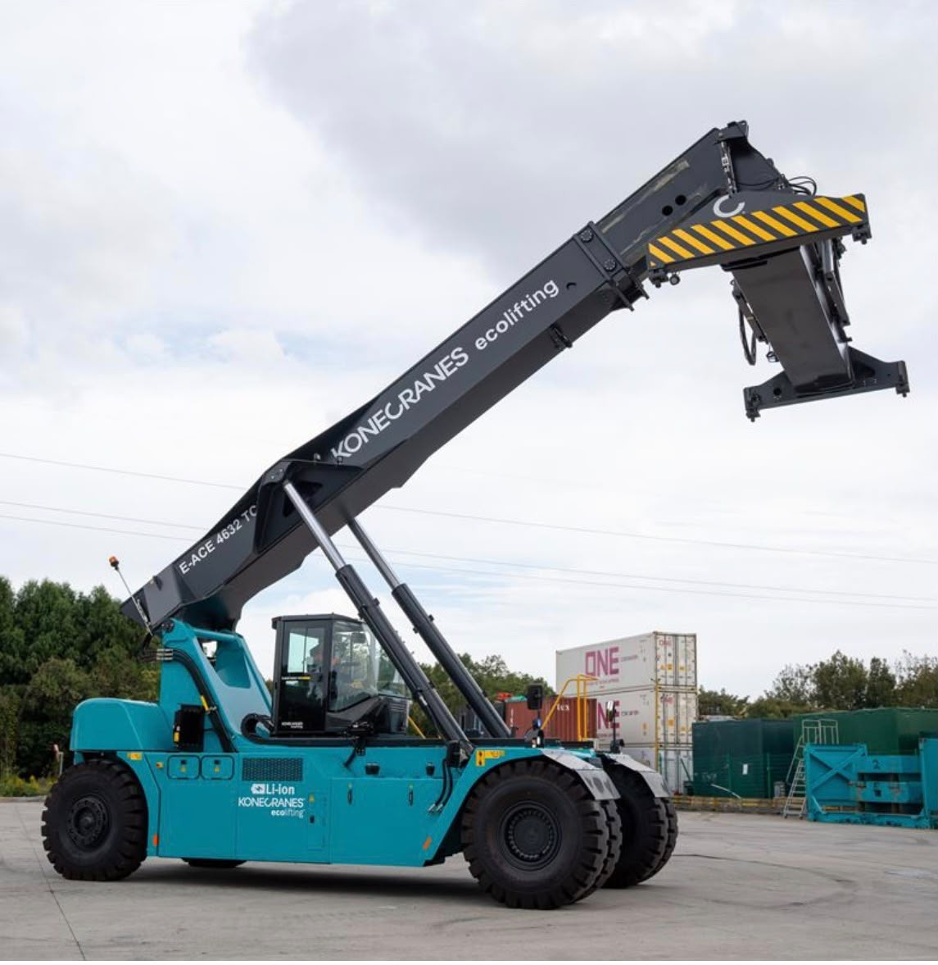
WASEEM
11 / SPECIALIST HANDLING
CONSTRUCTION COMPANY
Crane and container handling
Mobile cranes and reach stackers
MOBILE CRANE & SLUNG LOAD
REACH STACKER
WASEEM CONSTRUCTION COMPANY
13

Slide 14
WASEEM
12 / PLANNING THE REQUIREMENT
CONSTRUCTION COMPANY
Planning your equipment enquiry
Tell us about the job so we can discuss the equipment you need
01
02
03
04
THE TASK
THE LOAD
THE LOCATION
THE TIMING
What needs to be lifted, moved or accessed?
What are the dimensions, weight and handling requirements?
What access, space and ground conditions affect the work?
When is the equipment needed, and for how long?
WASEEM CONSTRUCTION COMPANY
14

Slide 15
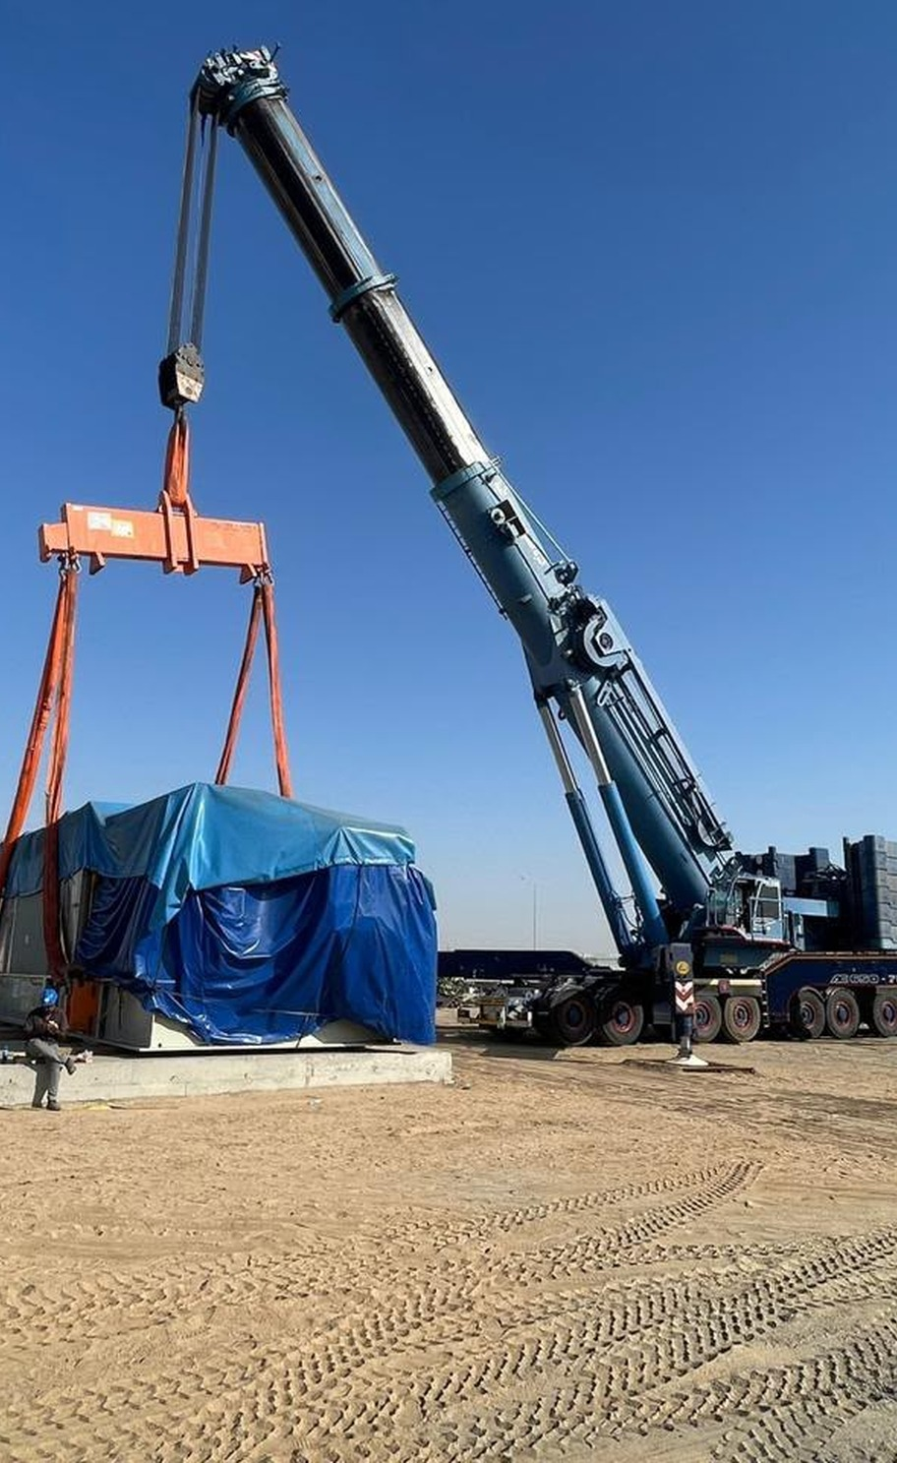
WASEEM CONSTRUCTION COMPANY
Contact our team
Email us with your job requirements
GENERAL ENQUIRIES
Wasim@wasconarabia.com
SALES ENQUIRIES
Sales@wasconarabia.com
Telephone
Office address
Registration no.
15

