Slide 1
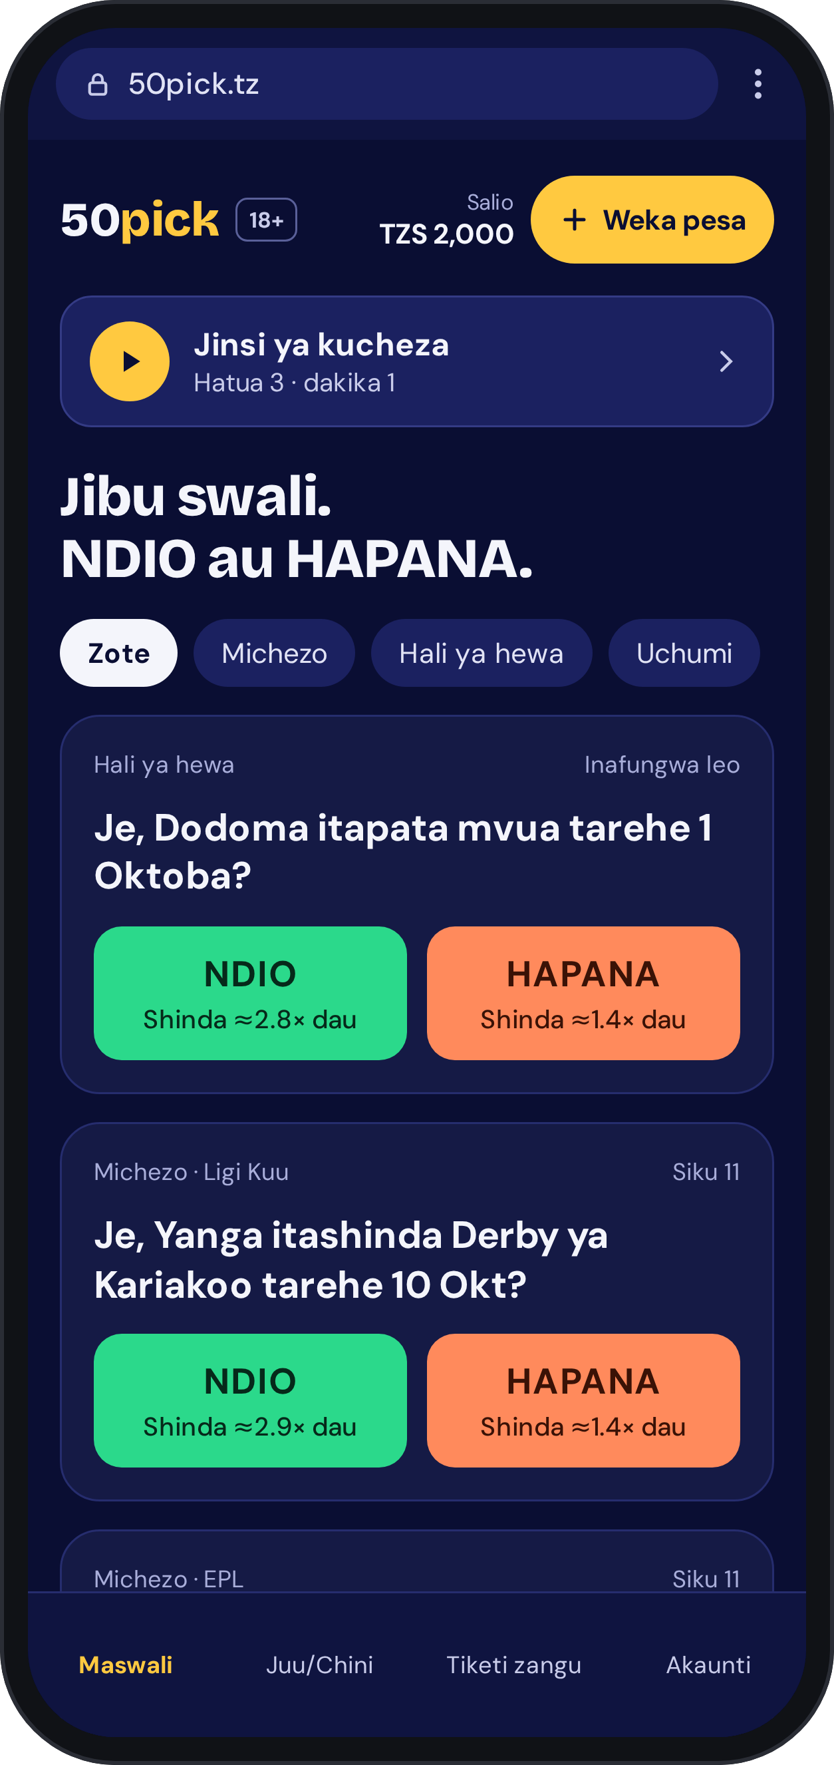
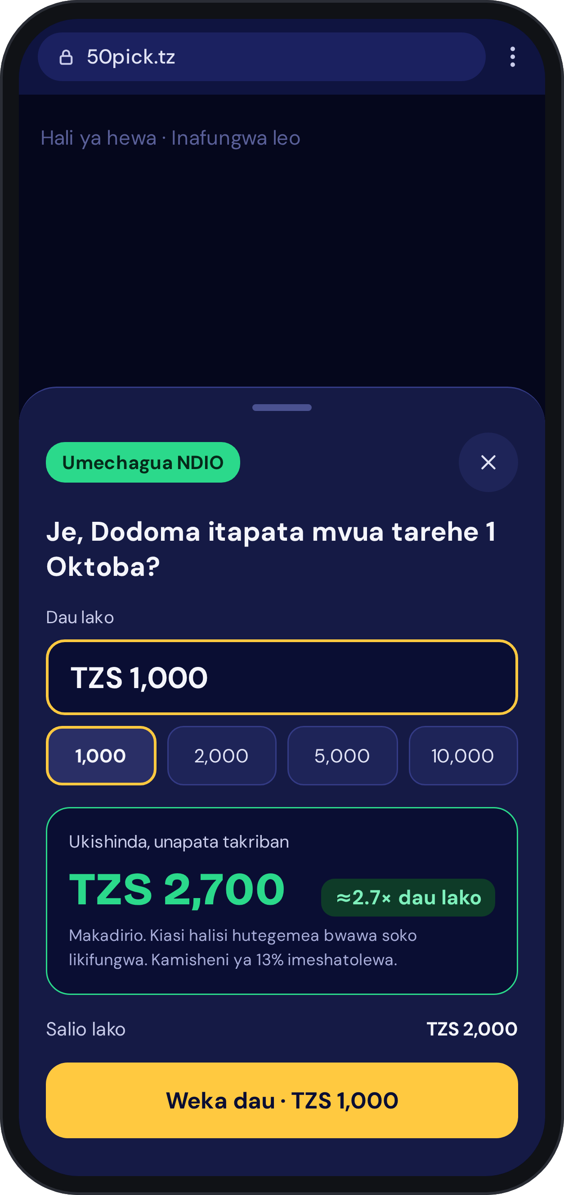
50pick
Pick. See what you win. Play.
The simplified 50pick.tz journey — clear YES/NO questions, winnings shown up front, and deposit exactly when it is needed.
Product proposal · September 2026

Slide 2
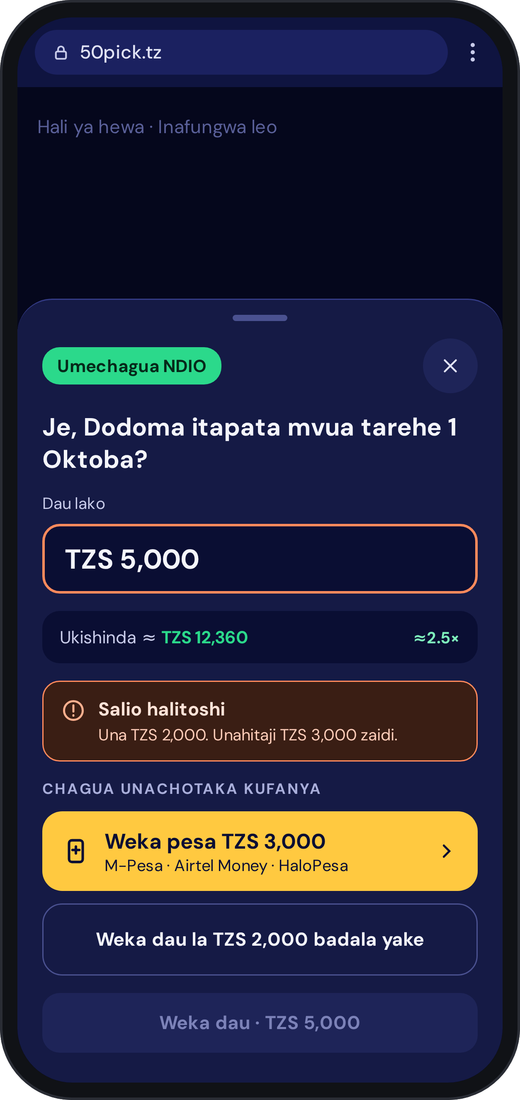
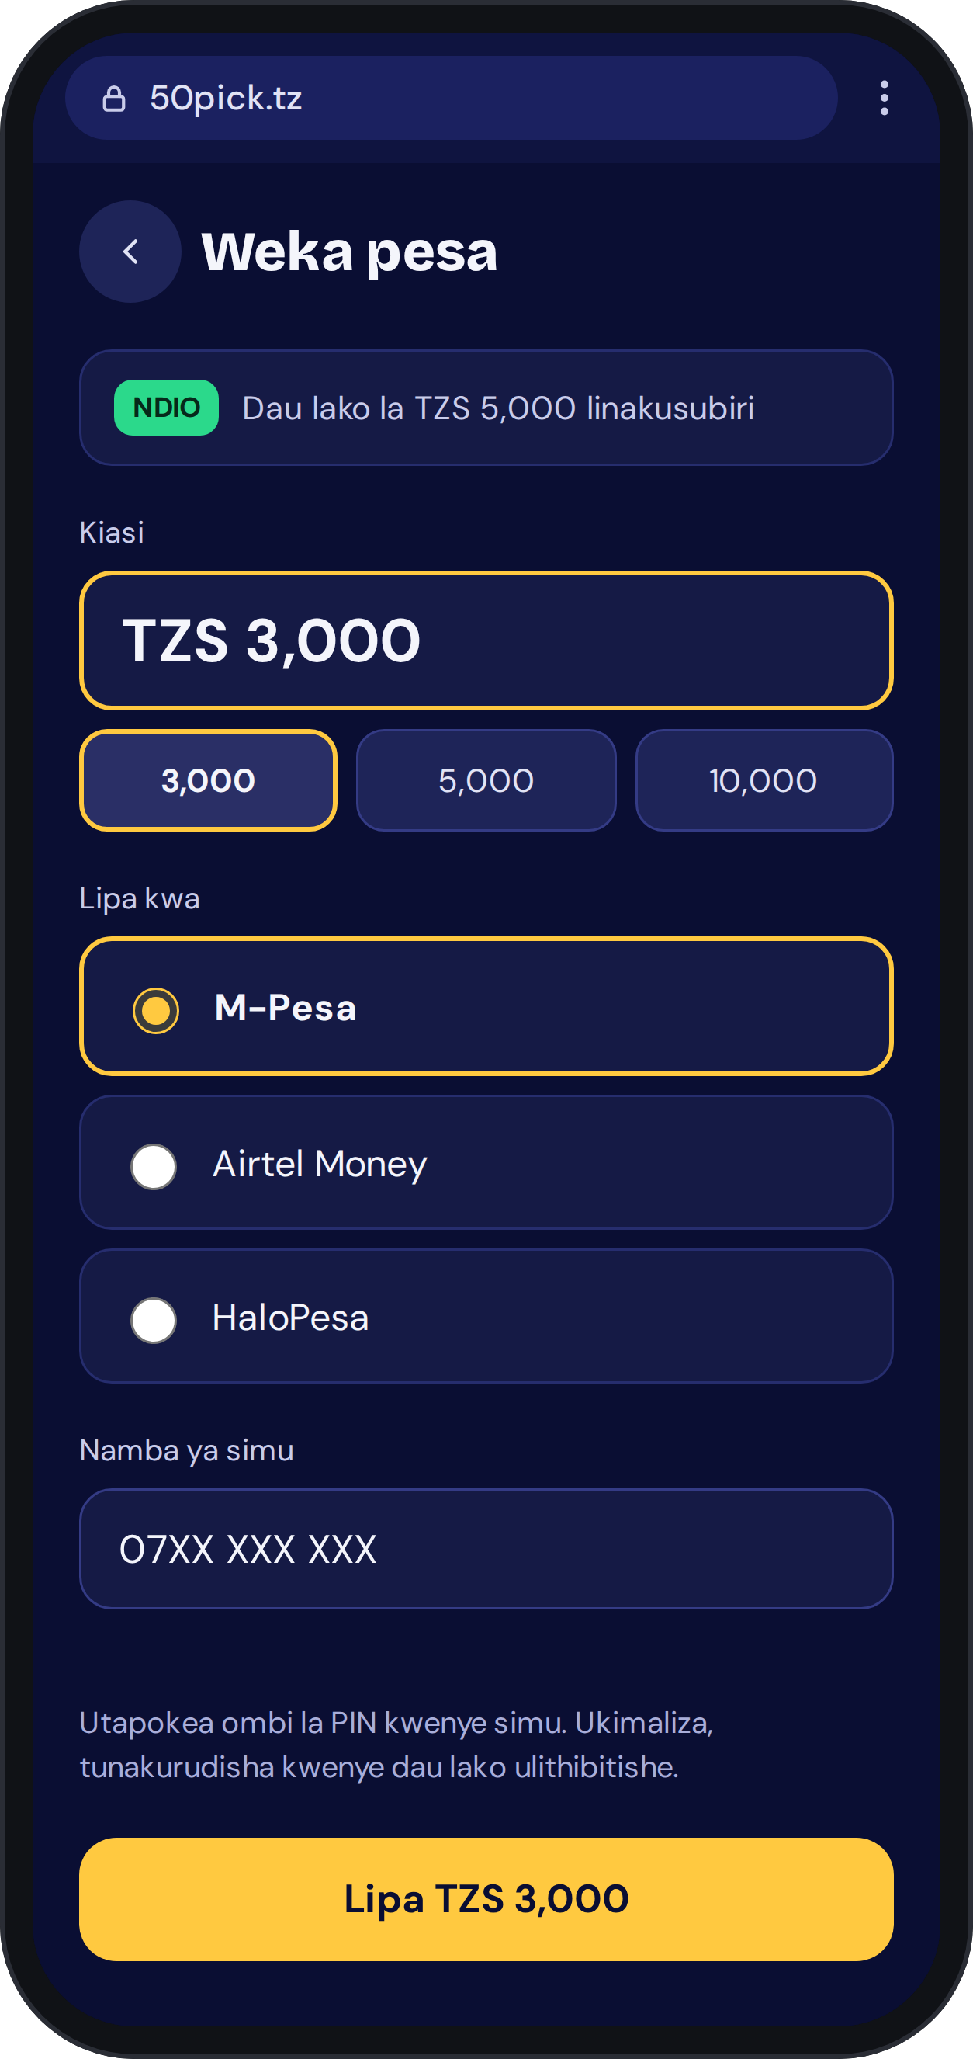
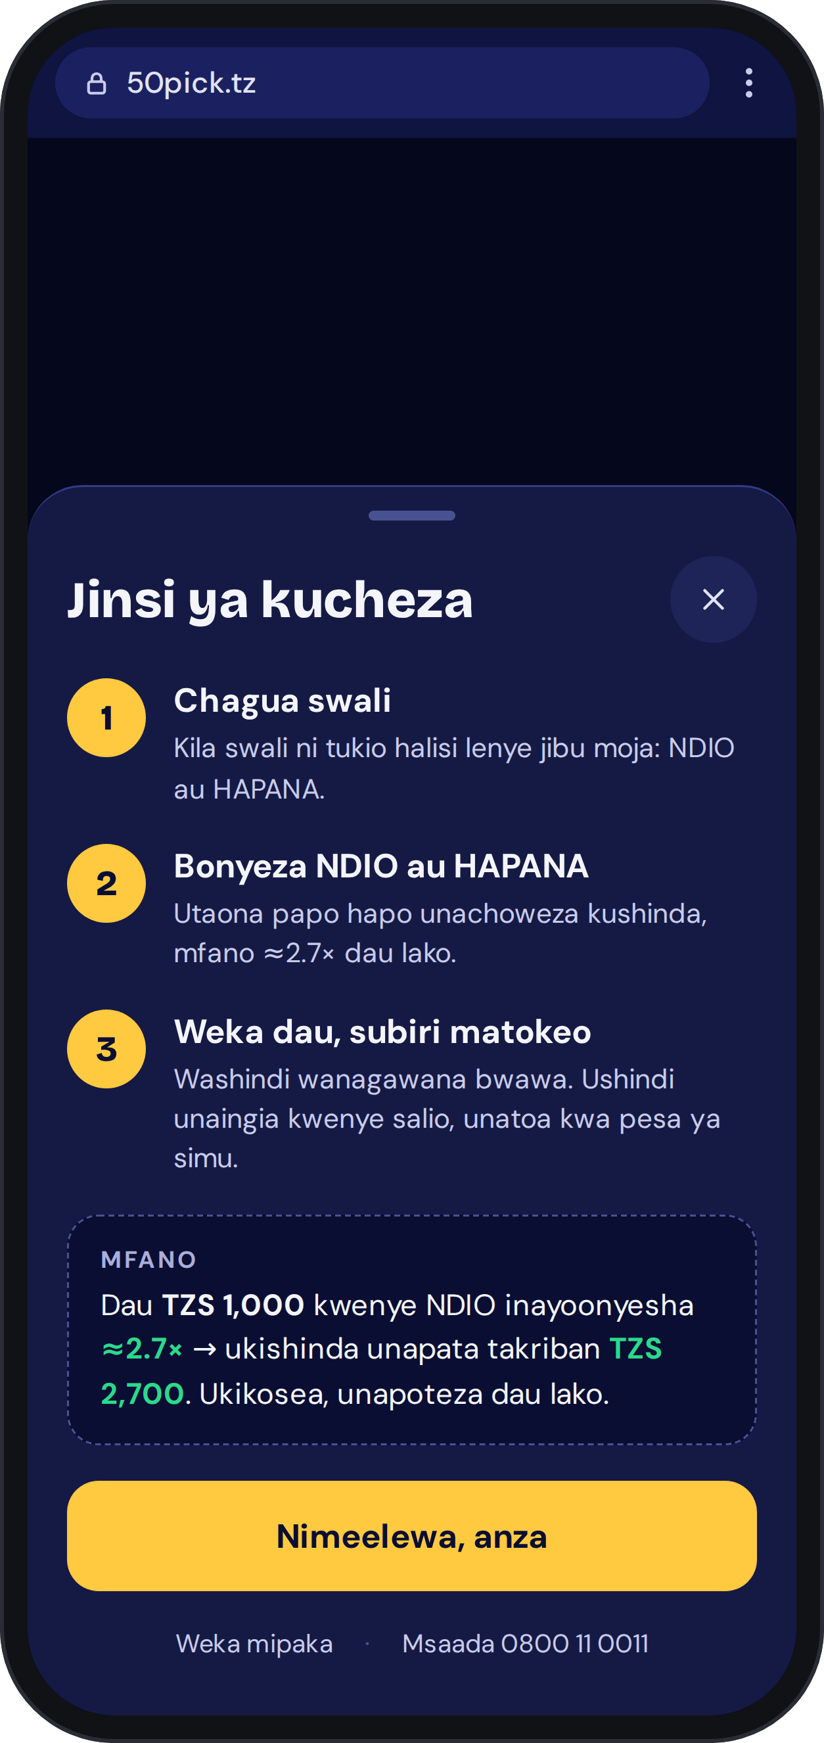
The new journey at a glance
1
2
3
4
5
Home: pick NDIO or HAPANA
See your winnings
Short? Deposit is next
Pay, then back to the bet
How to Play, anytime

Slide 3
SCREEN 1 · HOME PAGE
Home: one clear question, two big answers
1
Short YES/NO questions
One line, one idea. Full wording and source move to the detail page.
2
Winnings on every button
"Shinda ≈2.8× dau" replaces "NDIO @ 33%", so users see reward, not odds.
3
How to Play at the top
Full-width button, visible without scrolling.
4
Deposit always in reach
Balance and a gold Weka pesa button sit in the header.

Slide 4
SCREEN 2 · BET SHEET
Tap a side, see the money
If NDIO wins on a TZS 1,000 bet
≈ TZS 2,700
≈2.7× your bet
1
Opens instantly, even before sign-up
Stake box, quick amounts 1,000 / 2,000 / 5,000 / 10,000.
2
Payout updates live
Recalculated on every stake change from the current pool.
3
Honest wording
"Makadirio" note: the final amount depends on the pool at close; 13% commission already deducted.

Slide 5
SCREEN 3 · BALANCE TOO LOW
Not enough balance? Deposit is the next step
Instead of an error, the sheet shows the shortfall and two clearly separate options:
Primary · Weka pesa TZS 3,000
Pre-filled with the exact shortfall. M-Pesa, Airtel Money, HaloPesa.
Secondary · Bet TZS 2,000 instead
Place the bet with the balance already available.
The original "Weka dau" button stays visible but disabled, so the user sees why.

Slide 6
SCREEN 4 · DEPOSIT
Deposit in one screen, then straight back
1
The pending bet stays in view
"Dau lako la TZS 5,000 linakusubiri" at the top of the screen.
2
Everything pre-filled
Shortfall amount, last-used wallet and phone number.
3
One PIN prompt
Pay with M-Pesa, Airtel Money or HaloPesa on the phone.
4
Back to the bet, user confirms
Side and stake are kept. The bet is never placed automatically.

Slide 7
SCREEN 5 · HOW TO PLAY
How to Play, in three steps
1
Chagua swali
Every question is a real event with one answer: NDIO or HAPANA.
2
Bonyeza NDIO au HAPANA
See immediately what you can win, e.g. ≈2.7× your bet.
3
Weka dau, subiri matokeo
Winners share the pool; winnings go to balance and out via mobile money.
Opens automatically on a first visit, reachable from the home page after that. Weka mipaka and the 0800 11 0011 helpline are always linked.

Slide 8
What changes for the user
 | Today | After the change
Home page | Ticker, stats, gauge, games and cards compete | Short YES/NO questions first
Buttons | "NDIO @ 33%" — a probability | "Shinda ≈2.8× dau" — a reward
How it works | Mid-page, easy to miss | Button at the top + first-visit sheet
Placing a bet | Log in before seeing any payout | Payout preview first, sign-up after
Low balance | No path from the bet to deposit | Deposit is the next button, pre-filled
After deposit | User must find the market again | Returns to the same bet to confirm

Slide 9
To launch, we need to agree on
1
Logged-out preview
Can the bet sheet and payout open before sign-up?
2
Wallet callbacks
Can M-Pesa, Airtel Money and HaloPesa return users to the pending bet?
3
Short titles
Rewrite titles, or add a short-title field to each market?
4
Regulator review
Does the Gaming Board need to see the new payout wording?
Success measures: home → bet sheet, bet sheet → bet placed, short balance → deposit, deposit → bet completed, time to first bet.

