Slide 1





AI STOCK PRO INTELLIGENCE
Powered by Generative AI • Gemini Pro • yFinance • Streamlit
Team Members :-
Khusboo Kumari
Kripita Gupta
Rupam Jaiswal
Puja Jaiswal
Md Ali Sher

Slide 2


Problem Statement
1.The Problem: Information Overload
The Challenge: Retail investors face thousands of complex financial news articles daily, leading to decisions based on market rumors.
The Impact: Heavy jargon and lack of time create high financial risks for average investors.
2.The AI Solution (Gemini API)
Smart Summarization: Condenses long financial reports into 2–3 key bullet points.
Sentiment Analysis: Instantly labels market news as Positive (Bullish), Negative (Bearish), or Neutral.
Visual Dashboard: Transforms raw data into interactive, real-time charts.
3.Expected Outcomes & Deliverables
JSON
{
"web_app": "Interactive Streamlit Dashboard via Stock Ticker",
"charts": "Real-time stock price visualization using Plotly",
"ai_insights": "Simplified market news summaries in English/Hindi"
}

Slide 3

Solution
Data Ingestion (Python): The system automatically fetches live market feeds and the latest financial news based on the user-entered stock ticker (e.g., TCS.NS).
AI Engine (Google Gemini API): Processes heavy financial jargon and dense articles to generate simplified, easy-to-understand 2–3 key bullet points (supporting English/Hindi).
Automated Sentiment Analysis: Instantly categorizes the news impact as Positive (Bullish), Negative (Bearish), or Neutral to guide quick decision-making.
UI Delivery (Streamlit & Plotly): Renders a clean, interactive web dashboard combining real-time stock price Line Charts with precise AI insights side-by-side.
Data Ingestion (Python): Automatically fetches live market feeds and financial news based on user-entered stock tickers.
Automated Sentiment Analysis: Instantly categorizes news impact as Positive (Bullish), Negative (Bearish), or Neutral.
Key Technical Value
Jargon-Free Insights: Translates complex financial data into plain, accessible language for retail investors.
Time Efficiency: Saves time by delivering instant summaries instead of requiring 24/7 news monitoring.
Rapid Deployment: Built on a lightweight, highly responsive tech stack optimized for fast prototyping.
AI

Slide 4

Project Demo
Website link
https://final-capston-project-finance-generative-ai-kddkwfgmcs9synbfbb.streamlit.app

Slide 5
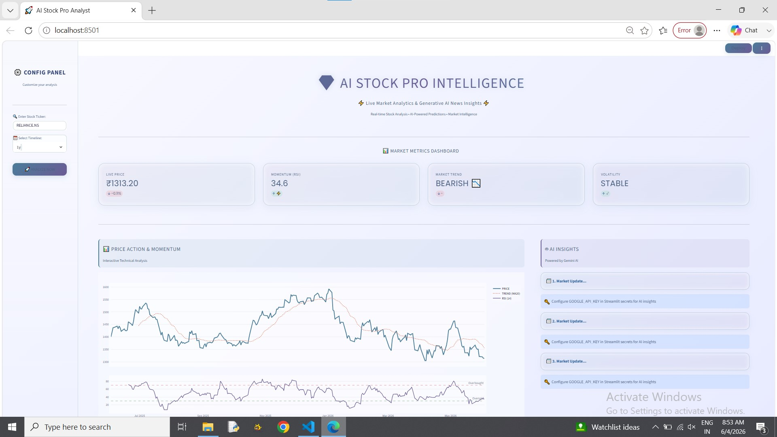
Output

Slide 6

Future Scope
📈 Technical Indicators: RSI, MACD, Bollinger Bands
🗂 Portfolio tracker for multiple stocks.
🔔 Price alert & watchlist notifications.
☁️ Deploy on Streamlit Cloud (public access)
📊 Historical sentiment trend visualization

Slide 7

Conclusion
What We Achieved
Real-time stock data via yFinance API.
Interactive Plotly price action charts
Gemini AI — Bullish / Bearish classification
Clean Streamlit UI — no coding needed to use
Supports Indian (NSE/BSE) & global stocks

Slide 8

AI STOCK PRO INTELLIGENCE
Generative AI Final Capstone Project
Python
Streamlit
yFinance
Gemini AI
Plotly
NSTI(W) PATNA • 2025 – 2026
Notes:
Thank You !!

