Slide 1
Process Lens — Order-to-Cash Business Case
Where is the O2C fulfillment process breaking down, what does it cost, and what's the fix?

Slide 2
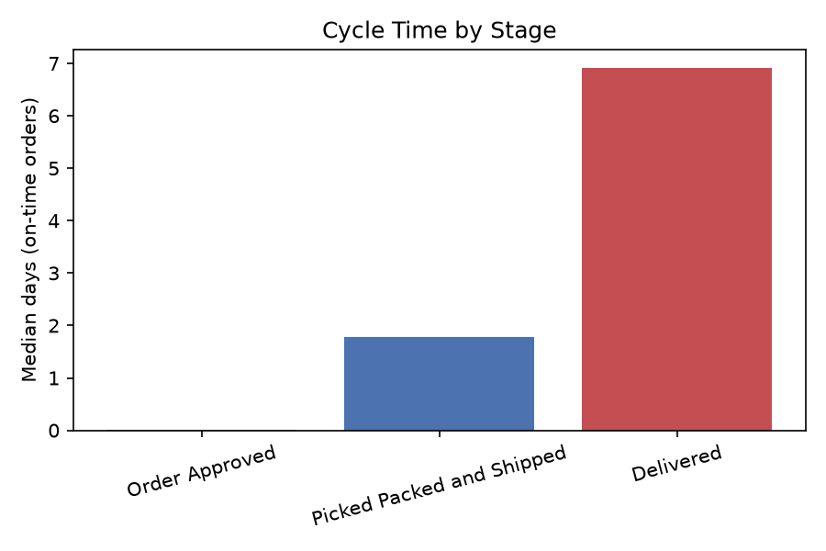
Situation
- 96,455 real Olist e-commerce orders analyzed end-to-end
- Overall on-time delivery (OTD) rate: 91.9%
- Late order rate: 8.1% (7,826 orders)
- Carrier delivery is 3.9x longer than pick/pack -- 7.09 vs 1.84 days median

Slide 3
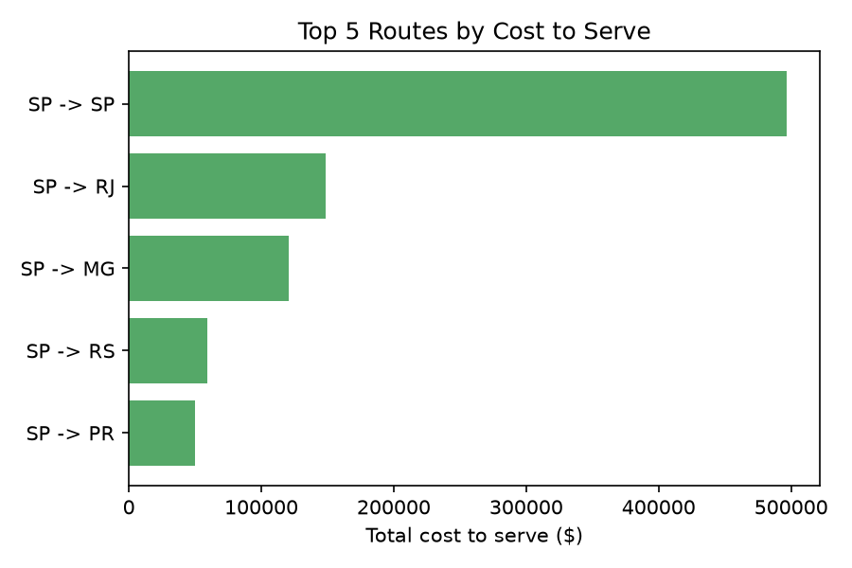
Complication
- Delivered stage confirmed as the primary bottleneck (Mann-Whitney U, p<0.000001, large effect)
- Late orders take about 17 more days at this single stage than on-time orders
- About 18 seller-customer routes account for 80% of all late deliveries
- Highest-cost route alone costs $496,942/year to serve

Slide 4
Answer
- Recommendation: target carrier renegotiation on the top ~18 highest-cost routes
- Base case: 3-year NPV $98,639, payback in 0.7 years
- Even the pessimistic scenario is NPV-positive ($2,896)
- Validated via discrete-event simulation before recommending, not just modeled on paper

Slide 5
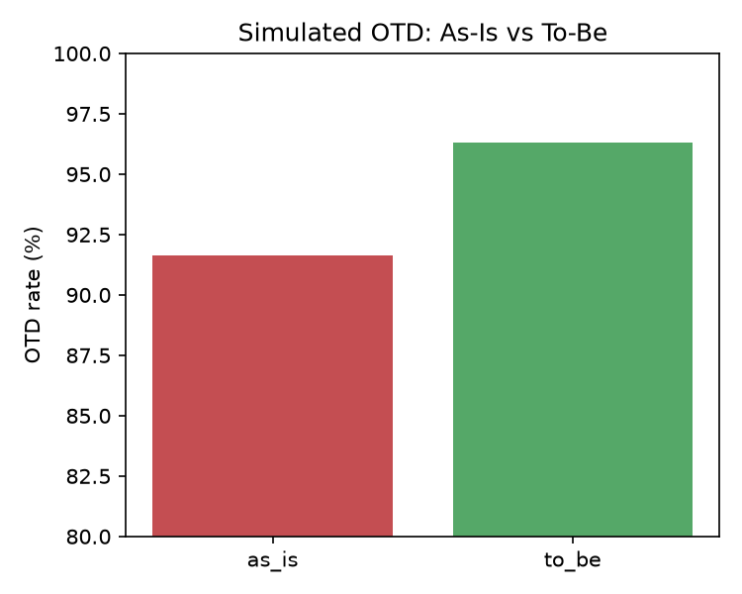
Validation
- Simulation calibrated to real data: 91.6% simulated vs 91.9% observed
- To-be redesign: OTD improves from 91.6% to 96.3% (4.7pp)
- Confirmed via non-overlapping 95% confidence intervals across 20 replications
- Predictive classifier (AUC-ROC 0.74) flags at-risk orders at creation -- top 20% flagged catches 41.5% of late orders

