Slide 1
Android App Development :Intro to Android
Prof. Seongwook Youn
Department of Software
Korea National University of Transportation

Slide 2

What is Android?
Mobile operating system maintained by Google
Originally purchased from Android, Inc. in 2005
Runs on phones, tablets, watches, TVs, …
Based on Java(dev language) and Linux(kernel)
The #1 mobile OS worldwide
Code is released as open source
Easier to customize, license, pirate, etc. than iOS

Slide 3
Why develop for Android?
Why not just write a web site?
Better, snappier UI
Able to use different kinds of widgets/controls than in a web page
More direct access to the device’s hardware (camera, GPS, etc.)
Users highly prefer apps over mobile web browsing

Slide 4

Why not iOS?
Why not just write apps for iOS, which runs on iPhones and iPads?
Familiar programming language
Java vs Object-c or Swift
Free developer tools
Apple charges $$$ for their tools
More liberated app store

Slide 5
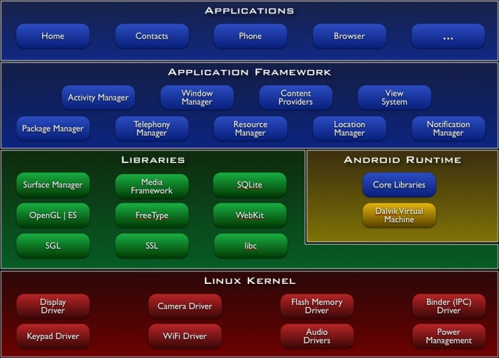
Android architecture
Notes:
Android OS provides libraries for many system features like contacts, phone dialing, notifications, 2D/3D graphics, database access, security / encryption, camera, audio, input/output, ...

Slide 6


Android runtime
Dalvik Virtual Machine
Android java code is compiled into a special Dalvik binary format (.dex files)
Compact and efficient than class files
Limited memory and batter power
Recently, the Dalvik VM has been replaced by ART
Core libraries
Java 5 standard edition
Collections, I/O etc
Notes:
Transfer class files to .dex files to run on Dalvik virtual machine

Slide 7
Android version history
Version |  | Date | Name
1.0-1.1 |  | Sep 2008 | None
1.5 |  | Apr 2009 | Cupcake
1.6 |  | Sep 2009 | Donut
2.0-2.1 |  | Oct 2009 | Éclair
2.2 |  | May 2010 | Froyo
2.3 |  | Dec 2010 | Gingerbread
3.0 |  | Feb 2011 | Honeycomb
4.0 |  | Oct 2011 | Ice Cream Sandwich
4.1-4.3 |  | Jul 2012 | Jelly Bean
4.4 |  | Oct 2013 | Kit Kat
5.0-5.1.1 |  | Nov 2014 | Lollipop
6.0-6.0.12 |  | Oct 2015 | Marshmallow
7.0 |  | Sep 2016 (?) | N

Slide 8
Android studio
Google’s official Android IDE (Nov 2014)
Includes everything you need to begin developing Android apps
IntelliJ IDE editor
Android studio plugin
Android SDK tools
Android platform tools
Android system image for the emulator
Replaces previous Eclipse-based environment
Free to download and use

Slide 9
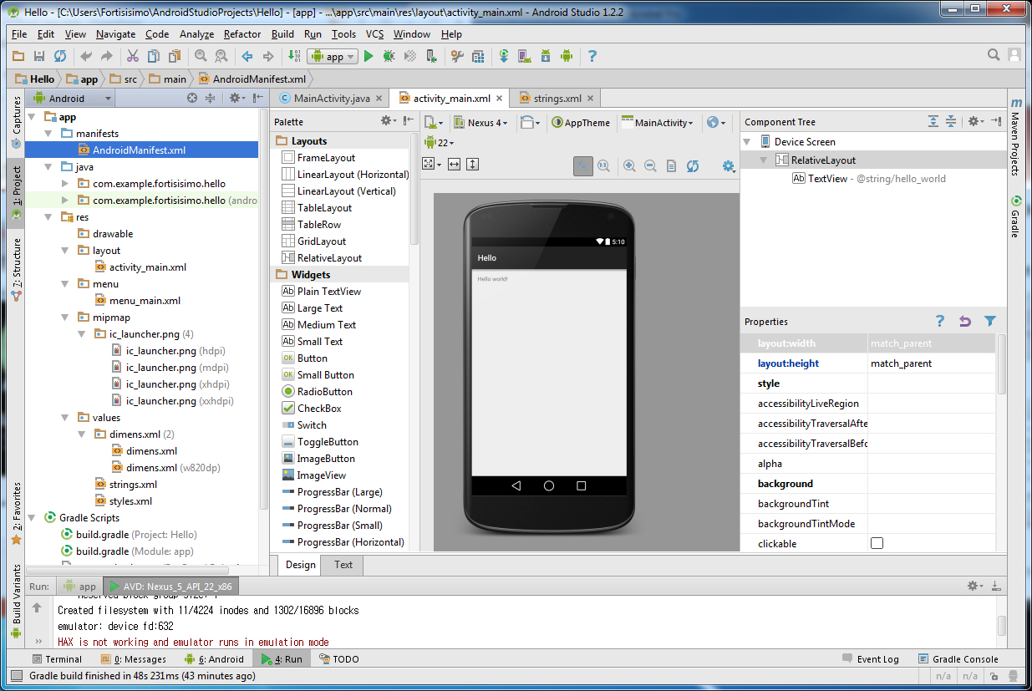
Android studio

Slide 10
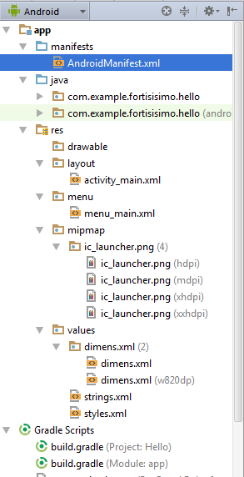
Project structure
AndroidManifest.xml
Overall project config and settings
Res/…
drawable/ = custom images
Layout/ = GUI layout
Menu/ = overall app menu options
Mipmap/ = icon image
Values/ = constant values and arrays
Strings = localization data
Styles = general appearance styling
Gradle
A build/compile management system

Slide 11
Android Virtual Device (AVD)
Allows you to run your project in an emulator
A software simulation of an entire Android tablet, phone, watch, etc.
When you click the “Run” button in Android studio, it builds your app, installs it on the virtual device, and loads it
Too slow!!!
Install your app on your actual Android device
App will run faster, better test of real execution
Require Android device

Slide 12
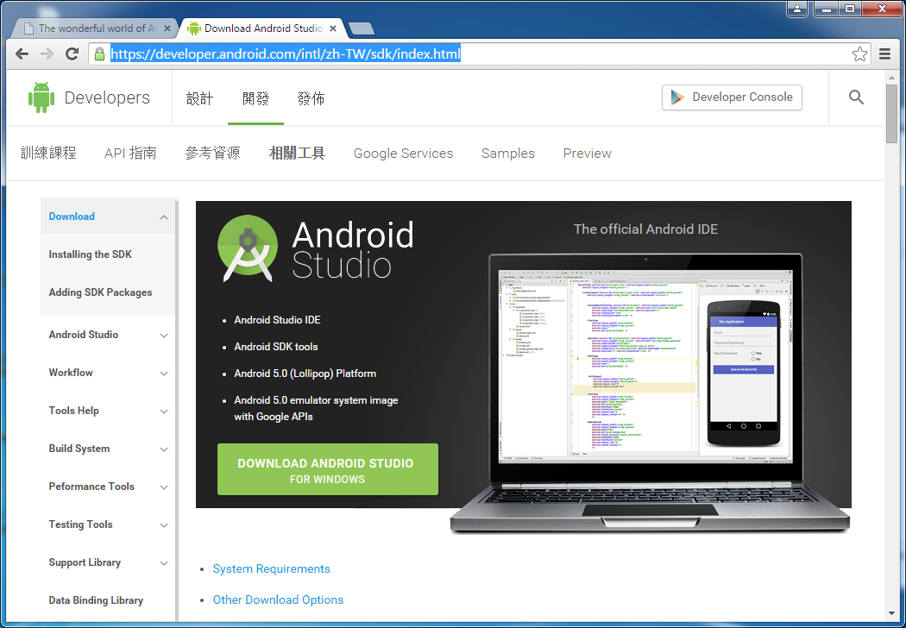
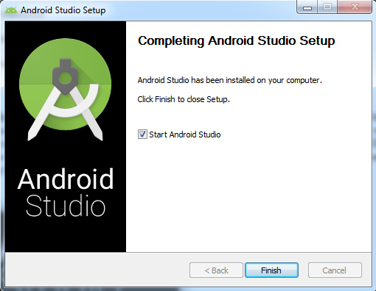
Getting started with Android
Install Android Studio and Java Development Kit(JDK) v7 or newer on your system

Slide 13
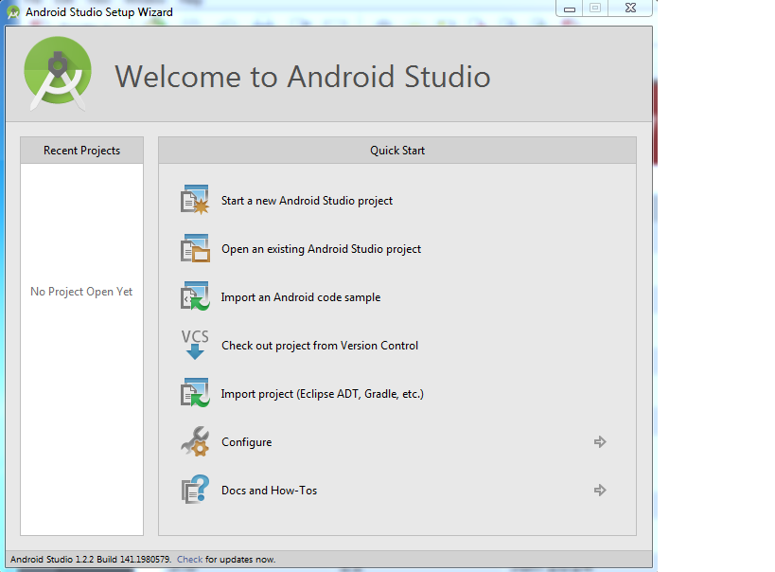
Getting started with Android

Slide 14
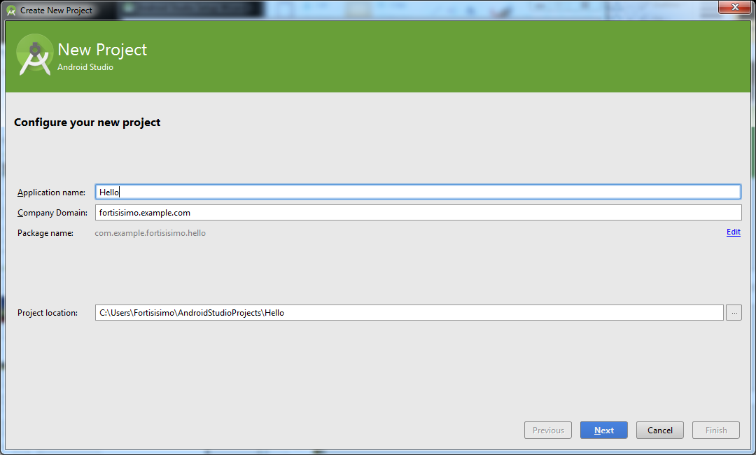
Creating a new project

Slide 15
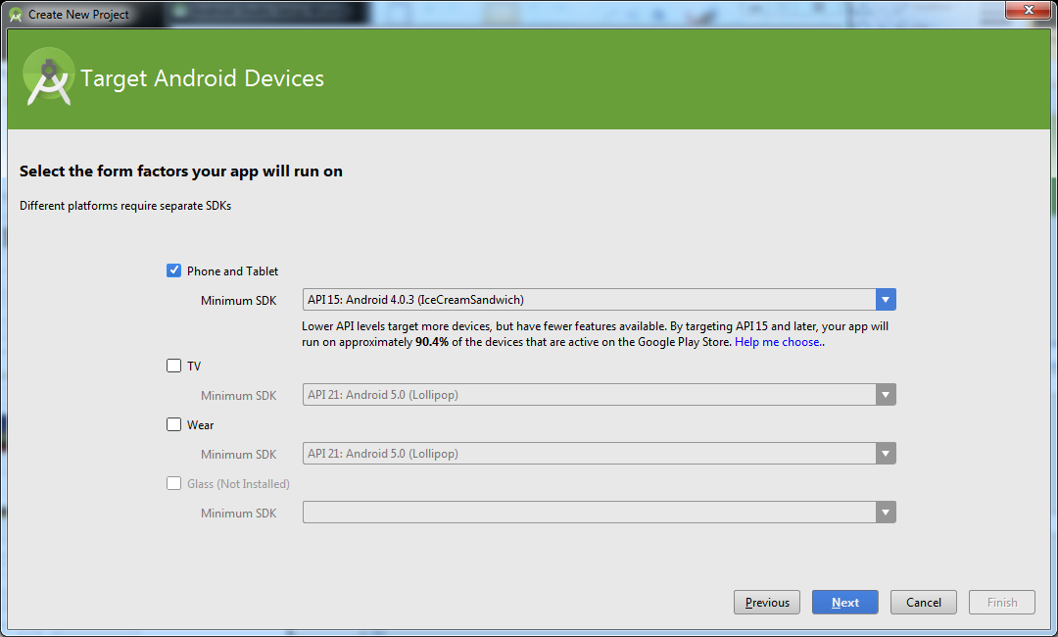
Creating a new project

Slide 16
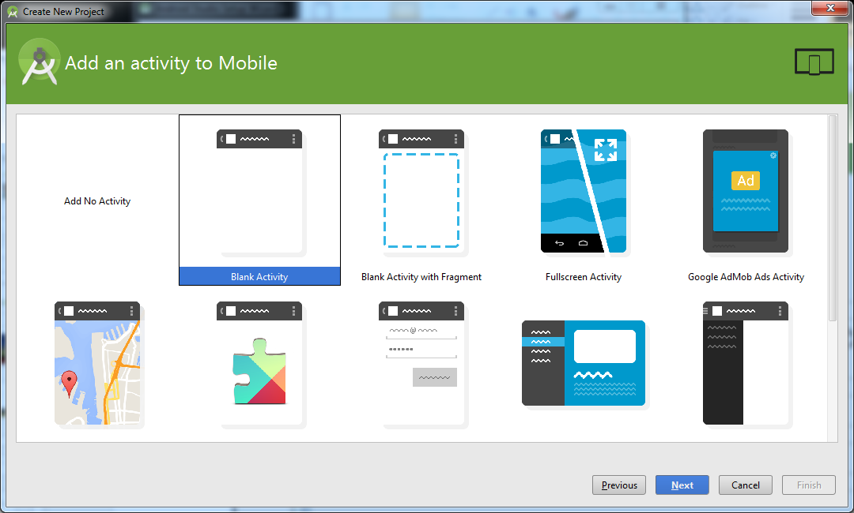
Creating a new project

Slide 17
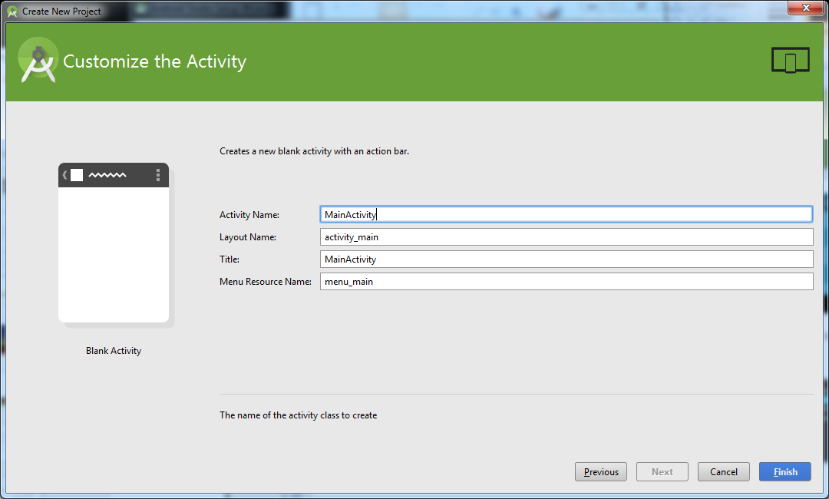
Creating a new project

Slide 18
Creating a new project

Slide 19
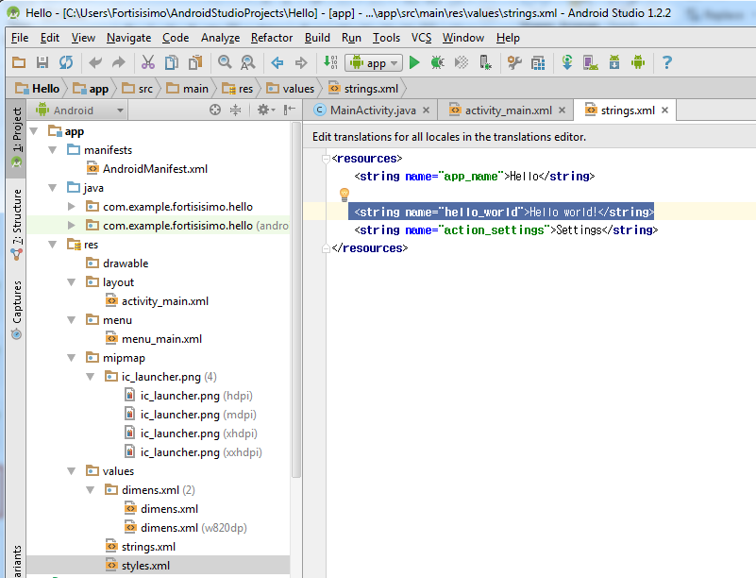
Creating a new project

Slide 20
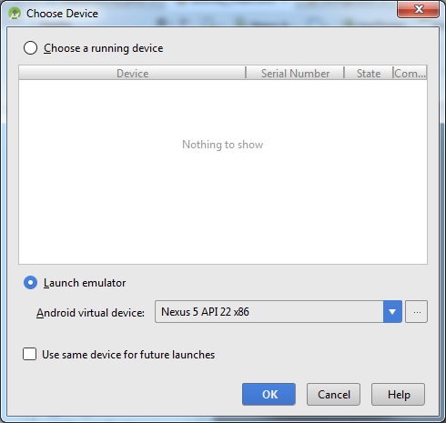
Emulator
Notes:
To run the app, disconnect your phone first, then click the run button in Android Studio. In Choose Device dialog, check Launch emulator and click OK. A device window will pop up. Android Studio will installs the app (the Hello.apk) on your AVD and starts it. this could take sometime, so go for a coffee

Slide 21
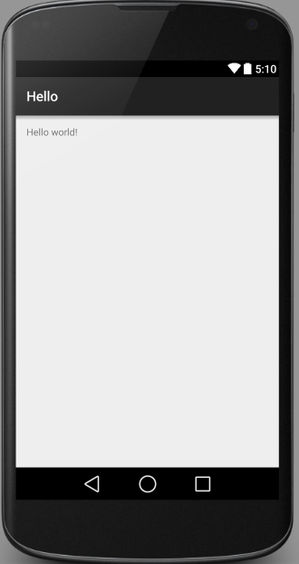
Output

