Slide 1
Day 2 Android Programming :First Application
Prof. Seongwook Youn
Department of Software
Korea National University of Transportation

Slide 2
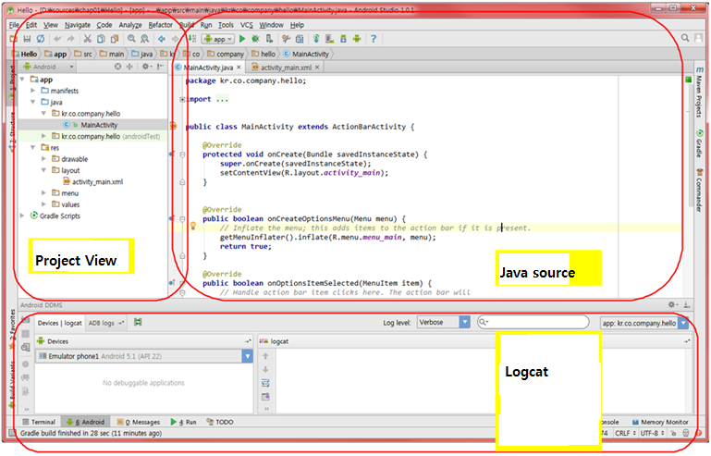
Application Components
Notes:
로그캣 – show several information during the application execution

Slide 3
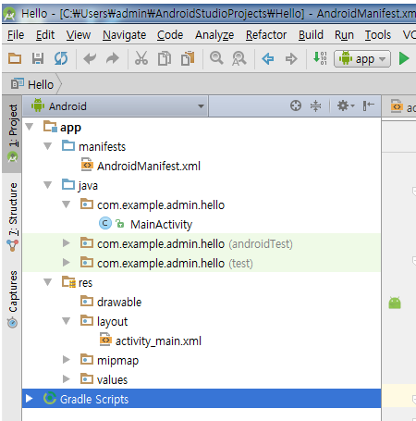
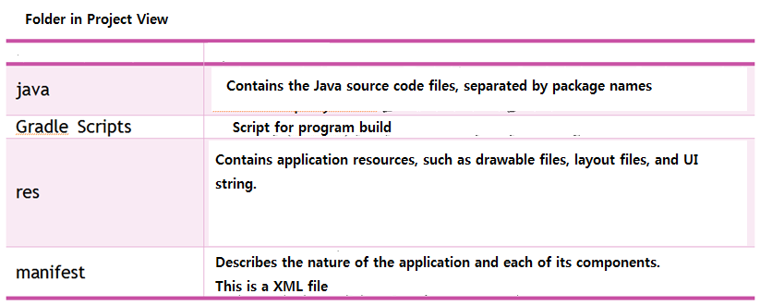
Package folder

Slide 4
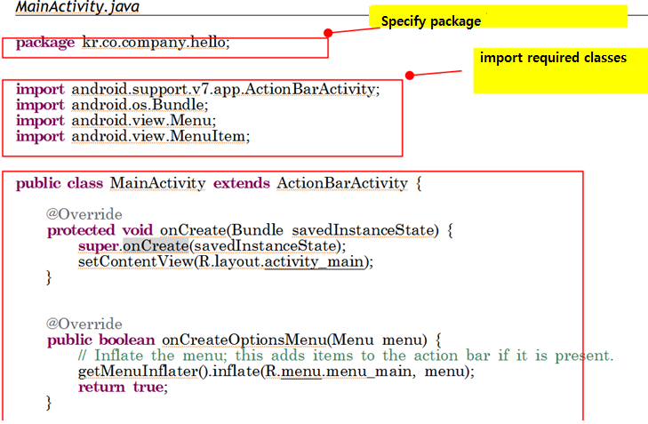
Automatically created source
Notes:
Android가 붙은 패키지는 android가 제공하는 package
Android에서 activity는 activity class로 생성된다. Activity는 화면을 통하여 사용자와 상호작용하는 활동을 의미.
For example, calling screen, taking a photo, sending an email, showing the map are all described by activity. Only one activity could be interacted at one time.
onCreate() method는 안드로이드 시스템에 의하여 activity가 생성되는 순간에 딱 한번 호출된다.
Super.onCreate()는 부모 클래스인 ActionBarActivity 클래스의 onCreate()를 호출
setContentView()는 activity의 화면을 설정하는 함수

Slide 5
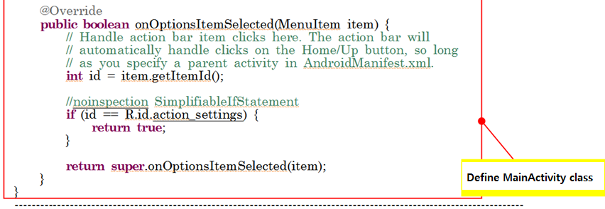
Automatically created source

Slide 6
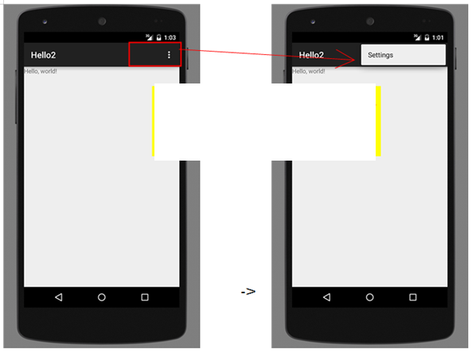
Output of auto-created code
Notes:
Hello run

Slide 7
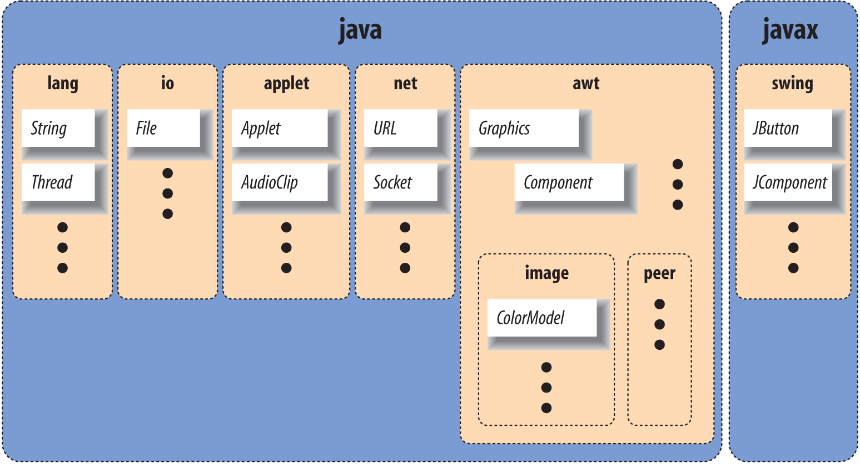
package kr.co.company.hello;
Package is a container of classes
Generally, use in reverse order of internet domain

Slide 8
import android.support.v7.app.ActionBar…
import statements make it possible to abbreviate references to data and methods in other packages
Android packages like
“import android.support.v7.app.ActionBar” are provided by Android

Slide 9
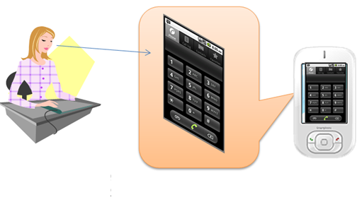
public class MainActivity extends ActionBarActivity { ... }
Definition of class
This is an activity because MainActivity inherits Activity.
Activity is an application component that provides a screen with which users can interact in order to do something
Notes:
Activity, service, broadcast receiver, content provider

Slide 10
Four app components
four types of app components
Activity, service, broadcast receiver, content provider
Activities
An activity represents a single screen with a user interface. For example, an email app might have one activity that shows a list of new emails, another activity to compose an email, and another activity for reading emails. Although the activities work together to form a cohesive user experience in the email app, each one is independent of the others. As such, a different app can start any one of these activities (if the email app allows it). For example, a camera app can start the activity in the email app that composes new mail, in order for the user to share a picture. An activity is implemented as a subclass of Activity

Slide 11
Four app components
Services
A service is a component that runs in the background to perform long-running operations or to perform work for remote processes. A service does not provide a user interface. For example, a service might play music in the background while the user is in a different app, or it might fetch data over the network without blocking user interaction with an activity. Another component, such as an activity, can start the service and let it run or bind to it in order to interact with it.

Slide 12
Four app components
Content providers
A content provider manages a shared set of app data. You can store the data in the file system, an SQLite database, on the web, or any other persistent storage location your app can access. Through the content provider, other apps can query or even modify the data (if the content provider allows it). For example, the Android system provides a content provider that manages the user's contact information. As such, any app with the proper permissions can query part of the content provider to read and write information about a particular person.

Slide 13
Four app components
Broadcast receivers
A broadcast receiver is a component that responds to system-wide broadcast announcements. Many broadcasts originate from the system—for example, a broadcast announcing that the screen has turned off, the battery is low, or a picture was captured. Apps can also initiate broadcasts—for example, to let other apps know that some data has been downloaded to the device and is available for them to use. Although broadcast receivers don't display a user interface, they may create a status bar notification to alert the user when a broadcast event occurs. More commonly, though, a broadcast receiver is just a "gateway" to other components and is intended to do a very minimal amount of work. For instance, it might initiate a service to perform some work based on the event.

Slide 14
@Override
Annotation type used to mark methods that override a method declaration in a superclass.
Annotation provides compiler with an additional information
@Override means that method overrides the method of parent class

Slide 15
public void onCreate() { … }
onCreate() method initializes your activity.
All kinds of initialization and user interface settings are here

Slide 16
super.onCreate(savedInstanceState);
It calls onCreate() of parent class ActionBarActivity class

Slide 17
setContentView(R.layout.activity_main);
The function setContentView() sets screen of activity
R.layout.activity_main is activity_main.xml

Slide 18
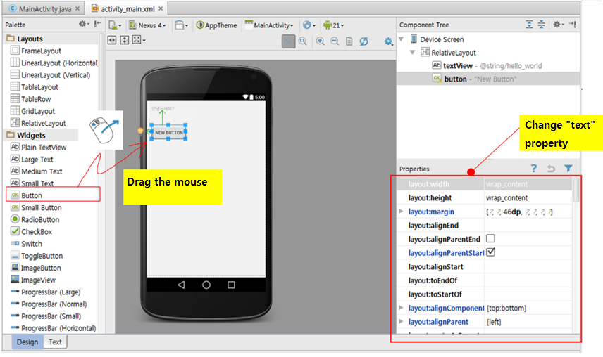
Automatically created source change
Notes:
Res/values/strings.xml에서 “Hello World!”를 “안녕하세요”로 바꿔본다.
폰트변경 – File/settings -> Editor/Colors & Fonts -> Font에서 Save As를 누르고 Font 조정 후 저장

Slide 19
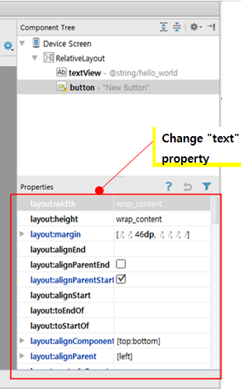
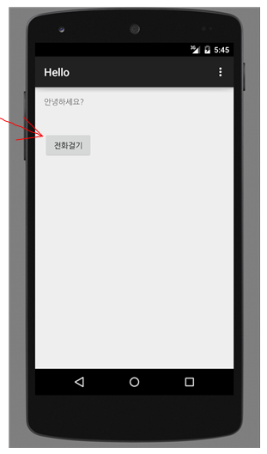
Change button’s text

Slide 20
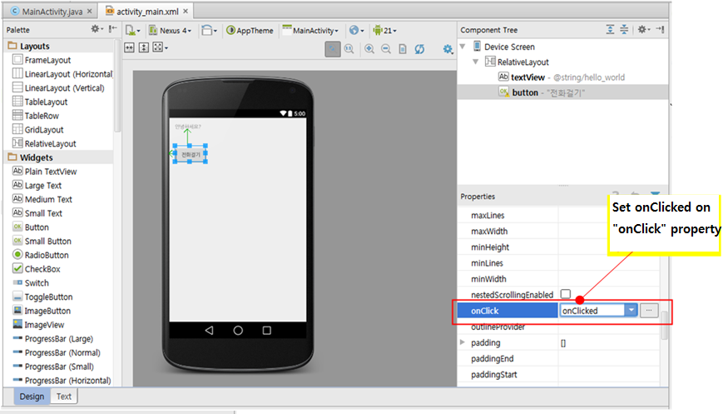
Change “onClick” property

Slide 21
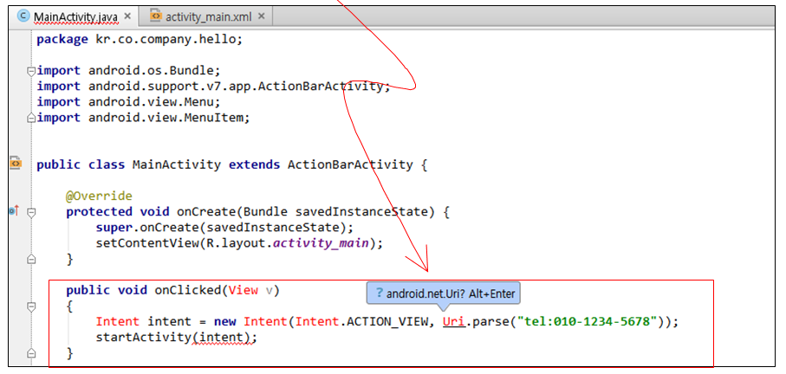
Add source
Notes:
To import required new packages, press “Alt + enter”

Slide 22
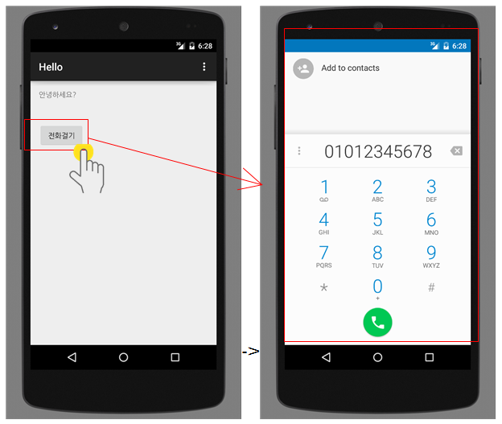
Run modified app
Notes:
에뮬레이터가 load되지 않으면. C:에서 avd manager.exe 파일을 찾는다.

Slide 23
TIP
IntelliJ IDEA offers an option to Optimize imports on the fly in File|Settings | Editor | General | Auto Import and Optimize imports option in the Commit Project dialog

Slide 24
Starting point of Android application
No main() in Android
Each activity runs individually
First run onCreate() method among many activities

Slide 25
Describe UI using XML
How to create UI
Use code(Traditional Java)
Use xml(Android prefer)
Android
Separate application appearance and application logic
Construct UI quickly

Slide 26
General Application Development Procedure
Write User Interface (XML)
Write java code(Java)
Write manifest file (XML)

Slide 27
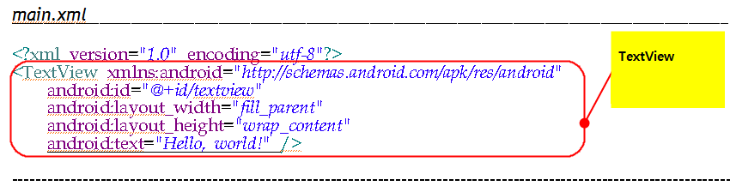
UI creation using XML
Java code UI ➔ XML UI
TextView tv = new TextView(this);
tv.setText("Hello, world!");

Slide 28
UI creation using XML
UI components can be represented as each element of XML
TextView component is represented as <TextView…/>

Slide 29
Analysis of XML file
<?xml version="1.0" encoding="utf-8"?>
<TextView xmlns:android="http://schemas.android.com/apk/res/android"
android:id="@+id/textview"
android:layout_width=＂match_parent"
android:layout_height="wrap_content"
android:text="Hello, world!" />
Notes:
다른 마크업 언어가 아닌 Xml 파일임을 나타냄. Use Unicode

Slide 30
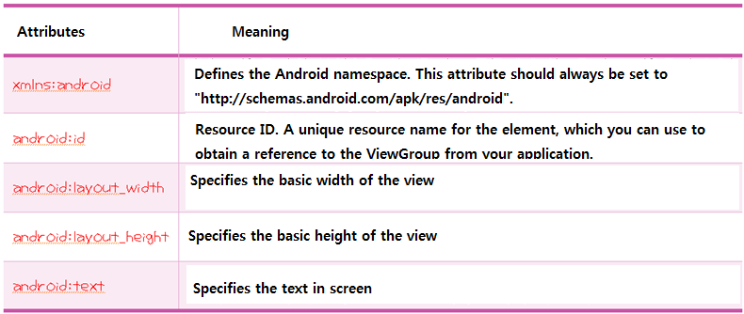
<TextView> attributes

Slide 31
XML
Logical elements are written with a start tag, with an end tag, with the content in between
<Greeting>Hello, world.</Greeting>
Attribute consists of “name/value” pair
<img src="madonna.jpg" alt='by Raphael'/>
img element has 2 attributes (src and alt)

Slide 32
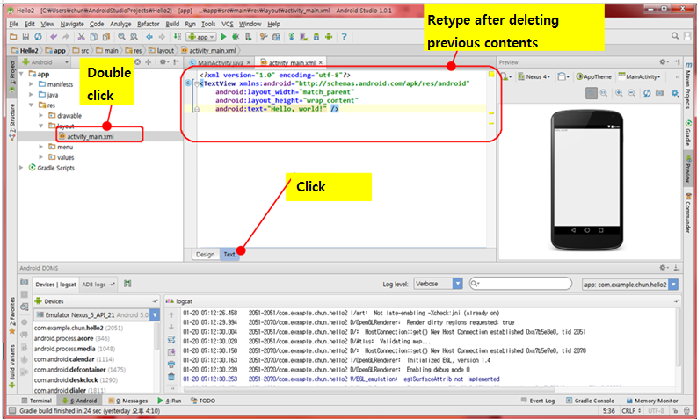
Location of XML file
Notes:
Hello 2

Slide 33
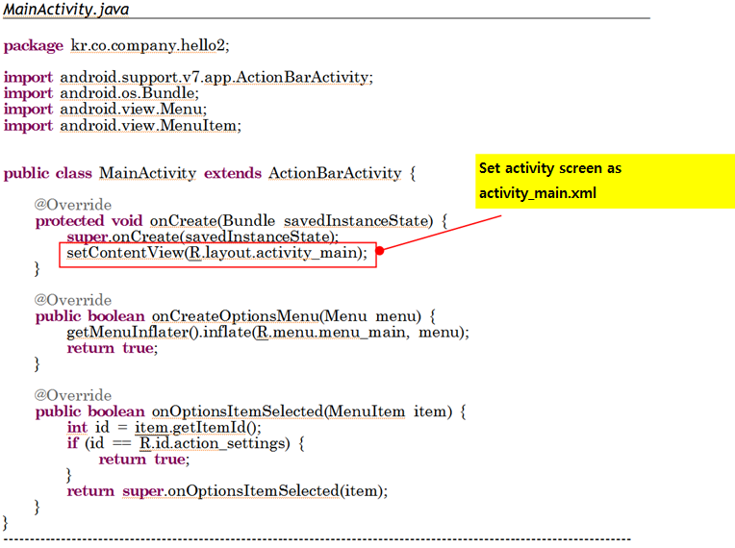
Connecting XML file to java code

Slide 34
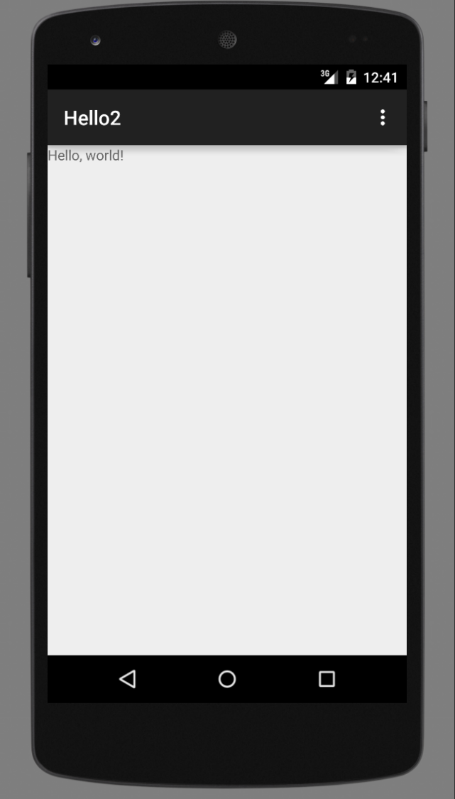
Output

Slide 35
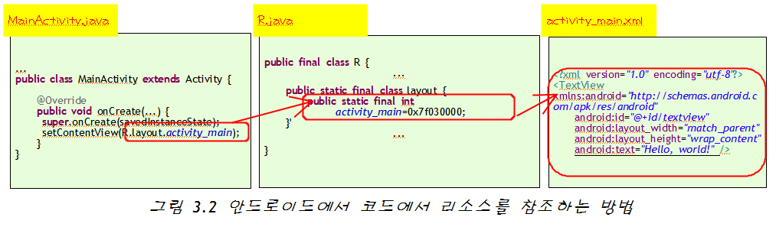
How to reference resource from java code
Notes:
각 리소스마다 겹치지 않는 식별자를 하나씩 부여한다. R.java에 모여있다.
각 리소스 타입별로 내부 클래스 작성

Slide 36
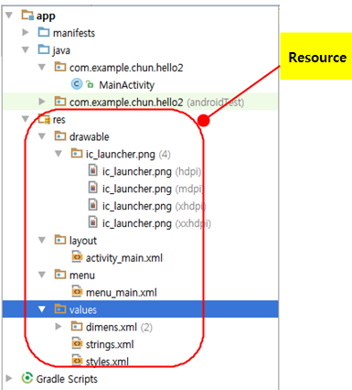
Resource
Android treats layout, image, string values, etc.

Slide 37
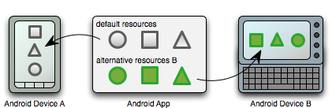
Why code and resources are separate?
Handle resource based on different devices.

Slide 38
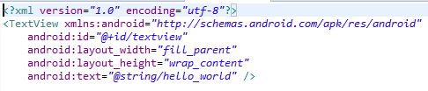
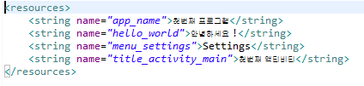
String resource
It is desirable that strings are described in xml
English, Korean, etc.

Slide 39
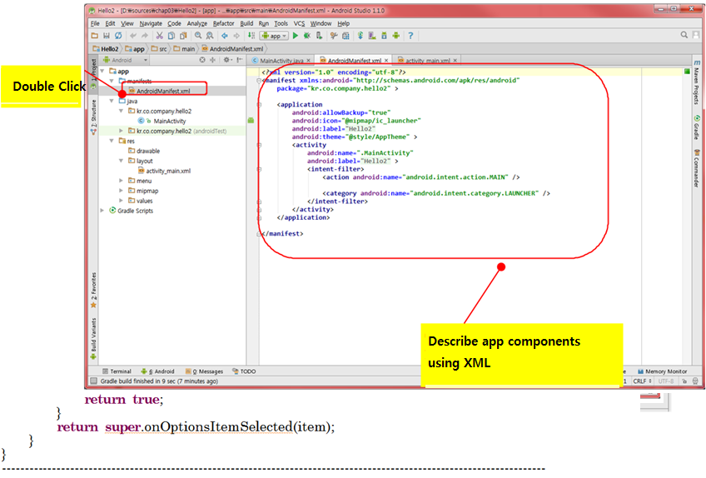
Manifest file
Notes:
앱에 들어가는 모든 컴포넌트에 대해 기술.

Slide 40
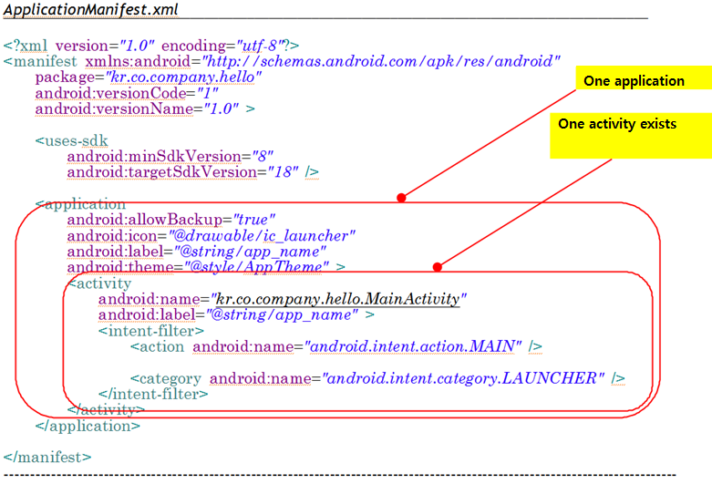
Manifest file

Slide 41
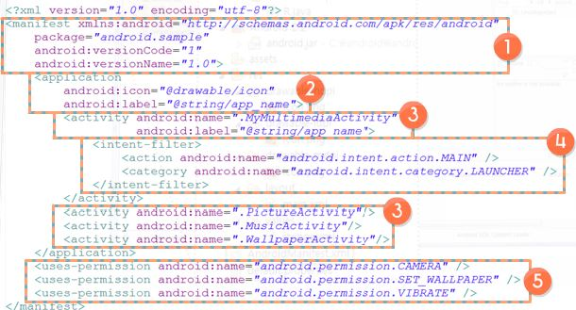
What’s in AndroidManifest.xml
1. <manifest> - package name, version info
2.<application> - Define app name and icon. Define only one <application> under <manifest>
3.<activity>- Define activity among four component. Define class name and label
4.<Intent-filter>- <action> define which job will be processed. <categoty> define type of component. Four activities are defined in this example
5.<uses-permission>- define resource access and authority for use. Camera, wall paper setting, and vibration capability are authorized to use in this example

Slide 42
Connecting to real device
Install USB driver
Turn on “USB debugging” in the device
Select to appropriate device in the Android studio
Samsung Galaxy series
Universal USB driver download & install
http://local.sec.samsung.com/comLocal/support/down/kies_main.do?kind=usb
LG G series
LG United mobile driver download & install
http://www.lgmobile.co.kr/lgmobile/front/main/mainList.dev#cur

Slide 43
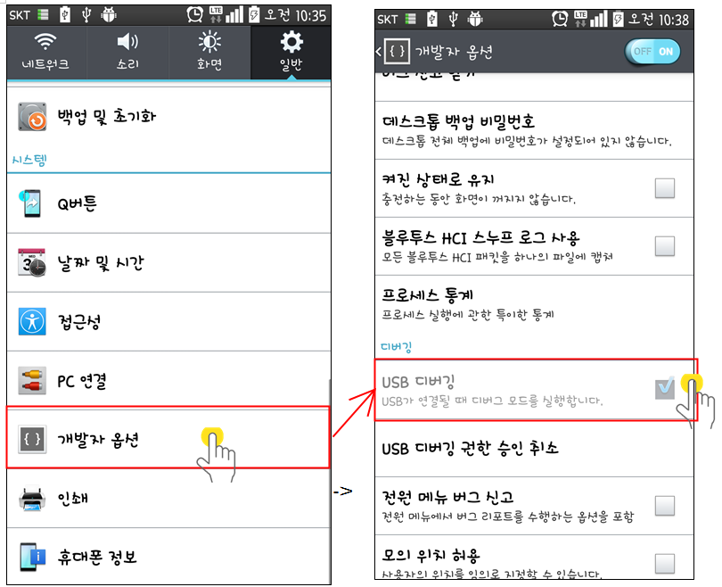
Turning on USB Debugging mode

Slide 44
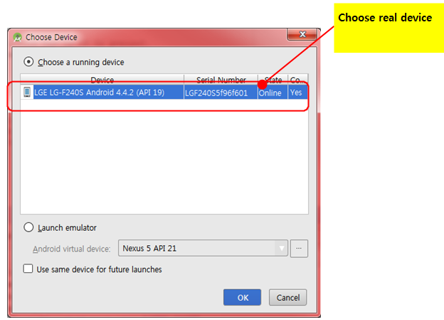
Choose device

Slide 45
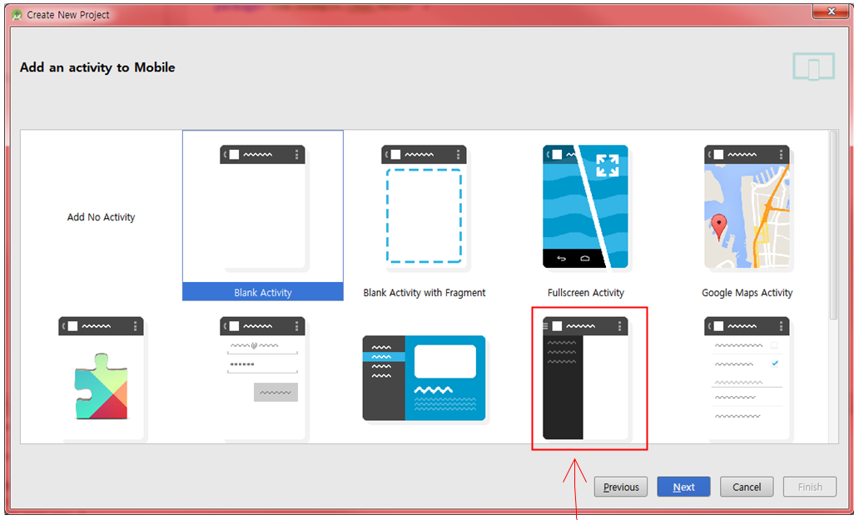
Several type of activities

Slide 46
Example - Hello4
Example
Create new project “Application name” as “Hello4”
Choose “Phone and Tablet” in“Select the form factors”
Choose “Navigation Drawer Activity” in “Add an activity to Mobile”
Run Emulator (AVD)
Run the application
Application Execution
Section 1, 2, 3
Each section covers entire screen when you choose each section (blank screen)
Return menu selection screen when you press the left of name of application

Slide 47
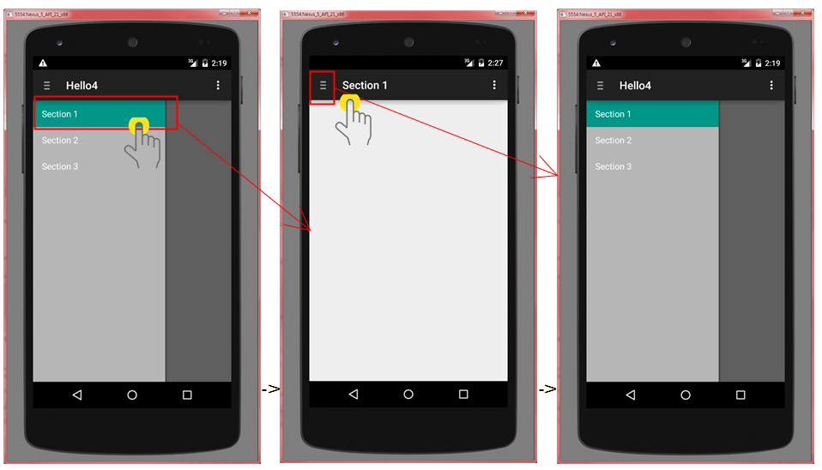
Output
Notes:
Fragment를 사용해서 화면 분할을 하고 있다. 화면이 커지면서 이렇게 화면을 나누어 사용하는 방식이 인기

Slide 48
Summary
Application composed of several components
Separate code and resource thoroughly
Code and resource are connected through R.java created automatically by development tool

