Slide 1
Android Programming :UI Basics
Prof. Seongwook Youn
Department of Software
Korea National University of Transportation

Slide 2

UI Basic

Slide 3
User Interface Basic
Don’t use Java’s Swing
Java’s swing is a memory hog
It uses quite a lot of memory
Android UI controls
There are number of UI controls provided by Android that allow you to build the graphical user interface for your app
Notes:
Android SDK includes button, list, etc.

Slide 4
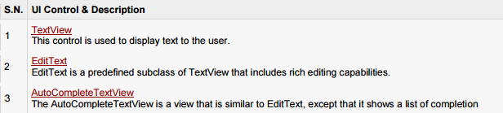
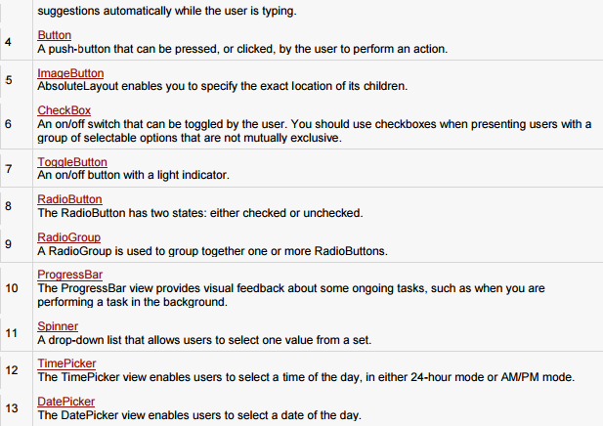
User Interface Basic

Slide 5
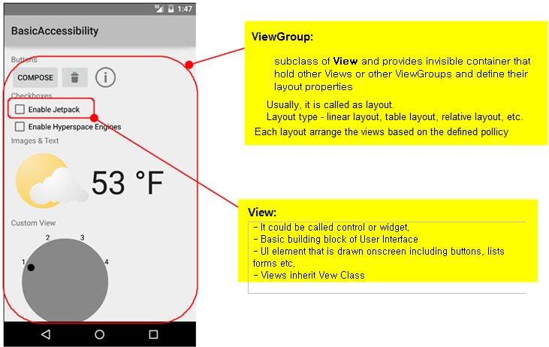
View and ViewGroup

Slide 6
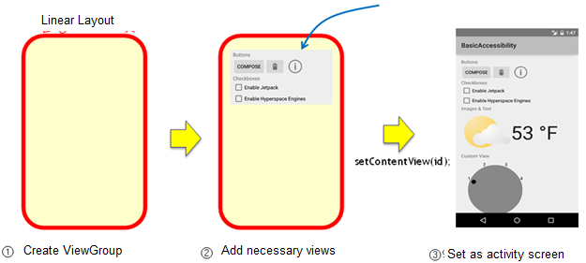
UI Design Procedure
Create ViewGroup
Add necessary views
Set as activity screen

Slide 7
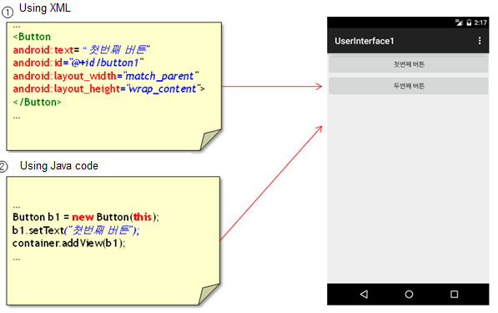
3 ways of UI design
Using XML
Using Java code
Mix of XML and Java code

Slide 8
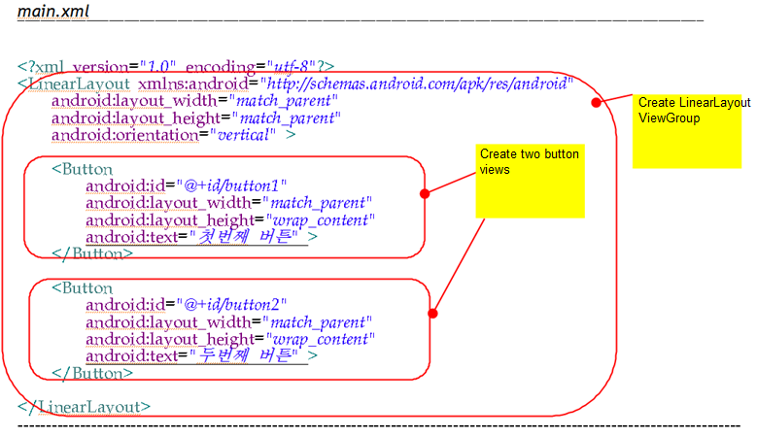
UI Design using XML
Notes:
LinearLayout은 container역할을 한다. 내부에 2개의 button요소를 정의한다. UserInterface1 실행

Slide 9
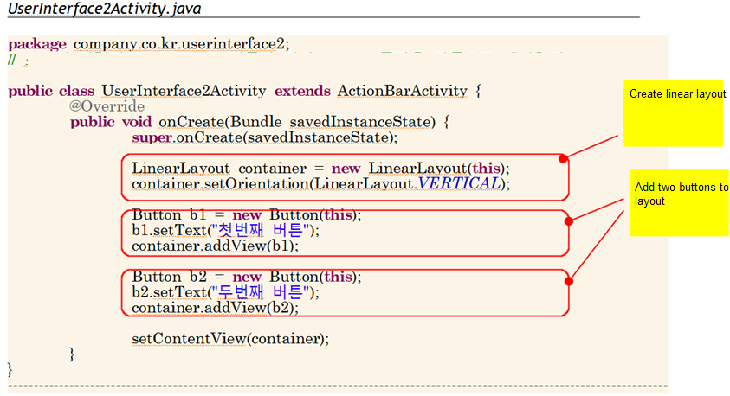
UI Design using Java Code

Slide 10
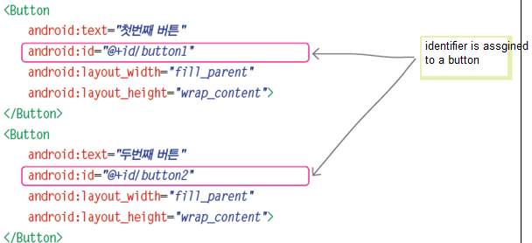
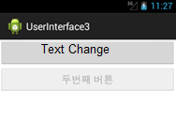
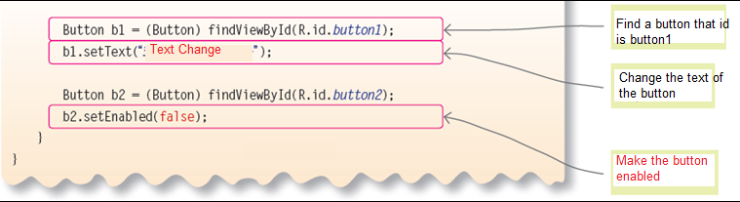
Combination of XML and Java code
Notes:
@는 리소스에서 참조, +는 새로 생성한다는 의미, id는 식별자를 나타내는 패키지 이름이며 button1이 실제로 첫 번째 버튼의 식별자가 된다. UserInterface3 실행

Slide 11
How to create a view
XML
Java code
Combination of XML and Java code

Slide 12
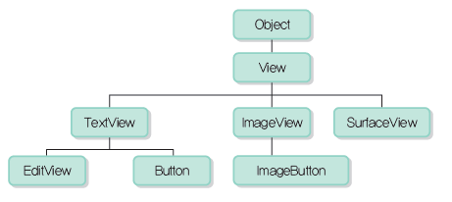
View
View class is parent class of every views
Field or method of View class can be commonly used by all the views

Slide 13
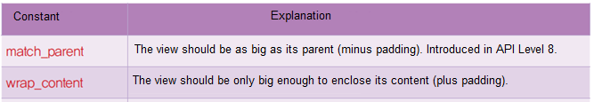
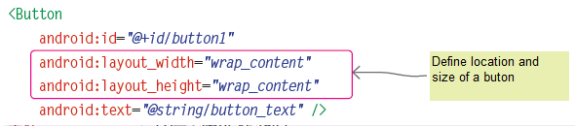
Field and Method of View
id
Identifier of view
Location and size of view
Notes:
LinearLayoutTest01 실행

Slide 14
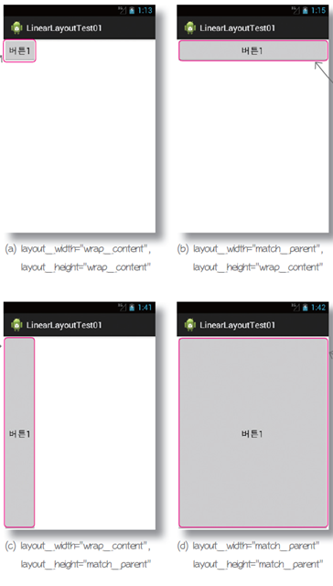

Slide 15
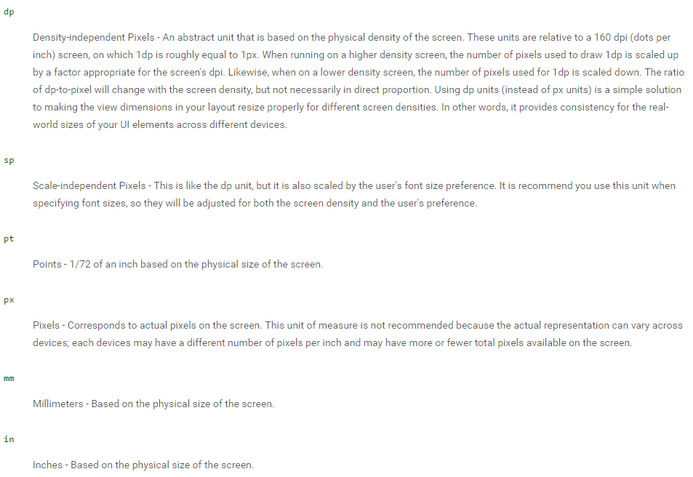
Dimension of View

Slide 16
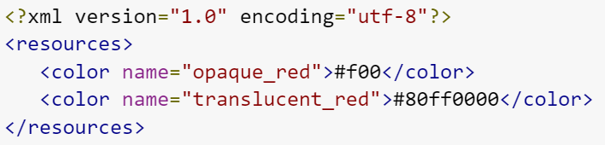
Color
A color value defined in XML. The color is specified with an RGB value and alpha channel. You can use a color resource any place that accepts a hexadecimal color value.
#RGB
#ARGB
#RRGGBB
#AARRGGBB

Slide 17
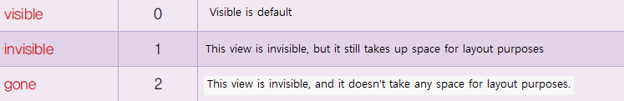
Visibility Attribute on Screen

Slide 18
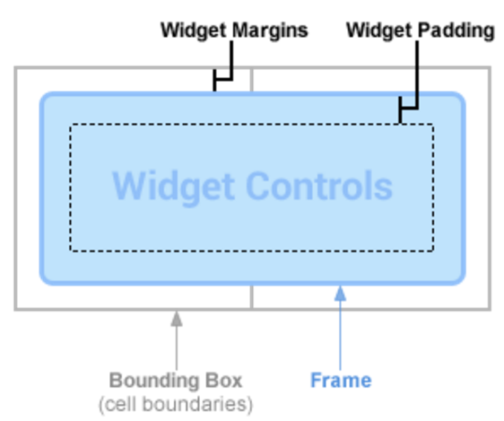
Margins and Padding
Margin – gap between the bounding box and frame
Padding – gap between the frame and widget controls

Slide 19
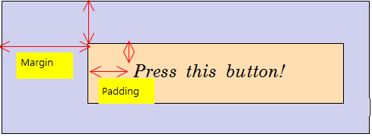
Margin and Padding
paddingLeft, paddingRight, paddingTop, paddingBottom
layout_marginLeft, layout_marginRight, layout_marginTop, layout_marginBottom

Slide 20
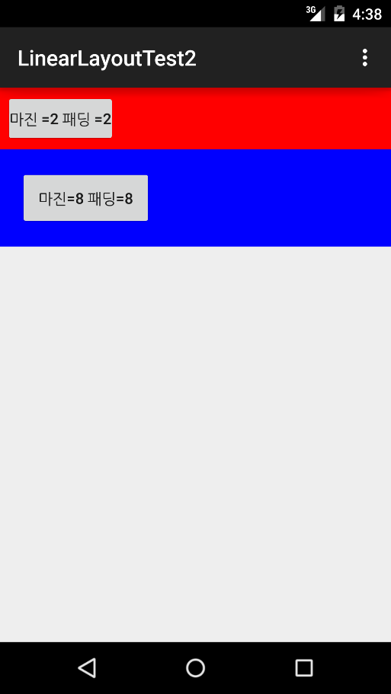
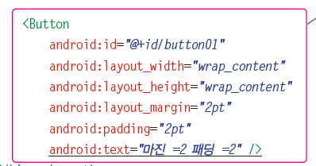
Example of Magin and Padding
Notes:
LinearLayoutTest2 실행

Slide 21
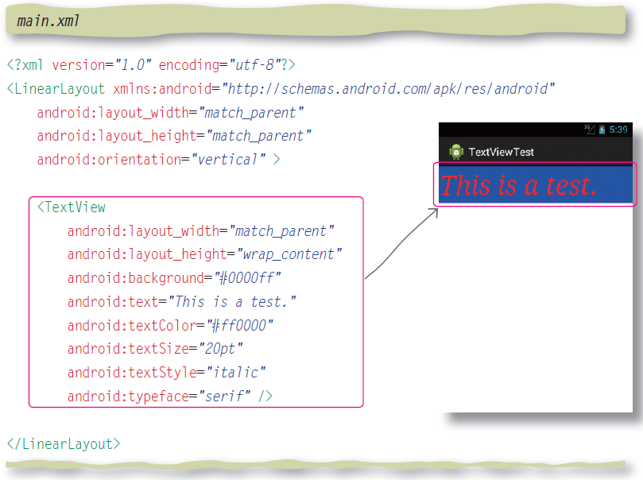
TextView

Slide 22
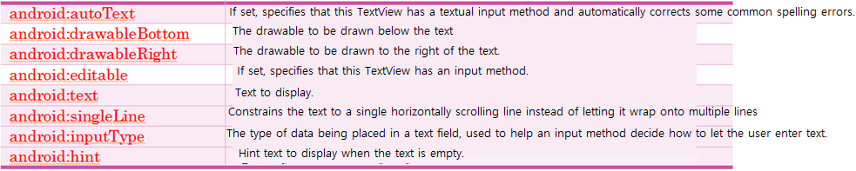
EditText

Slide 23
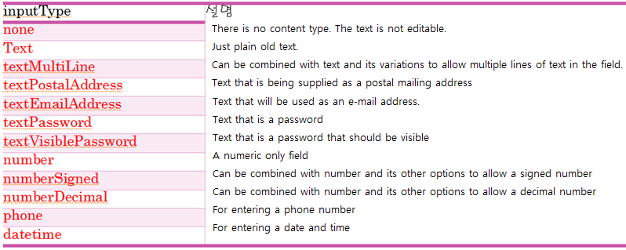
Attribute of inputType

Slide 24
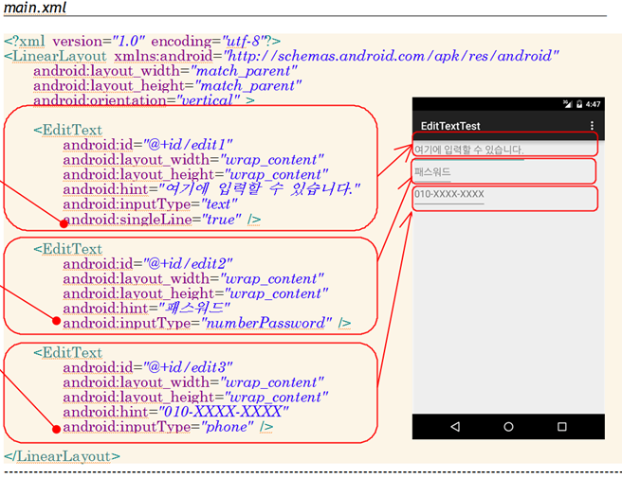
Example of EditText

Slide 25
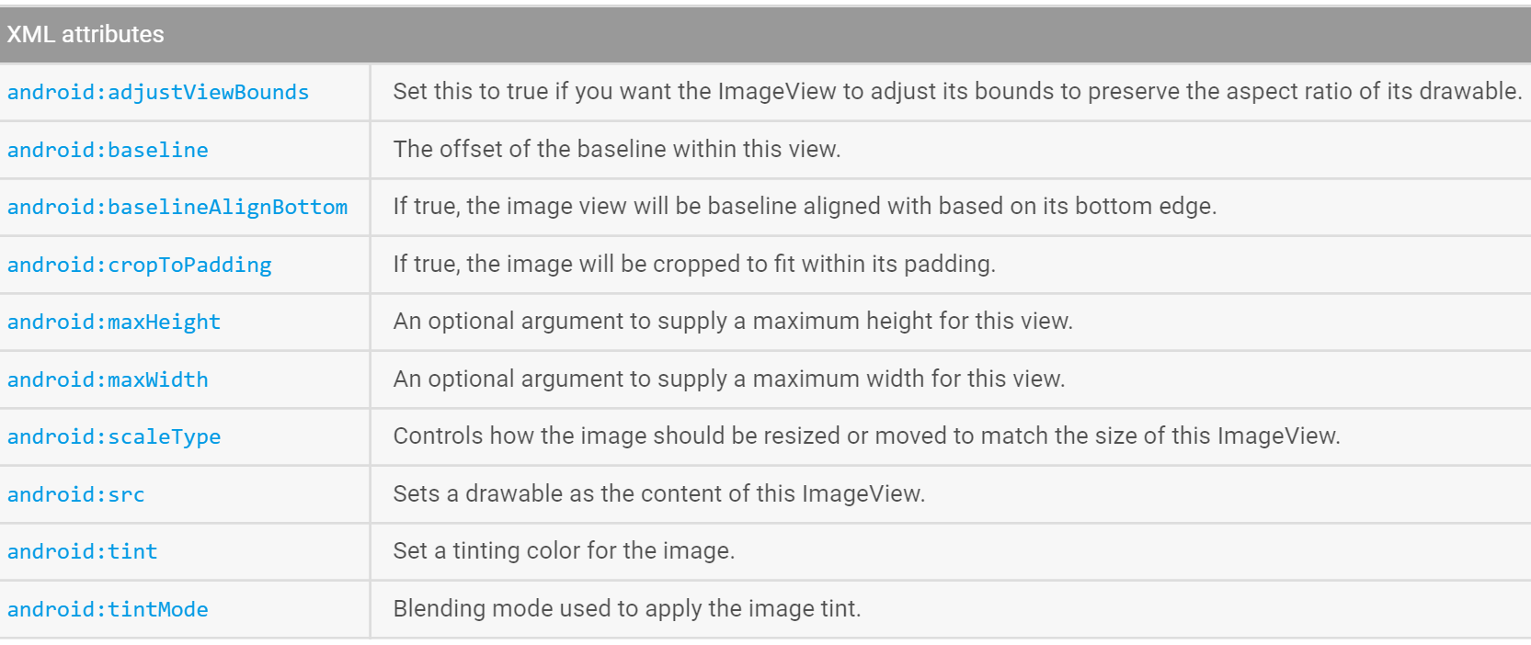
ImageView
Displays an arbitrary image, such as an ico

Slide 26
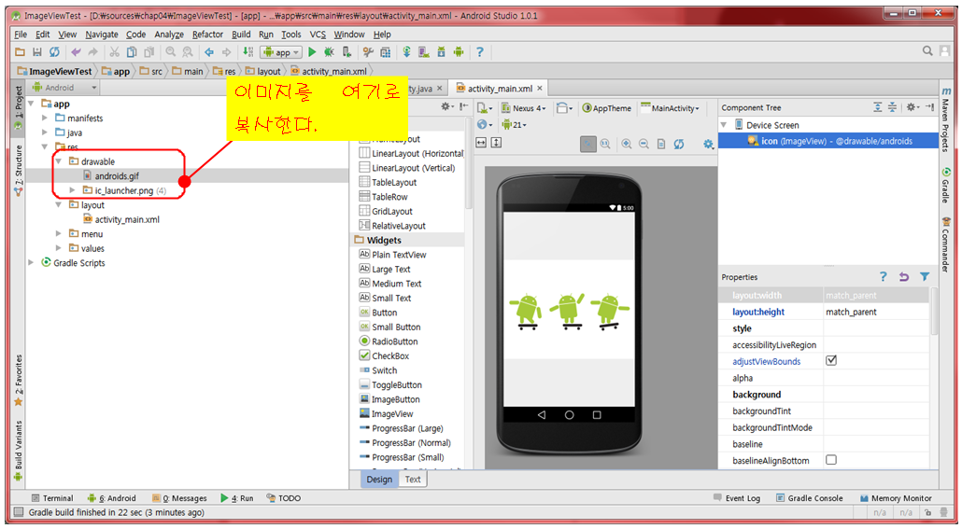
Use of ImageView
Copy an image to “src/drawable” folder.(Ctrl+C, Ctrl+V)

Slide 27
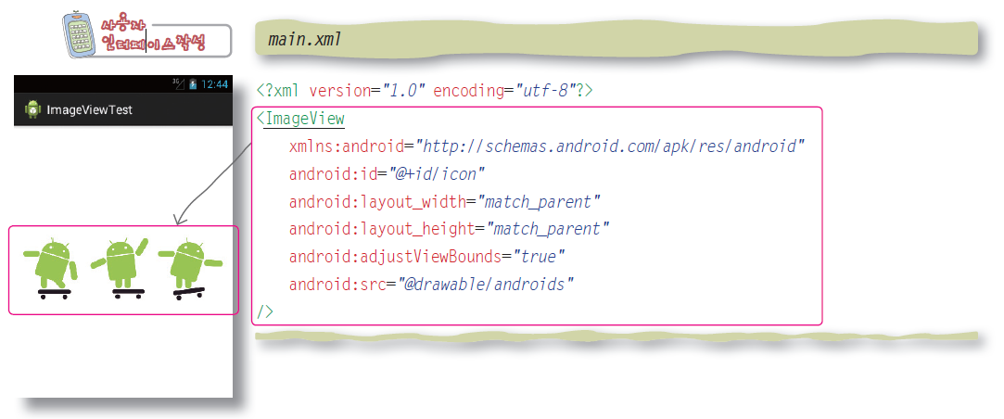
ImageView

Slide 28
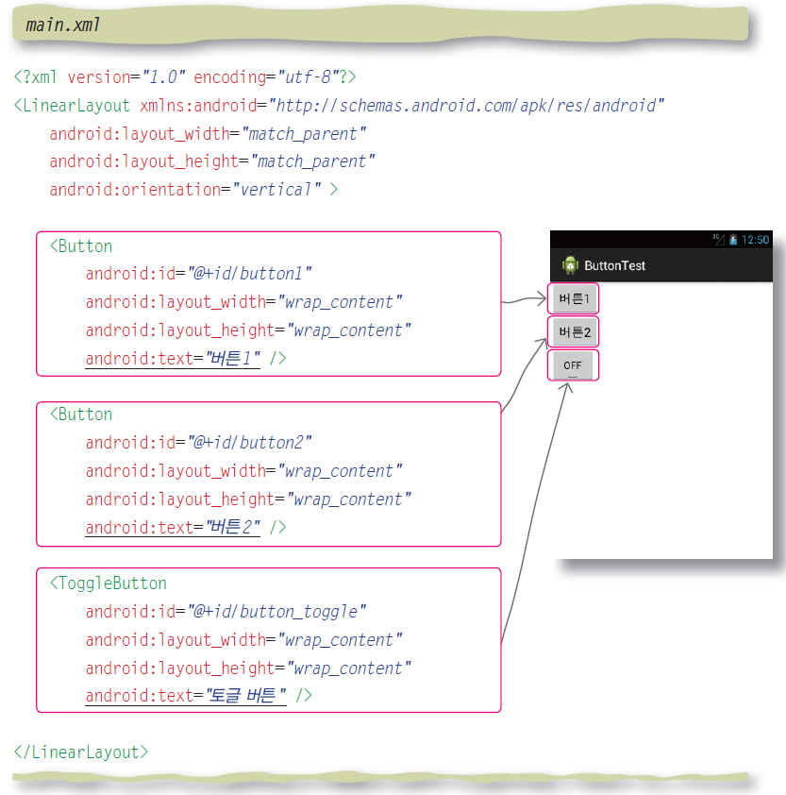
Button

Slide 29
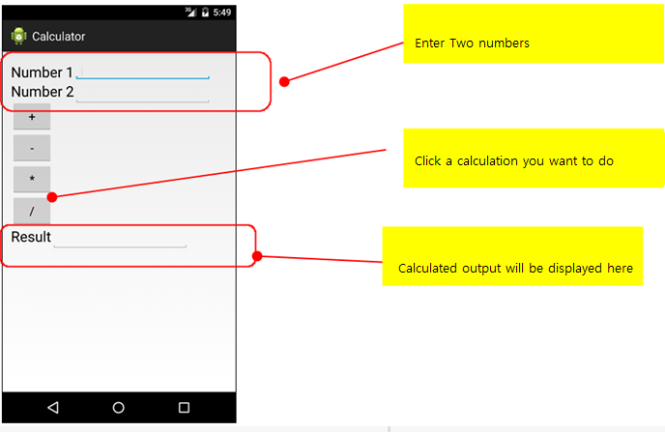
Lab: Calculator
Notes:
android:padding="2pt“ android:ems 글자수제한 Calculator 실행

