Slide 1
Android Programming :Layout
Prof. Seongwook Youn
Department of Software
Korea National University of Transportation

Slide 2
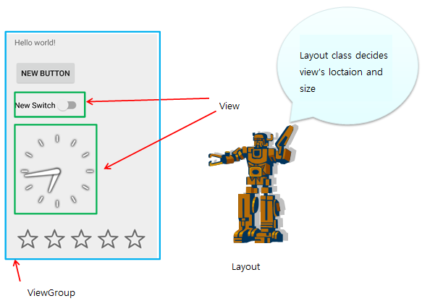
Layout
Defines the visual structure for a user interface, such as the UI for an activity or app widget.
Arrange views
Notes:
다양한 화면 크기를 가지기 때문에 절대적인 화면 위치를 사용하는 것 보다 상대적 뷰를 배치하는게 바람직하다.
Relative layout is more desirable than absolute layout because the screen size is different to each device

Slide 3
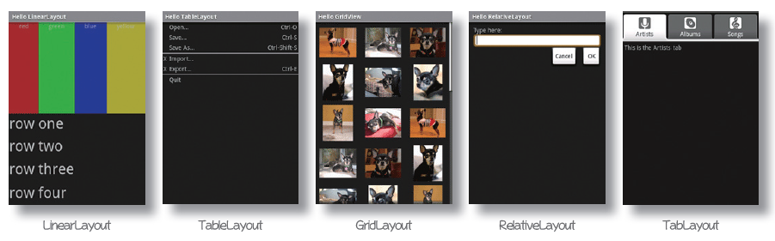
Layout Types
Notes:
그 외에 Absolutelayout, Framelayout이 존재

Slide 4
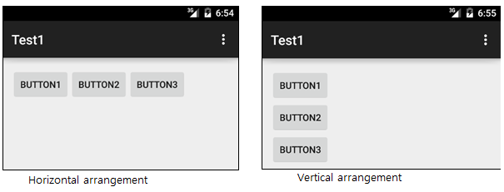
Linear Layout
View group that aligns all children in a single direction, vertically or horizontally. You can specify the layout direction with the android:orientation attribute

Slide 5
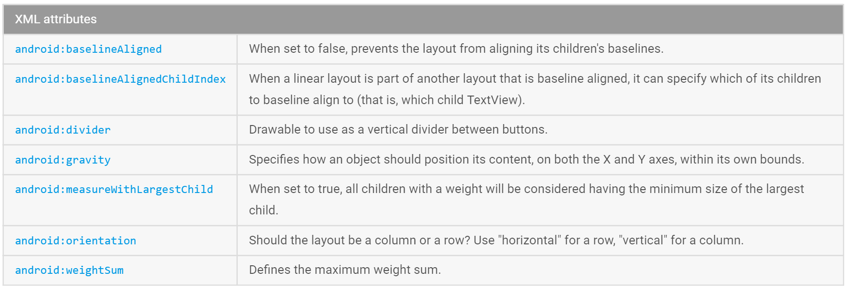
LinearLayout Class Attributes

Slide 6
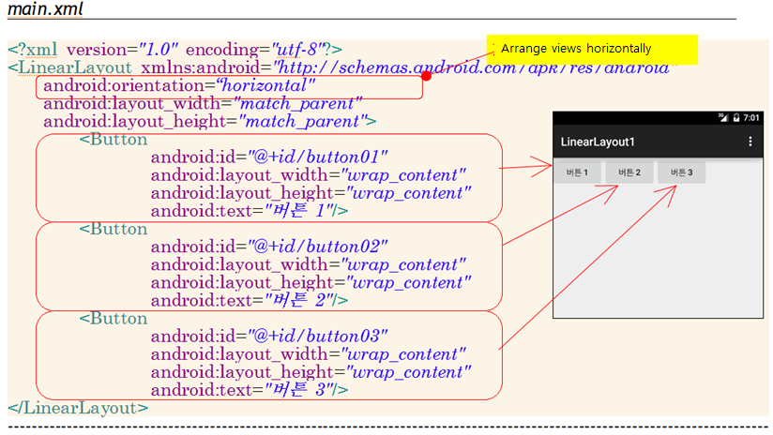
Linear Layout
Notes:
File -> New Project 에서 LinearLayout1 생성하고 xml 파일을 타입한다. Java화일은 변화 없다. Horizontal, vertical 바꿔본다.
LinearLayout1 실행

Slide 7
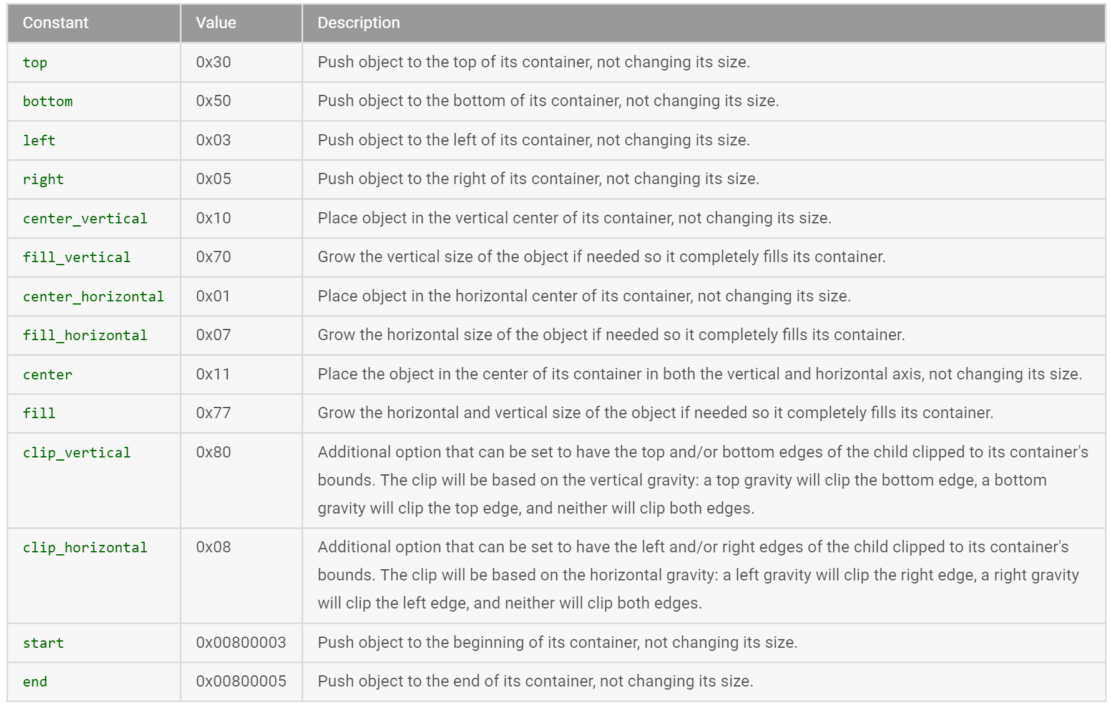
Gravity Attribute Values

Slide 8
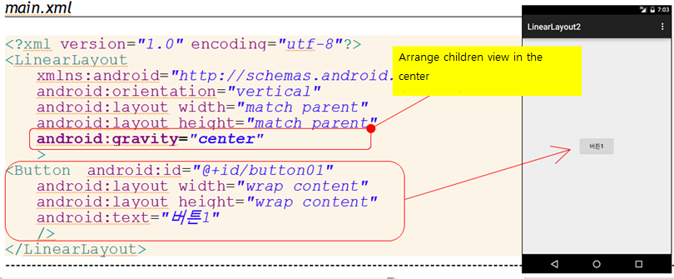
Gravity Attribute
Notes:
열려있는 project에서 Gravity 속성을 바꿔본다.

Slide 9
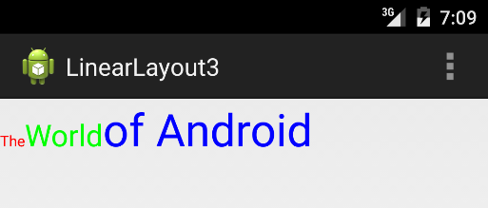
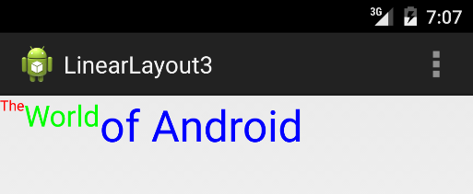
Baseline Alignment of Children Views
<LinearLayout xmlns:android="http://schemas.android.com/apk/res/android"
android:orientation="horizontal“
android:layout_width="fill_parent"
android:layout_height="fill_parent"
android:baselineAligned="true"
>
<LinearLayout
…
…
android:baselineAligned=＂false"
>
Notes:
LinearLayout3 프로젝트 생성

Slide 10
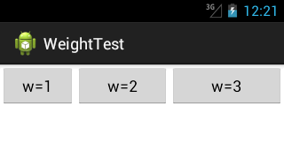
Weight
LinearLayout also supports assigning a weight to individual children with the android:layout_weightattribute. This attribute assigns an "importance" value to a view in terms of how much space it should occupy on the screen.
Each children views’ weights are 1,2,3, then remaining space are assigned to each view as 1/6, 2/6, 3/6

Slide 11
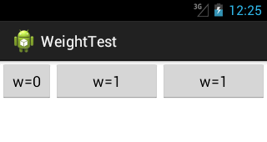
Weight
Two views’s weight is 1, then total remaining space is separated equally

Slide 12
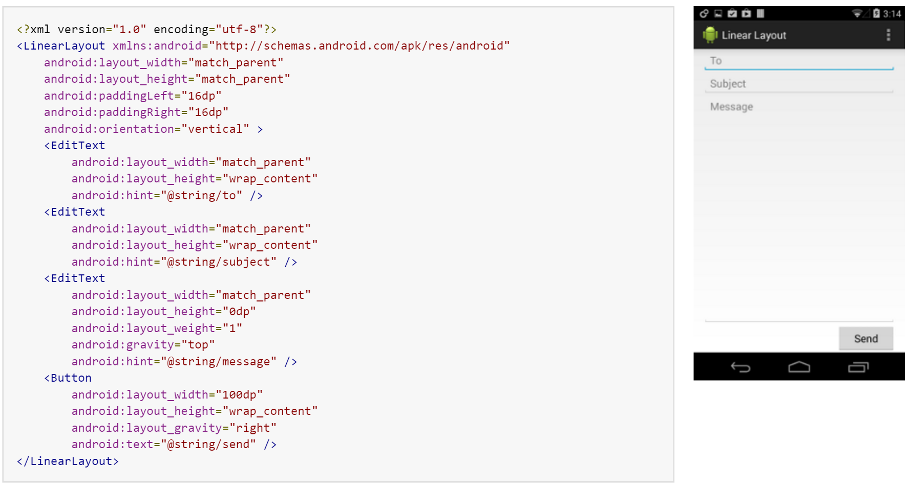
Example of Linear Layout

Slide 13
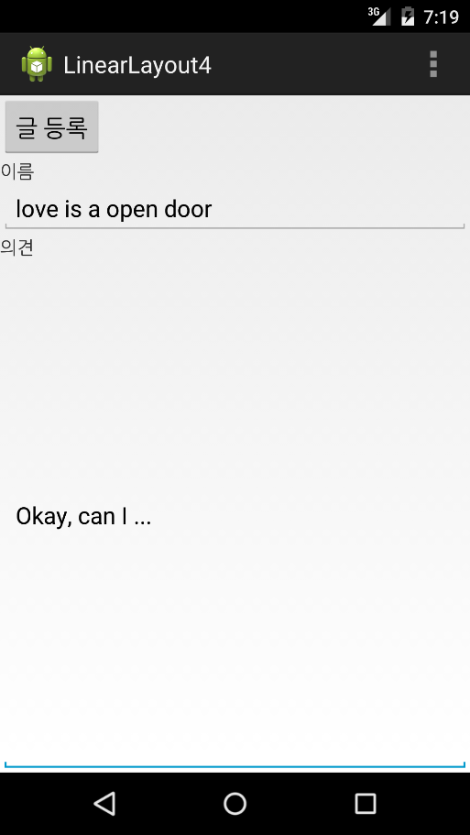
Example of weight
Weight of this EditText is 1 and all other views’ weight is 0

Slide 14
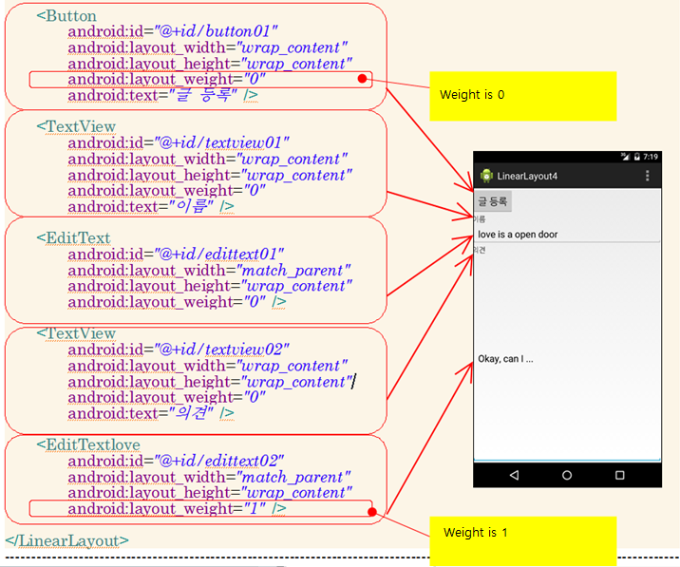
Notes:
LinearLayout4 실행

Slide 15
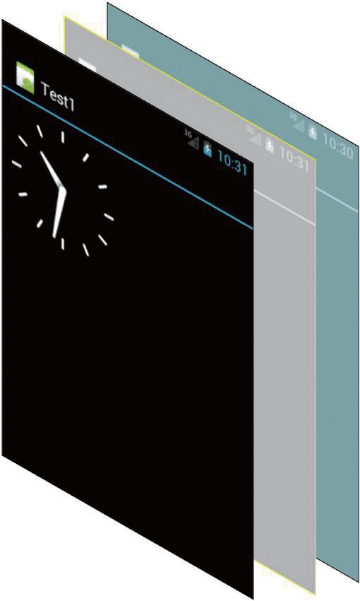
Frame Layout
FrameLayout is designed to block out an area on the screen to display a single item.

Slide 16
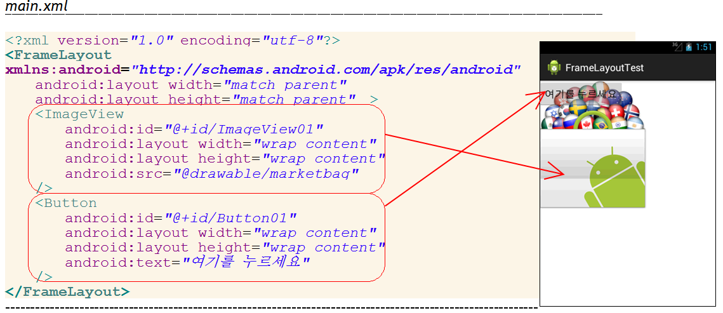
Frame Layout Example

Slide 17
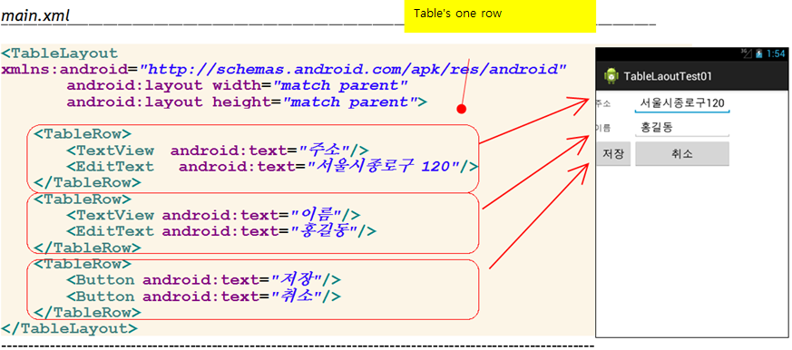
Table Layout
Notes:
TableLayoutTest01 실행

Slide 18
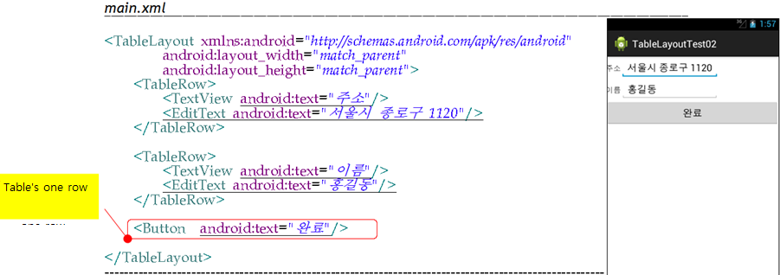
General View Could be one row

Slide 19
Relative Layout
RelativeLayout is a view group that displays child views in relative positions. The position of each view can be specified as relative to sibling elements (such as to the left-of or below another view) or in positions relative to the parent RelativeLayout are

Slide 20
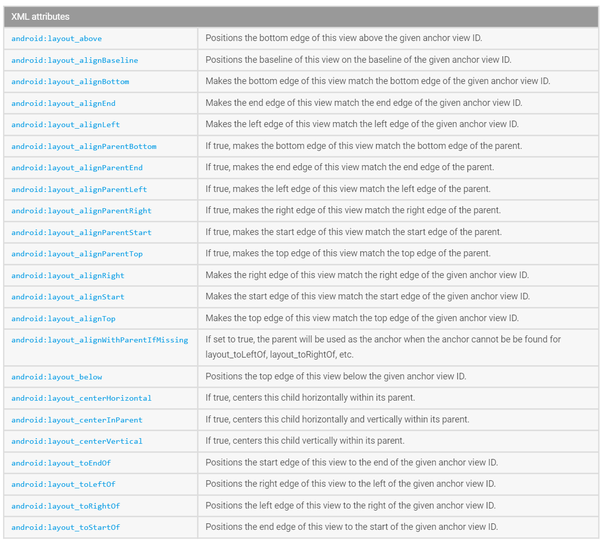
Relative Layout

Slide 21
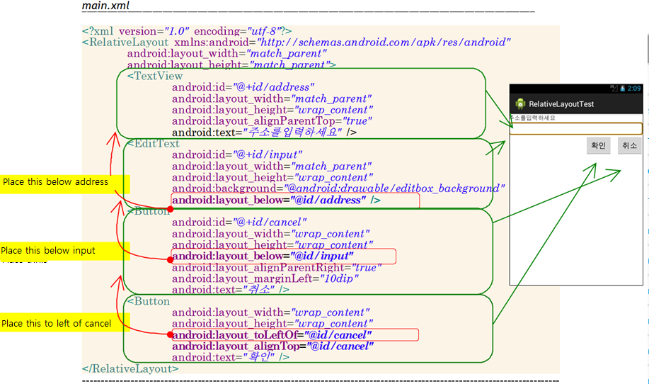
Relative Layout
Notes:
RelativeLayoutTest 실행

Slide 22
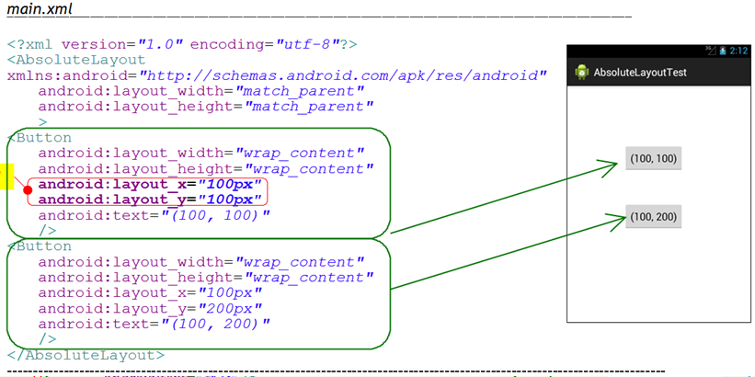
Absolute Layout

Slide 23
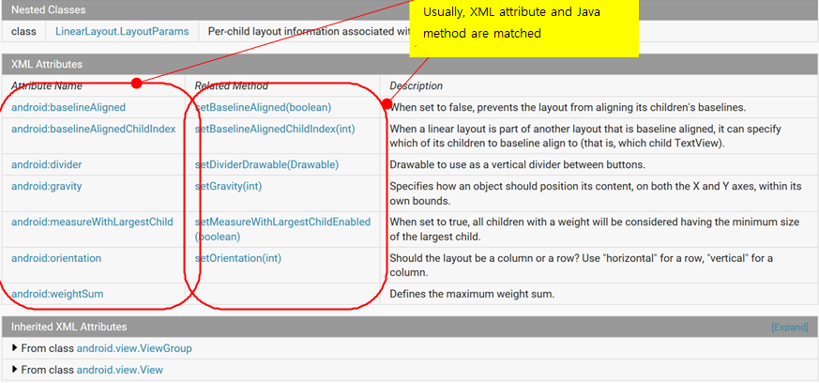
Change attributes by code

Slide 24
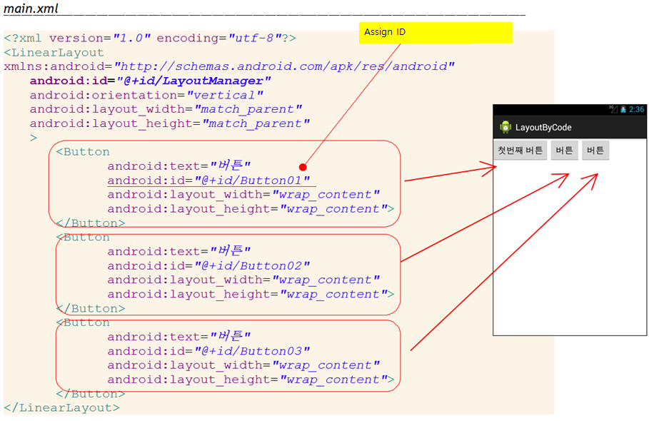
Attribute Change by Code

Slide 25
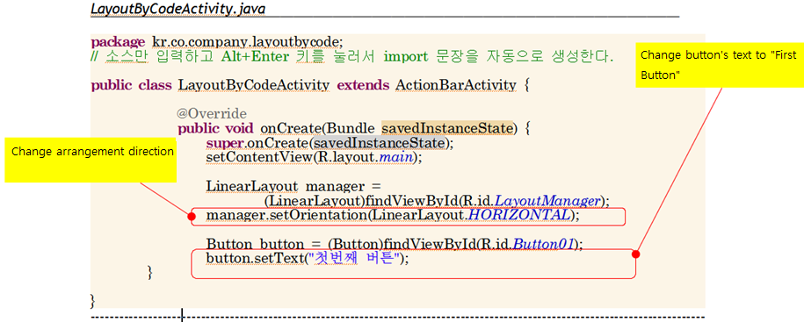
Attribute Change by Code
Notes:
LayoutByCode 실행

Slide 26
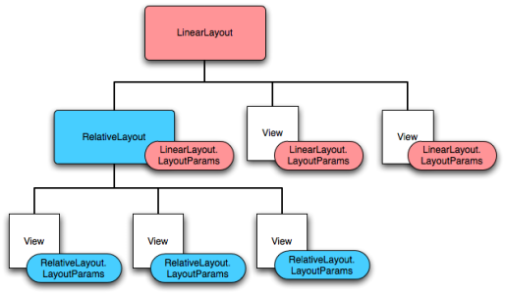
Create Layout Object by Code
Views’s structure

Slide 27
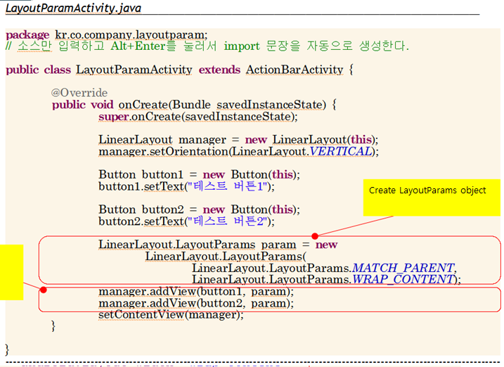
Create Layout by Code

Slide 28
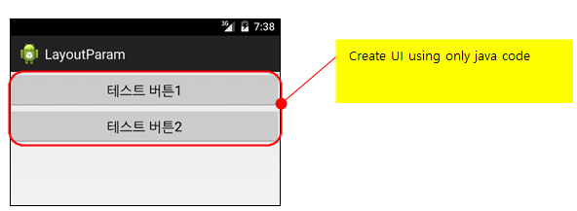
Output

Slide 29
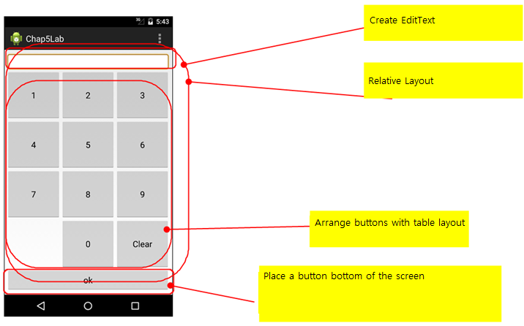
Lab: Calculator App Development
Notes:
Chap5Lab 실행

Slide 30
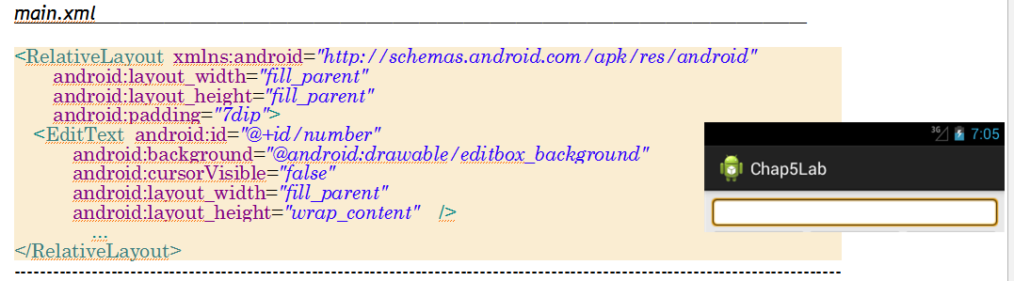
Top EditText Implementation

Slide 31
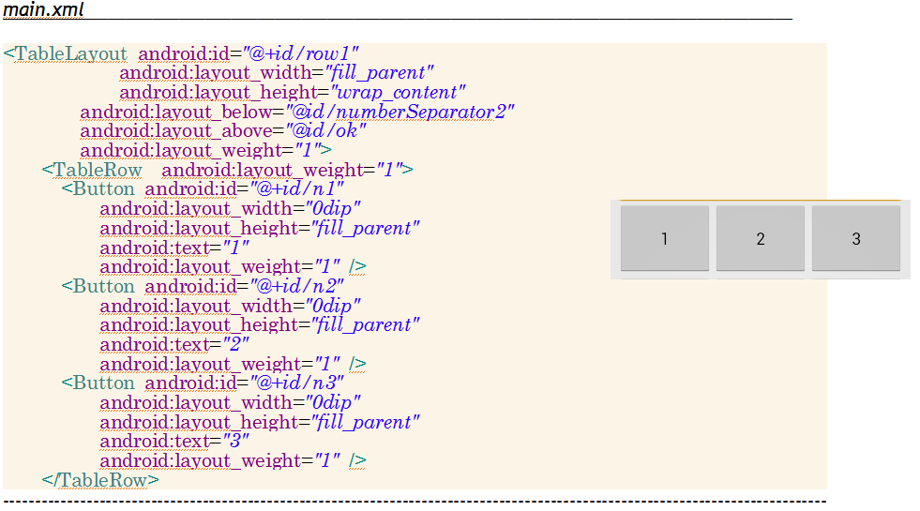
Buttons Arrangement using TableLayout

Slide 32
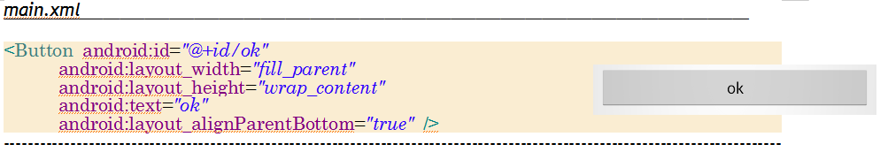
Bottom Button Implementation

