Slide 1
Android Programming :Input Widget
Prof. Seongwook Youn
Department of Software
Korea National University of Transportation

Slide 2
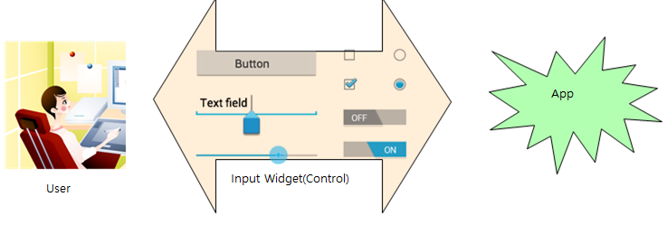
Input Widget (Control)
Input controls are the interactive components in your app's user interface.
Android provides a wide variety of controls you can use in your UI, such as buttons, text fields, seek bars, checkboxes, zoom buttons, toggle buttons, and many more.

Slide 3
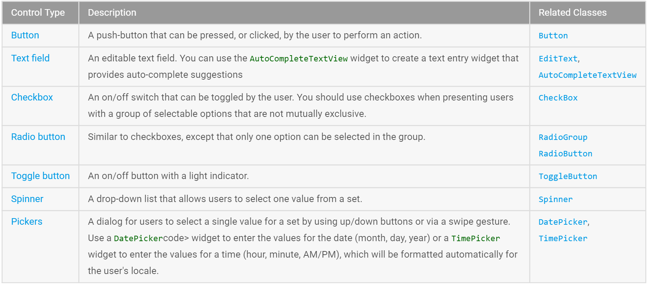
Common Controls

Slide 4
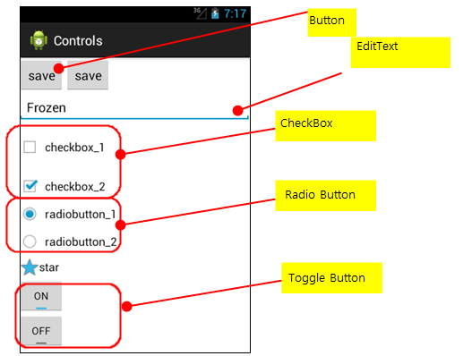
Input Control

Slide 5
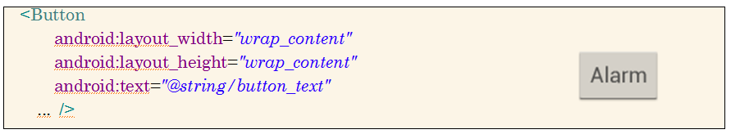
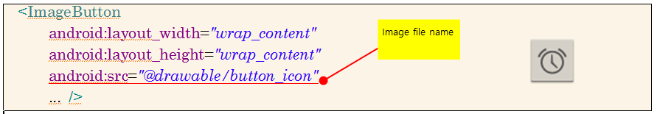
Button
Text button
Image button

Slide 6
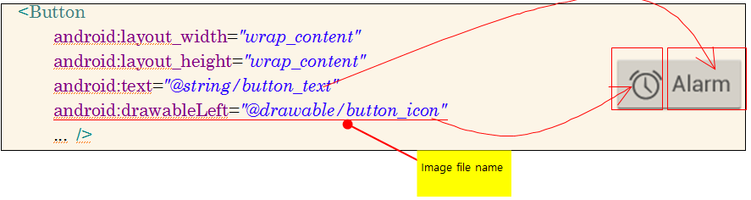
Button
Button w/ text and image simultaneously

Slide 7
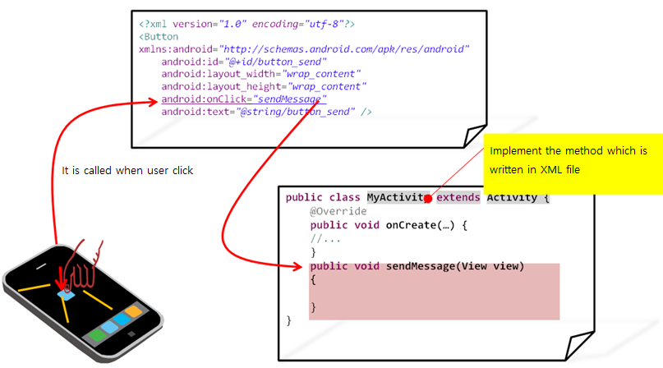
Button’s Event Handling
Three conditions of the method declared in onClick
- Be public
- Return void
- Define a View as its only parameter

Slide 8
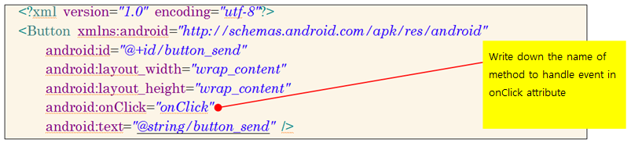
Brief Event Handling Method
Add onClick attribute on button element in layout

Slide 9
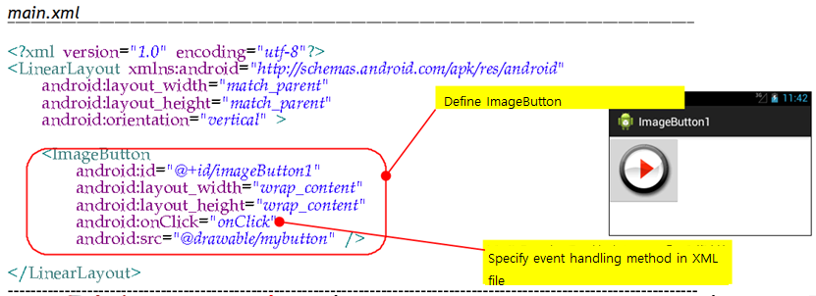
Image button using <ImageButton> tag

Slide 10
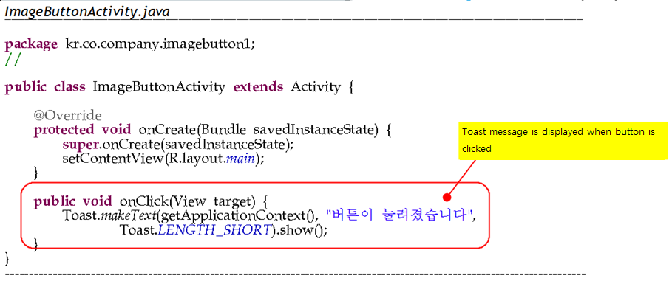
Event Handling Code
A toast provides simple feedback about an operation in a small popup. It only fills the amount of space required for the message and the current activity remains visible and interactive.
Notes:
ImageButton1 실행

Slide 11
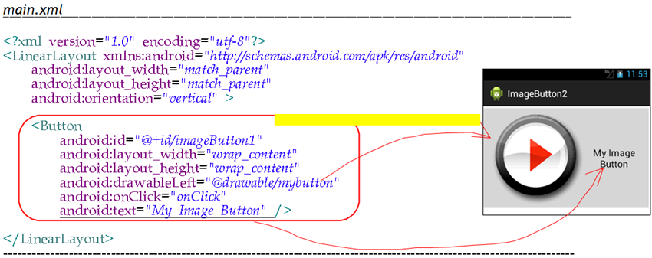
Display both image and text
* When you display both image and button, use the attributes like
android:drawableTop, android:drawableBottom,
android:drawableLeft, android:drawableRight
* Adjust a gap between text and image using android:drawablePadding

Slide 12
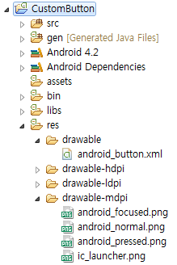



Custom Button
Register images can be used as button in XML file
/res/drawable/android_button.xml
<?xml version="1.0" encoding="utf-8"?>
<selector xmlns:android="http://schemas.android.com/apk/res/android">
<item android:drawable="@drawable/android_pressed"
android:state_pressed="true" />
<item android:drawable="@drawable/android_focused"
android:state_focused="true" />
<item android:drawable="@drawable/android_normal" />
</selector>

Slide 13
Layout File
Define a button in layout file
/res/layout/main.xml
<?xml version="1.0" encoding="utf-8"?>
<LinearLayout xmlns:android="http://schemas.android.com/apk/res/android"
android:layout_width="match_parent"
android:layout_height="match_parent"
android:orientation="vertical" >
<Button
android:id="@+id/button"
android:layout_width="wrap_content"
android:layout_height="wrap_content"
android:background="@drawable/android_button"
android:padding="10dp" />
</LinearLayout>
Notes:
커스텀 버튼을 만들려면 버튼의 background 속성에 버튼을 정의한 xml 파일을 지정한다.

Slide 14
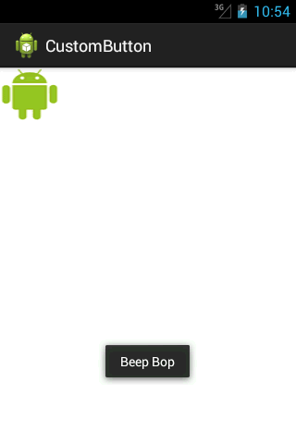
Custom Button
public class MainActivity extends Activity {
@Override
public void onCreate(Bundle savedInstanceState) {
super.onCreate(savedInstanceState);
setContentView(R.layout.main);
final Button button = (Button) findViewById(R.id.button);
button.setOnClickListener(new OnClickListener() {
public void onClick(View v) {
Toast.makeText(getApplicationContext(), "Beep Bop",
Toast.LENGTH_SHORT).show();
}
});
}
}
Notes:
주목받을 지 않을지에 대한 뷰의 상태를 변화시키기 위해서는 setFocusable(boolean).메소드를 호출한다. 터치모드에서는 setFocusableInTouchMode(boolean). 을 호출한다. Toast는 화면에 잠깐 메시지를 보여주는 기능으로 뷰의 일종이다.

Slide 15
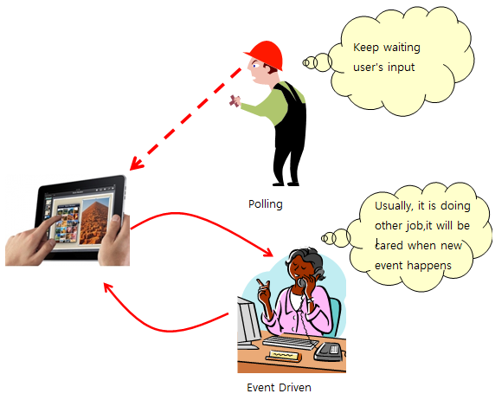
Polling and Event Driven
Polling
– Application is waiting
an input of user in infinite loop
- Takes a lot of CPU power

Slide 16
Event Handling Method in Android
Register event handling method in XML file
Easiest way
Create event handling object, then register to component
Override event handling method of View class
Usually, used in game

Slide 17
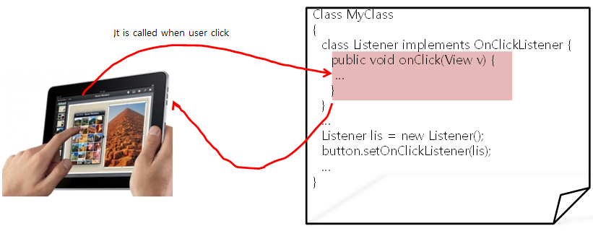
Use Event Handling Object
Button attached listener object handles event

Slide 18
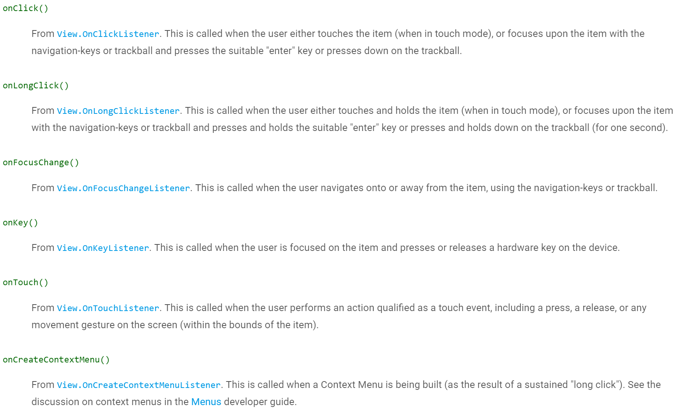
Event Listener

Slide 19
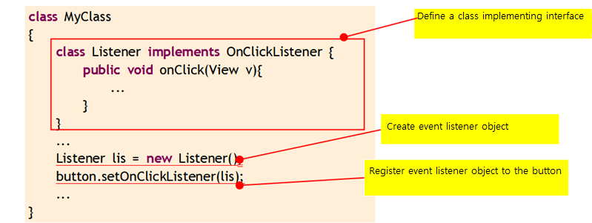
Event Listener
If you want to process a click event when you click on the button, create View.OnClickListener
object, then call setOnClickListener

