Slide 1
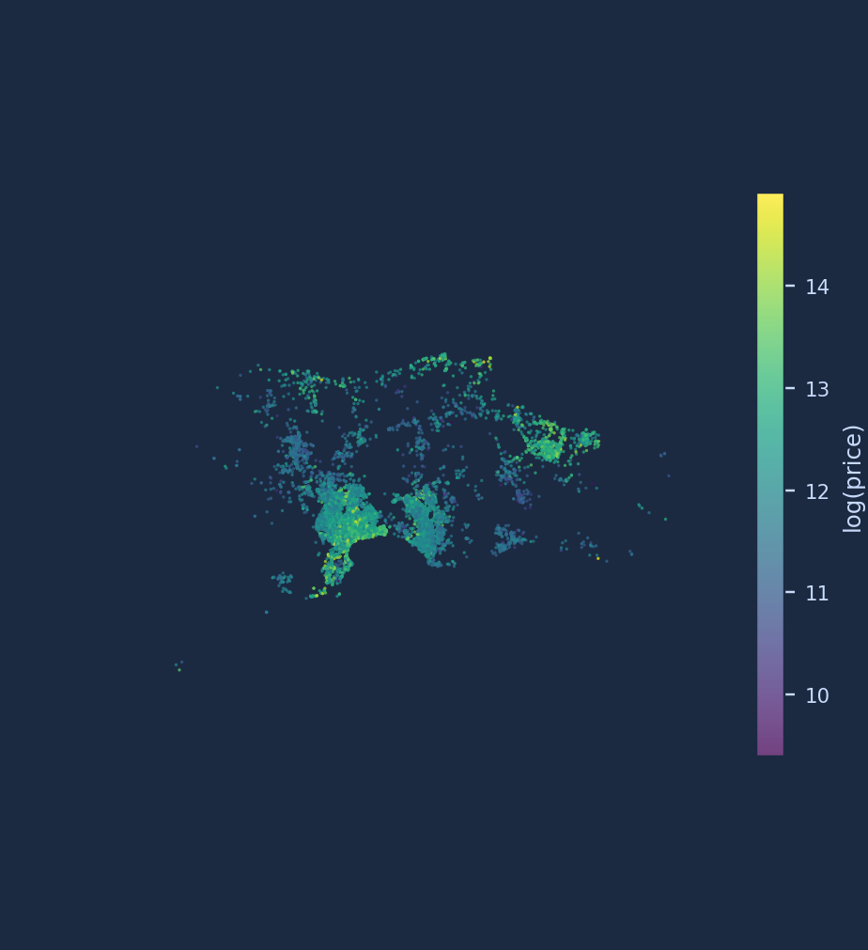
Baku Apartment Prices from the Inside
A from-scratch decision tree and Pegasos SVM on 57,421 bina.az listings
Alish Hajiyev · Tahmina Hüseynova · Nihat Ismayilzade · Elshan Samadzade
MLE-AI-201 Machine Learning · AI Academy · October 2026
Listings on the Absheron peninsula, coloured by log(price)
Notes:
[Tahmina · ~0:30]
Good afternoon. We are Alish, Tahmina, Nihat and Elshan. Our project asks one question: can two classical models written from scratch in NumPy — a decision tree and a support-vector machine — stand next to scikit-learn on real, messy apartment listings from bina.az? I will present the data and the experimental protocol, Elshan the tree, Alish the SVM, and Nihat the benchmark, bonuses and conclusions. I will also come back for the error analysis.

Slide 2
One real dataset, two learning tasks, two models we had to build ourselves
Why it matters:
  Listing prices are heavy-tailed, features mix numbers and Azerbaijani text, and the raw dump is genuinely dirty — the ideal stress test for the classical toolkit.
Task A — regression:
  predict log(price). Metrics: RMSE, MAE, R² on the log scale and in AZN.
Task B — classification:
  premium vs standard, threshold = median price of the training set (208,000 AZN). Metrics: precision, recall, F1, ROC-AUC, confusion matrix.
Golden rule:
  both models are our own NumPy code; scikit-learn appears only as the matched baseline.
100,775
57,421
raw scraped listings
clean residential rows
55
2 + 2
engineered features
from-scratch models + bonus baselines
≈ 0.002
gap to scikit-learn on both tasks (preview of the result)
Takeaway Same features, same split, matched hyperparameters — then the comparison is fair and the number means something.
Tahmina · Problem, data and protocol
Notes:
[Tahmina · ~1:00]
Our data comes from bina.az, the largest real-estate platform in Azerbaijan — one hundred thousand scraped listings. From this one dataset we built two tasks. Task A is regression: we predict the logarithm of the price, because prices have a heavy tail — a few very expensive apartments would otherwise dominate the error. Task B is classification: is a listing "premium" or "standard", where premium means above the median price of the training set, 208 thousand manat. The golden rule of the project: both models are our own NumPy code. Scikit-learn is used only as a baseline, with exactly the same features, the same split and matched hyperparameters. The headline, which Nihat will show in detail: our models land within about 0.002 of their scikit-learn twins on both tasks.

Slide 3
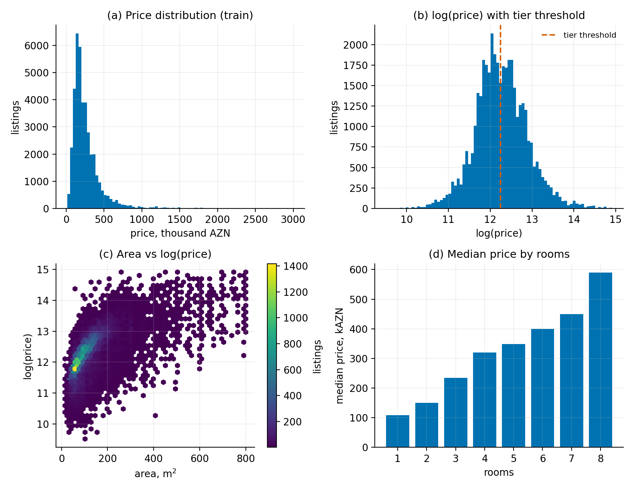
Cleaning removed 43% of rows — every rule is fixed, documented and reproducible
Step | Rule | Rows
0 | Raw Kaggle dump (51 columns, all prices AZN — asserted in code) | 100,775
1 | Keep the latest scrape per listing URL (scraper revisits) | 64,454
2 | Residential only: new build, old stock, house / garden house | 58,452
3 | Parse Azerbaijani strings: “145 m²”, “7 / 9”, “1.3 sot” → numbers | 58,452
4 | Fixed validity bounds: price 10k–3M, area 15–800 m², coords in AZ | 58,110
5 | Drop exact repost duplicates | 57,421
Missing values: constant + explicit “is-missing” indicator. No mean/median imputation, no quantile filters — nothing fitted that could leak from val/test.
Takeaway Rules, not statistics: a fixed bound is a decision made before any split exists, so it cannot leak.
Tahmina · Problem, data and protocol
Notes:
[Tahmina · ~1:00]
The raw data is a real scraped dump, so cleaning was a large part of the work, and every rule is code in data_prep.py. First, the scraper visited the same listing many times, so we keep the latest version of each listing URL — that removes thirty-six thousand rows. Second, we keep only residential categories; offices and land plots quote areas in different units and are a different market. Third, many numbers arrive as Azerbaijani text — "145 square metres", "floor 7 of 9" — and we parse them. Fourth, outliers: we use fixed bounds — price between ten thousand and three million manat, area between fifteen and eight hundred square metres, coordinates inside Azerbaijan. We deliberately avoid quantiles, because a quantile is a statistic of the whole dataset including the test rows. Missing values get a constant plus an indicator column — again, nothing is fitted. The figure shows what we are left with: a heavy-tailed price, a near-normal log-price, and area as the strongest single predictor.

Slide 4
Two columns were arithmetic functions of the target — dropped before any model saw them
Target leakage — dropped
55 features kept
Why one-hot, and fitted where?
unit_price = price / area
total_price = price restated (equal in 99.99% of rows)
Using them gives a perfect validation score and a useless model.
Numeric (9): area, rooms, floor, building floors, floor ratio, land area, lat, lng, distance to Fountains Square (haversine).
Binary flags (12): repaired, bill of sale, mortgage, agent-listed, agency, top / ground floor, Baku, has land, and is-missing indicators.
One-hot (34): 3 building categories; 30 most frequent districts + “other”.
Both models split on numeric thresholds; ordinal codes would impose a false order on districts.
The only data-dependent encoding choice — which 30 districts get a column — is fitted on the training rows alone.
All categorical text is NFC-normalised first so spelling variants collapse.
Also dropped
Identifiers, owner / shop names, address, free text, URLs, scrape timestamps; views / vip / featured — consequences of the listing, not traits of the flat.
Takeaway The statement promised to check for leakage; our feature matrix contains nothing computed from the answer.
Tahmina · Problem, data and protocol
Notes:
[Tahmina · ~0:50]
The most important slide of my part. The dataset contains two columns, unit_price and total_price. Unit price is price divided by area; total price equals the price in 99.99 percent of rows. They are computed from the target. If you train on them, validation looks perfect and the model is useless on a new listing. We dropped both, and we also dropped identifiers, free text and popularity counters such as views — those are consequences of the listing, not properties of the apartment. What remains are 55 features: numerics like area and the distance to the city centre, binary flags, and one-hot encodings for the building category and the thirty most frequent districts. One detail we are proud of: the list of thirty districts is chosen from the training rows only, so even the encoding does not see validation or test data.

Slide 5
Stratified 70/15/15 split; every statistic is learned from the training rows only
TRAIN 70%
VAL 15%
TEST 15%
40,197 rows
8,612 rows
8,612 rows
Stratified on deciles of log(price): each decile is shuffled with seed 42 and cut 70 / 15 / 15.
 | train | val | test
median log(price) | 12.2453 | 12.2453 | 12.2453
premium share | 49.9% | 49.8% | 49.8%
Tier threshold = train median only (208,000 AZN); val/test reuse it.
Scaler, district vocabulary, every hyperparameter: fitted / chosen on train + validation.
Test set touched once per final model. 5-fold CV on the train+val pool refits threshold and scaler inside every fold.
One command — python -m src.run_all — runs 10 sanity tests, then regenerates every number and figure (seed 42).
Takeaway We cannot stratify on the tier label — it only exists once train and its median exist — so we stratify on price deciles, which matches both tasks.
Tahmina · Problem, data and protocol
Notes:
[Tahmina · ~1:00]
Now the protocol. We use a seeded 70-15-15 split that is stratified on deciles of log-price: each decile is shuffled and cut separately, so all three parts have the same price distribution — the median log-price is identical to four decimals. This stratifies the regression task directly, and the classification task by construction, because the premium label is "above the train median", a cut inside the fifth decile; the premium share comes out at 49.9, 49.8, 49.8 percent. Two rules we followed strictly: the threshold, the scaler and every encoding choice come from the training rows only, and all hyperparameters are chosen on validation. The test set is used once per final model. Everything is reproducible with one command, which first runs ten sanity tests against scikit-learn on toy data and then regenerates every number and figure you will see. Elshan will now open the decision tree.

Slide 6
Our tree scores every candidate threshold of a feature in one vectorised pass
Split objective (sklearn weighting)
1 Sort
2 Accumulate
3 Score
4 Pick
Δ = N_node/N · [ I(node) − N_L/N_node · I(L) − N_R/N_node · I(R) ]
I = Gini 1 − Σ p_k² · entropy −Σ p_k log₂ p_k · MSE = variance
argsort the feature once per node
cumulative class counts (cls) or Σy, Σy² (reg) along the sorted order
impurity of every left/right prefix in one NumPy expression
largest Δ; threshold = midpoint of the two neighbouring values
Stopping rules (each unit-tested)
Leaves store the mean (regression) or class counts (classification) → predict_proba = leaf frequencies.
Feature importances = accumulated weighted impurity decrease, normalised.
Complexity O(F · N log N) per level — the same as scikit-learn; ours is pure NumPy, theirs is Cython (≈12× faster wall-clock).
Sanity test: on fully-determined toy sets our tree picks the identical feature and threshold as DecisionTreeClassifier.
max_depth · min_samples_split · min_samples_leaf · min_impurity_decrease (pruning rule identical to sklearn) · max_features per split (used by the forest bonus)
Takeaway The algorithm is small: ~250 lines of NumPy reproduce the library once the objective and the weighting are implemented exactly.
Elshan · Decision tree
Notes:
[Elshan · ~1:10]
Thank you, Tahmina. The tree is a CART-style binary tree with a scikit-learn-like fit, predict and predict_proba API. The core is the split search. The naive approach loops over every feature and every threshold and recomputes the impurity each time — far too slow for forty thousand rows in Python. Instead, for each feature we sort the samples once per node and walk the sorted order with cumulative sums: cumulative class counts for classification, cumulative sums of y and y-squared for regression. From these prefix sums the impurity of every possible left and right child falls out in a single NumPy expression, and we pick the largest weighted decrease. The threshold is the midpoint between the two neighbouring values, exactly as scikit-learn does. We support Gini, entropy and MSE, four stopping rules that are each covered by a unit test, and feature importances as the accumulated impurity decrease. The complexity is the same as the library's; the twelve-times wall-clock gap is Cython versus NumPy, not the algorithm.

Slide 7
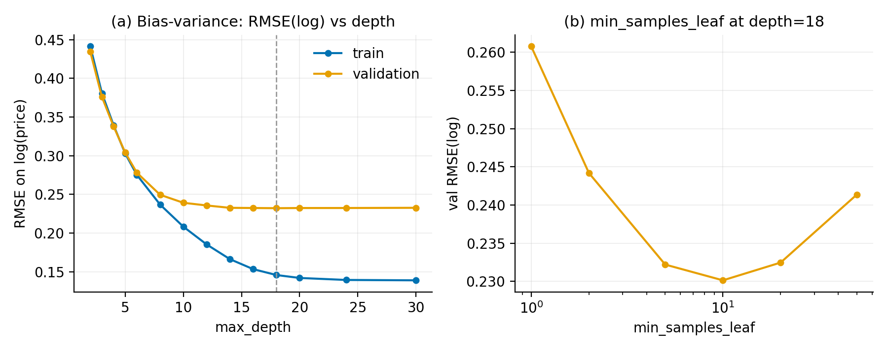
Validation error bottoms out at depth 18 — deeper trees only memorise the training set
Task A (log-price):
  train RMSE keeps falling (0.44 → 0.14) while validation flattens at 18 (0.2322) and drifts up by 30 (0.2327). Chosen on validation: depth 18, min_samples_leaf 10.
Task B (tier):
  Gini vs entropy nearly identical (val F1 0.923 vs 0.920); Gini at depth 16 chosen.
min_samples_leaf:
  a clean U-shape — 1 overfits, 50 underfits, 10 is best (panel b).
Takeaway Classic bias–variance: the train–validation gap widens with depth; the chosen configuration sits at the knee, not at the edge of the grid.
Elshan · Decision tree
Notes:
[Elshan · ~0:55]
This is the bias-variance story. On the left, training RMSE on log-price falls monotonically with depth, from 0.44 down to 0.14, while validation error flattens at depth 18 and then creeps up to depth 30 — the tree starts memorising. We chose depth 18 on validation, then swept min_samples_leaf at that depth and found a clean U-shape with the optimum at ten. For the classification task Gini and entropy are nearly identical, Gini slightly ahead, with the best depth at sixteen. All of this is chosen on the validation split; the test set was not touched until the final models were fixed.

Slide 8
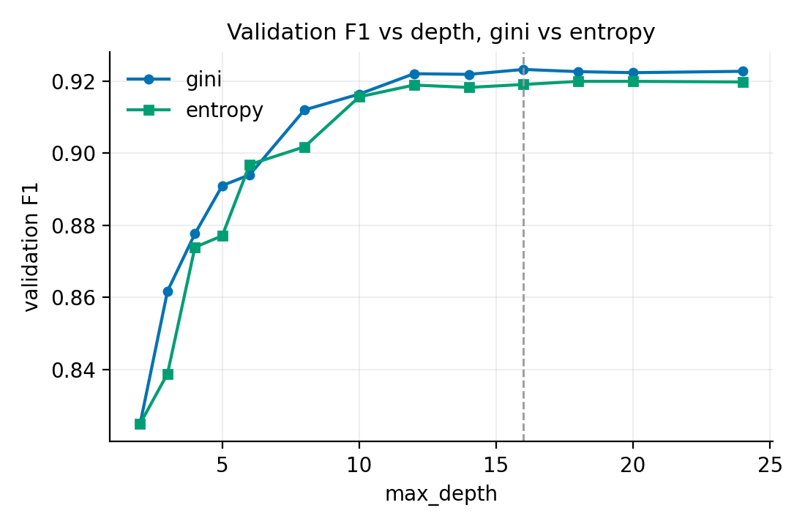
With matched hyperparameters our tree reproduces scikit-learn to the third decimal
 | Ours | sklearn
Task A — test RMSE (log) | 0.2289 | 0.2287
Task A — 5-fold CV RMSE (log) | 0.2298 ± 0.0022 | 0.2295 ± 0.0021
Task B — test F1 | 0.9228 | 0.9233
Task B — 5-fold CV F1 | 0.9226 ± 0.0022 | 0.9224 ± 0.0026
Fit time, 40k rows | ≈ 6 s | ≈ 0.5 s
Same objective, same weighting, same stopping rules → same trees up to tie-breaking.
Residual gap: equal-gain ties (we take the first feature; sklearn permutes features) and last-bit float midpoints.
CV std ≈ 0.002 ≫ the difference → the agreement is systematic, not one lucky split.
Takeaway The library's edge is engineering (Cython), not statistics — the numbers agree within cross-validation noise.
Elshan · Decision tree
Notes:
[Elshan · ~0:55]
Here is the comparison that the project is built around. With the same depth, leaf size and criterion, our tree and scikit-learn's agree on the test set to the third decimal on both tasks, and five-fold cross-validation shows the agreement is systematic: the standard deviation across folds is about 0.002, ten times the difference between the implementations. Where does the residual come from? Tie-breaking: when several splits have equal gain we take the first feature in column order, scikit-learn samples features in random order; and midpoint thresholds can differ in the last floating-point bits. The one real gap is speed — six seconds versus half a second — and that is Cython versus NumPy, not the algorithm. Alish will now show the SVM.

Slide 9
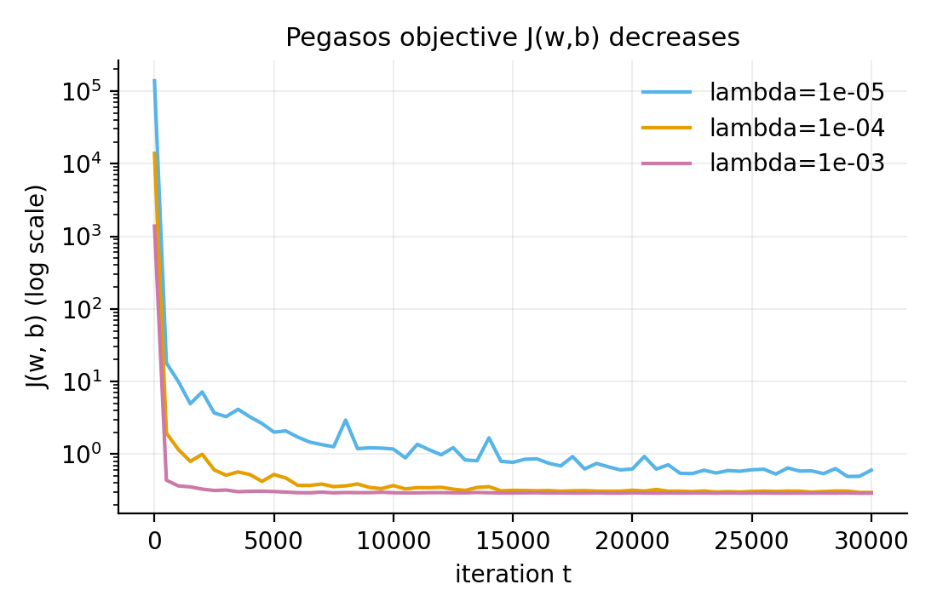
Pegasos: the soft-margin SVM solved by sub-gradient descent — no QP, no SMO
Objective (labels y ∈ {−1, +1})
J(w, b) = λ/2 · ‖w‖² + 1/n · Σᵢ max(0, 1 − yᵢ(w·xᵢ + b))
Mini-batch update at step t, η_t = 1/(λt), |B| = 64
hinge active (yᵢ(w·xᵢ+b) < 1): w ← (1 − η_t λ) w + η_t · mean(yᵢ xᵢ); b ← b + η_t · mean(yᵢ)
otherwise: w ← (1 − η_t λ) w
Bias not regularised; features standardised with training statistics (hinge loss is scale-sensitive).
Support vectors = training points with yᵢ(w·xᵢ+b) ≤ 1; margin width = 2/‖w‖.
Objective J tracked every 500 steps and shown to decrease (right).
Non-linearity: random Fourier features z(x) = √(2/D) cos(Wx + c), W ~ N(0, 2γI), D = 300 — an explicit map approximating the RBF kernel, so the same linear solver runs unchanged in O(nD).
Takeaway RFF over kernelised Pegasos: at n ≈ 40k, dual coefficients make every prediction O(n); RFF stays linear-time with one solver.
Alish · Pegasos SVM
Notes:
[Alish · ~1:10]
The SVM is trained with Pegasos. Instead of solving the dual quadratic programme, we minimise the primal directly: the regularised hinge loss, lambda over two times the squared norm of w plus the average hinge. Each step draws a mini-batch of 64 examples; for the examples inside the margin we move w towards y-times-x, and in every step we shrink w by one minus eta-lambda — that is the regulariser. The step size is one over lambda-t, the schedule from the Pegasos paper. The bias gets the same averaged sub-gradient but no shrinkage. Because the hinge loss is scale-sensitive we standardise features with training statistics. After training we read off the support vectors — the points on or inside the margin — and the margin width two over the norm of w. On the right you see the objective decreasing for three values of lambda. For a non-linear boundary we chose random Fourier features: a random cosine map whose inner products approximate the RBF kernel, so the identical linear solver runs on the transformed features in linear time.

Slide 10
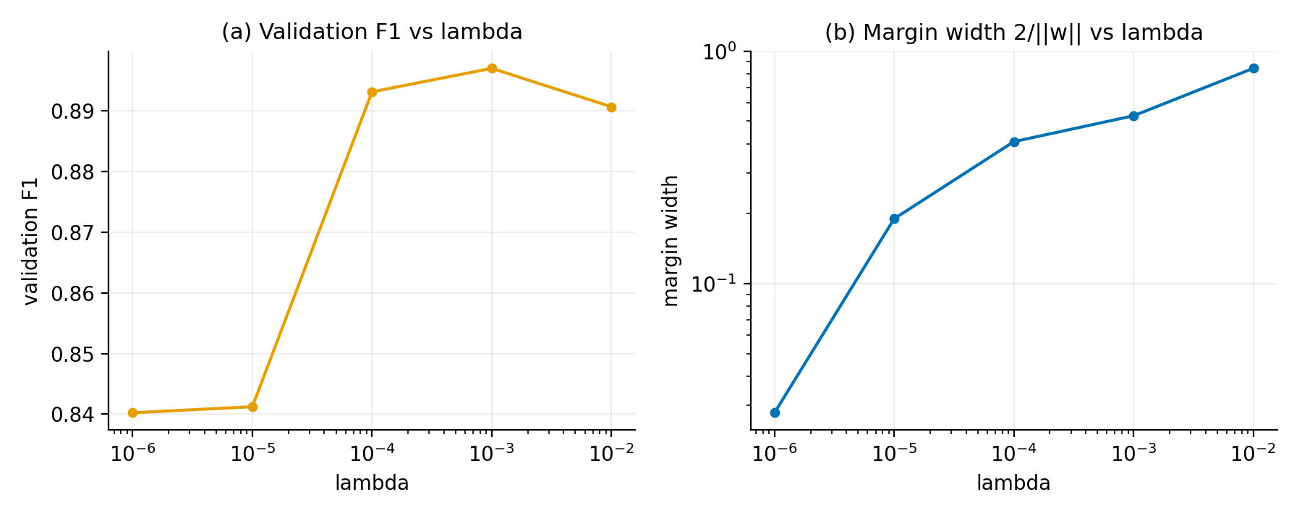
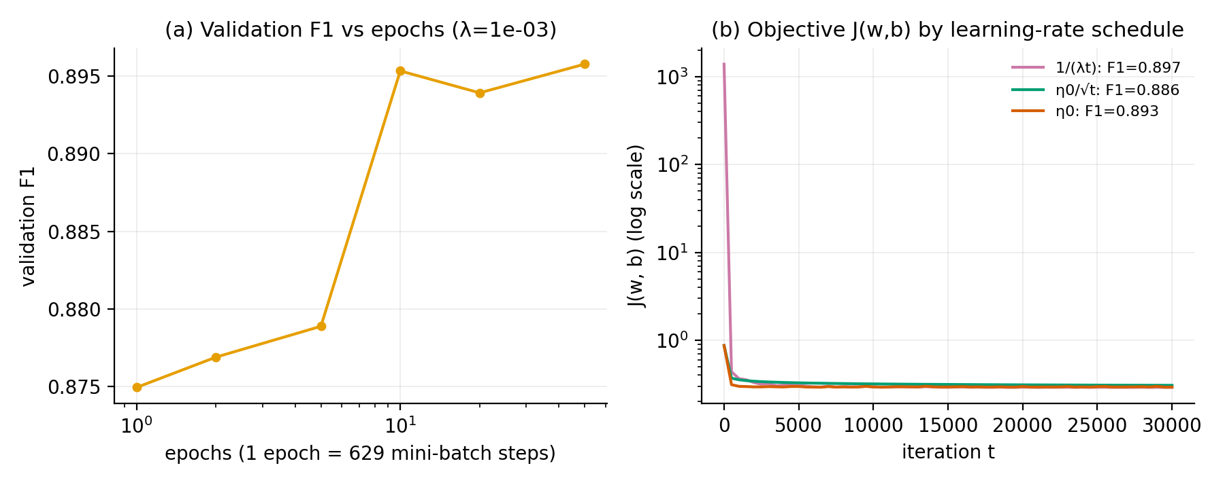
λ sets the margin–fit trade-off; 1/(λt) converges fastest; F1 plateaus after ~10 epochs
λ (regularisation):
  from 10⁻⁶ to 10⁻² the margin widens 30× (0.028 → 0.844); validation F1 peaks at λ = 10⁻³ — beyond that the model under-fits.
Epochs:
  1 epoch = 629 mini-batch steps. F1 is within noise of its plateau after ~10 epochs (0.895 vs 0.896 at 50).
Schedule:
  1/(λt) reaches the lowest J (0.291, F1 0.897); constant η₀ is close (0.893); η₀/√t shrinks w too slowly — wider margin (0.91) but worse placement (F1 0.886).
RFF bandwidth γ:
  best 0.01; larger γ over-fits sharply (F1 0.74 at γ = 0.1).
Takeaway All three solver knobs the statement asks for — λ, epochs, LR schedule — are exposed, and each visibly changes the margin or the metric.
Alish · Pegasos SVM
Notes:
[Alish · ~1:10]
The statement asks us to expose three solver hyperparameters and show that each matters. Lambda first: as it grows from ten to the minus six to ten to the minus two, the margin widens thirty times — stronger regularisation means a wider margin — while validation F1 peaks at ten to the minus three and then drops as the model under-fits. Epochs: one epoch is 629 mini-batch steps; F1 is essentially at its plateau after ten epochs, so our thirty thousand steps are generous. The schedule: the Pegasos one-over-lambda-t schedule reaches the lowest objective and the best F1; a constant step is close; one-over-root-t shrinks w too slowly, so it ends with a wider margin but a worse-placed boundary. Finally the RFF bandwidth gamma: 0.01 is best, and larger values over-fit sharply.

Slide 11
30% of training points are support vectors — the tiers interleave at the threshold; linear beats RBF here
3.79
0.53
11,917
Pegasos ≈ its sklearn twin: CV F1 0.8988 ± 0.0016 vs 0.9000 ± 0.0012.
Both RBF models — ours and sklearn's — lose 5 F1 points to linear: after one-hot encoding 46 of 55 features are binary and the premium boundary is near-linear in area + centrality; the RBF geometry mostly adds variance.
Two independent RBF implementations agreeing (0.849 vs 0.845) supports that reading.
SVC-RBF is O(n²): 16 s to fit on a 15k subsample and 11.5 s to predict — exactly why RFF was the right non-linearity at this scale.
‖w‖ — norm of the learned weight vector
margin width 2/‖w‖ (standardised units)
support vectors of 40,197 (30%) — margin ≤ 1
Task B, test set | F1 | ROC-AUC
Ours: Pegasos (linear) | 0.8971 | 0.956
sklearn: SGDClassifier(hinge), same λ | 0.8989 | 0.956
sklearn: LinearSVC, C = 1/(nλ) | 0.8934 | 0.955
Ours: Pegasos + RFF (D = 300, γ = 0.01) | 0.8491 | 0.933
sklearn: SVC-RBF (15k subsample) | 0.8449 | 0.926
Takeaway A margin you can see: 30% of points inside it tells us the classes genuinely overlap near 208k — the label, not the model, is the limit.
Alish · Pegasos SVM
Notes:
[Alish · ~0:50]
What did the SVM learn? The weight vector has norm 3.79, so the margin is 0.53 in standardised units, and almost twelve thousand of the forty thousand training points — thirty percent — are support vectors, on or inside the margin. That is a lot, and it is telling us something real: the two tiers genuinely interleave around the 208-thousand threshold. Against scikit-learn, Pegasos matches SGDClassifier with hinge loss and the same lambda within cross-validation noise. The surprising result is that both non-linear models lose to the linear ones by five F1 points — ours with random Fourier features and scikit-learn's SVC with an RBF kernel. Our reading: after one-hot encoding, 46 of 55 features are binary, and the premium boundary is close to linear in area and distance to the centre, so the RBF geometry mostly adds variance. The fact that two independent RBF implementations agree supports that. And note the cost: the exact RBF SVC needed sixteen seconds to fit on a fifteen-thousand-row subsample and eleven seconds just to predict. Nihat will now put everything side by side.

Slide 12
On both tasks the from-scratch models land within 0.002 of their scikit-learn twins
Task A — regression (test) | RMSE log | R² log | MAE AZN
Ours: DecisionTree (mse) | 0.2289 | 0.865 | 42,626
sklearn: DecisionTreeRegressor | 0.2287 | 0.866 | 42,598
Ours: RandomForest ×30 [bonus] | 0.2211 | 0.874 | 43,132
sklearn: RandomForestRegressor ×30 | 0.2166 | 0.879 | —
Ours: Ridge, normal equations [bonus] | 0.3006 | 0.768 | 61,345
Ours: LinearSVR, sub-gradient [bonus] | 0.3044 | 0.762 | 63,802
Task B — classification (test) | Acc | F1 | AUC
Ours: DecisionTree (gini, 16) | 0.923 | 0.9228 | 0.953
sklearn: DecisionTreeClassifier | 0.924 | 0.9233 | 0.953
Ours: PegasosSVM (linear) | 0.898 | 0.8971 | 0.956
sklearn: SGDClassifier (hinge) | 0.899 | 0.8989 | 0.956
sklearn: LinearSVC | 0.894 | 0.8934 | 0.955
Ours: Pegasos + RFF | 0.850 | 0.8491 | 0.933
sklearn: SVC-RBF (15k sub) | 0.846 | 0.8449 | 0.926
Uncertainty (5-fold CV, train+val pool, threshold and scaler refit per fold): tree RMSE 0.2298 ± 0.0022 vs 0.2295 ± 0.0021 · tree F1 0.9226 ± 0.0022 vs 0.9224 ± 0.0026 · Pegasos F1 0.8988 ± 0.0016 vs SGD 0.9000 ± 0.0012. Fit / predict times: our tree ≈ 6 s / 0.04 s, sklearn 0.5 s / 0.003 s; Pegasos 2.2 s; SVC-RBF 16 s / 11.5 s.
Takeaway Regression and classification are reported separately with task-appropriate metrics; no single number declares a winner.
Nihat · Benchmark, bonuses, limitations
Notes:
[Nihat · ~1:00]
Here is the full benchmark — all metrics implemented from scratch in evaluate.py, and a test asserts they equal scikit-learn's to one-e-minus-nine. Task A on the left: our tree and scikit-learn's agree to the third decimal on RMSE, R-squared and MAE in manat. The bonus forest improves the log-scale RMSE; the two linear bonus models trail by seven hundredths. Task B on the right: tree versus tree, Pegasos versus SGDClassifier, each within two thousandths of F1. Below the tables: five-fold cross-validation on the pooled train-plus-validation data, with the tier threshold and the scaler re-fitted inside every fold, so no fold leaks. The standard deviations — about 0.002 — are larger than every ours-versus-sklearn difference. And timings: the honest cost of pure NumPy is a ten-times slower tree.

Slide 13
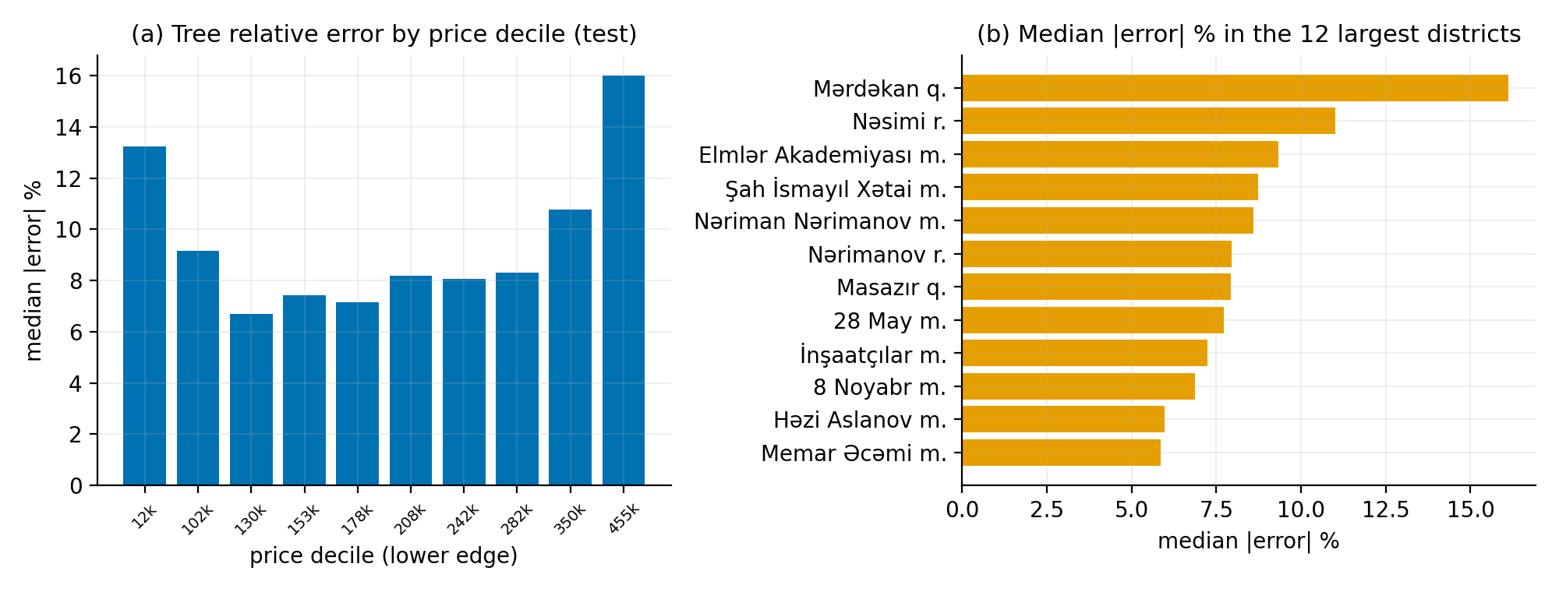
Errors cluster in three places: at the tier threshold, in the price tails, and in the periphery
58% · 62%
tree · SVM misclassifications whose true price is within ±15% of 208k AZN
13% · 16%
median |error| in the cheapest · most expensive decile, vs 7–8% mid-market
Feature importances and SVM weights agree: area (≈ 59% of impurity decrease), then distance to centre, longitude, district.
Worst district: Mərdəkan (garden-house suburb) 16% median error; k-means segments: periphery 14–21% vs ≈ 8% in the dense core.
Both tails are priced on what we do not observe — condition at the bottom; finish, view and prestige at the top.
Classification errors near the threshold are largely irreducible under a median-split framing — the label itself is a coin flip there.
Takeaway The remaining error is explained, not random: label noise at the cut, unobserved attributes in the tails, and sparse peripheral districts.
Tahmina · Error analysis
Notes:
[Tahmina · ~1:00]
Let me come back for the error analysis — where and why the models fail. For classification: fifty-eight percent of the tree's mistakes and sixty-two percent of the SVM's are listings whose true price is within fifteen percent of the 208-thousand threshold. For those the label is almost a coin flip, so most of the remaining error is in the framing, not in the model. For regression, the left panel: median relative error is seven to eight percent through the mid-market, rising to thirteen percent in the cheapest decile and sixteen in the most expensive — both tails are priced on things we do not observe. On the right, by district: the worst is Mərdəkan, a garden-house suburb, where land value and build quality are not in our features; the k-means bonus confirms the periphery is hardest. Feature importances from the tree and the SVM weights tell the same story: area first, then geography.

Slide 14
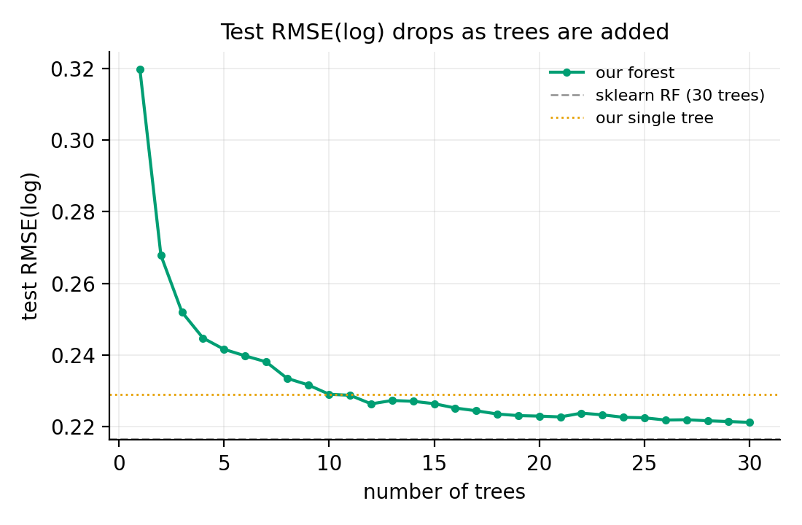
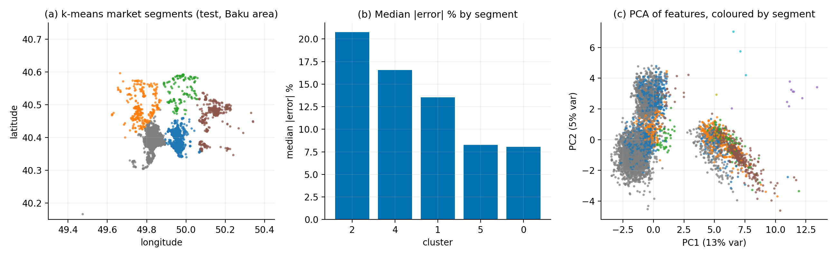
Bonus studies: linear models cannot express area × location; a forest of our trees gains 0.008 RMSE
P8 · Ridge + SVR from scratch
Ridge via normal equations (bias unpenalised) equals sklearn to 10⁻¹⁵. Linear SVR by full-batch sub-gradient descent on the ε-insensitive loss equals LinearSVR to 4 decimals (ε chosen on validation).
Both: RMSE_log ≈ 0.30 vs 0.23 for the tree.
P9 · Random forest of our trees
30 bootstrap trees, per-split √d feature subsampling via the tree's own max_features. Test RMSE_log 0.2289 → 0.2211; sklearn's forest 0.2166 with the same settings.
P10 · k-means + PCA market segments
k = 8 on coordinates (fit on non-test rows), PCA of the feature space coloured by segment: core Baku, coastal belt, garden suburbs. Segment error 8% (core) → 21% (periphery) sharpens the error analysis.
Takeaway Each bonus reuses the core code: the forest is our tree with max_features; the SVR is Pegasos with a tube loss; Ridge is the derivation from the exam.
Nihat · Benchmark, bonuses, limitations
Notes:
[Nihat · ~0:50]
Three bonus studies, each built on the core code rather than beside it. Ridge regression via the normal equations matches scikit-learn to machine precision, and a linear SVR trained by sub-gradient descent on the epsilon-insensitive loss — the regression twin of Pegasos — matches LinearSVR to four decimals. Both linear models stop at 0.30 RMSE on log-price against 0.23 for the tree: price formation is non-additive, area interacts with location, and a linear model cannot express that. Second, a random forest built from our own trees — thirty bootstrap trees with per-split feature subsampling — brings the tree from 0.229 down to 0.221, tracking scikit-learn's forest at 0.217; the curve shows test error falling as trees are added. Third, k-means on coordinates gives interpretable market segments and shows the periphery is where the regressor struggles.

Slide 15
Reproducible by one command, tested against the library — and honest about what the models cannot see
Engineering quality
Limitations and threats to validity
• Seed 42 everywhere: split, solvers, baselines.
• python -m src.run_all — runs 10 sanity tests, then regenerates every number, table and figure (≈ 10 min).
• Tests pin our tree to sklearn's split on fully-determined examples; Pegasos ≈ LinearSVC; SVR ≈ LinearSVR; Ridge ≡ Ridge; metrics ≡ sklearn to 10⁻⁹; split balance.
• Pinned requirements, dataset not committed, cleaning log with row counts, results.json + tables.md as artefacts.
• Modules: data_prep · decision_tree · svm · baselines · ensemble · evaluate · run_all.
• Asking prices, not transactions — every model learns seller behaviour.
• 99.7% of rows are Baku; nothing here generalises to other cities.
• Median-split tier makes the label noisy at the cut; ~60% of errors live there.
• exp(log-prediction) estimates the median, biasing AZN metrics for expensive listings (smearing would fix it).
• RFF tuned over a small γ grid with D = 300; SVC-RBF benchmarked on a 15k subsample.
• Free-text descriptions (renovation, view) unused — likely where the luxury-tail signal lives.
Takeaway Every claim on these slides is tied to a file in the repository and a number in results.json.
Nihat · Benchmark, bonuses, limitations
Notes:
[Nihat · ~0:50]
Two things an examiner should be able to trust. First, reproducibility: one command runs ten sanity tests and regenerates every number and figure you have seen, from a fixed seed, in about ten minutes; three runs on our laptops were byte-identical. The tests are the interesting part — they pin our tree to scikit-learn's exact split on toy data, and our metrics to the library's to one-e-minus-nine. Second, limitations, stated plainly. These are asking prices, not transactions. The data is Baku only. The median split makes the classification label noisy at the cut. Exponentiating a log prediction estimates the median, not the mean, which biases the manat metrics. Our RFF was tuned over a small grid, and the exact RBF baseline used a subsample. And the free-text descriptions, which plausibly carry the luxury-tail signal, are unused.

Slide 16
The classical algorithms are small — the library's edge is engineering
github.com/alishhajiyev/bina-ml-finall · tag v1.0-final · Thank you — questions?
Tree 0.2289 vs 0.2287 RMSE(log), F1 0.9228 vs 0.9233 · Pegasos F1 0.8971 vs 0.8989 · SVR = LinearSVR
Next: text features · group split by building · quantile forest · smearing-corrected AZN metrics
Alish Hajiyev | Pegasos SVM, LR schedules, margin & support vectors, random Fourier features, SVR bonus
Tahmina Hüseynova | Cleaning rules, leakage analysis, stratified split, run_all orchestrator, EDA & error analysis, report
Nihat Ismayilzade | Metrics from scratch, matched benchmark & 5-fold CV, test suite, Ridge and k-means/PCA bonuses, slides
Elshan Samadzade | Decision tree (vectorised split search, criteria, stopping rules, importances), tree experiments, forest bonus
Notes:
[Nihat · ~0:40]
To conclude. About 250 lines of careful NumPy reproduce scikit-learn's accuracy on 57 thousand real listings once the split objective and the sub-gradient schedule are implemented exactly; the remaining differences are tie-breaking and Cython, not statistics. We traced the residual error to the threshold band, the price tails and peripheral districts. Next steps would be text features from the descriptions, a group split by building, a quantile forest for price intervals, and a smearing correction for the manat metrics. Contributions were equal and are listed here and in the repository. Thank you — we are happy to take questions.

