Slide 1
Introduction to Machine Learning

Slide 2
About Me

Slide 3
Machine Learning
Motivational quote

Slide 4
What is machine learning really

Slide 5
Why now?

Slide 6
Applications and examples

Slide 7
Boiling down the facts

Slide 8
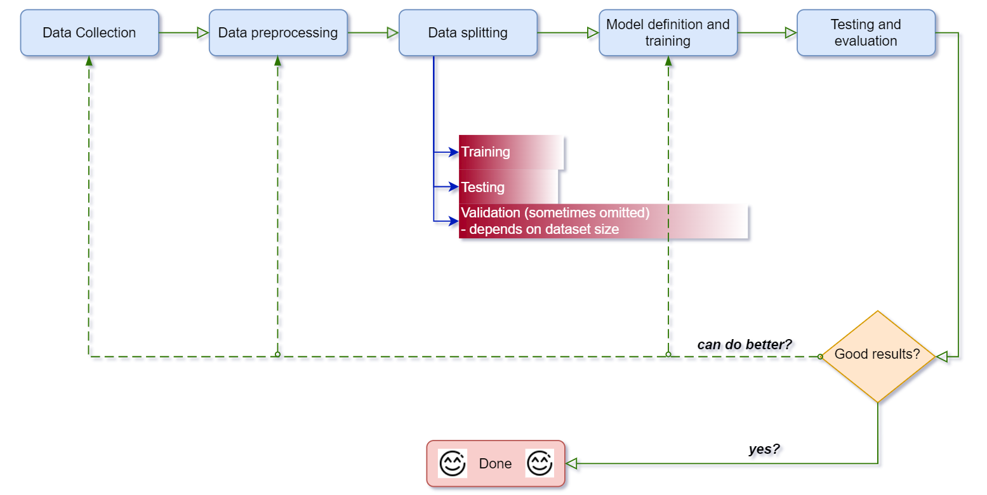
High Level Machine Learning Pipeline

Slide 9
Types of machine learning

Slide 10
Limitation of a linear classifier (non-linearly separable data)

Slide 11
K-nearest neighbors

Slide 12
Decision Tree

Slide 13
Overfitting / Underfitting

Slide 14
Bias / Variance Tradeoff

Slide 15
Going beyond linear regression

Slide 16
“Deep” Network = combined logistic models

Slide 17
Ensemble Learning
The wisdom of the crowd

Slide 18
Cross Validation

Slide 19
Occam Razor

Slide 20
No free lunch in Machine Learning

Slide 21
Unsupervised learning

Slide 22
Reinforcement Learning

