Slide 1
Introduction to Machine Learning
PECA
KTH 2022

Slide 2



About Me
My name is Ali Shibli.
I am 24 years old living in Stockholm originally from Lebanon
I am graduate student with a Machine Learning degree from KTH and background in computer engineering and pure math from AUB (Lebanon).
I have 3 years professional experience in machine learning, still growing.
My passions are coding, maths, sports, and movies..
I am so happy to be with you here today!
Happy coding day :D

Slide 3
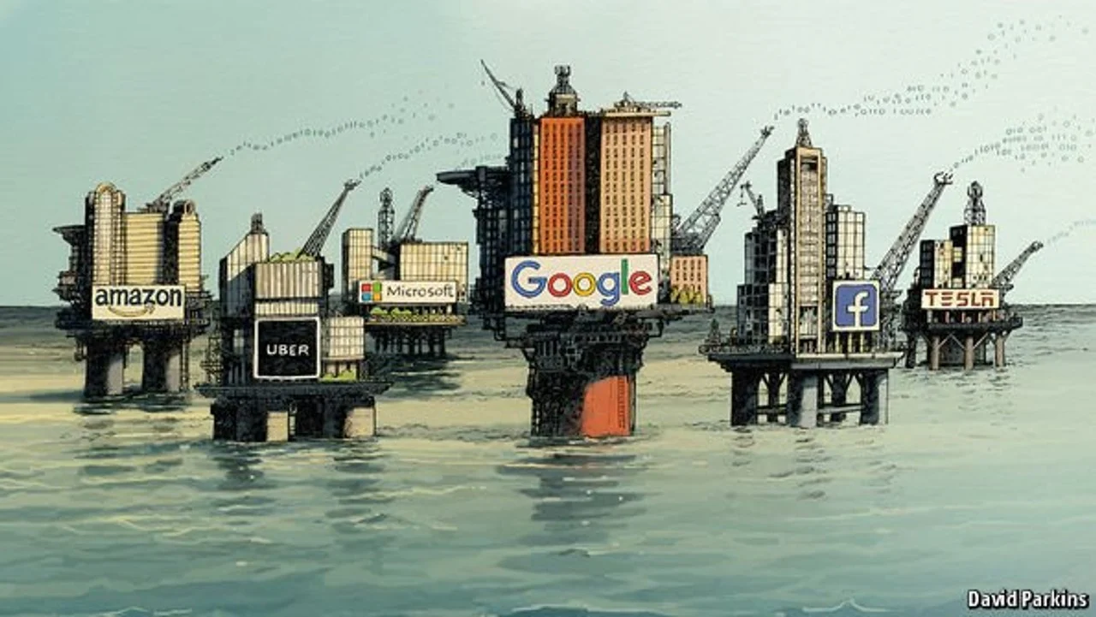
Why Machine Learning?
data is the new oil

Slide 4
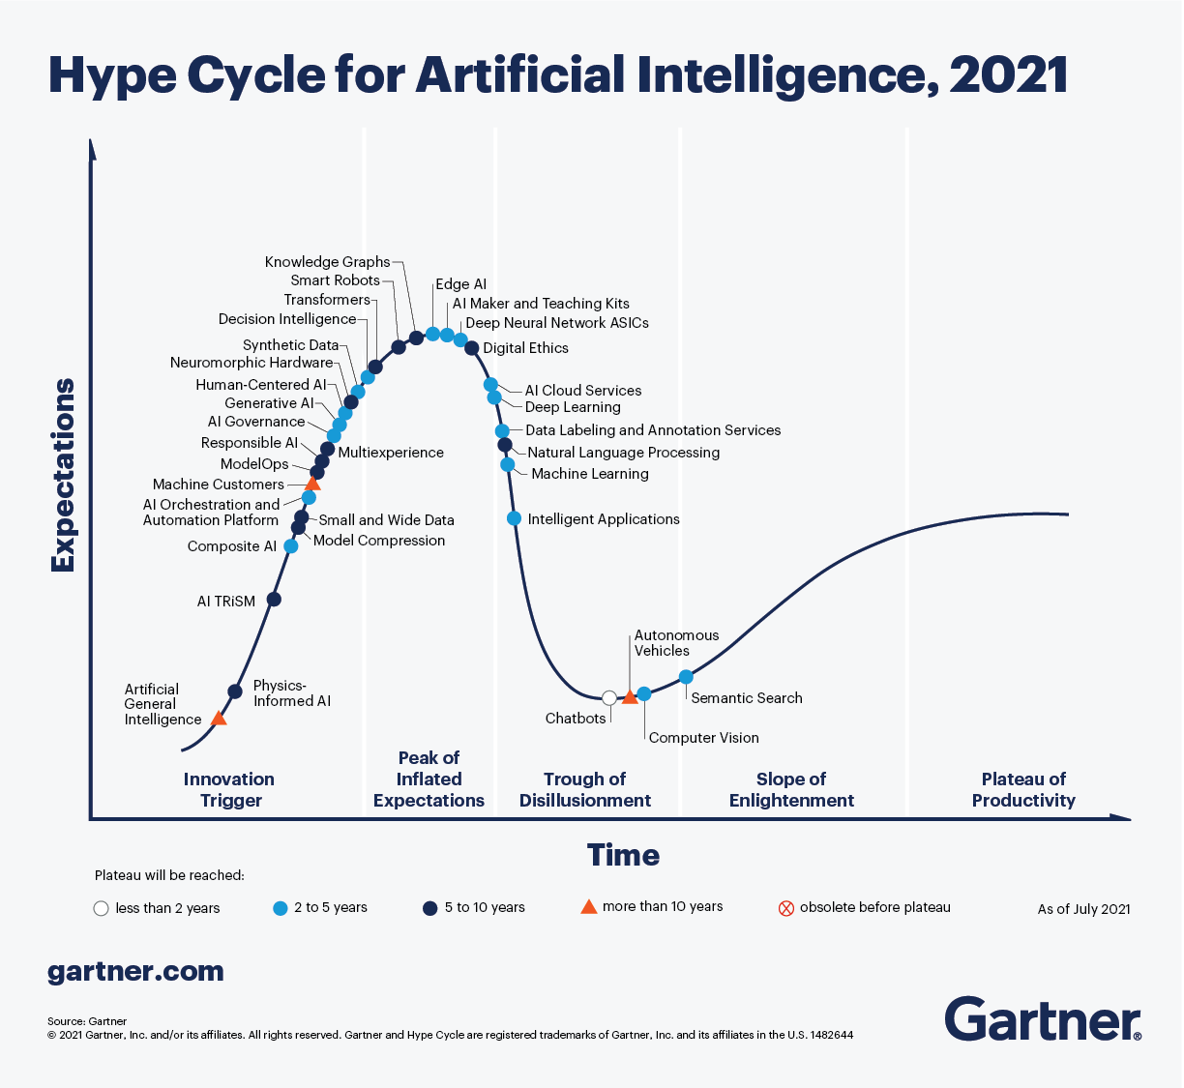

Slide 5
Short History on AI
https://dev.to/lschultebraucks/a-short-history-of-artificial-intelligence-7hm
Like 6 slides
First/second/third AI winters

Slide 6
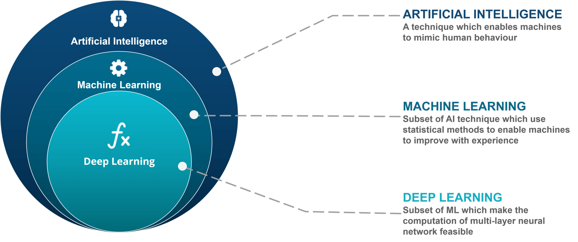
Boiling down the facts

Slide 7
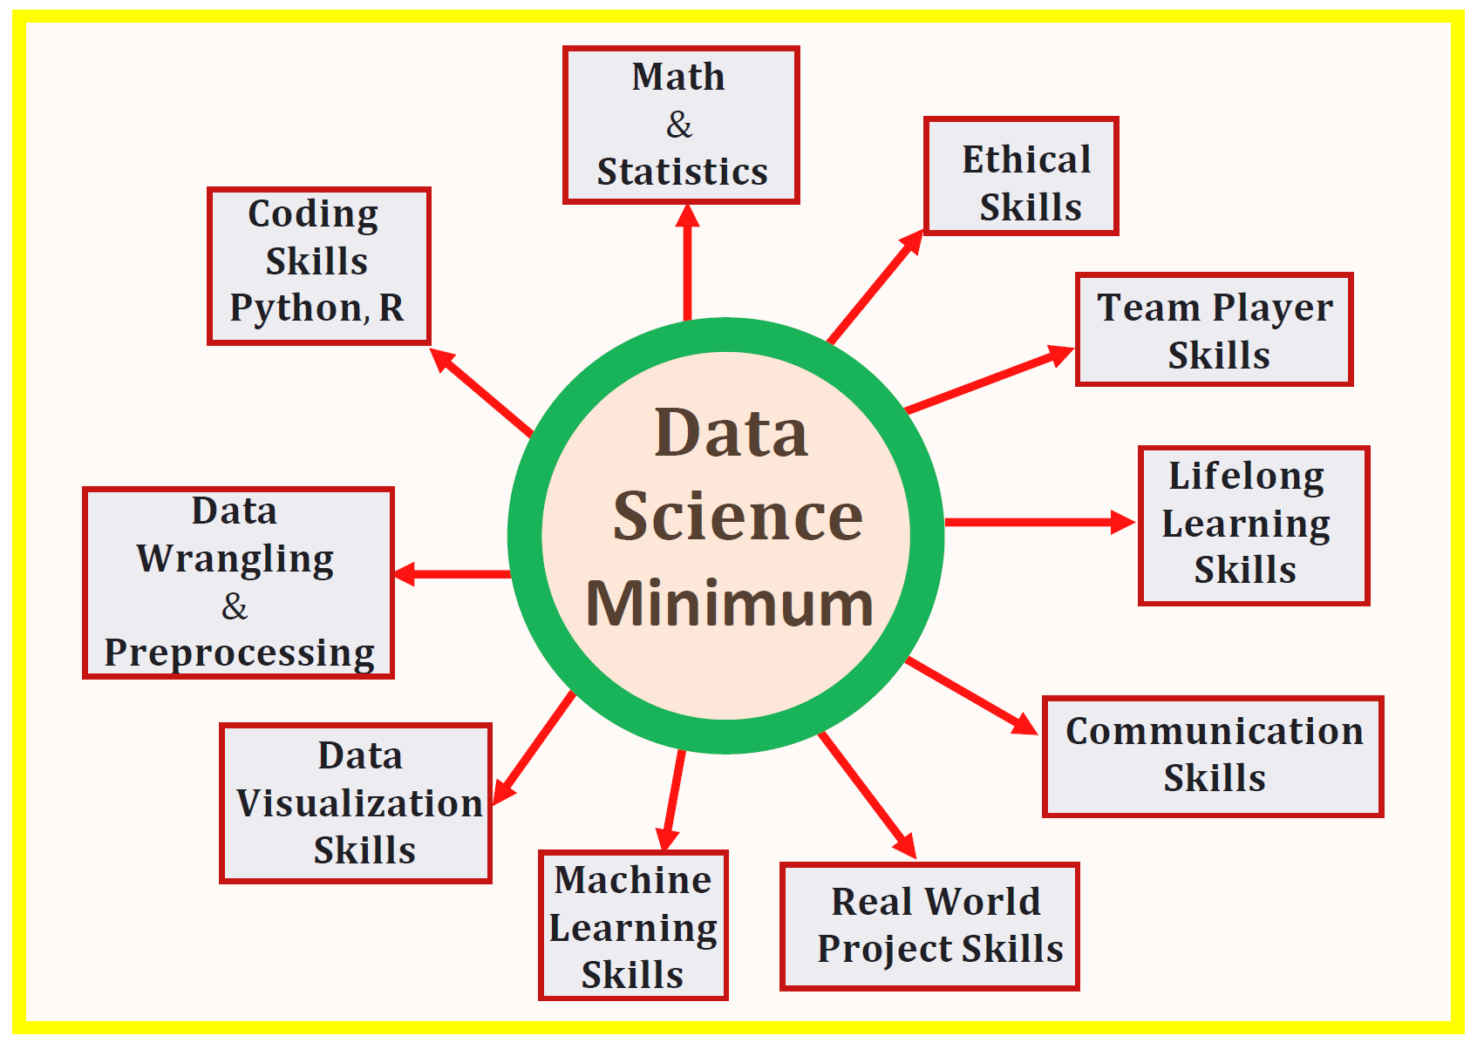
But, where is data science?

Slide 8
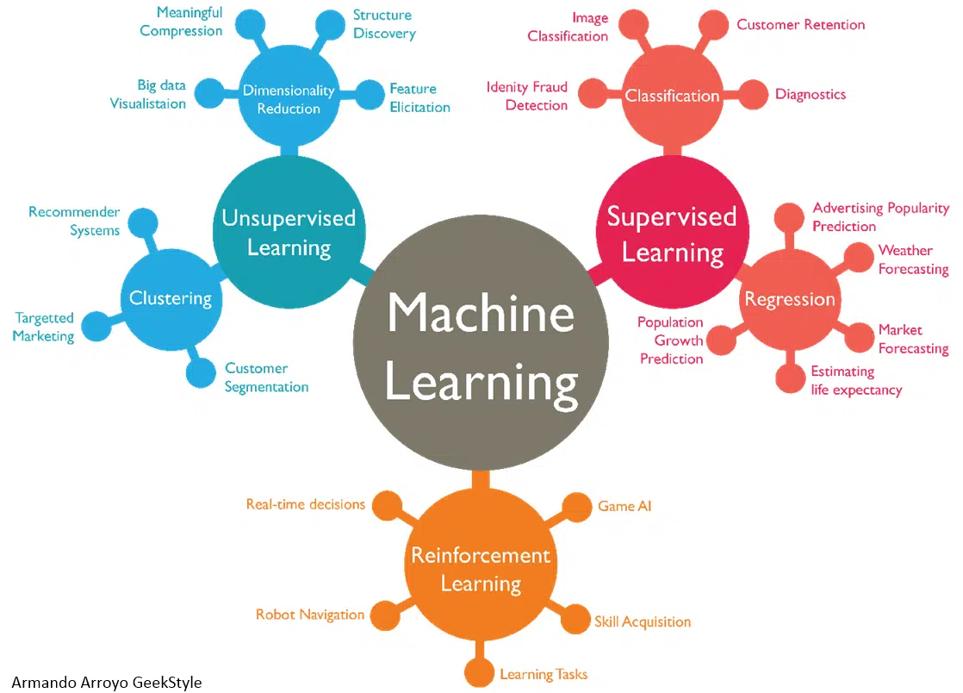
What machine learning technically is

Slide 9
Why now?
Very strong computing resources (GPUs, TPUs, cloud computing)
Very large amounts of data (the internet..)

Slide 10
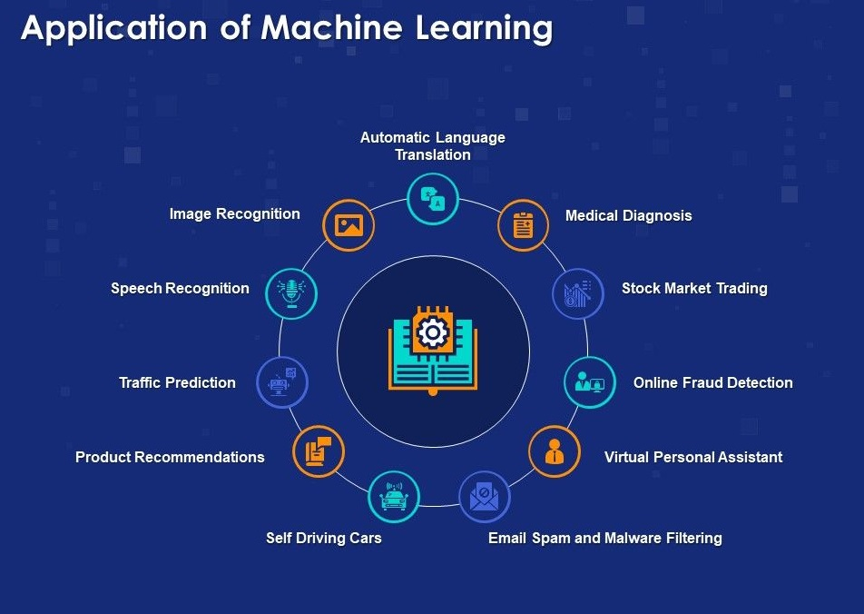
Applications of ML

Slide 11
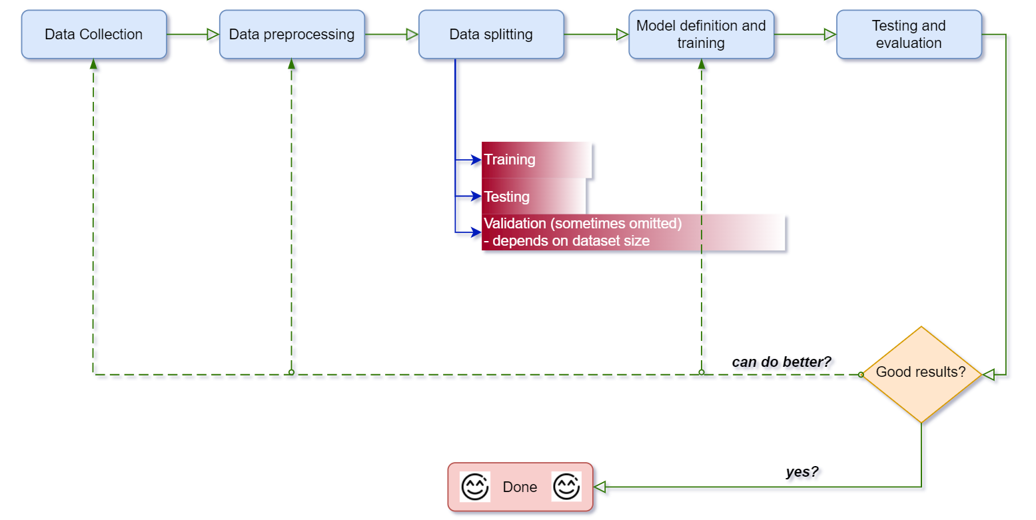
High Level Machine Learning Pipeline

Slide 12
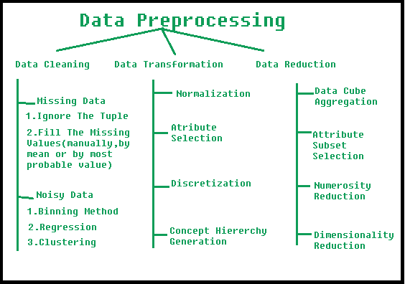
Most important: data preprocessing & cleaning

Slide 13
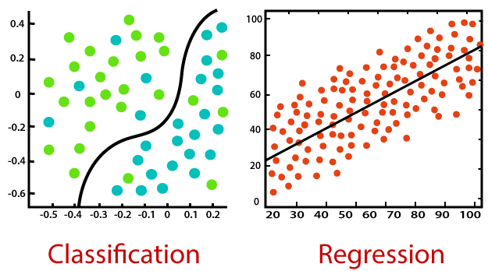
Going to the actual algorithms: Supervised Machine Learning
The main difference between Regression and Classification algorithms is that Regression algorithms are used to predict the continuous values such as price, salary, age, etc. and Classification algorithms are used to predict/Classify the discrete values such as Male or Female, True or False, Spam or Not Spam, etc.
1- Classification
2- Regression

Slide 14
Classification
Regression
Predicts discrete class labels
Examples:
Spam filtering
Sentiment analysis
Image classification
Predicts continuous labels
Examples:
Predict stock market prices
Life age expectancy
Forecasting revenues and expenses

Slide 15
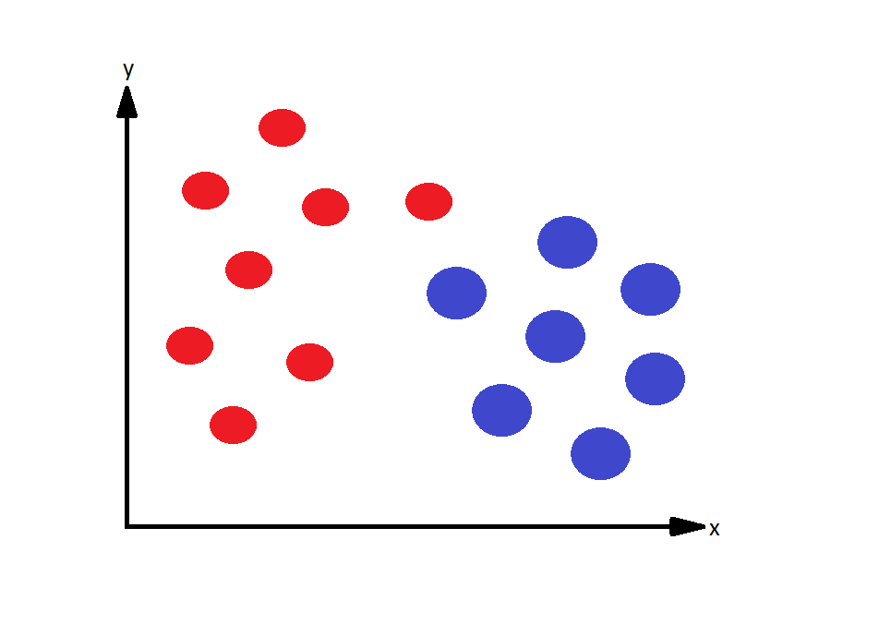
Classification Example

Slide 16
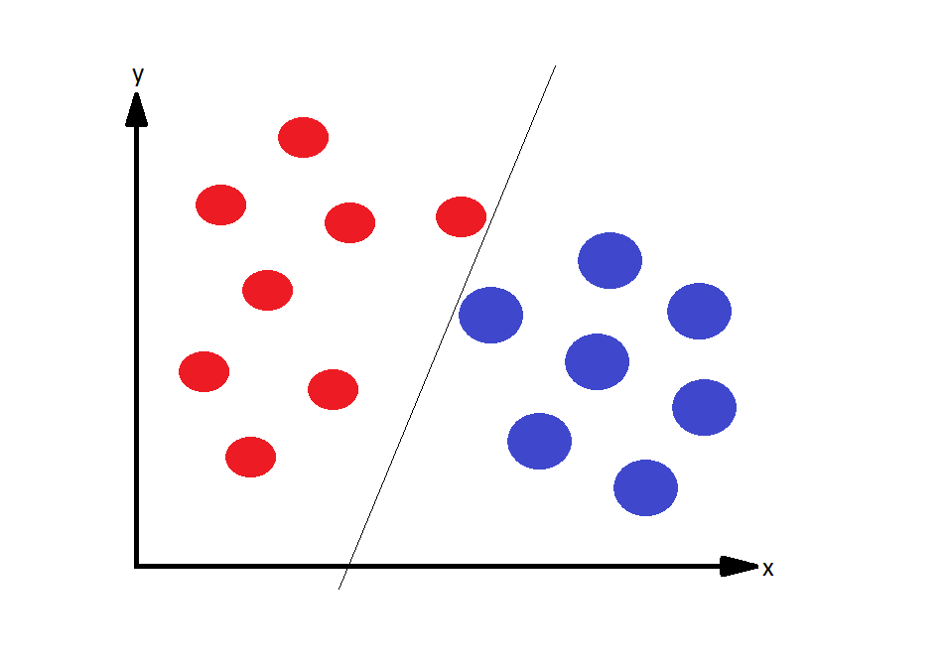
Linear classifier: perfect fit

Slide 17
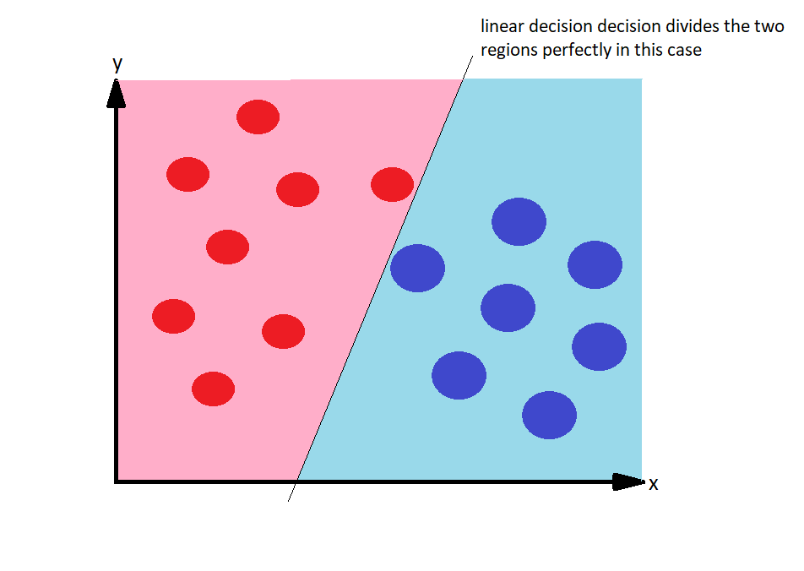
Linear classifier: perfect fit

Slide 18
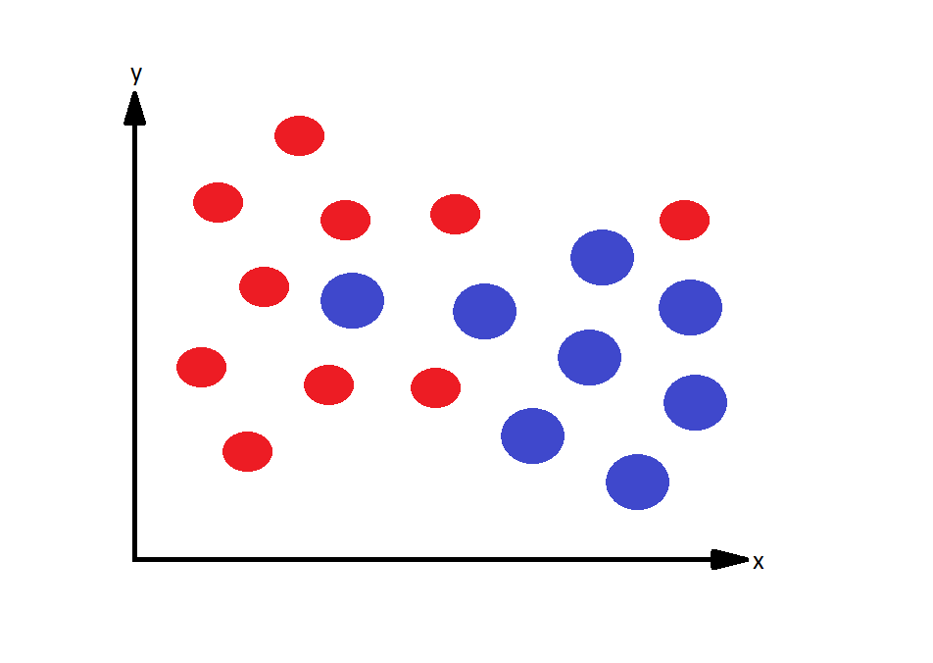
Limitation of a linear classifier (non-linearly separable data)

Slide 19
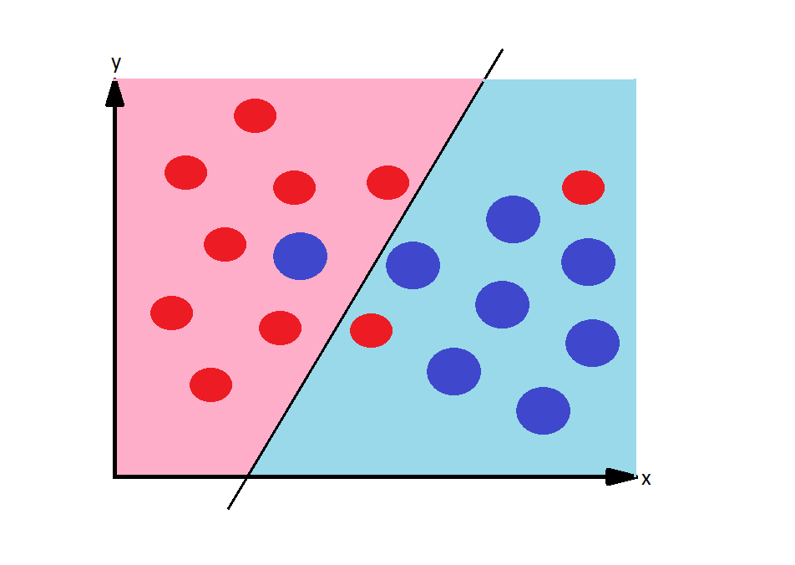
Limitation of a linear classifier (2)

Slide 20
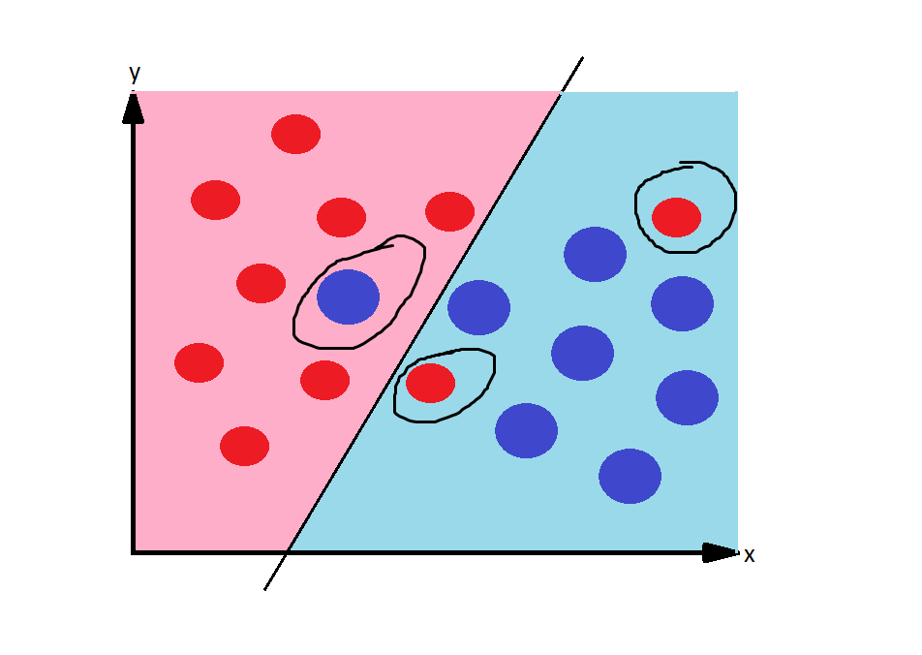
Limitation of a linear classifier (3)
A “good” linear classifier can at best make 3 mistakes in this example.

Slide 21
Generalizing to non linear models

Slide 22
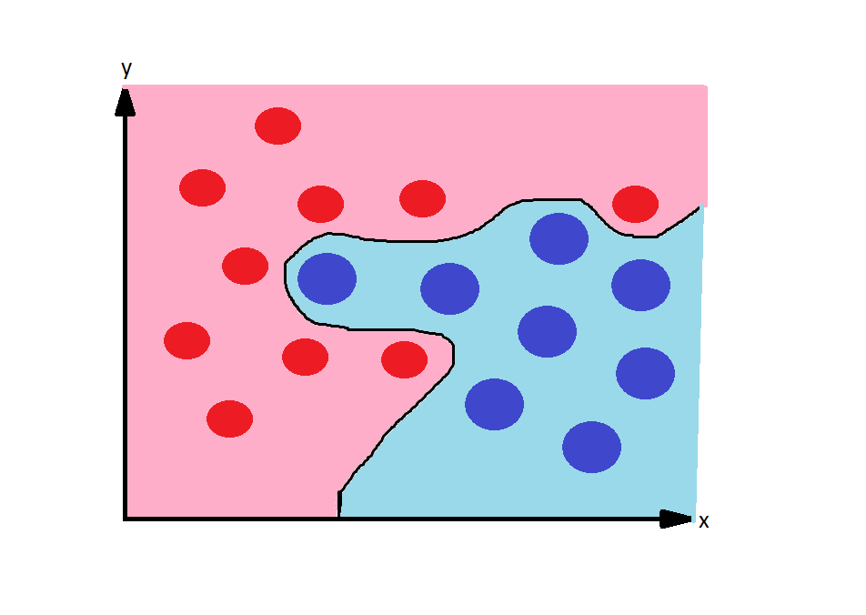
Generalizing to non linear models
This is a more complex model: non-linear model

Slide 23
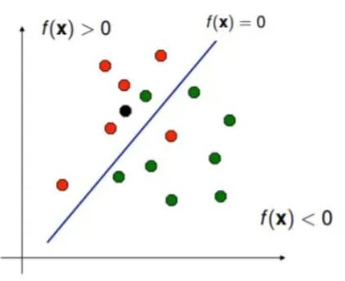
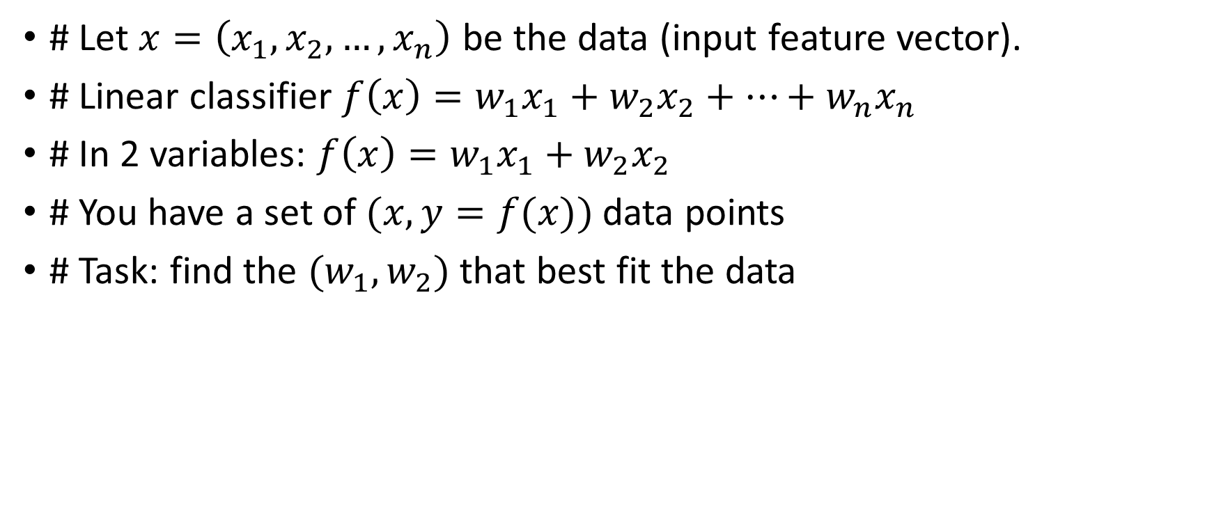
Formalizing the problem
# Let $x=\left(x_{1},x_{2},…, x_{n}\right)$ be the data (input feature vector).
# Linear classifier $f\left(x\right)=w_{1}x_{1}+w_{2}x_{2}+…+w_{n}x_{n}$
# In 2 variables: $f\left(x\right)=w_{1}x_{1}+w_{2}x_{2}$
# You have a set of $(x,y=f(x))$ data points
# Task: find the ${(w}_{1},w_{2})$ that best fit the data

Slide 24
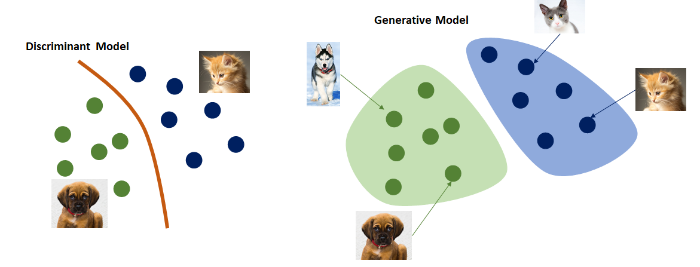
Algorithms to solve such a problem

Slide 25
Formalizing the Regression Problem

Slide 26
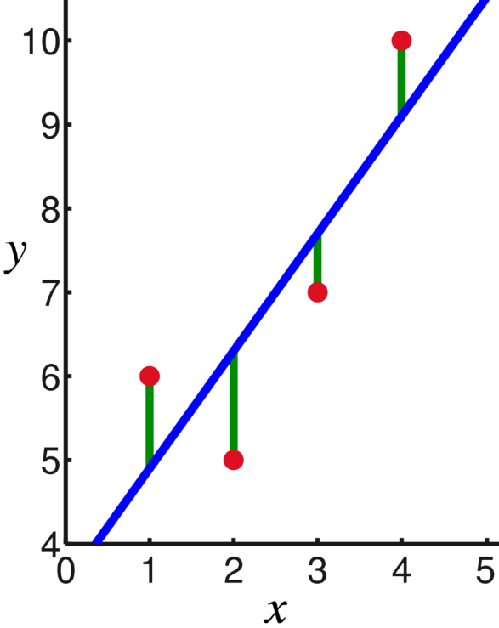
Most common linear regression algorithm
Linear regression
In 1 variable: y = a x + b
You have a set of (x,y) of data points
Find the (a,b) that best fit the equation
a: slope of the line
b: y-intercept
Solution: Least Squares
minimizes the squared distance
between the points and the solution line

Slide 27
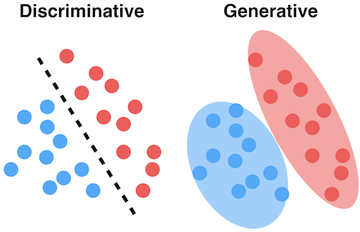
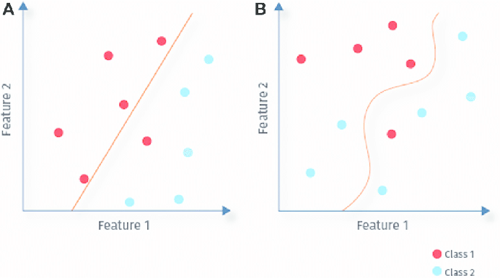
Common ML Algorithms
 | Linear model | Non-linear model
Discriminative model | Linear regression (for regression) & Logistic Regression (for classification) (*) Support vector machine (SVM) & support vector regressor (SVR) | K-nearest neighbors (*) Decision Trees (*)
Generative model | Linear Discriminative Analysis (LDA) Naïve Bayes | Generative Neural Networks
Linear
Non-linear

Slide 28
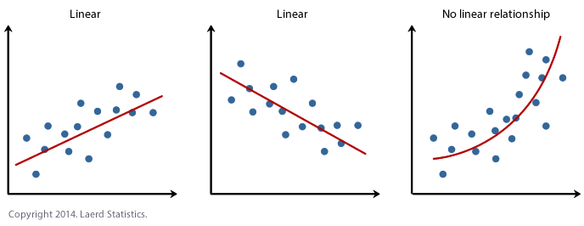
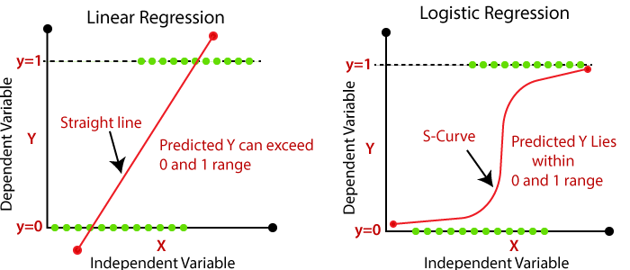
Linear/nonlinear regression vs logistic regression

Slide 29
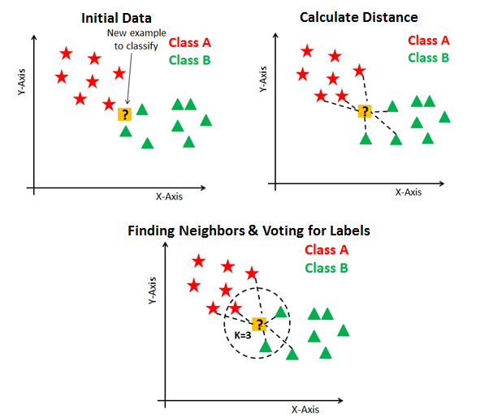
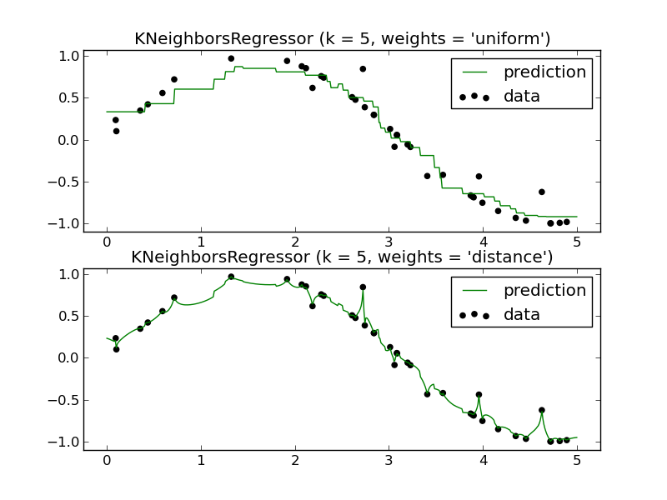
KNN Classifier vs KNN Regressor
Classifier
Regressor

Slide 30
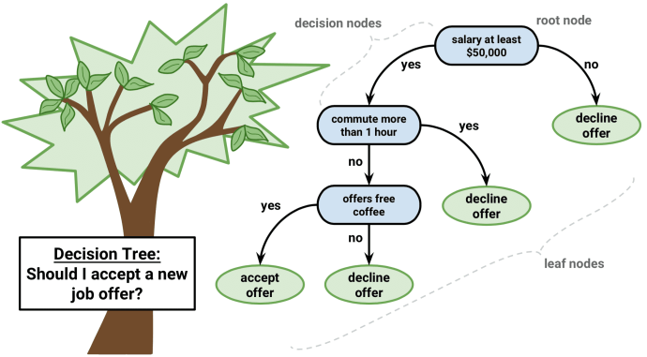
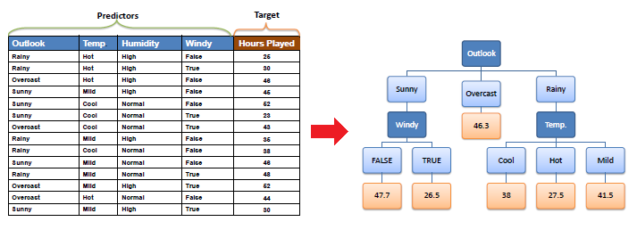
Decision Tree [https://www.saedsayad.com/decision_tree_reg.htm]
Classifier: discrete labels
Maximize “information gain” to find the nodes in the graph
Regressor: continuous labels
Minimize “standard deviation” to find the nodes in the graph

Slide 31
Overfitting / Underfitting

Slide 32
Bias / Variance Tradeoff

Slide 33
Going beyond linear regression

Slide 34
“Deep” Network = combined logistic models

Slide 35
Ensemble Learning
The wisdom of the crowd

Slide 36
Cross Validation

Slide 37
Occam Razor

Slide 38
No free lunch in Machine Learning

Slide 39
Unsupervised learning

Slide 40
Reinforcement Learning

Slide 41
Neural networks
https://towardsdatascience.com/building-our-first-neural-network-in-keras-bdc8abbc17f5

