Slide 1

Class-based Graph Anonymization for Social Network Data
Prof. Gasparre Ferraro
Data Protection & Privacy

Slide 2

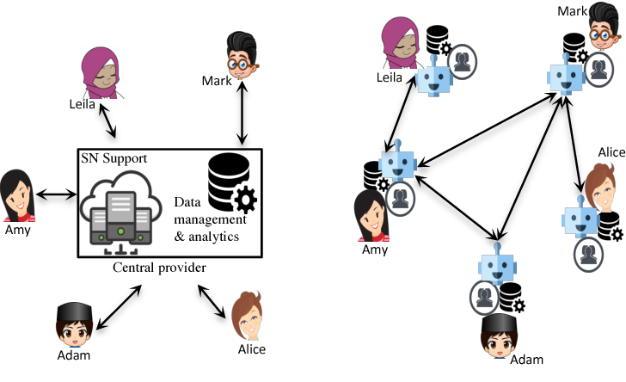
Definition:
A graph-based social network is a representation of a social network where individuals or entities are represented as nodes (also called vertices), and the relationships or interactions between them are represented as edges (such as friendship, kinship, common interest, financial exchange, dislikes, relationships) connecting these nodes. In the context of social media, graph-based models are particularly useful for illustrating and analyzing how people interact with each other and with content on the platform.

Slide 3

Introduction
The text discusses the challenges and importance of anonymizing data in Online Social Networks (OSNs) to protect users' privacy while maintaining the utility of the data for research. OSNs involve complex and sensitive data, including personal information and various types of interactions between users, such as friendships, messaging, blogging, and gaming. Traditional data anonymization techniques designed for tabular data, like k-anonymization, are insufficient for the rich, graph-structured data in OSNs. New methods are needed to effectively anonymize this data without compromising its value. The concept of "rich interaction graphs" is introduced to describe the complex and varied interactions in social networks, highlighting the need for advanced anonymization techniques.

Slide 4
Why class-based models:
Analyzing network dynamics
Discovering patterns of connectivity
Identifying influential nodes within the network
Recommending new connections or content based on existing relationships

Slide 5
Challenges:
Facebook and MySpace are examples of graph-based social networks that generate large amounts of data containing sensitive personal information. So the challenge is anonymizing data to protect individual privacy while preserving the utility of the data.
Traditional data anonymization methods, such as removing non-graph information or altering the graph structure by adding or deleting edges, are ineffective for the rich detail available in social network data. This richness limits the analysis due to the loss of detail caused by anonymization.

Slide 6
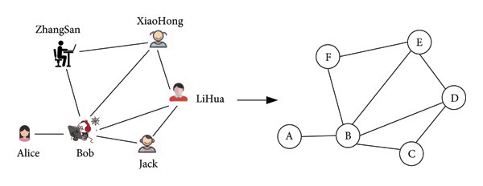
Masking the associations between entities and their interactions is too important but not to obscure them entirely. Such queries can be answered with some degree of accuracy.
We describe two types of anonymization techniques for such data, both based on partitioning the original entities into classes, and then analyze the ability of an attacker to infer additional information is minimized, or is zero, depending on the amount of background knowledge available to them.

Slide 7
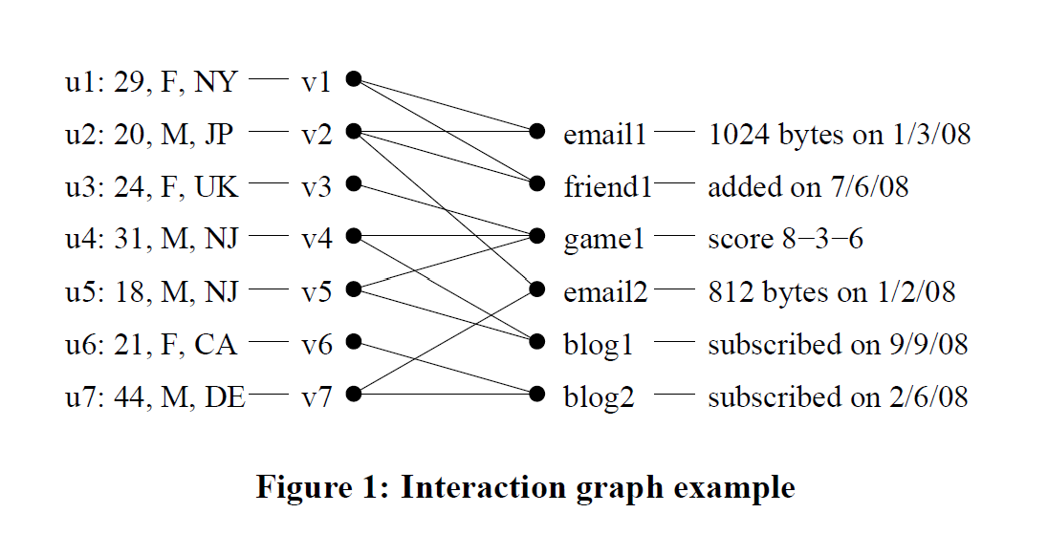
In an Online Social Network (OSN):
V represents the members of the network.
A hypergraph represents interactions, where each hyperedge consists of the set of entities involved in that interaction.

Slide 8
Label List approach:
We present the “label list” approach, which allocates a list of labels to each node in the graph, among which lies its true label. Each node in the graph gets a list of possible identifiers, including its true identifier. We show how these lists can be structured to ensure that the true identity cannot be inferred and provide a “safety condition” to ensure that the pattern of links between classes does not leak information.

Slide 9
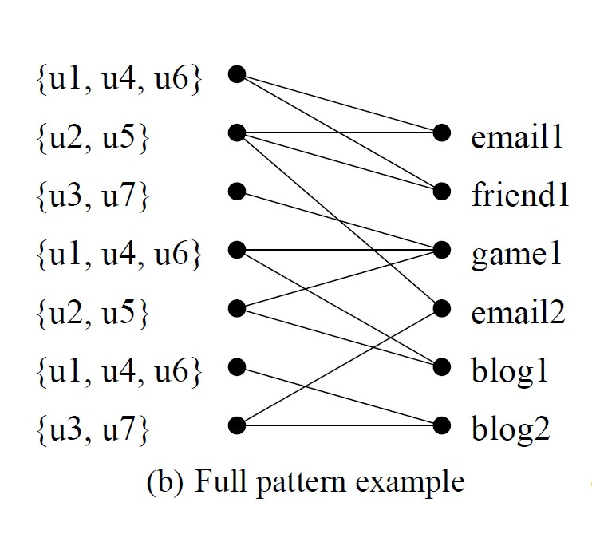
How:
The identifier of each node in the graph is replaced by a list of possible identifiers (or labels). This reveals partial information about the mapping from nodes to their true identifiers, and the links between them. Carefully chosen labeling ensures that an observer has a low probability of guessing the true mapping. Conceptually, this is related to permutation-based methods for anonymizing tabular data, which can be thought of as providing a short list of possible sensitive attributes for each record.

Slide 10
Partitioning approach:
We describe the “partitioning” approach, which partitions the entities into classes and represents the number of interactions at the level of classes, rather than nodes. This method is resilient to attackers with greater background information but has lower utility since less graph structure is revealed.

Slide 11
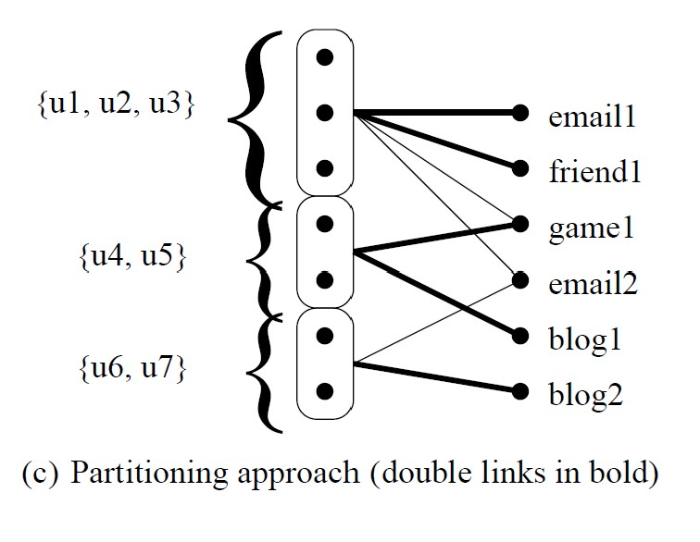
How:
This anonymization technique is based on partitioning the nodes in the graph into classes according to some criteria, such as their degree or centrality, and revealing only the number of interactions between and within the classes, without disclosing the mapping between the nodes and the classes.
the safety condition for this technique shows how to partition the nodes and construct the anonymized graph to satisfy the safety condition. It compares this technique with the label list approach in terms of the privacy and utility tradeoff and shows that it can preserve more structural information and enable more types of queries but at the cost of more information loss and less diversity.

Slide 12
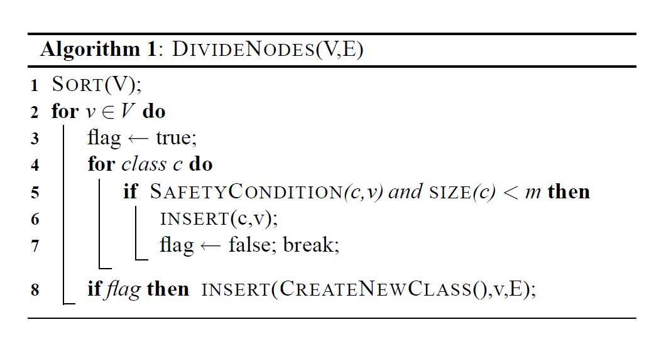
Nodes (V): The set of nodes in the graph that need to be anonymized. Each node represents an entity within the social network, such as an individual user.
Edges (E): The set of edges connecting the nodes, representing interactions between entities in the social network.
Classes: The nodes are divided into groups called classes. The division is based on ensuring privacy through a diversity of interactions within each class.
Parameter m: This is a crucial parameter that dictates the minimum size of each class. The algorithm ensures that each class has at least 'm' members.
5. Parameter k (≤ m): This parameter is used in generating label lists for nodes within each class. It specifies the maximum number of different labels (or possible true identities) that can be associated with each node in the anonymized data.

Slide 13
A simple greedy approach is illustrated in Algorithm. Here, we take each node v in turn and insert it in the first class that has fewer than m members, provided that performing this insertion would not violate the safety condition (lines 2–7).
This can be checked by ensuring that each node that participates in an interaction with v that it does not participate in an interaction with a node already in the class under consideration. If no class can be found that satisfies this condition, or all classes defined have at least m members, then a new class containing only v can be started (line 8); trivially, this class must satisfy the safety condition. The SAFETY CONDITION test can be implemented efficiently by maintaining for each class a list of all nodes that have an interaction with any member of the class. It is safe to insert v into a class if neither v nor any w that shares an interaction with v is present in the list.

Slide 14
O(|V||E|log|V|)
An attacker who observes data published using the (k,m)-uniform list approach and who does not know the original data can correctly guess which entities participate in an interaction with probability at most 1/k.
This prevents attacks based on a lack of diversity:
if (almost) every pair of nodes between two groups participates in some interaction, then an attacker could guess that some pair were friends and succeed with high probability. An attacker who observes data published using a full list and can use background knowledge to find the true identity of at most r nodes can guess which other entities participate in an interaction with probability at most 1/(k −r).

Slide 15
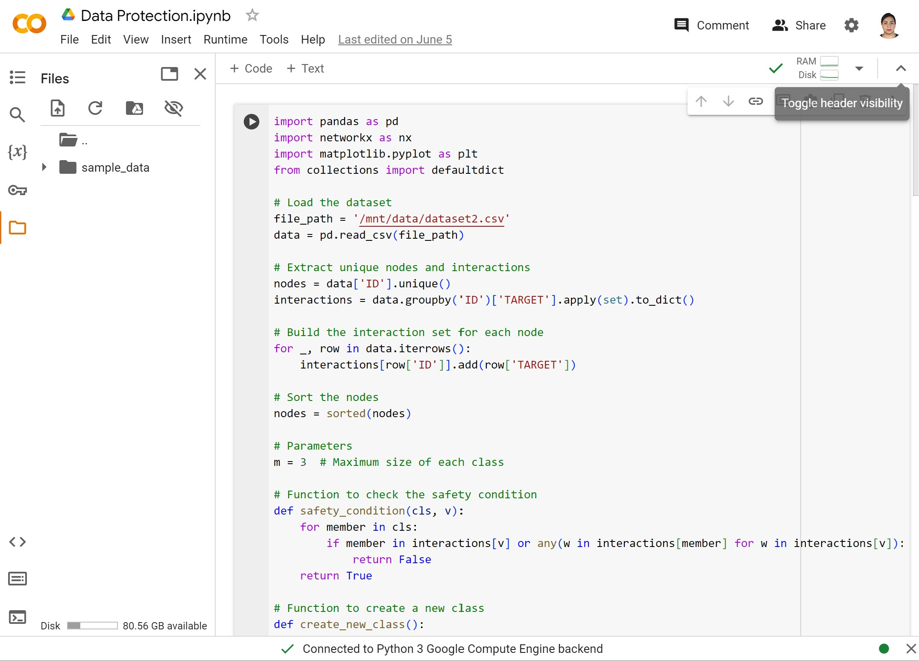
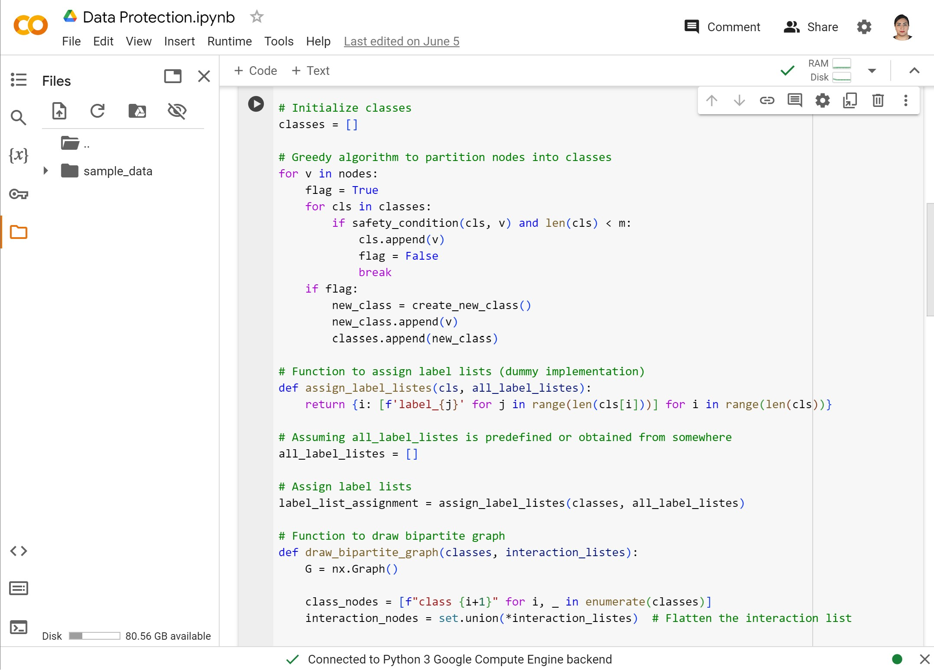
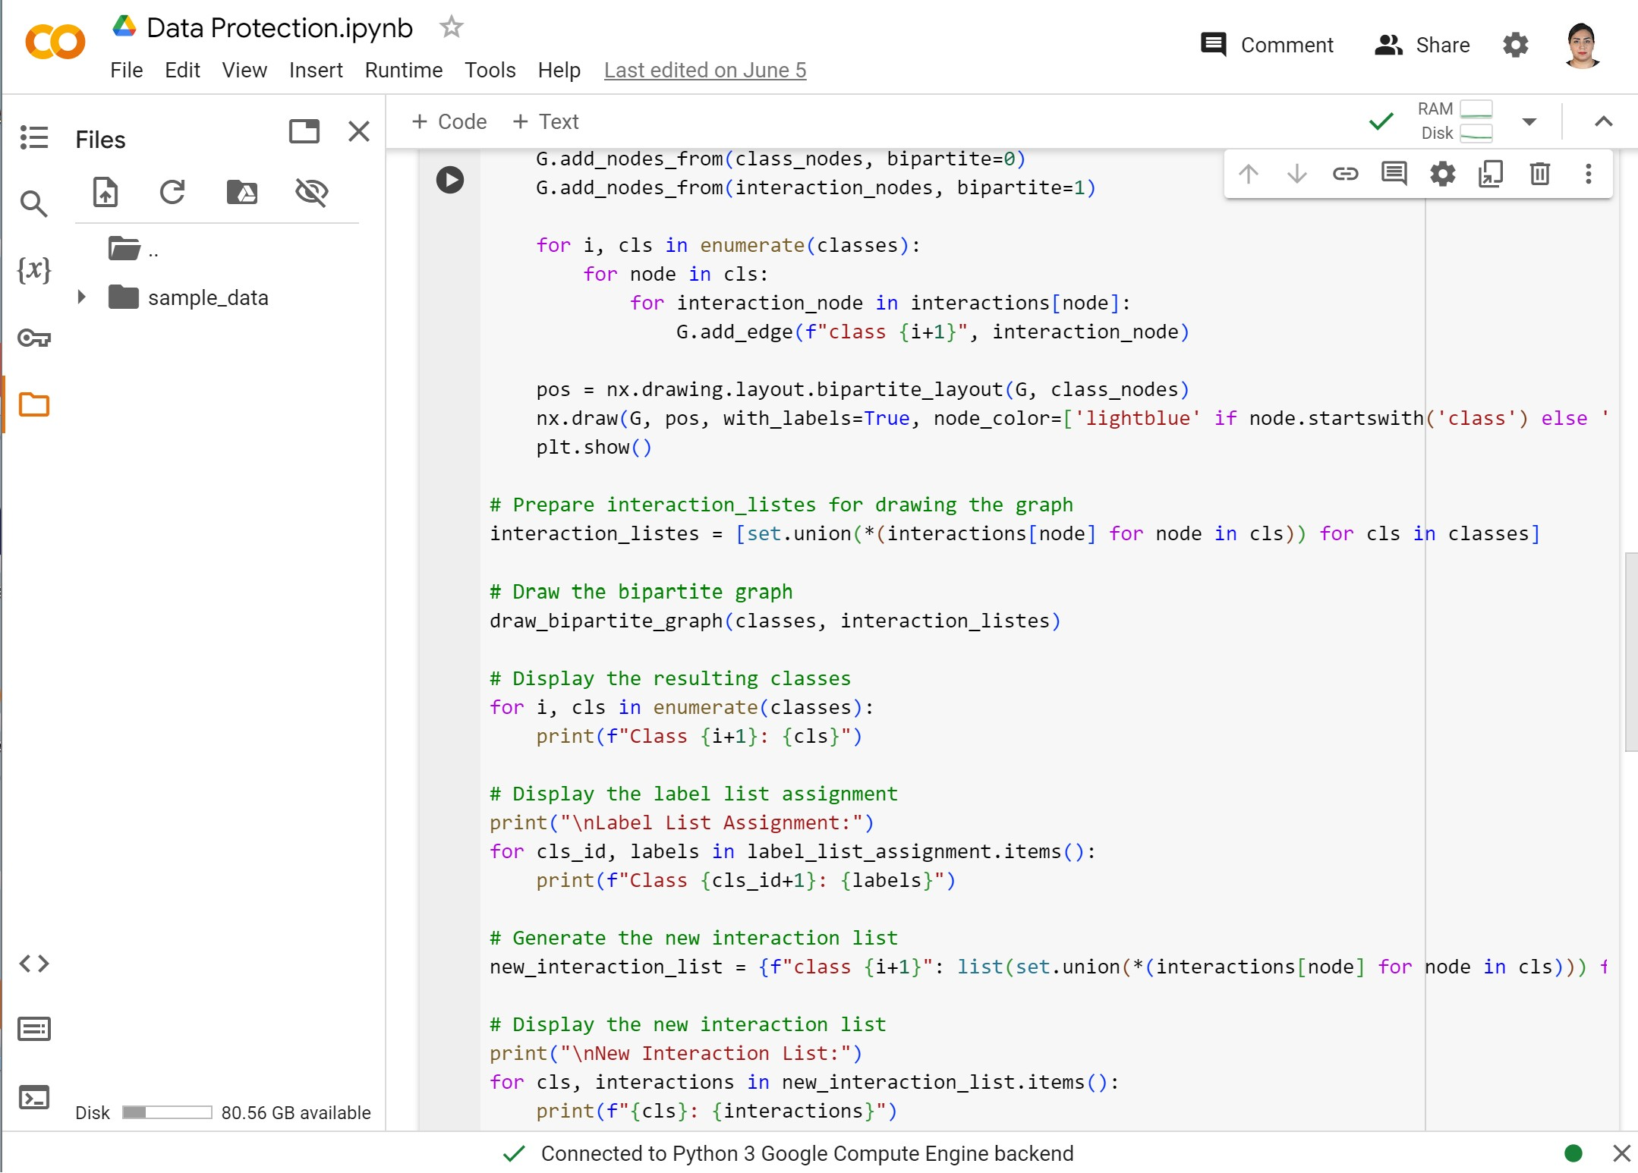
1
2
3

Slide 16
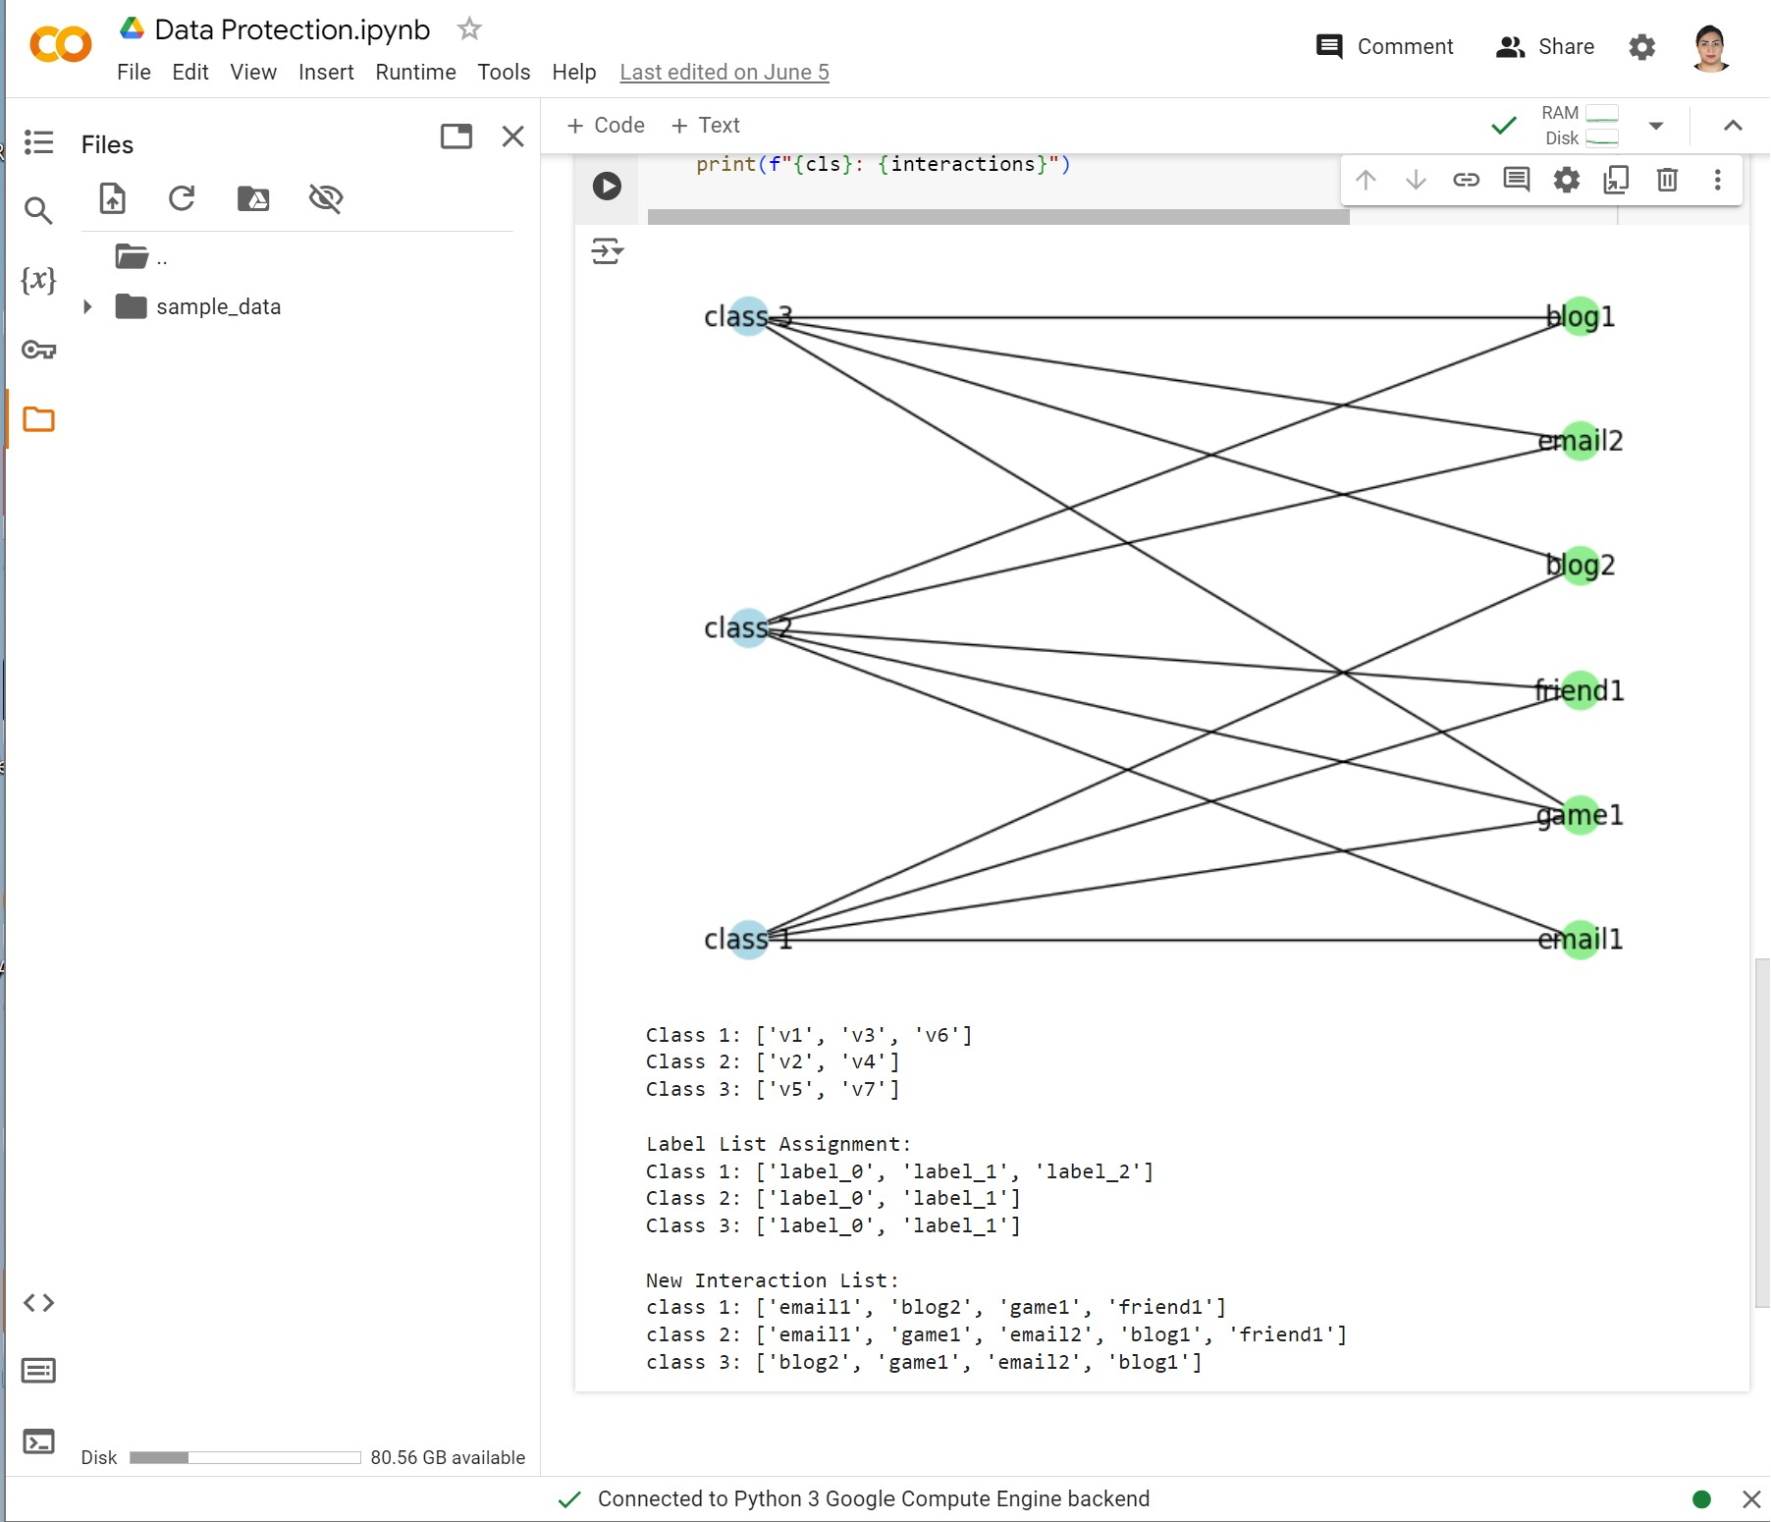

Slide 17
Conclusion
The problem of publishing sensitive social network data to allow complex ad hoc questions to be answered accurately while preserving the privacy of the data subjects remains challenging.
The article introduced new representations and techniques that allow rich data comprising many different interaction types to be anonymized effectively.
The empirical study validated our anonymization schemes' privacy-preservation and utility claims over various queries on two different datasets.
It remains a challenge to fully understand how to translate the aim of privacy for data subjects into precise quantifications of privacy goals, and better quantify the utility of resulting anonymization against an unknown future query workload.

Slide 18
Thanks for your Attention
Mina Asghari Kordeh Mahini_ ID: 6035679
Ali Shirdel_ID: 6065050

