Slide 1
Introduction to Python History, Functions, and Modules

Slide 2
What is Python?
High-level, interpreted programming language.
Created by Guido van Rossum and first released in 1991.
Emphasizes code readability with its use of significant indentation.

Slide 3
History of Python
Python 1.0: Released in 1994.
Python 2.0: Released in 2000 with new features like list comprehensions and garbage collection.
Python 3.0: Released in 2008, not backward-compatible with Python 2.x.
Continuous updates, with Python 3.10 released in 2021.

Slide 4
Functions & Modules

Slide 5
Functions in Python
Functions are blocks of code that perform a specific task.
Defined using the ‘def’ keyword.
Syntax: ‘def function_name(parameters):’

Slide 6
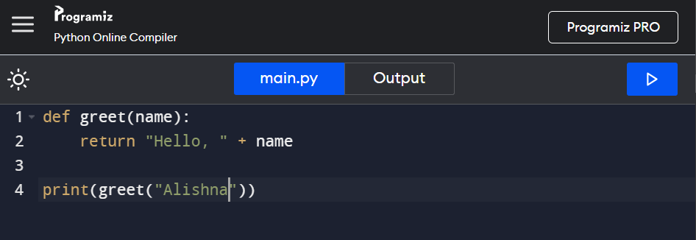
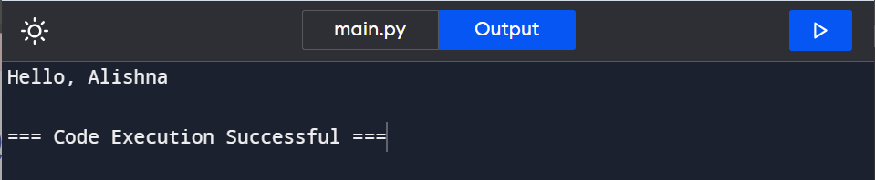
Example of a Function
Code Snippet

Slide 7
Modules in Python
Modules are files containing Python code (functions, variables, etc.).
Can be imported using the ‘import’ statement.
Example: ‘import math’

Slide 8
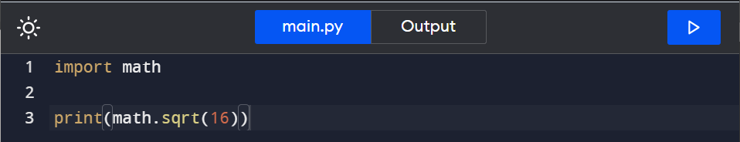
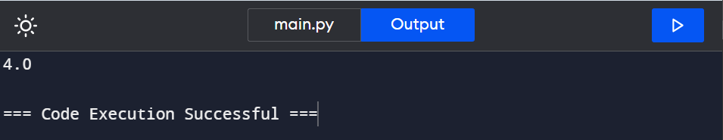
Example of a Module

Slide 9
Creating Your Own Module
Save functions and variables in a .py file.
Import your module using import module_name.
Example: Creating a mymodule.py file.

Slide 10
Conclusion
Python is a versatile language used in various fields.
Functions and modules are fundamental for code organization.
Explore Python’s extensive standard library for more functionality.

Slide 11
Thank you
ALISHNA MUKHYA A

