Slide 1
Numerical Software Development
Final Project
Linear
XGBoost
Implementation
0780828 - Alisher Mukashev

Slide 2
What was I going to do in this project?
Learn and understand the math background of XGBoost algorithm.
Implement XGBoost algorithm for linear regression.
Plot all results to get better understanding of the XGBoost algorithm
Write unit tests.
Compare to the original XGBoost.
Prepare final report and presentation.

Slide 3
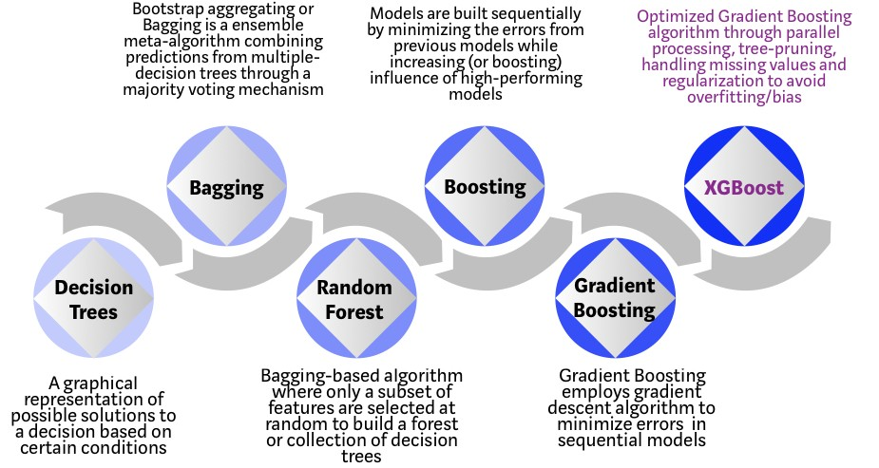
XGBoost algorithm

Slide 4
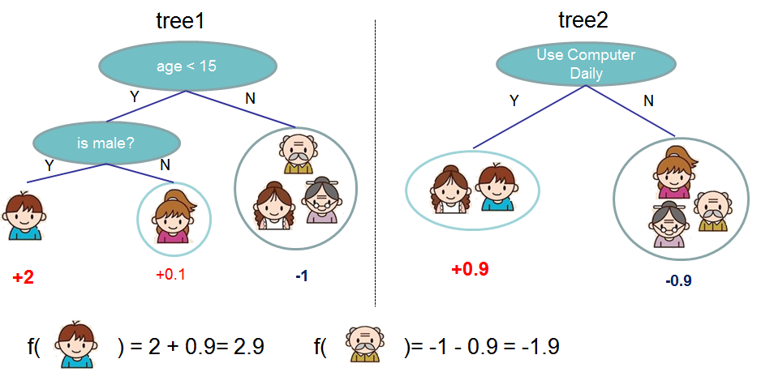
Ensemble learning

Slide 5
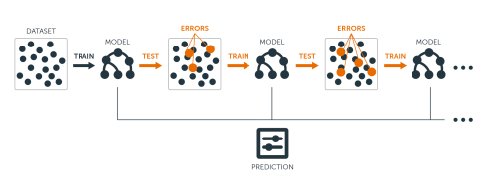
Boosting

Slide 6
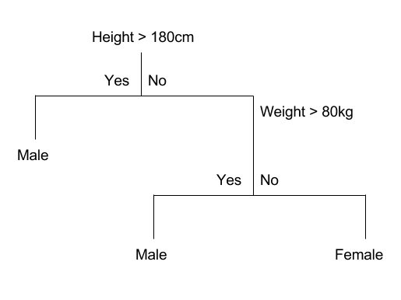
Decision tree

Slide 7
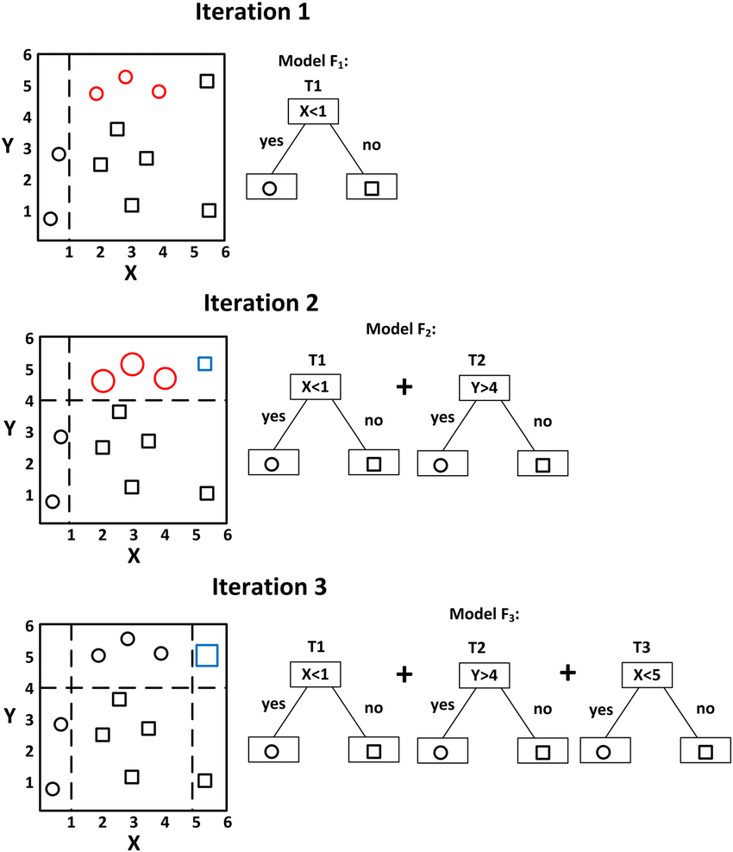
Gradient Boosting tree

Slide 8
XGBoost algorithm
State of the art performance in many ML tasks
Speed and Performance
L1 (Lasso Regression) and L2 (Ridge Regression) regularization which prevents the model from overfitting

Slide 9
Linear regression task

Slide 10
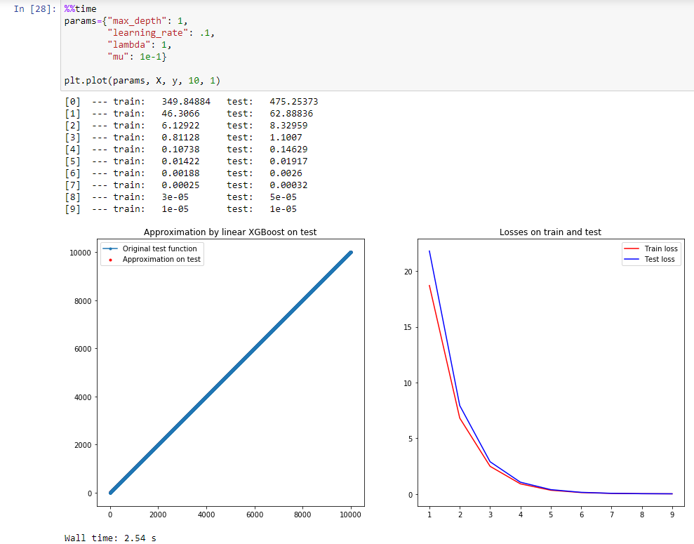
Results

Slide 11
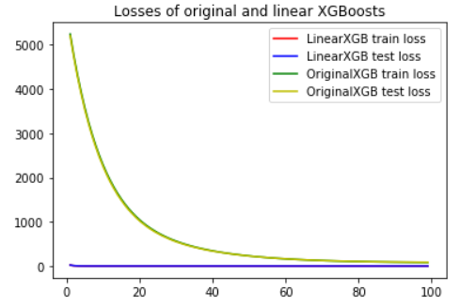
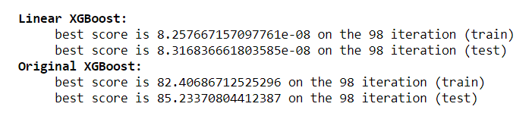
Compare to the original XGBoost

Slide 12
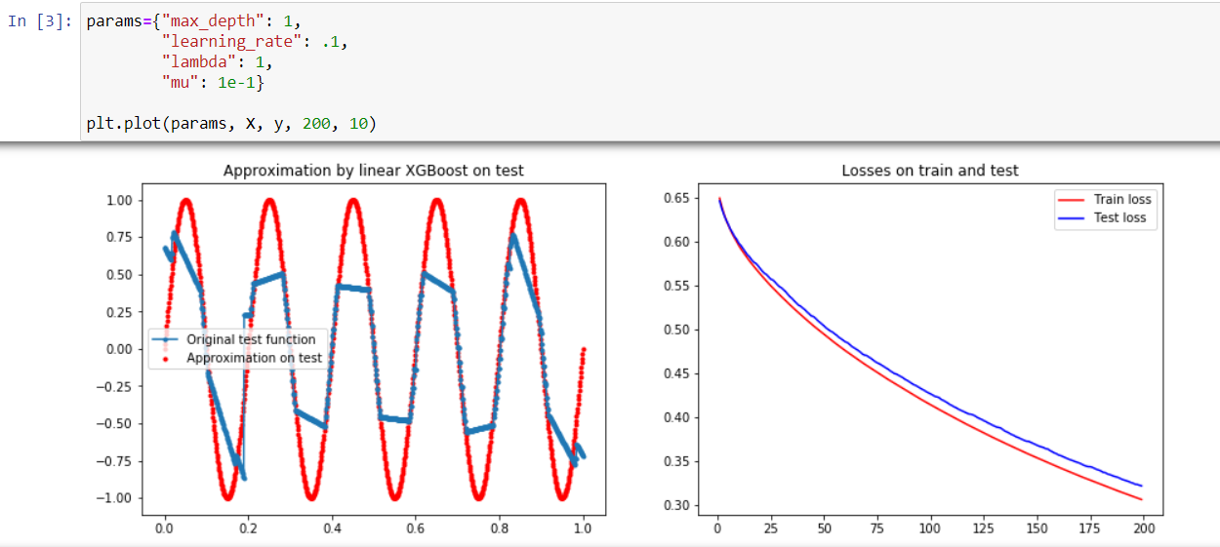
Results
Wall time: 8,01 s

Slide 13
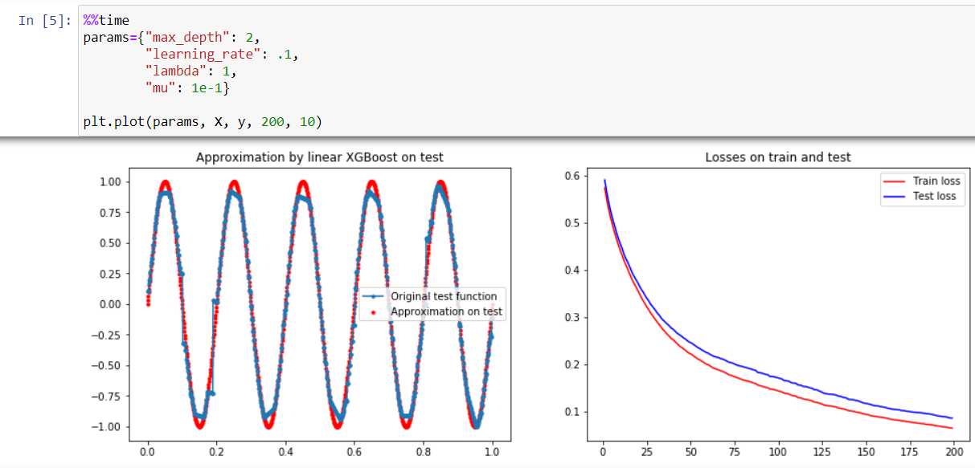
Results
Wall time: 15,1 s

Slide 14
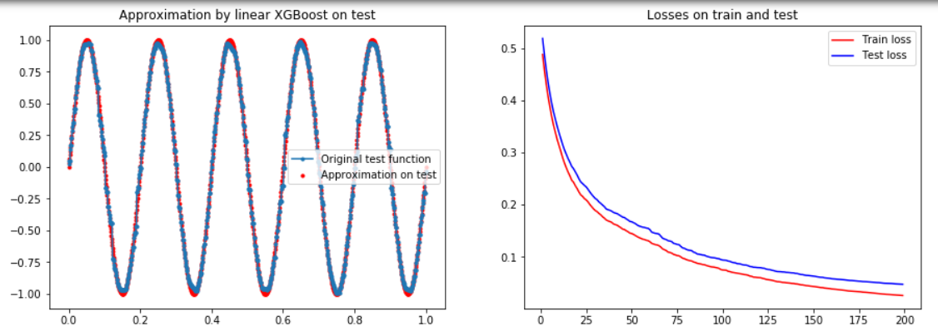
Results
Wall time: 27 s

Slide 15
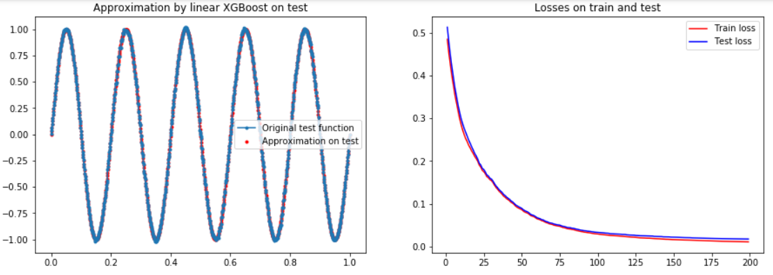
Results
Wall time: 26.9 s

Slide 16
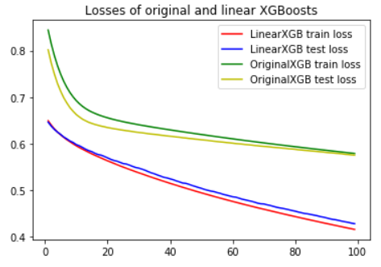
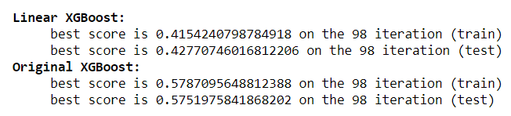
Compare to the original XGBoost

Slide 17
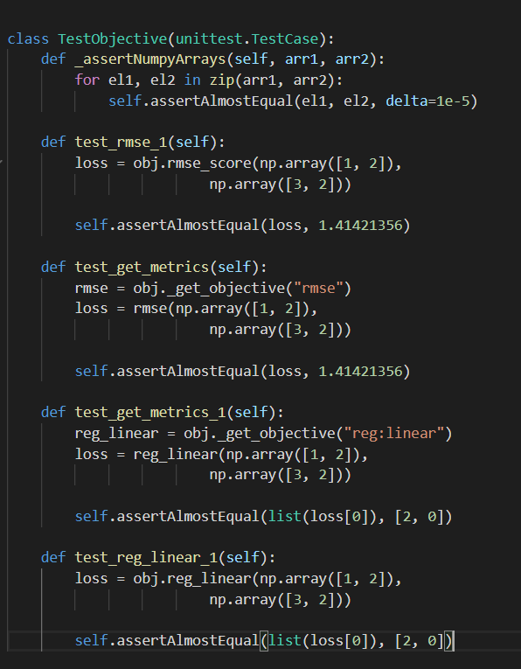
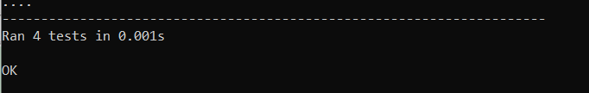
Unit tests

Slide 18

Thanks for the attention!

