Slide 1
Welcome

Slide 2
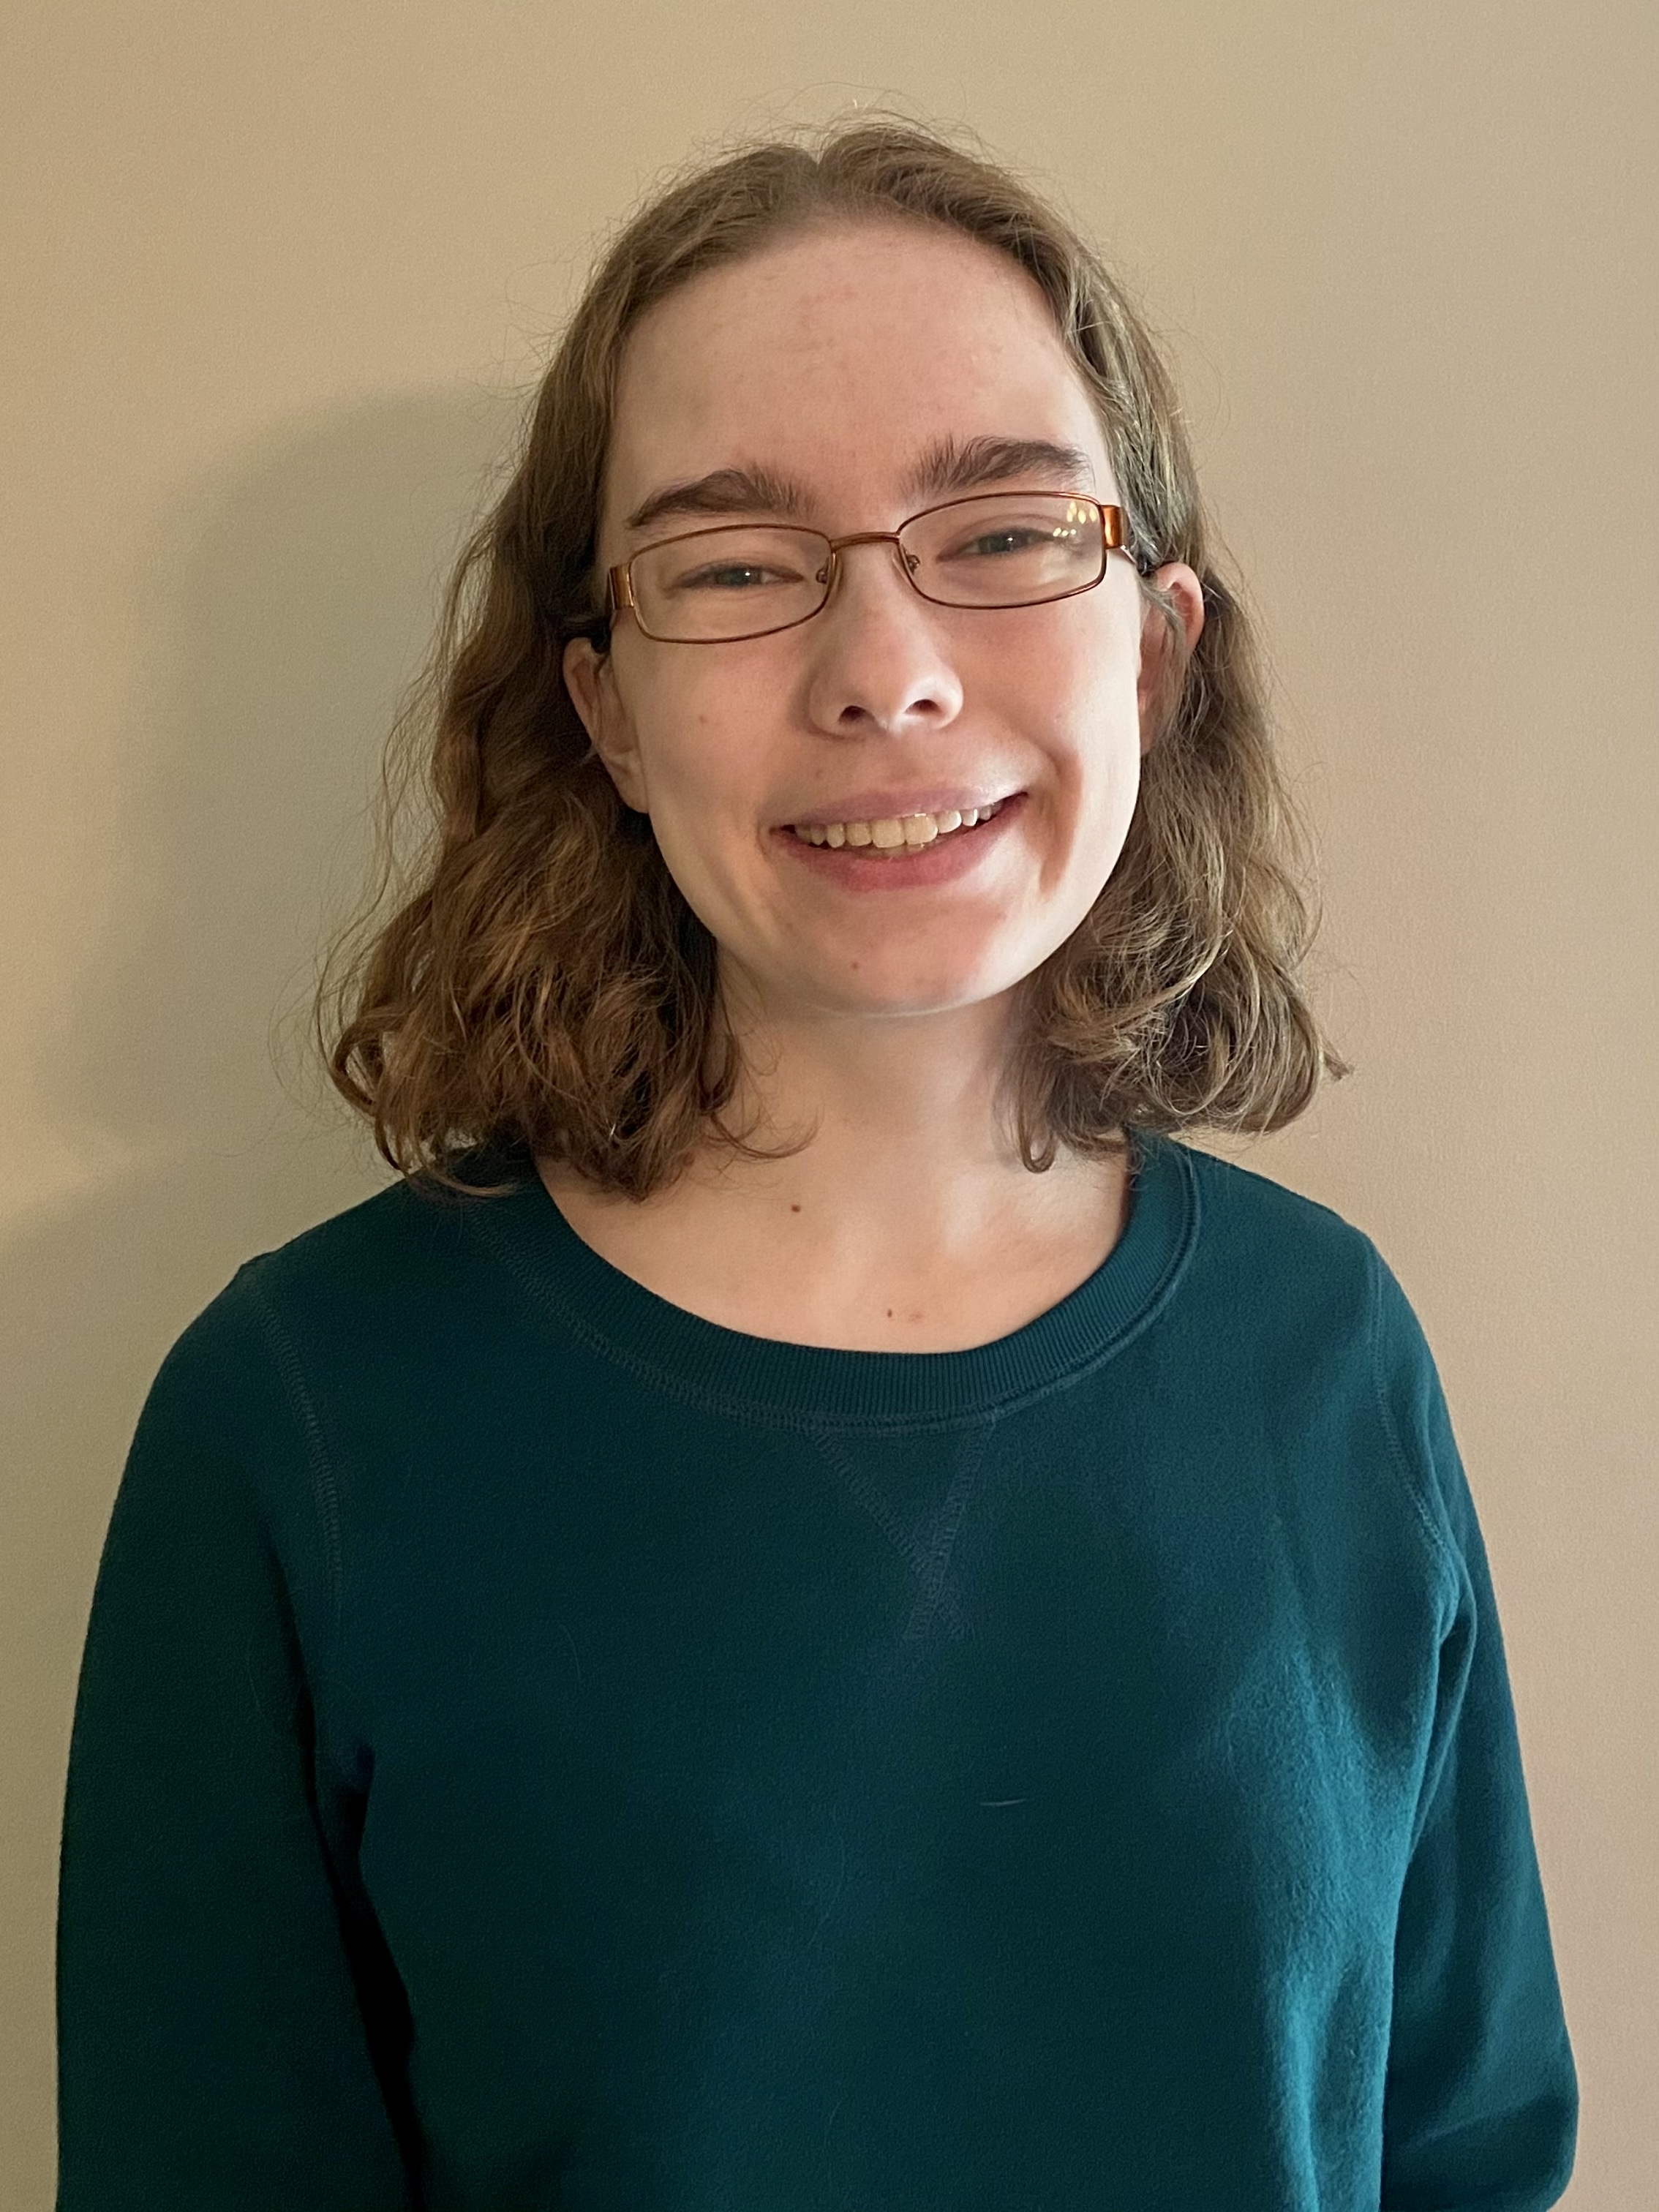
About Alison
Alison Obright MA

Slide 3
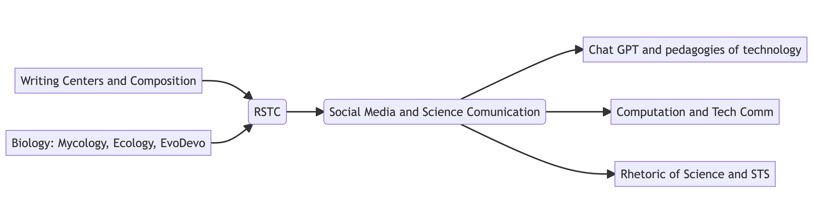
Alison Obright is a first year Ph.D student at the University of Minnesota. She is interested in rhetoric of science and technology and the ways that language mediates our relationship to science and technology. Currently, her interest has her examining narratives of decision making, computational methods in rhetoric, and the ways that technology, belief, and conspiracy interact.

Slide 4
Alison’s academic interest timeline.

Slide 5
Some of Alison’s work
Breuch, L.-A., Ghimire, A., Bolander, K., Deets, S., Obright, A., & Remcheck, J. (n.d.). Reconsidering Writing Pedagogy in the Era of ChatGPT: Results of a Usability Study of ChatGPT in Academic Writing, forthcoming
Deets, S., Baulch, C., Obright, A., & Card, D. J. (n.d.). Content Analysis, Construct Validity, and Artificial Intelligence: Implications for TPC and Graduate Programming. Journal of Business and Technical Communication, forthcoming

