Slide 1


BIG BRIDGE : Projet Big Data Santé et Environnement dans la ville de Nice en partenariat avec l’IMREDD
Irina GRIGOREVA – Oualid MANAI –
Walid RHAZADI – Sergey GORIANIN
Project manager : Pr Gabriel Mopolo
Scientific Resp : Pr Serge Miranda, Director of MBDS (www.mbds-fr.org)

Slide 2
SUMMARY
Project Presentation
What is IMREDD
State of Art
About Our Team
Project Organization
Data Description
Architecture and Data Management
Results of Data Analysis

Slide 3


DOES AIR POLLUTION AFFECT HEALTH ?
HEALTH
DATA
ENVIRONMENT DATA
BIG DATA PROJECT

Slide 4
PROJECT’S OBJECTIVE AND GOALS
Software tool
Management data
BIG Bridge
(DATA LAKE)
Data Analysis
Whether or not air pollution affects the growth of the number of patients with Dyspnea in Nice?

Slide 5
PROJECT’S PARTNER: IMREDD
the Mediterranean Institute for Risk, Environment and Sustainable Development
conduct and promote the scientific, technological, economic, social and human scientific and technological research and training activities of sustainable development;
impulse the logics of platforms necessary for mutualized research and development activities;
promote the valorization of previous activities by helping to identify and support innovative new entrepreneurs and by facilitating collaborative networks between existing actors, such as laboratories, companies, local authorities and associations.

Slide 6
EXISTING SOLUTIONS (state of the art)
REMITT
Technologies: Java, JEE, MySQL, REST/SOAP, Javascript
http://remitt.org/
Open Air
Technologies: R language
http://www.openair-project.org/
IBM Analytics (Watson)
Technologies: Cloud based service
https://www.ibm.com/analytics/watson-analytics/us-en/
OHDSI
Technologies:
Atlas, Achilles, Calypso,✓KnowledgeWebBase
http://www.ohdsi.org/
Easy Med Stat
Technologies: PHP
http://www.easymedstat.com/
FreeMED
Technologies: Web service
http://freemedsoftware.org/

Slide 7
COMPARING SOLUTIONS
Criteria Project | Analysis of medical data | Analysis of environment data | Open-source solution | Big Data | Real time analysis
Air Paca |  | ✓ | ✓ | ✓ | ✓
Open Air |  | ✓ | ✓ | ✓
OHDSI | ✓ |  |  | ✓
Easy Med Stats | ✓ |  |  | ✓
FreeMED | ✓ |  | ✓ | ✓
REMITT | ✓ |  | ✓ | ✓
Big Bridge - SE | ✓ | ✓ | ✓ | ✓ | ✓ (in future)

Slide 8

OUR TEAM
👧 Irina – project chief, developer
👦 Sergey – developer, medical expert
👦 Oualid - developer
👦 Walid - developer

Slide 9
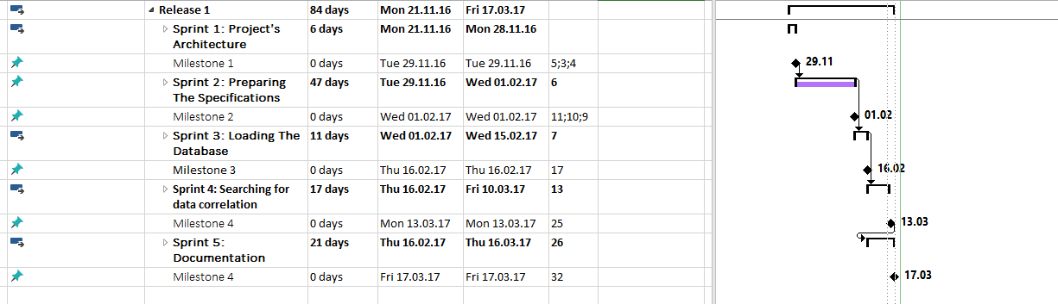
PROJECT’S ORGANIZATION

Slide 10

HEALTH DATA
Volume: 7854 rows, 25 columns
Type : SQL
Genre
Age
Address
Postal code
Ville
Admission
Sortie
Examen
Categorie de Recours
Libelle de Recours
Code de Recours
Libelle gravite
Libelle CCMU
Destination Confirmee
Type de sortie
Diag1 – diag10

Slide 11

ENVIRONMENTAL
DATA
Volume: 23016 rows, 6 columns
Type : CSV (EXCEL)
Station
Polluant
Mesure
Unité
Date
Value

Slide 12
Architecture of Big Bridge with Oracle DWH implementation

Slide 13
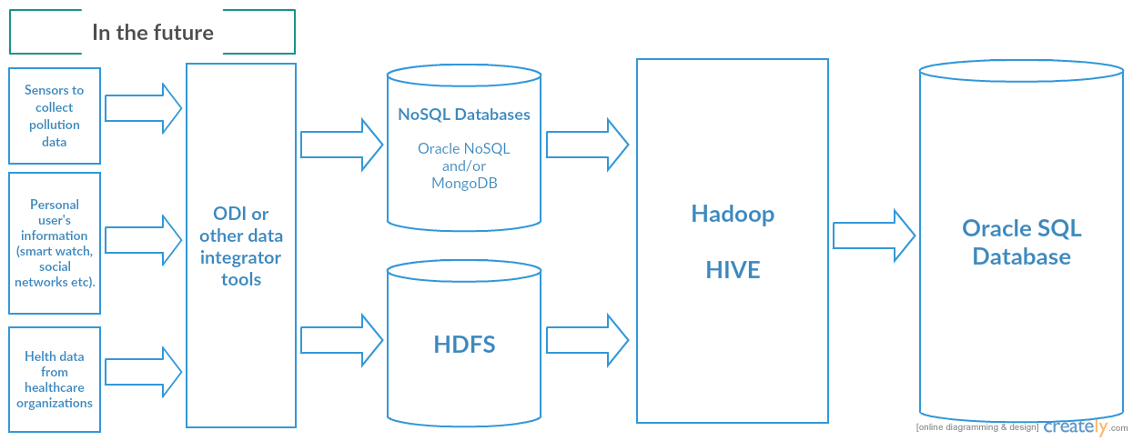

Slide 14
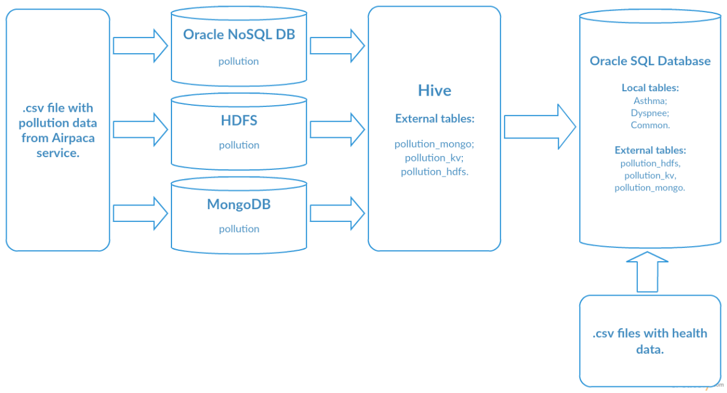
Database Executing time | Oracle NoSQL DB | HDFS | MongoDB
Time (secs.) | 0.83 | 0.257 | 0.57

Slide 15
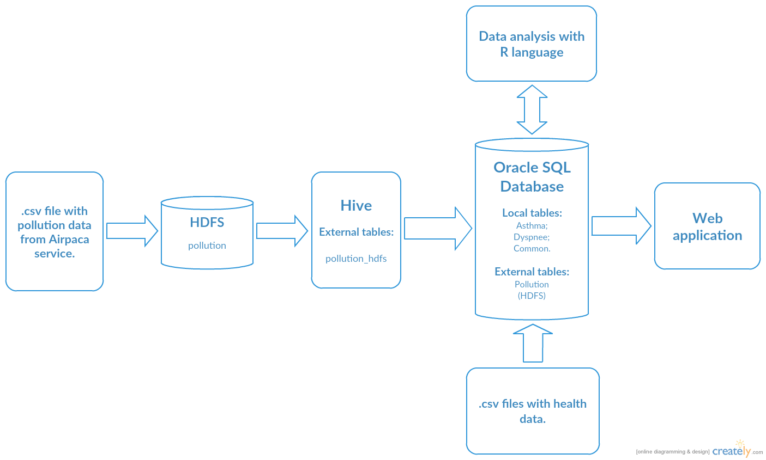

Slide 16
DATA ANALYSIS WITH R language
The population correlation coefficient ρX,Y between two random
variables X and Y with expected values μX and μY and standard
deviations σX and σY is defined as:
where E is the expected value operator, cov means covariance, and cor is a widely used alternative notation for the correlation coefficient

Slide 17
THE LINEAR CORRELATION COEFFICIENT OF UNFILTERED DATA
Data set 1 | Data set 2 | correlation coefficient
∆NO | ∆Patients | 0.1804087
∆NO2 | ∆Patients | 0.1012164
∆NOX | ∆Patients | 0.1616413
∆O3 | ∆Patients | -0.2199504
∆PM10 | ∆Patients | 0.05497636
∆PM2,5 | ∆Patients | 0.0786113

Slide 18
THE LINEAR CORRELATION COEFFICIENT OF FILTERED DATA BY DIAGNOSIS (Lung patients)
Data set 1 | Data set 2 | correlation coefficient
∆NO | ∆Patients(lung) | 0.1719213
∆NO2 | ∆Patients(lung) | 0.08888615
∆NOX | ∆Patients(lung) | 0.1535681
∆O3 | ∆Patients(lung) | -0.2045952
∆PM10 | ∆Patients(lung) | 0.06846391
∆PM2,5 | ∆Patients(lung) | 0.0973422

Slide 19
THE LINEAR CORRELATION COEFFICIENT OF FILTERED DATA BY DIAGNOSIS (Heart patients)
Data set 1 | Data set 2 | correlation coefficient
∆NO | ∆Patients(heart) | 0.1060834
∆NO2 | ∆Patients(heart) | 0.03138159
∆NOX | ∆Patients(heart) | 0.08371402
∆O3 | ∆Patients(heart) | -0.1386231
∆PM10 | ∆Patients(heart) | -0.005957092
∆PM2,5 | ∆Patients(heart) | 0.002553244

Slide 20
THE LINEAR CORRELATION COEFFICIENT OF INTERVAL DATA (5 days period)
Data set 1 | Data set 2 | correlation coefficient
∆NO | ∆Patients | 0.36395
∆NO2 | ∆Patients | 0.2697953
∆NOX | ∆Patients | 0.3613143
∆O3 | ∆Patients | -0.371573
∆PM10 | ∆Patients | 0.1243245
∆PM2,5 | ∆Patients | 0.1249298

Slide 21
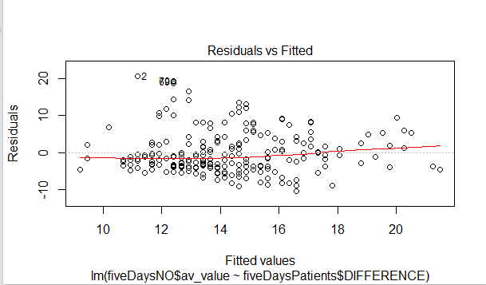
LINEAR REGRESSION MODEL
NO ~ patients

Slide 22
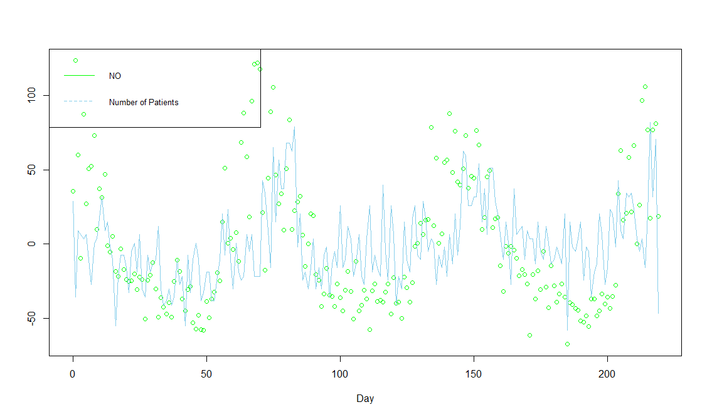
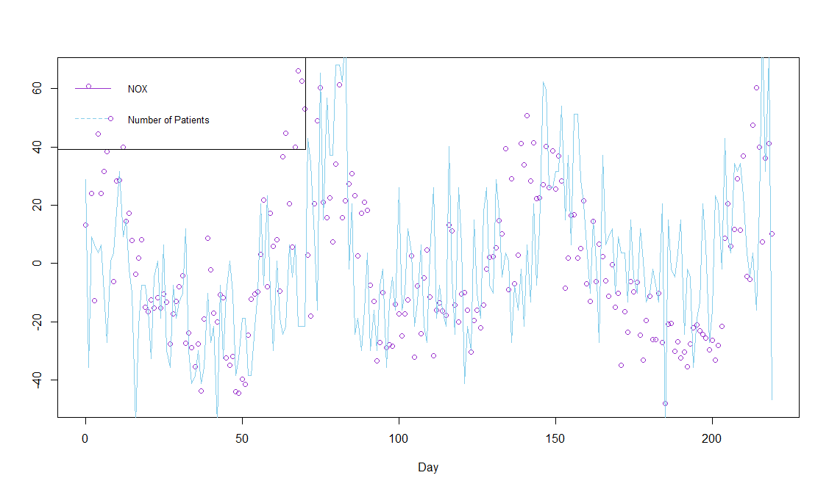
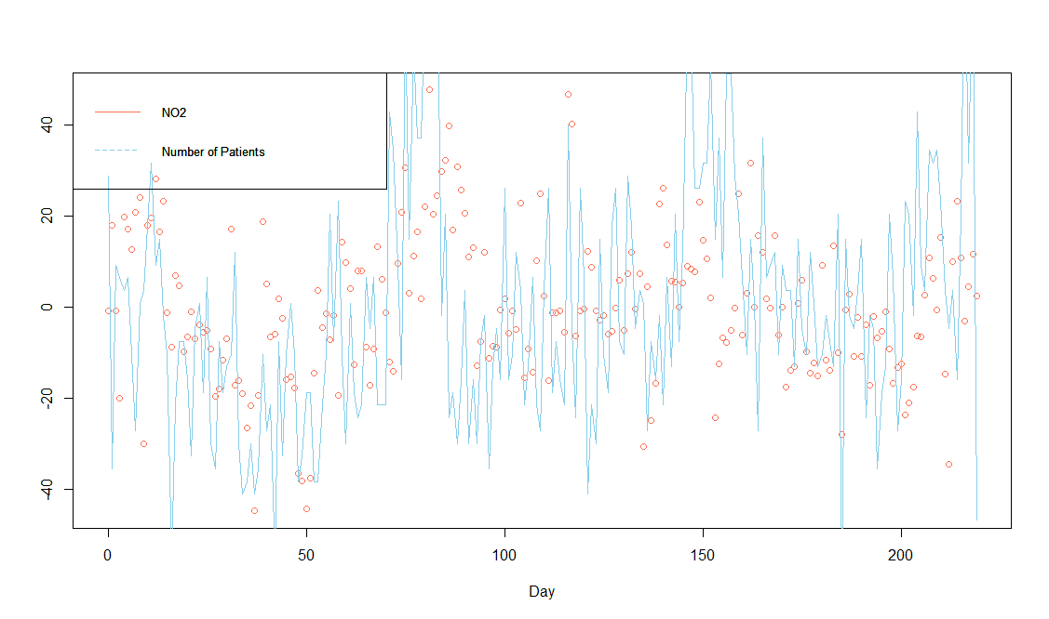
As we can see from the results of the analysis, the greatest correlation coefficient with a set of patients concern pollutants - NО, NО2, NОХ, which also correlate with each other. But to confirm the existence of a linear correlation this coefficient is not enough.

Slide 23
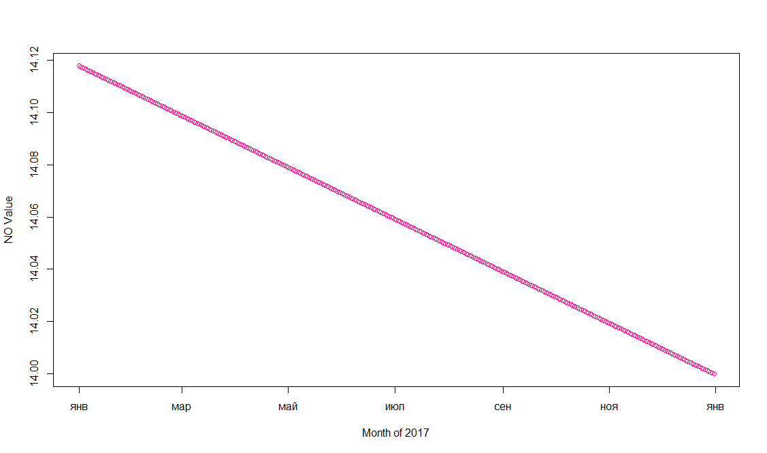
EXTRAPOLATION OF THE ENVIRONMENTAL DATA

Slide 24
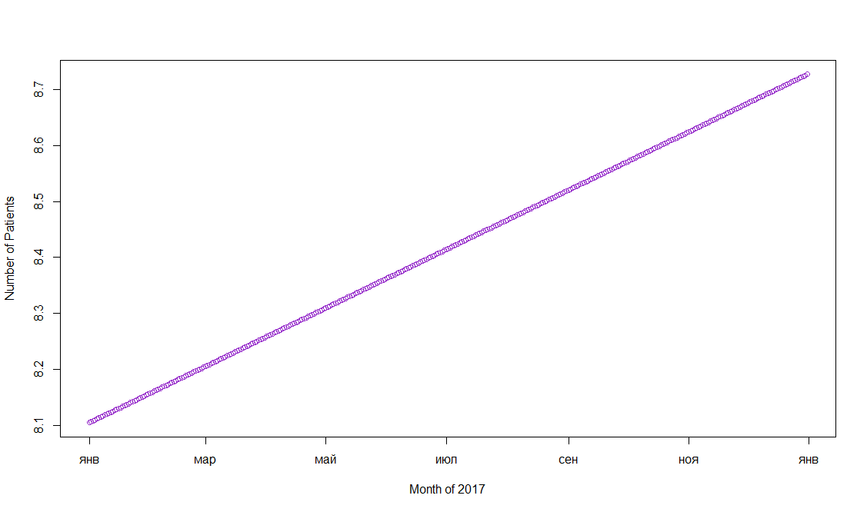
EXTRAPOLATION OF THE HEALTH DATA

Slide 25
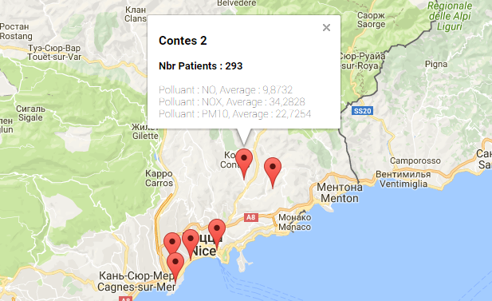
DISPLAYING THE MAP IN THE WEB APPLICATION
Place your screenshot here
Displaying the result of OLAP query on the Map – average value of each pollutant and total number of patients for each station in Nice

Slide 26
CONCLUSION
Keep making the correlation research on such pollutants: NO, NO2, NOX
(try other Machine Learning methods)
Enrich the project with unstructured data coming both from social networks and captors in connected watches
Clustering and Classification for the Health Data, defining the Risk Factors
Real-time cartography for monitored individuals

Slide 27
THANK YOU
Any questions?
e-mail: irina-gry@yandex.ru

