Slide 1


BIG BRIDGE : Projet Big Data Santé et Environnement dans la ville de Nice en partenariat avec l’IMREDD Rapport de stage
Irina GRIGOREVA
Project manager : Pr Gabriel Mopolo
Scientific Resp : Pr Serge Miranda, Director of MBDS (www.mbds-fr.org)

Slide 2
SUMMARY
Project Presentation
Objective and goals of the internship
Project Organization
Data Description
Architecture and Data Management
Description of web service for manipulating data
Results of Data Analysis
Demo

Slide 3


OBJECTIVE AND GOALS
real-time personal data
Software tool
Management data
BIG Bridge
(DATA LAKE)
Data Analysis
real-time air quality data
Whether or not air pollution affects the growth of the number of patients with Dyspnea in Nice?

Slide 4

PROJECT’S TEAM
👧 Irina Grigoreva – developer
👦 Sergey Gorianin – medical consultant

Slide 5
PROJECT’S ORGANIZATION
Getting data from the watch to the Nosql DB; implementing the Android application; writing an algorithm for generating data |  | 24.07.2017 | 25.08.2017
Getting semi-real pollution data from PACA website; implementing the web service for manipulating data |  | 28.07.2017 | 18.08.2017
Writing the specifications for analysis |  | 02.08.2017 | 02.08.2017
Implementation the data analysis with R |  | 18.08.2017 | 30.08.2017

Slide 6

Personal DATA
Source: FitBit API
Profile data:
User Id
Weight
Height
Age
Date of birth
Full name
Gender
Indicator of smoking
Indicator of drinking alcohol
Cardiac data:
User Id
Date
Calories (out of range zone)
Minutes (out of range zone)
Calories (fat burn zone)
Minutes (fat burn zone)
Calories (cardio zone)
Minutes (cardio zone)
Calories (peak zone)
Minutes (peak zone)

Slide 7

ENVIRONMENTAL
DATA
Source: AirPaca API
Date
City
Postal code
Value
Quality

Slide 8
Architecture of Big Bridge with Oracle DWH implementation

Slide 9
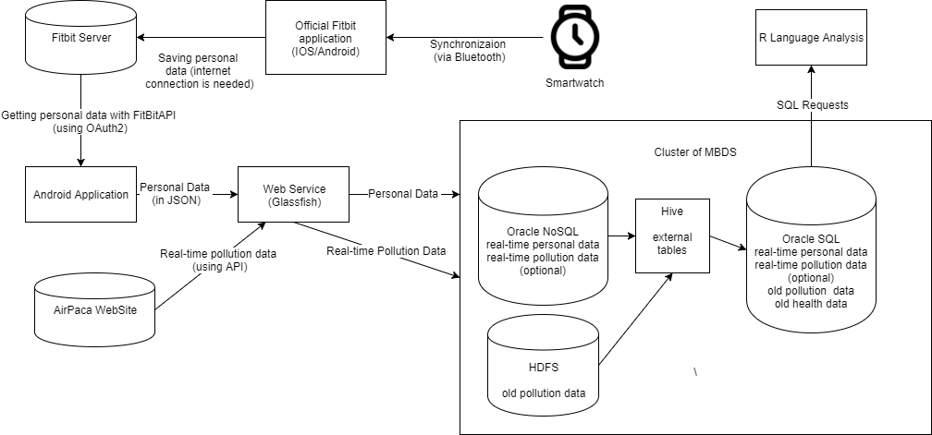

Slide 10
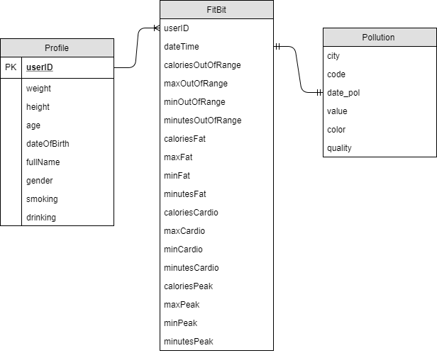

Slide 11
WEB SERVICE
Making possible the transferring of personal data between the Android application and the NoSQL database;
It is a REST service which has realized using the Java programming language and the Spring framework;
Using the @GetMapping for mapping the requests;
Running on the Glassfish server.
Saving profile data from Android Application
Saving real-time pollution data from AirPaca API
Saving heart-rate data from Android Application

Slide 12
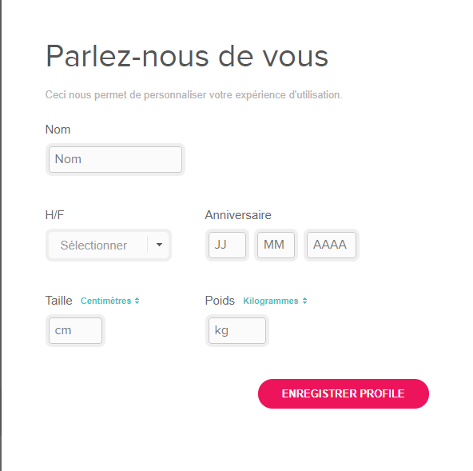
CREATING A NEW FITBIT PROFILE
Desktop FitBit application
Android/IOS official Fitbit application
synchronization with the device
data transfer to the FitBit server for further access

Slide 13
Group of risk | Low | Middle | High
Description | Gender: male, female; Ages: less or equals 45; Bad habits: none; Physical activity: normal or high level; Body mass index: 18.5 – 24.9 | Gender: male, female; Ages: if there are no bad habits, the ages are in range from 46 to 60 years. In case of bad habits existence, the ages are in range from 30 to 50 years. Physical activity: normal or low level. Body mass index: less than 18.5 and from 25 to 30. | Gender: male, female Ages: if user has no bad habits and his body mass index is from 18.5 to 24.9, the ages are from 60 and older. Main case of most diseases is the age of user. In case of bad habits existence, ages are in range from 50 and older. In case of high body mass index (more than 25) ages are in rage from 50 and older. In case of body mass index more than 25, also user has bad habits, the ages are in range from 45 and older. Physical activity is on low level.

Slide 14
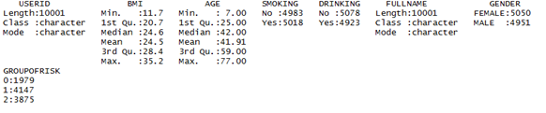
DATA ANALYSIS WITH R language

Slide 15
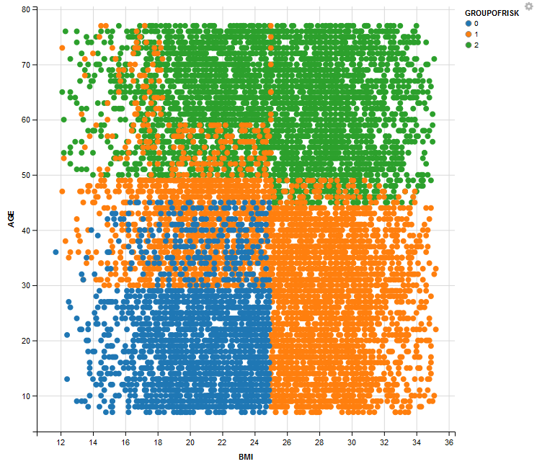
RISK GROUP DITRIBUTION

Slide 16
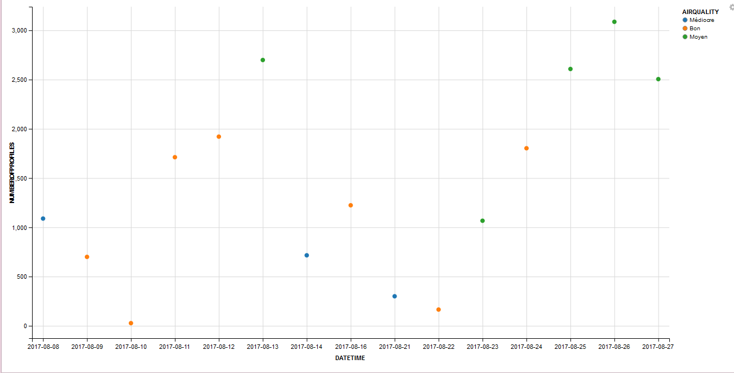
HIGH RISK PROFILES – QUALITY OF AIR RELATION

Slide 17
RESULT OF THE PREDICTION METHOD

Slide 18
CONCLUSION
The project has been enriched with unstructured data coming from the smartwatch and from AirPaca service
Risk Factors are defined, сlassification and clustering methods have applied to data
System is used for making personal recommendations based on daily air quality and cardiac activity of user

Slide 19
DEMONSTRATION

Slide 20
THANK YOU
Any questions?
e-mail: irina-gry@yandex.ru

