Slide 1

Finding vulnerable Java code with CodeBERT
Class-weighted cross-entropy on imbalanced data: a partial reproduction of Shestov et al. (2025)
Bekzat Saulebay (25MD0294) · Group 9 topic, individual work
MSITM 5134 Management of Organizational Data · KBTU · Midterm 2026
Notes:
Good afternoon. My name is Bekzat Saulebay. I did the Group 9 topic on my own: finding vulnerable Java code with CodeBERT, as a partial reproduction of the paper by Shestov and co-authors.

Slide 2
About 1 in 35 functions is vulnerable
644
97.4%
My question
vulnerable functions out of 22,877 in X1 with P3 after cleaning (2.8%)
test accuracy of a model that never flags anything. The 93% target is met before any training
Does class weighting help CodeBERT? The paper says plain class weighting did not help its 13-billion-parameter model
What I did
1 Pin and check the data
2 Clean it, quarantine doubtful labels
3 Load a warehouse built from my ER model
4 Train CodeBERT with class weights
5 Measure what a review team gains
Notes:
The data is the paper's X1 dataset: about twenty-three thousand Java functions, and only six hundred forty-four are vulnerable, about one in thirty-five. So a model that never flags anything is already right ninety-seven percent of the time, and the ninety-three percent target is met before any training. My question: the paper says class weighting did not help its big model. Does it help CodeBERT?

Slide 3
Data lifecycle and value chain
1
Acquisition
pinned commit, SHA-256 checked
2
Validation
rules R1 to R5, 41 rows quarantined
3
Storage
read-only raw files, SQLite warehouse
4
Transformation
56 copies removed, cut at 512 tokens
5
Training
CodeBERT with class-weighted loss
6
Evaluation
test split once, 95% intervals
7
Retention
keep hashes and logs, delete checkpoints
what evaluation finds becomes a new quality rule (the leakage rule R5)
Information value chain (Lecture 1), with my example
Raw data
Processed
Information
Knowledge
Insights
Decisions
Value
24,288 JSONL rows in two versions
22,877 clean functions
1 vulnerable in 35; P3 code is short
trained model, metrics with intervals
it spots fix-touched code, not the bug
review top-scored code first; never a gate
fewer review hours per real vulnerability
Notes:
I managed the data through its whole lifecycle. Every source is pinned to an exact version and checked against its hash on every run. What evaluation finds becomes a new quality rule. And the value chain ends with a decision: which code a security team reads first.

Slide 4
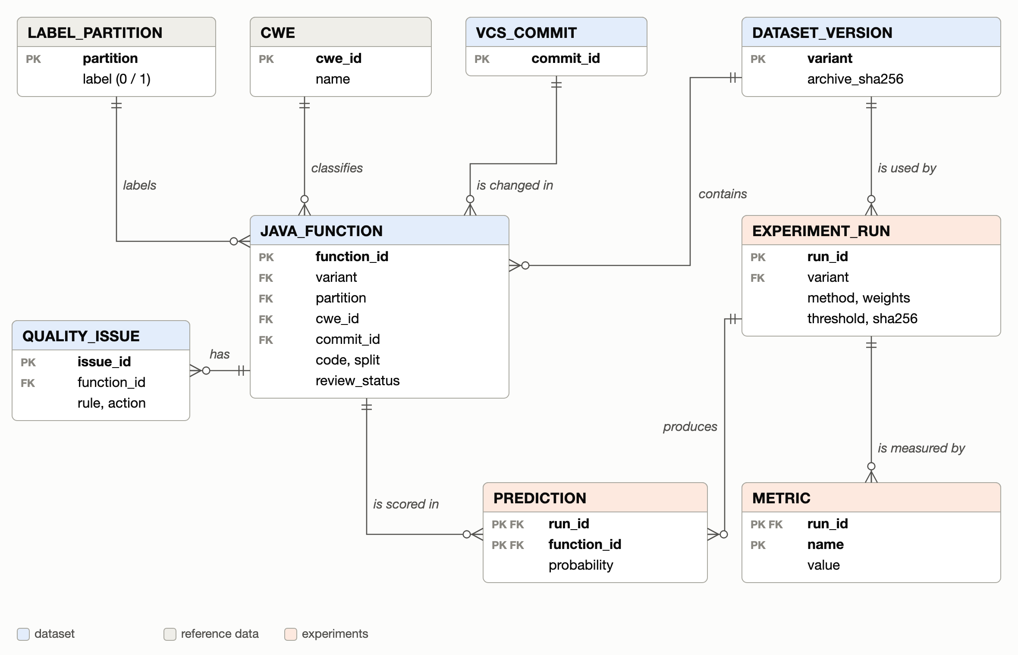



One warehouse, built from my ER model
9 tables, keys enforced
Every entity of the model is one SQLite table. Foreign keys and CHECK rules refuse bad rows.
The label is stored once
The status already decides the label, so it lives in label_partition (third normal form).
Training reads SQL, results come back
train.py reads the view model_input; evaluate.py writes runs, predictions and metrics back.
Notes:
My ER model has nine entities, and the warehouse has exactly these nine tables, with keys enforced. The label is stored once, because the status already decides it. Training reads one SQL view, so a quarantined row can never reach the model, and the results go back into the same database.

Slide 5
Clean format, problems in meaning
41
rows quarantined: 19 functions have one label in one dataset version and the other label in the other
33
validation or test rows were copies of training code: removed, so no model is tested on code it has seen
50%
of vulnerable and fixed functions are longer than 512 tokens: CodeBERT never sees their end
Median length: 476 tokens (vulnerable), 540 (fixed), 90 (unchanged). Short unchanged code makes length alone a strong clue.
Notes:
The data looks clean at first. The problems are in the meaning. Forty-one rows have conflicting labels, so they wait in quarantine. Thirty-three test and validation rows were copies of training code, and I removed them. And half of the vulnerable functions are longer than CodeBERT's limit of five hundred twelve tokens, so the model never sees their end.

Slide 6





The system and its controls
SOURCES
INGEST AND QUALITY
WAREHOUSE
MODELS
EVALUATION AND USE
GitHub dataset
commit 862ed17
train.py
primary method
evaluate.py
metrics, intervals
data_pipeline.py
SHA-256 check
read-only raw zone
rules R1 to R5
warehouse.db
9 tables, mode 600
view model_input
results tables
MITRE CWE 4.20
alternative.py
report and slides
CodeBERT
revision 3b0952f
baselines.py
demo.py
checks the hash
results written back: experiment_run, prediction, metric
Pinned versions
SHA-256 integrity
Least privilege
Lineage and audit
Offline training
Notes:
This is the system: three pinned sources, the pipeline, the warehouse, the models, and the results flow back. Under every step there are five controls: pinned versions, hashes, least privilege, an audit log, and training without network access.

Slide 7





A library that calls home
Other controls in the code
What I saw
A test run of train.py warned that it was sending requests to the Hugging Face Hub, although CodeBERT was already in the local cache.
Why
When transformers loads a pickle .bin checkpoint, it starts a background thread that asks the Hub for a safetensors copy and can ask Hugging Face's conversion service to make one.
What I did
Switched it off (DISABLE_SAFETENSORS_CONVERSION=1), turned telemetry off, load from the cache only. The warning was gone.
Integrity
SHA-256 on both archives, the CWE catalog and every model file
Least privilege
raw files read-only, warehouse readable by its owner, read-only connections
Safe model files
my weights as safetensors; demo.py refuses a file whose hash changed
Pickle loading
the base .bin loads with weights_only, torch 2.14 (CVE-2025-32434)
Notes:
One finding surprised me. My training script started talking to the Hugging Face Hub, although the model was already on disk. The transformers library does this in the background when it loads an old pickle file. For a company with private code that is a real risk, so I switched it off and load everything from the local cache.

Slide 8



Who owns the data, and the rules I follow
Asset | Owner | Licence and use
X1 dataset | dataset authors (GitHub rmusab) | no licence file: study use only, not redistributed
CodeBERT | Microsoft | MIT licence (GitHub)
CWE catalog | MITRE | reuse with MITRE's notice
Warehouse, models | me (the student) | me and the lecturer only
A triage aid, never a gate
code is never called safe because the model did not flag it
No analysis of people
I never look up commit authors or rank developers
Labels are never edited
conflicts wait in quarantine for a security expert
Roles (RACI): data owner, data steward, data and ML engineer, compliance, security. Full matrix in the report.
Law: a commit id leads to its author, so under GDPR and Kazakhstan Law 94-V it is indirectly personal data.
No model without a record
data version, configuration and SHA-256 for every run
Notes:
I do not own the source data, and it has no licence, so I use it for study only and do not redistribute it. My rules: the model is a triage aid, never a gate. No analysis of people, because a commit id leads to its author, which is personal data under GDPR and the Kazakh law. And labels are never edited by hand.

Slide 9
CodeBERT with a class-weighted loss
Class weights w = N / (2 · N of the class)
Protocol of the paper
Model
CodeBERT: 125 million parameters, pretrained on code. A classification head says vulnerable or not. All weights are fine-tuned.
0.515
16.68
1
Train for 4 epochs
not vulnerable
vulnerable
2
Keep the epoch with the best validation ROC AUC
Alternative
CodeBERT frozen; the mean of its last layer goes into a class-weighted logistic regression: 769 numbers trained.
One vulnerable function counts as much as 32 others. Ablations: no weights, and the square root of these weights.
3
Pick the threshold with the best validation F1
4
Score the test split once
Same seed (42), batch 16, learning rate 2e-5, inputs cut at 512 tokens, Apple M3 Pro GPU
Notes:
I fine-tuned CodeBERT, a model with a hundred twenty-five million parameters. With plain cross-entropy, a model can keep the loss low by always saying 'not vulnerable'. Class weights are meant to fix that: here one vulnerable function counts like 32 safe ones. I also trained without weights and with milder weights, to measure the effect.

Slide 10
Training: quality and cost
 | Primary | Alternative | TF-IDF
Trained numbers | 124,647,170 | 769 | 100,001
Time | 49 min | 3 min | 2 s
Hardware | GPU | GPU | CPU
Test ROC AUC | 0.849 | 0.819 | 0.871
Test F1 | 0.222 | 0.153 | 0.326
The alternative is about 16 times faster but clearly worse: it ranks no better than code length. TF-IDF matches CodeBERT's ranking in 2 seconds on a normal CPU.
Notes:
Validation ROC AUC went up almost every epoch, and the model without weights was ahead from the start. One run takes about 49 minutes on my laptop's GPU. The alternative, frozen CodeBERT, takes 3 minutes but is clearly worse. TF-IDF takes 2 seconds on a normal processor and matches CodeBERT.

Slide 11
Results on the test split
Model | Accuracy | Precision | Recall | F1 | ROC AUC | P1 vs P2
CodeBERT, class-weighted (primary) | 90.5% | 0.141 | 0.525 | 0.222 | 0.849 | 0.470
CodeBERT, no weights | 92.8% | 0.188 | 0.534 | 0.278 | 0.862 | 0.485
CodeBERT, square-root weights | 92.1% | 0.145 | 0.415 | 0.215 | 0.851 | 0.473
Frozen CodeBERT + LR (alternative) | 86.6% | 0.091 | 0.466 | 0.153 | 0.819 | 0.460
TF-IDF + LR | 95.5% | 0.268 | 0.415 | 0.326 | 0.871 | 0.505
Code length only | 89.9% | 0.105 | 0.381 | 0.165 | 0.807 | 0.470
Always "not vulnerable" | 97.4% | 0.000 | 0.000 | 0.000 | 0.500 | –
Accuracy ≥ 93%?
90.5%
With the paper's threshold rule the model flags 440 test functions and is right 90.5% of the time, below the target. At the default threshold 0.5 it reaches 93.1%, but finds fewer vulnerable functions (recall 0.37 instead of 0.53). Flagging nothing gives 97.4%.
Test split: 4,547 functions, 118 vulnerable. Threshold from validation (best F1). P1 vs P2 = ROC AUC on vulnerable functions against their own fixed versions.
Notes:
On the test split the model reaches a ROC AUC of 0.85 and an F1 of 0.22, the same as the paper's CodeBERT-style baseline. About the accuracy target: with the paper's threshold I get 90.5%. At threshold 0.5 I reach 93.1%, but find fewer vulnerable functions. Flagging nothing gives ninety-seven.

Slide 12
Class weighting did not help
Without weights the same model ranks as well: ROC AUC 0.862 against 0.849, a difference inside the noise (-0.028 to +0.003).
Its F1 is clearly higher: 0.278 against 0.222.
The weights only push the scores up: at 0.5 the plain model flags 8 functions, the weighted one 286. With the threshold chosen on validation, as in the paper, that buys nothing.
Milder square-root weights: ROC AUC 0.851, F1 0.215.
Same answer as the paper for its 13B model.
Notes:
So, does class weighting help? No. Without weights the same model ranks just as well, and its F1 is clearly higher, 28 against 22. The weights only push the scores up, so that 0.5 works as a threshold. But the threshold is chosen on validation anyway, so they buy nothing. The paper found the same.

Slide 13
It finds fix commits, not the bug
Flagged: 53% of vulnerable functions, 55% of their fixed versions, 7% of untouched code. Vulnerable against fixed: ROC AUC 0.47, which is chance.
Reading the top 10% of functions finds 53% of the vulnerable ones, the top 20% finds 72%. Random order would find 10% and 20%.
Notes:
Why? The model flags about half of the vulnerable functions, but also half of their fixed versions, and only 7 percent of untouched code. So it learned to spot code that a fix touched, not the bug itself. Still, reading the top ten percent of functions finds about half of the vulnerable ones.

Slide 14


What I recommend
Order the review queue, never approve code
Reading the top 10% of functions finds about half of the vulnerable ones. The other half is missed.
Measure recall at a review budget
At 1 in 35, accuracy rewards flagging nothing. Re-check the threshold on your own code: the same one flagged 6.8% of validation and 9.7% of test.
Tune the threshold, not the loss
Class weights only moved where 0.5 falls. Without them CodeBERT was at least as good (F1 0.278 against 0.222).
Fix the data before a bigger model
TF-IDF matched CodeBERT in 2 seconds on a CPU. Split by project, review the 41 quarantined rows, read past 512 tokens.
Notes:
My recommendations: use the model to order the review queue, never to approve code. Measure recall for the review budget, not accuracy. Tune the threshold, not the loss. And fix the data before buying a bigger model: here even TF-IDF ranked as well as CodeBERT.

Slide 15

Summary and live demo
Reproduced
CodeBERT with class weights: ROC AUC 0.85, F1 0.22, as the paper's CodeBERT-style model
Live demo
Weights
did not help: without them the same model reached F1 0.28; tune the threshold instead
python demo.py --sample 2
checks the model's SHA-256, then scores a SQL query built by hand, its prepared-statement fix, a getter, and two real test functions from each partition
Limit
no model tells a vulnerable function from its own fix; TF-IDF matches CodeBERT
Use
order the review queue (top 10% finds 53% of vulnerable code), never as a gate
Code, notebook, report and logs are in the Midterm folder; README.md explains how to run everything
Notes:
To sum up, and a short demo. The demo checks the model's hash, then scores a textbook SQL injection and its fix. Both get almost zero, because the model never learned what a vulnerability is. That is the main lesson of this project. Thank you, I am ready for your questions.

