Slide 1

Computers and Programming
Principles of Computer Programming I
Spring/Fall 20XX

Slide 2
Outline
Principles of Computer Programming
Computer language concepts
Software Concepts
Programming workflow
Visual Studio concepts

Slide 3
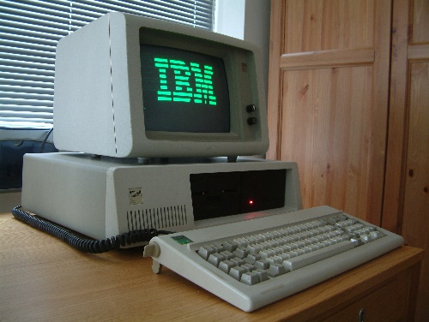
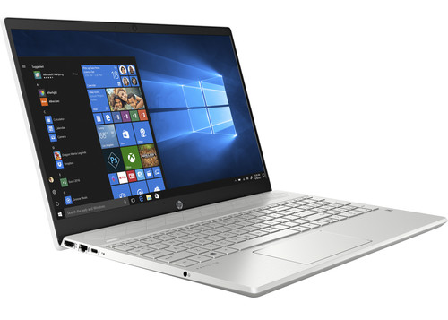
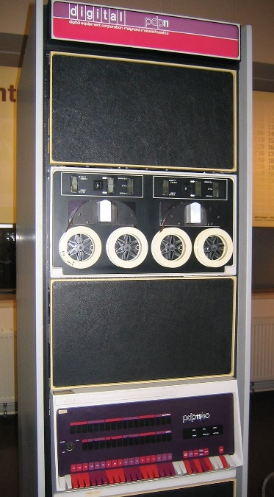
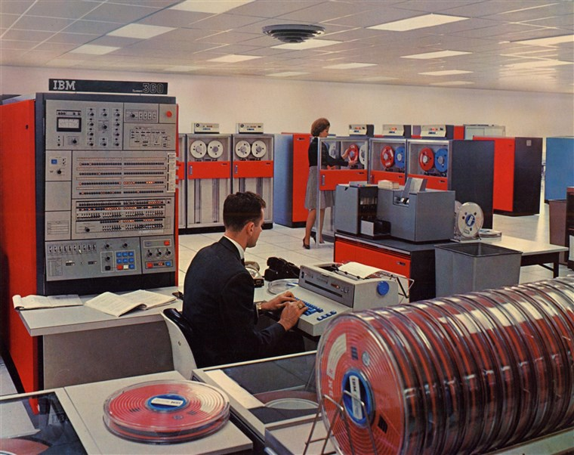
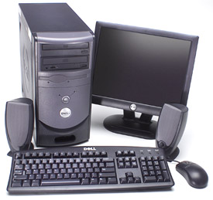
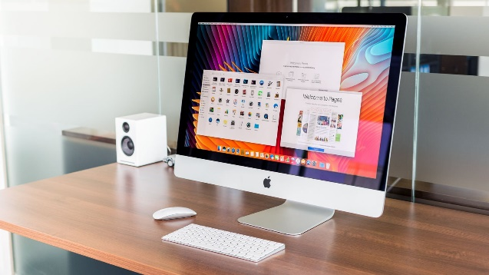
Computer Programming
Computers: frequently changing hardware
Rapid increases in capability (storage, speed, graphics, etc.)

Slide 4

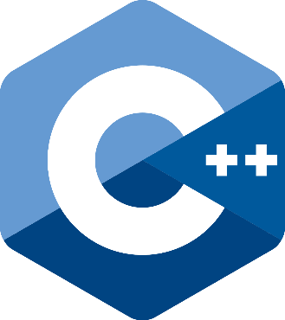





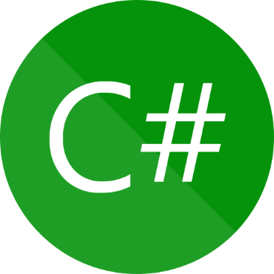
Computer Programming
Programming: Many different languages for instructing computers what to do, different tools for different jobs
Scripting
Graphics, video games, server software
OS and drivers
Desktop and web apps
New server software
Interactive web pages
Scientific computation

Slide 5
Principles of Computer Programming
Learn common principles behind all languages
How to organize and structure data
How to express logical conditions and relations
How to solve problems with programs
Won’t change even as languages and hardware change
Mathematical theory: All programming languages are equivalent

Slide 6
Outline
Principles of Computer Programming
Computer language concepts
Software concepts
Programming workflow
Visual Studio concepts

Slide 7
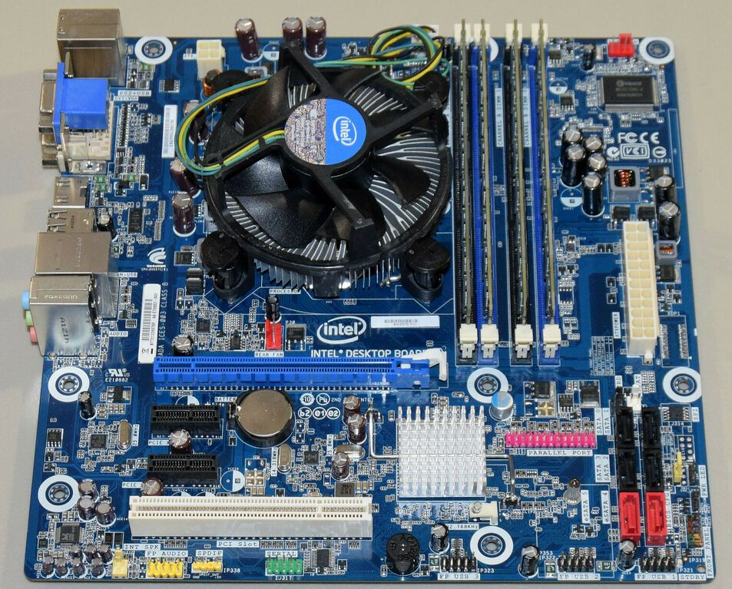
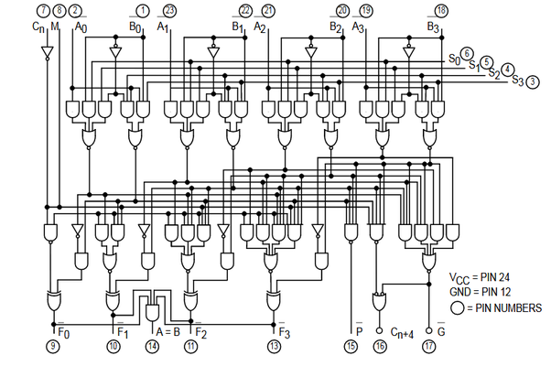
From Hardware to Software
Machine language: Binary digits (1 and 0) representing on/off state of wires
Encodes basic instructions for computer (CPU): read, write, add, subtract, etc.
Each CPU could have its own, but most follow a standard: either x86 or ARM
0000001100111011
set these wires to OFF
set these wires to ON

Slide 8

Assembly Language
Assembly language
“Human-readable” (kind of) representation of machine instructions – letters and symbols instead of bits
Assembler: translates assembly language to machine code
Each statement produces one machine instruction
x86 assembly $→$ x86 machine code
pushq %rbx
movq %rdx, %rbx
call plus
movq %rax, (%rbx)
popq %rbx
Assembler
0000001110011011 1100101001011000 0010110010101101 1100010011010011
Machine code

Slide 9
High-Level Language
High-level language: C
Much more human-readable
Statements don’t correspond directly to machine instructions
Compiler: Translates high-level language to machine code
Each high-level language and target machine needs its own compiler
Incorporates code libraries
After compiling, run the machine code
void sumstore(int x, int y,
int *dest) {
int res = plus(x, y);
*dest = res;
}
C Compiler
0000001110011011 1100101001011000 0010110010101101 1100010011010011
Machine code

Slide 10
Compiled vs. Interpreted
Interpreter: Directly executes high-level code by translating one instruction at a time
Less waiting before you can run your program
Runs slower than compiled machine code
High-level language: Python
def sum3(a, b, c):
return a + b + c
Python Interpreter
0000001110011011 1100101001011000
1100010011010011
0100011101011110
0010110010101101
Machine code chunks

Slide 11
Managed High-Level Languages
Some features of both compiled & interpreted
Compiler produces an intermediate language
Like assembly, but not tied to any CPU
Runtime: an interpreter for the intermediate language
static void SayHi() {
Console.WriteLine("Hi");
}
High-level language: C#
C# Compiler
CIL (Common Intermediate Language)
.maxstack 8
IL_0000: nop
IL_0001: ldstr "Hi"
.NET Runtime (CIL Interpreter)
Machine code chunks
0000001110011011 1100101001011000
1100010011010011
0100011101011110

Slide 12
Why Managed Languages?
Platform: Combination of OS (Windows, Mac, Linux) and hardware
Compiled code only works on one platform
Must write a new compiler for each platform and re-compile all code
Interpreter can generate code for the current platform without recompiling
Interpreting IL much faster than interpreting high-level language
static void SayHi() {
Console.WriteLine("Hi");
}
C# Compiler
.maxstack 8
IL_0000: nop
IL_0001: ldstr "Hi"
Windows .NET Runtime
Mac .NET Runtime
0000001110011011 1100101001011000
1100010011010011
0100011101011110

Slide 13
Outline
Principles of Computer Programming
Computer language concepts
Software concepts
Programming workflow
Visual Studio concepts

Slide 14
Software Concepts
Programs receive input and produce output
Keyboard
Images on screen
Mouse
Text in console
Data in Files
Data in files
Running program
Input
Output

Slide 15
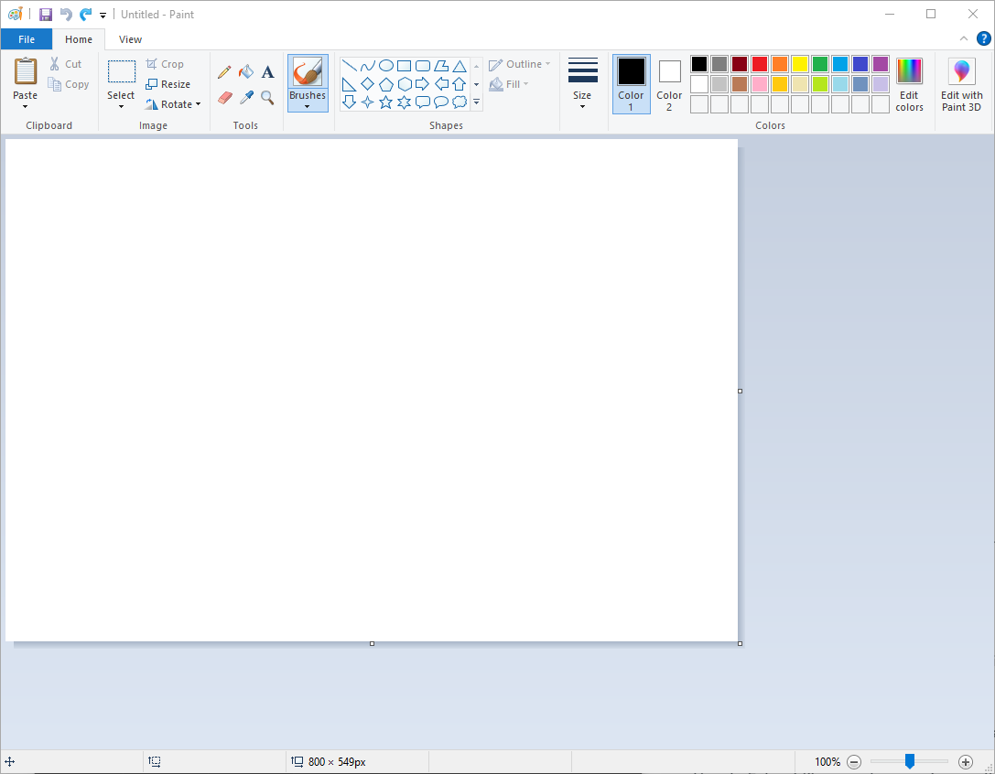
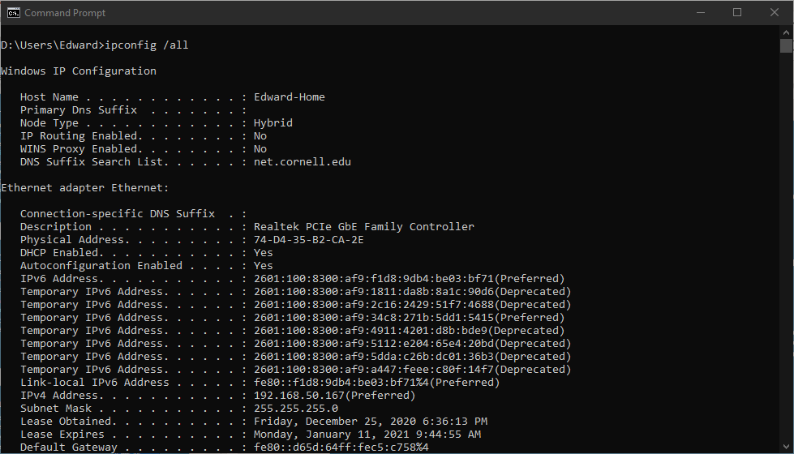
Software Concepts
Two ways of interacting with a program: Command-Line Interface (CLI) and Graphical User Interface (GUI)
Type input at command prompt
Output printed to console
CLI
GUI

Slide 16
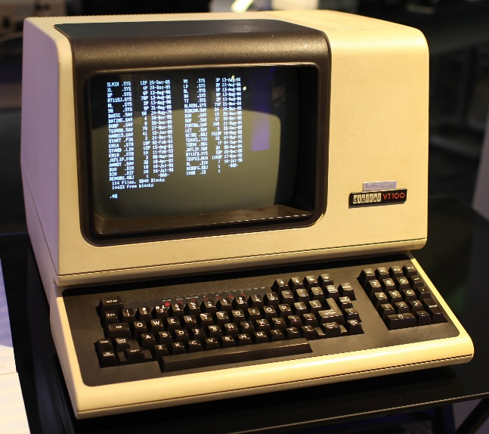
Why CLI?
Same interface as those old “text-only” computers
Very portable: All computers support it
GUI depends on OS to help draw “windows” on screen
Simple and easy to work with, lets you focus on your program’s logic instead of managing input/output with graphics

Slide 17
Outline
Principles of Computer Programming
Computer language concepts
Software concepts
Programming workflow
Visual Studio concepts

Slide 18
Programming Workflow
Write / Edit code
Does it compile?
Developer
Debug
Fix compile error
no
yes
Run
Test again
Does it work?
Tester
no
yes
Success!

Slide 19
Interpreted Language Workflow
For comparison: workflow for a language like Python
All errors happen when you run the program, even syntax mistakes that would be “compile errors”
Why might you prefer a compiled language?
Debug
Write / Edit code
Fix syntax
Run
Syntax error
Test again
Why not?
Does it work?
no
Logical error
yes
Success!

Slide 20
Outline
Principles of Computer Programming
Computer language concepts
Software concepts
Programming workflow
Visual Studio concepts

Slide 21
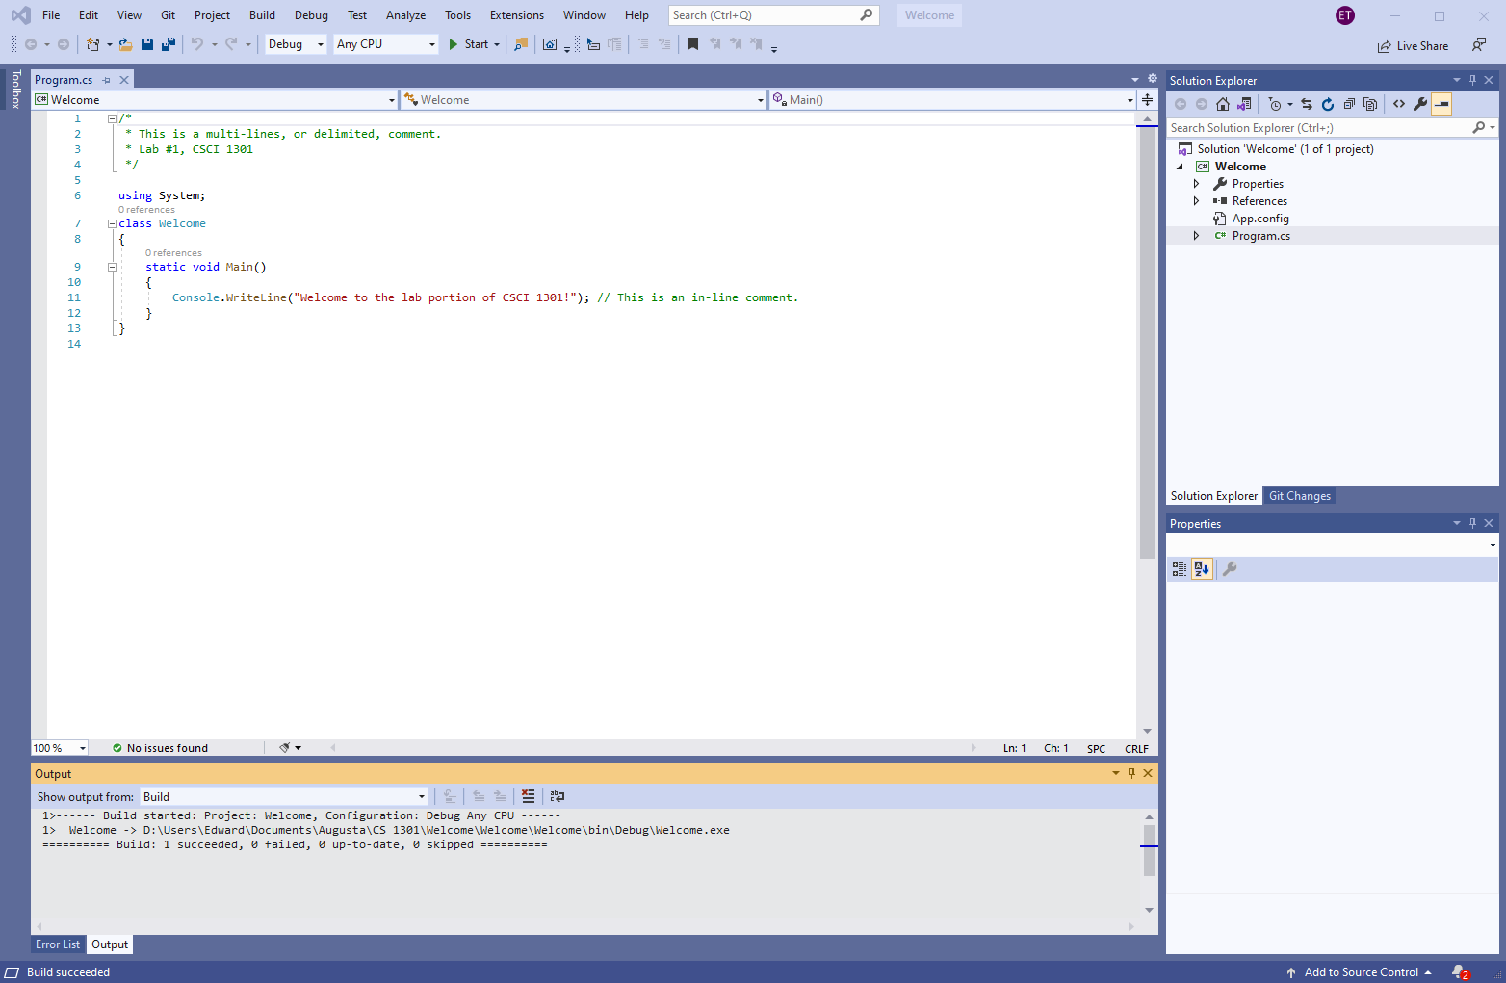
Visual Studio: An IDE
Integrated Development Environment: A text editor, compiler, debugger, file browser, other tools
Can write, compile, run code without leaving Visual Studio
Tools to help you navigate and edit code
Text editor
File browser
Compiler output

Slide 22
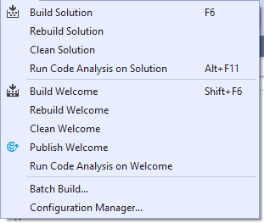
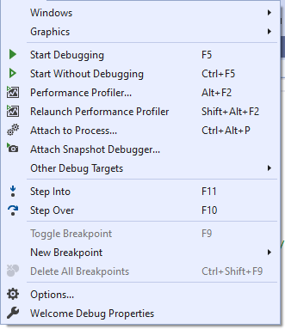
Terminology Quirks
Solution: A software project in Visual Studio, including source code, metadata, data files, images, etc.
“Build solution” = compile code
“Start without debugging” = run application

