Slide 1

C# Fundamentals
Principles of Computer Programming I
Spring/Fall 20XX

Slide 2
Outline
C# Introduction
Example C# program
Rules vs. Conventions of C#
Reserved words and identifiers
Console.Write and Console.WriteLine
Escape sequence

Slide 3
C#: A Managed Language
More portable and safe than C or C++, older “unmanaged” languages
Similar to Java
JVM is the runtime for Java Bytecode, the IL
Comes with large standard library (.NET Framework)
static void SayHi() {
Console.WriteLine("Hi");
}
High-level language: C#
C# Compiler
CIL (Common Intermediate Language)
.maxstack 8
IL_0000: nop
IL_0001: ldstr "Hi"
.NET Runtime (CIL Interpreter)
Machine code chunks
0000001110011011 1100101001011000
1100010011010011
0100011101011110

Slide 4

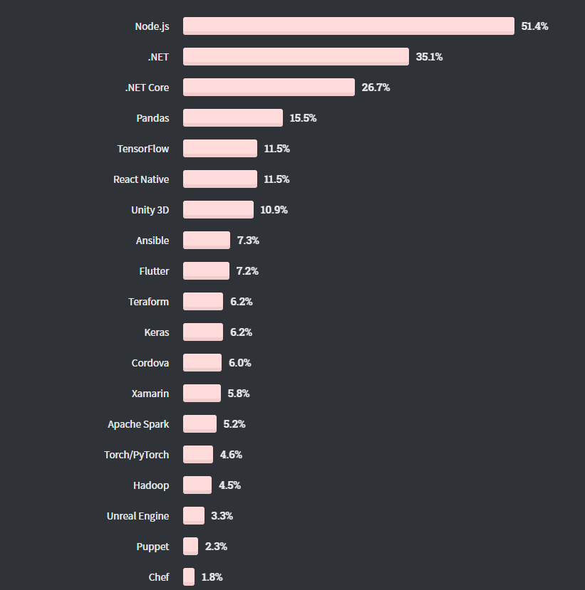
C#: Widespread and Popular
Most Used Languages 2020
Most Used Libraries/Frameworks
For websites, not applications
Written in C#
StackOverflow Developer Survey 2020

Slide 5
C#: Object-Oriented
Paradigms for programming languages: Functional, procedural, logical, object-oriented, event-based
Philosophies for organizing code and expressing ideas in code
C# is primarily object-oriented
Program mostly consists of objects, reusable modules of code
Set of data (attributes)
Functions related to that data (methods)
Object
Data (attributes, state)
Function (method)
Function (method)

Slide 6
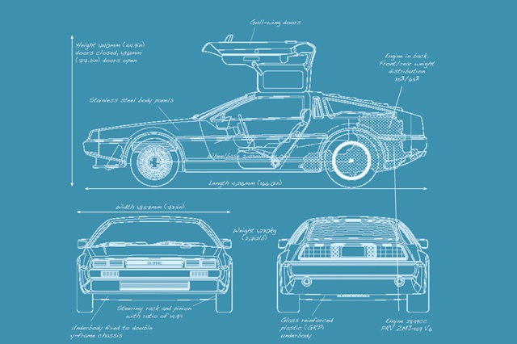

Object Terminology
Class = blueprint, template for object
Code that describes an object
Object = single instance of class
Running code, with specific values/state
Each object is a “copy” of the class
Method = function that modifies object
Defined in class, but executed on specific object (usually)
Attribute = data stored in object

Slide 7
Object Examples
Car object:
Attributes:
Engine status (off, idle, accelerating)
Transmission/gear position
Methods:
Press/release pedals
Turn steering wheel
Shift transmission
Audio object:
Attributes:
Sound data
Current playback position
Target playback device
Methods:
Play, pause, stop
Fast forward, rewind

Slide 8
Outline
C# Introduction
Example C# program
Rules vs. Conventions of C#
Reserved words and identifiers
Console.Write and Console.WriteLine
Escape sequence

Slide 9
A Simple Program
/*
* This program welcomes
* you to class
*/
using System;
class Welcome
{
static void Main()
{
Console.WriteLine("Welcome to PCP!");
}
}
// I'm a comment!
Import code definitions in the namespace System
Multi-line comment
Class name
Method name
Real content of program: One action, print a line of text to the console
Class declaration
Method declaration
Statement ends in semicolon
Class
Method call
Argument to WriteLine
Single-line comment
Notes:
Start with the one line of code that actually does something (Console.WriteLine). This is a statement that directs the computer to print a line of text to the console (terminal window). It has the name of a class, then a period, then the name of a method; this means “call the WriteLine method in the Console class.” The text in parentheses is the argument to WriteLine; it’s the input to the WriteLine method. WriteLine prints on the screen whatever text you put in its argument. Finally, the statement ends with a semicolon.
Then go back to the beginning of the program and work down from the top:
- A multi-line comment
- A using statement, which is necessary in order to access the standard library code (define namespaces). Note that this statement also ends in a semicolon
- A class declaration, which has a header and a body. The name of the class is Welcome.
- A method declaration, which has as header and a body. The name of the method is Main. Our statement is in the body of the method.
- A single-line comment, which begins with // and ends at the end of the line

Slide 10
Outline
C# Introduction
Example C# program
Rules vs. Conventions of C#
Reserved words and identifiers
Console.Write and Console.WriteLine
Escape sequence

Slide 11
Basic C# Syntax Rules
Each statement must end in a semicolon ;
Class and method declarations are not statements – they contain statements
All words are case-sensitive
A class named welcome is not the same as one named Welcome
Braces { } and parentheses ( ) must be matched
Finish what you start: once you start a class definition with {, you must end it with }

Slide 12
More C# Rules
Whitespace – spaces, tabs, newlines – has (almost) no meaning
Unless it is within string data, like "Welcome to PCP!"
Must have 1 space between words
Note: Colors also don’t matter – they’re added by Visual Studio
All C# applications must have a method named Main
When the application starts, the Main method is the first code to run
Same program as before
using System;class Welcome{static void Main(){Console.WriteLine("Welcome to PCP!");}}

Slide 13
C# Conventions
Not enforced by compiler, but expected by humans
Indentation: Each time you start a block with {, indent 4 spaces
class Welcome
{
static void Main()
{
Console.WriteLine("Welcome to PCP!");
Console.WriteLine("Hello World!");
}
}
Beginning of class-definition block
Inside class definition: Indent
Beginning of method-definition block
Inside method definition: Indent
Next line stays at same indentation
End of method-definition block: un-indent

Slide 14
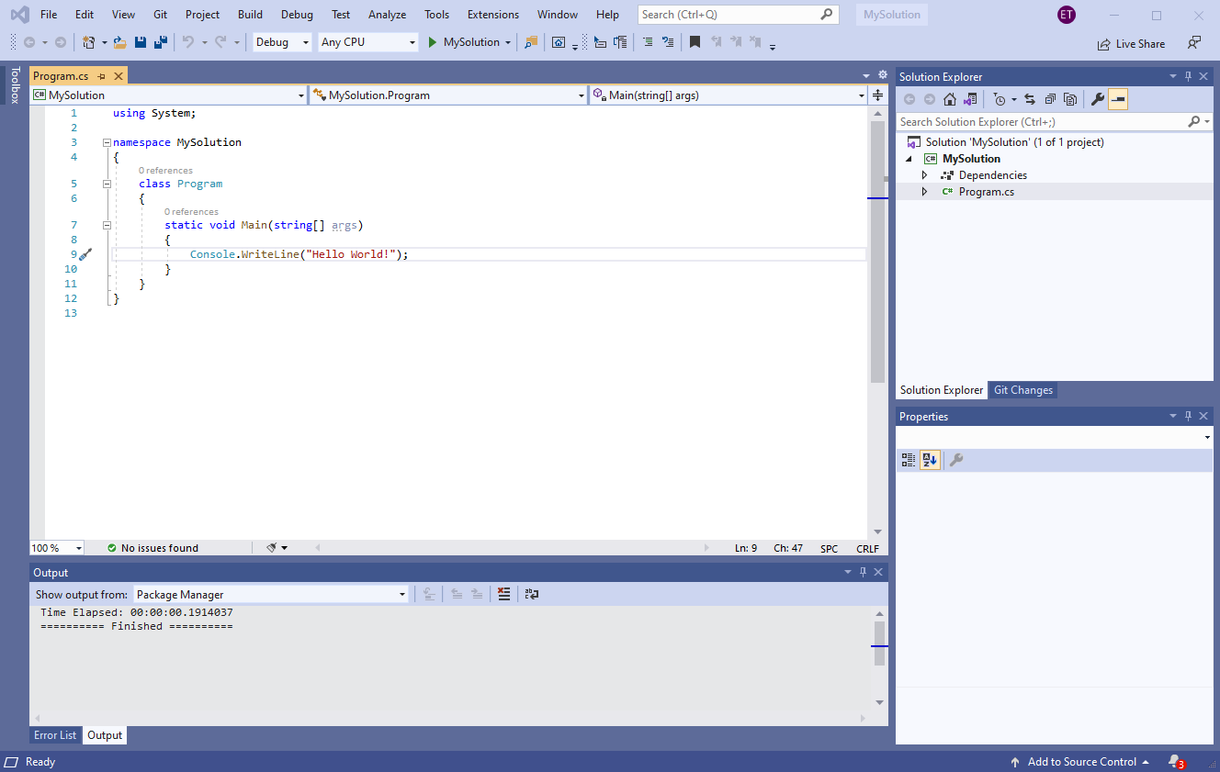
C# Conventions
Each .cs file contains one class
The .cs file has the same name as the class
File program.cs
Class Program

Slide 15
Outline
C# Introduction
Example C# program
Rules vs. Conventions of C#
Reserved words and identifiers
Console.Write and Console.WriteLine
Escape sequence

Slide 16
Reserved Words in C#
Keywords in the language, colored blue by Visual Studio
Can only be used for one specific purpose; cannot be changed or re-used as a name for something
using
class
public
private
namespace
this
if
else
for
while
do
return
bool
byte
short
long
void
int
string
object
double
float
decimal
char

Slide 17
Identifiers in C#
Names a programmer chooses
For classes, variables, methods, namespaces, etc.
Some have already been chosen by other programmers: System, Console, WriteLine…
Also colored by Visual Studio:
Class name
Method name
class Welcome
{
static void Main()
{
Console.WriteLine("Hello World!");
}
}
Class name

Slide 18
Identifier Rules
Must not be a reserved word
Must contain only letters, numbers, and _ (underscore)
No spaces
Must not begin with a number
Remember: Case sensitive, like everything in C#
Are these valid identifiers? My_class class1 class Class thisClass this

Slide 19

Identifier Conventions
Should be descriptive
AudioFile is a better class name than a
Should be easy to read and type
ClAsS is valid, but not a good idea
Multi-word names should use CamelCase
Class and method names should start with capitals: AudioFile
A.k.a. UpperCamelCase or PascalCase
Variable names should start with lowercase: myFile

Slide 20
Outline
C# Introduction
Example C# program
Rules vs. Conventions of C#
Reserved words and identifiers
Console.Write and Console.WriteLine
Escape sequences

Slide 21
The WriteLine Function
Code in welcome.cs
Program output in terminal
class Welcome
{
static void Main()
{
Console.WriteLine("Hello World!");
}
}
Hello World!
class Welcome
{
static void Main()
{
Console.WriteLine("Hello");
Console.WriteLine("World!");
}
}
Hello
World!

Slide 22

Statements in a Method
C# rule: Each statement must end in a semicolon
Statement $≠$ line of code in your .cs file
Class and method declarations are not statements
Class declaration – no semicolon needed
class Welcome
{
static void Main()
{
Console.WriteLine("Welcome");
Console.WriteLine("to");
Console.WriteLine("CSCI 1301");
}
}
Method declaration – no semicolon needed
Each statement ends in a semicolon
Braces are part of the class/method declaration, to show which statements are “inside” – no semicolon needed

Slide 23
Write vs. WriteLine
Console.WriteLine: Print text and then start a new line
Console.Write: Just print the text, no newline
class Welcome
{
static void Main()
{
Console.Write("Hello");
Console.Write("World!");
}
}
HelloWorld!
How could we fix this to print “Hello World!” (with a space)?

Slide 24
Write and WriteLine
Console.WriteLine puts “cursor” at start of next line
A subsequent Console.Write will start there
class Welcome
{
static void Main()
{
Console.Write("Hello ");
Console.WriteLine("World!");
Console.Write("Welcome to ");
Console.WriteLine("CSCI 1301!");
}
}
Hello World!
Welcome to CSCI 1301!

Slide 25
Outline
C# Introduction
Example C# program
Rules vs. Conventions of C#
Reserved words and identifiers
Console.Write and Console.WriteLine
Escape sequences

Slide 26
Making the Newline “Visible”
These programs print the same output:
class Welcome
{
static void Main()
{
Console.WriteLine("Hello");
Console.WriteLine("World!");
}
}
class Welcome
{
static void Main()
{
Console.Write("Hello\nWorld!\n");
}
}
“\n”: The escape sequence for “newline”
Means “insert a newline character here”

Slide 27
Special, Hard-to-Type Characters
Escape sequences: use “normal” letters to represent “special” characters
\n = newline character, i.e. result of pressing “enter”
\t = tab character, a single extra-wide space
class Welcome
{
static void Main()
{
Console.Write("Hello\tWorld!");
}
}
Hello World!

Slide 28
Quotes Inside Strings
class Welcome
{
static void Main()
{
Console.WriteLine("This is "in quotes"");
}
}
String ends
Invalid code!
Compile error!
\" = double-quote character, without ending the string in C#
class Welcome
{
static void Main()
{
Console.WriteLine("This is \"in quotes\"");
}
}
This is "in quotes"

Slide 29
What If You Need a Backslash?
All escape sequences start with \
If C# sees a \ in your string, it assumes the next letter is for an escape sequence
Solution: The escape sequence \\ = a single \ character
Console.WriteLine("Go to C:\Users\Edward");
Compile error!
Invalid escape sequence: \U
Go to C:\Users\Edward
Console.WriteLine("Go to C:\\Users\\Edward");

