Slide 1

Datatypes and Variables: More Details
Principles of Computer Programming I
Spring/Fall 20XX

Slide 2
Outline
More About C# Datatypes
Integer types and sizes
Floating-point type precision
Value vs. Reference Types
Overflow and Underflow

Slide 3
Variables: Memory Locations
Note: Numeric variables have a default value of 0
A variable names a memory location in which to store data
Declaring a variable = reserving memory, giving it a name
Assigning a variable = storing data to that address in memory
RAM addresses
int myAge;
myAge
29
myAge = 29;
int year
2021
decimal tax
0.08

Slide 4

Integer Types by Size
RAM addresses
How much memory do you use to store each variable?
Depends on the size of the number
int = 4 bytes = $−2^{31}…2^{31}−1$
long = 8 bytes = ${−2}^{63}…2^{63}−1$
short = 2 bytes = $−2^{15}…2^{15}−1$
byte = 1 byte = $0…255$
byte is unsigned by default
1 byte
int myInt
long myLong
short myShort
byte myByte

Slide 5

Signed vs. Unsigned
Unsigned versions of types can store larger (positive) values, in the same number of bytes
ushort = 2 bytes = $0…2^{16}−1$
uint = 4 bytes = $0…2^{32}−1$
ulong = 8 bytes = $0…2^{64}−1$
Why? Storing the plus/minus sign takes one bit (binary digit), so the number itself must be 1 bit smaller
Power of 2 greater than int

Slide 6




Integer Format Details
2⁴
2³
2²
2¹
2⁰
Computers store numbers in binary, i.e. base-2
uint = 4 bytes = 32 bits (digits)
Sign bit replaces a digit, so int can only store a 31-bit number
10101
= 21
Byte 4
Byte 3
Byte 2
Byte 1
The $2^{31}$ digit
11101110
01101011
00101000
00000000
The $2^{0}$ digit
In decimal: 4,000,000,000
The $2^{30}$ digit
0
1101110
01101011
00101000
00000000
The $2^{0}$ digit
In decimal: 1,852,516,352
Sign bit: 0 for +, 1 for –

Slide 7
Outline
More About C# Datatypes
Integer types and sizes
Floating-point type precision
Value vs. Reference Types
Overflow and Underflow

Slide 8
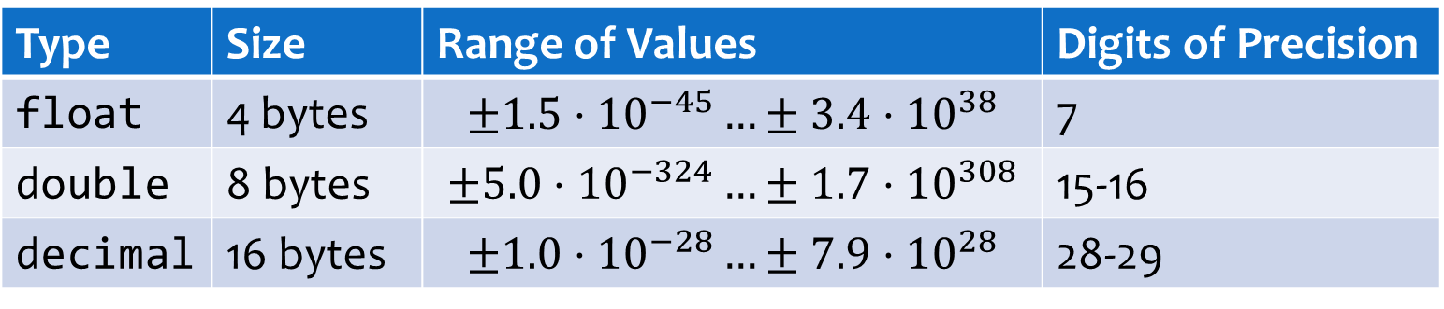
Floating-Point Types by Size
How many significant figures do you care about?
float and double: approximations of decimal values
decimal: exact decimal values, as long as they fit in range
Type | Size | Range of Values | Digits of Precision
float | 4 bytes | $$±1.5⋅{10}^{−45}…±3.4⋅{10}^{38}$$ | 7
double | 8 bytes | $$±5.0⋅{10}^{−324}…±1.7⋅{10}^{308}$$ | 15-16
decimal | 16 bytes | $$±1.0⋅{10}^{−28}…±7.9⋅{10}^{28}$$ | 28-29

Slide 9


Approximate Decimals
float and double use binary (base 2) fractions:
Why “floating point”? Actually it’s binary scientific notation:
2²
2¹
2⁰
2⁻¹
2⁻²
101.01
= 4+1 +
$$1/4$$
= 5.25
Mantissa
10101e-10
Exponent
Shift “.” left by 2
Or read it as a decimal
$$21⋅2^{−2}=\frac{21}{4}=5.25$$
101.01

Slide 10






Approximate Decimals
Some decimal (base 10) fractions can’t be expressed in binary
Decimal 0.1 = $\frac{1}{10}$. Can you express $\frac{1}{10}$ as a sum of $\frac{1}{4},\frac{1}{8},\frac{1}{16},\frac{1}{32},…$ ?
Truncating the infinite sequence leads to errors, just like with $\frac{1}{3}$:
$$\frac{1}{16}$$
$$\frac{1}{32}$$
$$\frac{1}{256}$$
$$\frac{1}{512}$$
=.099609375
.000110011…
(…00110011…)
$\frac{1}{3}+\frac{2}{3}$ in decimal =
.33333333 + .66666666 = .99999999 $≠$ 1

Slide 11

Exact Decimals
The decimal type uses decimal (base 10) fractions
Finite decimals stay finite, so no unexpected errors
But computers can only use binary, how does that work?
Decimal 5.1:
110011 e₁₀-1
Mantissa
Exponent, but as a power of 10
51
10⁻¹
$$51⋅{10}^{−1}=\frac{51}{10}=5.1$$

Slide 12
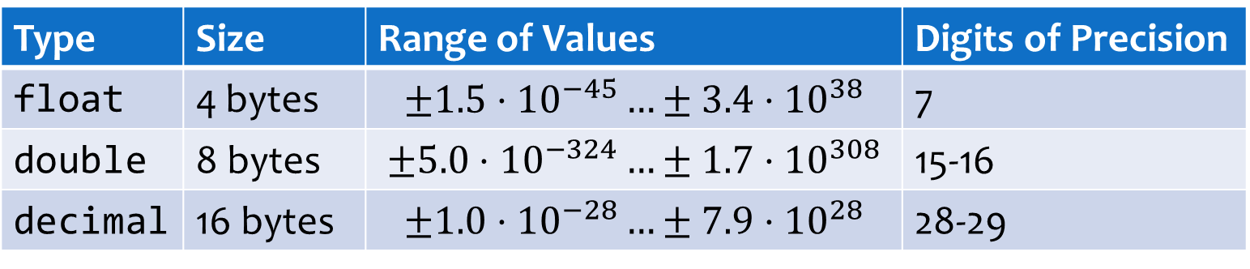
Choosing a Floating-Point Type
More precision sounds good, why not always use decimal?
Much slower to compute with than double
Base-10 exponent is hard, base-2 exponent is easy
Only use if you really need exact values of .01, i.e. money
Physical measurements are not that exact
Type | Size | Range of Values | Digits of Precision
float | 4 bytes | $$±1.5⋅{10}^{−45}…±3.4⋅{10}^{38}$$ | 7
double | 8 bytes | $$±5.0⋅{10}^{−324}…±1.7⋅{10}^{308}$$ | 15-16
decimal | 16 bytes | $$±1.0⋅{10}^{−28}…±7.9⋅{10}^{28}$$ | 28-29

Slide 13
Outline
More About C# Datatypes
Integer types and sizes
Floating-point type precision
Value vs. Reference Types
Overflow and Underflow

Slide 14
Value Types
Variables name memory locations
Value Type: Named memory location just stores the value – what you’d expect
Numeric types (int, uint, double, decimal, etc.)
char
bool – logical true or false
RAM addresses
int myAge
29
4 bytes
bool isOn
true
char initial
't'
double height
1.28
8 bytes

Slide 15
Reference Types
Named memory location stores a reference to the data, not the data itself
Contents of the named memory location = the address of another memory location
This location stores the actual data
string
object – and all objects you create
RAM addresses
string word
0x7ff4238
"Hello"

Slide 16
Implications of Reference Types
Assignment copies the value, but not the data it refers to
RAM addresses
string word = "Hello";
string word
0x7ff4238
string word2 = word;
string word2
0x7ff4238
"Hello"

Slide 17
Outline
More About C# Datatypes
Integer types and sizes
Floating-point type precision
Value vs. Reference Types
Overflow and Underflow

Slide 18
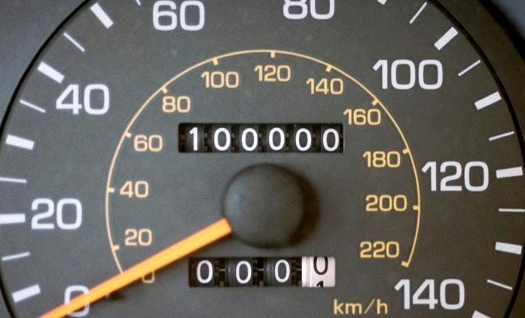
The Overflow Problem
What happens when the odometer reads 999999 and you drive 1 more mile?
Same problem with C# integers: Fixed number of digits (bits), once they are all 1, adding 1 “rolls over”
uint with value 4,294,967,295:
11111111
11111111
11111111
11111111
+ 1
00000000
00000000
00000000
00000000

Slide 19
The Overflow Problem
Even worse with signed integers: Adding 2 positive numbers results in a negative number!
In C#, this does not make your program crash
int with value 2,147,483,647
0
1111111
11111111
11111111
11111111
Sign bit
+ 1
int with value -2,147,483,648
1
0000000
00000000
00000000
00000000

Slide 20
Overflow Bug Example
Console.WriteLine("Enter requested loan amount for first person");
uint loan1 = uint.Parse(Console.ReadLine());
Console.WriteLine("Enter requested loan amount for second person");
uint loan2 = uint.Parse(Console.ReadLine());
if(loan1 + loan2 < 10000)
{
Console.WriteLine("Your loans are approved!");
}
else
{
Console.WriteLine("Error: The sum of the loans exceeds "
+ " the maximum of $10,000");
}
4000000000 + 294967300 = 4
What if loan1 is 4,000,000,000 and loan2 is 294,967,300?

Slide 21
The Underflow Problem
Floating-point types have range limits (limited size of exponent)
Any number smaller than minimum value will be rounded to 0
This applies even to intermediate values in a calculation:
float myNumber = 1E-45f;
myNumber = myNumber / 10;
Console.WriteLine(myNumber);
0
float myNumber = 1E-45f;
myNumber = (myNumber / 10) * 10;
Console.WriteLine(myNumber);
0

