Slide 1

Operators and Conversions Between Data Types
Principles of Computer Programming I
Spring/Fall 20XX

Slide 2
Outline
Arithmetic and Assignment Operators
Data Types and Literal Assignment
Implicit Conversions
Explicit Conversions

Slide 3
More Variable Declaration
Can declare multiple variables on one line:
Can combine declarations and initializations:
double length;
double depth;
double height;
equivalent
double length, depth, height;
comma
int age = 30;
int weight;
int votes;
equivalent
int age = 30, weight, votes;

Slide 4

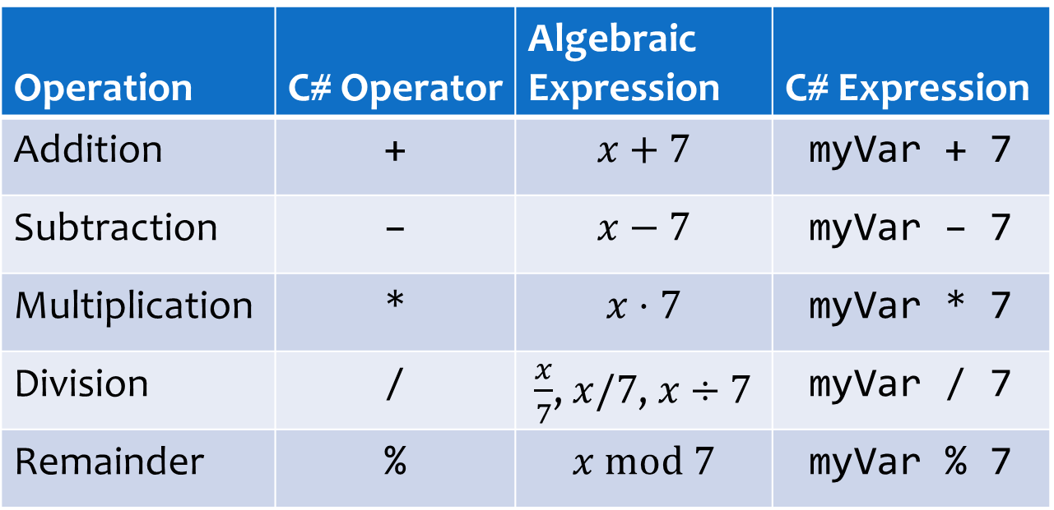
Doing Arithmetic
C# has math operators for numeric data
Operation | C# Operator | Algebraic Expression | C# Expression
Addition | + | $$x+7$$ | myVar + 7
Subtraction | – | $$x−7$$ | myVar – 7
Multiplication | * | $$x⋅7$$ | myVar * 7
Division | / | $\frac{x}{7}$, $x/7$, $x÷7$ | myVar / 7
Remainder | % | $$x \text{mod} 7$$ | myVar % 7
Remainder after integer division: $44 mod 7=2$ because $44÷7=6$ with remainder $2$

Slide 5
Arithmetic and Assignment
Result of an arithmetic expression is a numeric value
Numeric values can be assigned to variables
Type of variable must match type of expression
int myVar = 3 * 4;
The value 12 is stored in myVar
This expression evaluates to 12
double goodSum = 4.5 + 6.4;
This expression evaluates to 10.9
float badSum = 4.5 + 6.4;
float floatSum = 4.5f + 6.4f;

Slide 6
Arithmetic and Variables
Variable in arithmetic expression = read its current value
int a = 4;
int b = a + 5;
a = b * 2;
b = a – 20;
a has value 4, so b gets the resulting value 9
b has value 9, now a is assigned new value 18
a has value 18, now b is assigned new value -2
float x = 30.0f;
float y = x / 8f;
x = 2f * y + 0.5f;
float z = y * 1.5f;
x has value 30, so y gets the value 3.75
y has value 3.75, x is assigned new value 8
y has value 3.75, z is assigned 5.625
Notes:
TODO: Add more examples here

Slide 7
Self-Assignment
A variable can appear on both sides of the = operator
Entire right side is evaluated before doing assignment
int myVar = 4;
myVar = myVar * 2;
What does this do?
Store result of 4 * 2 into myVar
Read myVar’s current value, 4
float x = 30.0f;
float y = x / 8f;
x = 2f * x + 0.5f;
y = y * 1.5f + y;
y gets the value 3.75, as before
x is assigned new value 60.5
y is assigned new value 9.375
y has value 3.75 both times

Slide 8
Self-Assignment Shortcuts
Compound assignment operators: combine arithmetic and assignment
Entire right side is evaluated before compound operator
Compound operator can only replace one arithmetic operator
Statement | Equivalent
x += 2; | x = x + 2;
x -= 2; | x = x – 2;
x *= 2; | x = x * 2;
x /= 2; | x = x / 2;
int myVar = 4;
myVar *= 2;
myVar += 6 * -3;
myVar changes to 8 like before
myVar gets new value -10
Result of expression is -18
x *= 2f;
x += 0.5f;
x = 2f * x + 0.5f;

Slide 9
Outline
Arithmetic and Assignment Operators
Data Types and Literal Assignment
Implicit Conversions
Explicit Conversions

Slide 10
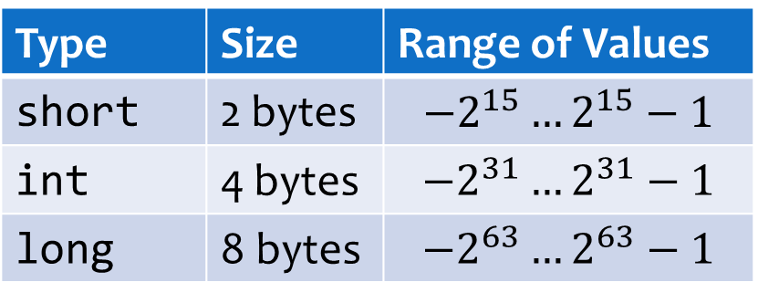
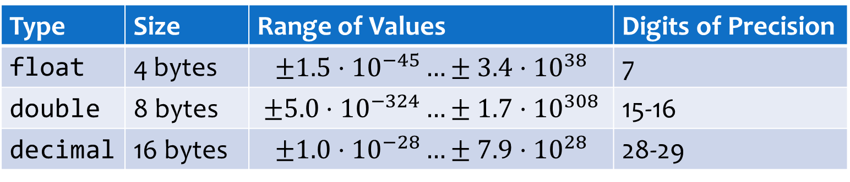
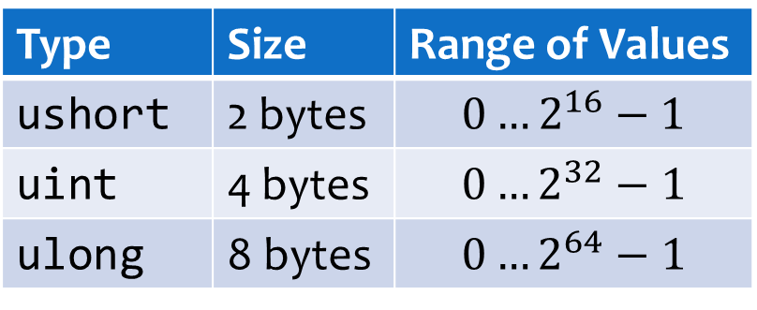
Review: Numeric Data Types
Integers
Floating-point
Size & range
Type | Size | Range of Values
short | 2 bytes | $$−2^{15}…2^{15}−1$$
int | 4 bytes | $$−2^{31}…2^{31}−1$$
long | 8 bytes | $${−2}^{63}…2^{63}−1$$
Type | Size | Range of Values
ushort | 2 bytes | $$0…2^{16}−1$$
uint | 4 bytes | $$0…2^{32}−1$$
ulong | 8 bytes | $$0…2^{64}−1$$
Type | Size | Range of Values | Digits of Precision
float | 4 bytes | $$±1.5⋅{10}^{−45}…±3.4⋅{10}^{38}$$ | 7
double | 8 bytes | $$±5.0⋅{10}^{−324}…±1.7⋅{10}^{308}$$ | 15-16
decimal | 16 bytes | $$±1.0⋅{10}^{−28}…±7.9⋅{10}^{28}$$ | 28-29

Slide 11
Assignment From Literals
If literal type matches variable type, assignment always works:
What if literal type is different?
int myAge = 29;
double myHeight = 1.77;
float radius = 2.3f;
float radius = 2.3;
Error! Can’t convert double to float
float radius = 2;
No error, even though 2 is an int literal
Why does this work?

Slide 12
Implicit Conversions
Value type must still match variable type
Some types can be implicitly converted to others:
Also applies to assignment from variables:
int value
float radius = 2;
implicit conversion
radius
2.0f
float value
int length = 2;
float radius = length;
value 2 implicitly converted to 2.0f
gets value 2.0f

Slide 13
Implicit Conversions
Type | Possible Implicit Conversions
short | int, long, float, double, decimal
int | long, float, double, decimal
long | float, double, decimal
ushort | uint, int, ulong, long, decimal, float, double
uint | ulong, long, float, double, decimal
ulong | float, double, decimal
float | double
What’s the pattern here? Given a type, what can you implicitly convert it to?

Slide 14

Implicit Conversions are “Safe”
int range: $−2^{31}…2^{31}−1$; float integer range: $±3.4⋅{10}^{38}$
Any int can be stored in a float without losing data
Reverse is not safe: Storing 4.7f in an int will lose the fraction
All integer types are safe to convert to float or double
Preserves data
330062719
330062719.0f
int
float
19
19.357f
Loses data

Slide 15
Other Safe Conversions
Smaller integer to larger integer; float to double
Unsigned to larger signed integer (why larger?)
short
int
long
float
double
ushort
int
uint
long
Unsafe, can lose data

Slide 16
Outline
Arithmetic and Assignment Operators
Data Types and Literal Assignment
Implicit Conversions
Explicit Conversions

Slide 17
Data-Losing Conversions
Unsafe conversions: Potential to lose data
Will not happen automatically; compile error
19.35499674
19.354998f
19
double
float
int
Loses significant figures
Loses fractional part
double length = 2.886;
float radius = length;
Error! Can’t convert double to float

Slide 18
Explicit Conversion with Casts
Cast operator: Force the compiler to allow an unsafe conversion
Explicit conversion from original to target type must exist
Most built-in C# types have explicit conversions defined
double length = 2.886;
float radius = (float) length;
double value
gets value 2.886f
Target type name in parentheses
string strAge = "29";
int myAge = (int) strAge;
Error! Can’t convert string to int

Slide 19
Casting Side-Effects
Casting from floating-point to integer: fraction is truncated
Casting to less precise floating-point: fraction is rounded
int intLength = (int) length;
value: 2.886
gets value 2
cast to int
decimal myDecimal = 123456789.999999918m;
double myDouble = (double) myDecimal;
float myFloat = (float) myDouble;
myDouble: 123456789.99999993
myFloat: 123456790.0f

Slide 20
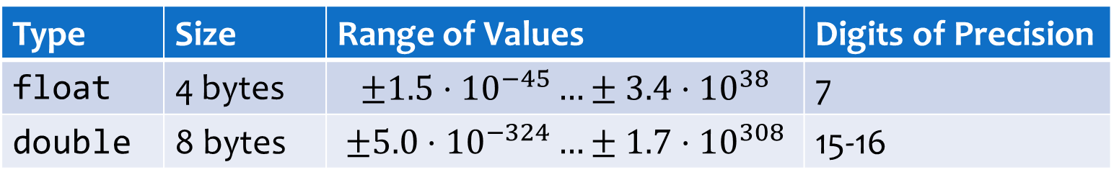
Floating-Point Casts and Range
float is less precise than double, but also has a smaller range
What if the double value is outside the range?
Type | Size | Range of Values | Digits of Precision
float | 4 bytes | $$±1.5⋅{10}^{−45}…±3.4⋅{10}^{38}$$ | 7
double | 8 bytes | $$±5.0⋅{10}^{−324}…±1.7⋅{10}^{308}$$ | 15-16
double myDouble = 3.5e-300;
float myFloat = (float) myDouble;
double myDouble = 6.2e57;
float myFloat = (float) myDouble;
myFloat: 0f
myFloat: Infinity
Notes:
Hint: This is very similar to the overflow/underflow problem…

Slide 21
Casting Side-Effects
Casting to smaller integer: Most significant bits are truncated
long myLong = 1000000;
int myInt = (int) myLong;
myLong
Byte 8
Byte 7
Byte 6
Byte 5
Byte 4
Byte 3
Byte 2
Byte 1
0
0000000
00000000
00000000
00000000
00000000
00001111
01000010
01000000
Delete
Keep
0
0000000
00001111
01000010
01000000
int value: 1000000
myInt gets assigned 1000000
Notes:
Why? If the number could actually fit in the smaller int, this will preserve the value

Slide 22
Casting Side-Effects
Caution: Truncating bits will not “round down” in decimal
int bigNumber = (int) 10203040506;
10203040506 as a long
Byte 8
Byte 7
Byte 6
Byte 5
Byte 4
Byte 3
Byte 2
Byte 1
0
0000000
00000000
00000000
00000010
01100000
00100110
00001010
11111010
Delete
Keep
0
1100000
00100110
00001010
11111010
int value: 1613105914
bigNumber gets assigned 1613105914

Slide 23

Casting Side-Effects
Caution: Highest bit of truncated number becomes the sign bit
int bigNumber = (int) 9223372036854775807;
long maximum: $2^{63}−1$
Byte 8
Byte 7
Byte 6
Byte 5
Byte 4
Byte 3
Byte 2
Byte 1
0
1111111
11111111
11111111
11111111
11111111
11111111
11111111
11111111
Delete
Keep
1
1111111
11111111
11111111
11111111
int value: -1
bigNumber gets assigned -1

Slide 24
Casting Side-Effects
Casting to decimal: Stored precisely, unless it is out of range – crashes with a System.OverflowException
Only time C# will “check” for overflow by default, instead of letting weird behavior happen
decimal fromSmall = (decimal) 42.76875;
double bigDouble = 2.65e35;
decimal fromBig = (decimal) bigDouble;
fromSmall: 42.76875m
System.OverflowException!

Slide 25
Common Conversions Summary
Implicit (safe)
Explicit – may crash
int
float
double
decimal
Explicit – truncating
Explicit – rounding

