Slide 1
Error matters
Alison L Gibbs
MAA Seaway
November 1, 2019

Slide 2
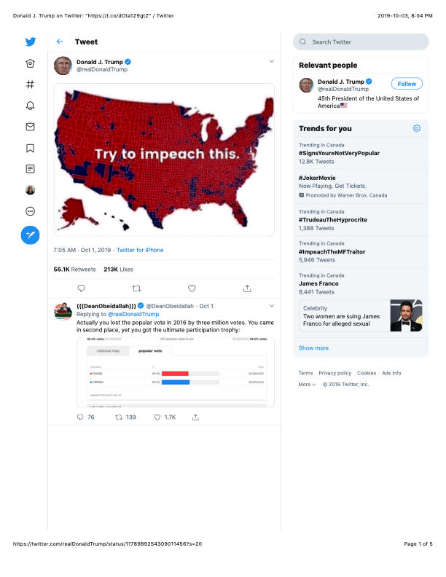
Notes:
Although not quite on target … what got me thinking about this …

Slide 3
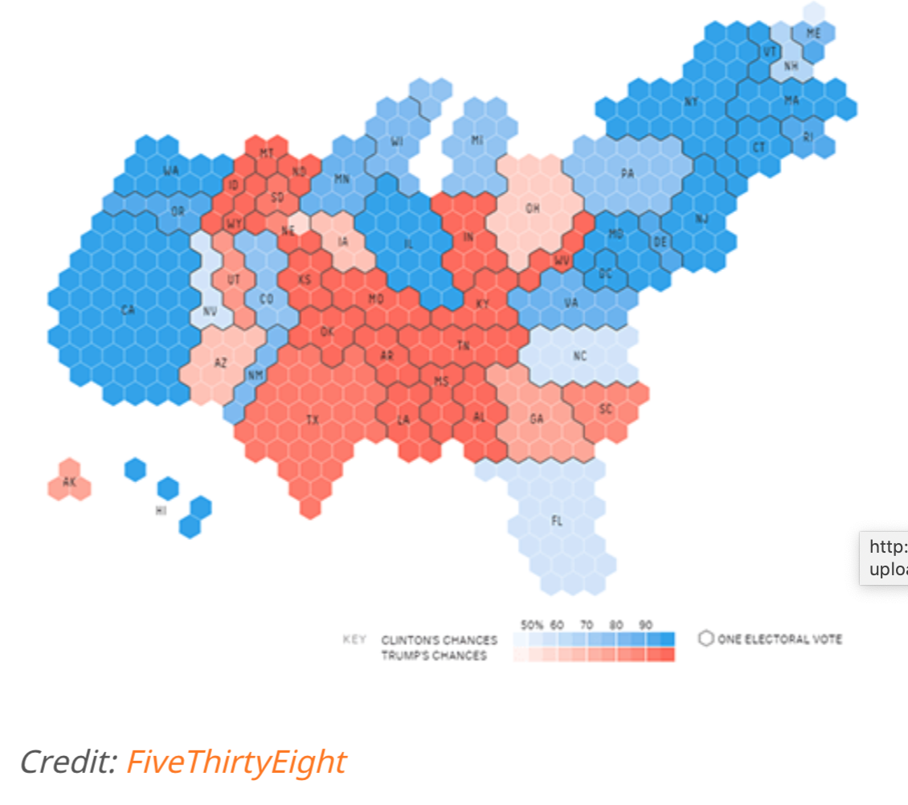
Notes:
http://metrocosm.com/election-2016-map-3d/

Slide 4
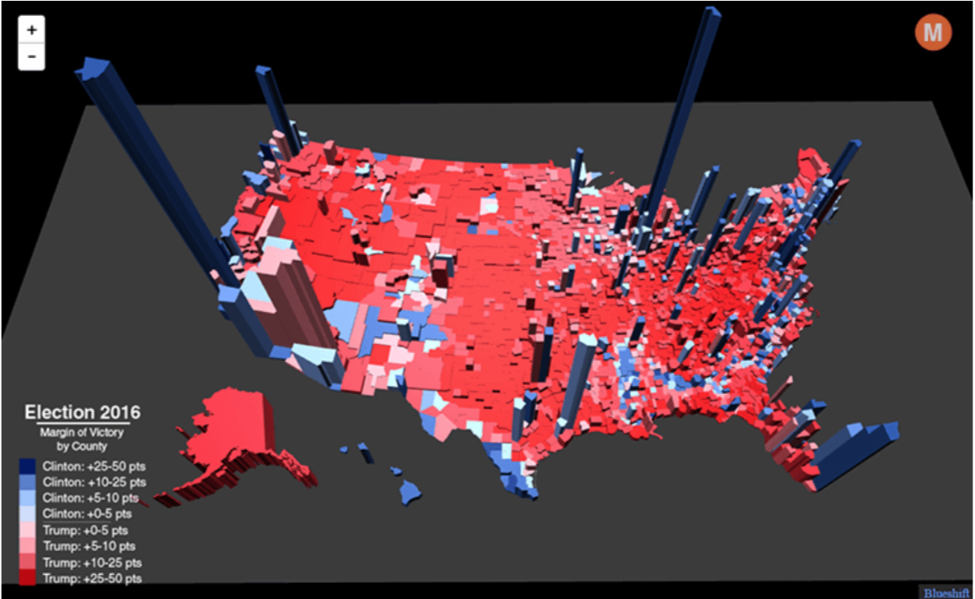
Notes:
http://metrocosm.com/election-2016-map-3d/

Slide 5
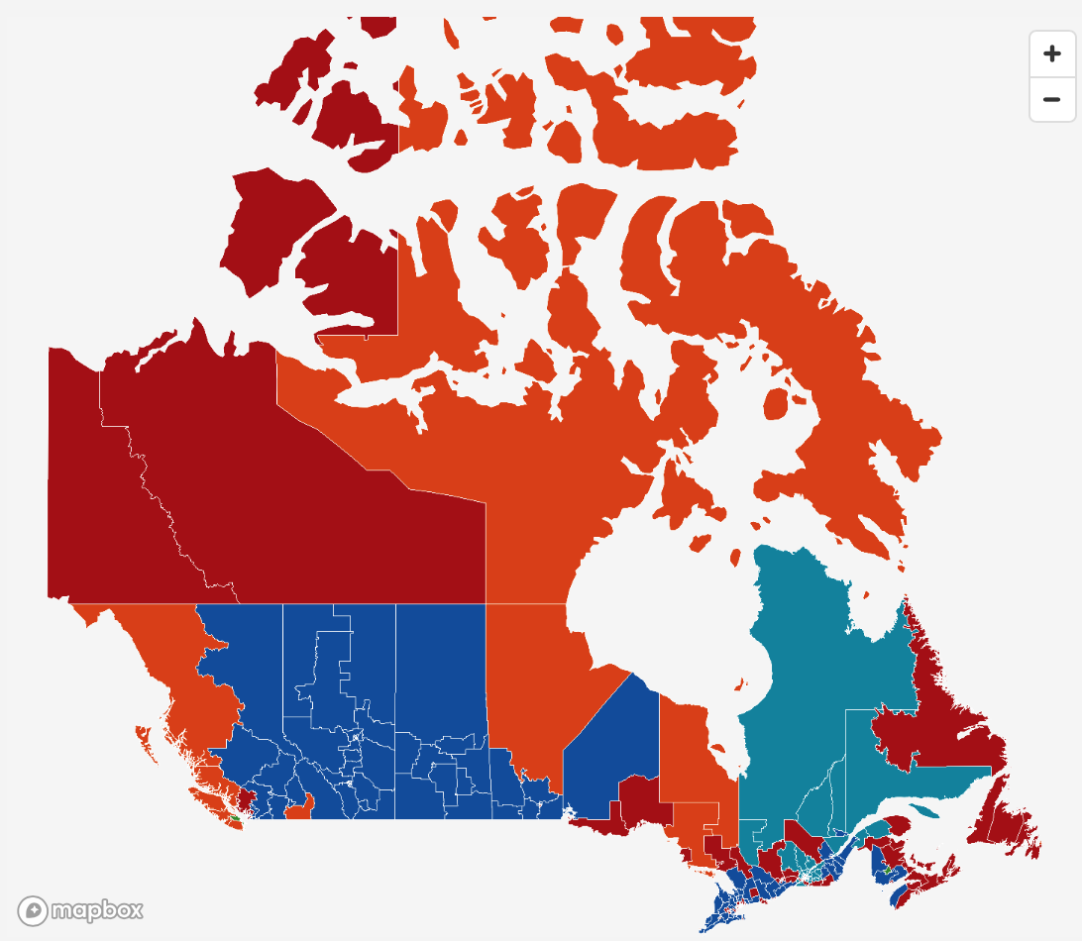
Notes:
https://newsinteractives.cbc.ca/elections/federal/2019/results/

Slide 6
Kidney cancer rates in the US (visualizations)
Breast cancer rates in Ontario (data)

Slide 7
A certain town is served by two hospitals. In the larger hospital about 45 babies are born each day, and in the smaller hospital about 15 babies are born each day. As you know, about 50% of all babies are boys. However, the exact percentage varies from day to day. Sometimes it may be higher than 50%, sometimes lower.
For a period of 1 year, each hospital recorded the days on which more than 60 percent of the babies born were boys. Which hospital do you think recorded more such days?
The larger hospital
The smaller hospital
About the same (that is, within 5% of each other)
[Tversky & Kahneman, 1974)

Slide 8
References
AL Gibbs (2016). Random Sampling to Support Informal Inference Using Census at School. Simulation-Based Inference blog. https://www.causeweb.org/sbi/?p=1079
A hands-on activity to illustrate the effect of sample size when comparing the estimate of a proportion between two groups.
EA Steel, M Liermann & P Guttorp (2019). Beyond Calculations: A Course in Statistical Thinking. The American Statistician 72:51, 392-401. https://doi.org/10.1080/00031305.2018.1505657
An description for a course in statistical thinking for senior students.
Y-K Tang & MS Gilthorpe (2007). The most dangerous hospital or the most dangerous equation? BMC Health Services Research 7:185. https://doi.org/10.1186/1472-6963-7-185
The importance of considering the variablity in hospitals of different sizes when comparing their mortality rates.
A Tversky & D Kahneman (1974). Judgment under Uncertainty: Heuristics and Biases. Science 185, 1124-1131.
An examination of the heuristics people use and the errors they can lead to.
H Wainer & HL Zwerling (2006). Evidence That Smaller Schools Do Not Improve Student Achievement. Phi Delta Kappan, December 2006, 300-303.
Smaller schools have higher variance so are represented in both the highest and lowest performing schools. We need to be careful using data for policy decisions.
H Wainer (2007). The Most Dangerous Equation. American Scientist 95:3.
When making decisions, ignoring how error is related to to sample size is perilous.

