Slide 1
Beyond p<0.05 What should we teach about hypothesis testing?
Alison L Gibbs
Department of Statistical Sciences
University of Toronto
Materials: https://github.com/alisongibbs/MAASeawayWorkshop2019
https://alisongibbs.github.io
alison.gibbs@utoronto.ca
MAA Seaway November 1, 2019
Notes:
Introduce me and my motivation for today – work together to develop what to do

Slide 2
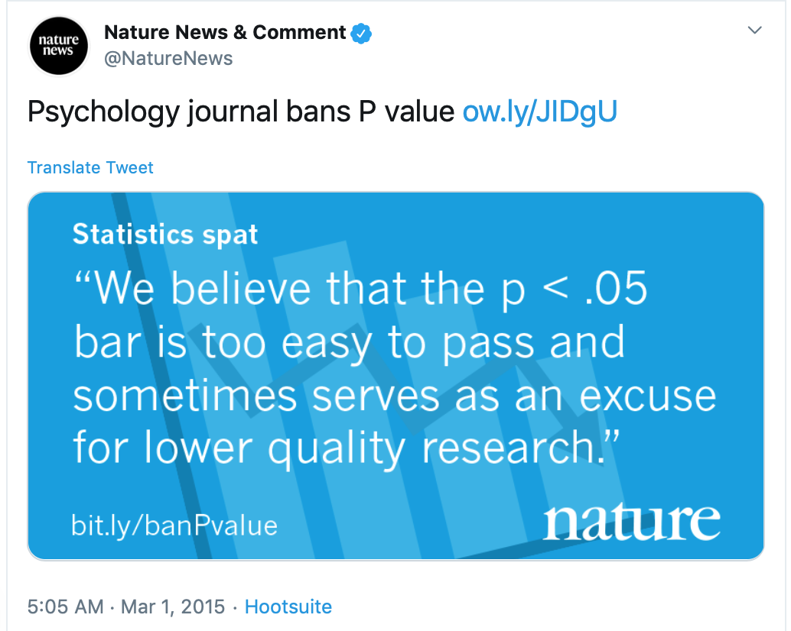
March 2015
Notes:
Note: replicability vs reproducibility
Basic and Applied Social Psychology

Slide 3
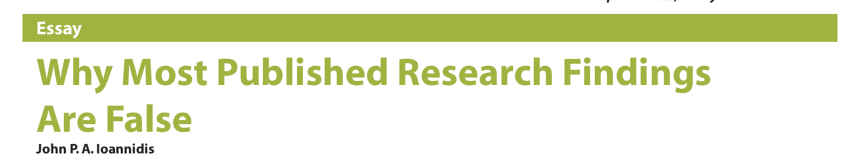
10 years earlier

Slide 4
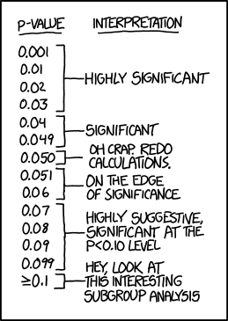
https://xkcd.com/1478/
Notes:
Note difference between p-values and statistical significance

Slide 5
A clinical oncologist is investigating the efficacy of a new treatment on reduction in tumour size. She randomly assigns patients to the new treatment or old treatment and compares the mean of the reduction in tumour size between the two groups. She carries out a statistical test and the P-value is 0.001.
How many of the following are valid interpretations of the P-value?
The probability of observing a difference between the treatment groups as large or larger than she observed if the new treatment has the same efficacy as the old treatment. VALID / NOT VALID
The probability of getting a difference between treatments as extreme as or more extreme than the ones in this study in repeated sampling. VALID / NOT VALID
The probability that the new treatment works the same as the old treatment. VALID / NOT VALID
The probability that the new treatment, on average, reduces tumour size more than the old treatment. VALID / NOT VALID
Notes:
The issue…
Despite our best efforts…
Students don’t understand what a P-value is
Have to accept they’re not getting it and move on
Would it make a difference if I changed the context?

Slide 6
From the New England Journal of Medicine (2019)
We have now clarified, expanded, and refined our statistical guidelines for authors to cover both clinical trials and observational studies. The new guidelines discuss many aspects of the reporting of studies in the Journal, including a requirement to replace P values with estimates of effects or association and 95% confidence intervals when neither the protocol nor the statistical analysis plan has specified methods used to adjust for multiplicity. Journal editors and statistical consultants have become increasingly concerned about the overuse and misinterpretation of significance testing and P values in the medical literature. Along with their strengths, P values are subject to inherent weaknesses, as summarized in recent publications from the American Statistical Association.
P values indicate how incompatible the observed data may be with a null hypothesis; “P<0.05” implies that a treatment effect or exposure association larger than that observed would occur less than 5% of the time under a null hypothesis of no effect or association and assuming no confounding. Concluding that the null hypothesis is false when in fact it is true (a type I error in statistical terms) has a likelihood of less than 5%. When P values are reported for multiple outcomes without adjustment for multiplicity, the probability of declaring a treatment difference when none exists can be much higher than 5%. When 10 tests are conducted, the probability that at least one of the 10 will have a P value less than 0.05 may be as high as 40% when the null hypothesis of no difference is true. Even when no adjustment for multiplicity is needed, P values do not represent the probability that the null hypothesis is false: P<0.05 does not imply that the probability of the null hypothesis is less than 5%. Because P values provide no information about the variability of an estimated association (its standard error), nonsignificant P values do not distinguish between group differences that are truly negligible and group differences that are noninformative because of large standard errors. P values provide no information about the size of an effect or an association.

Slide 7
Today:
Have a discussion about ideas for teaching statistics going forward.
Be it resolved(?): We should no longer teach statistical significance.
Don’t throw the baby out with the bathwater.
The importance of error.
What is a P-value?
What happens when you don’t have a plan.
Assessing the quality of studies.
7. What would you like to discuss?
BREAK
Notes:
Just do one thing…
Today … work through which ones you want

Slide 8
From the ASA Statement on Statistical Significance and P-Values (2016)
P-values can indicate how incompatible the data are with a specified statistical model.
P-values do not measure the probability that the studied hypothesis is true, or the probability that the data were produced by chance alone.
Scientific conclusions and business or policy decisions should not be based only on whether a P-value passes a specific threshold.
Proper inference requires full reporting and transparency.
A P-value, or statistical significance, does not measure the size of an effect or the importance of a result.
By itself, a P-value does not provide a good measure of evidence regarding a model or hypothesis.

Slide 9
From the editorial ”Moving to a World Beyond ‘p < 0.05’” (2019)
ATOM:
Accept Uncertainty
be Thoughtful
be Open
be Modest

Slide 10
Suggested goal:
Change science culture from an over-reliance on P-values, one student at a time

Slide 11
Things to think about
What proportion of the introductory course should be testing?
Topics to avoid? Type 1 / 2 errors, a formulaic approach.
Think about the issues from checklist in every single example.
Give students examples that are murky.

