Slide 1

MTSI 2018 Summer Intern Project
By Jake Crawford, Alison Howland

Slide 2


Jenkins Build system
Set up Atlassian products Jira, Confluence, Bitbucket
Jenkins autobuilds on push and deploys to Nexus
JIRA
BitBucket
Confluence
Jenkins

Slide 3
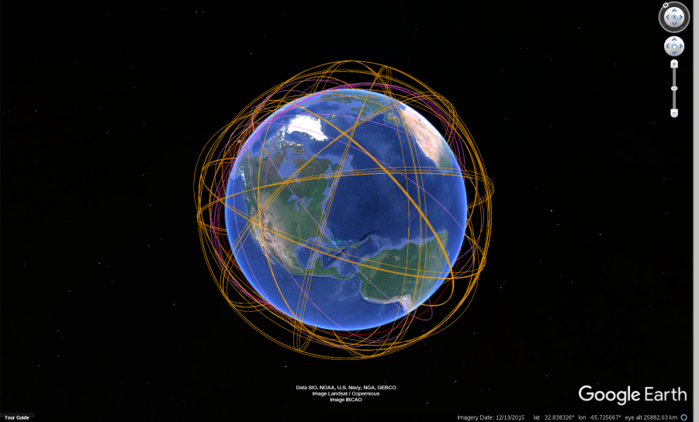
Updated Satellite Tracker Code
Turned Ant to Maven

Slide 4

Tweet Maps
Points
Polygons
WMS
Sandbox1
Sandbox2

