Slide 1
hypothesis testing for the mean
Alison Kleffner

Slide 2
schedule
Basic Definitions
Population (Parameter) vs. Sample (Statistics)
Hypothesis Testing for a Single Mean
Setting up hypothesis
Conditions
Finding Standardized Statistics and Drawing Conclusion

Slide 3
Population (Parameter) vs. Sample (Statistics)

Slide 4
Most of what we do in Statistics is trying to understand a set of information. This set of information is from a . . .
Population: The complete collection of ALL elements that are of interest for a given problem.
The population is often so big that obtaining all information about its elements is either difficult or impossible. So, we work with a more manageable set of data that we obtain from a . . .
Sample: A sub-collection of elements drawn from a population.
Observation: The collection of measurements from a particular unit in a sample.
What subject you are taking data on
Variable: Any measurable characteristic of an observation.

Slide 5
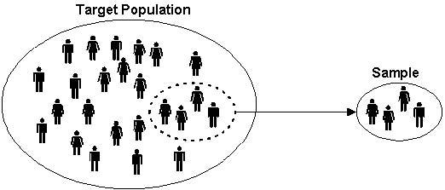
Population vs Sample

Slide 6
Definitions
Sample: The set of observational units on which we collect data.
Sample size: The number of observational units in the sample.
Statistic: The number summarizing the result of the sample.
This is the number observed in the study.
Population: The complete collection of ALL elements that are of interest for a given problem.
Parameter: the long-run numerical property of the process.
What is it that you want to know?

Slide 7
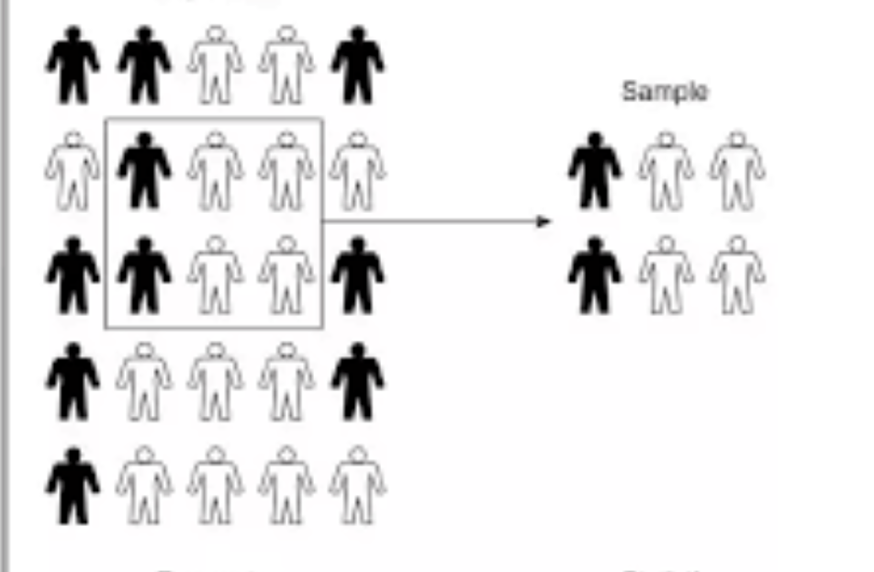
Want to use statistic to estimate the parameter
Population
Sample
Parameter → Population
Typically Unknown Value
Statistic → Sample
Known Value
(aka observed statistic)
Statistic
Parameter

Slide 8
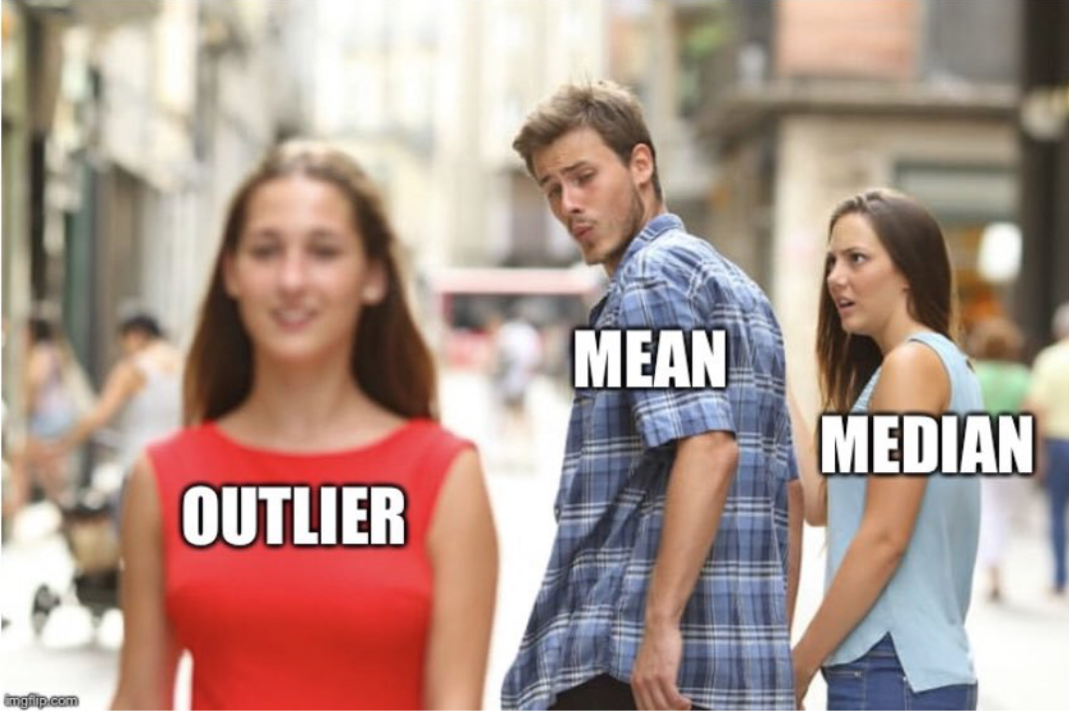
Vocabulary – Quantitative data
Summary Statistics
Mean:
Add up all the values first, then divide by the total number of values.
Median:
Half of the data is above, half is below.
“Middle” value when data is ordered.
Outliers: unusual data points.
Our Parameter is going to focus on the mean

Slide 9
Example
Population?
Avocados from 2017
Parameter?
The (long run) average price of an avocado in 2017.
Sample?
94 avocados from 2017
Statistic?
1.44
Sample Size?
94
It is a well-known fact that Millennials LOVE Avocado Toast. It's also a well-known fact that all Millennials live in their parent’s basements. Clearly, they aren't buying homes because they are buying too much Avocado Toast! Was the Avocadopocalypse of 2017 real? In the past, an avocado cost $1.36. To test the avocadopaocalypse, we collected a random sample of 94 avocados from 2017. The average price of an avocado was $1.44 with a sample standard deviation of 0.41

Slide 10
Your Turn
Population?
College Students
Parameter?
(True) average number of hours a college student sleeps a night
Sample?
32 college students
Statistic?
5.5
Sample Size?
32
It has been recommended US adults get 8 hours of sleep per night. A random sample of 32 college students was taken and was found that on average, they got 5.5 hours of sleep with a standard deviation of 0.71.

Slide 11
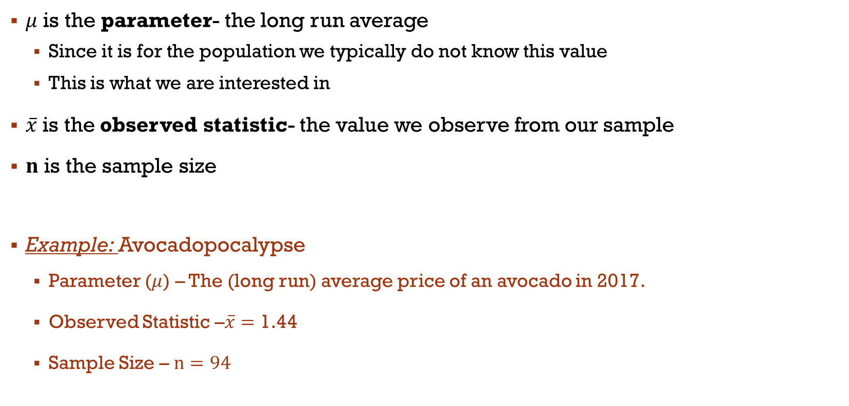
Symbols
$μ$ is the parameter- the long run average
Since it is for the population we typically do not know this value
This is what we are interested in
$\overline{x}$is the observed statistic- the value we observe from our sample
$n$ is the sample size
Example: Avocadopocalypse
Parameter ($μ$) – The (long run) average price of an avocado in 2017.
Observed Statistic –$\overline{x}=$ 1.44
Sample Size – $n=94$

Slide 12
Statistical Significance
Statistics – Estimate broad populations
No way to collect all information
Want to know when is a sample Statistically Significant?
So What is Statistical Significance?
Asking ourselves: “Is our result unlikely to have occurred by random chance?”
How do we determine this? Hypothesis Testing

Slide 13


Hypothesis Testing

Slide 14
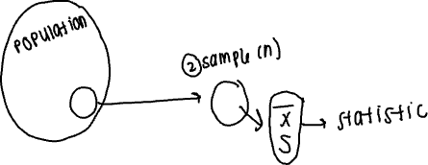
Hypothesis testing steps
Make an initial assumption.
Collecting data (sample) – find statistic
Based on the sample, reject or fail to reject the initial assumption.

Slide 15
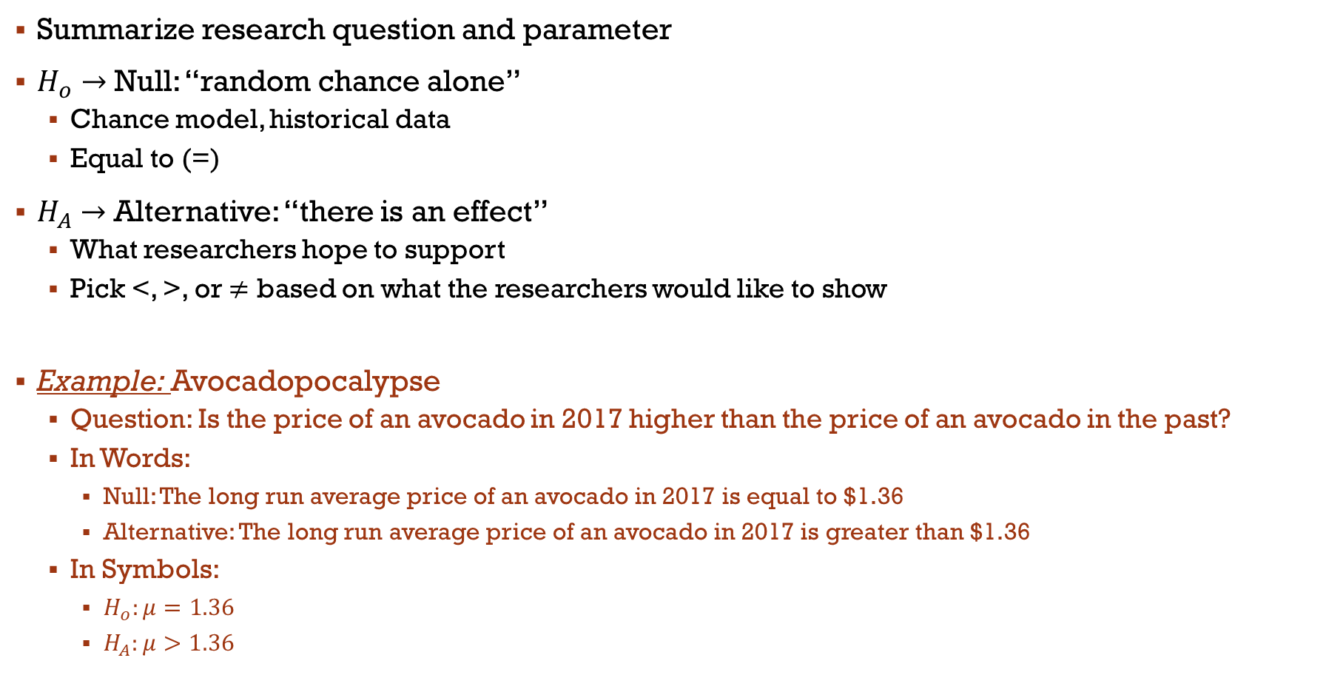
setting up Hypothesis
Summarize research question and parameter
$H_{o}→$ Null: “random chance alone”
Chance model, historical data
Equal to (=)
$H_{A}→$ Alternative: “there is an effect”
What researchers hope to support
Pick <, >, or $≠$ based on what the researchers would like to show
Example: Avocadopocalypse
Question: Is the price of an avocado in 2017 higher than the price of an avocado in the past?
In Words:
Null: The long run average price of an avocado in 2017 is equal to $1.36
Alternative: The long run average price of an avocado in 2017 is greater than $1.36
In Symbols:
$H_{o}:μ=1.36$
$H_{A}:μ>1.36$

Slide 16
Your turn
Write out your Hypotheses:
In Words
H0: The true average number of hours a college student sleeps a night is equal to 8.
HA: The true average number of hours a college student sleeps a night is less than 8.
In Symbols
H0: µ = 8
HA: µ < 8
It has been recommended US adults get 8 hours of sleep per night. A random sample of 32 college students was taken and was found that on average, they got 5.5 hours of sleep with a standard deviation of 0.71. Is the average less than the recommended 8 hours?

Slide 17
Comparing our statistic
Need something (null distribution) to compare to our statistic
With mathematical theory we should be able to predict what the pattern of the null distribution will look like
Null Distribution: is the probability distribution of the test statistic when the null hypothesis is true.
From the theoretical distribution we will then be able to find p-values and standardized statistics

Slide 18
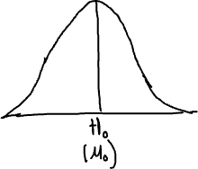
Null Distribution
Null Distribution Commonalities
Sample size (helps to determine variability)
Symmetric ‘bell’ shaped distribution
Centered at null hypothesis value
Can predict things about null…
Where it will be centered
If its bell shaped (normally distributed)
Standard deviation of the null distribution
Predictions used to calculate the standardized statistic

Slide 19
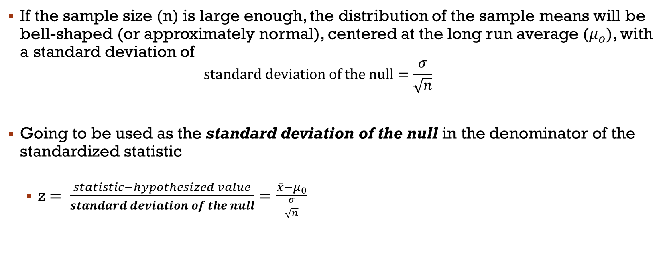
Central Limit Theorem
If the sample size (n) is large enough, the distribution of the sample means will be bell-shaped (or approximately normal), centered at the long run average ($μ_{o}$), with a standard deviation of
$$standard deviation of the null=\frac{σ}{\sqrt{n}}$$
Going to be used as the standard deviation of the null in the denominator of the standardized statistic
z$= \frac{statistic−hypothesized value}{standard deviation of the null}=\frac{\overline{x}−μ_{0}}{\frac{σ}{\sqrt{n}}}$

Slide 20
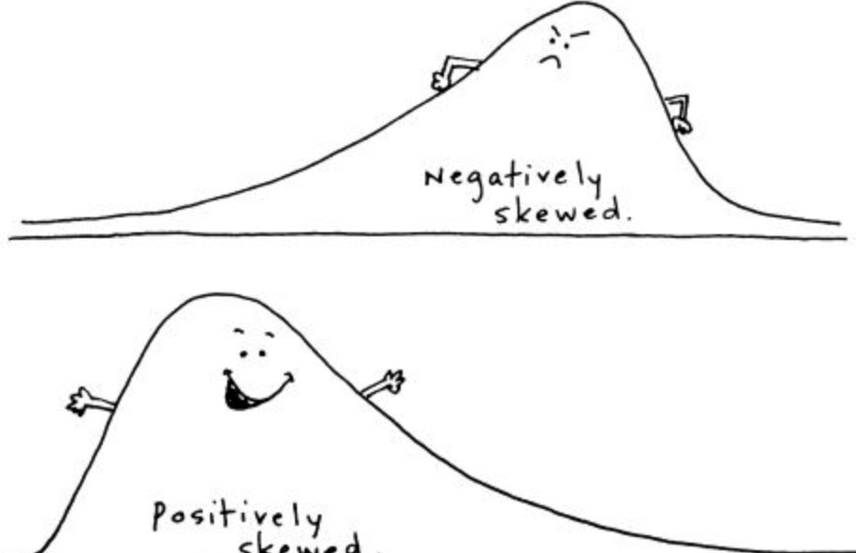
conditions
If you want to use Central Limit Theorem need to meet certain conditions
Need a sample size large enough, in order to say the null will follow the Normal Distribution
n ≥ 30
Sampling distribution is symmetric
Assume each observation is independent of each other
n ≤ 10% of population
Doesn’t always work
If the sample size is small …
null distribution will not be approximately bell-shaped and the resulting standardized statistics are not accurate

Slide 21
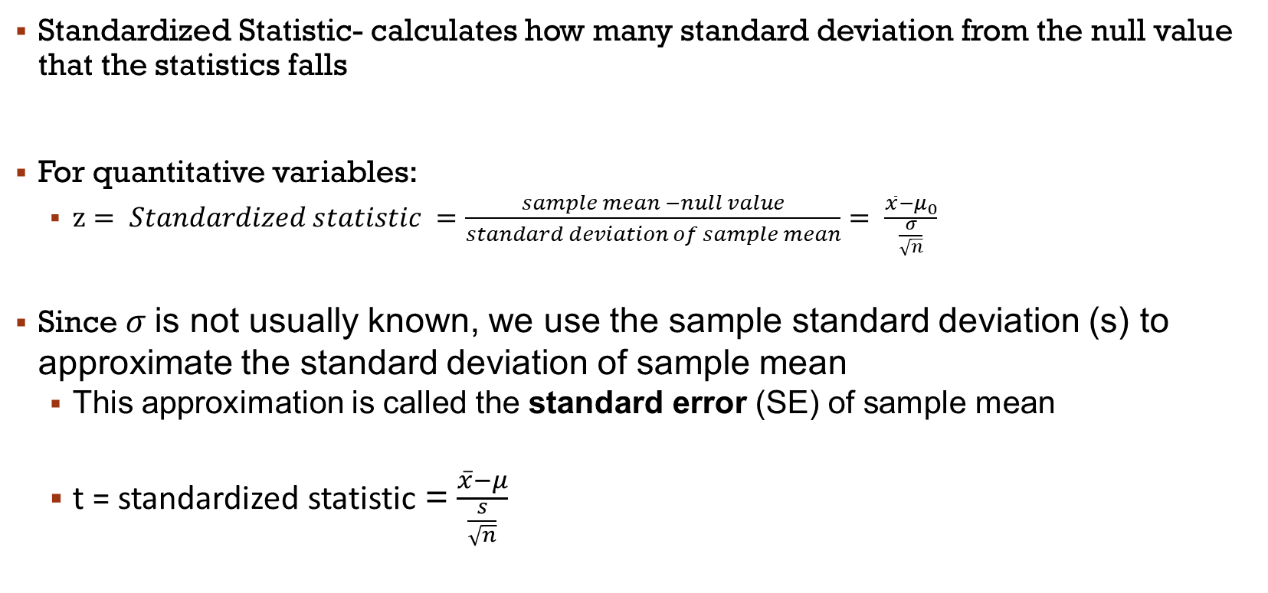
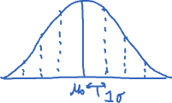
Standardized Statistic
Standardized Statistic- calculates how many standard deviation from the null value that the statistics falls
For quantitative variables:
$z= Standardized statistic =\frac{sample mean −null value}{standard deviation of sample mean}= \frac{\overline{x}−μ_{0}}{\frac{σ}{\sqrt{n}}}$
Since $σ$is not usually known, we use the sample standard deviation (s) to approximate the standard deviation of sample mean
This approximation is called the standard error (SE) of sample mean
t = standardized statistic = $\frac{\overline{x}−μ}{\frac{s}{\sqrt{n}}}$

Slide 22
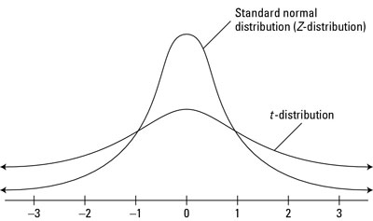
T statistic vs. Z statistic
Like with the normal approximation, need a reference distribution
With categorical, using z (standard normal) distribution
Using standard error instead of standard deviation results in no longer using normal distribution
Different reference distribution: t distribution

Slide 23
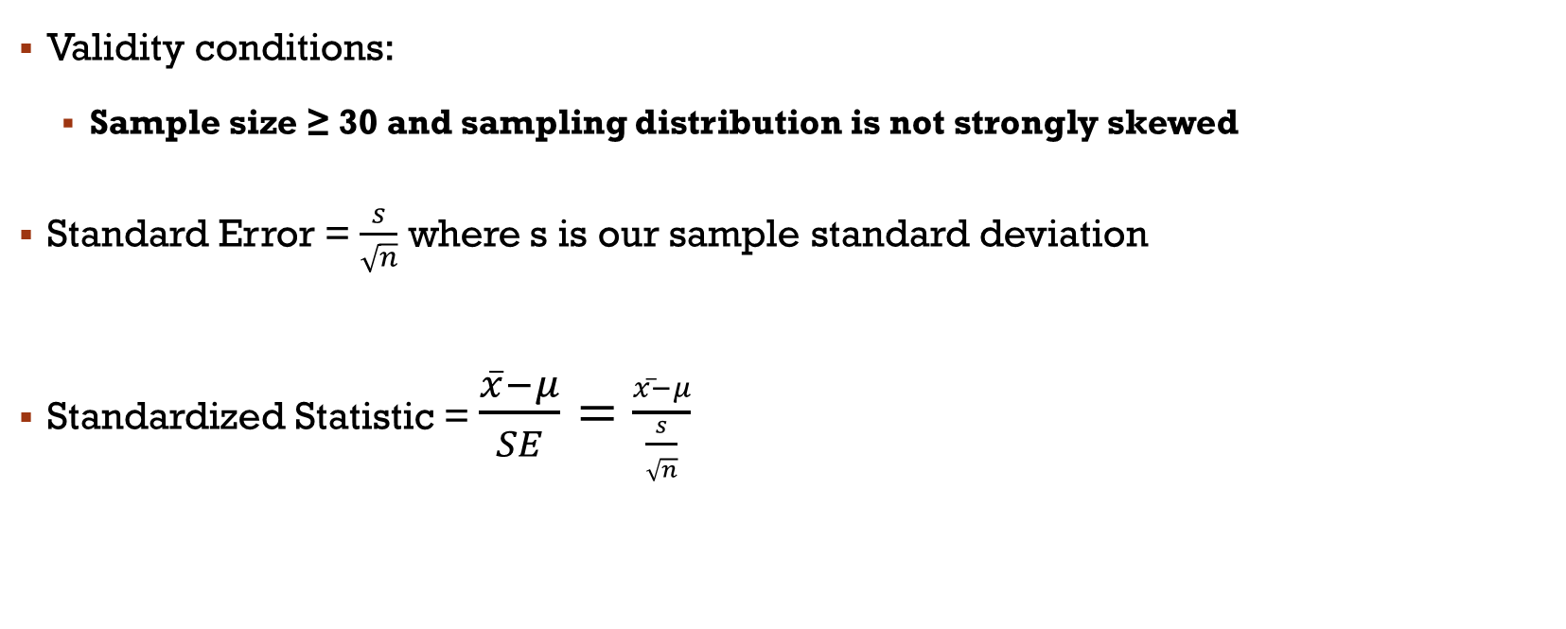
Summary of calculations
Validity conditions:
Sample size ≥ 30 and sampling distribution is not strongly skewed
Standard Error = $\frac{s}{\sqrt{n}}$ where s is our sample standard deviation
Standardized Statistic = $\frac{\overline{x}−μ}{SE}=\frac{\overline{x}−μ}{\frac{s}{\sqrt{n}}}$

Slide 24
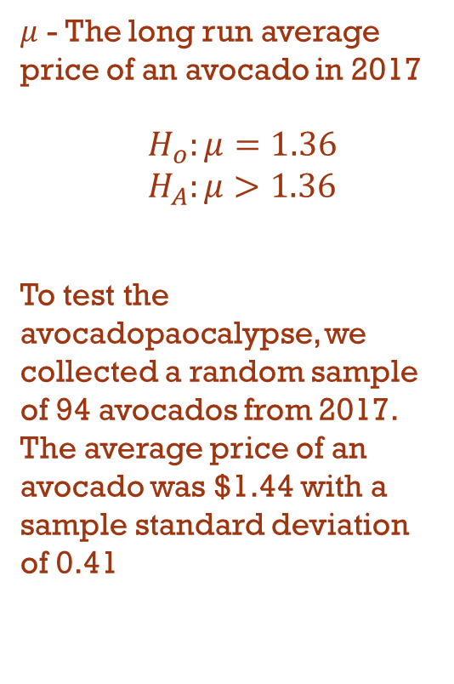
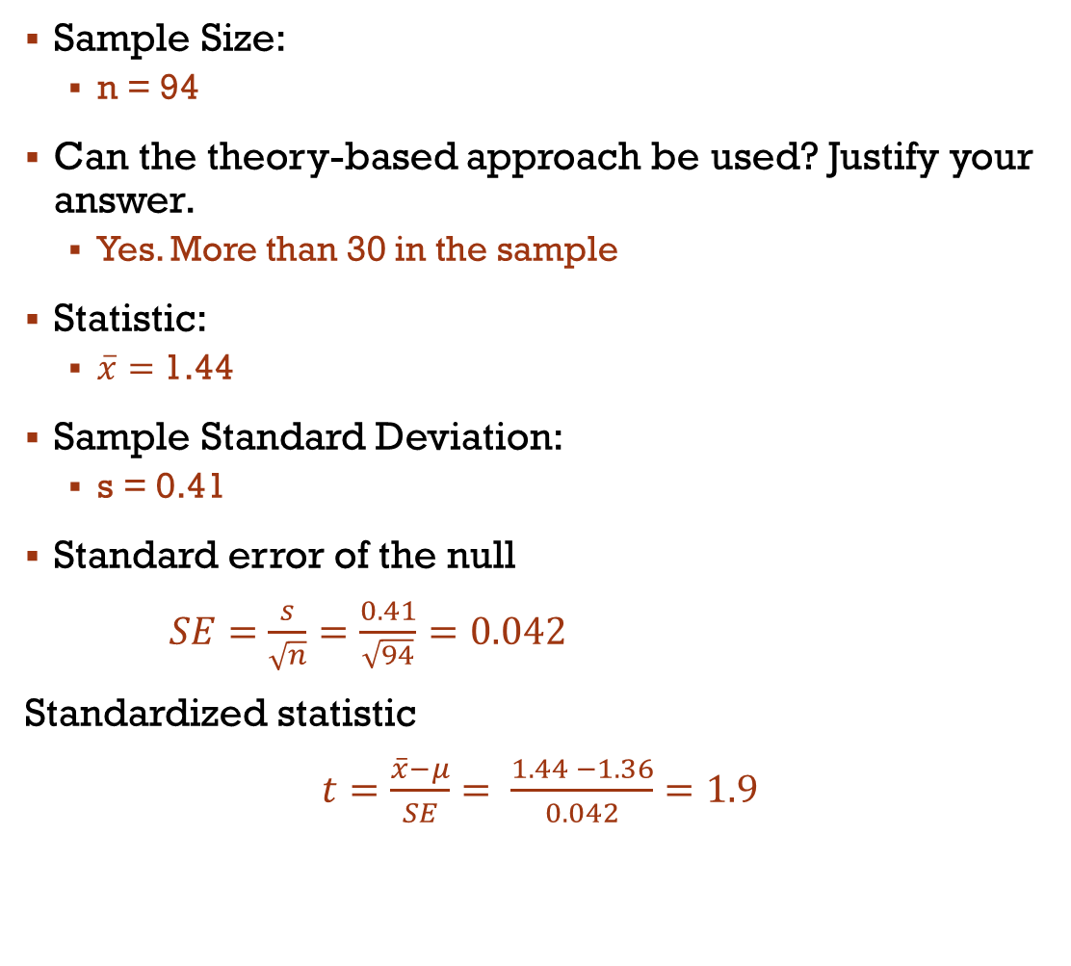
avocadopaocalypse
Sample Size:
n = 94
Can the theory-based approach be used? Justify your answer.
Yes. More than 30 in the sample
Statistic:
$\overline{x}=$ 1.44
Sample Standard Deviation:
s = 0.41
Standard error of the null
$SE=$ $\frac{s}{\sqrt{n}}=\frac{0.41}{\sqrt{94}}=0.042$
Standardized statistic
$t=\frac{\overline{x}−μ}{SE}= \frac{1.44 −1.36}{0.042}=1.9$
$μ$ - The long run average price of an avocado in 2017
$$H_{o}:μ=1.36$$
$$H_{A}:μ>1.36$$
To test the avocadopaocalypse, we collected a random sample of 94 avocados from 2017. The average price of an avocado was $1.44 with a sample standard deviation of 0.41

Slide 25
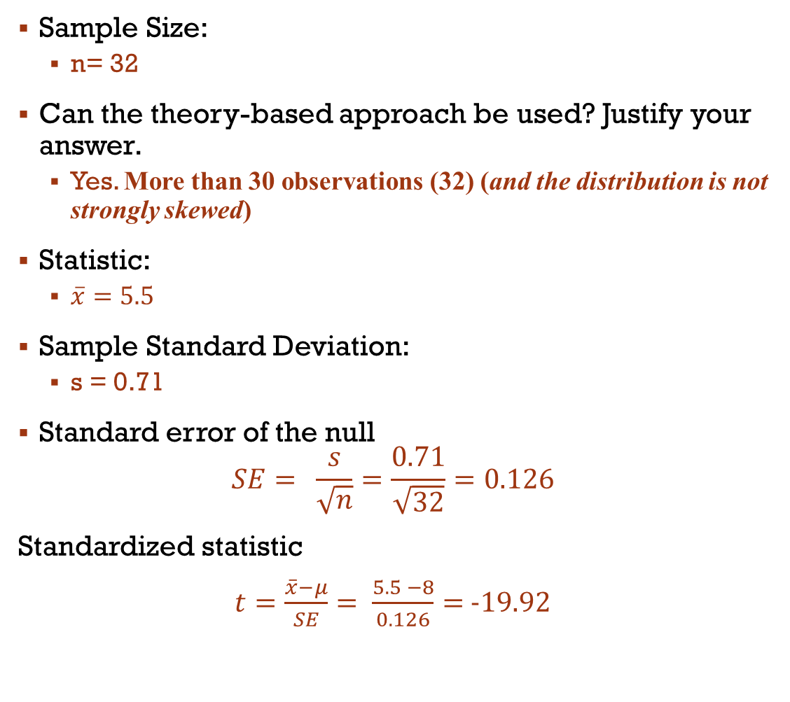
YOUR TURN
Sample Size:
n= 32
Can the theory-based approach be used? Justify your answer.
Yes. More than 30 observations (32) (and the distribution is not strongly skewed)
Statistic:
$\overline{x}=5.5$
Sample Standard Deviation:
s = 0.71
Standard error of the null
$$SE= \frac{s}{\sqrt{n}}=\frac{0.71}{\sqrt{32}}=0.126$$
Standardized statistic
$t=\frac{\overline{x}−μ}{SE}= \frac{5.5 −8}{0.126}=$ -19.92
It has been recommended US adults get 8 hours of sleep per night. A random sample of 32 college students was taken and was found that on average, they got 5.5 hours of sleep with a standard deviation of 0.71. Is the average less than the recommended 8 hours?

Slide 26
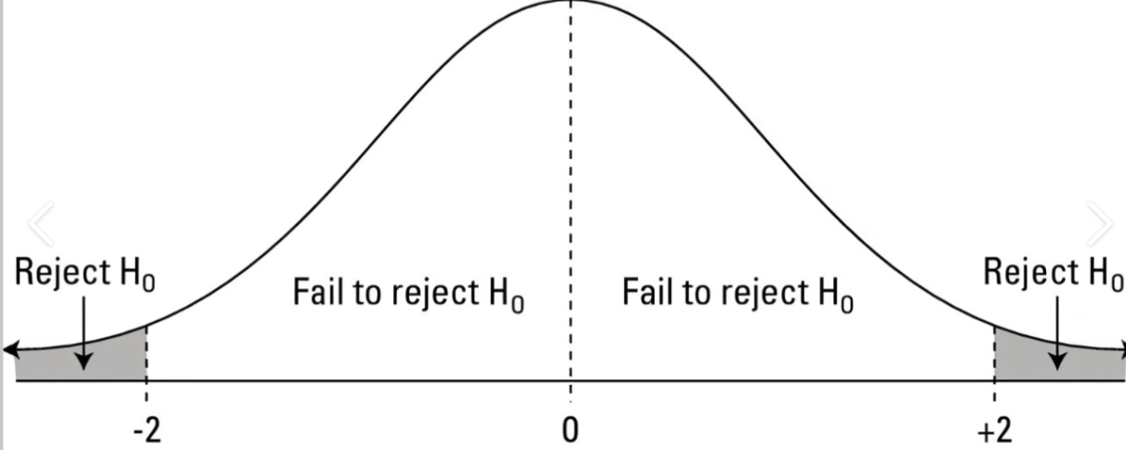
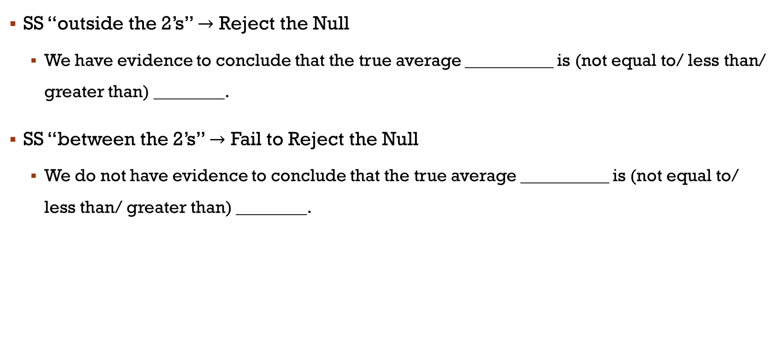
One Quantitative Variable Conclusions
SS “outside the 2’s” $→$ Reject the Null
We have evidence to conclude that the true average __________ is (not equal to/ less than/ greater than) ________.
SS “between the 2’s” $→$ Fail to Reject the Null
We do not have evidence to conclude that the true average __________ is (not equal to/ less than/ greater than) ________.

Slide 27
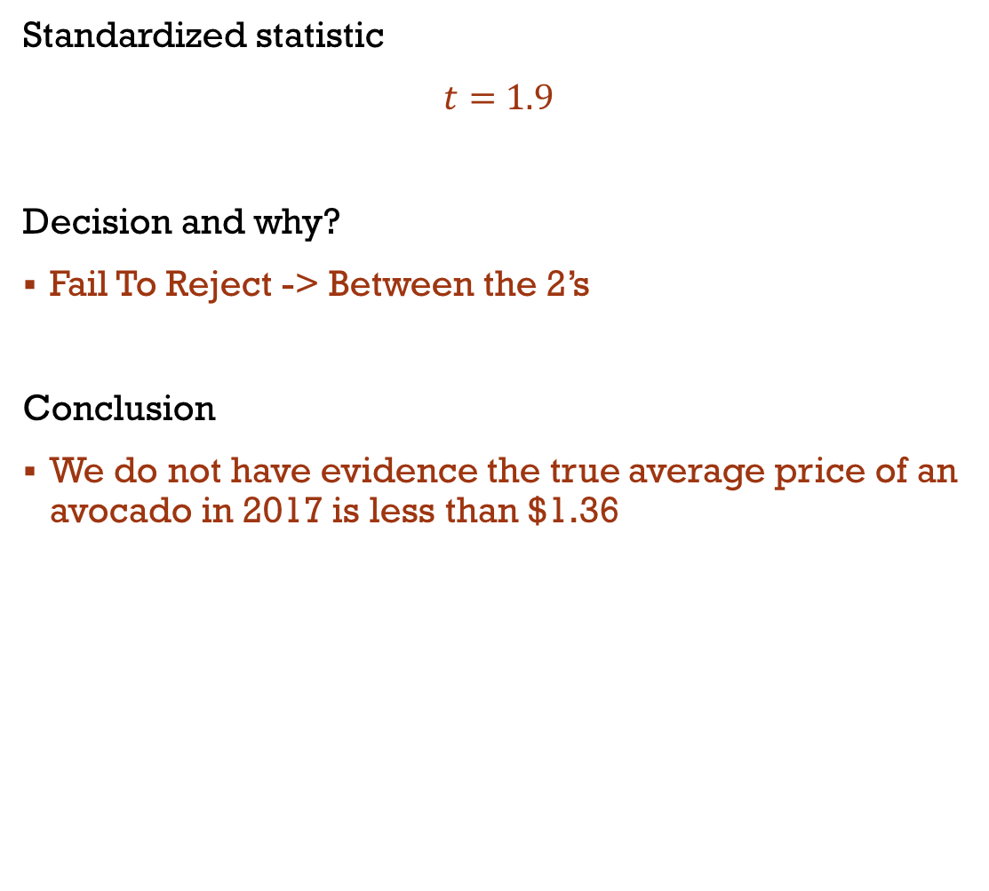
avocadopaocalypse
Standardized statistic
$t=$ $1.9$
Decision and why?
Fail To Reject -> Between the 2’s
Conclusion
We do not have evidence the true average price of an avocado in 2017 is less than $1.36
$μ$ - The long run average price of an avocado in 2017
$$H_{o}:μ=1.36$$
$$H_{A}:μ>1.36$$
To test the avocadopaocalypse, we collected a random sample of 94 avocados from 2017. The average price of an avocado was $1.44 with a sample standard deviation of 0.41

Slide 28
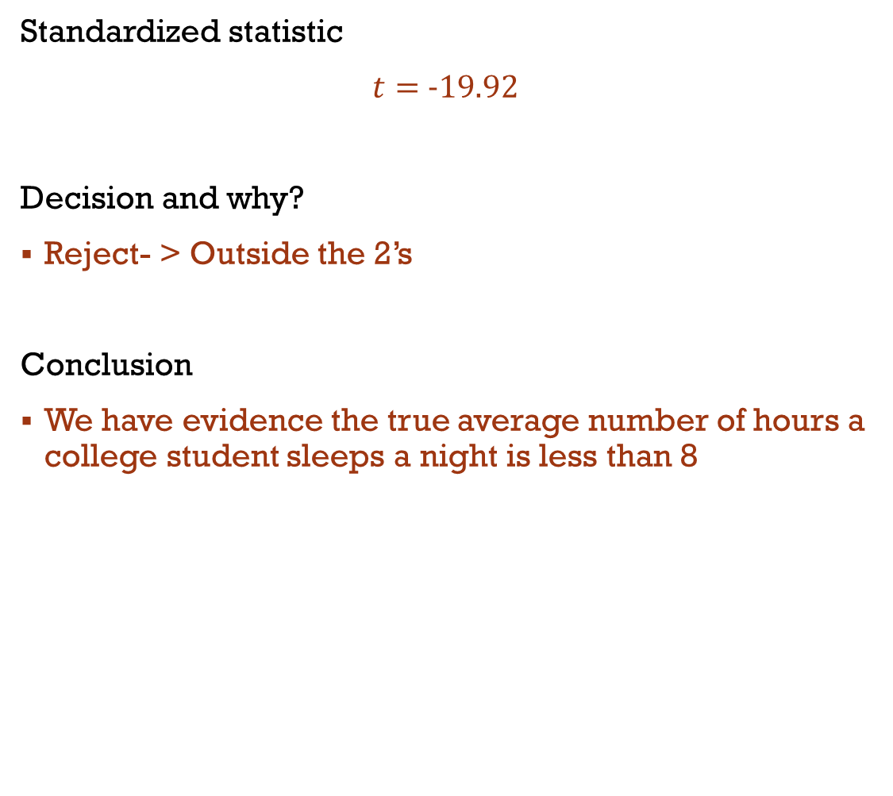
YOUR TURN
Standardized statistic
$t=$ -19.92
Decision and why?
Reject- > Outside the 2’s
Conclusion
We have evidence the true average number of hours a college student sleeps a night is less than 8
It has been recommended US adults get 8 hours of sleep per night. A random sample of 32 college students was taken and was found that on average, they got 5.5 hours of sleep with a standard deviation of 0.71. Is the average less than the recommended 8 hours?

Slide 29
Practice (time Permitting)
Identify the following:
Population
Parameter
Sample
Statistic
Sample Size
Set up the correct Null and Alternative Hypothesis
Determine if the assumptions for our test is met. If so, calculate the standardized statistic.
Based on the standardized statistic, what is your conclusion?
Suppose a company wanted to test if the machine that is filling the milk bottles it aims to sell, is filling the bottles the correct amount. The mean amount of milk in each bottle is supposed to be 30 Oz. To check if the machine is operating properly, 44 filled bottles were randomly sampled. The average amount of milk in each bottle is 32.2 with a standard deviation of 3.4 and the distribution is not strongly skewed. Suppose they want to know if the average amount of milk in each bottle is more than 30 oz.

Slide 30
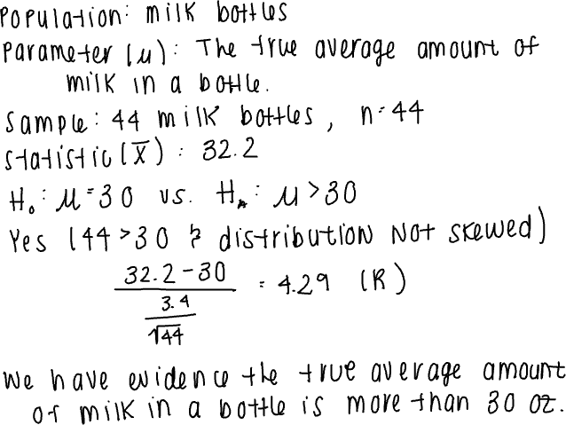
solutions
Suppose a company wanted to test if the machine that is filling the milk bottles it aims to sell, is filling the bottles the correct amount. The mean amount of milk in each bottle is supposed to be 30 Oz. To check if the machine is operating properly, 44 filled bottles were randomly sampled. The average amount of milk in each bottle is 32.2 with a standard deviation of 3.4 and the distribution is not strongly skewed. Suppose they want to know if the average amount of milk in each bottle is more than 30 oz.

Slide 31
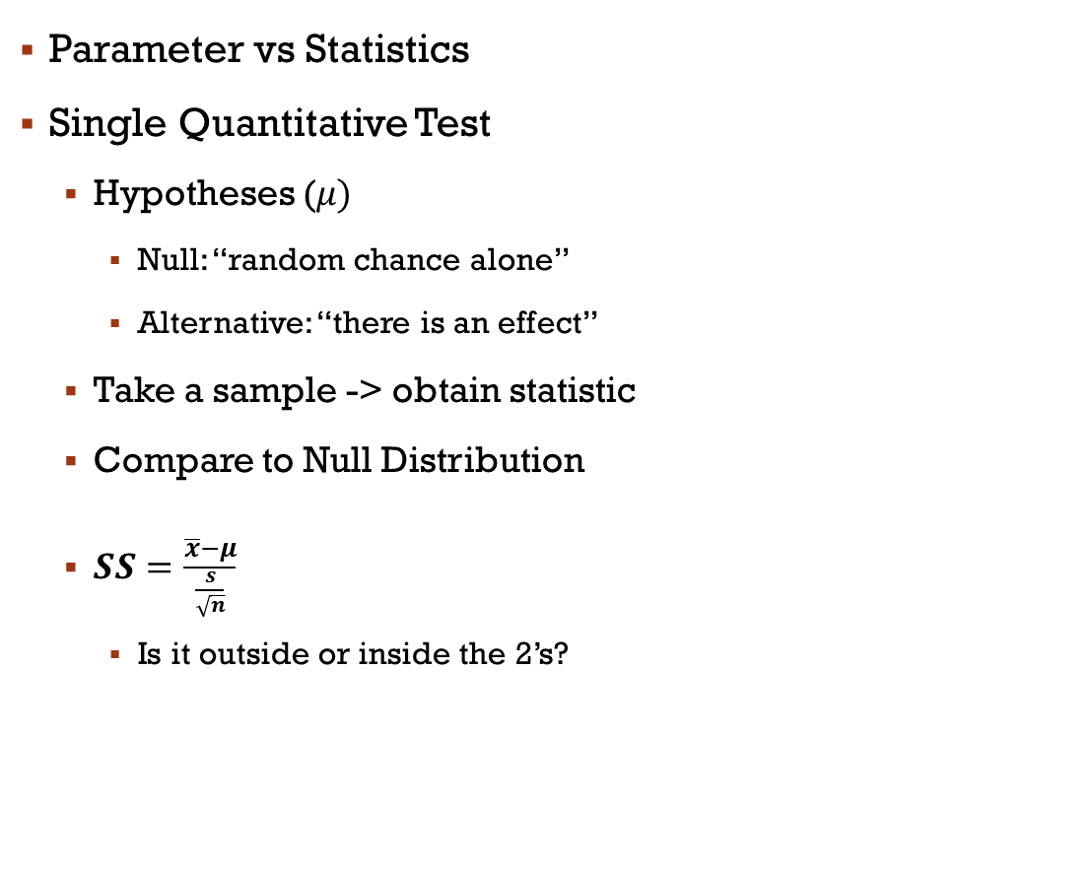
Review
Parameter vs Statistics
Single Quantitative Test
Hypotheses ($μ)$
Null: “random chance alone”
Alternative: “there is an effect”
Take a sample -> obtain statistic
Compare to Null Distribution
$SS=\frac{\overline{x}−μ}{\frac{s}{\sqrt{n}}}$
Is it outside or inside the 2’s?

