Slide 1
Can We Say What Caused the Effect?
Alison Kleffner

Slide 2
Schedule
Explanatory vs. Response Variables
Association vs. Causation
Impact of Confounding Variables
Observational vs. Experimental Studies
Random Assignment
What conclusions can we draw?

Slide 3
Association vs Causation

Slide 4
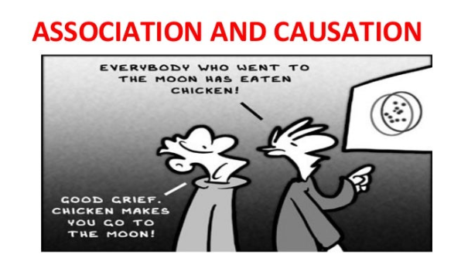
Introduction
Can we say what caused the effect?
What other things outside our study could affect our results?
What must we keep in mind when we collect our data?
Focus on research questions that compare two groups:
Are children who used night lights as infants more likely to need glasses than those who didn’t use night lights?

Slide 5
Objectives
Determine when there is an association between our two variables.
Determine when we can conclude the outcome of one variable causes an outcome of the other.
Does smoking cause lung cancer?
What other things outside our study could affect our results?
What must we keep in mind when we collect data?

Slide 6
Terminology
Explanatory Variable (Independent, Predictor):
Variable we think is “explaining” the change in the response variable.
This is the variable researchers manipulate.
Response Variable (Dependent):
Variable that is being changed by explanatory variable.
Example: We may think that if you eat an apple every day you have to go to the doctor less.

Slide 7
Choose the Explanatory and Response
Choose the explanatory and response variable:
Smoking and Lung Cancer
Heart Disease and Diet
Exam Score and Hours Studied
Vitamin C and Colds
Hair Color and Eye Color
Sometimes there is a clear distinction between explanatory and response variables and sometimes there isn’t.

Slide 8
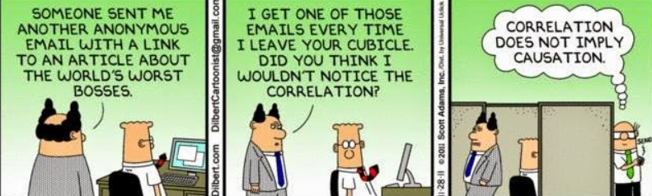
Association vs. Causation

Slide 9
Concepts
Association: if one variable gives you valuable information about the other
Hours of studying before exam perhaps gives information about the score you will achieve
How many apples you ate perhaps gives information about how many times you will go to the doctor
Cause and Effect:
Can we conclude cause and effect from our study? Is our explanatory causing the change in the response?
Confounding variable: A variable related to both the explanatory and response variable in such a way that its effects cannot be separated from the effects of the explanatory
Causes Bias
Association does not justify causation (because of possible confounding variables)

Slide 10
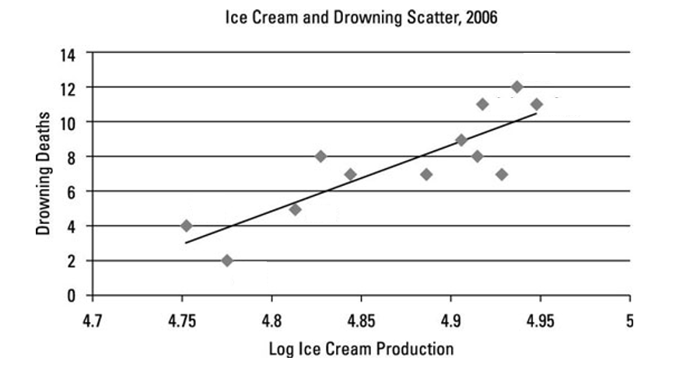
Amount of ice cream sold and deaths by drownings (Moore, 1993)

Slide 11
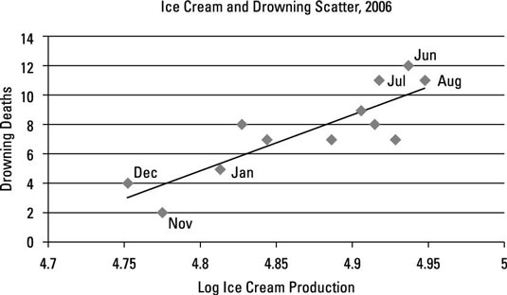
Amount of ice cream sold and deaths by drownings (Moore, 1993)

Slide 12
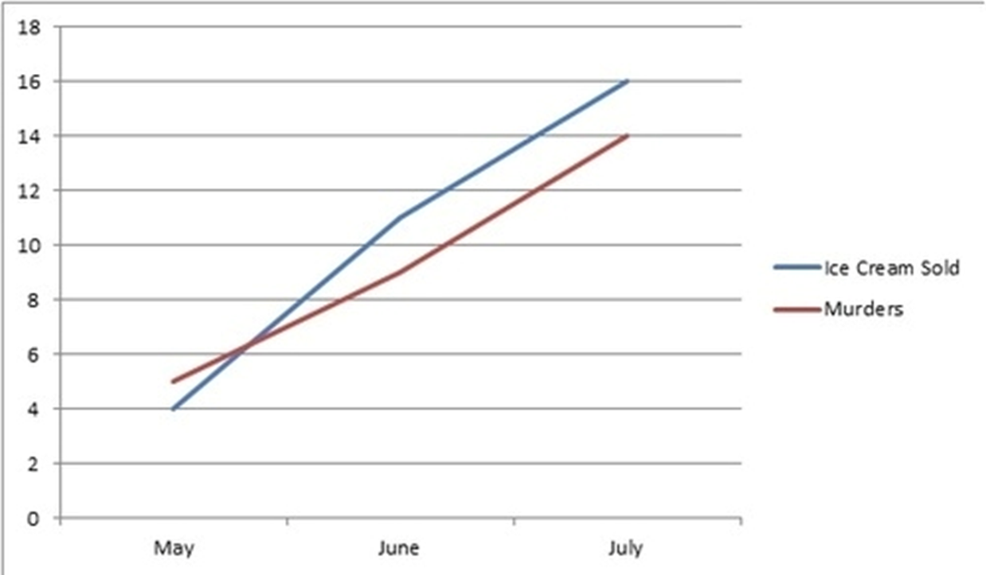
Confounding Variable – Month/Temp
Ice Cream Sold
Drownings

Slide 13
???
Amount of Ice Cream (Explanatory)
Number of Drownings
(Response)
Month/Temperature
(Confounding Variable)

Slide 14
Scenario
Claim-
Explanatory variable-
Response variable-
Potential confounding variable-
Researchers found that countries that have more TV’s per 1,000 people have a higher average lifespan.

Slide 15
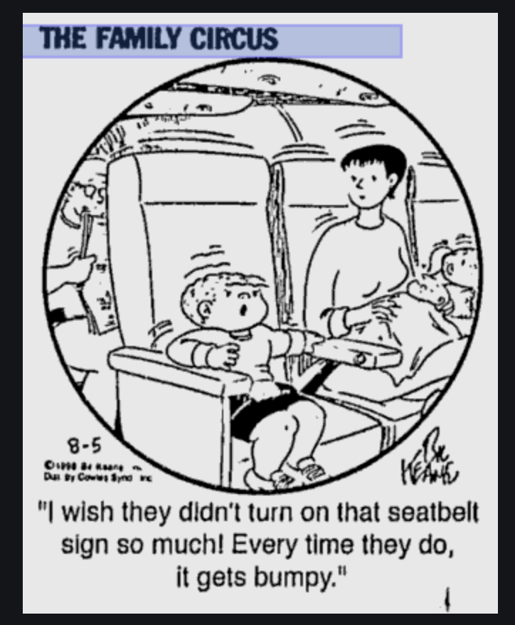
What’s the confounding variable here?

Slide 16
Your Turn!
Claim -
Then identify the following:
Explanatory variable-
Response variable-
Potential confounding variable-
Explain Bias
Resource: Google Spurious Correlations
Think of a topic!
After you’ve found a topic, come up with a research question.
Be creative!

Slide 17
Take Away
Identify which explanatory and response variables.
Determine if there is an association between the explanatory and response variables.
Identify potential confounding variables.
How do they provide an alternate explanation of the association between the explanatory and response variable?

Slide 18
Introduction
How can we take a sample so that we can reduce the risk of having confounding variables?
Confounding variable add bias to our study
Additional factor we’re not accounting for that affects our results.
Big picture
Observational vs. Experimental Studies
Random Sampling vs. Random Assignment

Slide 19
Sampling

Slide 20
Definitions:
Population: entire collection of observational units we are interested in
Relates to Parameter
Sample: A subset of the population
Relates to Statistic
Goal: Generalization
Not only to describe the sample but to generalize characteristics of the sample to a much larger population

Slide 21
Sampling
Representative sample: A sample is representative if it is similar to or represents the whole population from which it has been drawn
Example: Would data from this class be representative of all TCU students?
Bias: when the statistic consistently overestimates or underestimates the population parameter of interest.
Example: Would asking TCU students enrolled in 8 am classes if they are morning people be representative of all TCU students?

Slide 22
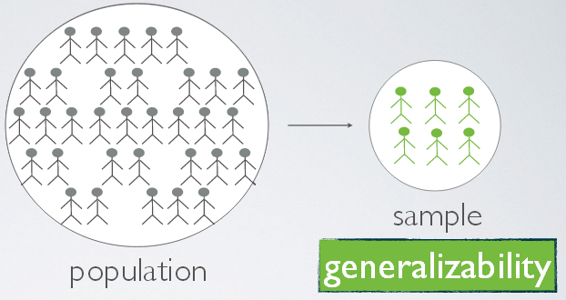
How to Sample?
1. Convenience Sampling
Not a very good way to select a sample
Essentially just go out and pick a set observational units.
Relies on human judgment.
2. Simple Random Sample
Every population member has an equal probability of being chosen
Allows us to generalize our results to the entire population
How does it work?
A simple random sample is when you choose individually randomly from the sampling frame and each individual has the same chance of being selected.
A sampling frame is a list of all the individual in the population of interest

Slide 23
Experimental vs Observational Studies

Slide 24
Have a nice trip
Researchers want to compare two recovery strategies:
Lowering (quickly stepping down with front leg and then raising back leg over the object)
Elevating (lifting front leg over the object).
24 subjects have agreed to participate in such a study:
8 between the ages of 21-40
16 between the ages of 41-60
Identify the following:
Explanatory Variable
Response Variable
Potential Confounding Variable
An area of research in biomechanics and gerontology concerns falls and fall-related injuries, especially for elderly people. Recent studies have focused on how individuals respond to large postural disturbances (e.g., tripping, induced slips). One question is whether subjects can be instructed to improve their recovery from such disturbances.

Slide 25
Observational Study
Groups you compare are “just there.”
Data observed and collected on subjects
Examples:
Customer review surveys
Teacher evaluations
Smokers vs nonsmokers and lung cancer

Slide 26
Experiments
You create the groups by what you choose to do to the people or the experimental units. Assigning conditions to be compared
Manipulation of groups
Examples
Assign one group of people to a diet another group to an exercise program, then measure weight loss on each group
Students are assigned to listen to classical music or country music before an exam. Then the two groups scores on the exam are compared

Slide 27
Example
How could this study be an example of an observational study?
What would we have to do in order to make this an experimental study?
Researchers want to set up an experiment OR observational study in order to answer the research question “Does exercise help prevent against colds and the flu?”

Slide 28
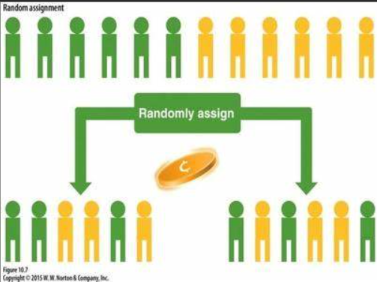
Randomized Experiment
Use a method of chance in order to make the assignments.
Random assignment allows us to balance out confounding variables
Random Assignment: produce similar groups so we can say there is a cause-and-effect relationship between explanatory and response variables.

Slide 29
Have a nice trip
Researchers want to compare two recovery strategies:
Lowering
Elevating
24 subjects have agreed to participate in such a study:
8 between the ages of 21-40
16 between the ages of 41-60
Possibility 1: Assign the 8 people between the ages of 21-40 to use the elevating strategy and the 16 people between the ages of 41-60 to use the lowering strategy.
Possibility 2: Assign 4 people between the ages of 21-40 and 8 people between the ages of 41-60 to each group. Show how the proportion of people between the ages of 41-60 in each group is the same.

Slide 30
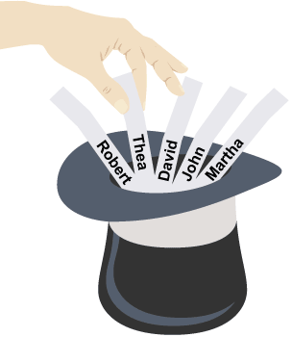
Have a nice trip
Random Assignment!
Because there will always be more potential confounding variables which could be distributed unevenly between the groups being compared
Suppose we put each person’s name on a slip, put those slips in a hat and mix them up thoroughly, and then randomly draw out 12 slips for names of people to assign to the elevating strategy.
What proportion of this group (elevating strategy) do you expect will be between the ages of 41-60?
Do you think we will always get an 8/8 split?
Researchers want to compare two recovery strategies:
Lowering
Elevating
24 subjects have agreed to participate in such a study:
8 between the ages of 21-40
16 between the ages of 41-60

Slide 31
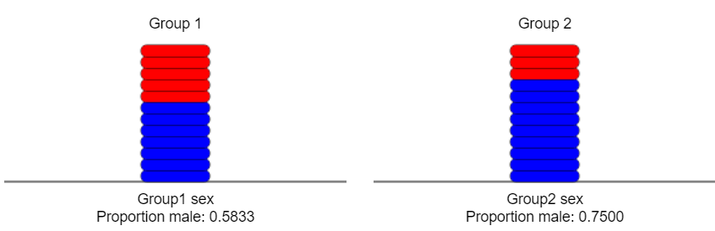
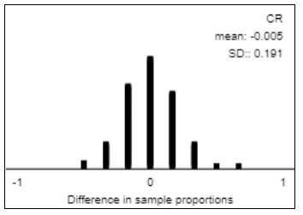
Have a nice trip
Key Idea: Randomly assigning experimental units to groups tends to balance out all other variables between the groups. Any variables that could have an effect on the response should be equalized between the two groups and therefore should not be confounding.
Researchers want to compare two recovery strategies:
Lowering
Elevating
24 subjects have agreed to participate in such a study:
8 between the ages of 21-40
16 between the ages of 41-60
Simulation: Random Assignment between the two groups, simulated 100 times
Proportion 41-60: 0.5833
Proportion 41-60: 0.75

Slide 32
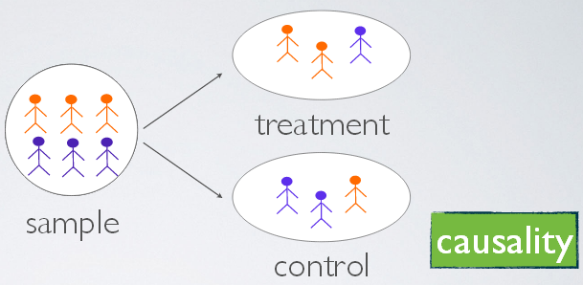
Assignment of Explanatory Variable
Random Assignment
Experimental Studies balance out confounding variables
Manipulate groups to analyze
Determine Causation
No Random Assignment
Observational Studies
Analyzing data that we do not change, simply given the data
A study may be observation because it is easier, or because perhaps it is not possible or ethical to assign groups
Cannot Determine Causation, only potentially association

Slide 33
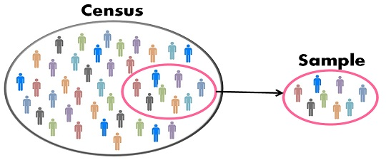
Random vs. Random
Sampling:
If random then generalize results to population.
If not random then cannot generalize results to population.
Population
Sample
Assignment of Explanatory Variable:
If random then causation.
Experimental Study
If not random then only association.
Observational Study
Group 1
Group 2

Slide 34
Example
Identify the explanatory and response variables in this study
Is this an experimental or observation study? How do you know?
If this is an observational study, how would you turn this into an experiment? Is this possible/ethical?
An article about handwriting appeared in the October 11, 2006 issue of the Washington Post. The article mentioned that among student who took the essay portion of the SAT exam in 2005-2006, those who wrote in cursive style score significantly higher on the essay , on average, than students who used printed block letters.

Slide 35
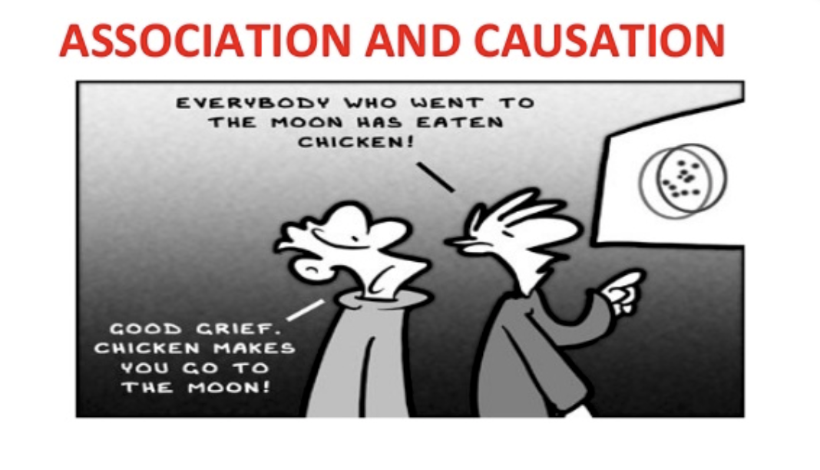
Review
Explanatory vs. Response Variables
Association vs. Causation
Impact of Confounding Variables
Generating a Sample
Observational vs. Experimental Studies
Random Assignment
What conclusions can we draw?

