Slide 1
DIAGNOSTIC ANALYSIS USING PYTHON
A case study on the UK’s National Health Service (NHS)
Notes:
Hello, thank you for joining this presentation. My name is Alison, and I will be presenting the diagnostic analysis of NHS appointment utilization and capacity leakage

Slide 2
AGENDA
Context and Objectives
Where the Pressure is: Overall Appointment Demand
Booking Gaps, Appointment Delivery Modes, and Regional DNA (Did Not Attend) Trends
Reducing Missed Appointments: Recommendations

Slide 3
Missed appointments: why this matters
The National Health Service (NHS) must plan future infrastructure and resources to keep pace with a growing population. To budget effectively, it needs a clear understanding of how services are currently used across its network and where pressure on the system is greatest.
One significant concern is the capacity and cost wasted when patients miss their general practice (GP) appointments.
Objectives
Map Demand and wasted capacity How are appointment volumes and wasted capacity from missed appointments distributed across regions and services, and which regions are most affected?
Understand drivers of missed appointments What appointment features – such as mode, service type, and lead time – are associated with higher risk of a no-show?
Prioritize action Where should the NHS prioritize interventions and capacity to reduce missed appointments and wasted capacity?
Notes:
The NHS must expand its infrastructure to keep pace with a growing population. To budget effectively, we need to understand current utilization trends and, specifically, how to manage the 'hidden crisis' of missed appointments (DNAs). Every missed slot represents a wasted clinical resource. Our objective today is to map where this capacity is lost, identify the risk factors, and provide data-driven recommendations to stabilize the system

Slide 4
WHERE THE PRESSURE IS

Slide 5
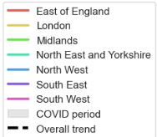
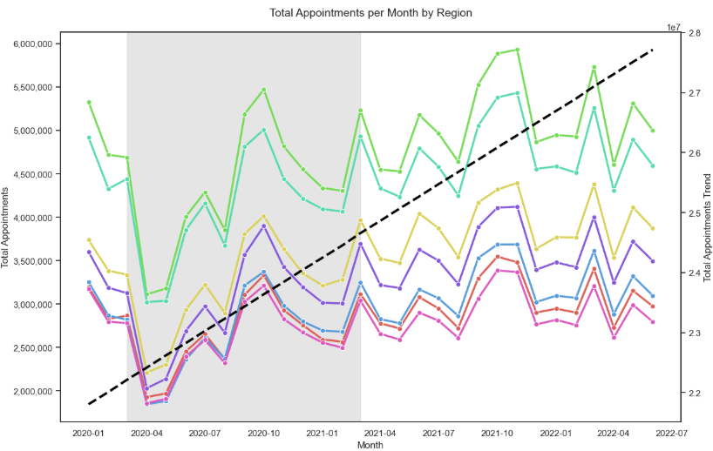
The regional landscape: appointment demand
Top 3 regions: Midlands, North East & Yorkshire, and London
Average monthly appointments post-covid
Oct: 2nd wave of COVID
Nov: 2nd Lockdown begins
Mar: End of COVID
1 | Midlands | 5,104,506
2 | NE & Yorkshire | 4,717,111
3 | London | 3,892,947
4 | South East | 3,575,477
5 | North West | 3,180,259
6 | East of England | 3,038,537
7 | South West | 2,888,396
Jun: Phased reopening of schools and shops
Pre-Christmas Rush Sep - Nov
Notes:
This assessment covers data from January 2020 to June 2022. To ensure our insights reflect the 'new normal' rather than pandemic-era anomalies, we have excluded the primary COVID-19 period (March 2020–March 2021) from our post-pandemic trend analysis
Looking at the regional landscape, volumes post-April 2021 have been stable, ranging from 2.5 million to 5.5 million appointments monthly. We observed a consistent 'Autumn Surge' between September and November. This aligns with the seasonal uptick in respiratory and chronic conditions. Our top three busiest regions are the Midlands, North East & Yorkshire, and London

Slide 6
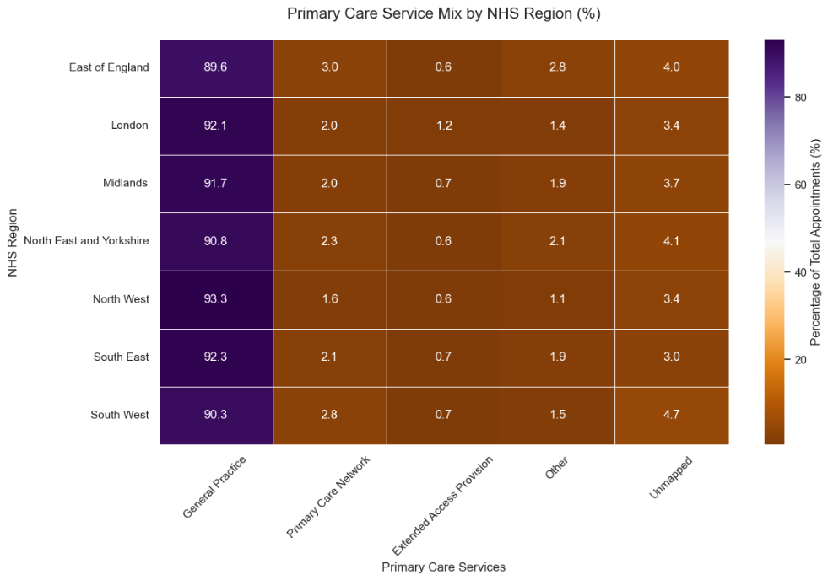

SERVICE MIX:
GP accounts for ~90% of appointment demand across regions
General Practice (GP) ~90% - 93%
Primary Care Networks ~1.6% - 3.0%
Extended Access Provision ~0.6% - 1.2%
Other services ~1.1% - 2.8%
Unmapped care 3.0% - 4.7% (e.g. ~156K in London)
This unmapped share may hide real pressure in specific service lines and will limit how precisely we can target capacity and interventions.
Notes:
In terms of the service mix, 90% of the appointment demand are accounted by General Practice, which explains why missed appointments for these services have been a great concern for NHS. Side note, we noticed that there is a significant amount of unmapped records and it's paramount for the NHS to address this eventually as it will limit how precisely we can target capacity and interventions in our plan

Slide 7
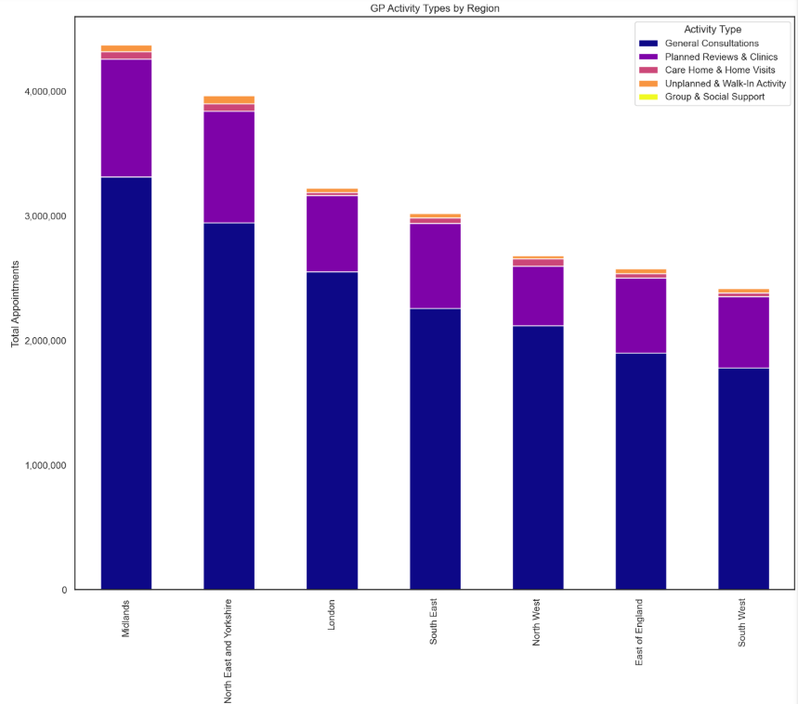
GP Activity profiling
Monthly Regional Variation in GP Consultation Types
Core GP Activity Types: General Consultations and Planned Reviews & Clinics account for the vast majority (roughly 90%+) of all activities
Consistent Proportions: Despite the difference in total volume, the ratio of activity types is remarkably similar across the country
Group & Social Support and Care Home & Home Visits, while clinically vital, they represent a small portion of the total appointment volume in GP
Notes:
When we then dove into the national categories or "activity types" under GP - a broader segmentation of national categories, we understand that general consultations and planned reviews and clinics account for the vast majority (roughly 90%+), meaning that we will most likely be prioritizing resourcing these specific activity types over the others

Slide 8
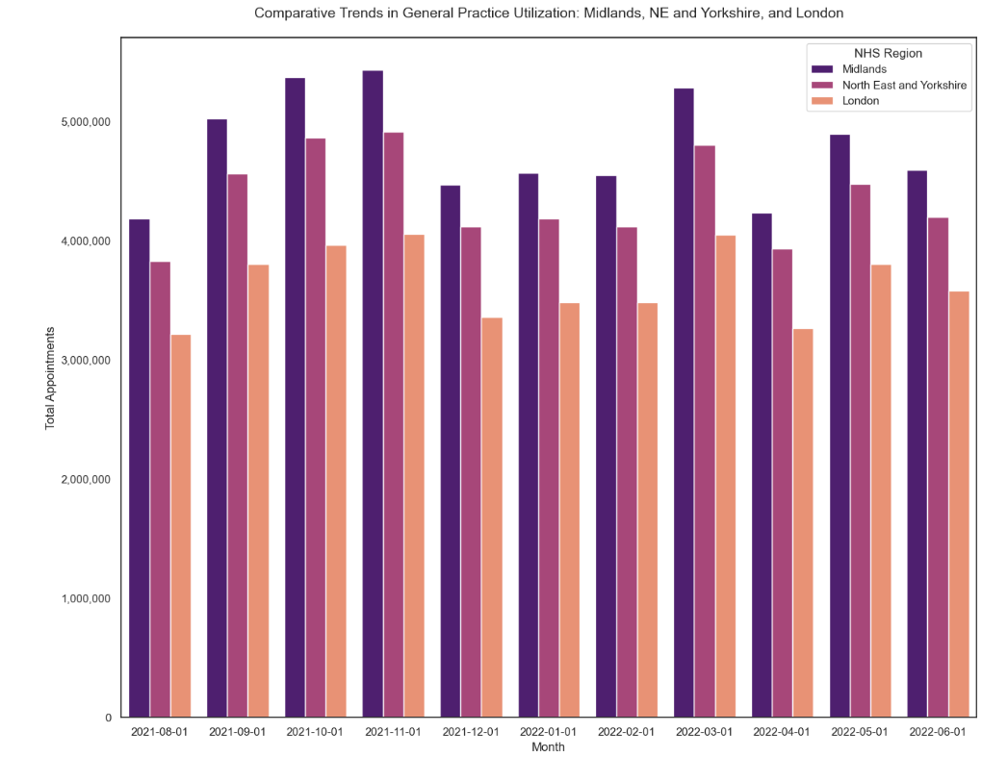
TREND IN GP APPOINTMENT DEMAND
Focusing on the 3 highest-volume regions
Observations
Consistent ‘M-shaped’ seasonal pattern across all 3 regions
Aug – Nov: steady rise in volume, peaking in Nov, aligned with school return and viral respiratory season (Pre-Christmas Rush)
Dec: sharp drop in appointments, likely reflecting reduced capacity over the holiday period
Jan – Mar: rebound in demand and activity, driven by deferred Dec care, peak winter illness, and year-end push to complete reviews
Apr: further dip, mirroring Dec, likely linked to Easter holiday-related capacity constraints
Notes:
Our seasonal trend analysis on the 3 highest volume regions reveal the same pattern we'd identified earlier - that being the Pre-Christmas Rush from Sep - Nov. As you can see here, there is a steady rise in volume starting from August and peaks in November which aligns with the start of school’s fall semester, and the viral respiratory season.
This is an excellent forecast of where we should be proactively scaling staff before the winter surge begins

Slide 9
Booking Gaps, delivery modes, and regional dna trends

Slide 10
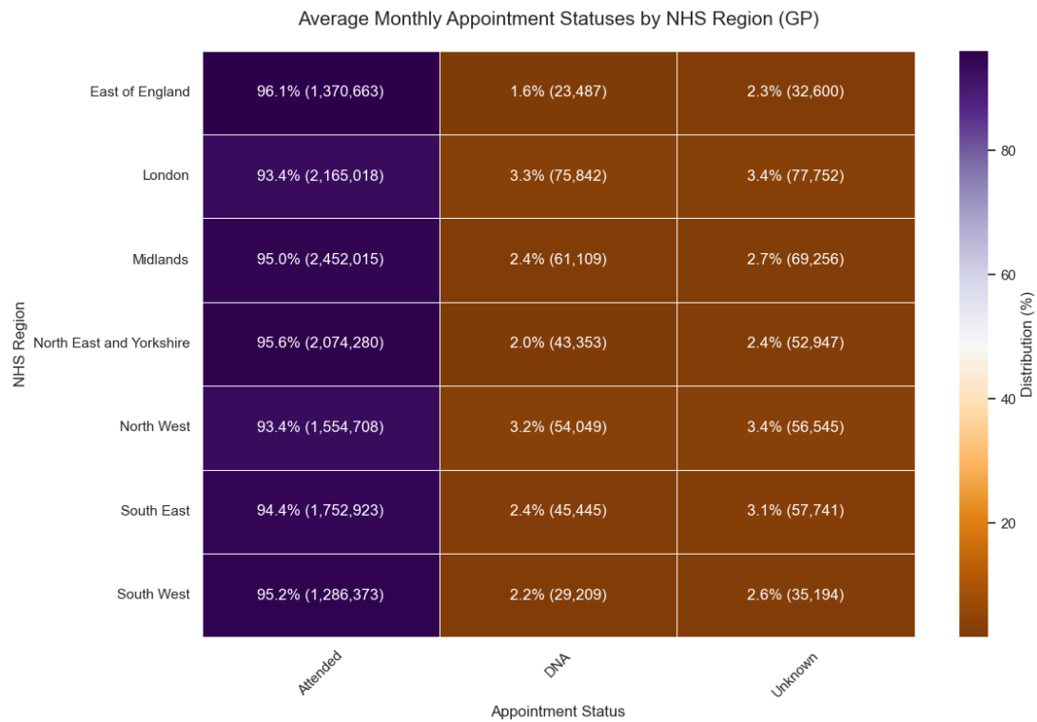
Where capacity is wasted: missed GP appointments
Attendance is high overall ~95% of appointments are attended each month across regions
The remaining ~5% comprises missed appointments (DNA – Did Not Attend) and those recorded as Unknown
London and North West show the highest rate of DNA, with the Midlands slightly above the national average
North East and Yorkshire, despite having the second-largest appointment volume, records one of the lowest DNA rates, ranking third-lowest overall
Unknown records are substantial, ranging from 32.6k – 77.7k for all regions This is concerning, as it limits our ability to reliably identify true no-shows
Notes:
When we look at missed appointments (DNAs), the data reveals interesting regional disparities. While the Midlands and London have high volumes of DNAs, the North West is particularly concerning—it records a disproportionately high DNA rate compared to other regions. In contrast, the North East & Yorkshire manages high volumes with significantly higher attendance rates. This suggests that the issue is not just volume, but how effectively local ICBs manage their population density and appointment availability

Slide 11
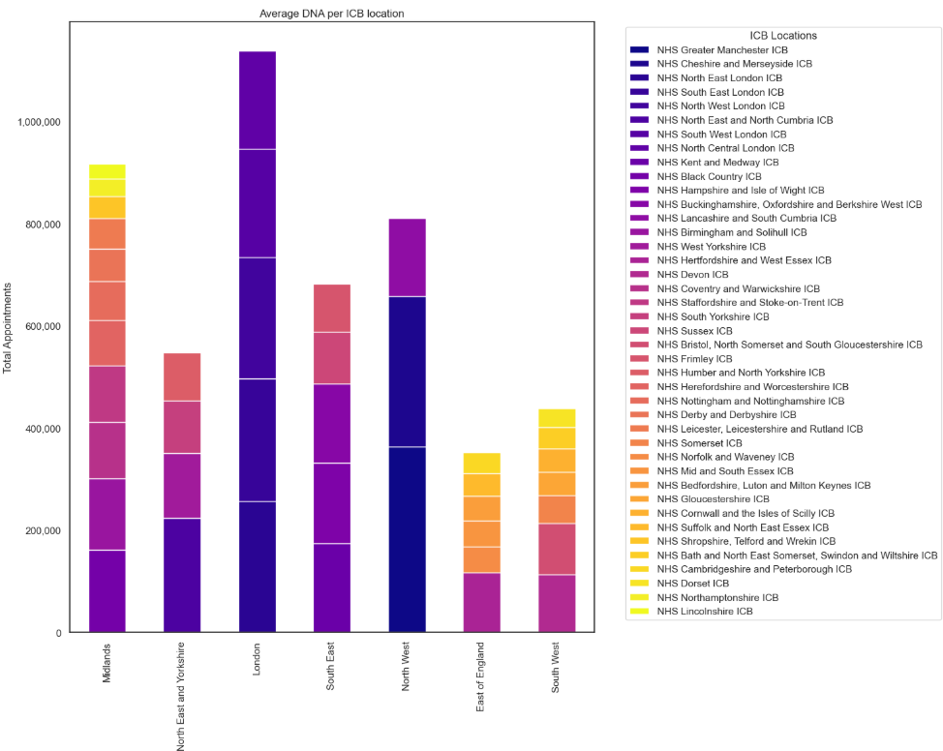
ICB Hotspots:
Where Capacity Is Most at Risk
Top 10 ICBs by missed appointments (April 2021 – Jun 2022)
1 | NHS Greater Manchester ICB | 363,897
2 | NHS Cheshire and Merseyside ICB | 294,319
3 | NHS North East London ICB | 256,358
4 | NHS South East London ICB | 240,376
5 | NHS North West London ICB | 237,697
6 | NHS North East and North Cumbria ICB | 223,759
7 | NHS South West London ICB | 212,325
8 | NHS North Central London ICB | 190,888
9 | NHS Kent and Medway ICB | 174,094
10 | NHS Black Country ICB | 162,029
Notes:
Further more, you can see regions with the highest missed appointment volumes coincidentally are comprised of fewer sub-icb locations. North West, for example has 3 – Greater Manchester, Cheshire and Merseyside, and Lancashire and South Cumbria.
Although London has 5 sub-icb locations, its population density is much more concentrated compared to its neighboring regions, which explains why it also has a higher appointment volumes.

Slide 12
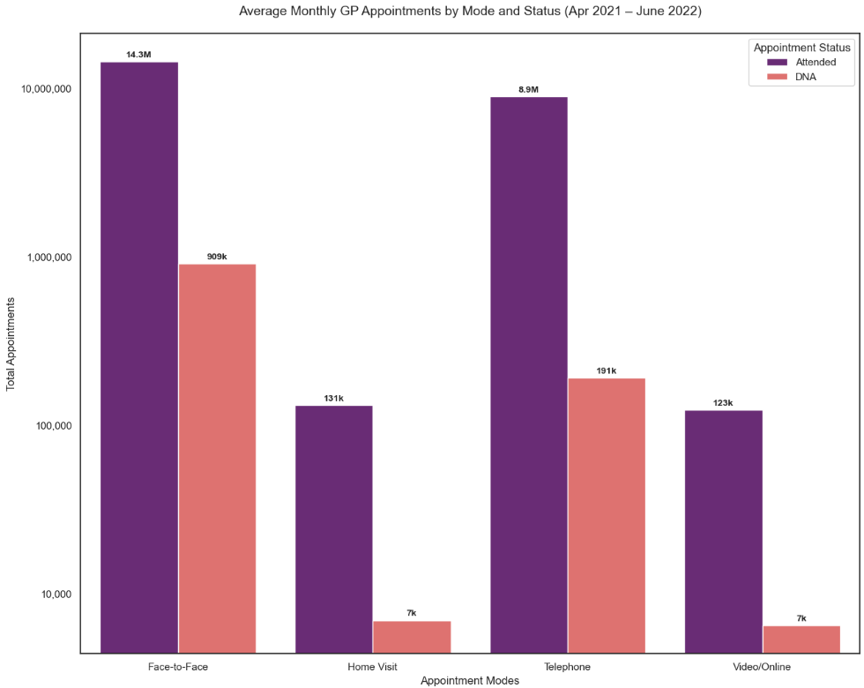
The dna gap:
Physical vs virtual
Face-to-Face and Telephone consultations constitutes 98% of the total appointments, making them the backbone of operations
While higher DNA counts are expected in high-volume modes, the no-attendance rate for Face-to-Face (4%) is 50x higher than Telephone (0.08%)
Home Visits and Video/Online appointment modes account for ~2% of volume but maintain near-perfect attendance with rates below 0.1%
Overall attendance pattern suggests that virtual modes are significantly more resilient to no-shows than physical consultation
Notes:
When analyzing delivery modes, we found that Face-to-Face appointments—the backbone of our operations—suffer from a 4% DNA rate, which is 50 times higher than Telephone consultations. Virtual modes are clearly more resilient to 'no-shows

Slide 13
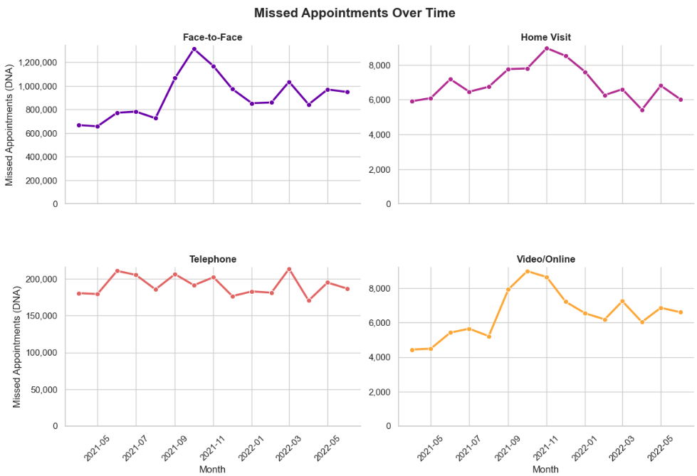
SEASONAL VOLATILITY:
THE Q3 CAPACITY LEAKAGE
Between Sep – Nov, all delivery modes – excluding Telephone – experienced a synchronized surge in missed appointments, peaking during the onset of winter pressures
Face-to-Face consultations saw the most drastic impact, with an 80% uptick in DNAs at the October peak compared to August levels
Despite their lower volume, Video/Online appointments mirrored this trend, showing a ~70% increase in missed sessions over the same period
This spike correlates directly with the annual increase in clinical demand. Capacity is ‘leaked’ through DNAs at the exact moment the system is under the highest seasonal stress.
Pre-Christmas Rush Sep - Nov
Notes:
Ironically enough, as we further investigated the DNA attendance rates over time, we noticed that all 3 modes, with the exception of Telephone experience a surge in missed appointments between Sep - Nov. This is a critical insight as it correlates directly with the annual increase in clinical demand during the Pre-Christmas rush. Capacity is leaked through DNAs at the exact moment the system is under the highest seasonal stress.

Slide 14
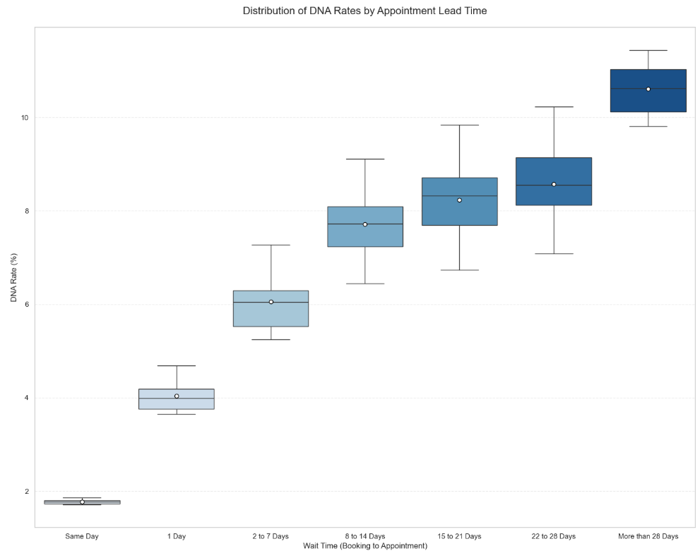
The wait-time penalty:
How lead time drives dnaS
Same-day bookings account for 45% of total volume and maintain the highest reliability, with a DNA rate of just 1.8%
Attendance is most stable within the first 48 hours. Once an appointment is booked more than 2 days in advance, the median DNA more than triples, jumping from ~1.8% to over 6%
Appointments booked more than a month in advance experience DNA rates over 10%. This suggests that the longer a patient waits, the more likely the appointment is ‘forgotten’ or become irrelevant
There is a direct correlation between wait time and missed appointments. Shortening the booking-to-appointment window is not just a patient satisfaction goal; it is a critical tool for preserving clinical capacity
Notes:
Most importantly, we identified a 'Wait-Time Penalty.' Our analysis shows a positive correlation between lead time and non-attendance. Attendance is stable within 48 hours, but the DNA risk triples when appointments are scheduled beyond 2 days. Appointments booked over 28 days in advance see failure rates exceeding 10%. Shortening this booking-to-appointment window is a critical tool for preserving clinical capacity

Slide 15
recommendations

Slide 16
RECOMMENDATION
Prioritize London and North West for resourcing
We identify Greater Manchester, Cheshire and Merseyside, and London ICBs as primary hotspots in need of additional capacity.
It is highly advisable for each ICB locations to prepare for a seasonal capacity buffer – such as increasing temporary or part-time staff availability – specifically for the September to November window to mitigate the predictable surge in appointments during the winter period
Estimating Staffing Capacity from Appointment Duration
After estimating the average length of an appointment, the data shows that the mean actual duration is approximately 14 minutes.
Assumptions (based on clinical-facing capacity only):
1 full-time staff member = 8-hour workday = 480 minutes
Appointment per staff per day = 480 minutes / 14 minutes = 34 appointments
Working month = 20 days
Appointment per staff per month = 34 appointments a day * 20 days = 680 appointments
Notes:
To stabilize capacity, I propose 4 key interventions:
We identify Greater Manchester, Cheshire and Merseyside, and London ICBs as primary hotspots. We recommend a seasonal 'capacity buffer'—such as temporary staffing—during the September–November surge. The next slide will feature a suggested staff headcounts for all regions but before we proceed, a quick explanation on the calculations.

Slide 17
SUGGESTED STAFF HEADCOUNTS
Note:
Calculation below reflects pure appointment-facing time only
Excludes part-time staff, sickness, annual leave, training, and other non-clinical activities
Region | Avg Monthly Appts | Max Appt Count | Avg Staff needed per month | Max Staff needed for winter months | Additional Staff %
Midlands | 4,882,988 | 5,646,820 | 7,181 | 8,304 | 16%
North East and Yorkshire | 4,535,982 | 5,207,779 | 6,671 | 7,658 | 15%
London | 3,685,351 | 4,142,482 | 5,420 | 6,092 | 12%
South East | 3,424,830 | 3,926,508 | 5,037 | 5,774 | 15%
North West | 3,008,509 | 3,470,050 | 4,424 | 5,103 | 15%
East of England | 2,935,940 | 3,401,791 | 4,318 | 5,003 | 16%
South West | 2,780,276 | 3,230,894 | 4,089 | 4,751 | 16%

Slide 18
Further RECOMMENDATION
Implement a Smart Scheduling SMS into workflow
Integrate automated SMS reminders into the appointment booking workflow 1 – 2 days before the scheduled appointment. I recommend further incorporating a mandatory opt-in confirmation step to improve attendance predictability.
Shift preliminary triages to digital channels
Move routine or initial triages to Telephone or Video/Online appointment modes so the NHS can preserve finite Face-to-Face capacity for patients with complex clinical needs. Given that virtual appointment modes have better attendance rates, this shift can further mitigate missed appointments.
Address the Unknown Data Quality Gap
Standardize data entry protocols at the point of booking. The high volume of ‘Unknown’ settings suggests that current booking systems allow for data ‘shortcuts’ that bypass critical reporting fields.
Notes:
The final 3 recommendations are targeted at how to reduce missed appointments
Smart Scheduling: "Integrate automated SMS reminders 24–48 hours before appointments. I further recommend a mandatory 'opt-in' confirmation step to proactively identify cancellations."
Digital-First Triage: "Shift routine inquiries to Telephone or Video channels. This preserves our finite face-to-face capacity for complex, high-acuity cases."
Data Integrity: "Standardize data entry protocols at the point of booking. We cannot manage the capacity we cannot accurately measure."
"By implementing these data-informed strategies, the NHS can move from reactive scheduling to proactive capacity management. Thank you for your time."

