Slide 1
PREDICTING FUTURE OUTCOMES
A case study on Turtle Games
Notes:
Hi everyone, I’m Alison. Today, I’m sharing the results of a data-driven deep dive into Turtle Games’ first year of operations. My goal is to show you exactly who our customers are and how we can more effectively drive loyalty and revenue.

Slide 2
AGENDA
Project Overview
The Loyalty Engine
Customer Personas
Sentiment Pulse
Recommendations

Slide 3
PROJECT OVERVIEW
Optimizing Market Performance through Business Intelligence
As Turtle Games moves beyond its inaugural year, it is critical for us to leverage our customer intelligence to inform our upcoming sales strategies. Our analysis focused on four key pillars to scale our performance.
KEY OBJECTIVES
Loyalty Drivers Determine the primary behavioural factors that drive loyalty point accumulation
Customer Profiling Identify specific customer personas we should be targeting
Customer Feedback Distill raw reviews into a clear sentiment pulse to guide marketing campaigns
Predictive Forecasting Assess current data’s ability to accurately project future loyalty trends
Notes:
Turtle Games has a wealth of data from our first year, but data only has value if it’s actionable. Our analysis focused on four key pillars to scale our performance:

Slide 4
The loyalty engine

Slide 5
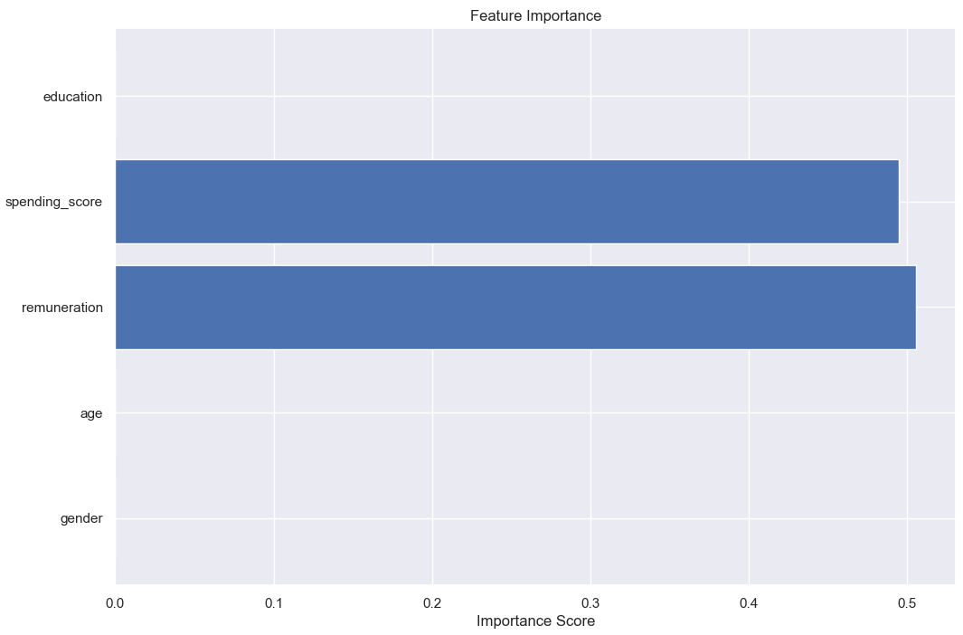
IDENTIFYING THE VALUE DRIVERS
The Strategic Filter
Age, Gender, and Education showed zero predictive power
Spending and Remuneration are the only statistically significant drivers
Notes:
We analyzed the full spectrum of customer data—from age to education—to identify what actually drives our bottom line. This 'Strategic Filter' allowed us to set aside the noise and focus our resources on the two metrics that truly dictate loyalty.
When we looked at what actually predicts loyalty, the data gave us a very clear answer. It’s not about who the customer is—it’s about their financials. As you can see, Remuneration and Spending Score each contribute about 50% to our model’s predictive power. They are the twin engines of our loyalty program. Everything else—age, gender, education—was essentially 'noise' that didn't help us predict behavior at all. By narrowing our focus to these two metrics, we've built a much leaner and more accurate strategy

Slide 6
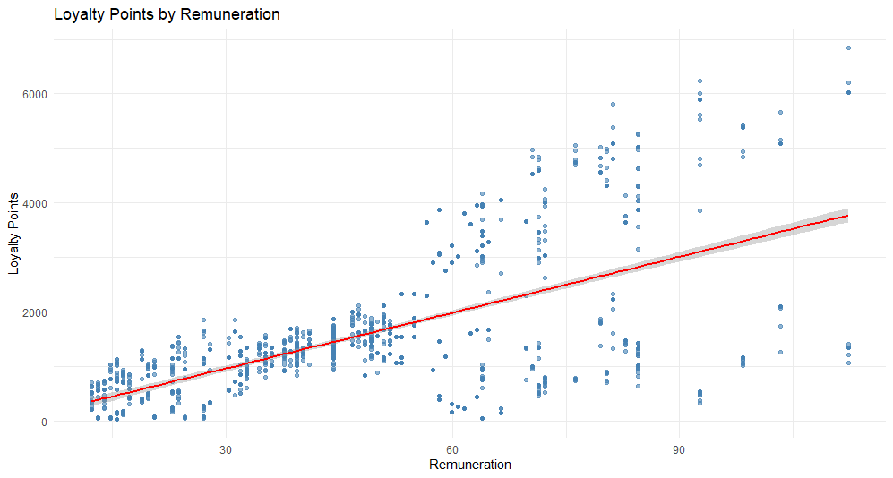
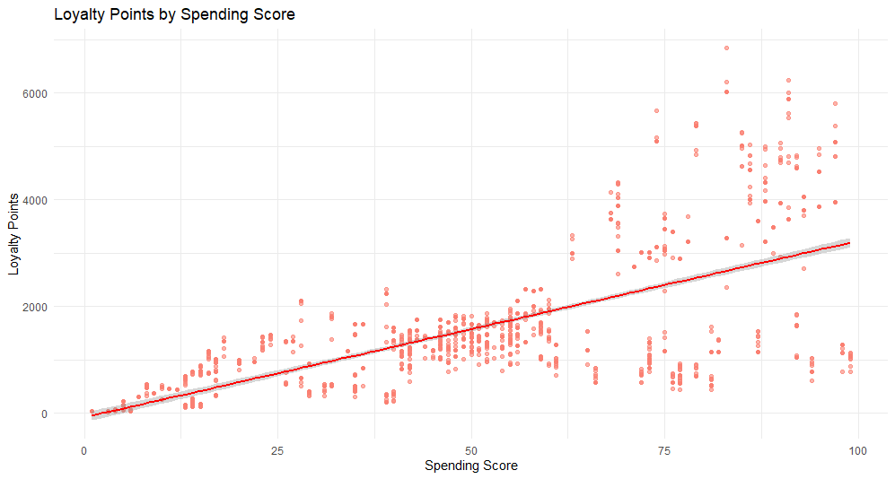
PRIMARY DRIVERS OF LOYALTY
Financial Behaviour Outweighs Demographics
The Trend Both Spending Score and Remuneration show strong positive correlations with loyalty points
The Fanning Effect High-income and high-spending levels exhibit increased variance, revealing two distinct high-value segments
High Velocity Earners: High-income (£55k+) and high-spending (Score > 63) customers who accumulate 2,000+ points at an accelerated pace.
Conservative Earners: Customers in the same financial bracket who remain under the 2,000-point threshold despite having the capacity to spend.
Notes:
While the "typical" customer follows a predictable linear path, our growth potential lies in converting "Conservative Earners" into "Accelerators.

Slide 7
CUSTOMER PERSONAS

Slide 8
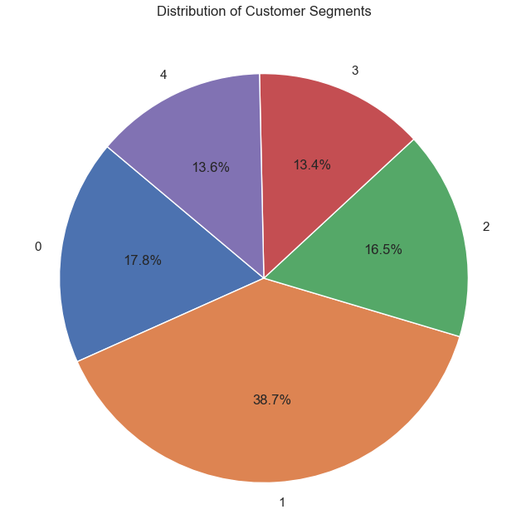
STRATEGIC PERSONAS
Customer Segment Profiles
Segment 0 (Premium Spenders – 17.8%) High Remuneration (£55k – £100k) and high Spending Scores (65 – 95)
Segment 1 (Core Customer Base – 38.7%) Average Remuneration (£30k - £50k) and average Spending Scores (40 – 60)
Segment 2 (Conservative/High-Savers – 16.5%) High Remuneration (£60k - £ 100k) but low Spending Scores (5 – 35)
Segment 3 (High Propensity/Low Income – 13.4%) Low Remuneration (£10k - £30k) but high Spending Scores (60 – 100)
Segment 4 (Budget Limited – 13.6%) Low Remuneration (£10 - £30) and low Spending Scores (5 – 40)

Slide 9
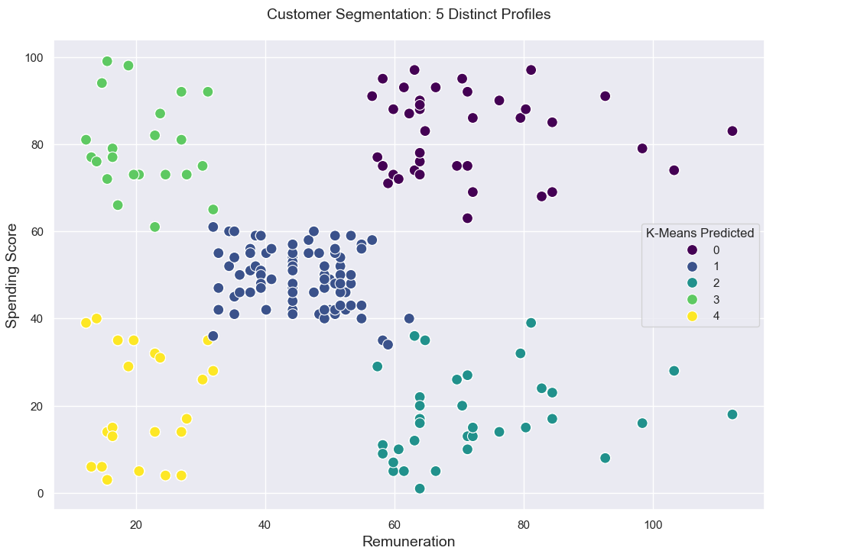
THE ENGAGEMENT GAP
The Challenges
Core Customer Base: How can we motivate this group of people to spend more?
Segment 2 Conservative/High Savers : These customers earn as much as our VIPs but spend like our Budget Limited customers
The Opportunity
Determine whether Core Customer Base customers are motivated by price-points or if they could be upscaled
Identify which products incentivize our Conservative High Savers to spend money on – it might be a good opportunity to market similar products to encourage a transition

Slide 10
Sentiment pulse

Slide 11
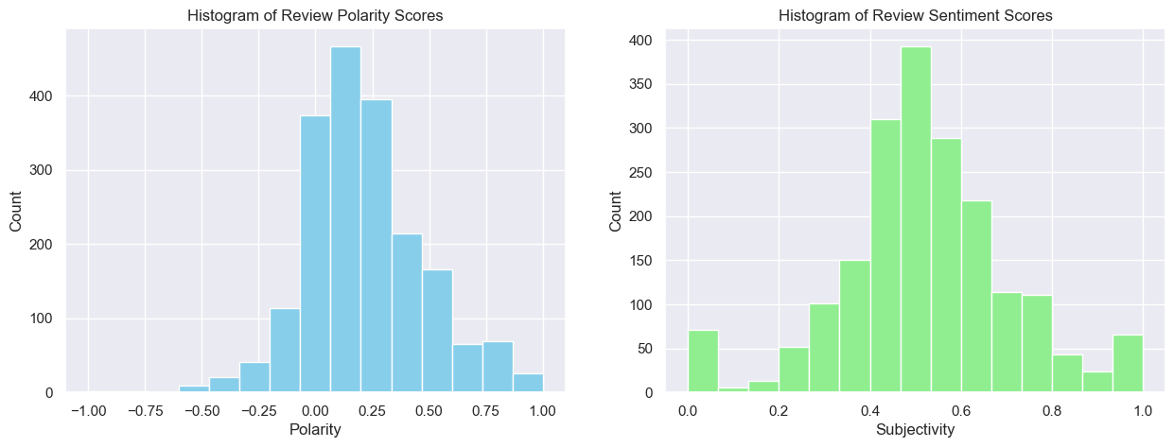
SENTIMENT PULSE: BRAND HEALTH
“Neutral to Positive”
Our sentiment histogram reveals a stable brand pulse, but with a significant Neutral Spike.
Notes:
Most of the review feedback are clustering around the 0.0 to 0.5 ranges, which indicates a stable, low-risk brand environment with minimal customer satisfaction. However, the high density of neutral scores suggests that a significant portion of the customer base is satisfied but not yet highly engaged.

Slide 12
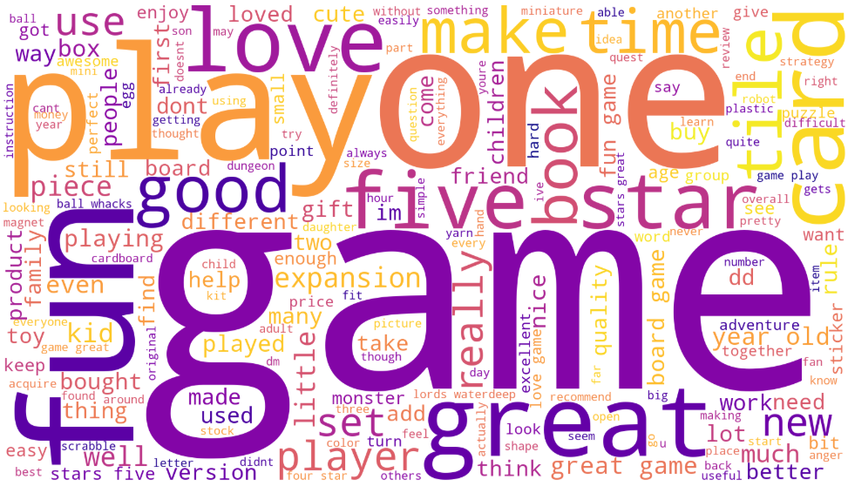
SENTIMENT PULSE: BRAND HEALTH
Top 10 most common words
1 | Game
2 | Great
3 | Fun
4 | One
5 | Play
6 | Like
7 | Stars
8 | Love
9 | Good
10 | Five
Notes:
When cross-referenced with this Word Cloud, which highlights recurring themes of Great, Fun, and Like, it is clear that our strengths lie in functional reliability. The insight here is that while the loyalty program is functioning, there is an untapped opportunity to move Neutral customers into Positive advocates through more personalized, emotion-driven marketing communications.

Slide 13
RECOMMENDATION
Target the Conservative/High Savers Segment 2 Customer Profile Identify high conversion products for Segment 2. Sales Team should market high affinity products to these customers to test whether they can replicate success.
Upscale our Core Market Customers Our Core Market is stable. Test price-elasticity to see if we can increase margins without losing volume
Close the Data Gap Capturing Product Category at checkout might resolve current model error and achieve 90%+ accuracy
Emotive Marketing Devise personalized, emotion-driven marketing communications

