Slide 1
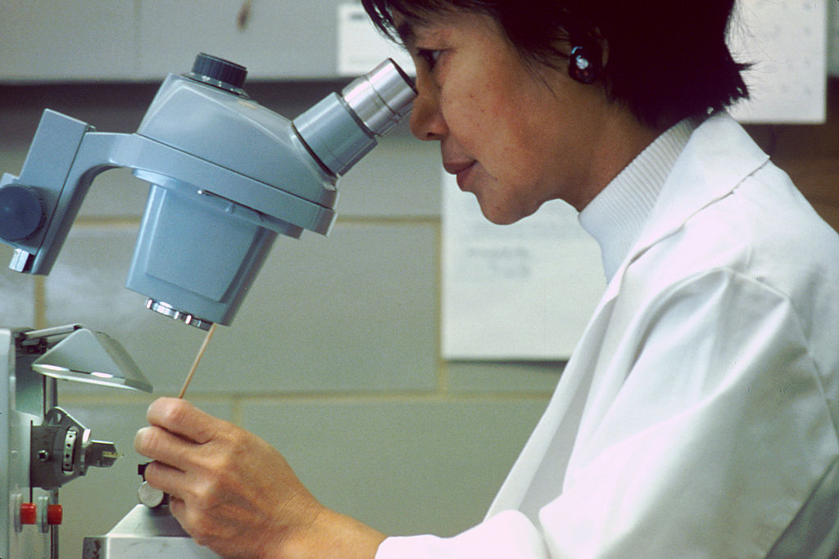
Analyzing Data
Randy Leonard
Digital frameworks
Northwestern University – Spring 2020
Github.com/randyleonard99/digitalframeworks-spring2020

Slide 2
Steps to a data story
Find data
Clean data
Analyze data
Present data

Slide 3
Agenda
Interviewing data
Data analysis in Excel

Slide 4
“Interviewing” Data
Common techniques:

Slide 5
“Interviewing” Data
Common techniques:
Sum, sort, pivot/aggregate, filter
Max, min, median
Percent change, trends, outliers
Chart, histogram, scatter, bar, disaggregate

Slide 6
“Interviewing” Data
Knowing what to look for:

Slide 7
“Interviewing” Data
Knowing what to look for:
What did I find last time?
What have other people found with similar data?
… or with analogous data?
If I were talking to a friend over beers about this data, what would I point out as interesting?
What surprises me? What doesn’t?
What questions does this data bring up?

Slide 8
“Interviewing” Data
Avoiding pitfalls:
Compare apples to apples not oranges
Check assumptions
Think critically about each step
Compared to what? Have a baseline
Normalize, consider controls, look for influence
Document each step, recheck each calculation
Run analysis multiple ways, have others do it their own way
Listen to your instincts – and reactions from experts

Slide 9
“Interviewing” Data
Questions you might ask a human source (let’s say a cop):
“Are there any interesting stories from your time on the force?”
Which college in town gives you guys the most trouble?
What’s the busiest shift to work on?

Slide 10
“Interviewing” Data
“Are there any interesting stories from your time on the force?”
Look for unusual data. For example:
Filter police reports to drunk and disorderlies
Filter time 0800 – 1200
Map XY data, and look for any unexpected locations

Slide 11
“Interviewing” Data
“Which college in town gives you guys the most trouble?”
Use XY coordinates to determine if police report is within a mile of a college
Group police reports by month
Sum up the number of monthly police reports for each college

Slide 12
“Interviewing” Data
“What’s the busiest shift to work on?”
Group police reports by shift
Group reports by month
Calculate average number of reports per month for each shift

Slide 13





“Interviewing” Data
Tips for “regular” interviews:
Ask direct, but open ended, questions
Be willing to go where answers lead you
Ask newsworthy questions
Get the name of the dog
Be aware your source may be dishonest or have an agenda

Slide 14
“Interviewing” Data
Tips for data interviews:
Phrase specific questions in your head before you begin using the computer
If you find an interesting trend, keep exploring it
Find the newsworthy trends/stories in the data
See if there’s any color you can track down either in the data or through external sources
Think about what your data may be missing and who published it

