Slide 1
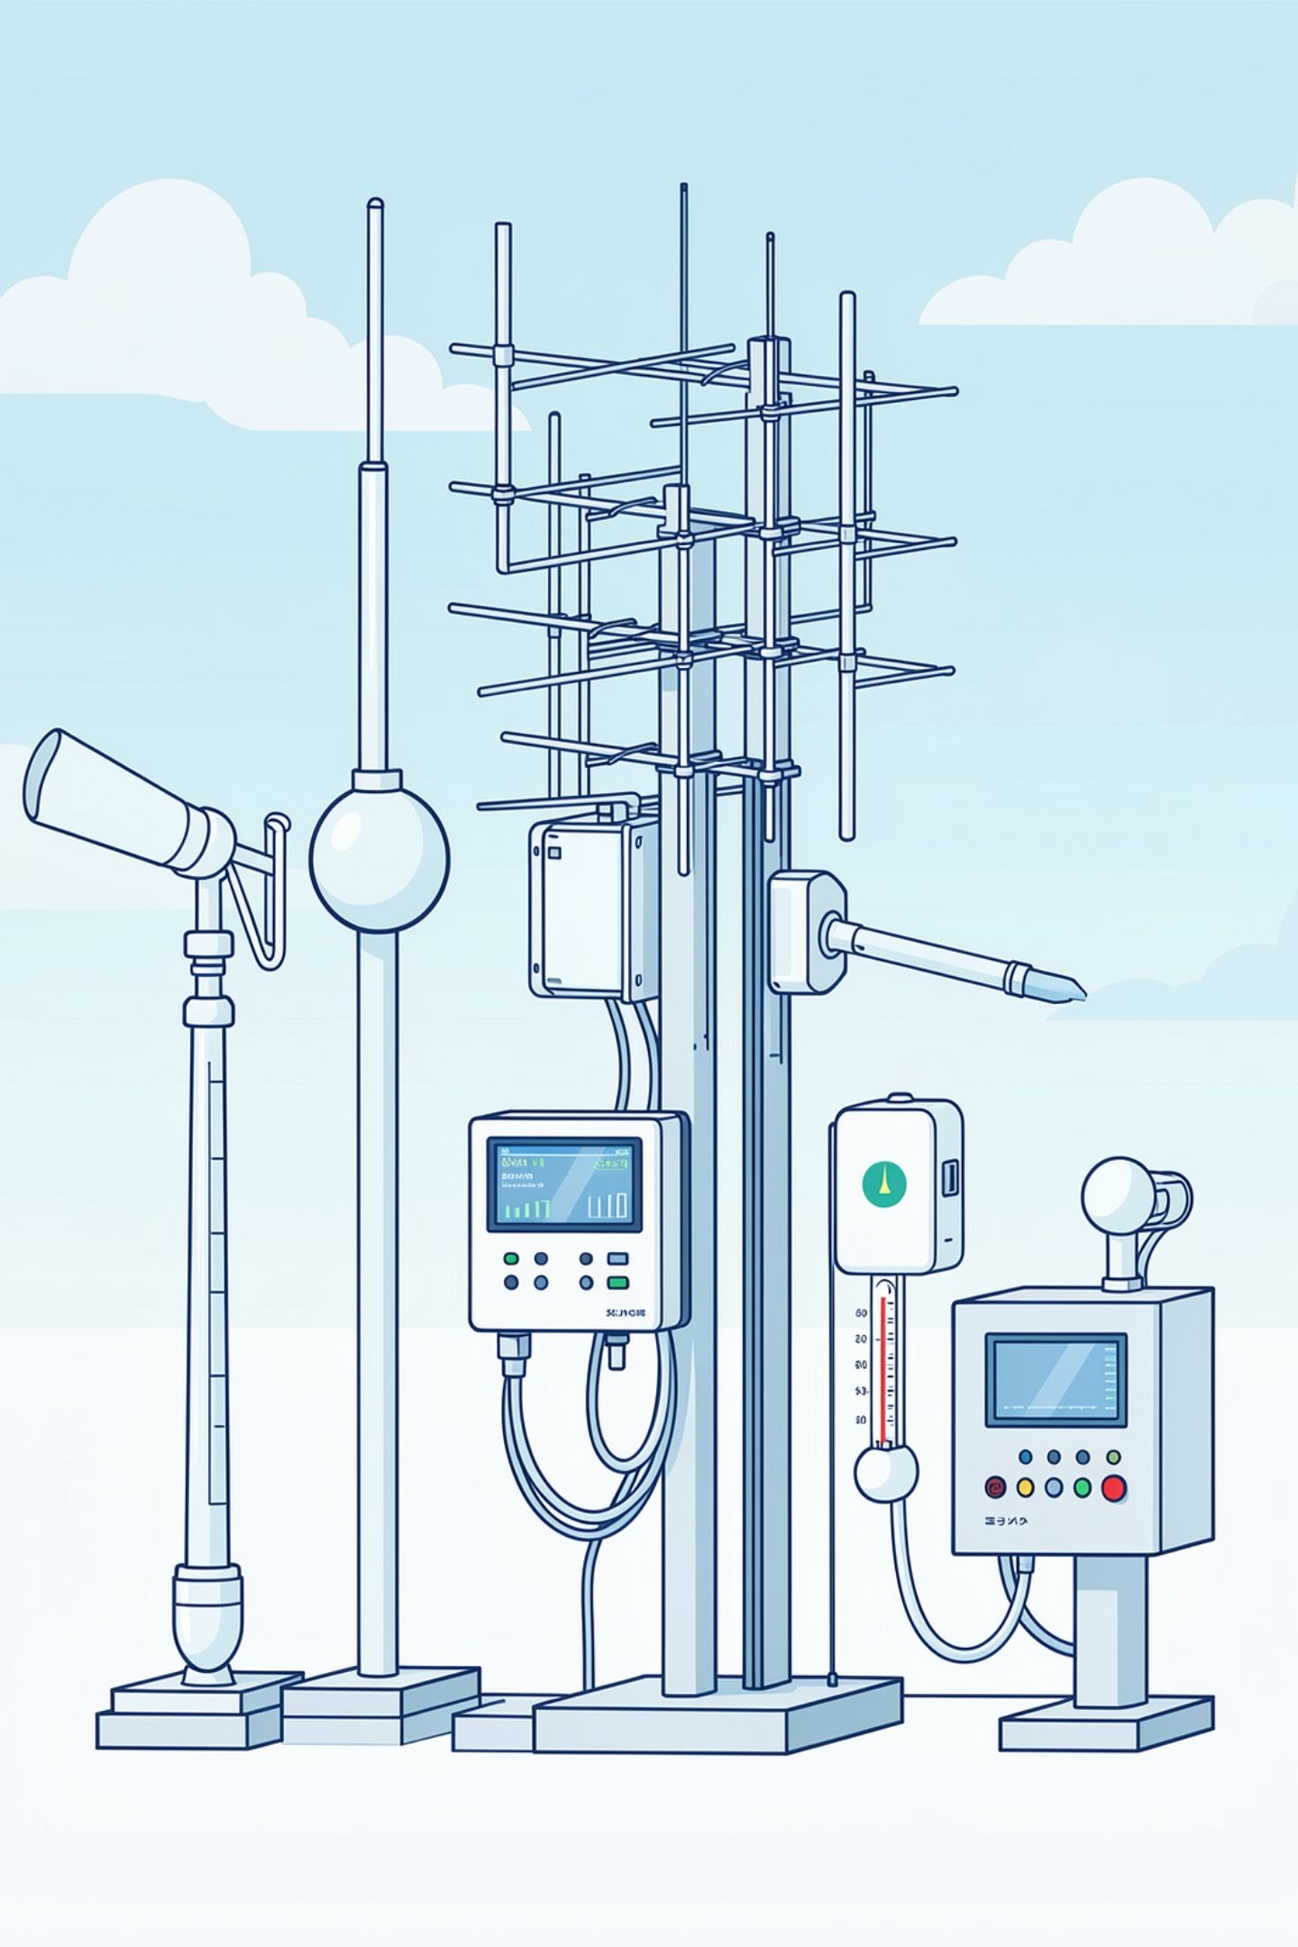
EMBEDDED SYSTEMS PROJECT
Weather Monitoring & Data Logging Station
Embedded Systems Project — ATmega32

Slide 2
Table of Contents
Introduction / Title
Abstract
Project Objectives
Approach & System Architecture
Drivers Used
Hardware Requirements
Software Requirements
Project Structure
Layered Architecture
Sampling Schedule
EEPROM Memory Layout
Alarm Conditions
Future Improvements
Course Information
Team & Acknowledgments

Slide 3
Abstract
Real-time environmental monitoring station using ATmega32
Continuous sensor data acquisition and LCD display
Historical data logging to EEPROM with threshold-based alarms
Serial UART communication for data retrieval

Slide 4
Project Objectives
This project aims to achieve the following key objectives:
Continuously monitor environmental conditions
Display real-time sensor values on LCD
Store historical measurements in internal EEPROM
Generate edge-triggered, threshold-based alarms
Support serial communication with a PC over UART
Implement periodic sampling using Timer0-based cooperative scheduler
Build reusable, layered embedded drivers
Apply strict layered software architecture (LIB/Common → MCAL → HAL → APP)

Slide 5
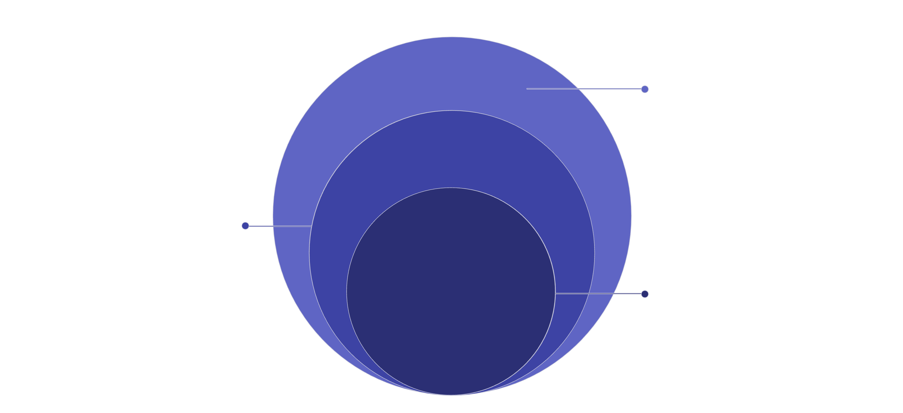
Approach
System Architecture
MCAL & Libraries
Microcontroller drivers and common services
Hardware Abstraction
Abstracts hardware for APP
Application Layer
Top-level features and user logic
This project employs a strict layered design: APP → HAL → MCAL → LIB/Common. Each layer is designed to interact only with the layer directly beneath it, ensuring modularity and maintainability. This architecture keeps drivers reusable and hardware details isolated, promoting a clean separation of concerns and making the system adaptable to different hardware configurations.

Slide 6
Key Components
Real-time Sensor Reading
LCD Display
EEPROM Data Logging
Continuously monitors Temperature (LM35) and Light (LDR) every 500ms for immediate environmental data.
Provides live, instant measurements of all monitored environmental parameters directly on a connected LCD screen.
Stores historical environmental measurements every 5 seconds, with capacity to hold up to 60 records in internal EEPROM.
Threshold-based Alarm System
UART Interface
Activates edge-triggered alerts when predefined environmental thresholds are exceeded, ensuring timely notifications.
Enables serial communication with a PC, allowing for efficient data retrieval and execution of system commands.
Sampling Schedule
Task
Frequency
Read Temperature
500 ms
Read Light Sensor
500 ms
Update LCD
1000 ms
Save Data (EEPROM)
5000 ms
Check Alarm
500 ms
UART Communication
Event Driven

Slide 7
Drivers Used
MCAL (Microcontroller Abstraction Layer)
ADC — Converts analog sensor signals to digital values for temperature and light measurements.
GIE — Manages global interrupt enable/disable for system-wide interrupt control.
EXTI — Handles external interrupt events for responsive system behavior.
TIMER0 — Provides timing and scheduling capabilities in Normal, CTC, and PWM modes for periodic tasks.
UART — Enables serial communication with a PC for data retrieval and command execution.
LCD — Controls a 16x2 LCD display for real-time status visualization.
HAL (Hardware Abstraction Layer)
LM35 — Temperature sensor driver that converts analog readings to Celsius values.
LDR — Light sensor driver that converts analog readings to light intensity percentages.
EEPROM — Internal memory driver for persistent data storage and retrieval of logged records.
LIB / Common
STD_TYPES.h — Defines standard data types such as uint8_t, uint16_t, and others for consistent type usage.
BIT_MATH.h — Provides bit manipulation macros for efficient register operations.
Common register-map / macros — Centralized hardware register definitions and utility macros.

Slide 8
Hardware Requirements
ATmega32 Microcontroller
LM35 Temperature Sensor
LDR Sensor
(8-bit AVR processor)
(analog temperature measurement)
(Light Dependent Resistor for light intensity)
16x2 LCD Display
Internal EEPROM
UART Interface
(for real-time status visualization)
(for data storage)
(e.g., CH340 USB-to-Serial converter for PC communication)

Slide 9
Software Requirements
Microchip Studio / Atmel Studio
Proteus
(IDE for development)
(simulation and circuit design)
AVR-GCC
Git / GitHub
(compiler for AVR microcontrollers)
(version control and repository management)

Slide 10
Project Structure
Weather_Station/
├── APP/
│ ├── main.c
│ ├── Weather_Controller/
│ ├── DataLogger/
│ ├── AlarmManager/
│ ├── Monitoring/
│ └── UART_Handler/
├── HAL/
│ ├── LCD/
│ ├── LM35/
│ ├── LDR/
│ └── EEPROM/
├── MCAL/
│ ├── ADC/
│ ├── GIE/
│ ├── EXTI/
│ ├── TIMER0/
│ └── UART/
├── LIB/
│ ├── STD_TYPES.h
│ ├── BIT_MATH.h
│ └── (Common register-map / macros)
└── README.md
Each module follows a consistent 4-file layout:
ModuleName_Config.h (configuration & tunable parameters)
ModuleName_Interface.h (public API exposed to other layers)
ModuleName_Private.h (internal macros / prototypes)
ModuleName_Program.c (implementation)

Slide 11
Layered Architecture
This project implements a strict layered software architecture to ensure modularity, reusability, and maintainability. Each layer is designed with specific responsibilities, and interactions are strictly unidirectional, meaning a layer can only call functions or access services provided by the layer immediately below it.
APP Layer (Application): Contains the high-level application logic and features, such as managing weather data, logging, alarms, monitoring, and UART communication. This layer depends on the HAL for hardware interactions.
HAL Layer (Hardware Abstraction): Provides an abstract interface to various hardware components, simplifying their use for the application layer. It includes drivers for the LCD, LM35 temperature sensor, LDR light sensor, and EEPROM.
MCAL Layer (Microcontroller Abstraction): Directly interacts with the microcontroller's peripherals. This layer includes drivers for ADC, GIE (Global Interrupt Enable), EXTI (External Interrupt), TIMER0, and UART, abstracting the low-level register operations.
LIB/Common Layer (Libraries): Consists of fundamental libraries and common utilities, such as standard type definitions (STD_TYPES) and bit manipulation macros (BIT_MATH), which are utilized across all other layers.
This approach isolates hardware details from application logic, making the system adaptable to different hardware configurations and promoting cleaner code separation.

Slide 12
EEPROM Memory Layout
Address
Stored Data
0x0000
Record Counter
0x0002
Record 1 (3 bytes)
0x0005
Record 2 (3 bytes)
0x0008
Record 3 (3 bytes)
...
...
Key Information:
Each record occupies 3 bytes (Record ID + Temperature + Light)
Maximum capacity: 60 records
Record Counter starts at address 0x0000 (2 bytes)
First data record starts at address 0x0002
Total EEPROM usage: 2 bytes (counter) + (60 × 3 bytes) = 182 bytes

Slide 13
Alarm Conditions
Alarm
Condition
High Temperature
Temp > High Threshold
Low Temperature
Temp < Low Threshold
High Light
Light > High Threshold
Low Light
Light < Low Threshold
EEPROM Full
Record count = 60
Additional Information:
All alarms are edge-triggered (fired once per threshold crossing, not repeated while condition persists)
When a limit is exceeded, a UART notification is sent
LCD/status output is updated accordingly
Alarms help prevent system damage and alert users to abnormal conditions

Slide 14
Future Improvements
Humidity Sensor (DHT11/DHT22)
RTC Time Stamping for logged records
SD Card data logging
Expand storage capacity beyond EEPROM
Add humidity monitoring capabilities
Include timestamps for historical data
Wi-Fi / IoT cloud dashboard
Weather trend analysis
Enable remote monitoring and data access
Implement data analysis and trend visualization

Slide 15
Course Information
Embedded Systems Diploma
Embedded C programming
AVR Microcontroller Architecture
ADC, LCD, EEPROM, UART peripherals
Timers & Interrupts
Driver Development
Layered Software Architecture
This project demonstrates practical application of all these topics in a real-world embedded systems scenario.

Slide 16
Team & Acknowledgments
Team
Acknowledgments
Members
Special thanks to:
Ali Mohamed Ramadan Elsotohy
Seif Alaa Abd El Fattah
Ahmed Sobhy Mohammed
Ahmed Ayman Fekry
National Telecommunications Institute (NTI)
Eng. Hesham Ahmed
Gestell Team
License
Leader
Eng. Hesham Ahmed
This project was developed during the NTI Embedded Systems Training Program.
Licensed under the MIT License.
Project Organization: Gestell

