Slide 1

Production line of charts
Complete all basic charts
Effective use of Box Plots
Pareto chart
Dynamic moving Average
Matthew Morris
Git: Morrisdata
MatthewMorris.DA@gmail.com

Slide 2

Previously in Data Analytics

Slide 3

Frequency
 |  | FREQUENCY
Score Bins | TALLY | FREQUENCY | RELATIVE FREQUENCY | CUMULATIVE FREQUENCY | RELATIVE AND CUMULATIVE FREQUENCY
90-99 | IIII | 4 | 4/20=20% | 4 | 4/20 = 20%
80-89 | IIII | 5 | 5/20=25% | 9 | 9/20 = 45%
70-79 | IIII I | 6 | 6/20=30% | 15 | 15/20 = 75%
60-69 | IIII | 4 | 4/20=20% | 19 | 19/20 = 95%
50-59 | I | 1 | 1/20=5% | 20 | 20/20 = 100%

Slide 4
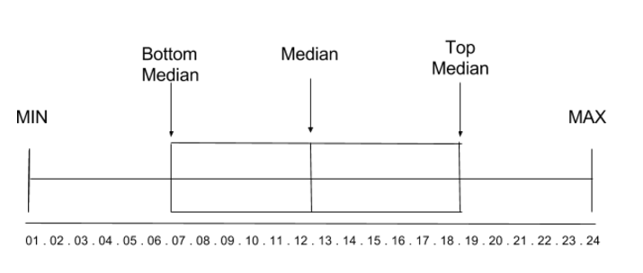
Box Plot

Slide 5
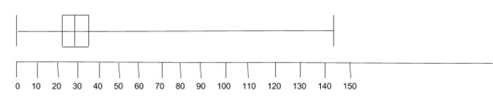
Box Plot
MIN =0
Q1 = 22
Q2 = 29
Q3 = 36
MAX = 144

Slide 6
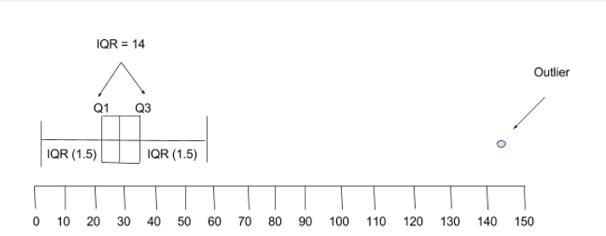
Box Plot

Slide 7
Normal Empirical Rule
95% of values
68% of values
2.5 % of Values
2.5 % of Values
13.5%
34%
34%
13.5%
Z -3 -2 -1 0 1 2 3 Z
% 2.5%ile 16%ile 50%ile 84%ile 97.5%ile %
X 1 4 7 10 13 X
Notes:
Explain data types:
● Categorical (also Qualitative)
○ Categorical variables represent types of data which may be divided into groups
○ Examples of categorical variables are race, sex, age group, and educational level
● Numerical (also Quantitative)
○ Values of a quantitative variable can be ordered and measured
○ Examples include age, height, sales, volume
○ Numbers are not always numerical data. Example: Gender (0=Male, 1=Female)
Instructor: Ask the class to identify the data types present in the dataset:
● States
● Funds raised
● Date/time (can be both)
○ Months of the year - categorical
○ Date and time of project creation - numerical
Numerical data can be evaluated using a few summary metrics. Here are four very useful ones with which to start:
● Count( )
● Min( )
● Max( )
● Average( )
● Demonstrate calculating each measure on a single sample set of numbers.
● Explain why it’s important to always use these summary metrics when doing exploratory analysis.

Slide 8
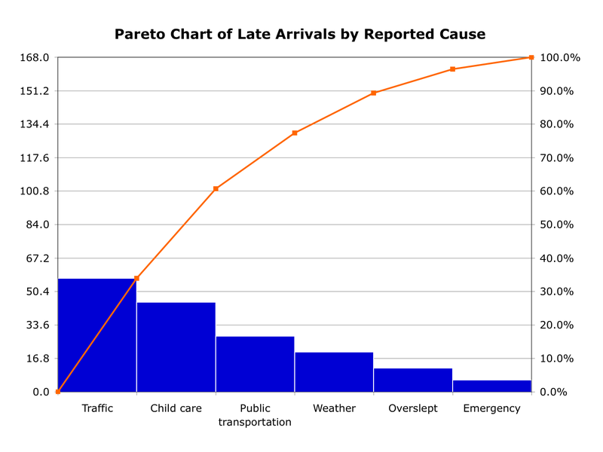
Pareto
Notes:
Explain data types:
● Categorical (also Qualitative)
○ Categorical variables represent types of data which may be divided into groups
○ Examples of categorical variables are race, sex, age group, and educational level
● Numerical (also Quantitative)
○ Values of a quantitative variable can be ordered and measured
○ Examples include age, height, sales, volume
○ Numbers are not always numerical data. Example: Gender (0=Male, 1=Female)
Instructor: Ask the class to identify the data types present in the dataset:
● States
● Funds raised
● Date/time (can be both)
○ Months of the year - categorical
○ Date and time of project creation - numerical
Numerical data can be evaluated using a few summary metrics. Here are four very useful ones with which to start:
● Count( )
● Min( )
● Max( )
● Average( )
● Demonstrate calculating each measure on a single sample set of numbers.
● Explain why it’s important to always use these summary metrics when doing exploratory analysis.

Slide 9
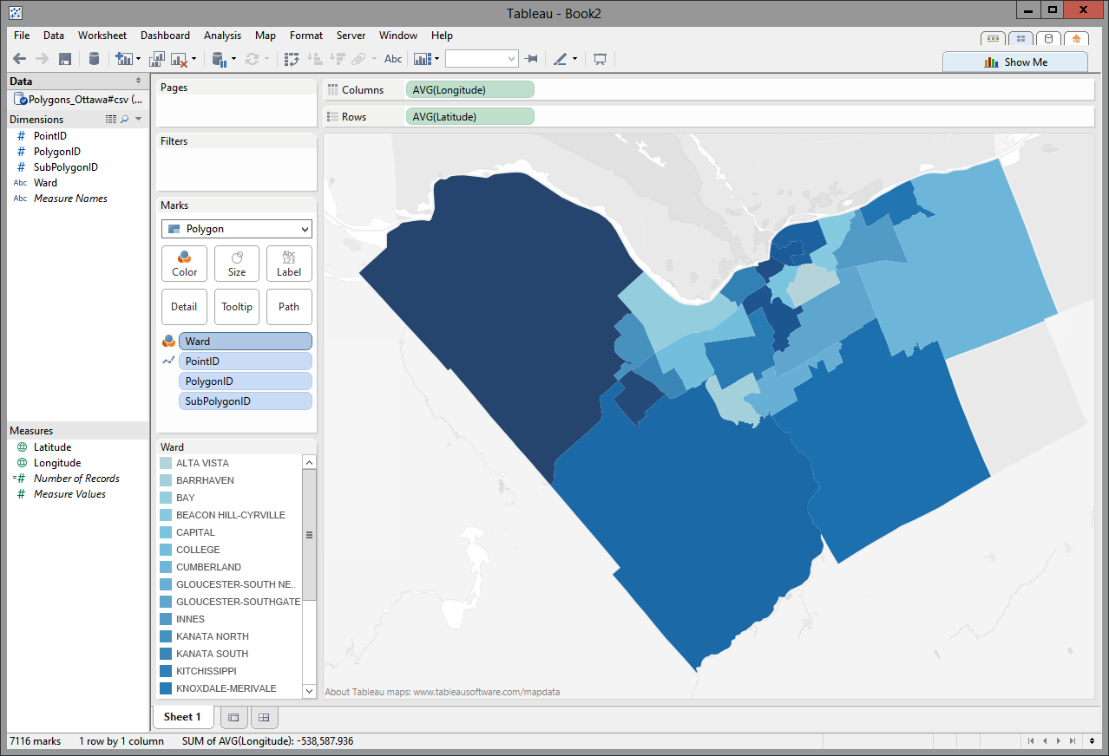
Polygon
founder of Predictive
Polygon map
Notes:
Explain data types:
● Categorical (also Qualitative)
○ Categorical variables represent types of data which may be divided into groups
○ Examples of categorical variables are race, sex, age group, and educational level
● Numerical (also Quantitative)
○ Values of a quantitative variable can be ordered and measured
○ Examples include age, height, sales, volume
○ Numbers are not always numerical data. Example: Gender (0=Male, 1=Female)
Instructor: Ask the class to identify the data types present in the dataset:
● States
● Funds raised
● Date/time (can be both)
○ Months of the year - categorical
○ Date and time of project creation - numerical
Numerical data can be evaluated using a few summary metrics. Here are four very useful ones with which to start:
● Count( )
● Min( )
● Max( )
● Average( )
● Demonstrate calculating each measure on a single sample set of numbers.
● Explain why it’s important to always use these summary metrics when doing exploratory analysis.

Slide 10
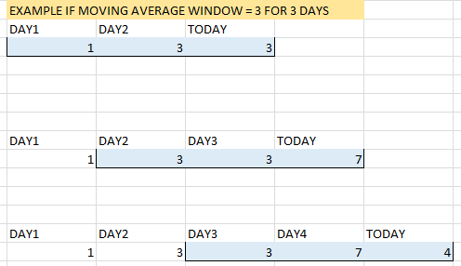
Moving Average
Notes:
Explain data types:
● Categorical (also Qualitative)
○ Categorical variables represent types of data which may be divided into groups
○ Examples of categorical variables are race, sex, age group, and educational level
● Numerical (also Quantitative)
○ Values of a quantitative variable can be ordered and measured
○ Examples include age, height, sales, volume
○ Numbers are not always numerical data. Example: Gender (0=Male, 1=Female)
Instructor: Ask the class to identify the data types present in the dataset:
● States
● Funds raised
● Date/time (can be both)
○ Months of the year - categorical
○ Date and time of project creation - numerical
Numerical data can be evaluated using a few summary metrics. Here are four very useful ones with which to start:
● Count( )
● Min( )
● Max( )
● Average( )
● Demonstrate calculating each measure on a single sample set of numbers.
● Explain why it’s important to always use these summary metrics when doing exploratory analysis.

Slide 11
Q & A
The greatest value of a picture is when it forces us
to notice what we never expected to see.
John Tukey, American Mathematician

Slide 12

EXIT TICKET
Production line of Charts
CLASS :
QUESTION: Why is it a good idea to create a production line of Charts?

