Slide 1

Wine Time
Can we predict and classify the cost of wine?
Project by Alissa Mochalov

Slide 2

My research Question
What I want to explore in this project, is a very simple question- Can we, given selected features, predict and classify the prices of different wines?
Some googling made it clear that there are many variables that can affect the price of wine. From origin country to abv (Alcohol by volume) percentage, specific and exclusive regions and more.
So, even if one bottle of Bordeaux might be relatively cheap, another one- from a different micro-region, or from an earlier time, might be a lot more expensive.

Slide 3
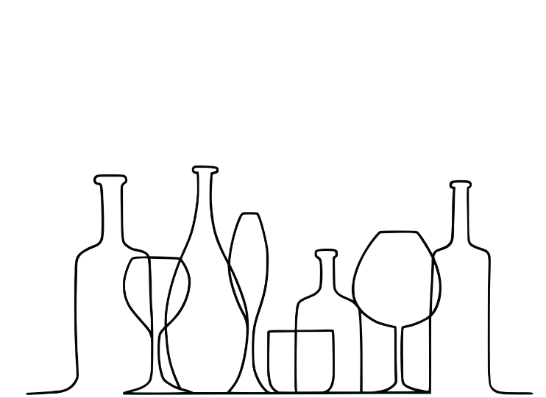
Data Collection- acquiring data (Crawling).
Data Handling- cleaning and managing the data.
EDA- visualizing the data and the connections within it.
Machine Learning- analyzing our data.
Acquiring the data, managing and visualizing it and finally- the math, are all the steps needed to reach a conclusion.
My path to an answer

Slide 4
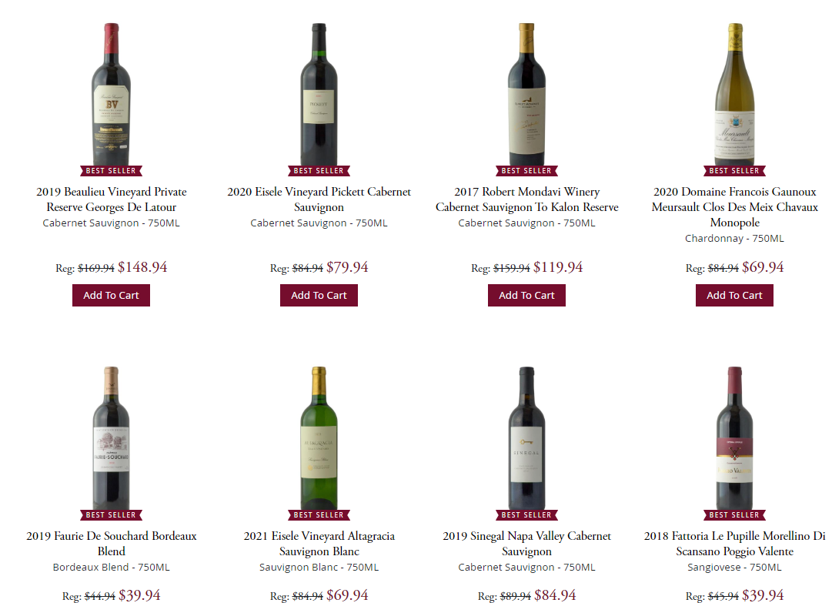

Data Acquisition

Slide 5
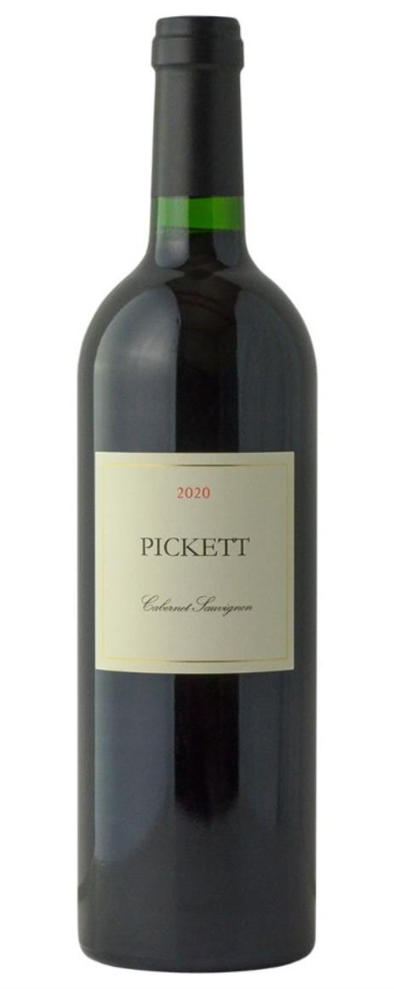
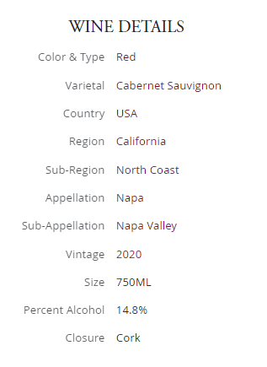
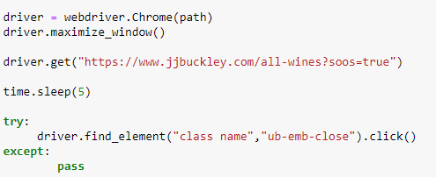
Crawling and Selenium
After going through many sources, the richest of them all was JJ Buckley’s site of fine wines. On this site, one can find thousands of different wines, each with a lot of information to collect.
Using Selenium, learning a little about HTML and CSS, and through a lot trial and error, I acquired the desired features of each wine.
Clicking pop ups was a bigger part of it than I thought…

Slide 6
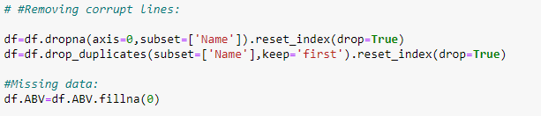
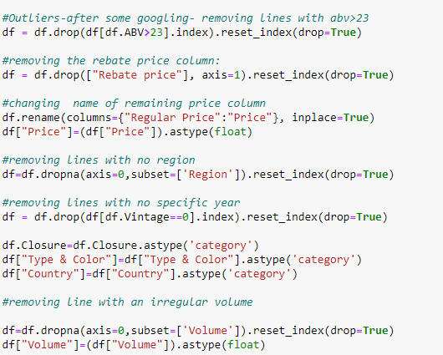
Data Handling
With the data collected written into a Pandas data frame, it is time for the important step of cleaning and prepping the data.
This process included:
Cleaning and removing duplicates, corrupt rows, columns and rows that can be irrelevant or have too many missing values.
Filling some missing or incorrect values, converting others, organizing the data and even adding columns.

Slide 7
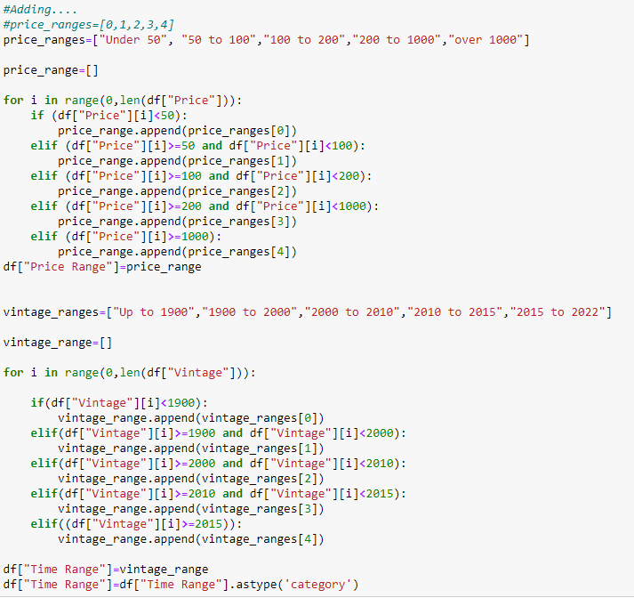
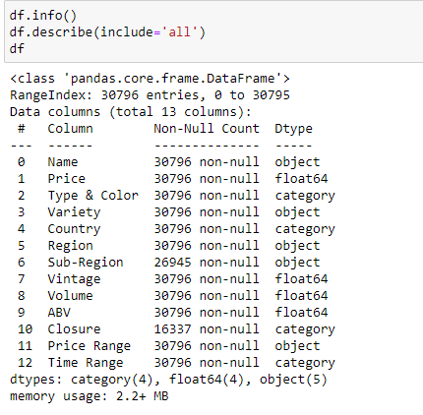
Adding ranges for easier calculations and visualization in the future:
Constantly checking data info:

Slide 8

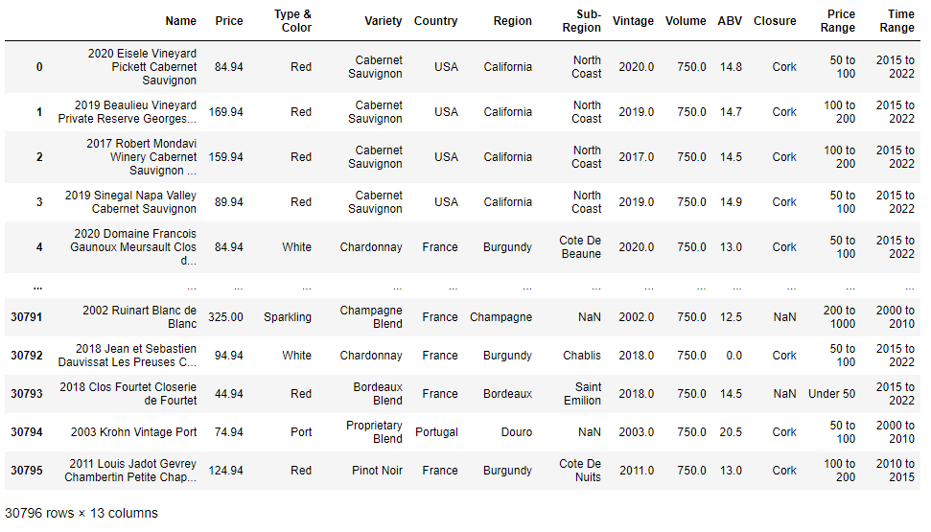
All Ready!

Slide 9
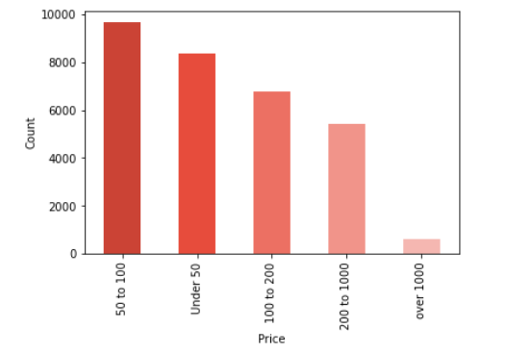
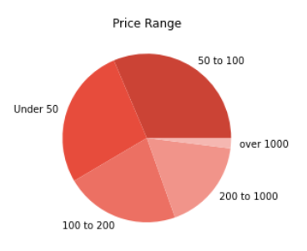
EDA
First, let’s see the different price ranges:
You can usually find wine in bars, but who doesn’t like a pie?

Slide 10

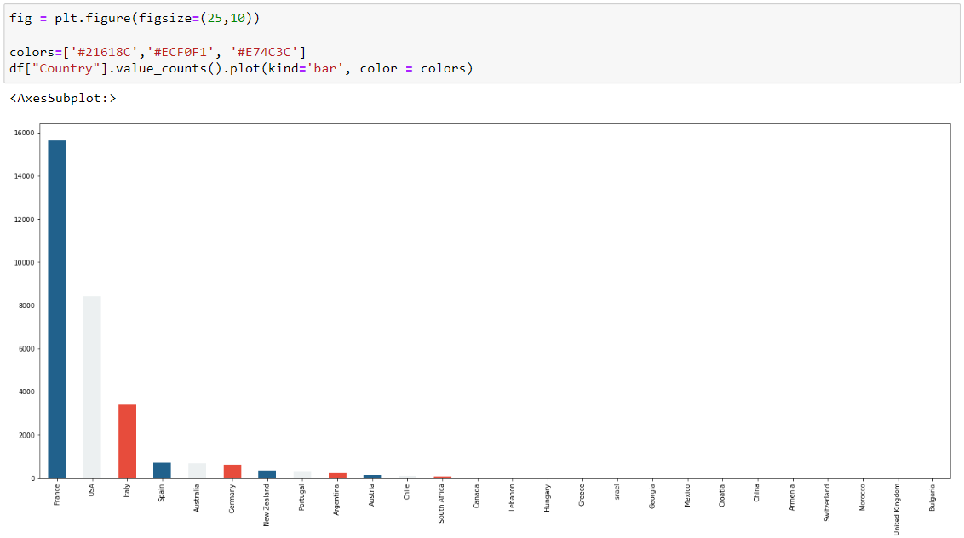
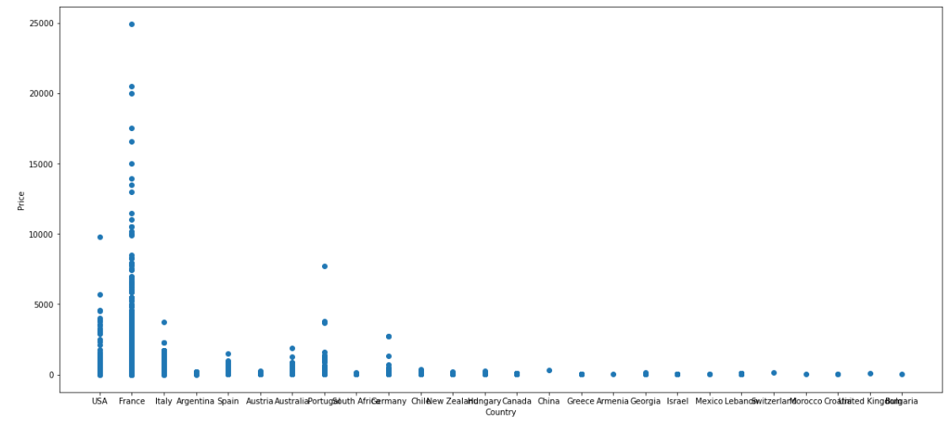
France not only has the most wines…
But is also home to the most expensive ones.

Slide 11
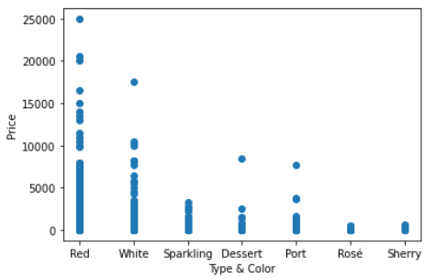
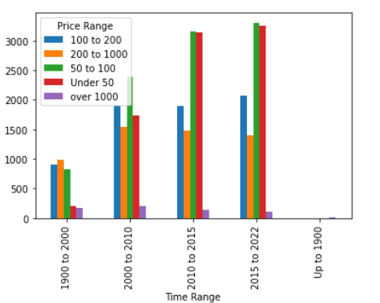
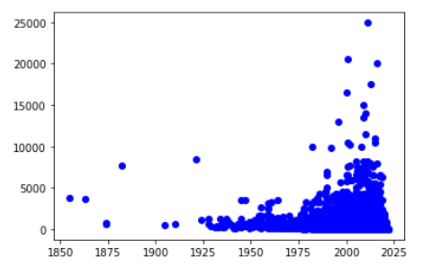
Red wine is usually more expensive
And newer wines are usually cheaper
Even though the most expensive ones are relatively recent

Slide 12
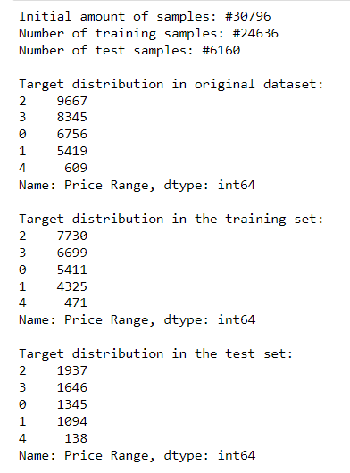
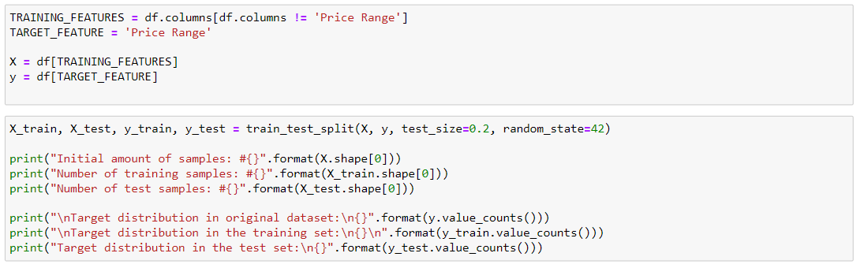
Machine Learning
To find out if the price range of wine can be predicted, supervised learning is key.
The dataset will be split and used as a training set and a test set.

Slide 13
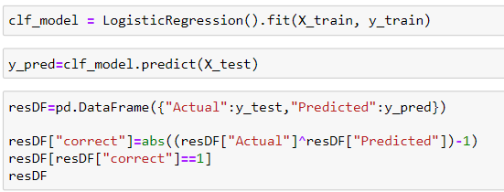
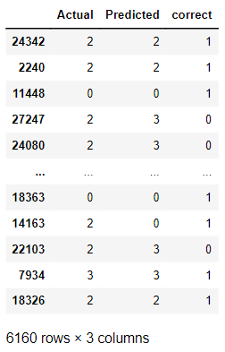
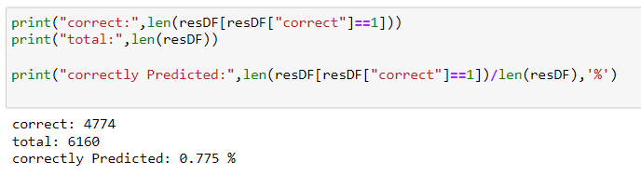
Logistic Regression
0.75% is not all bad, but no so good either.
Best to try another model…

Slide 14
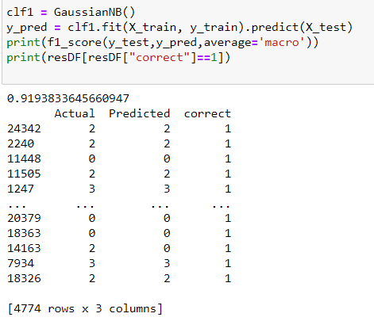
Naïve Base it is!
With this model, we get a good score, that is not influenced by overfitting.

Slide 15
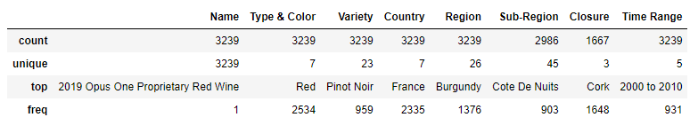
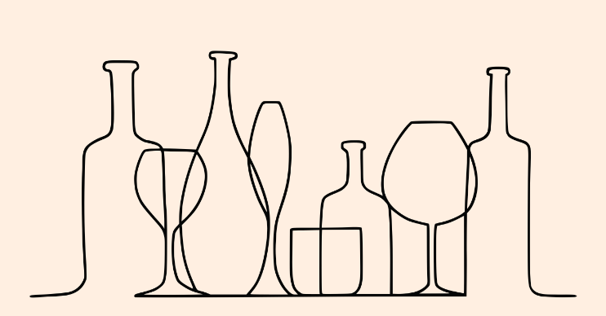
What do the most expensive wines have in common?
There appears to be a connection between the price and the origin country, type and age.
But can it be predicted and correctly classified?

Slide 16
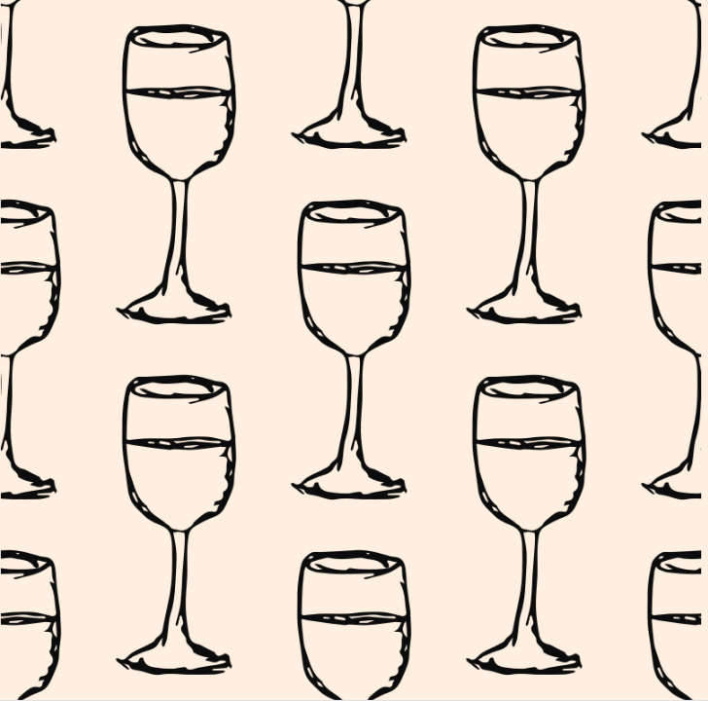
Conclusion!
It’s clear now that there is a correlation between the price and the origin country, type and age, while some features, like abv%, don’t affect the price as much.
It was very interesting to find out that even though there are a lot more cheaper wines today, the most expensive ones are also not very old.
Another question that might be intriguing- does the price of wine correlates to its quality?
But I’ll leave that for my next project…

