Slide 1


Development of Emergency Vehicle Signalling System
Presented for the evaluation of Remote Internship
by
Yaman Parasher, Gerguri Gerald, Farid Orujov & De Paula Alisson Rodrigues
Scuola Superiore Sant’Anna

Slide 2
Outline of the Presentation
  Scenario ( Test Setup )
A brief about the task given, describing a test setup of the emergency vehicle signalling system
Tasks & Solutions Implemented
Brief about the route, vehicle icon construction & position calculation along with direction
Solution of the ‘Same Road Problem’
Description of the logic applied with some extra useful text
Closure
The updated code of the project can be find at https://github.com/alisson42/TecipEmergVeh.git

Slide 3
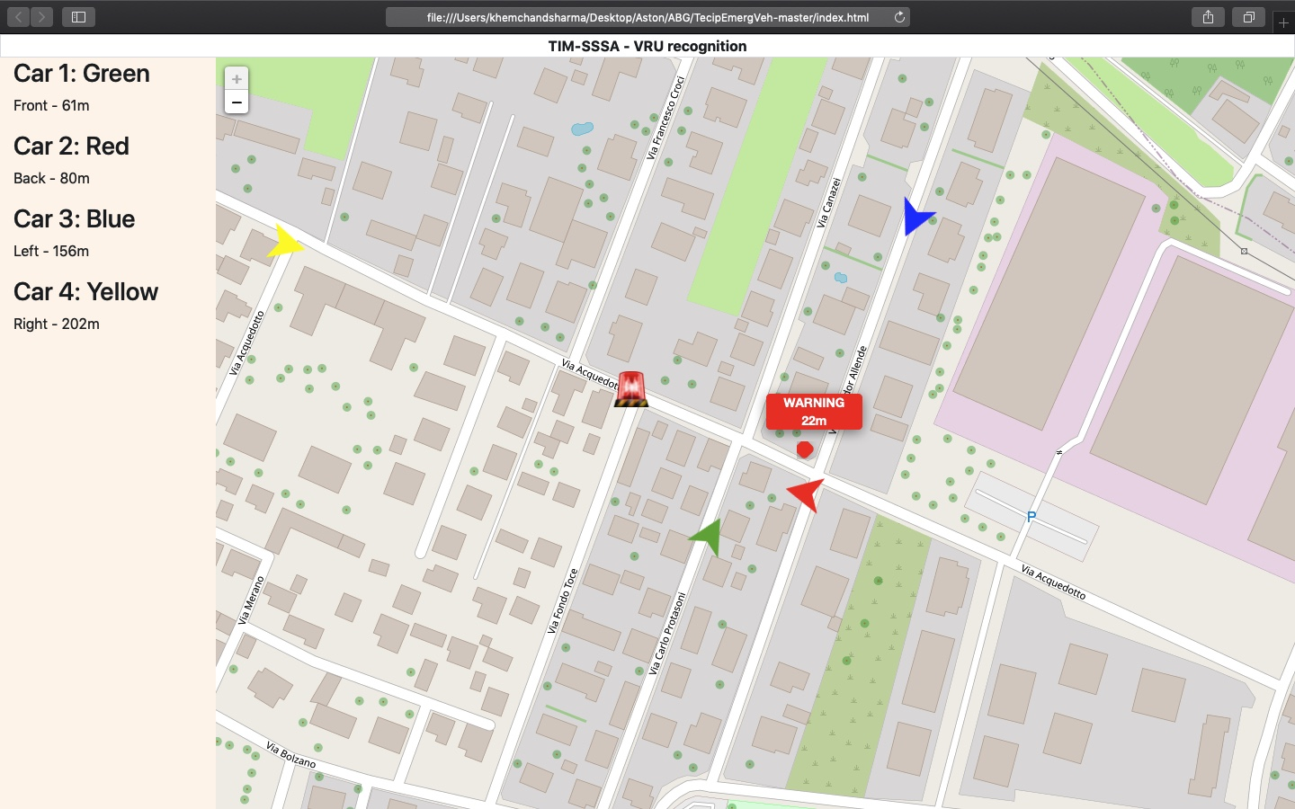
Scenario (Test Setup)
Screenshot of the Test Setup System Developed
Network of straight two-way road with a lot of intersection & four cars (Red, Yellow , Green & Blue)
Emergency vehicle will follow the red from back and surpass it
Yellow vehicle surpass the emergency vehicle while coming from the front
Green & Blue will come perpendicularly to the emergency vehicle from the opposite direction to each other
Condition –
Red & Yellow should start their run at distance greater than 300m from the emergency vehicle. Same goes with Green& Blue.
1

Slide 4
Tasks & Solutions Implemented
Route Construction
Created a sequence of coordinates to simulate a route and export via CSV
Convert the information from the CSV file into a JSON format and call it directly into the code
Vehicle Icon Construction
Downloaded vector image editing software to edit the icons of vehicles on the map to have different colours
Change the choice of colours through the vehicle ID instead of through the relative distance
Created a numerical id pattern to designate each device
Position calculation
Calculated the distance traveled by the vehicle between the current position and the last update received and therefore also calculating the vehicle's instantaneous speed
Created a routine to treat JSON with the coordinates and update the position of the cars on the map
Calculated the absolute position between ordinary vehicles and the emergency vehicle
Added leaflet command which enable us to rotate an icon with exact angle
Calculated an angle between actual and previous points and apply the rotation command to show the direction of a vehicle
1

Slide 5
‘Same Road Problem’ Solution
Problem
The server was returning "undefined" when the cars are on the same road
Solution
Changed the file main.js in which we added one more column to the auxiliary matrix 'current_position', where we add the parameter for angle to
Using the angle information we can determine if the vehicles are heading in the same direction (if they have similar angles) or in opposite direction (in case they have more or less a difference of 180 degrees)
In practice, the program has a tolerance of 60 degrees, that means, if a car is point at 90 degrees (in our code that means East) to the emergency vehicle, the algorithm understands that any car heading in the window interval of 30 to 150 degrees is driving in the same direction (since we already know they are in the same road)
This window of 120 degrees (+- 60 degrees) is also applied to the opposite direction
Knowing the direction (angles) of the other vehicles it is possible to know if the emergency vehicle is ahead in front of the other vehicle or behind it)
Logic Applied
If the emergency vehicle is heading north, the latitude values tend to increase, so if the other vehicle in the same road has a latitude bigger than the emergency vehicle, that means that the car is in front of the emergency vehicle (meaning the other vehicle is "behind")
In the algorithm we first determine which component is predominant: X or Y (longitude or latitude) and then we compare the position to see the relative position in the road (who is in front of who, knowing that they are in the same direction or in the opposite direction)
The main changes can be seen in the lines 1975 to 2015 of main.js
Some comments were also added for your kind perusal
1

