Slide 1
Yuruna
Cross-cloud Kubernetes-based applications
Alisson Sol et al.

Slide 2
Yuruna goals
Enable developers to build parameterized K8S applications…
… deploying infrastructure resources to clouds in a parameterized way;
… building components and pushing to repositories;
… installing the workloads in the infrastructure resources.
Don’t reinvent
… deploying infrastructure resources to clouds: uses Terraform
… building components: uses Docker containers
… deploying workloads: uses Helm

Slide 3
Personas
Developer using “applications”
Just deploy application to their own resources created in their accounts
Developer configuring “applications”
Will pick resource templates and components, and configure how those are deployed as workloads
Developers creating artifacts
Create a configurable Terraform template
Create a component
Create a Helm chart

Slide 4
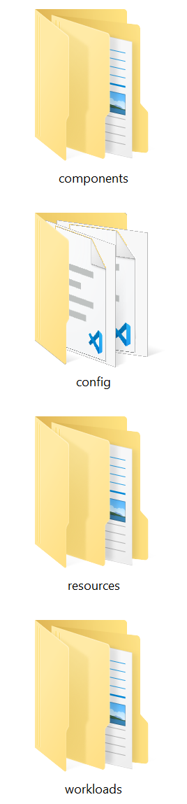
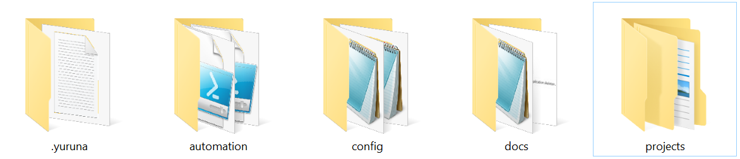
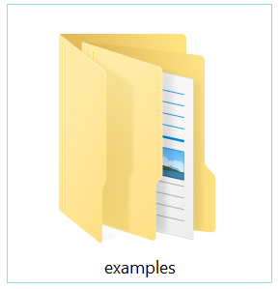

Folder structure

Slide 5
Framework folders
Temporary files
Global configuration
PowerShell
scripts
Documentation

Slide 6
Projects
Components:
code and Docker files
Configuration:
project-specific
Resource templates: Terraform
Workloads templates: Helm

Slide 7
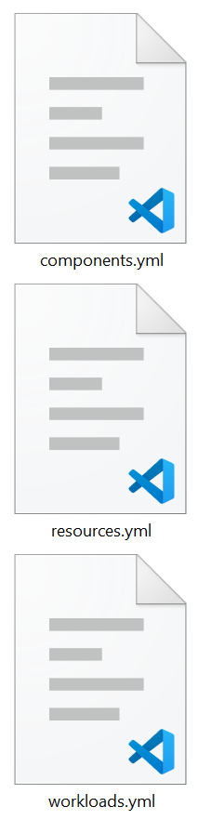
Configuration
Components to build (Docker)
Resources to deploy (Terraform)
Map components to resources (Helm)

Slide 8
Templates
Code, Docker files, binaries
Terraform templates (miss variable values)
Helm charts (miss variable values)

Slide 9
yuruna resources
For each resource in resources.yml
copy template to work folder under .yuruna
apply variables from resources.yml
execute terraform apply from work folder
creates local .terraform under work folder, which can be used later in terraform destroy

Slide 10
yuruna components
For each component in components.yml
apply global variables, resources.output variables, workload variables
execute build command in the folder
command is parameter in components.yml
tag and push component to registry

Slide 11
yuruna workloads
For each workload in workloads.yml
switch to context
apply deployments: chart, kubectl, helm, or shell
copy chart to work folder under .yuruna
apply global variables, resources.output variables, workload variables
execute helm install in work folder
other expressions use ${env:vars}

Slide 12
yuruna command details
Creates subfolders under .yuruna folder with [project] name
-name option to “name” workfolder
There are yuruna_root and project_root variables
Projects can be somewhere else, away from the yuruna_root
References in files should be relative to project_root
Example
.\yuruna.ps1 workloads C:\Git\yuruna\projects\examples\website localhost

Slide 13
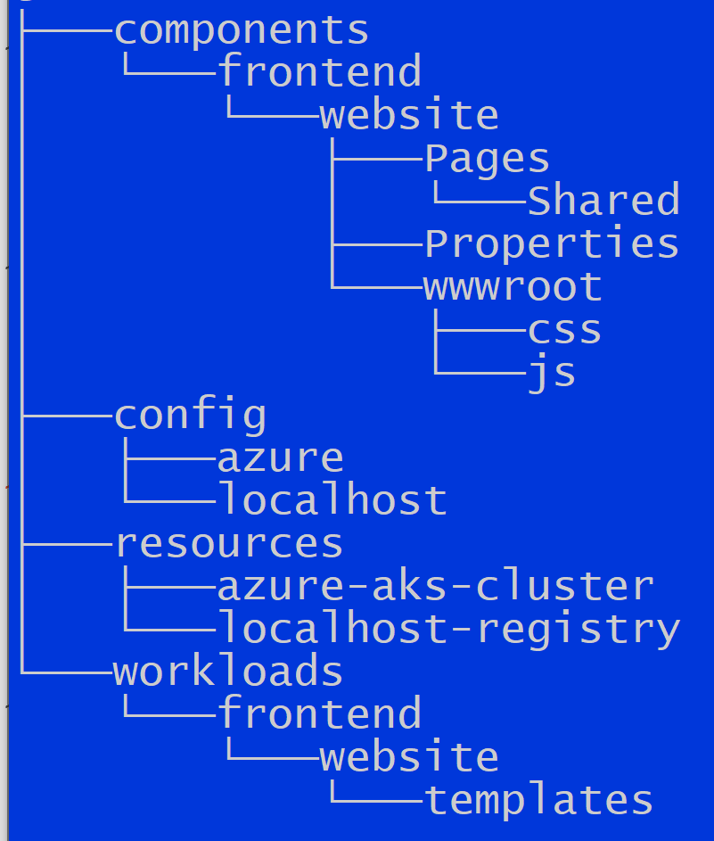
Multiple configurations
Create subfolders under config
Each subfolder needs to have its own copy of the configuration files
resources.yml
components.yml
workloads.yml
If such files are found under “config” then they are used
Indicate config_subfolder
yuruna resources [website-folder] localhost
yuruna components [website-folder] localhost
yuruna workloads [website-folder] localhost

Slide 14
Resources.yml
# Resources information - localhost
---
globalVariables:
namespace: "yuruna"
clusterDnsPrefix: "yuruna"
clusterName: "yuruna"
clusterRegion: "westus2"
clusterVersion: "1.20.0"
frontendIpName: "localhost"
resourceGroup: "yuruna"
resourceTags: "yuruna"
nodeCount: 1
registryName: "localhost:5000"
resources:
# Localhost with Docker Desktop
# Nothing needs to be created: just provide cluster name
- name: "docker-desktop"
template: ""
variables:
# Terraform template will run local registry
- name: "localhost-registry"
template: "localhost-registry"
variables:

Slide 15
Components.yml
# Components information - localhost
---
globalVariables:
containerPrefix: "yuruna"
registryLocation: "localhost:5000"
registryName: "localhost"
buildCommand: docker build --rm -f ${env:dockerfile} -t "${env:containerPrefix}/${env:project}:latest" "${env:buildPath}"
tagCommand: docker tag "${env:containerPrefix}/${env:project}:latest" "${env:registryLocation}/${env:containerPrefix}/${env:project}:latest"
pushCommand: docker push "${env:registryLocation}/${env:containerPrefix}/${env:project}:latest"
components:
- project: "website"
buildPath: "frontend/website"
variables:

Slide 16
Workloads.yml (part 1)
# Workloads information - localhost
---
globalVariables:
namespace: "yuruna"
containerPrefix: "yuruna"
registryLocation: "localhost:5000"
registryName: "localhost"
frontendIpName: "localhost"
frontendIpAddress: "127.0.0.1"
site: "localhost"
dockerUsername: "dummy"
dockerPassword: "dummy"
certManagerIssuerEmail: "certificates@yuruna.com"
websiteTlsSecret: "website-tls-secret"

Slide 17
Workloads.yml (part 2)
workloads:
- context: "docker-desktop"
deployments:
- kubectl: "create namespace ${env:namespace}"
- kubectl: "config set-context --current --namespace=${env:namespace}"
- kubectl: "delete secret registry-credential"
- kubectl: "create secret docker-registry registry-credential --docker-server=http://${env:registryLocation} --docker-username=${env:dockerUsername} --docker-password=${env:dockerPassword}"
- helm: "repo add ingress-nginx https://kubernetes.github.io/ingress-nginx"
- helm: "repo update"
- helm: "uninstall nginx-ingress --namespace ${env:namespace}"
- helm: >
install nginx-ingress ingress-nginx/ingress-nginx
--namespace ${env:namespace}
--set controller.replicaCount=2
--set controller.nodeSelector."beta\.kubernetes\.io/os"=linux
--set defaultBackend.nodeSelector."beta\.kubernetes\.io/os"=linux
--set controller.service.loadBalancerIP="${env:frontendIpAddress}"
--set controller.service.annotations."service\.beta\.kubernetes\.io/azure-dns-label-name"="${env:frontendIpName}"
--set controller.service.annotations."kubernetes\.io/ingress\.global-static-ip-name"="${env:frontendIpName}"
- kubectl: "apply --validate=false -f https://github.com/jetstack/cert-manager/releases/download/v1.1.0/cert-manager.yaml"
- shell: "mkcert -install"
- shell: "mkcert -key-file \"${env:workFolder}/website-tls.key\" -cert-file \"${env:workFolder}/website-tls.crt\" yuruna.com \"*.yuruna.com\" yuruna.test localhost 127.0.0.1 ::1"
- kubectl: "delete secret ${env:websiteTlsSecret}"
- kubectl: "create secret tls ${env:websiteTlsSecret} --key \"${env:workFolder}/website-tls.key\" --cert \"${env:workFolder}/website-tls.crt\""
- shell: "Start-Sleep -s 59"
- chart: "frontend/website"
variables:

Slide 18
Backyard
CNCF artwork: https://github.com/cncf/artwork
Yuruna: https://bit.ly/asol-yrn
PowerShell Best Practices: http://powershell-guru.com/

