Slide 1
Grava
Microsoft Research, IC3, AI Frameworks

Slide 2
What is Grava?
Grava is a framework for continuous sharing of state and operations across pods in different Kubernetes clusters despite server and network failures.
Notes:
Reference: https://microsoft.sharepoint-df.com/teams/ic3po/wiki/2020-10-IC3-FM.aspx

Slide 3
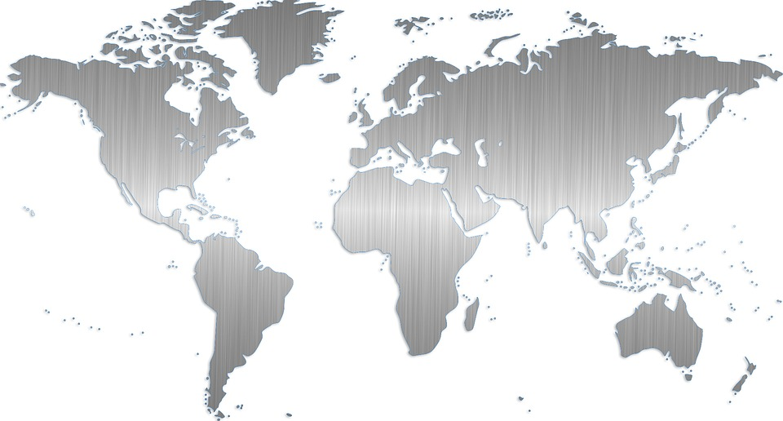
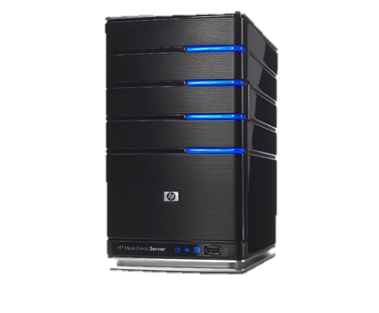

Customer Scenario

Slide 4
Customer Scenario - Failure

Slide 5
Customer Scenario - Recovery

Slide 6
User Stories (customer of the “framework”)
As a “client application”, I get startup info about a pool of Grava servers, so I can establish initial connection.
As a “framework client library”, I keep getting regular updates about servers added/removed from pool.
As a “client application”, I can connect to any server to read/write a value based on a key, so that I can keep “shared state”.
As a “Grava server”, I keep values consistent across machines, so that clients can write/read from any machine in the pool.
Notes:
https://microsoft.sharepoint-df.com/teams/ic3po/wiki/2020-10-IC3-FM.aspx
Reference: https://github.com/microsoft/Ironclad/tree/b2afa7e3eb65285fd3dba4ffa9dc10c6da593727/ironfleet

