Slide 1
What Makes a Good Wine? An Exploratory Data Analysis
Alissa Trujillo
DSC 530
Professor Parajulee

Slide 2
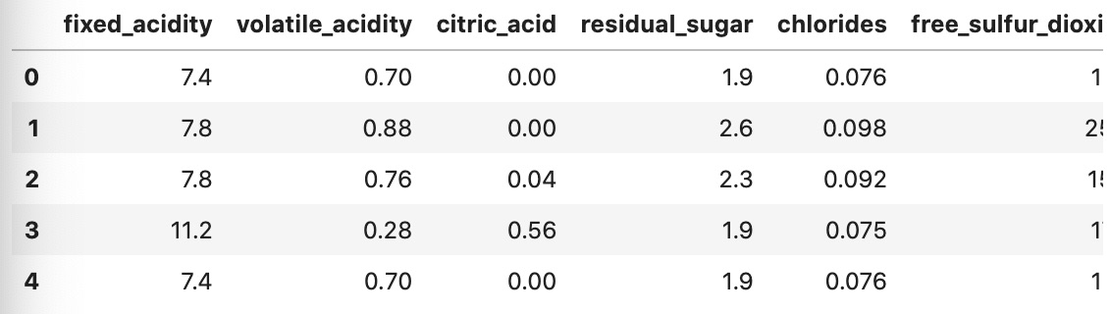
Dataset
I will be using a Wine Quality dataset that I found on Kaggle
Link: https://www.kaggle.com/datasets/rajyellow46/wine-quality

Slide 3

Variables

Slide 4
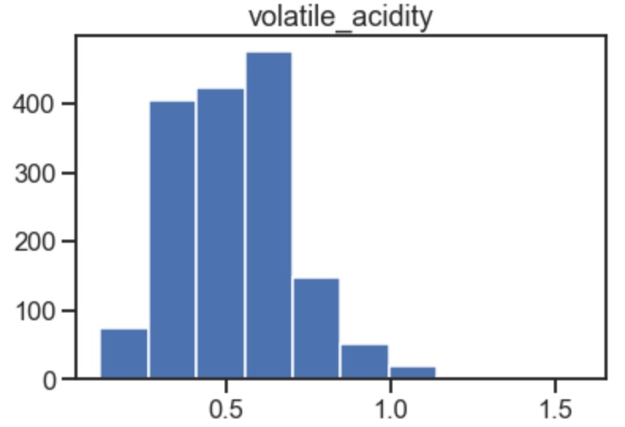
Volatile Acidity
The amount of acetic acid in the wine. This can lead to a vinegar-like taste when levels are too high.
Mean: 0.5278205128205131 Mode: 0.6 Range: 1.46 Q1: 0.39 Median: 0.52 Q3: 0.64 Kurtosis: 1.2255422501791422

Slide 5
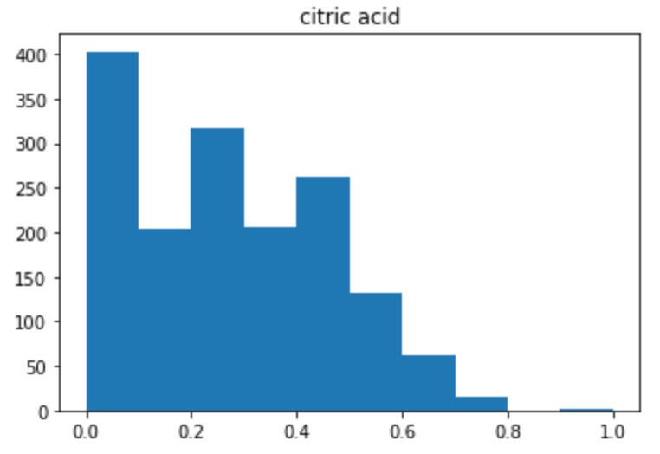
Citric Acid
Can add freshness to the wine, when added in limited quantities.
Mean: 0.2709756097560964 Mode: 0.0 Range: 1.0 Q1: 0.09 Median: 0.26 Q3: 0.42 Kurtosis: -0.7889975153633966

Slide 6
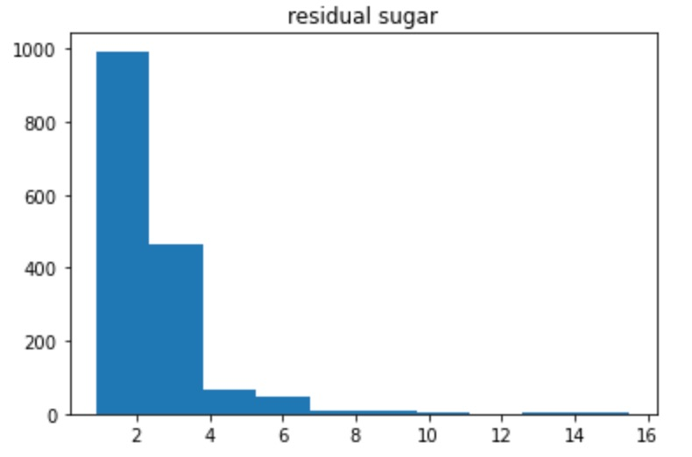
Residual Sugar
The amount of sugar that remains after fermentation stops.
Mean: 2.5388055034396517 Mode: 2.0 Range: 14.6 Q1: 1.9 Median: 2.2 Q3: 2.6 Kurtosis: 28.617595424475443

Slide 7
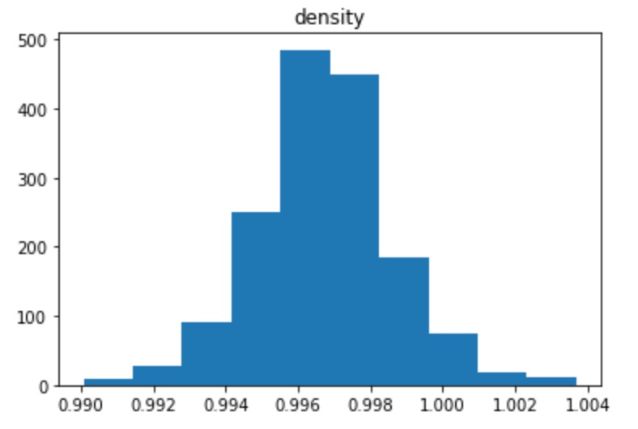
Density
Density compared to water. This is determined by alcohol and sugar content.
Mean: 0.9967466791744831 Mode: 0.9972 Range: 0.01361999999999996 Q1: 0.9956 Median: 0.99675 Q3: 0.997835 Kurtosis: 0.9340790654648123

Slide 8
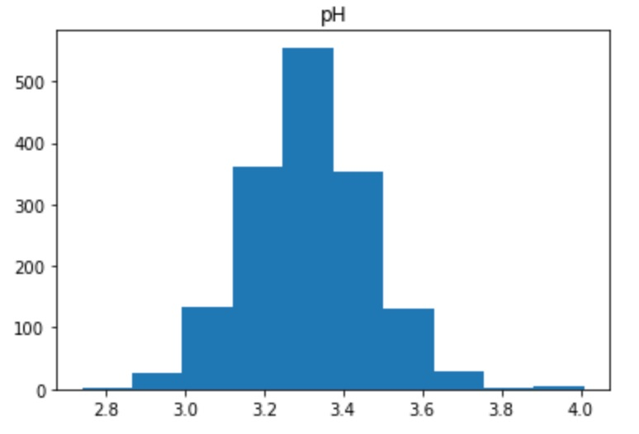
pH
Denotes how acidic or basic a wine is. Most wines are on the acidic side, roughly around 3-4.
Mean: 3.311113195747343 Mode: 3.3 Range: 1.2699999999999996 Q1: 3.21 Median: 3.31 Q3: 3.4 Kurtosis: 0.806942508246574

Slide 9
Alcohol
The alcohol content of the wine.
Mean: 10.422983114446502 Mode: 9.5 Range: 6.5 Q1: 9.5 Median: 10.2 Q3: 11.1 Kurtosis: 0.2000293113417695

Slide 10
Low alcohol content vs. high alcohol content
We will define this by separating wines that have an alcohol content >= 11 from wines that have a lower alcohol content.

Slide 11
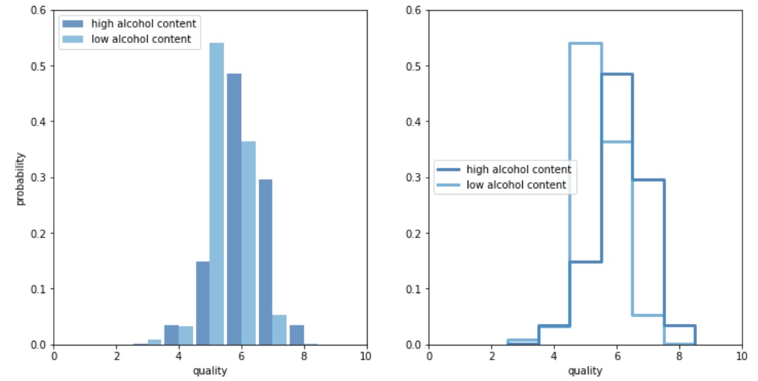
Low alcohol content vs. high alcohol content
According to our PMF’s, it looks like wines with a higher alcohol content tend to be rated higher. We will conduct additional tests to see whether this is statistically significant.

Slide 12
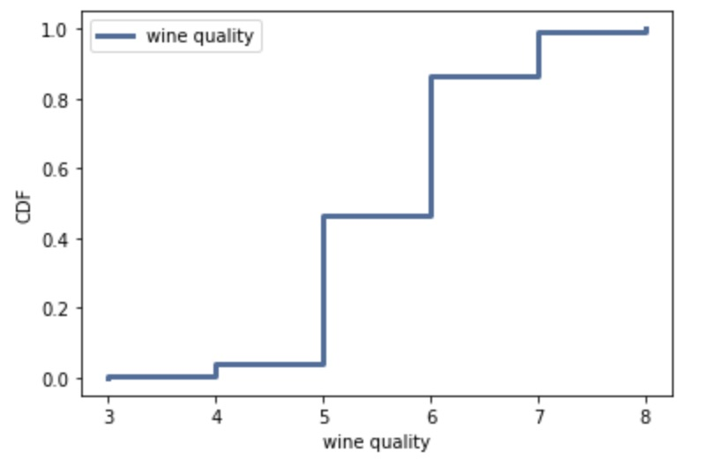
Computing a CDF
This figure shows us the cumulative probability for each quality rating for the selected wines. We can see that a rating of 4 or below is very rare, and the moderate values (5-6) have the highest incidence in the data. Ratings higher than 6 are quite rare as well. This tells us that a majority of wines receive a quality rating that is close to average, which is what we would expect to see in a fair rating system.

Slide 13
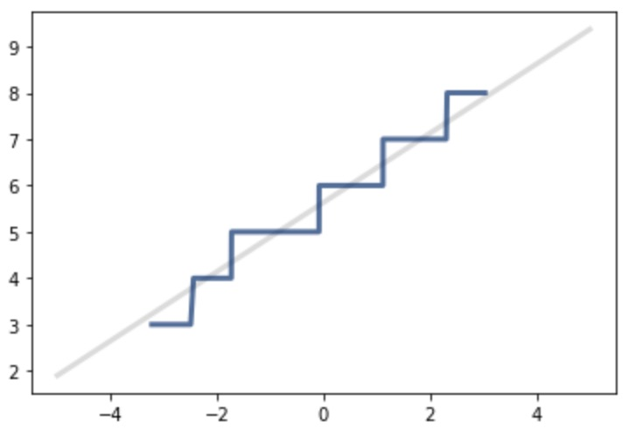
Analytical Distributions: The Normal Distribution
Since the wines in our data are more likely to receive moderate ratings and less likely to receive extreme rankings (either good or bad) this data seems like a great fit for a normal model. To test whether the normal model is in fact a solid fit, we will plot it against our actual data points using the MakeNormalPlot function from the brfss.
Looking at our graph, the data follows the pattern of the normal distribution pretty well. The main issue we can see is the stair-like appearance of our data line due to the ratings being solely whole numbers, rather than fractions of numbers.

Slide 14
Scatterplots

Slide 15
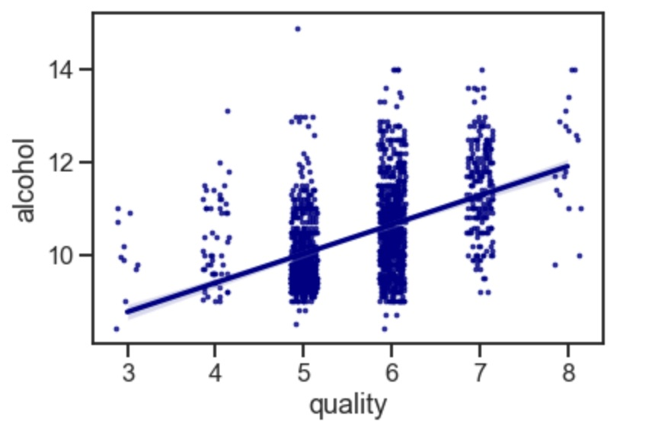
Alcohol content vs. wine quality
The Pearson's correlation for wine quality and alcohol is 0.476. This means that there is a positive correlation between the two variables. As alcohol content increases, wine quality also increases. The covariance between wine quality and alcohol content is 0.410, meaning that the variables tend to vary together. We can see an upwards trend in our scatterplot, evidenced by the regression line. This relationship is best described with a linear shape.

Slide 16
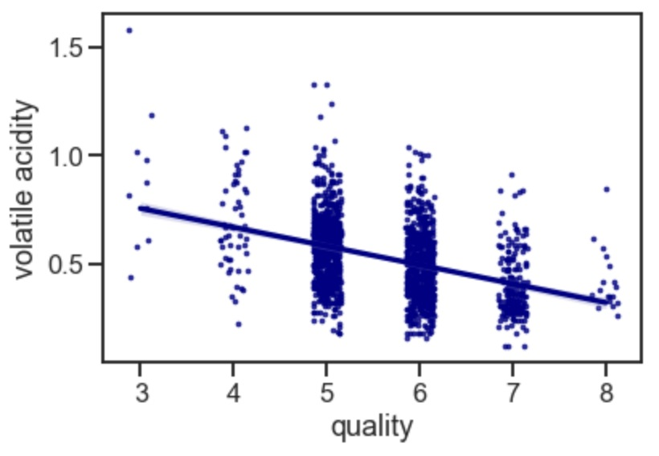
Volatile Acidity vs. Wine Quality
The Pearson's correlation for wine quality and alcohol is -0.391. This means that there is a negative correlation between the two variables. As volatile acidity increases, wine quality decreases. The covariance between wine quality and alcohol content is -0.056, meaning that the variables have a very slight tendency to move in the opposite direction. We can see an downwards trend in our scatterplot, evidenced by the regression line. This relationship is best described with a linear shape.

Slide 17
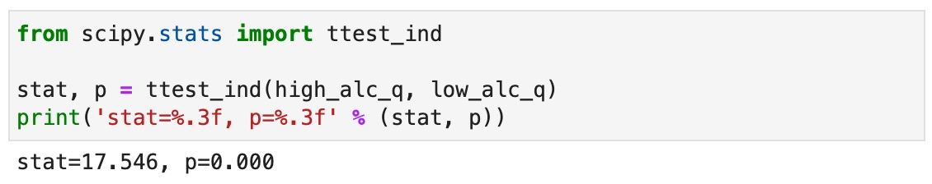
Hypothesis Testing
The hypothesis I am aiming to test is whether there is a significant difference in quality depending on the alcohol content of the wine.
The p-value for our hypothesis test is very close to 0, meaning that the difference in quality between wines with low alcohol content and wines with high alcohol content is statistically significant.

Slide 18
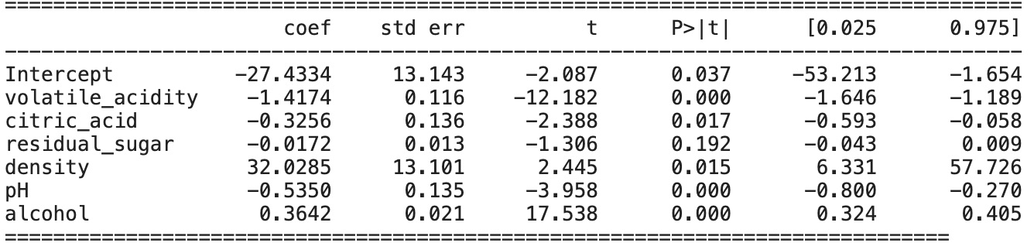
Fitting A Regression
Looking at the results of our regression, we can see that there is a p-value under p=0.05 for each of the measured variables with the exception of pH. This means that Volatile Acidity, Citric Acid, Residual Sugar, Density, pH and Alcohol all have a significant effect on the quality of a wine. Since quality is measured after wine is brewed, when all of these factors are already measured, we can confidently say that there is a one-directional causal relationship.

